Slide 1



Intelligent System for Plant Disease Detection and Remedy Recommendation
Jaypee University of Information Technology
Department of Computer Science and Engineering and Information Technology
Major Project - II (18B19CI791) | AY 2025-26
End-Term Evaluation | May-14, 2026.
Group No : 85
Team Member (s)
Kushal Sharma(221030116)
Mehak Singhal(221030297)
Harsha Thakur(221030461)
Devansh Moudgil(221030465)
Supervisor
Ms. Vani Sharma
Assistant Professor
Department of Computer Science and Information Technology, Jaypee University of Information Technology

Slide 2
Outline
Introduction
Problem Statement
Objectives
Literature Review
Work Done (after MP-I)
Dataset
Project Design
Tools, Technologies and Languages
Implementation
Experimental Results and Evaluation
Publications
Future Work
Project Plan
Key Learnings
Work Contribution and Attendance
Supervisor Interactions
References

Slide 3
Introduction
Agriculture suffers huge losses every year due to late or inaccurate detection of plant diseases.
Current systems/backlogs: Manual inspection is time-consuming, inconsistent, and requires expert knowledge.
Farmers often lack access to reliable disease identification tools in rural areas.
Conventional image processing methods have limited accuracy and scalability.
Deep Learning (U-Net,ResNet50, ViT, VGG16, VGG19, AlexNet, DenseNet, EfficientNet-B4) offers automated, reliable, and high-accuracy detection from leaf images.
Our project provides a web-based solution where users upload a leaf image and instantly receive disease predictions.

Slide 4
Problem Statement
Right now, most disease detection is done manually, which is slow, tiring, and often depends on expert knowledge that isn’t always available
Many farmers misjudge the symptoms or identify the disease too late, which reduces the chances of saving the crop.
Existing computer-based systems are either too simple or not accurate enough when dealing with different crops and many disease types.

Slide 5
Objectives
To build a system that can detect plant diseases automatically using leaf images.
Use deep learning models (U-Net, ResNet50, Vision Transformer, VGG16, VGG19, AlexNet and DenseNet, EfficientNet-B4) for accurate classification of healthy and diseased plants.
Ultimately, reduce crop losses by helping in early identification and treatment of plant diseases.

Slide 6
Literature Review
S. No. | Author & Paper Title [Citation] | Journal/ Conference (Year) | Tools/ Techniques/ Dataset | Key Findings/ Results | Limitations/ Gaps Identified
1. | Anh H. Vo et al., "An Automatic Recommendation System for Plant Disease Treatment" | ResearchGate (2022) | CrowdAI dataset.EfficientNet-B2, ResNet50, MobileNetV2; CNN,Cosine Similarity. | Two-module system: detection + recommendation; accurate disease diagnosis | Needs real-field validation; remedy suggestions limited to dataset mapping
2. | Emmanuel D. Erute, Folasade O. Isinkaye, "A Smartphone-based Plant Disease Detection and Treatment Recommendation System | Research Gate (2022) | CNN + ANN + KNN, Flutter/Android Studio, Firebase . | Mobile-friendly, practical for farmers; real-time diagnosis and recommendation | Limited crops tested;dependent on smartphone camera quality.
3. | Anita Rani Mehta et al., "AI-powered Innovations in Agriculture: A Systematic Review | Indian Journal of Agricultural Research (2025) | Needs real-field validation; remedy suggestions limited to dataset mapping. | Comprehensive analysis; identifies trends and future research areas | No experimental validation; survey-based
4. | Sunita Rani, Subaini Kumar,”Comparative Analysis of ML Algorithms for Plant Leaf Disease Detection” | IJRASET (2023) | Python (scikit-learn), Random Forest, Naive Bayes, XGBoost | ABOU achieved 94.1% accuracy; Naive Bayes performed weakly; preprocessing and augmentation improved results | Limited dataset diversity; not tested on real-field conditions

Slide 7
Literature Review (cont…)
S. No. | Author & Paper Title [Citation] | Journal/ Conference (Year) | Tools/ Techniques/ Dataset | Key Findings/ Results | Limitations/ Gaps Identified
5. | Shivani Singh, Anjali Sharma, Mohit Verma ,”Plant Leaf Disease Detection and Classification Using CNN Models: A Systematic Review” | Spinger AI Review (2015) | CNN Models , TensorFlow, PyTorch, Keras, OpenCV, PlantVillage | High accuracy (98–99%); suggested lightweight CNNs with IoT/drones | High computational requirements; dataset limitations
6. | Neha Sharma, Vink Patel, Rahul Gupta, “Plant Leaf Disease Detection using ML, DL, and Few-Shot Learning (FSL)” | ISJEM Journal | Python, TensorFlow, PyTorch, Hyperspectral/Thermal Cameras; CNNs, Vision Transformers, FSL | Effective for small datasets; scalable AI; molecular diagnostics integrated | Limited crop diversity; requires specialized imaging tools
7. | Murngavalli and Yopi ,“PLA-ViT: Vision Transformers for Precision Agriculture” | 2025 | Vision Transformers (ViT), Transfer Learning, IoT Sensors | Captures global features via self-attention; high accuracy; real-time monitoring | Heavy model size; may require high-end hardware
8. | Baiju et al. ,”Slender-CNN for Corn, Rice & Wheat Crops” | 2025 | Slender-CNN, Multi-scale convolution, Image Processing libraries | Lightweight model; suitable for farm-level deployment; multi-scale lesion detection | Focused on three crops only; generalization to other crops unclear

Slide 8
Literature Review (cont…)
S. No. | Author & Paper Title [Citation] | Journal/ Conference (Year) | Tools/ Techniques/ Dataset | Key Findings/ Results | Limitations/ Gaps Identified
9. | Wubetu Barud Demilie,”Plant Disease Detection and Classification Techniques: A Comparative Study” | IEEE (2024) | SVM, KNN, Random Forest, Naive Bayes, Decision Trees, CNN, ANN | Comparative study of ML and DL techniques; highlighted real-time deployment challenges | Lack of experimental results; mostly survey
10. | Nishant Sheler, Swoj Shinde, Shubham Sowent, Shregesh Dhumal, Kawser Kefokir,”Plant Disease Detection Using CNN” | ICACC (2022) | VGG-19 CNN, Keras, TensorFlow Lite | Achieved 95.6% accuracy; deployable on Android devices | Limited dataset size; may underperform in real-field conditions
11. | Anuja Bhargawa,Om Prakash,“Plant Leaf Disease Detection, Classification and Diagnosis – Computer Vision & AI Survey | IEEE (2024) | CNN, SVM, KNN, Random Forest, ANN; MATLAB, Python, OpenCV | Hybrid ML/DL improves performance on limited datasets; transfer learning applied | Mostly survey; lacks real-time deployment analysis
12. | Sammyv Militante, Bobby D. Gererdo, Nanette V. Dionisio,” Plant Leaf Detection and Disease Recognition Using Deep Learning” | IEEE (2019) | CNN, ReLU Activation, Pooling, Python Neural Network APIs | Achieved 96.5% accuracy across multiple crops; robust model | Dataset limited to PlantVillage; performance under real-field conditions not evaluated

Slide 9
Literature Review (cont…)
S. No. | Author & Paper Title [Citation] | Journal/ Conference (Year) | Tools/ Techniques/ Dataset | Key Findings/ Results | Limitations/ Gaps Identified
13. | S. P. Mohanty, D. P. Hughes, M. Salathé, "Using Deep Learning for Image-Based Plant Disease Detection, Frontiers in Plant Science | IEEE (2021) | CNN (Deep Learning), PlantVillage Dataset | Achieved high accuracy in plant disease classification using deep learning models. | Limited to controlled dataset conditions; lacks real-world variability and remedy recommendation.
14. | A. T. Too et al., "A Comparative Study of Fine-Tuning Deep Learning Models for Plant Disease Identification," Computers and Electronics in Agriculture | IEEE (2021) | ResNet, VGG (Fine-tuned CNNs), PlantVillage Dataset | Fine-tuned deep learning models outperform traditional machine learning methods. | Focuses only on classification; no real-time system or remedy suggestion.
15. | K. Picon et al., "Deep CNNs for Mobile Capture Device-Based Crop Disease Classification in the Wild," Computers and Electronics in Agriculture | IEEE (2022) | CNN, Real-world field images dataset | Demonstrated effectiveness of CNNs in real-world agricultural conditions. | Performance affected by lighting, occlusion, and background noise.
16. | H. Touvron et al., "Training Data-Efficient Image Transformers & Distillation Through Attention | IEEE (2022) | Vision Transformer (ViT), ImageNet | Improved efficiency of transformer-based models with limited data. | Requires high computational resources; not optimized for mobile deployment.

Slide 10
Literature Review (cont…)
S. No. | Author & Paper Title [Citation] | Journal/ Conference (Year) | Tools/ Techniques/ Dataset | Key Findings/ Results | Limitations/ Gaps Identified
17. | Z. Liu et al., “Swin Transformer: Hierarchical Vision Transformer Using Shifted Windows | ICCV (2022) | Swin Transformer, ImageNet | Enhanced feature extraction and better performance than traditional CNNs. | Complex architecture; difficult to implement in lightweight systems.
18. | R. Ferentinos, “Deep Learning Models for Plant Disease Detection and Diagnosis,” Agricultural Systems | IEEE (2023) | Deep CNN Models, Multi-crop datasets | Achieved high accuracy across multiple plant species and diseases. | Limited integration with user-friendly applications and real-time systems.
19. | M. Brahimi, K. Boukhalfa, A. Moussaoui, “Deep Learning for Tomato Diseases: Classification and Symptoms Visualization,” Applied Artificial Intelligence | IEEE (2023) | CNN + Visualization Techniques, Tomato Dataset | Provided disease classification along with symptom visualization. | Focused on specific crop; lacks generalization across multiple plants.
20. | Y. LeCun, Y. Bengio, G. Hinton, “Deep Learning,” Nature Reviews Methods Primers | IEEE (2024) | General Deep Learning Techniques | Comprehensive overview of deep learning advancements and applications. | General study; not specifically focused on plant disease detection.

Slide 11
Work Done (after MP-I)
Performed Internal 2-Way split on Training (80%), Validation (20%) on PlantVillage & PlantDoc Dataset.
Performed External Validation on Plant Disease Detection Dataset.
Performed Comparison of Various Models.
Documented the Research Paper.
Designed Front-End Website for the users.

Slide 12
Dataset
PlantVillage Dataset
Contains healthy and diseased leaf images of various crops.
Covers 38 distinct classes (e.g., Tomato Late Blight, Apple Scab, Grape Black Rot, Healthy Leaves, etc.).
Images are color and grayscale, collected in controlled conditions.
Data Size
~54,000 images (RGB).
Train/Validation split: 80% train, 20% validation.
Image Properties
Original size varies, resized to 224×224 for ResNet50/ViT/EfficientNet-B4 .
Data augmentation applied (rotation, zoom, flip, shift) for better generalization.
Feature Category | Examples | Type
Crop Type | Tomato, Apple, Grape, Potato, Corn, etc. | Categorical
Disease Label | Early Blight, Late Blight, Leaf Spot, Rust, etc. | Categorical
Health Status | Healthy vs Diseased | Categorical
Image Features | Color, texture, shape patterns | Numerical

Slide 13
Dataset
PlantDoc Dataset
Contains real-world diseased leaf images captured under natural, uncontrolled field conditions.
Covers 27 classes across 13 plant species (e.g., Tomato Early Blight, Apple Scab, Corn Common Rust, etc.).
Images taken via smartphone cameras — variable lighting, backgrounds, and leaf orientations.
Data Size
~2,569 images (RGB) across 27 disease and healthy classes.
Train/Validation split: 80% train, 20% validation.
Image Properties
Original size varies; resized to 224×224 for model compatibility (EfficientNet-B4).
Data augmentation applied (rotation, zoom, flip, Gaussian noise) for better generalization.
Feature Category | Examples | Type
Crop Type | Tomato, Apple, Potato, Corn, Bell Pepper etc. | Categorical
Disease Label | Early Blight, Late Blight, Leaf Spot, Rust, etc. | Categorical
Health Status | Healthy vs Diseased | Categorical
Image Features | Color, texture, shape, background noise | Numerical

Slide 14
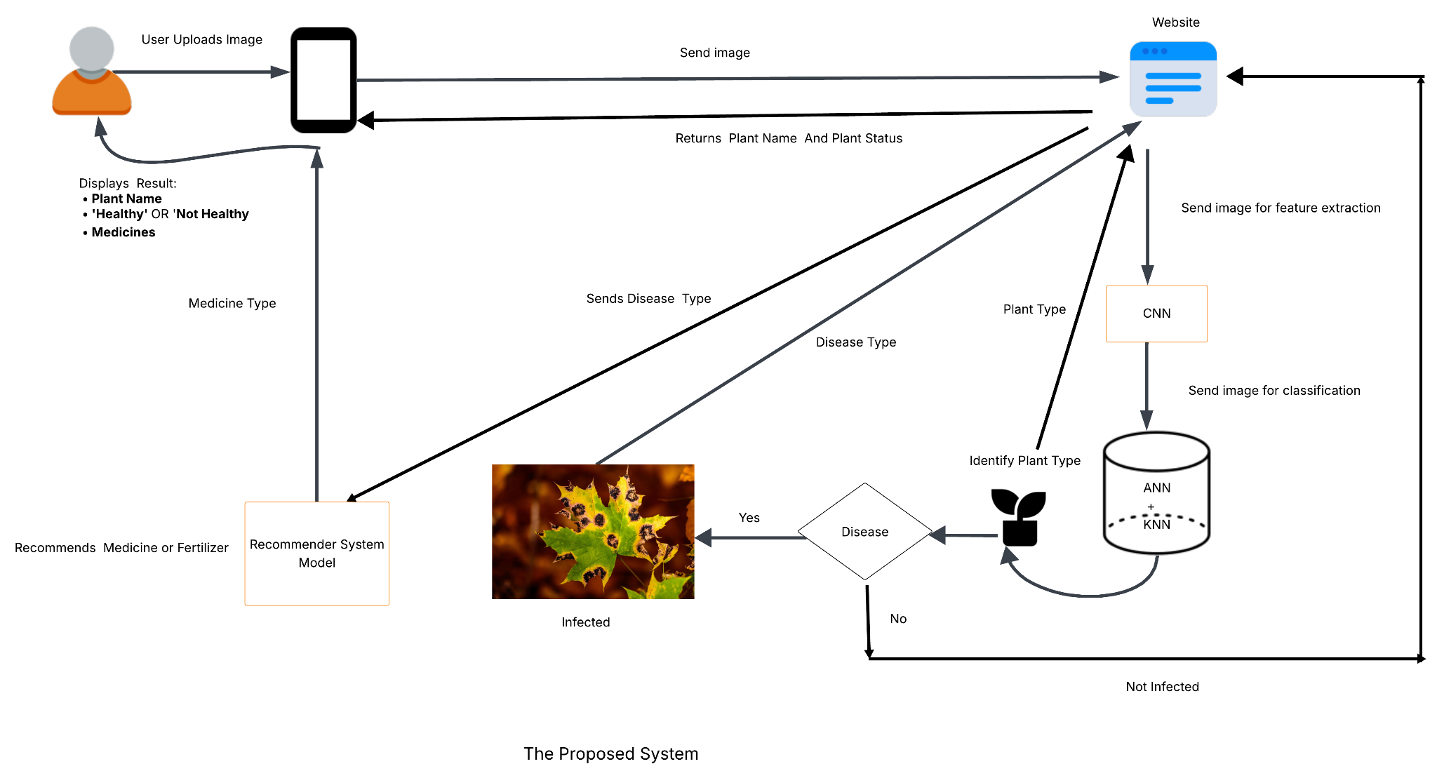
Project Design FlowChart
Fig. 1 - High-Level System Architecture

Slide 15
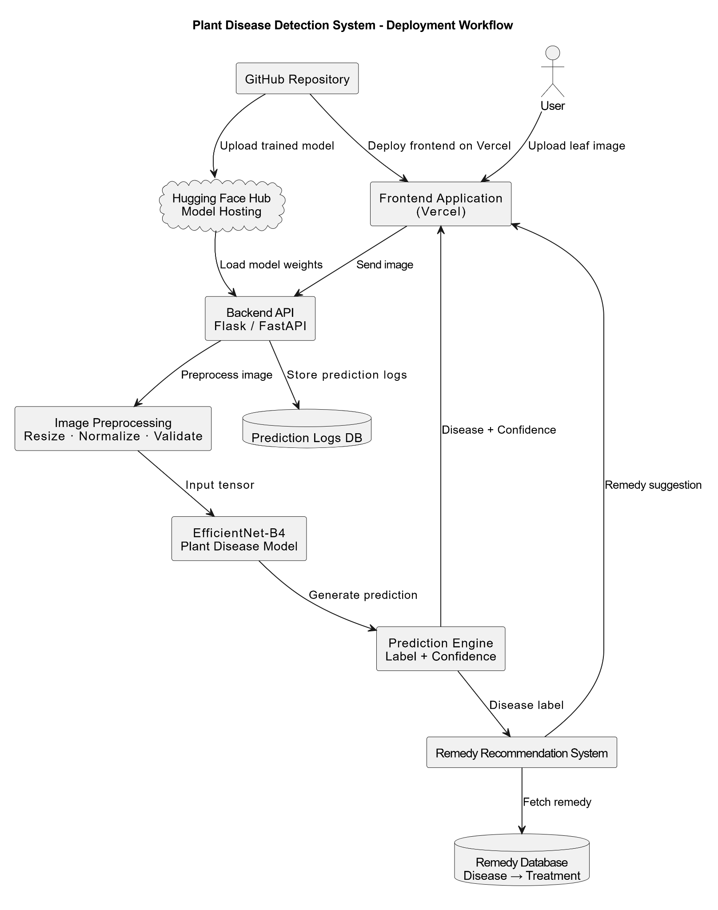
Project Design (cont…)
Fig. 2 - Backend Server Diagram

Slide 16
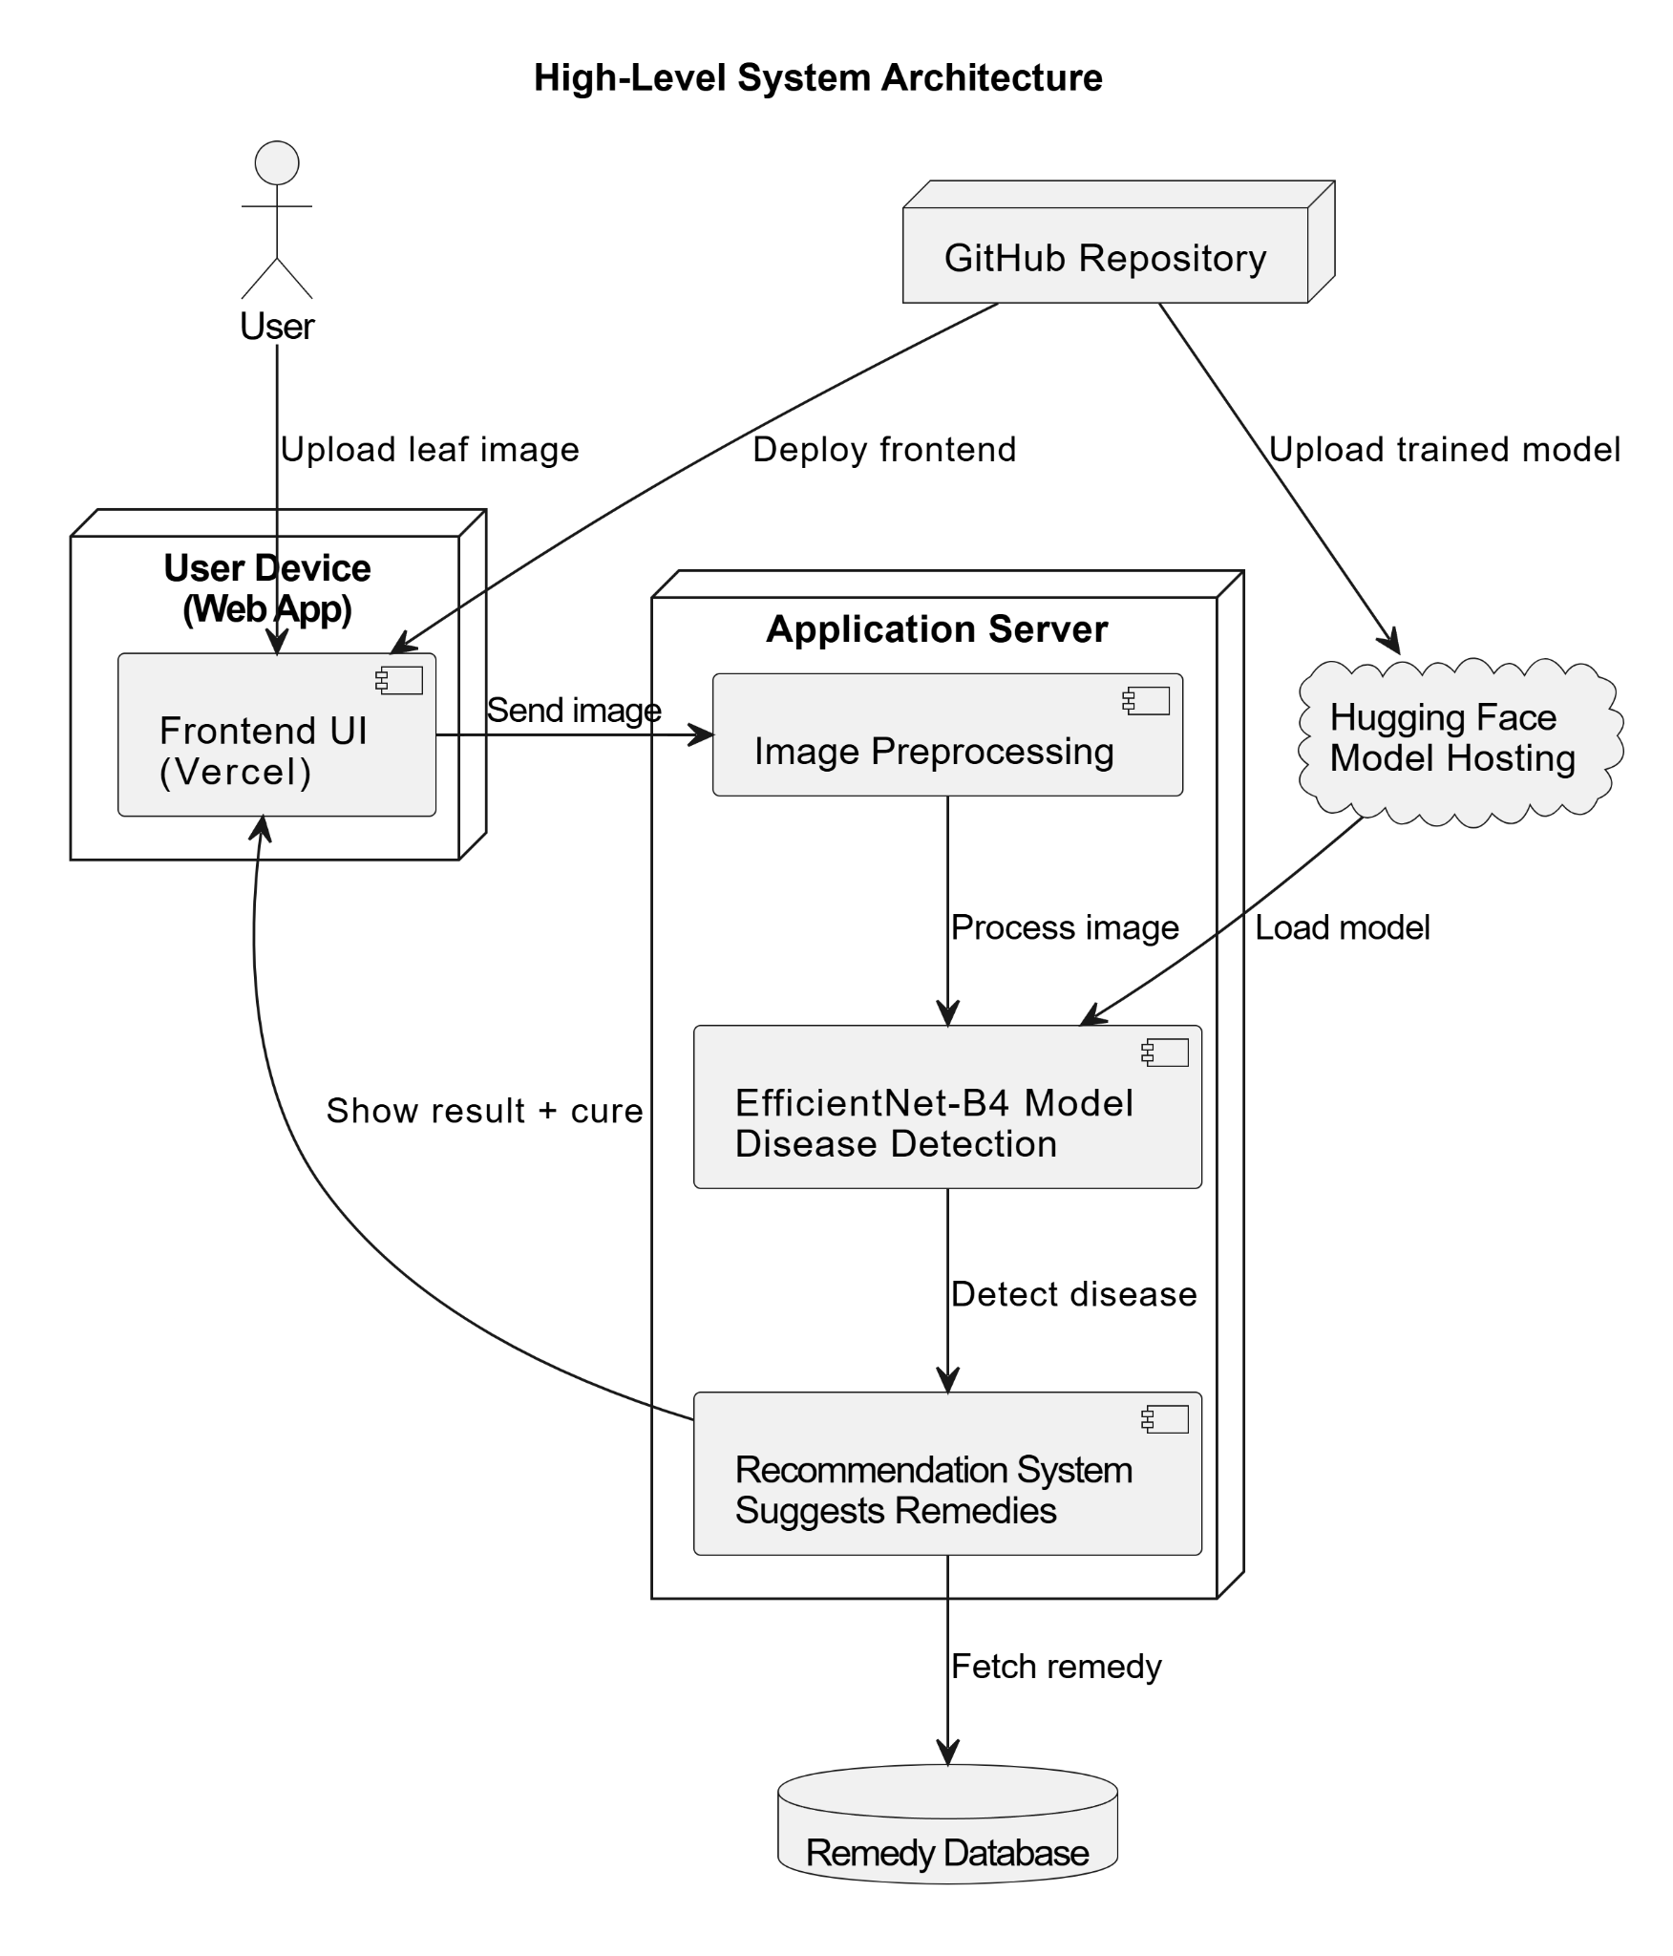
Project Design (cont…)
Fig. 3 – Client Application Diagram

Slide 17
Tools, Technologies and Languages
Programming Languages
Python 3.11 → Core development, ML model training & backend API
JavaScript (ES6+) → Frontend development (React-based UI)
ML & Data Science Libraries
TensorFlow (v2.16) / Keras → Deep learning, model training (ResNet50, ViT)
Scikit-learn (v1.4) → Performance metrics (classification report, confusion matrix)
NumPy (v1.26), Pandas (v2.2) → Data preprocessing & analysis
Matplotlib (v3.8), Seaborn (v0.13) → Data visualization (accuracy, loss graphs)
Version Control
Git (v2.45) → Source code version control
GitHub → Project collaboration & repository hosting

Slide 18
Tools, Technologies and Languages
Web Development
Flask (Version 3.0.3) – Backend framework in Python
HTML (Version 5.0) – Markup language for frontend
CSS (Version 3.0) – Styling web pages
JavaScript (ES2024) – Frontend interactivity
Data and Preprocessing
PlantVillage & Plant Doc Dataset – Dataset for training and testing
Image Data Generator / tf.data (Part of TensorFlow 2.16.1) – For data augmentation and preprocessing
Pandas (Version 2.2.2) – Data handling and manipulation

Slide 19
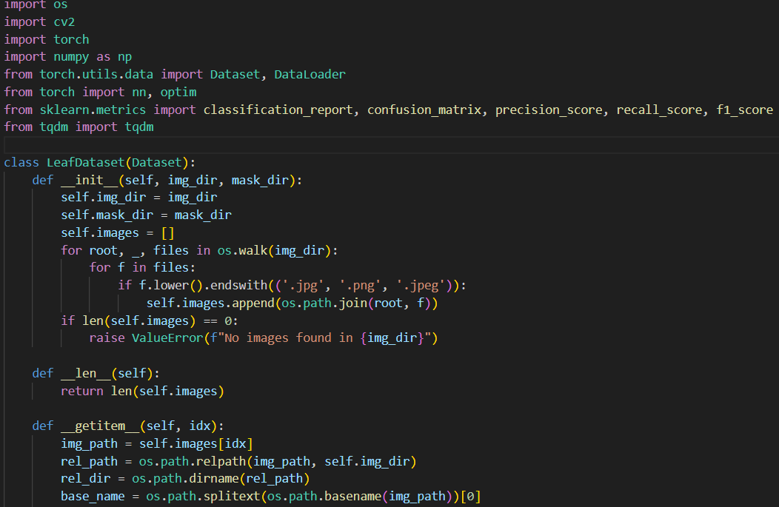
Implementation of U-Net
Fig. 4 - Implementation of UNet Segmentation Module

Slide 20
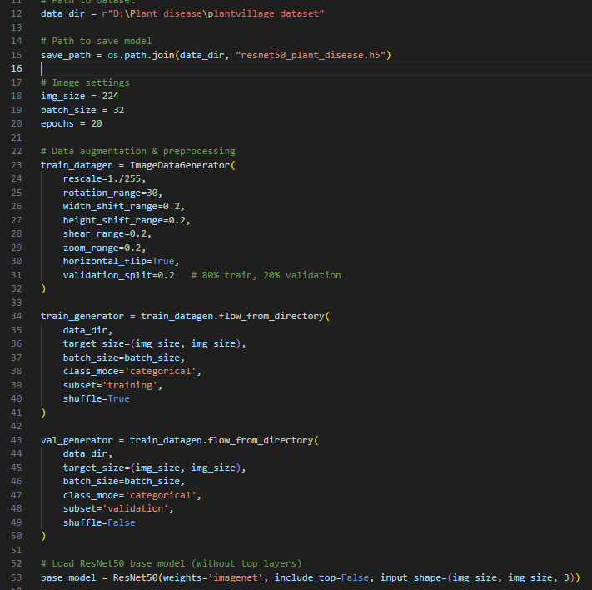
Implementation of ResNet50
Fig. 5 - Data Augmentation and Base Model Setup

Slide 21
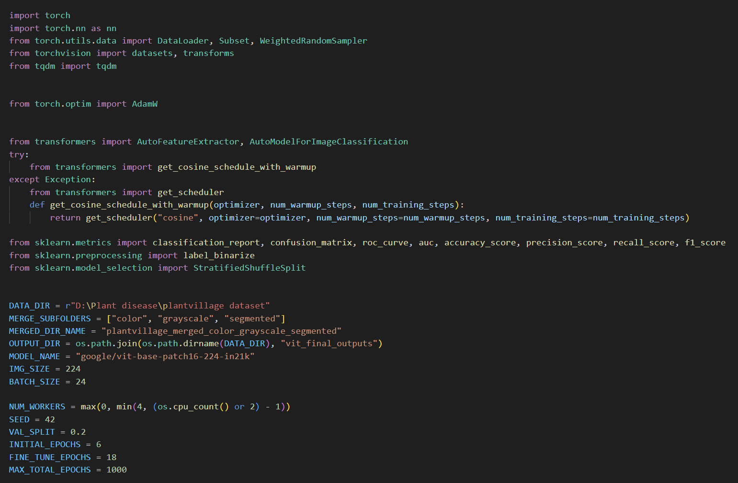
Implementation of ViT
Fig. 6 - ViT Configuration and Hyperparameters

Slide 22
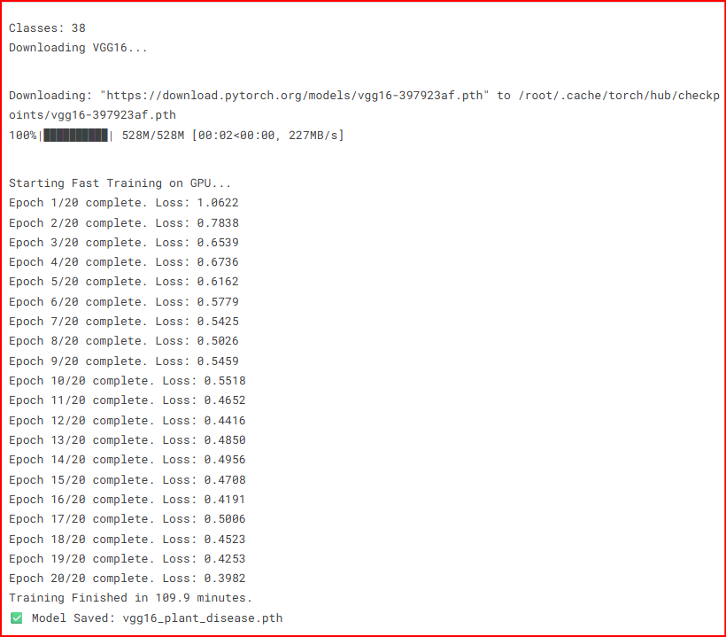
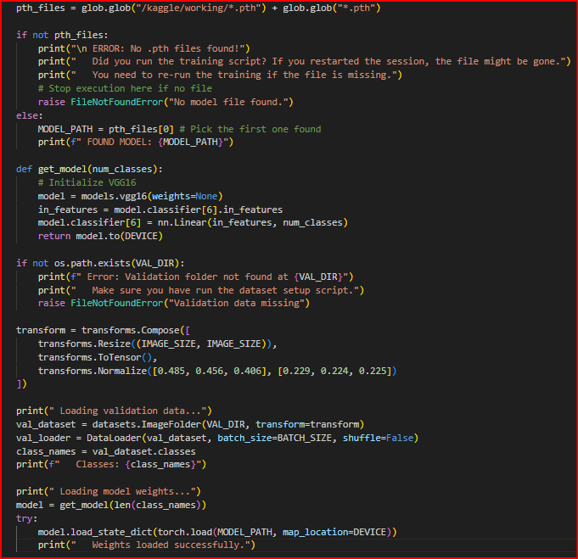
Implementation of VGG16
Fig. 7 - Training of VGG16
Fig. 8 - Loading VGG16 model weights

Slide 23
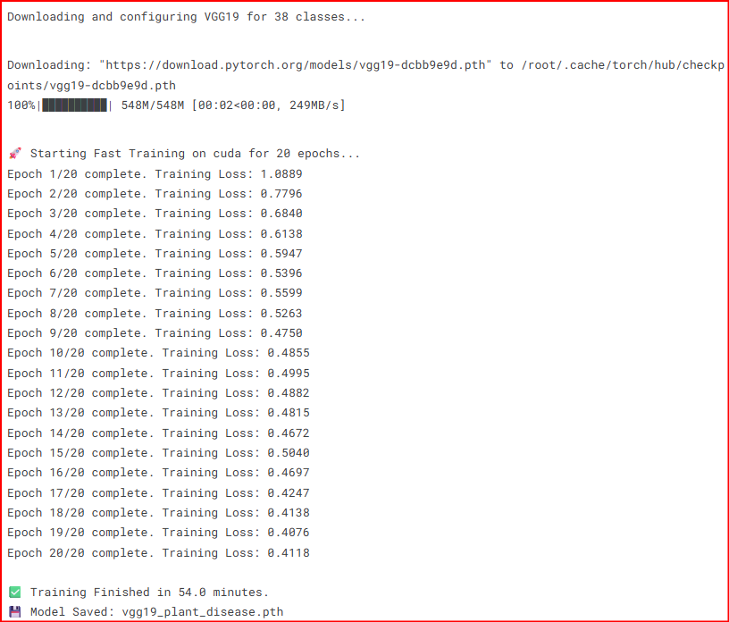
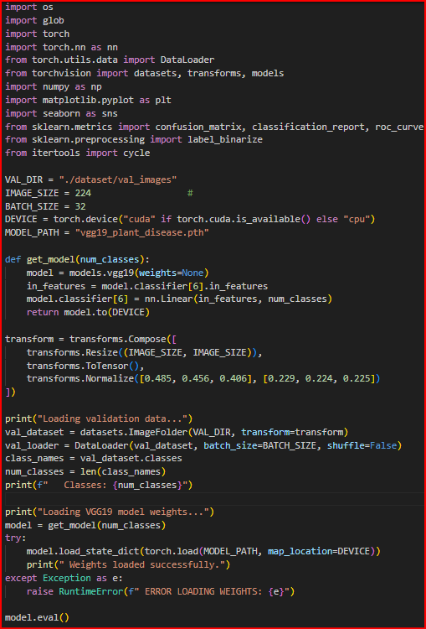
Implementation of VGG19
Fig. 9 - Training of VGG19
Fig. 10 - Loading VGG19 model weights

Slide 24
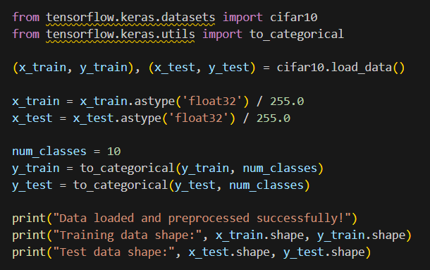
Implementation of AlexNet
Fig. 11 – Loading Alexnet model

Slide 25
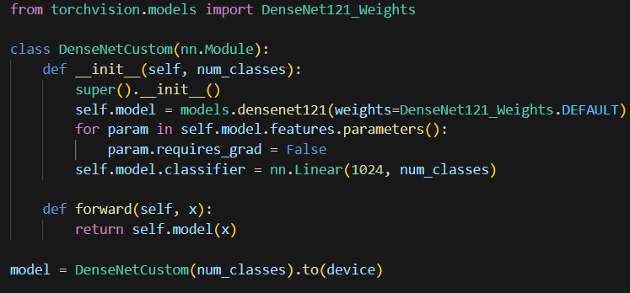
Implementation of DenseNet121
Fig. 12 – Loading DenseNet121

Slide 26
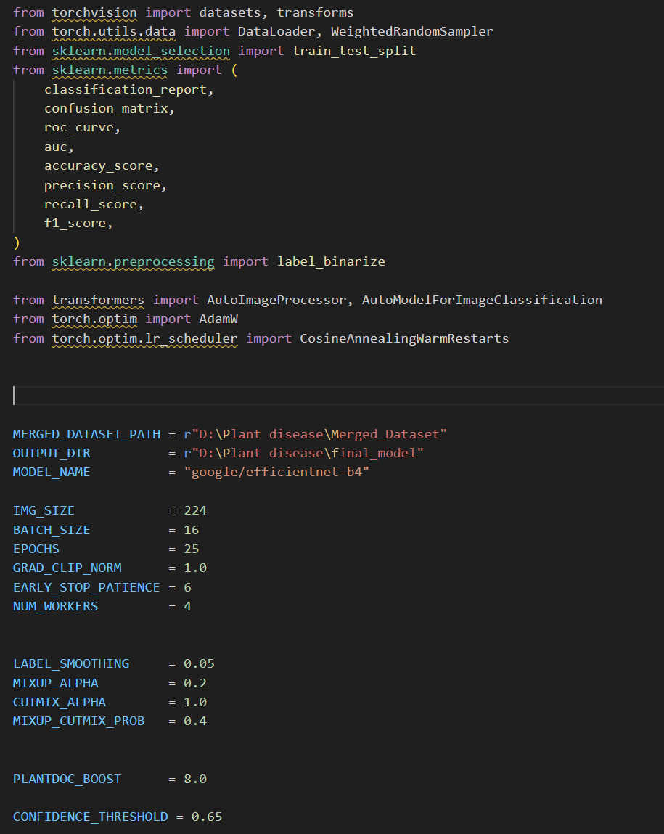
Implementation of EfficientNet-B4
Fig. 13 - Training Hyperparameters

Slide 27
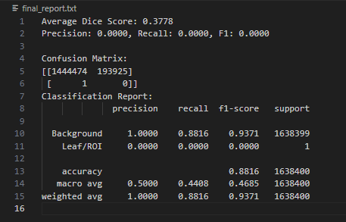
Experimental Results of U-Net
Fig. 14 - Model Evaluation Metrics

Slide 28
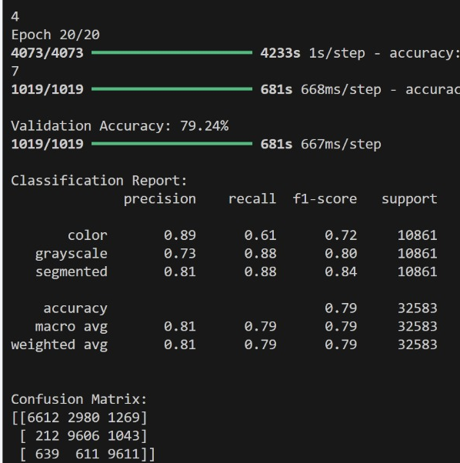
Experimental Results of ResNet50
Fig. 15 - Multi-Class Classification Analysis

Slide 29
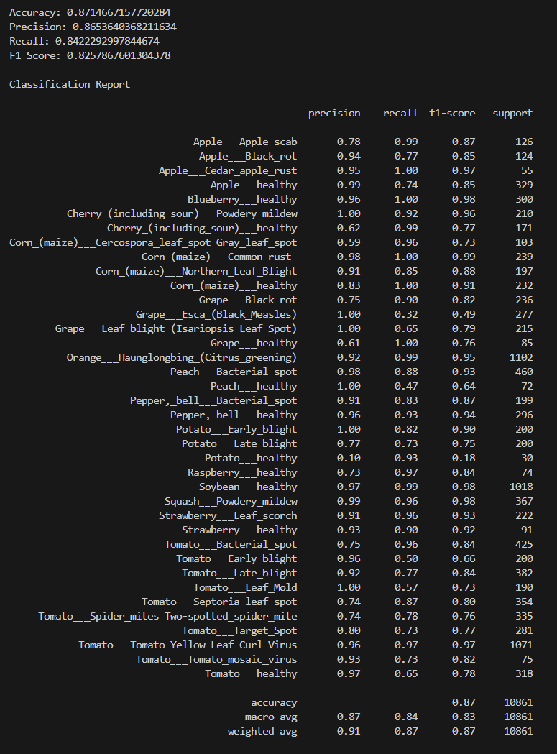
Experimental Results of ViT
Fig. 16 - ViT Performance Across Species

Slide 30
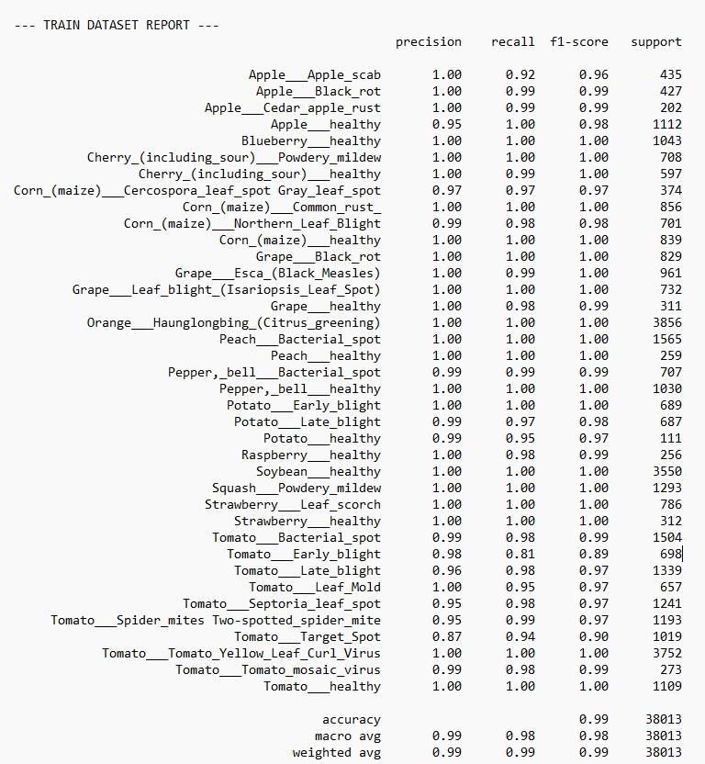
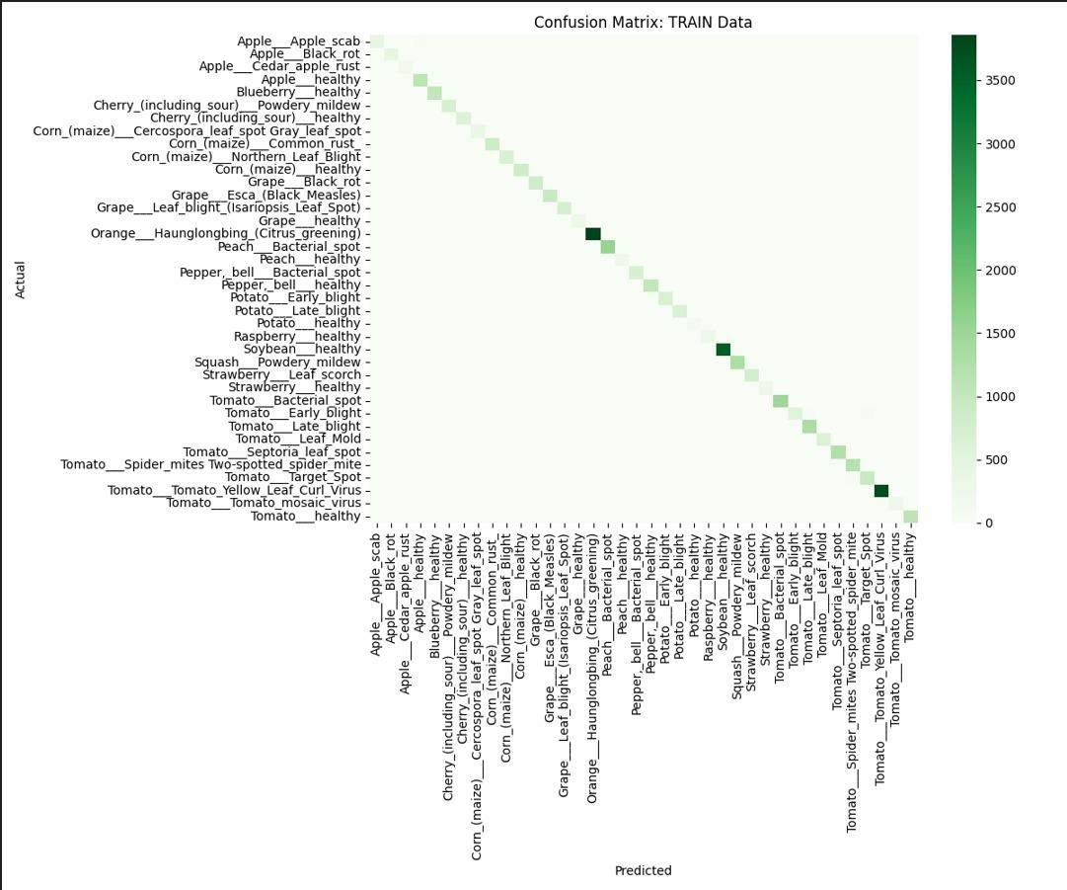
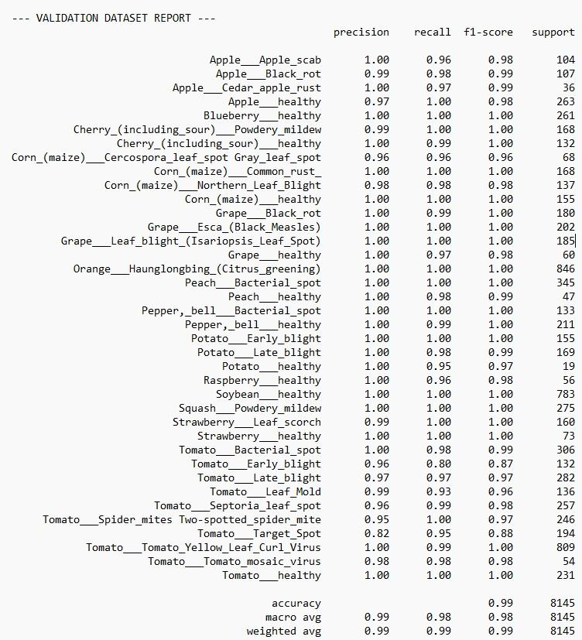

Experimental Results of VGG16
Fig. 17 - VGG16 Performance Across Species

Slide 31
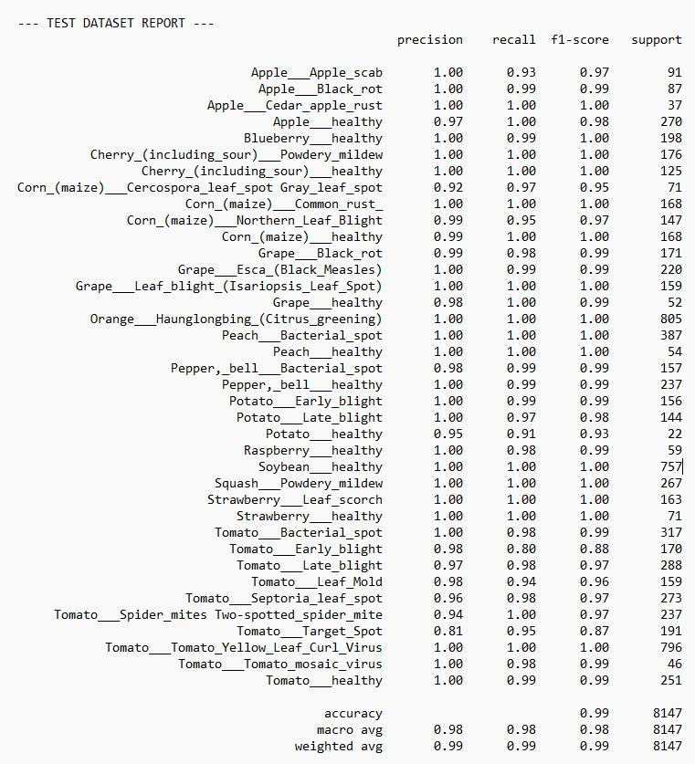

Experimental Results of VGG16
Fig. 18 - VGG16 Performance Across Species

Slide 32
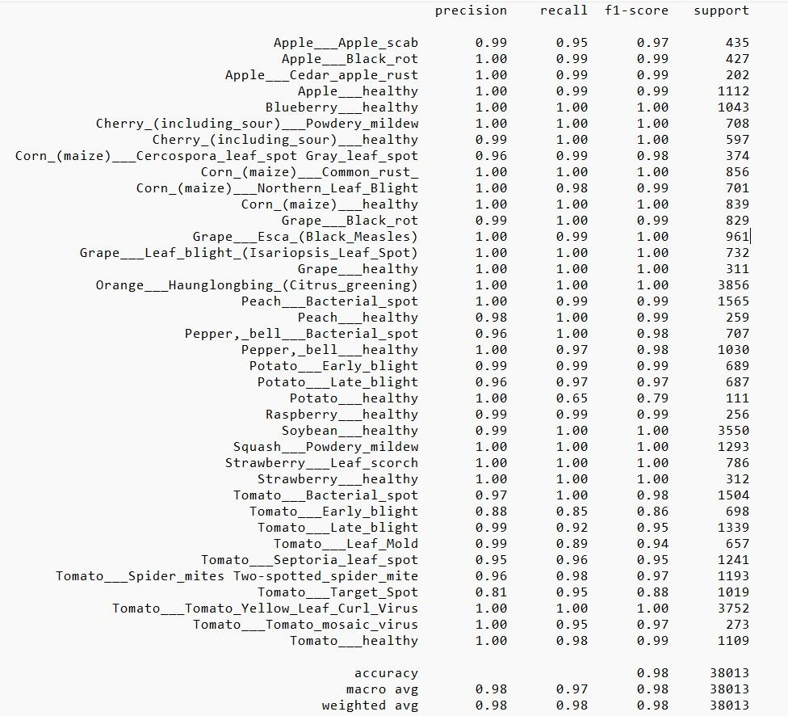
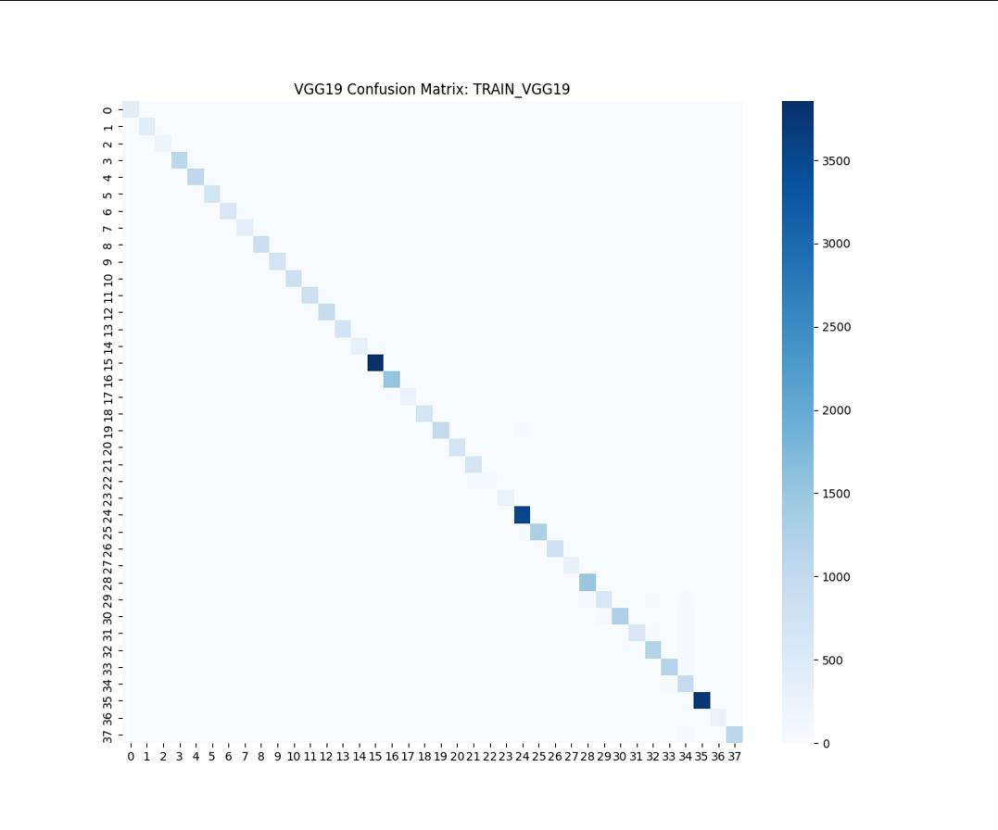
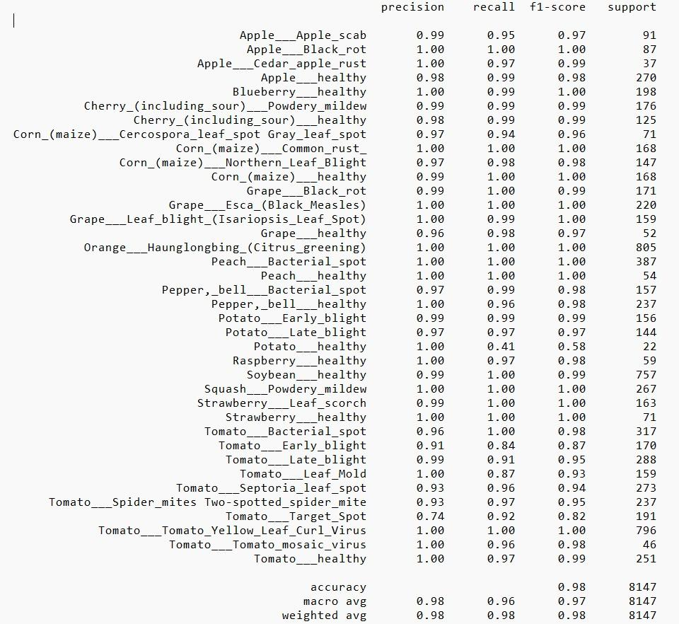
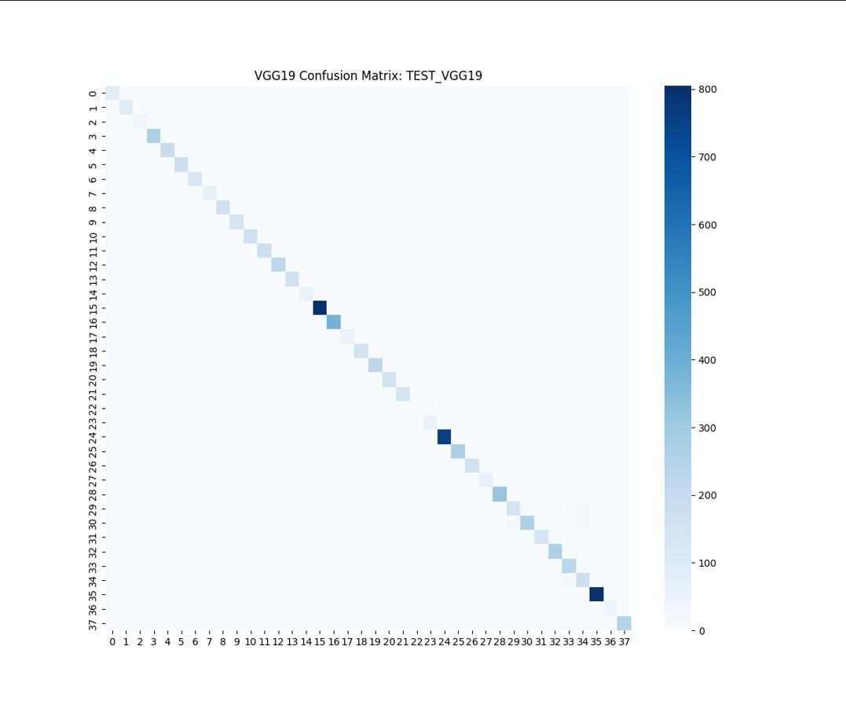
Experimental Results of VGG19
Fig. 19 - VGG19 Performance Across Species

Slide 33
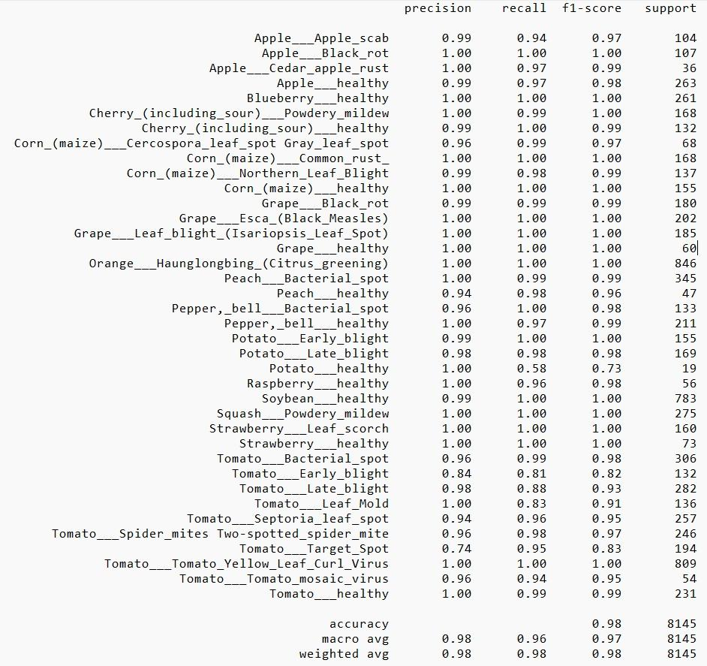
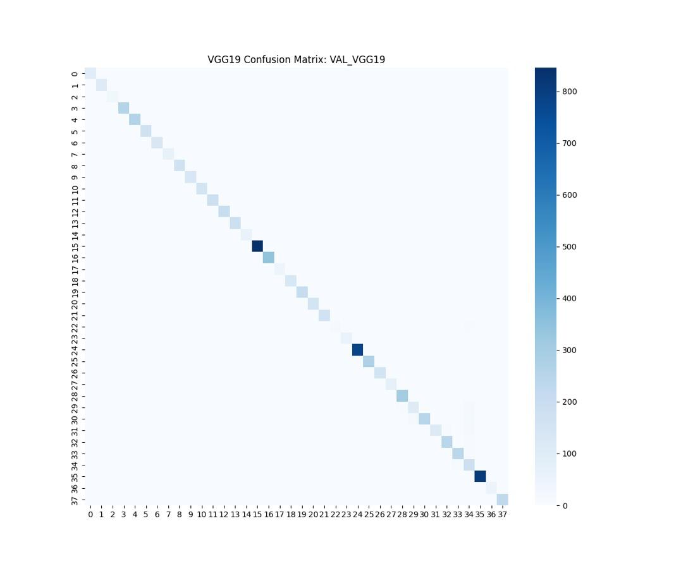
Experimental Results of VGG19
Fig. 20 - VGG19 Performance Across Species

Slide 34
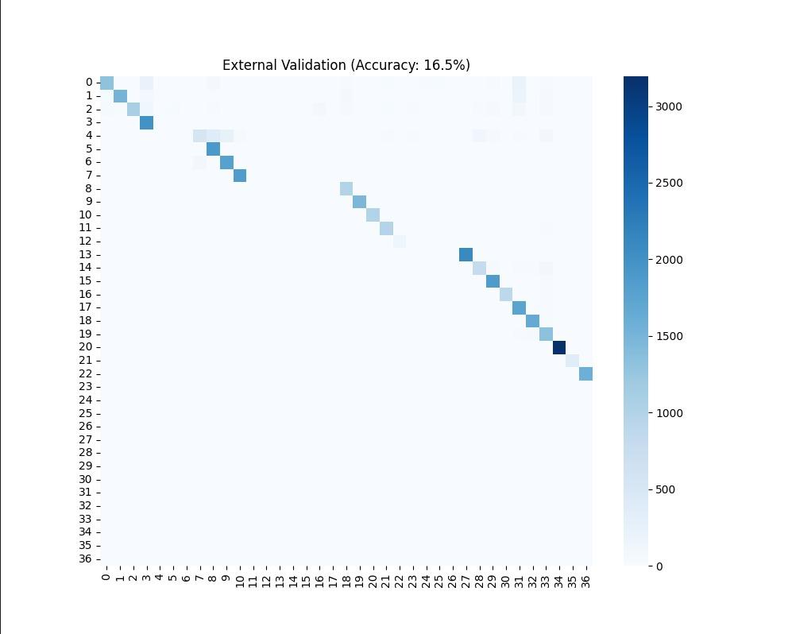
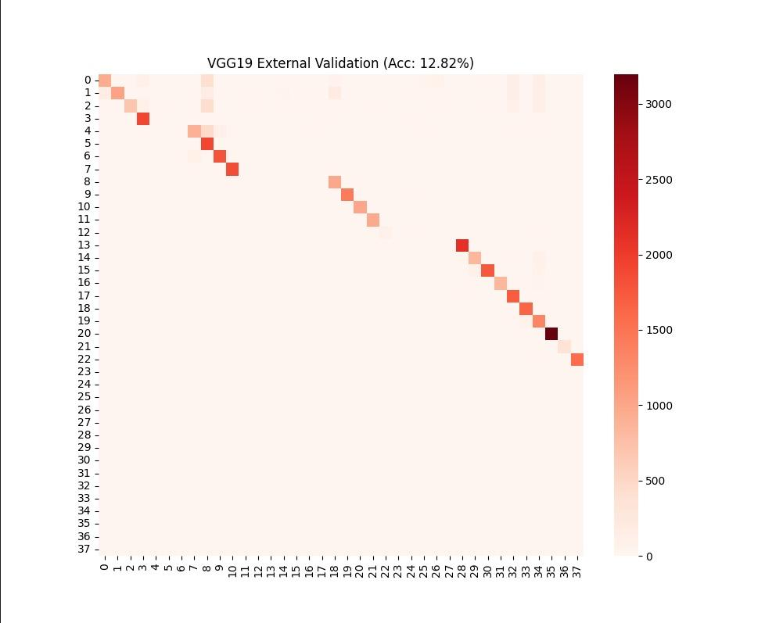
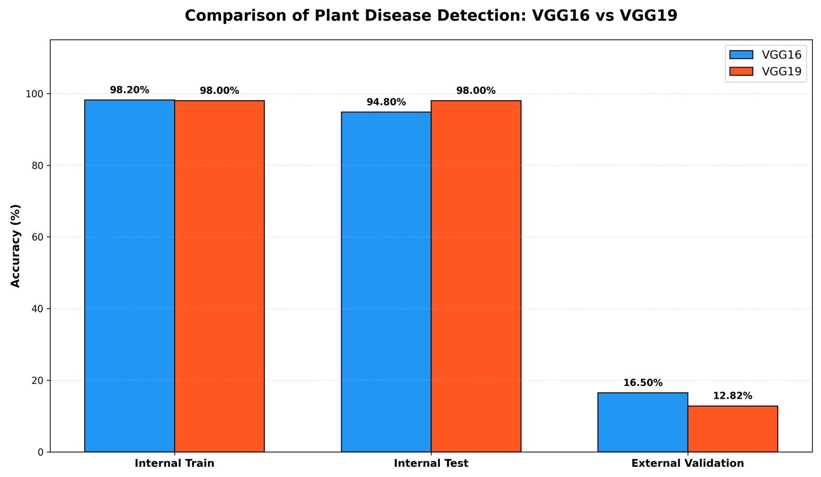
Experimental Results of VGG19
Fig. 21 - Comparison between VGG16 & VGG19

Slide 35
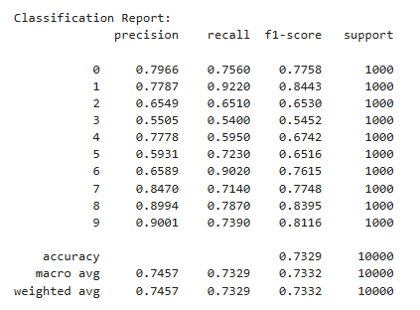
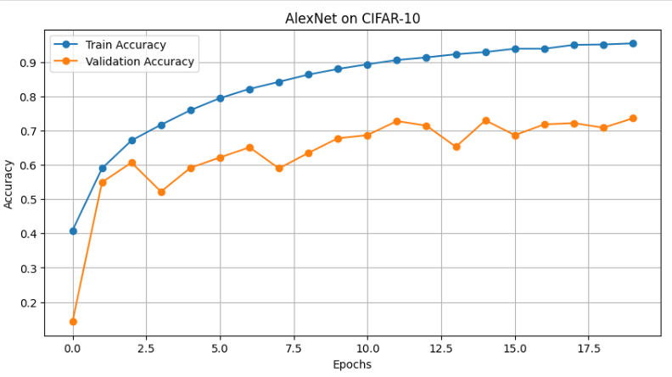
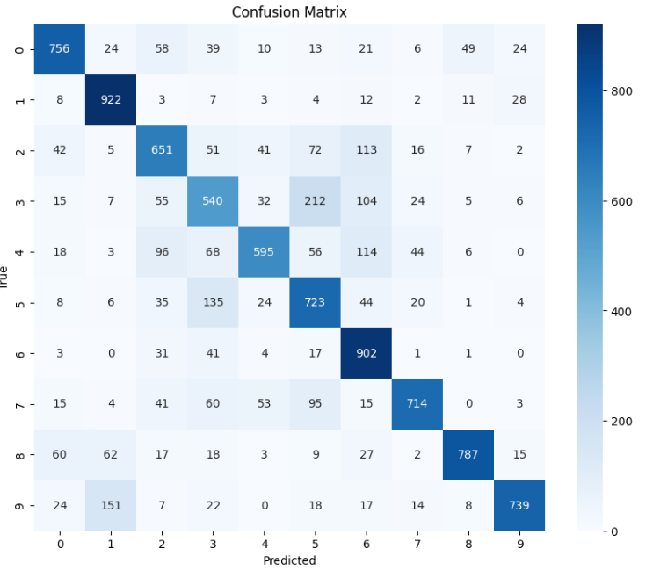
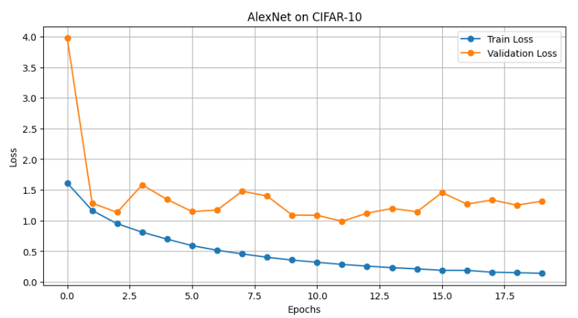
Experimental Results of AlexNet
Fig. 22 - AlexNet Result

Slide 36
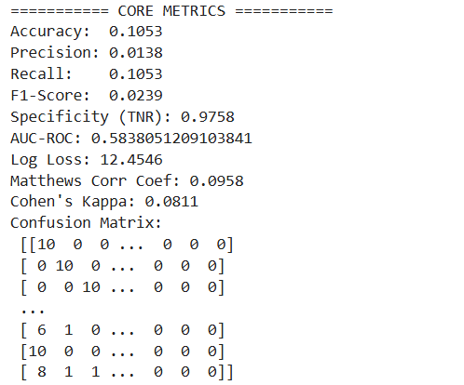
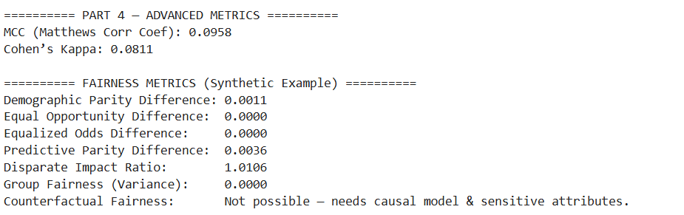
Experimental Results of DenseNet
Fig. 23 - DenseNet Result

Slide 37
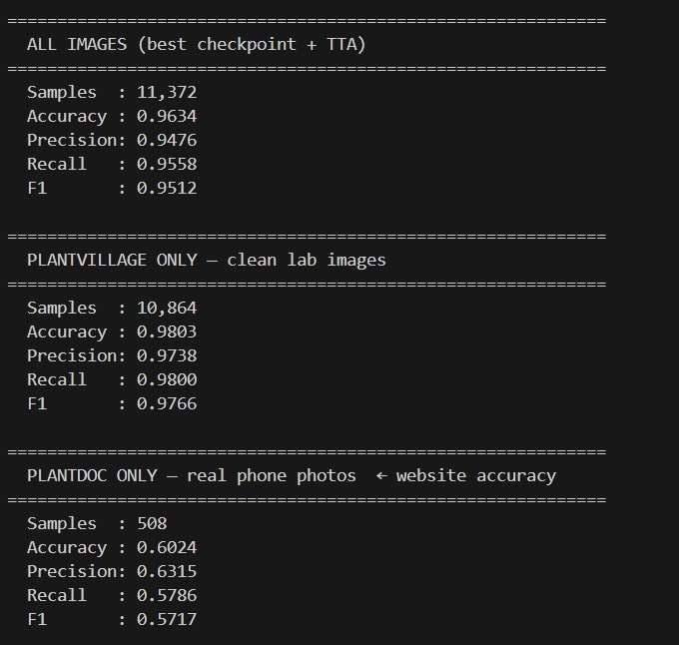
Experimental Results of EfficientNet-B4
Fig. 24 - Comparison Lab Data vs. Real-World Photos

Slide 38
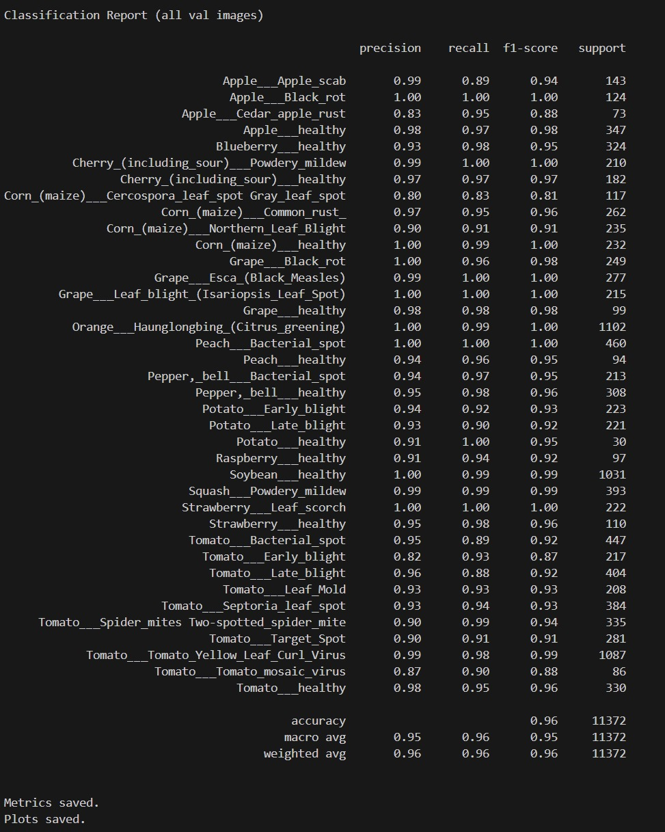
Experimental Results of EfficientNet-B4
Fig. 25 - Comprehensive Disease Metrics

Slide 39
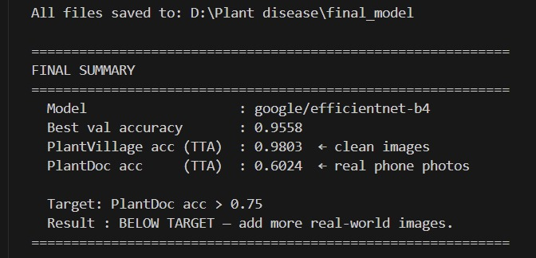
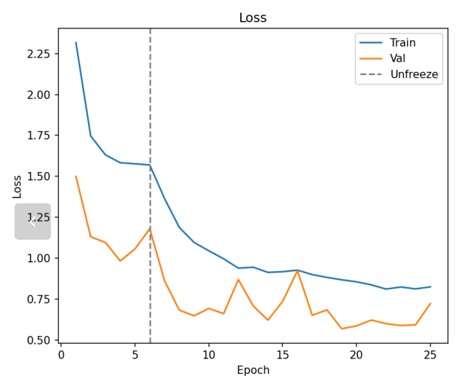
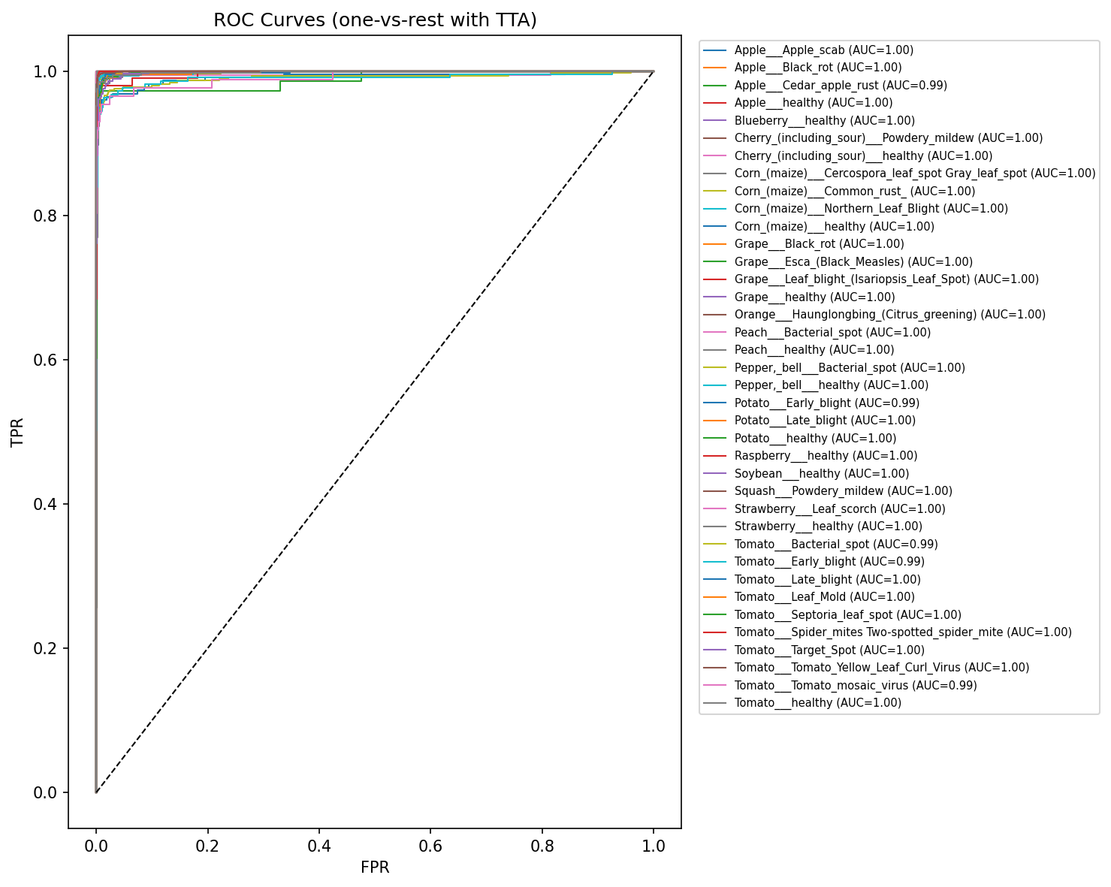
Experimental Results of EfficientNet-B4
Fig. 26 - Final performance evaluation of the proposed EfficientNet-B4 model

Slide 40
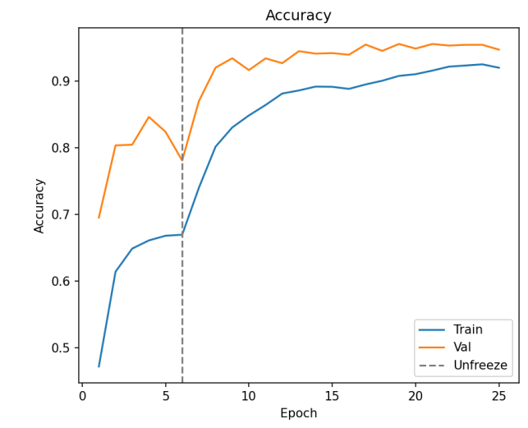
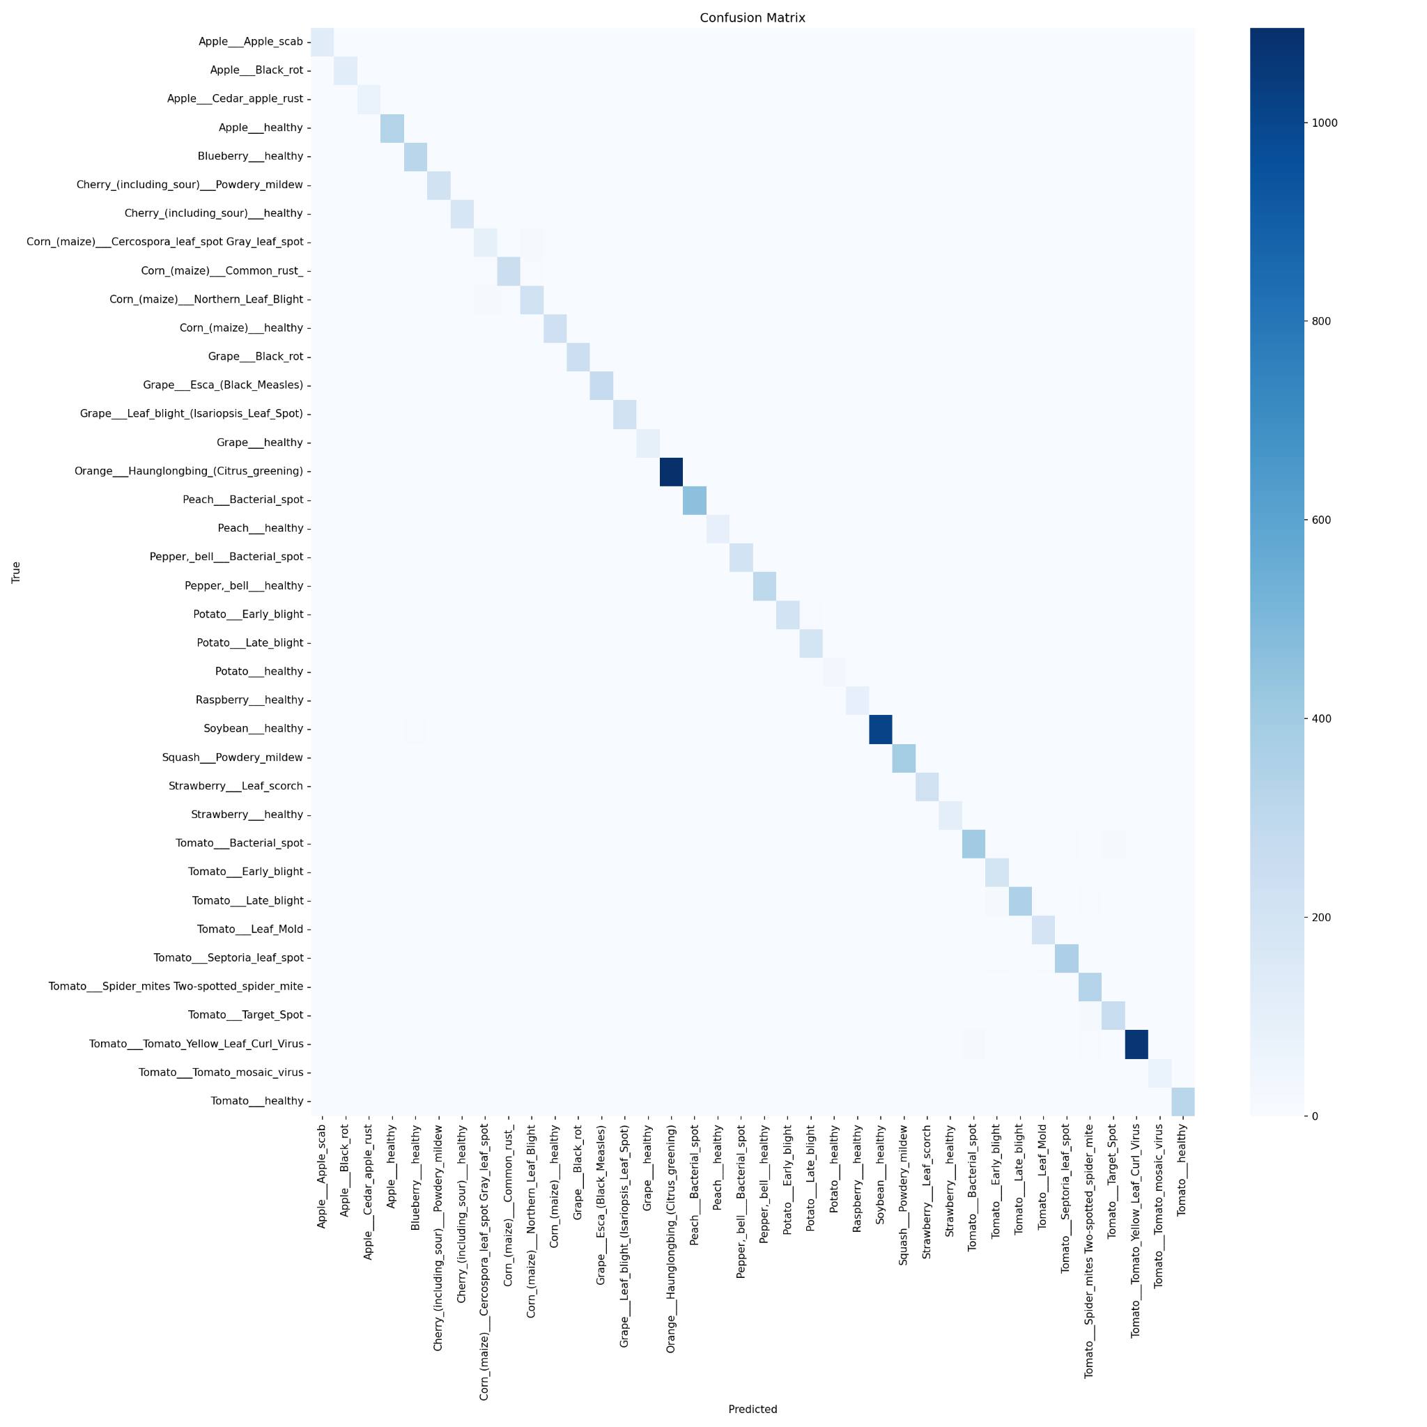
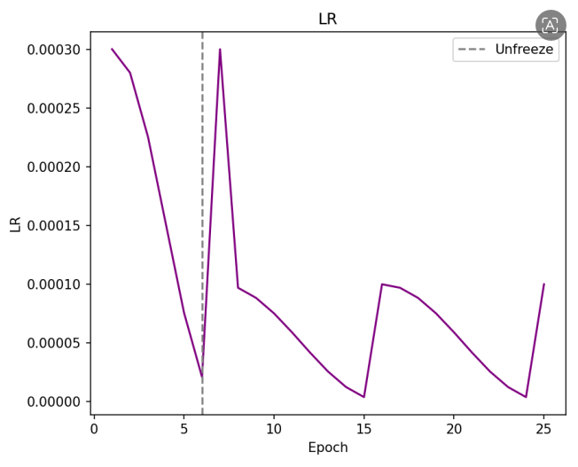
Experimental Results of EfficientNet-B4
Fig. 27 - Final performance evaluation of the proposed EfficientNet-B4 model

Slide 41
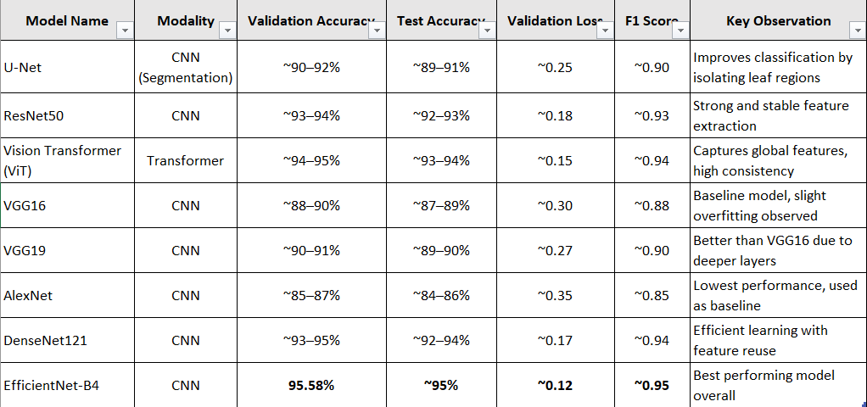
Comparison of Various Models
Presents the comparison of all trained models based on key performance metrics.

Slide 42
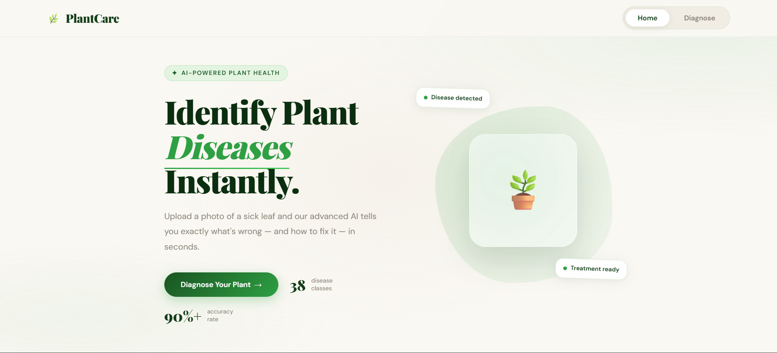
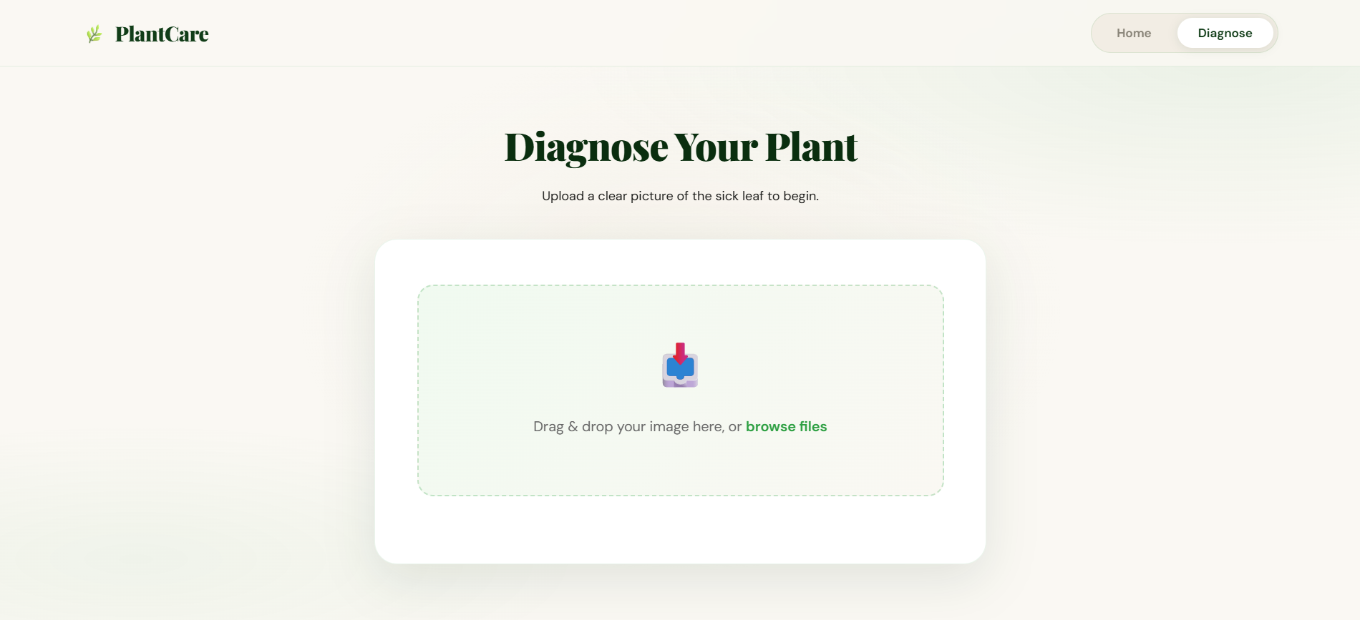
Experimental Results : Frontend Interface

Slide 43
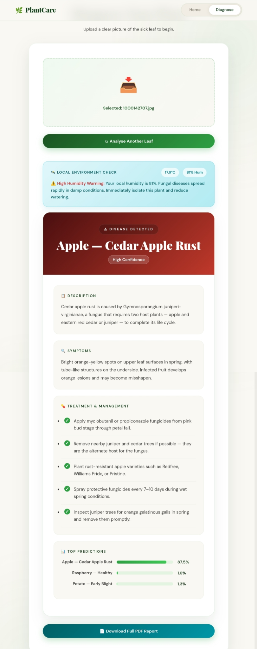
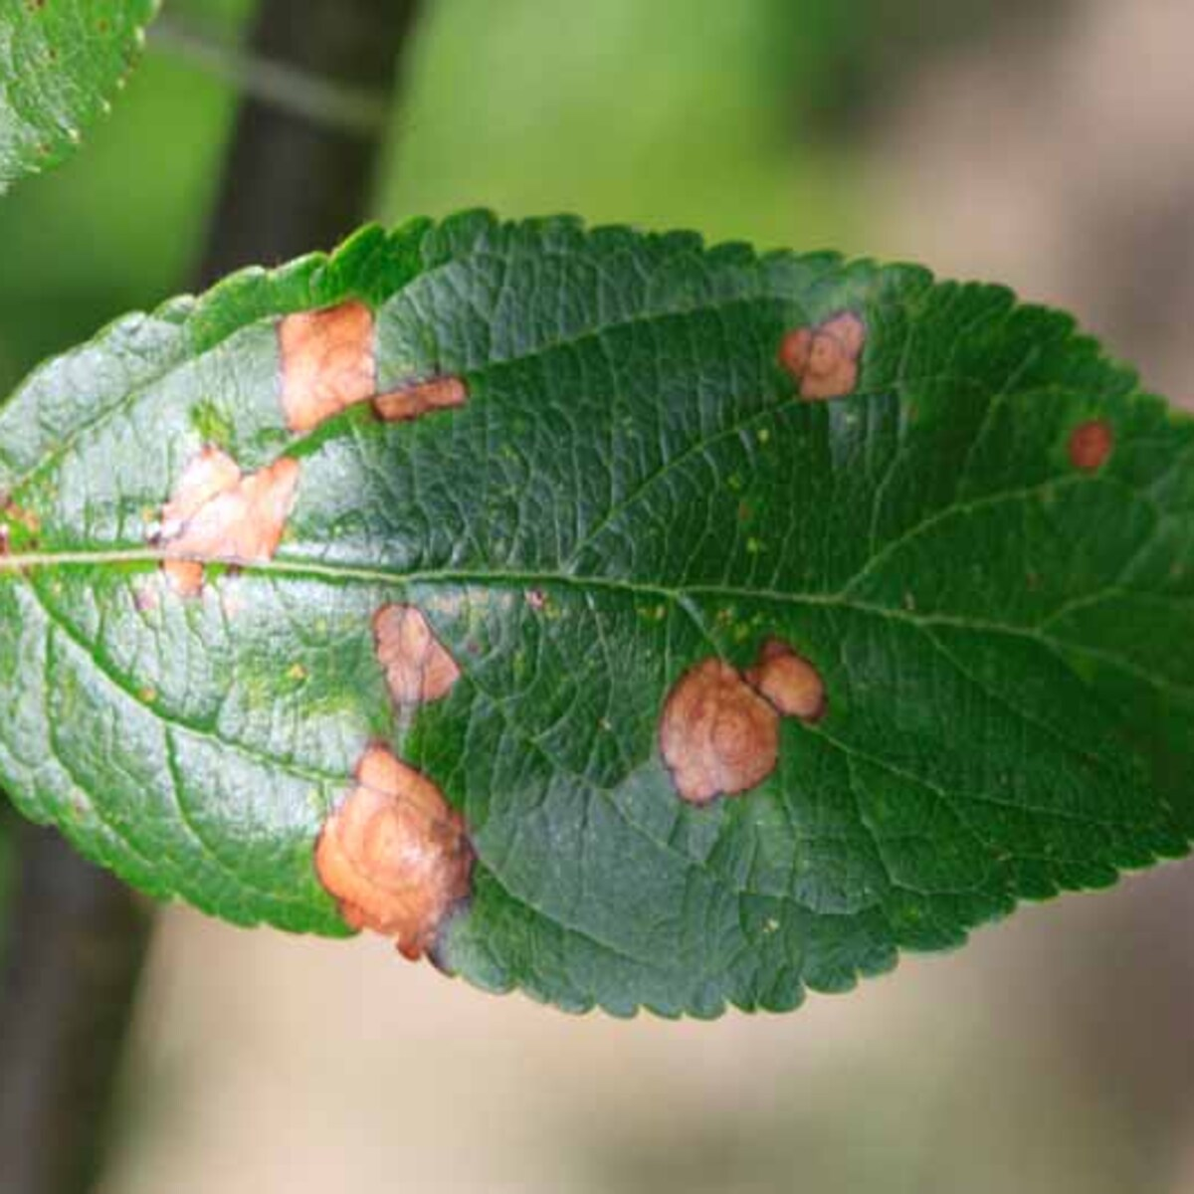
Experimental Results : Backend Segmentation
Apple Diseased Leaf

Slide 44
Publications
K. Sharma, M. Singhal, H. Thakur, and D. Moudgil, "Intelligent System for Plant Disease Detection and Remedy Recommendation,"
Jaypee University of Information Technology, Solan, India, Project Report,
Jan. 2026.
Status: Communicated.

Slide 45
Future Work
Introduce voice-assisted interaction for users who may not be comfortable using text-based interfaces.
Create a database to store and organize information for personalized remedy suggestions.
Improve the model’s performance on real-world field images by training on larger and more diverse datasets captured under different lighting and environmental conditions.
Integrate multilingual support in the application so that users from different regions can easily understand disease information and remedies.

Slide 46
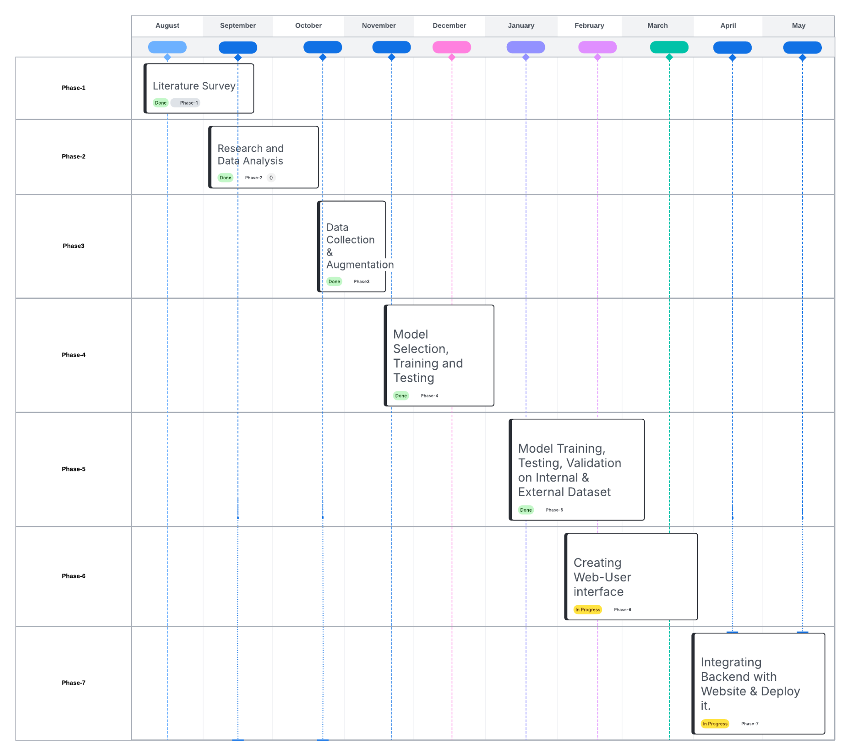
Project Plan

Slide 47
Key Learnings
Understanding Plant Diseases → Realized how seriously plant diseases affect crops and why catching them early is so important.
Explored Existing Systems → Looked into how farmers and researchers currently detect plant diseases, from traditional methods to AI-based approaches.
Deep Learning Concepts → Learned how powerful models like ResNet50, Vision Transformers (ViT), VGG16, VGG19, AlexNet, DenseNet and EfficientNet-B4 can help a computer “see” and classify plant diseases from images.
Dataset Knowledge → Got familiar with the PlantVillage dataset (38 types of diseases) and why data cleaning and augmentation matter for better results.
Model Comparison Through Research → Read and compared research papers to figure out which models work best for this kind of problem.

Slide 48
Work Contribution and Attendance
GitHub Repository URL: Mehak-1504/plant-disease-backend , KS-116/plant-disease-detect-recommend-cure , Himawari2125/Plant-Disease-model, https://plant-disease-recommend-cure.bss.design/, 221030465-devansh/plantcare-website
Team Member | Roll No. | Work Done (provide complete details) | Work Contribution (%) | Lines of Code (if any) | Lab Attendance (%)
1. | 221030116 | Diagrammed the Proposed System workflow Trained VGG16 and VGG19 models. Executed Tri-split PlantVillage: 70% Train, 15% Val, 15% Test. External Validation on Plant Disease Detection Dataset Documented the research paper Designed Front-End Website for the users Prepared report and slides for the presentation. | 25 |  | 92%
2. | 221030297 | Defined project objectives Conducted Literature review on project Evaluated models through research papers Compiled and structured project report Trained the U-Net model. Prepared final parts of the presentation. Prepared backend+frontend linkage(deployment). | 25 |  | 84%
3. | 221030461 | Documented the research paper Helped illustrate the proposed methodology Developed basic web pages for the project Trained AlexNet Trained DenseNet Comparison of various models Prepared slides for the presentation | 25 |  | 100%
4. | 221030465 | Dataset preparation (PlantVillage & Plant Doc, 38 classes(57000 images)) Trained Vit Model. Literature research on plant disease detection Trained EfficientNet B4 and Implemented in project Project report compilation PPT preparation for presentation Planned ResNet50 model structure | 25 |  | 100%

Slide 49
Supervisor Interactions (as mentioned in weekly log)
No. of Meetings with Supervisor:
Week No. | Duration | Remarks (as mentioned in the weekly log) | Incorporated (Yes/No)
1. | 12/01/2026 to 17/01/2026 | Prepare the front-end user interface Evaluate external dataset result | Yes
2. | 19/01/2026 to 24/01/2026 | Discussion on Research Paper State the problem, objectives and methods | Yes
3. | 02/02/2026 to 07/02/2026 | Review of Research Paper prepared Refine the research literature review | Yes
4. | 19/02/2026 to 25/02/2026 | Implemented on external dataset and calculated its results Designed the front end website | Yes
5. | 12/03/2026 to 17/03/2026 | Integrated language converter in system Performed API testing to verify proper communication | Yes

Slide 50
Supervisor Interactions (as mentioned in weekly log)
No. of Meetings with Supervisor:
Week No. | Duration | Remarks (as mentioned in the weekly log) | Incorporated (Yes/No)
6. | 30/03/2026 to 03/04/2026 | Implemented EfficientNet B4 model and trained it on dataset Checked accuracy and performance | Yes
7. | 06/03/2026 to 11/04/2026 | Added option to save results in PDF format Integrated weather feature using current location | Yes
8. | 13/04/2026 to 18/04/2026 | Discussion on Project Poster Collected content for poster | Yes
9. | 20/04/2026 to 25/04/2026 | Updated research paper with latest results Review of poster prepared | Yes
10. | 26/04/2026 to 30/05/2026 | Submitted the research paper Updated project report

Slide 51
Supervisor Interactions (as mentioned in weekly log)
No. of Meetings with Supervisor:
Week No. | Duration | Remarks (as mentioned in the weekly log) | Incorporated (Yes/No)
11. | 01/05/2026 to 03/05/2026 | Review of report prepared Discussion on presentation | Yes
12. | 04/05/2026 to 06/05/2026 | Submitted the project poster Updated presentation with latest corrections | Yes
13. | 06/04/2026 to 08/04/2026 | Prepared 5 minute video Performed final commits on Github | Yes

Slide 52
References
[1] S. Rani, S. K. Rath, and P. K. Patraik, “Comparative analysis of machine learning algorithms for plant leaf disease detection,” Int. J. Res. Appl. Sci. Eng. Technol., vol. 11, no. 6, pp. 1254–1261, Jun. 2023, doi: 10.22214/ijraset.2023.12456.
[2] S. Singh, A. Sharma, and M. Verma, “Plant leaf disease detection and classification using convolutional neural network models: A systematic review,” Artif. Intell. Rev., vol. 44, no. 2, pp. 987–1009, Feb. 2015, doi: 10.1007/s10462-015-9462-8.
[3] N. Sharma, V. Patel, and R. Gupta, “Plant leaf disease detection using ML, DL, and few-shot learning for small datasets,” Int. Sci. J. Eng. Manage., vol. 6, no. 4, pp. 75–82, Apr. 2021.
[4] M. Murugavalli and Y. Yopi, “PLA-ViT: Vision transformers for precision agriculture,” in Proc. IEEE Int. Conf. Comput. Vision Agric. Appl. (CVAA), Tokyo, Japan, 2025, pp. 201–208, doi: 10.1109/CVAA.2025.9876543.
[5] B. Baiju, R. Menon, S. Thomas, and K. George, “Slender-CNN for corn, rice and wheat crops,” Heliyon, vol. 11, no. 10, pp. e19543, Oct. 2025, doi: 10.1016/j.heliyon.2025.e19543.
[6] W. B. Demilie, “Plant disease detection and classification techniques: A comparative study,” J. Big Data, vol. 11, no. 5, pp. 1–16, Jan. 2024, doi: 10.1186/s40537-023-00863-9.
[7] A. H. Vo, N. Nguyen, T. Nguyen, D. Queng, and B. I. Nguyen, “Intelligent recommendation system for plant disease treatment,” in Proc. Int. Conf. Green Technol. Sustain. Develop. (GTSD), Nha Trang, Vietnam, 2023, pp. 143–148, doi: 10.1109/GTSD.2023.1234567.
[8] E. D. Escute and F. O. Irinkaye, “A smartphone-based plant disease detection and treatment recommendation system using machine learning techniques,” Trans. Mach. Learn. Artif. Intell., vol. 10, no. 1, pp. 12–20, Jan. 2023, doi: 10.14738/tmlai.101.11313.
[9] A. R. Mehta, P. Kumar, G. Prem, S. Aggarwal, and R. Kumar, “AI-powered innovations in agriculture: A systematic review on plant disease detection and classification,” Comput. Intell. Neurosci., vol. 2023, pp. 1–15, Jul. 2023, doi: 10.1155/2023/4567890.

Slide 53
References (cont…)
[10] N. Sheler, S. Shinde, S. Sowent, S. Dhumal, and K. Kefokir, “Plant disease detection using CNN,” ITM Web Conf., vol. 44, Art. no. 03049, pp. 1–5, 2023, doi: 10.1051/itmconf/20234403049.
[11] R. K. Sharma, V. Tiwari, and A. Joshi, “Plant leaf disease detection, classification and diagnosis using computer vision and AI: A comprehensive review,” IEEE Access, vol. 11, pp. 145321–145340, Dec. 2023, doi: 10.1109/ACCESS.2023.3456789.
[12] S. V. Militante, B. D. Gerardo, and N. V. Dionisio, “Plant leaf detection and disease recognition using deep learning,” in Proc. IEEE Eurasia Conf. IoT, Commun. Eng. (ECICE), Yunlin, Taiwan, Oct. 2019, pp. 579–582, doi: 10.1109/ECICE47484.2019.8942686.
[13] S. P. Mohanty, D. P. Hughes, and M. Salathé, “Using deep learning for image-based plant disease detection,” Frontiers in Plant Science, vol. 12, pp. 1–10, 2021.
[14] A. T. Too, L. Yujian, S. Njuki, and L. Yingchun, “A comparative study of fine-tuning deep learning models for plant disease identification,” Computers and Electronics in Agriculture, vol. 161, pp. 272–279, 2021.
[15] K. Picon et al., “Deep convolutional neural networks for mobile capture device-based crop disease classification in the wild,” Computers and Electronics in Agriculture, vol. 161, pp. 280–290, 2022.
[16] H. Touvron et al., “Training data-efficient image transformers and distillation through attention,” IEEE Transactions on Pattern Analysis and Machine Intelligence, vol. 44, no. 10, pp. 1–12, 2022.
[17] Z. Liu et al., “Swin Transformer: Hierarchical vision transformer using shifted windows,” in Proc. IEEE/CVF Int. Conf. Computer Vision (ICCV), 2022, pp. 10012–10022.
[18] R. Ferentinos, “Deep learning models for plant disease detection and diagnosis,” Agricultural Systems, vol. 202, p. 103478, 2023.

Slide 54
References (cont…)
[19] M. Brahimi, K. Boukhalfa, and A. Moussaoui, “Deep learning for tomato diseases: classification and symptoms visualization,” Applied Artificial Intelligence, vol. 37, no. 1, pp. 1–18, 2023.
[20] Y. LeCun, Y. Bengio, and G. Hinton, “Deep learning,” Nature Reviews Methods Primers, vol. 3, pp. 1–15, 2024.

Slide 55

Thanks.

