Slide 1
Calculating Catalan Numbers in a Multithreading System
COP 6611 - Operating Systems
Ariel Gomez, Yoel Polanco

Slide 2
Agenda
Introduction to Catalan Numbers
Definition
Computer Uses
Observations
Standard Implementations
Naïve Recursion
Memoized Recursion
Iterative Dynamic Programming
Multithreaded Implementation
Methodology
Process Flow
Results
Performance

Slide 3
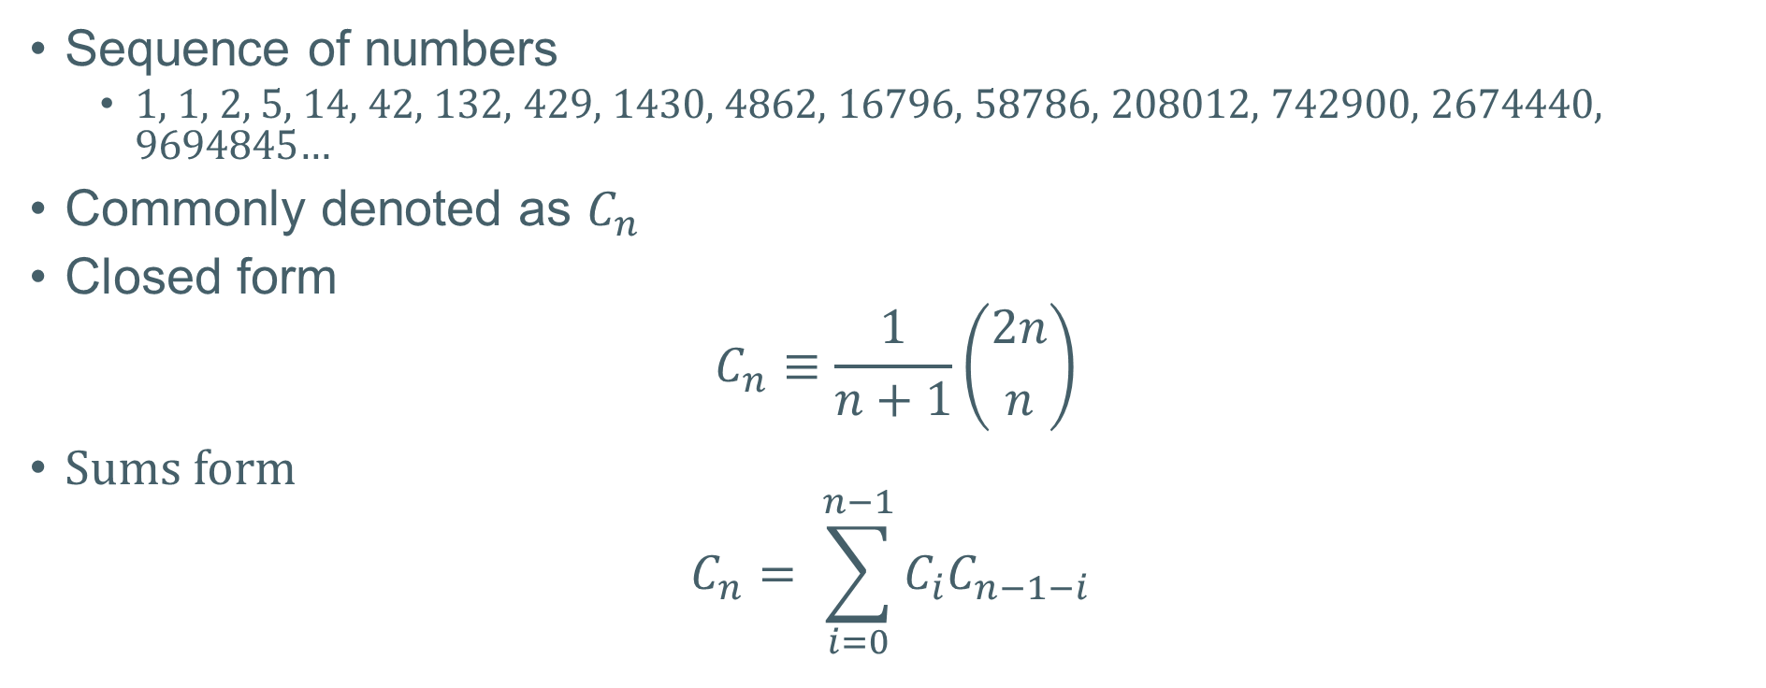
Catalan Numbers
Sequence of numbers
1, 1, 2, 5, 14, 42, 132, 429, 1430, 4862, 16796, 58786, 208012, 742900, 2674440, 9694845…
Commonly denoted as $C_{n}$
Closed form
$$C_{n}≡\frac{1}{n+1}\left({2n \atop n}\right)$$
Sums form
$$C_{n}= \sum_{i=0}^{n−1}{C_{i}C_{n−1−i}}$$

Slide 4
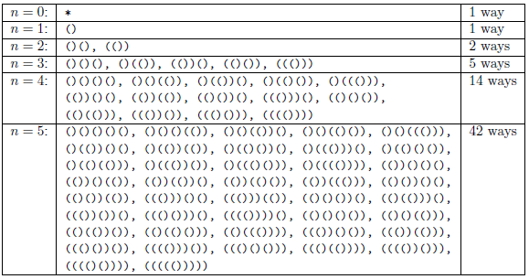
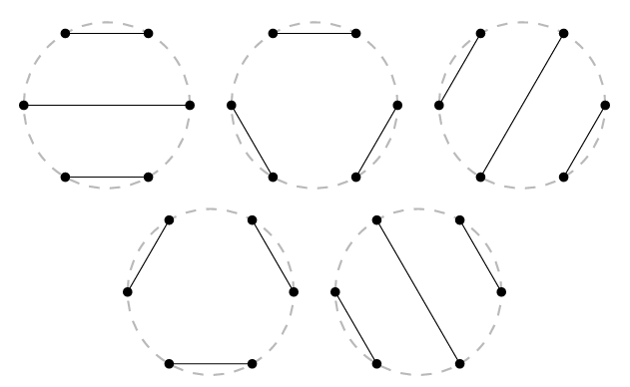
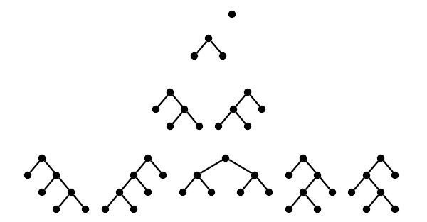
Computer Uses
Balanced parenthesis: number of ways to insert n pairs of parentheses in a word of n+1 letters.
Non-intersecting chords: Number of ways of joining 2n points on a circle to form n nonintersecting chords
Binary Trees: number of rooted binary trees with n internal nodes.
… OEIS has many more examples!

Slide 5
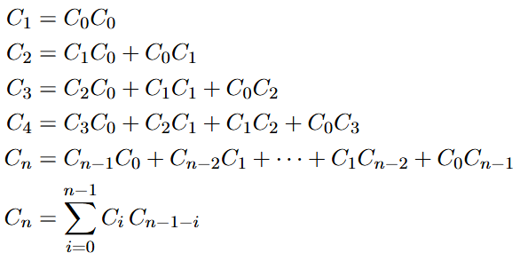
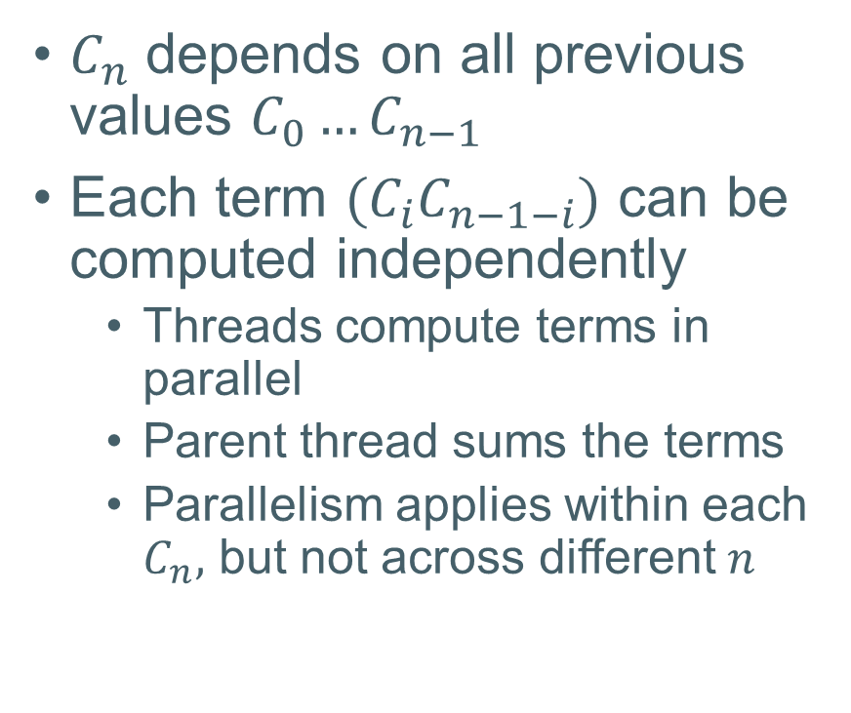
Observations
$C_{n}$ depends on all previous values $C_{0}​…C_{n−1}$
Each term ${(C}_{i}C_{n−1−i})$ can be computed independently
Threads compute terms in parallel
Parent thread sums the terms
Parallelism applies within each $C_{n},$ but not across different $n$

Slide 6
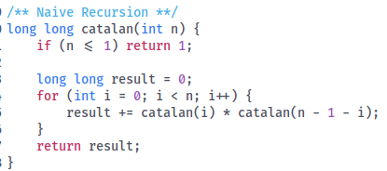
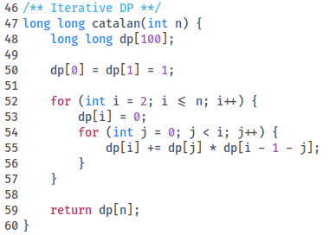
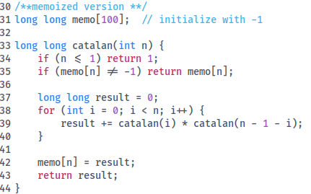
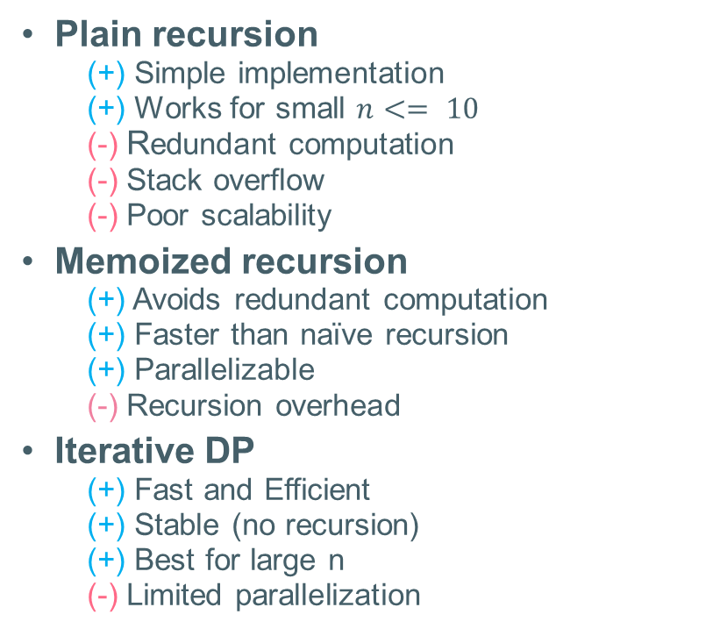
Possible Solution/Issues
Plain recursion
(+) Simple implementation
(+) Works for small $n<= 10$
(-) Redundant computation
(-) Stack overflow
(-) Poor scalability
Memoized recursion
(+) Avoids redundant computation
(+) Faster than naïve recursion
(+) Parallelizable
(-) Recursion overhead
Iterative DP
(+) Fast and Efficient
(+) Stable (no recursion)
(+) Best for large n
(-) Limited parallelization

Slide 7
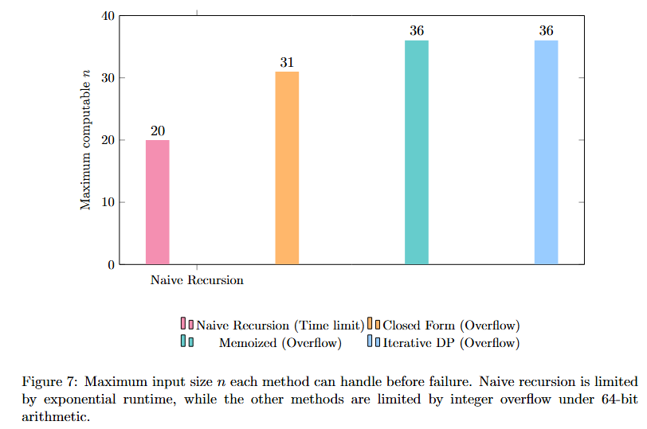
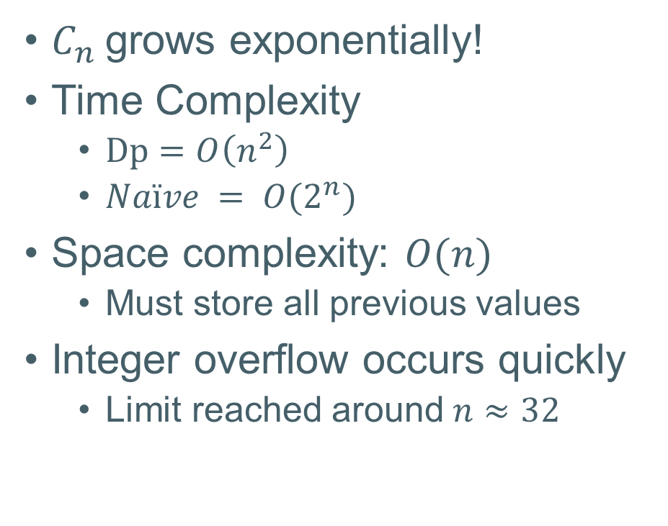
Overall Issues
$C_{n}$grows exponentially!
Time Complexity
$Dp=O\left(n^{2}\right)$
$Naïve = O(2^{n})$
Space complexity: $O(n)$
Must store all previous values
Integer overflow occurs quickly
Limit reached around$n≈32$

Slide 8
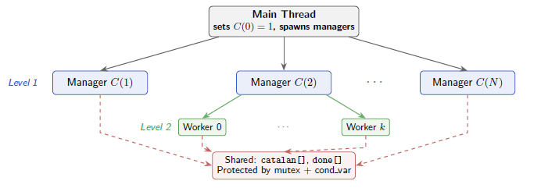
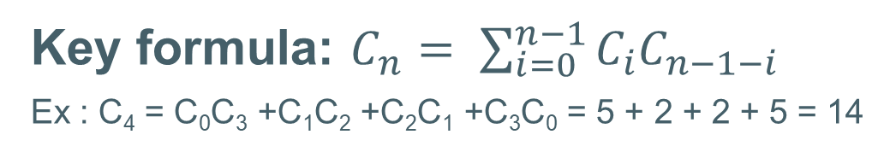
Multithread Solution
Goal: compute Catalan numbers C₀ to C_{n}
Methodology:
1. Initialize C₀ 2. Assign one manager thread per Catalan number ( 0 excluded ) 3. Wait for dependencies to be satisfied 4. Split each recurrence into worker-thread chunks 5. Compute partial sums in parallel 6. Combine and store results 7. Notify manager threads
Key formula: $C_{n}= \sum_{i=0}^{n−1}{C_{i}C_{n−1−i}}$
Ex : C₄ = C₀C₃ +C₁C₂ +C₂C₁ +C₃C₀ = 5 + 2 + 2 + 5 = 14

Slide 9
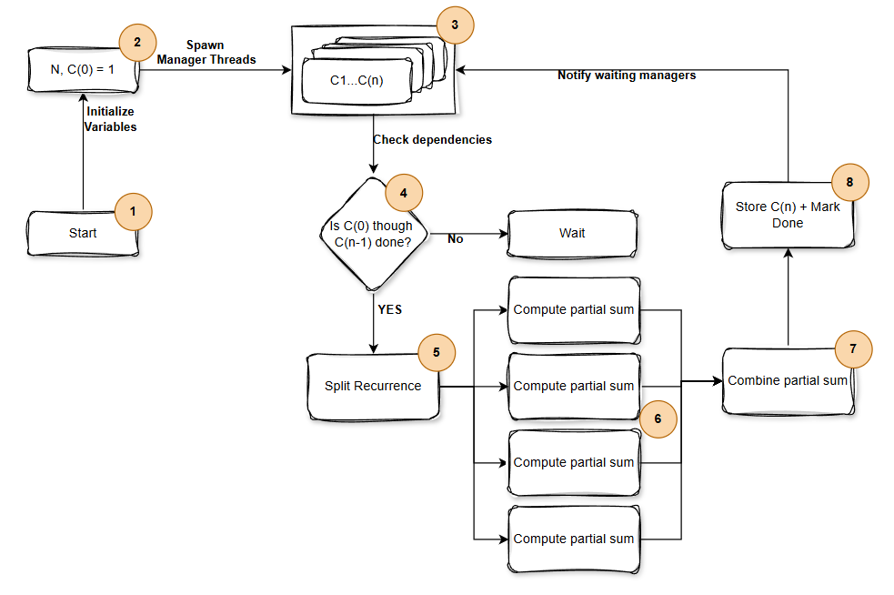
Process Flow
Start
Execute program
Read input
Read input.txt
Set C₀ = 1
Spawn manager threads
Program creates one thread per Catalan Number
Wait for dependencies to be satisfied
Managers wait until all previous Catalan numbers are computed
Split each recurrence into worker-thread chunks
Each manager uses up to 4 threads to compute inner calculation
Compute partial sums in parallel
Combine and store results
Notify waiting threads
Each manager begins work once C₀…C_{n−1} are computed

Slide 10
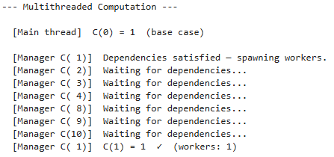
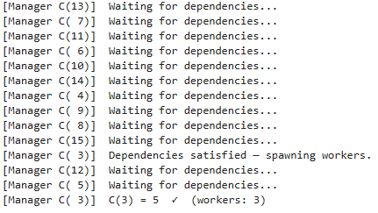
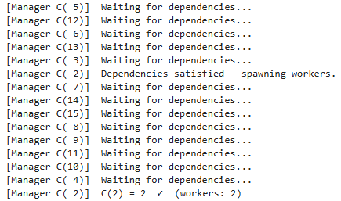
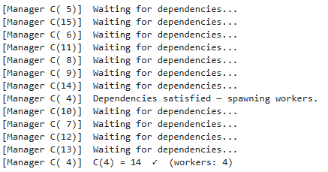
Results
Each manager waits until all dependencies are satisfied before executing their own Catalan number

Slide 11
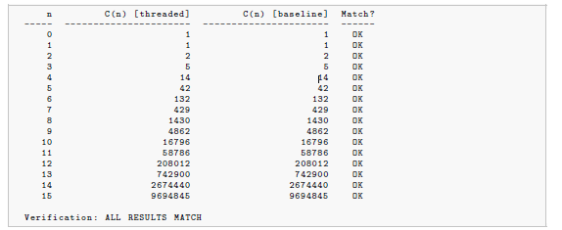
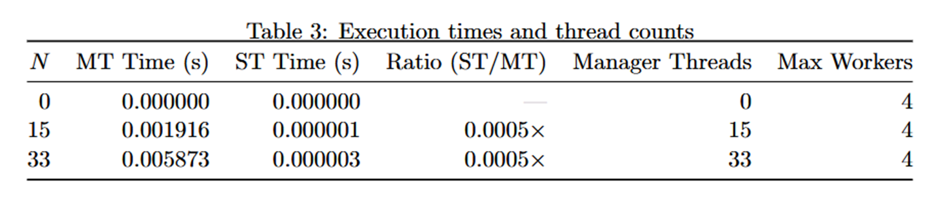
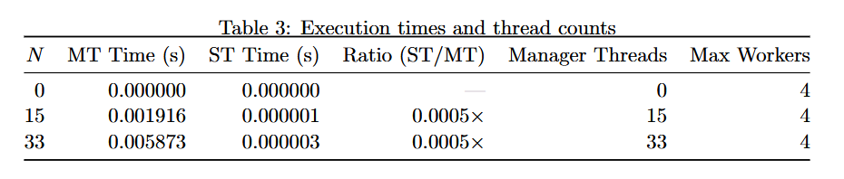
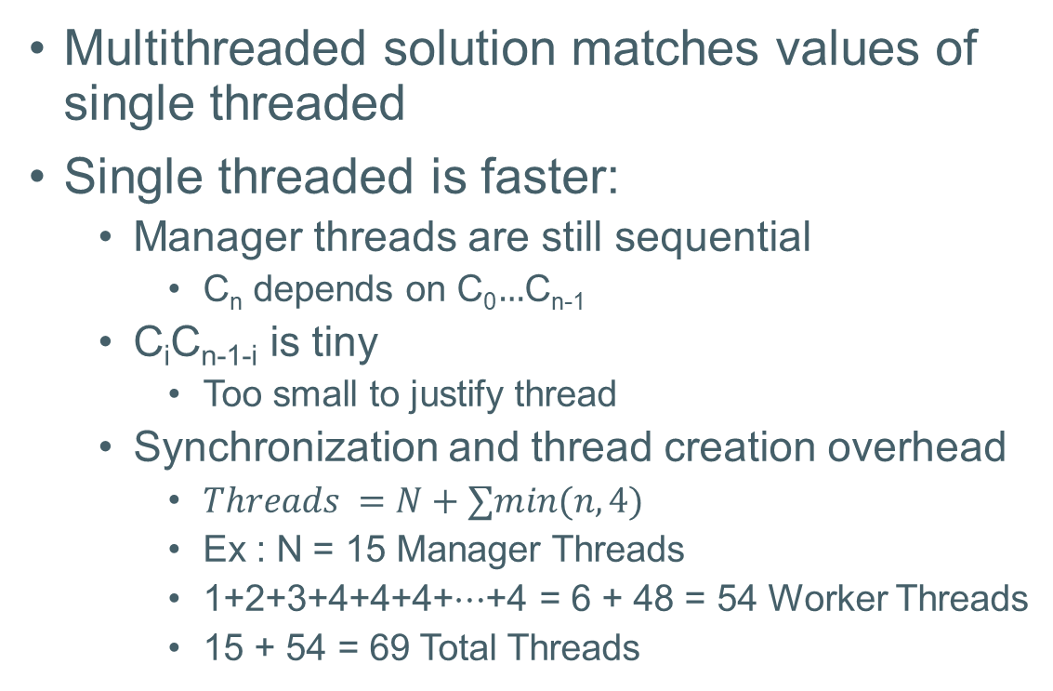
Performance Comparison
Multithreaded solution matches values of single threaded
Single threaded is faster:
Manager threads are still sequential
C_{n} depends on C₀$…$C_{n-1}
C_{i}C_{n-1-i} is tiny
Too small to justify thread
Synchronization and thread creation overhead
$Threads =N+∑min(n,4)$
Ex : N = 15 Manager Threads
1+2+3+4+4+4+⋯+4 ​​= 6 + 48 = 54 Worker Threads
15 + 54 = 69 Total Threads
S$ingle Thread =2,000× faster!$

Slide 12
Conclusion
Introducing parallelism does not result in better performance
Time complexity is worse than sequential because overhead dependencies
Space complexity is worse than sequential because multithreaded still uses N manager threads and up to 4 worker threads
Per-thread stack allocation is also higher
Per-worker workload is a single multiplication C_{i}⋅C_{n−1−i}
The overhead of creating a thread vastly exceeds the cost of that multiplication.
Project demonstrated proper thread creation, use of mutexes, condition variables, and guaranteeing mutual exclusion.

Slide 13
DEMO

