Slide 1
Multi-Agent Data Sharing Systems P2P and Blackboard Architectures
Mini Project Presentation
Project 1: College Data Sharing System – P2P Project 2: Hospital Management System – Blackboard
Adharshini KS
23ALR002

Slide 2
P2P College Data Sharing System
College Data Sharing System
The system uses a Peer-to-Peer architecture for sharing college information.
It consists of four independent agents: Student, Faculty, Library, and Placement.
Each agent manages its own specific information and services.
Agents can directly request and exchange information with other agents.
Main Goal : To demonstrate decentralized communication and data sharing between multiple intelligent agents.

Slide 3
Problem Statement & Objective
Problem
College departments maintain different types of information independently.
Sharing information between departments can require multiple intermediaries.
Objective
Build a multi-agent system using P2P architecture.
Allow every agent to directly communicate with every other agent.
Enable agents to request, process, and share information.
Demonstrate decentralized collaboration between college departments.

Slide 4
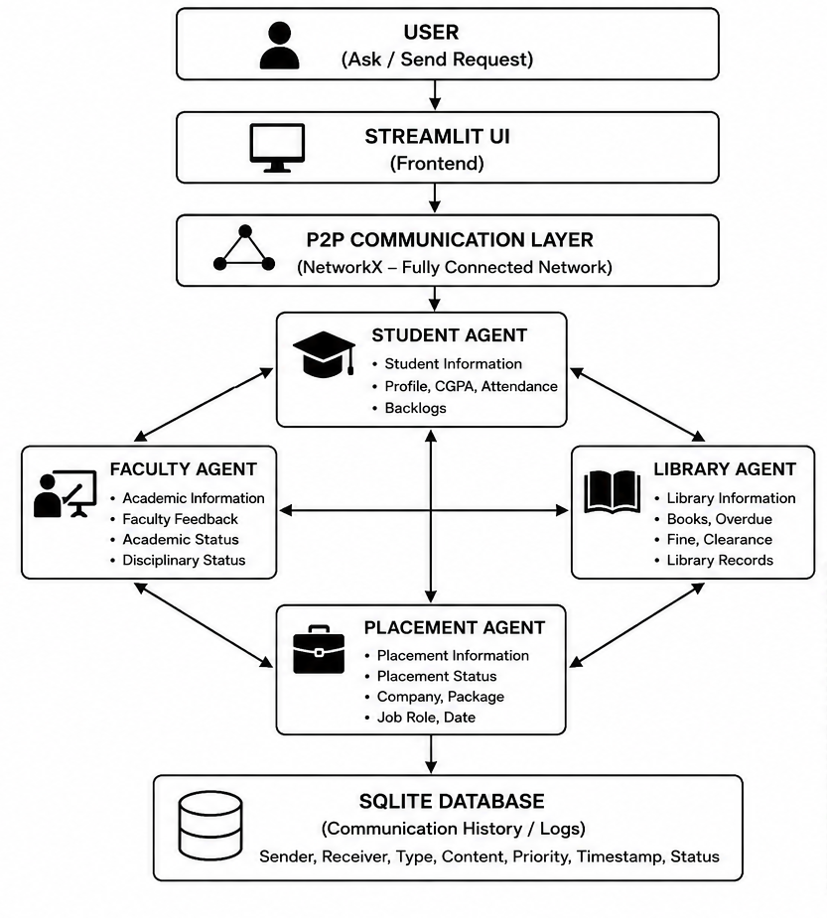
P2P Architecture
Decentralized Network : Each agent acts as an independent peer without a central controller.
Direct Agent Communication : Every agent can communicate directly with other agents to exchange information.
Independent Agents : Each agent performs its own specific task and manages its own operations.
Data Sharing : Agents share required data directly with other agents in the network.
Parallel Processing : Multiple agents can perform different tasks simultaneously

Slide 5
P2P Agents & Responsibilities
Agent | Responsibility
🎓 Student Agent | Student details and academic information
👨‍🏫 Faculty Agent | Faculty and academic information
📚 Library Agent | Books, borrowing, and availability
💼 Placement Agent | Eligibility and placement opportunities
Agents in College System : Each agent has independent responsibilities and data, but can directly communicate with all other agents.

Slide 6
P2P Communication Workflow
Example: Placement Eligibility
User Query:
Check whether Student S101 is eligible for placement.
Process
Request is initiated by an agent.
Relevant peer agents receive the request.
Each agent independently processes the request.
Responses are returned directly.
Information is combined to produce the result.
Student Agent
│
├──────────► Faculty Agent
│ ↓
│ CGPA / Attendance
│
├──────────► Library Agent
│ ↓
│ Library Status
│
└──────────► Placement Agent
↓
Eligibility Check

Slide 7
P2P Example & Expected Result
Information | Result
CGPA | 8.2
Attendance | 86%
Library Fine | ₹0
Pending Books | None
Placement Criteria | CGPA ≥ 7.5
Student S101 Final Result
PLACEMENT ELIGIBLE
Project Benefit
Decentralized communication
Direct agent interaction
Independent data management
Flexible information sharing

Slide 8
Blackboard Project Introduction
Hospital Management System
The system uses Blackboard Architecture for centralized knowledge sharing.
Four specialized agents collaborate through a common Blackboard.
Agents
🩺 Doctor Agent
🧪 Laboratory Agent
💊 Pharmacy Agent
💰 Billing Agent
Main Goal
To demonstrate indirect communication and collaborative decision-making through a shared knowledge repository.

Slide 9
Problem Statement & Objective
Problem
Hospital information is generated by multiple departments.
Doctors, laboratories, pharmacies, and billing systems need to share patient information.
Objective
Create a shared Blackboard for hospital information.
Allow specialized agents to read and update shared information.
Enable agents to collaborate without direct agent-to-agent connections.
Generate a complete patient-care and billing workflow.

Slide 10
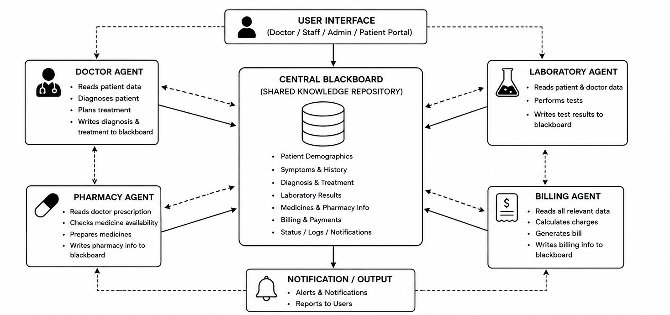
Blackboard Architecture

Slide 11
Blackboard Architecture
Central Blackboard : A shared repository stores all information required by different agents.
Agent Interaction : Agents read information from and write updates to the Blackboard.
Shared Knowledge : All agents access the latest available data from a common knowledge source.
Task Coordination : Agents coordinate their tasks by using information posted by other agents.
Parallel Processing : Multiple agents can work simultaneously using the shared information.
Centralized Data Management : Data is maintained in one common location, reducing duplication and inconsistency.

Slide 12
Blackboard Agents & Responsibilities
Agent | Responsibility
🩺 Doctor Agent | Diagnosis and treatment planning
🧪 Laboratory Agent | Medical tests and results
💊 Pharmacy Agent | Prescriptions and medicine availability
💰 Billing Agent | Treatment, test, and medicine charges
Key Point : Each agent contributes its specialized knowledge to the shared Blackboard.

Slide 13
Blackboard Communication Workflow
Patient Information
↓
Blackboard
↓
Doctor Agent
↓
Diagnosis
↓
Blackboard
↓
Laboratory Agent
↓
Test Results
↓
Blackboard
↓
Pharmacy Agent
↓
Prescription
↓
Blackboard
↓
Billing Agent
↓
Final Bill
Example: Patient Treatment
Process
Patient information is added to the Blackboard.
Doctor Agent reads the patient information.
Diagnosis and treatment details are added.
Laboratory Agent updates test results.
Pharmacy Agent updates prescription information.
Billing Agent calculates the final cost.

Slide 14
Blackboard Example & Expected Result
Patient P101
Doctor Agent
→ Diagnosis: Infection → Treatment: Antibiotics
Laboratory Agent
→ Blood Test: Completed → Result: Abnormal
Pharmacy Agent
→ Medicine: Antibiotics → Availability: Available
Billing Agent
→ Consultation: ₹500 → Test: ₹800 → Medicine: ₹600
Final Bill
Total = ₹1,900
All information is maintained through the Blackboard.

Slide 15
Conclusion
P2P architecture demonstrates decentralized communication between independent agents.
Blackboard architecture demonstrates centralized knowledge sharing between specialized agents.
Both systems demonstrate how multiple agents can collaborate to solve real-world problems.
The projects show practical applications of Agentic AI and Multi-Agent Systems.

Slide 16
Thank You
Google Colab Links,
P2P Architecture
https://colab.research.google.com/drive/1S0xme9IQV8IOXFgydPK6rC7XAk9iqJIT?usp=sharing
Blackboard Architecture
https://colab.research.google.com/drive/1KZX9-cf1h83ftcE8ovBvHThdWsOt6yEA?usp=sharing
GitHub Link
https://github.com/KS-Adharshini/Agentic-AI.git

