Slide 1
North South University
CSE499
Senior Design Project
Group 02
Name | ID
Kazi Safin Arafat | 2211778642
Khondokar Sajid | 2211778642
Moushumi Akter Mow | 2021983642
Rakibul Hasan Ridoy | 1731339042

Slide 2
Machine Learning Based
Network Intrusion Detection System
for IoT Devices

Slide 3
Introduction
IoT
NIDS
ML

Slide 4


Introduction
IoT
20

Slide 5
Introduction
NIDS
Threat Detection
Traffic Analysis
Alert
Compliance

Slide 6


Problem Statement
NIDS

Slide 7

Problem Statement
NIDS

Slide 8
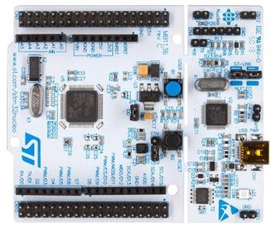
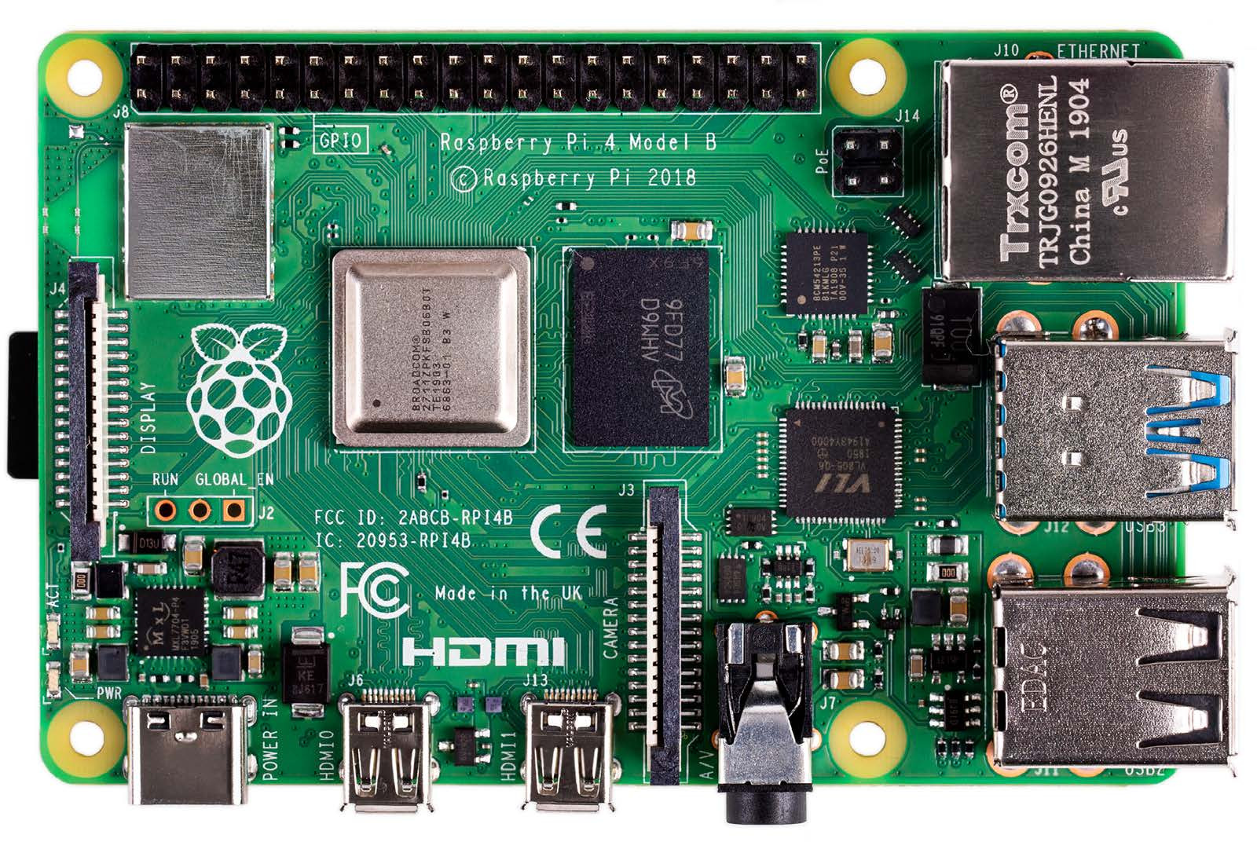
Problem Statement
IoT

Slide 9
Problem Statement
IoT
Raspberry Pi 4
Cortex-M4
64 Mhz
256KB
STM32 Nucleo / Discovery
Cortex-M3/M4
64Mhz
64~512KB

Slide 10
Problem Statement
Existing NIDS requires high computational power
IoT devices have limited processing and energy capacity
Current model fails to provide real time detection on constrained devices

Slide 11
Objectives
Build or adapt a model that runs efficiently on IoT hardware
Detect and classify attacks in real-time
Optimize for energy and memory usage
Evaluate accuracy, latency, and false alarm rate

Slide 12
Literature Review
S. Pande and A. Khamparia, “Explainable deep neural network based analysis on intrusion detection systems,” Computer Science, vol. 24, no. 1, 2023.
DNN-based IDS with explainable AI (LRP, LIME)
High accuracy on NSL-KDD and CICIDS datasets
Limitation: Heavy model; not suitable for constrained IoT devices
D. Krishnan, S. Singh, and V. Sugumaran, “Explainable AI for zero-day attack detection in IoT networks using attention fusion model,” Discover Internet of Things, 2025.
Attention Fusion Model (CNN+LSTM) for zero-day attack detection
Grad-CAM and SHAP for interpretability
Robust on IoT datasets (~97% accuracy)
Limitation: Tested on simulators, not real IoT hardware
K. Fatema et al., “Federated XAI IDS: An Explainable and Safeguarding Privacy Approach to Detect Intrusion Combining Federated Learning and SHAP,” Future Internet, vol. 17, no. 6, 2025
Federated Learning + XAI (SHAP) for distributed IDS
Ensures privacy and local explainability
Accuracy >95%
Limitation: Edge nodes need relatively high computation; communication overhead

Slide 13
Literature Review
N. Almolhis, “Intrusion Detection Using Hybrid Random Forest and Attention Models and Explainable AI Visualization,” Journal of Internet Services and Information Security, 2025.
Hybrid Random Forest + Attention Network
Visual explanations with SHAP, Grad-CAM
Accuracy >96%
Limitation: Computationally heavy for IoT nodes
A. E. Muhammad et al., “L-XAIDS: A LIME-based eXplainable AI
L-XAIDS, model-agnostic framework with LIME
Human-readable local explanations
Accuracy ~94%
Limitation: High LIME computation cost; not real-time IoT friendly
D. Peisker et al., “Evaluating Explainable AI for Deep Learning-Based
Evaluates XAI techniques (LIME, SHAP, Grad-CAM) on DL-based IDS
Benchmarks fidelity, stability, computation cost
Limitation: No IoT deployment; evaluation only

Slide 14
Propose Methodology
Data
Preprocessing
Detection
Models
Model Architecture
Evaluation
Metrics
Explainability Techniques
Optimization
False Positive Reduction

Slide 15
Timeline
Week 03 | Submit proposal report and slides with related work and system architecture sketch.
Week 05 | Present literature review, highlighting gaps and our approach, with references.
Week 06 | Deliver solution report with methodology, datasets, and pseudocode.
Week 08 | Provide progress report with early model tests, small dataset results, and challenges.
Week 09 | Share code snapshot, demo video of pipeline on IoT setup (e.g., ESP32), and explanation outputs.
Week 11 | Submit final report, presentation, complete code with docs, and human study results.

Slide 16
EXPECTED DELIVERABLES
A working detection system with explainability, optimized for IoT devices like ESP32 or Android, deployable in real-world scenarios.
Tables and graphs comparing model performance (e.g. F1-Score, ROC-AUC), explanation quality (e.g., fidelity, comprehensibility), and IoT efficiency (e.g., latency, energy)
Explanation evaluations for fidelity, consistency, comprehensibility, and overhead, proving our system’s reliability.
A GitHub repo with README, requirements.txt, Jupyter notebooks, and a detailed IoT deployment guide for devices like ESP32 and Raspberry Pi.

Slide 17
EXPECTED DELIVERABLES
A working detection system with explainability, optimized for IoT devices like ESP32 or Android, deployable in real-world scenarios.
Explanation evaluations for fidelity, consistency, comprehensibility, and overhead, proving our system’s reliability.
Tables and graphs comparing model performance (e.g. F1-Score, ROC-AUC), explanation quality (e.g., fidelity, comprehensibility), and IoT efficiency (e.g., latency, energy)
A GitHub repo with README, requirements.txt, Jupyter notebooks, and a detailed IoT deployment guide for devices like ESP32 and Raspberry Pi.

Slide 18
Challenges
Data Scarcity: Use transfer learning from big datasets to small ones and generate synthetic IoT traffic with Scapy.
Overfitting: Apply cross-validation, dropout, and L2 regularization to keep models generalizable.
Recruiting Participants: Find Cybersecurity Professionals is hard to come by.
Device Limits: Train complex models on cloud servers, then compress for edge deployment using TensorFlow Lite’s converter.
Ethics: Ensure data anonymity, obtain informed consent for human studies, and follow GDPR guidelines.

Slide 19
The End
Thank you Everyone

