Slide 1

Machine Learning Approach to Network Intrusion Detection for IoT Devices
CSE 499A — Section 15 — Group 02
Team Members:
Kazi Safin Arafat (2211778642)
Khondokar Sajid (2211954042)
Moushumi Akter Mow (2021983642)
Rakibul Hasan Ridoy (1731339042)
Instructor: Md. Mohammad Shifat-E-Rabbi
North South University

Slide 2

A Wake-Up Call: The Mirai Botnet Incident
The Mirai malware attack in 2016 remains a stark reminder of IoT vulnerabilities. This sophisticated botnet hijacked thousands of insecure IoT devices, transforming them into a formidable attack force. These compromised devices then launched massive Distributed Denial of Service (DDoS) attacks, crippling major internet services like Twitter, Netflix, and GitHub.
Why This Matters: The Critical Need for Anomaly Detection
IoT Vulnerability
IoT devices are inherently vulnerable and easy to compromise due to often weak security protocols and default credentials.
Targeted Attacks
Attackers actively seek out these unmonitored devices, leveraging them for large-scale cyber operations without immediate detection.
Early Detection is Key
Our system focuses on early anomaly detection, identifying unusual behaviour before it escalates into a full-blown cyberattack.
Lightweight Solutions
The deployment of lightweight, ML-based Intrusion Detection Systems (IDS) is not just beneficial, but essential for the security of modern IoT ecosystems.

Slide 3




The Alarming State of Global IoT Security
The proliferation of IoT devices presents an ever-expanding attack surface. With over 15 billion IoT devices estimated in 2023, the scale of the challenge is immense.
57%
2-5 Yrs
15B+
Known Vulnerabilities
End-of-Life Updates
Devices Worldwide
More than half of all IoT devices contain known security vulnerabilities, making them prime targets for cyber criminals.
Many devices cease receiving critical security updates after just 2-5 years, leaving them permanently exposed to new threats.
The sheer number of interconnected devices creates a massive, growing attack surface that is difficult to monitor and protect.
Traditional IDS were designed for large computer networks
These solutions must handle IoT’s unique challenges:
They require high CPU, RAM, and storage resources
limited memory
IoT devices are tiny, low-power, and often battery-operated
limited processing power
Heavy IDS tools cannot run efficiently on such constrained devices
always-online exposure
IoT needs lightweight, optimized intrusion detection solutions
large-scale deployment

Slide 4
Project Goals and Scope
Project Goal
Scope (CSE499A)
To evaluate a comprehensive range of existing Machine Learning models for intrusion detection.
Our focus is on applying and optimising existing ML techniques, rather than developing novel algorithms.
To select the most robust and efficient model capable of identifying network anomalies effectively.
We will conduct a thorough comparison between supervised and unsupervised learning methods to determine their suitability.
To deploy the chosen model on a Raspberry Pi for real-time intrusion detection capabilities within an IoT environment.
The project includes building a complete preprocessing and deployment pipeline for practical application.
This project aims to bridge the gap between theoretical ML models and their practical, real-world application in securing IoT networks.

Slide 5
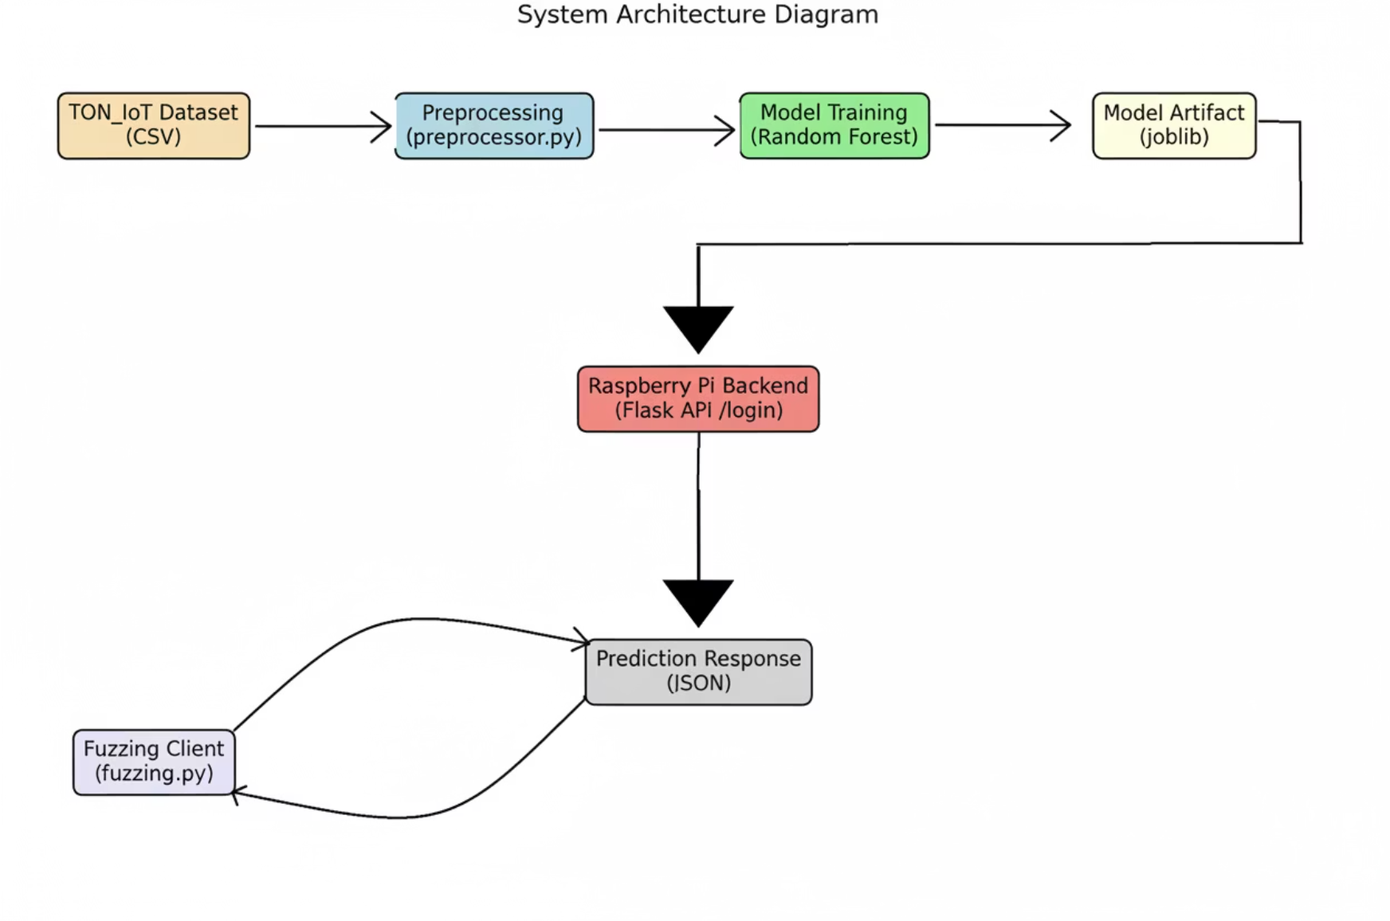
System Overview: Real-Time IoT Intrusion Detection
Our system is designed for efficient, real-time intrusion detection in IoT networks. The workflow starts with incoming IoT traffic, which is then processed, analysed by an ML model, and ultimately leads to a prediction of normal or anomalous behaviour.
JSON Input
Feature Formatting & Scaling
Model Inference
Normal / Attack Decision
Data is received in JSON format, ensuring compatibility and ease of integration with various IoT devices and platforms.
Raw data undergoes essential formatting and scaling to prepare it for optimal model performance, removing noise and normalising values.
The preprocessed data is fed into the deployed Machine Learning model for rapid and accurate inference, identifying potential threats.
The system provides a clear decision: classifying incoming traffic as either benign (Normal) or malicious (Attack), triggering appropriate responses.

Slide 6

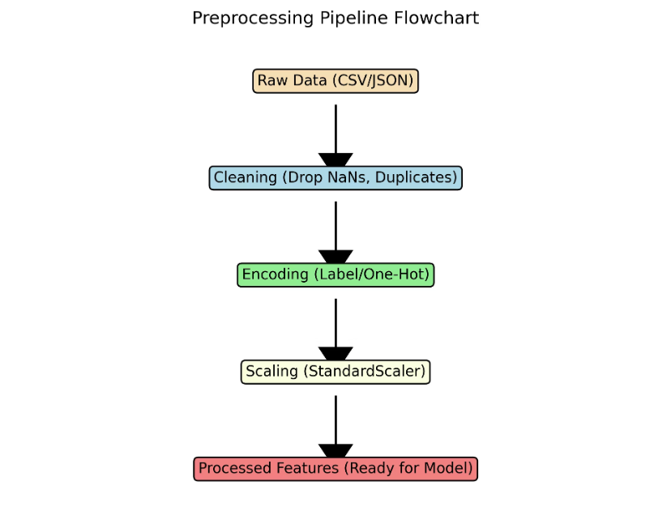





Datasets and Preprocessing: Fueling Intelligent Detection
Accurate intrusion detection relies heavily on high-quality datasets and meticulous preprocessing. We leveraged two distinct datasets to train and validate our models.
Key Datasets
Preprocessing Steps
Data Cleaning
TON_IoT:
Removal of inconsistencies, missing values, and irrelevant entries to ensure data integrity.
Contains real IoT cyberattack scenarios
Categorical Encoding
Includes diverse attack types observed in actual IoT environments
Conversion of categorical features into numerical representations suitable for machine learning algorithms.
Highly realistic and representative of modern IoT deployments
Ideal for evaluating model performance under real-world conditions
Feature Scaling
Provides complex, noisy, imbalanced data typical of IoT networks
Normalisation or standardisation of numerical features to prevent dominance by features with larger values.
NSL-KDD:
Feature Engineering
A classical and widely used IDS benchmark dataset
Creation of new, more informative features from existing ones to enhance model predictive power.
Commonly used in network security research
Saving Artifacts
Suitable for validating basic model behavior and correctness
Storage of preprocessor components (scalers, encoders, feature ordering) to ensure consistent application during deployment.
More balanced and cleaner compared to TON_IoT
Helps confirm the effectiveness of preprocessing and training pipeline

Slide 7
Models and Mathematical Foundations
We explored a diverse range of Machine Learning models, categorising them into supervised and unsupervised approaches, to identify the most effective solution for IoT intrusion detection.
Supervised Learning Models
Unsupervised Learning Models
These models learn from labelled data, where each instance is tagged as either normal or anomalous. They are highly effective for detecting known attack patterns.
These models identify anomalies without prior knowledge of attack types, making them suitable for detecting zero-day attacks and unknown threats.
Random Forest (RF): An ensemble method that builds multiple decision trees and merges their predictions for higher accuracy and robustness.
Isolation Forest (IF): An ensemble of isolation trees that explicitly isolate anomalies instead of profiling normal data points.
XGBoost: A highly efficient and flexible gradient boosting framework that is known for its speed and performance.
One-Class SVM (OCSVM): A variant of SVM used for novelty detection, training on a dataset of "normal" instances and detecting any deviation from this norm.
Support Vector Machine (SVM): A powerful algorithm for classification and regression tasks, finding an optimal hyperplane to separate classes.
Autoencoder: A neural network that learns to compress data into a lower-dimensional representation and then reconstruct it. Anomalies are detected by high reconstruction errors.
Logistic Regression: A statistical model used for binary classification, estimating probabilities using a logistic function.
Underlying Mathematical Concepts
K-Nearest Neighbours (KNN): A non-parametric, instance-based learning algorithm that classifies new data points based on the majority class of their k-nearest neighbours.
Random Forest Gini Impurity: G = 1 - \sum p_k^2. Measures the likelihood of an incorrect classification if a data point is randomly chosen from a split.
Decision Tree: A tree-like model where each internal node represents a test on an attribute, each branch represents an outcome of the test, and each leaf node represents a class label.
XGBoost Loss Function: Involves a regularised objective function that includes both a loss term (measuring prediction error) and a regularisation term (controlling model complexity).
Isolation Forest Anomaly Score: Anomalies have shorter average path lengths in isolation trees, as they are easier to separate from the majority of data points.

Slide 8
Performance Insights: TON_IoT and NSL-KDD Findings
Our rigorous evaluation across two distinct datasets yielded crucial insights into the performance characteristics of various Machine Learning models, guiding our final selection for deployment.
TON_IoT Findings
NSL-KDD Findings
The TON_IoT dataset, with its focus on real-world IoT cyberattacks, provided a critical testbed for our models:
Testing against the classical NSL-KDD dataset served to validate our methodological approach and preprocessing pipeline:
XGBoost: Consistently delivered the highest accuracy, demonstrating its strong capability in classifying diverse IoT attack types.
RF & XGBoost: Both models produced strong accuracy results, confirming their general efficacy in network intrusion detection tasks.
Random Forest: Showcased an optimal balance between high performance and computational speed, making it a strong candidate for resource-constrained IoT environments.
Preprocessing Validation: The consistent high performance of these established models on NSL-KDD confirmed that our preprocessing pipeline was correctly implemented and effectively prepared the data for ML analysis.
Isolation Forest: Proved to be a decent performer for unsupervised anomaly detection, highlighting its potential for identifying novel threats.
One-Class SVM (OCSVM): Exhibited unstable performance, suggesting it may not be ideally suited for the complexity and variability of IoT traffic in this context.
Ensemble methods are the strongest overall.
Random Forest chosen for deployment due to its accuracy, efficiency, and low resource footprint —
perfect for Raspberry Pi intrusion detection.

Slide 9






Deployment: Raspberry Pi and Real-Time Testing
To demonstrate the practical applicability of our solution, we deployed the selected Machine Learning model on a Raspberry Pi, creating a functional, real-time intrusion detection system.
Fuzzing Workflow
CSV Row
Simulated network traffic data from a CSV file.
JSON Conversion
Each row converted into a JSON object.
POST Request
JSON data sent to the Raspberry Pi API.
Raspberry Pi Processing
Backend Architecture
Data processed by the deployed model.
Flask API: A lightweight web framework providing the interface for receiving network traffic data.
Prediction & Logging
Preprocessor Module: Integrates the saved preprocessing artifacts to transform incoming raw data into a format suitable for the model.
Output logged as normal or attack.
Random Forest Model: The selected ML model, chosen for its balance of accuracy and efficiency, embedded for rapid inference.
/login Endpoint: A specific API endpoint designed to simulate typical IoT device traffic or authentication attempts for monitoring.
System Workflow
Incoming Data → Preprocessing → Model → Normal/Attack Decision

Slide 10


Insights, Limitations, and Future Work
Our project successfully demonstrated the viability of ML-based intrusion detection in IoT networks, but also highlighted areas for further development.
Key Findings
Limitations
Future Work (CSE499B)
Ensemble models (like Random Forest and XGBoost) consistently provided the strongest performance.
Lack of Explainability: The current models do not provide insights into why a specific decision was made (no SHAP integration).
Explainable AI (XAI): Incorporating SHAP values or other XAI techniques for better interpretability.
Random Forest emerged as the ideal model for real-time IoT deployment due to its balance of accuracy and efficiency.
No Zero-Day Detection: Supervised models struggle with novel, previously unseen attack types.
Zero-Day Generalisation: Enhancing models to detect novel attack patterns more effectively.
A Raspberry Pi is a capable platform for hosting an ML-based IDS, proving its feasibility for edge deployment.
Single Device Testing: Deployment and testing were limited to a single Raspberry Pi device.
Model Compression: Optimising models for even smaller footprints and faster inference on highly resource-constrained devices.
Dataset Imbalance: Real-world datasets often have a significant imbalance between normal and anomalous traffic, impacting model training.
ESP32 Deployment: Exploring deployment on ultra-low-power microcontrollers like ESP32.
Hybrid IDS Systems: Developing systems that combine the strengths of both supervised and unsupervised methods.

