Slide 1

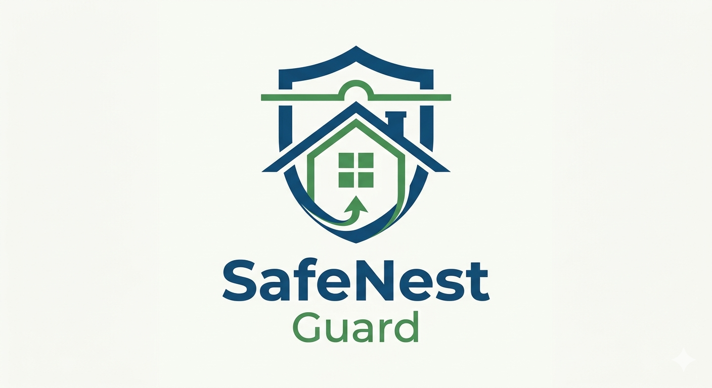
SafeNest Guard
AI-Powered IoT Security for Bangladeshi Homes
with Instant Bangla Threat Alerts
Khondokar Sajid (2211954042)
Kazi Safin Arafat (2211778642)
Moushumi Akter Mow (2021983642)
Rakibul Hasan Ridoy (1731339042)
Faculty Advisor: Md. Mohammad Shifat-E-Rabbi
CSE 499B · ECE Department · North South University · Spring 2026
NSU ACM SC Innovation Challenge — Season 20

Slide 2

The Problem — Bangladesh's IoT Blind Spot
15M+
0
100%
IoT Devices
Local IDS
Unmonitored
Families
in BD homes today
solutions designed for BD
no local security
no Bangla alerts exist
What is happening in Bangladeshi homes right now:
Your CCTV camera is being watched by a stranger — and you do not know
Your smart lock was opened remotely last night — and nobody told you
Your router is leaking private data to foreign servers — silently, every day
Every existing security tool is in English, cloud-dependent, and built for Western homes
Load-shedding kills cloud security — your home is dark and unprotected for hours
SafeNest Guard · CSE 499B · North South University · Spring 2026

Slide 3

"BIG BROTHER
IS WATCHING YOU"
— George Orwell, 1984
Today in Bangladesh, Big Brother has a different face:
A hacker watching your bedroom camera
A thief who just unlocked your front door remotely
A server silently collecting your family's data
SafeNest Guard · CSE 499B · North South University · Spring 2026

Slide 4
✕
SafeNest Guard
Stops Big Brother.
→
Your home. Your devices.
Your privacy. Protected.
— In Bangla.
We see the attacker before your family does. Then we alert you — in Bangla — with exactly what to do.
SafeNest Guard · CSE 499B · North South University · Spring 2026

Slide 5
What We Built — In One Slide
SafeNest Guard is:
What it solves:
A real-time AI security system for home IoT devices
Running on a $50 Raspberry Pi 4 — no cloud needed
Working offline during load-shedding
Alerting your family in Bangla — no English needed
Watching your camera, smart lock, and router 24/7
Detects known attacks:
DDoS, brute force, port scans, ARP spoofing
Detects zero-day threats:
Unknown attacks — no signature needed
Verifies the real owner:
Distinguishes you from a hacker in the same city
Context-aware for BD:
Prayer times, load-shedding, Fri-Sat weekend encoded
One device. $50. Protects your
entire home network.
Alerts in Bangla:
Device name + immediate action steps
SafeNest Guard · CSE 499B · North South University · Spring 2026

Slide 6
How It Works — 5-Layer AI Pipeline
1. CAPTURE
→
2. DETECT
→
3. VERIFY
→
4. DECIDE
→
5. ALERT
tcpdump + CICFlowMeter
91 network features
AI models: RF + XGBoost
+ Zero-Day ensemble
Behavioral Trust Check
Is it really you?
SAFE / WATCH / THREAT
Context-aware logic
Bangla Telegram message
+ Live Dashboard
Your Home IoT Devices:
↑ All traffic goes through the 5-layer AI pipeline above ↑
📷
🔒
📡
IP Camera
Smart Lock
Router
Watched 24/7
Access verified
Traffic analyzed
SafeNest Guard · CSE 499B · North South University · Spring 2026

Slide 7
TRAV — Is It You, or the Attacker?
✅
🔴
Owner in Melbourne
Hacker — Same Dhaka ISP
VS
Accessing from Australia
Same behavior patterns
Same timing rhythm
Same country. Same ISP.
Different behavior pattern.
Different timing.
Trust Score: 0.92 → SAFE
Trust Score: 0.34 → THREAT
Family is not alerted.
Access is legitimate.
Family gets Bangla alert.
Access is blocked.
Trust Gap = 0.64 — No other IDS system in Bangladesh can tell the difference. We can.
SafeNest Guard · CSE 499B · North South University · Spring 2026

Slide 8
Instant Bangla Alerts — MQTT · Telegram · Live Dashboard
📱 Telegram Alert (Bangla)
📡
MQTT + HiveMQ Cloud
Real-time event streaming to any device. Works instantly.
🔴 THREAT সনাক্ত!
ডিভাইস: লিভিং রুম ক্যামেরা
সময়: রাত ১১:৪৩
ট্রাস্ট স্কোর: ০.২৮ (সন্দেহজনক)
📋 এখনই করুন:
১. ক্যামেরার পাওয়ার বন্ধ করুন
২. রাউটার রিস্টার্ট করুন
৩. পাসওয়ার্ড পরিবর্তন করুন
📊
Live Dashboard
See all 3 devices — SAFE, WATCH, THREAT — in one screen.
⚡
Works Offline
Load-shedding? No internet? Pi keeps monitoring locally.
🔒
No Data Leaves Home
No English. No technical knowledge. Just clear steps.
All AI runs on Pi. Your traffic never goes to any server.
SafeNest Guard · CSE 499B · North South University · Spring 2026

Slide 9
Validated Results — Numbers That Matter
0.983
0.969
<1%
0.64
Detection F1
Zero-Day AUC
False Alarms
Trust Gap
RF + XGBoost
IF + AE + GRU ensemble
on legit traffic
Owner vs Attacker
Ablation Study — Each component adds value (red = naive zero-day fusion hurts; teal = full system)
Owner vs Attacker Trust Score — gap of 0.64 is decisive
SafeNest Guard · CSE 499B · North South University · Spring 2026

Slide 10
Impact — Who Benefits and How
👨‍👩‍👧 Bangladeshi Families
🏫 Schools & Campuses
🏭 Garment Factories & Offices
Know immediately if someone is watching their camera or accessing their smart lock. Receive alerts in Bangla — no English needed.
Monitor multiple IoT devices across buildings. Get instant alerts on unauthorized access. Safe campus, safe students.
Protect business camera networks and routers. Monitor access remotely. One Pi protects an entire floor.
🇧🇩 Bangladesh as a Nation
🌍 Environment
💡 Innovation
First locally-designed IoT security system. Built for our language, our culture, our infrastructure.
3-7 W Raspberry Pi vs 100 W cloud server. Saves 200 kWh per home per year. No e-waste cycle.
First IDS globally to encode prayer times, load-shedding, and local ISP patterns as security signals.
SafeNest Guard · CSE 499B · North South University · Spring 2026

Slide 11
Business Model — From Home to Market
🎯 Market: 15 million+ unprotected IoT devices in Bangladesh · Currently zero local solutions · Growing 30%/year
Free Tier
Home Pro
Business
৳0
৳299
/month
৳999/mo
Local monitoring
Basic Bangla alerts
Dashboard access
AI-powered alerts
Cloud dashboard
Custom alert rules
Multi-device
Multi-location
B2B licensing
🔧 One-time $50 hardware cost per home — no ongoing hardware fee
🏗️ Scales from 1 home to a 50-branch garment factory with no extra hardware
🌐 Managed installation service for non-technical families
📈 Freemium drives adoption; Pro and Business generate recurring revenue
SafeNest Guard · CSE 499B · North South University · Spring 2026

Slide 12
Your Home Is Safe Now.
SafeNest Guard is watching, so you don't have to.
F1 = 0.983
AUC = 0.969
< 1% False Alarm
Trust Gap = 0.64
Bangla Alerts
$50 Hardware
Thank you.
Department of Electrical & Computer Engineering · North South University · NSU ACM SC Innovation Challenge Season 20
SafeNest Guard · CSE 499B · North South University · Spring 2026

