Slide 1
TUGA IT 2017
LISBON, PORTUGAL

Slide 2





THANK YOU TO OUR SPONSORS

Slide 3

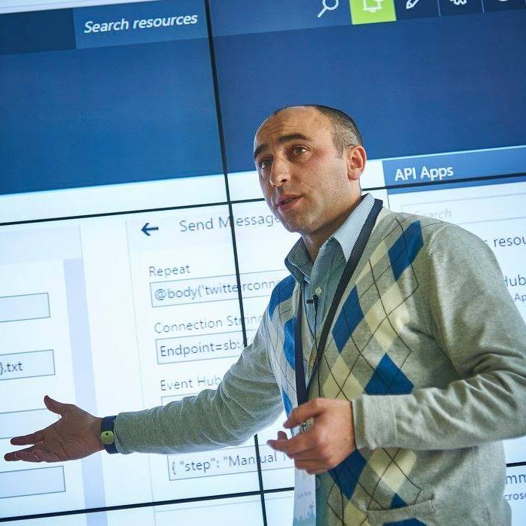


Who am I?
Codeless Wizard
Microsoft Azure & Visio MVP
sandro.pereira@devscope.net
linkedin.com/in/sandropereira
@sandro_asp
https://blog.sandro-pereira.com/
Public speaker
Book author: “BizTalk Mapping Patterns and Best Practices”
Sandro Pereira
Notes:
Interested in all things integration – which of course includes MS Flow

Slide 4
THE SPEAKER NIGHTMARE Eval Forms, OCR, Logic Apps, Azure Functions & Power BI
Sandro Pereira
Microsoft Azure MVP

Slide 5
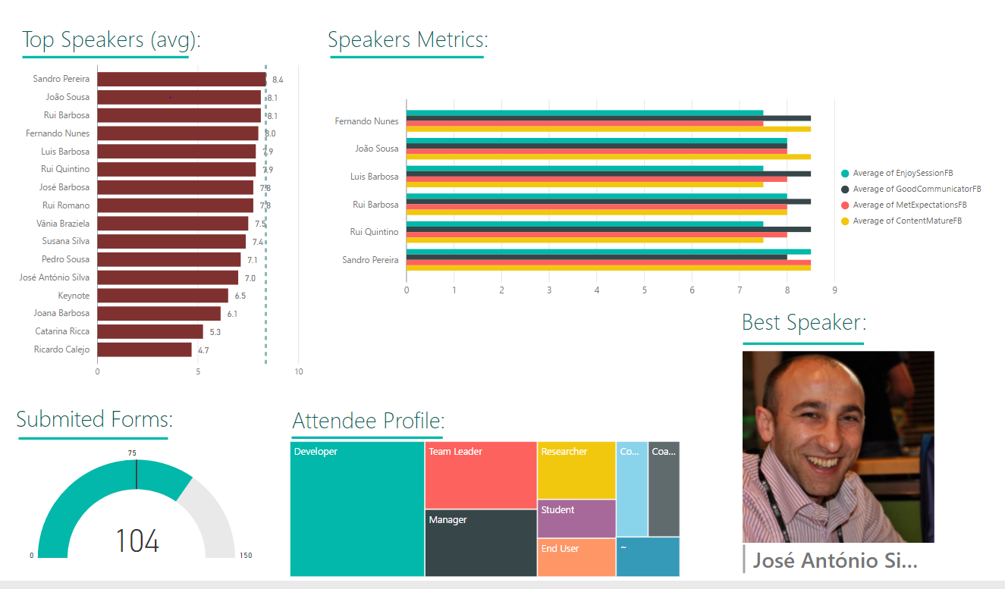
On-premises Applications
Azure Applications
Requirements:
Guarantee that all orders are delivered and processed, independent if the on-premises applications are online
Be able to easily produce metrics to business users
Be able to have or set different incoming channels
Save contacts for contacts newsletter/promotions campaigns
KPI’s
Event Attendees
Logic Apps
Azure
Functions
Power BI

Slide 6
I understand that Evaluation
forms first but… what about
invoices?
first

Slide 7
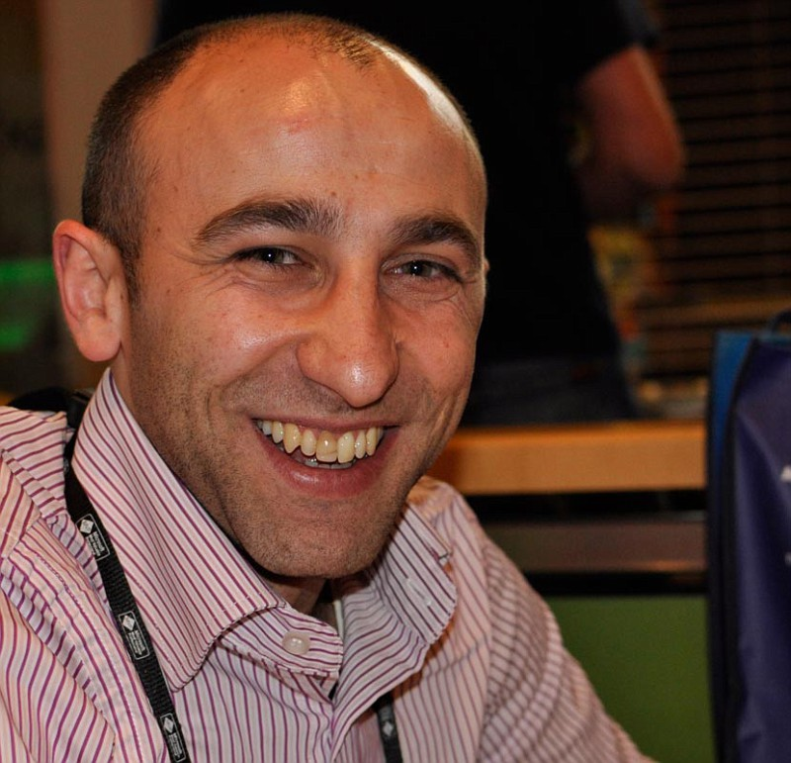





Thanks
sandro.pereira@devscope.net
linkedin.com/in/sandropereira
@sandro_asp
sandroaspbiztalkblog.wordpress.com
+351 223 751 350
www.devscope.net

Slide 8
THANK YOU TO OUR SPONSORS

