Slide 1
Plan 3

Slide 2
Content
01
Our team
02
Chatbot
03
Our project

Slide 3



OUR TEAM
GOSTUDIO
Frontend Backend Developer
Q&A engineer
Code Cheker
Scrum Trainer

Slide 4

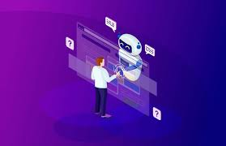
ChatBot
n

Slide 5
ABOUT THE PROJECT
. menu()
. Title()
. piBot()

Slide 6
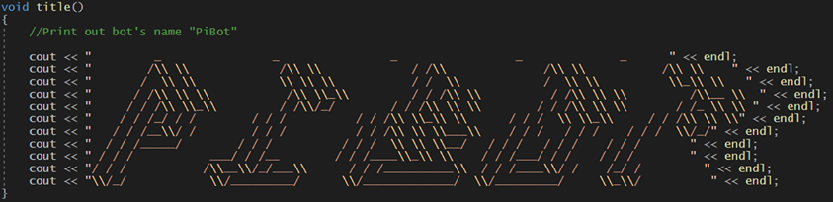

Slide 7
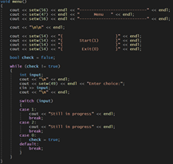
POOR DESIGN

Slide 8
THANKS!
Does anyone have any question?

