Slide 1
Analysis on “External-Memory Exact and Approximate All-Pairs Shortest-Paths in Undirected Graphs”
Team DD

Slide 2
The paper presents 3 algorithms.
A cache-oblivious exact algorithm for APSP in unweighted undirected graphs.
A cache-aware approximate algorithm for APSP in undirected graphs.
A cache-aware exact algorithm for APSP in weighted undirected graphs.

Slide 3
Background Knowledge
The APSP problem

Slide 4
APSP problem
All-pairs shortest path problem
Given a (directed or undirected) graph G with vertex set V[G], edge set E[G], and a non-negative real-valued weight function w over E[G], the APSP problem seeks to find a path of minimum total edge-weight between every pair of vertices in V[G].

Slide 5
Background Knowledge
The APSP problem
Cache-oblivious model

Slide 6
Cache-oblivious model
Cache-oblivious model is a modification for the cache-aware model (which is the 2-level internal and external memory model we talked about in class!)
﻿Similar to cache-aware model, cache oblivious model also consists of a two-level memory hierarchy, but algorithms are designed and analyzed without using the parameters M and B in the algorithm description, and ﻿it is assumed that an optimal cache-replacement strategy is used.

Slide 7
Background Knowledge
The APSP problem
Cache-oblivious model
Spanning tree and Euler tour of spanning tree

Slide 8
Spanning tree
A spanning tree is a tree that connects all the vertices of a graph with the minimum possible number of edges.
Thus, a spanning tree is always connected. Also, a spanning tree never contains a cycle.

Slide 9
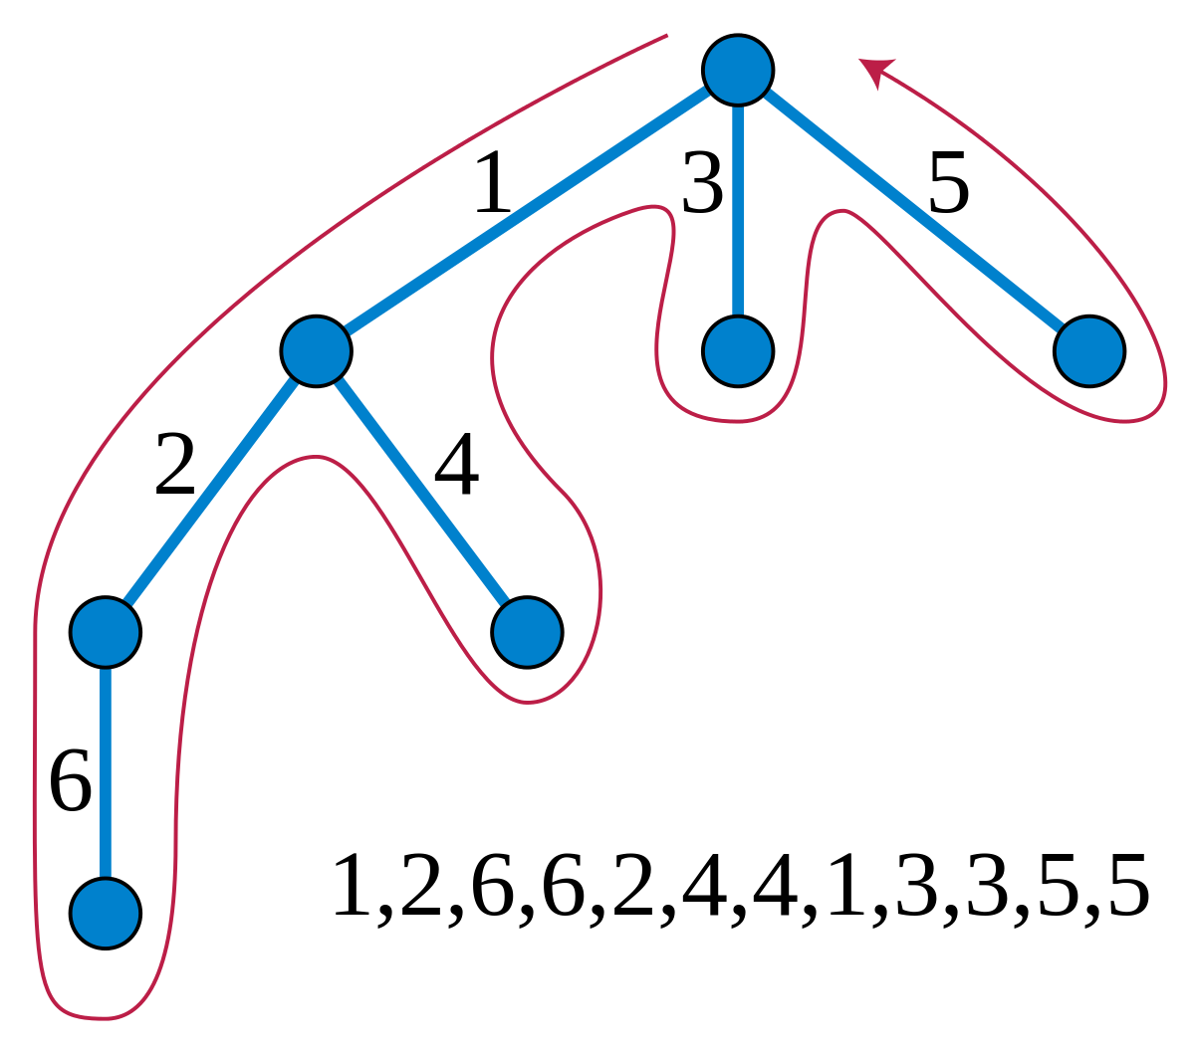
Euler tour of spanning tree
An Eulerian cycle, Eulerian circuit or Euler tour in an undirected graph is a cycle that uses each edge exactly once.
The tree is viewed as a directed graph that contains two directed edges for each edge in the tree.
How to find it?
Using Depth First Search!

Slide 10

The cache-oblivious exact algorithm for APSP problem on unweighted undirected graph
Overview:
1. Find a sequence of the nodes using Euler Tour of the Spanning Tree of G, marked as
2. Apply MR-BFS on v1
3. Apply Incremental-BFS on the rest of nodes.
Two major components

Slide 11
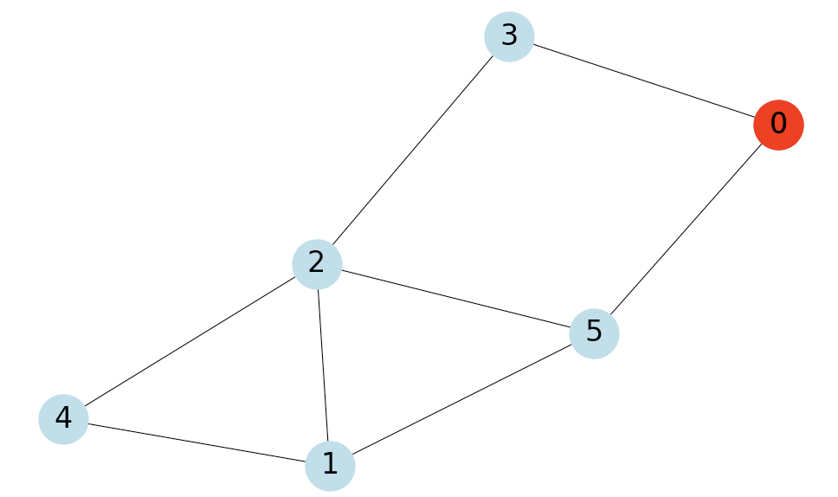
MR-BFS(Graph G, source node s): computes the BFS level of each node with respect to s
L[i]: set of nodes in BFS level i.
N(v): set of vertices adjacent to vertex v
Start with L[-1] = [], L[0] = [s], i = 1:
For each i < V:
Compute L[i]
Put example here

Slide 12
MR-BFS(Graph G, source node s):
L[i]: set of nodes in BFS level i.
N(v): set of vertices adjacent to vertex v
1. Construct N(L(i − 1)):
For each v ∈ L(i−1), accesses to its adjacency lists.
Put example here

Slide 13
MR-BFS(Graph G, source node s):
L[i]: set of nodes in BFS level i.
N(v): set of vertices adjacent to vertex v
2. Remove duplicates from N(L(i − 1)):
Sort the nodes in N(L(i−1)).
scan and compaction.
denote the result by L′(i).
Put example here

Slide 14
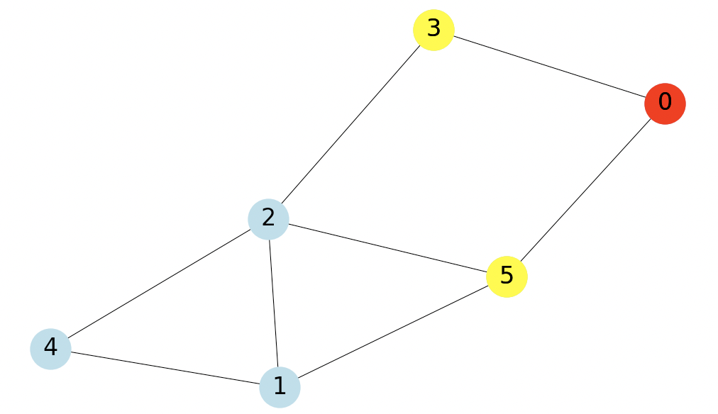
MR-BFS(Graph G, source node s):
L[i]: set of nodes in BFS level i.
N(v): set of vertices adjacent to vertex v
3. Remove nodes in L′(i) that occur in L(i − 1) ∪ L(i − 2):
Parallel scan L′(i), L(i−1) and L(i−2).
The result set is the L(i) we want.
Put example here

Slide 15
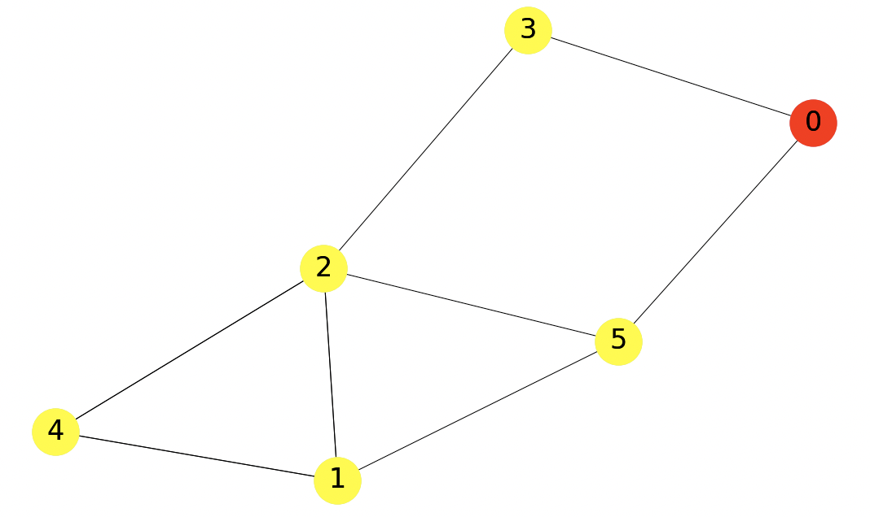
MR-BFS(Graph G, source node s):
L[i]: set of nodes in BFS level i.
N(v): set of vertices adjacent to vertex v
We can easily obtain the shortest path between source node s and any other node n∈G.
Put example here

Slide 16
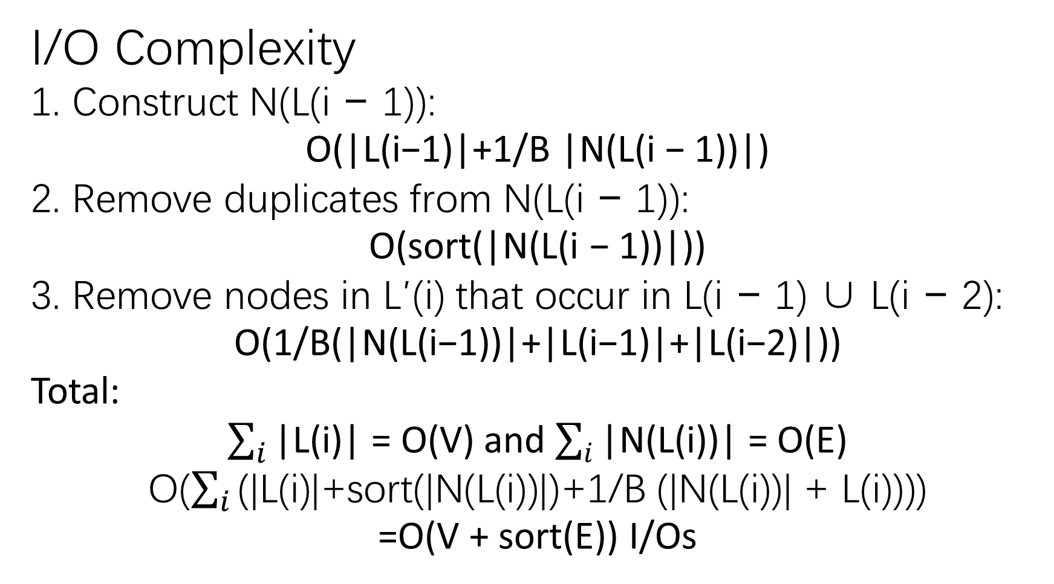
I/O Complexity
1. Construct N(L(i − 1)):
O(|L(i−1)|+1/B |N(L(i − 1))|)
2. Remove duplicates from N(L(i − 1)):
O(sort(|N(L(i − 1))|))
3. Remove nodes in L′(i) that occur in L(i − 1) ∪ L(i − 2):
O(1/B(|N(L(i−1))|+|L(i−1)|+|L(i−2)|))
Total:
$\sum_{i}{\text{|}\text{L}\text{(}\text{i}\text{)}\text{|}}$ = O(V) and $\sum_{i}{\text{|}\text{N}\text{(}\text{L}\text{(}\text{i}\text{))|}}$ = O(E)
O($\sum_{i}{\text{(|}\text{L}\text{(}\text{i}\text{)|+}\text{sort}\text{(|}\text{N}\text{(}\text{L}\text{(}\text{i}\text{))|)+1/}\text{B}\text{ (|}\text{N}\text{(}\text{L}\text{(}\text{i}\text{))| + }\text{L}\text{(}\text{i}\text{)))}}$)
=O(V + sort(E)) I/Os

Slide 17
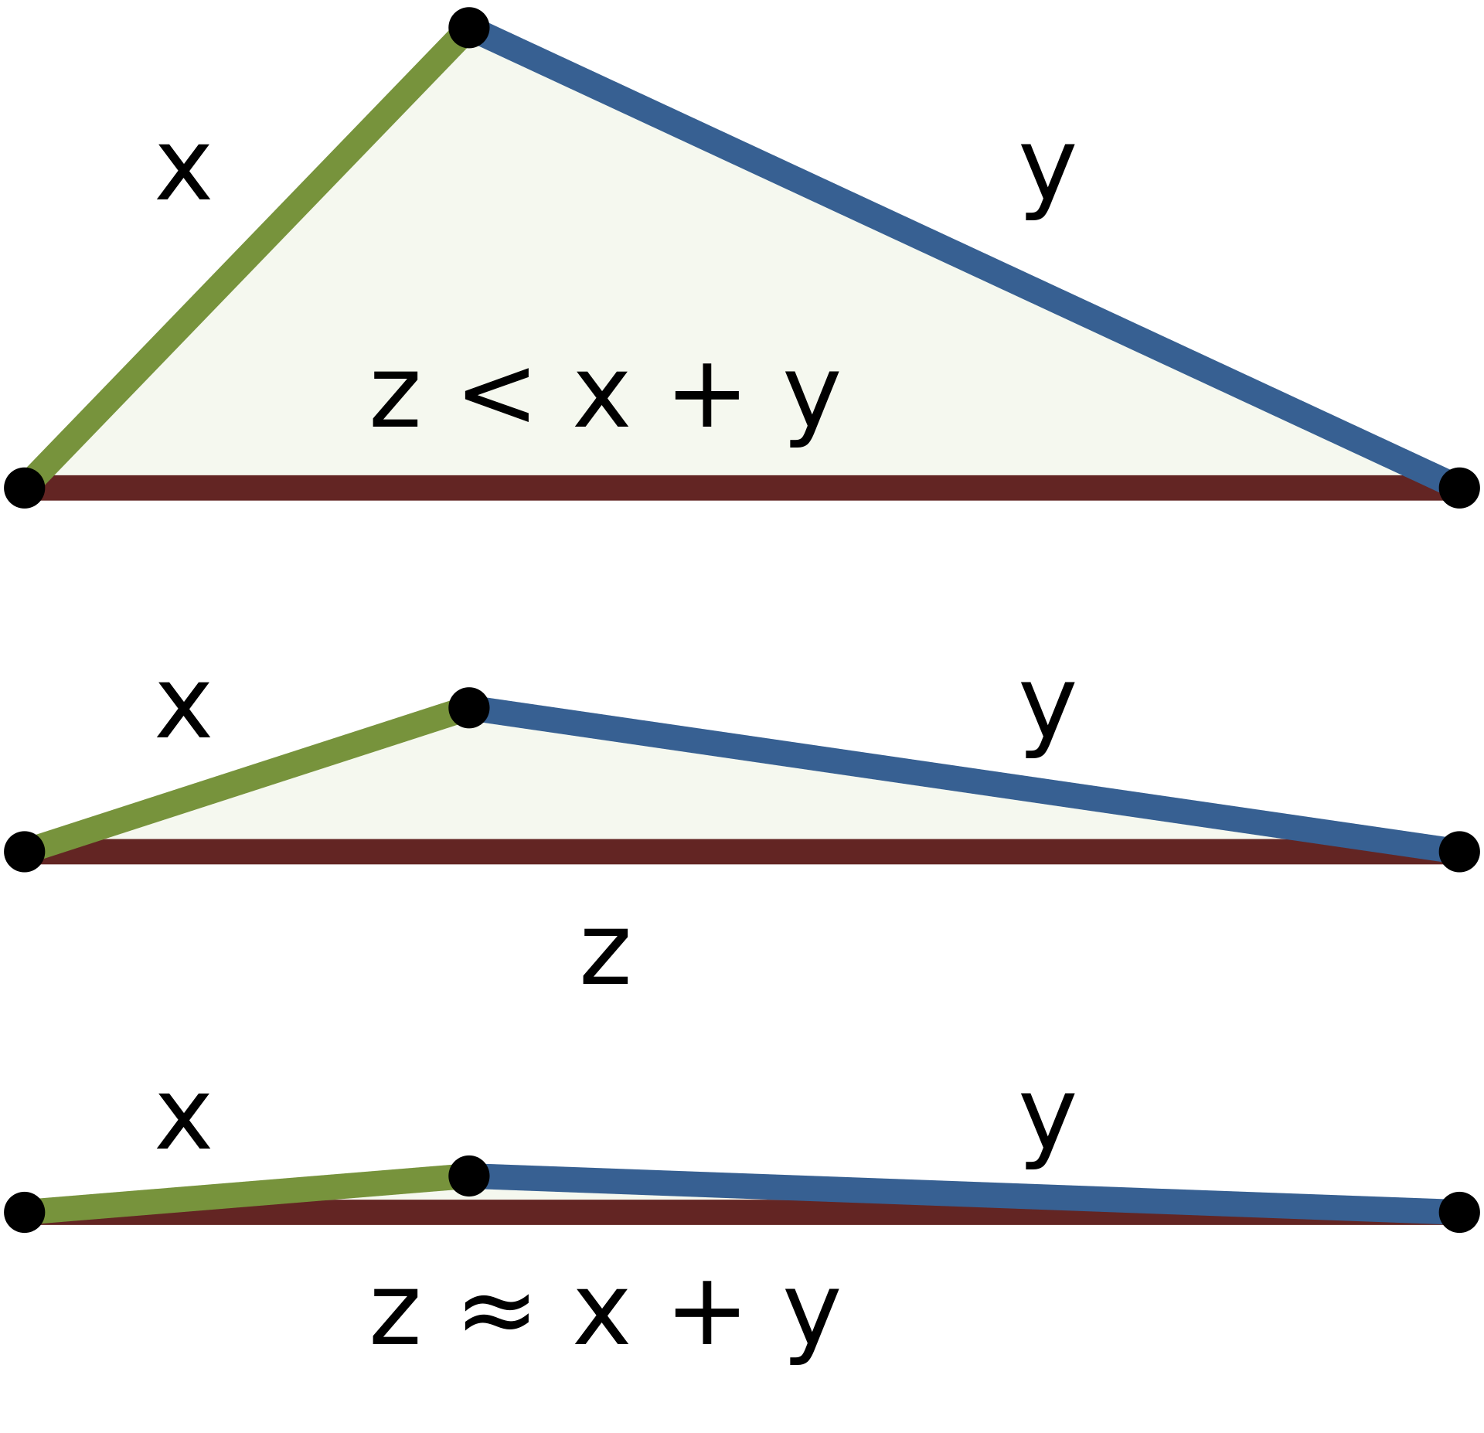
For unweighted undirected graphs:
Observation 1:
d(u, v) = d(v, u)
Observation 2:
d(u,w) − d(u, v) ≤ d(v,w) ≤ d(u,w) + d(u, v).
Triangle Inequality

Slide 18
Sort the adjacency lists in non-decreasing order by d(u, ·)
A(j): portion of the sorted list which contains adjacency lists of vertices w with d(u,w) = j
Observation 3:
The adjacency list of any vertex w with d(v,w) = i must reside in some A(j) where
i − d(u, v) ≤ j ≤ i + d(u, v)
With this observation, we have the next BFS algorithm.

Slide 19
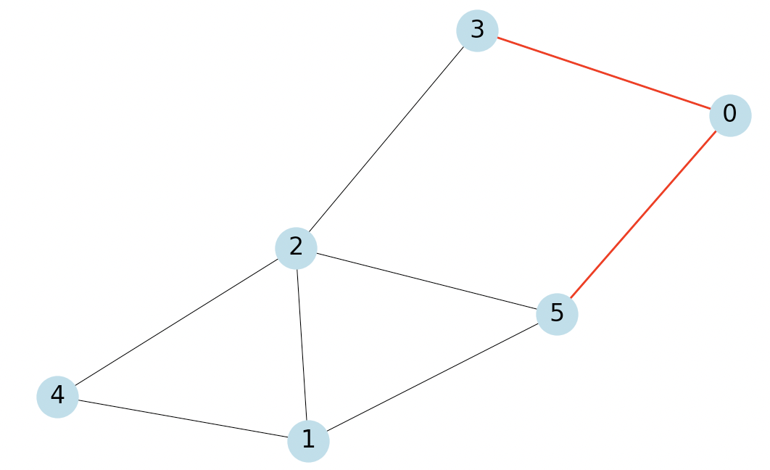
Incremental-BFS(G, u, v, d(u, ·)): computes
d(v, w) for all w ∈ V [G]
unweighted undirected graph G
two vertices u, v ∈ V [G]
d(u,w) for all w ∈ V [G]
L[i]: set of nodes in BFS level i.
N(v): set of vertices adjacent to vertex v
Adj_lists: adjacency lists of G
A(i): portion of Adj_lists with exactly distance i from u.
1. Sort the Adj_lists:
d(u, x) ≤ d(u, y) ∧ x < y
Adj_lists = {3: [0, 2], 5: [0, 1, 2], 1: [2, 4, 5], 2: [1, 3, 4, 5], 4: [1, 2]}

Slide 20
Incremental-BFS(G, u, v, d(u, ·)):
unweighted undirected graph G
two vertices u, v ∈ V [G]
d(u,w) for all w ∈ V [G]
L[i]: set of nodes in BFS level i.
N(v): set of vertices adjacent to vertex v
Adj_lists: adjacency lists of G
2. Construct N(L(i − 1)):
For j ← max{0, i−1−d(u, v)} to min{|V |−1, i−1+d(u, v)} do:
Extract the adjacency list of each w ∈ V [G]
that appears in L(i − 1) and
whose adjacency list appears in A(j)
i = 2 V = 2
N(L(i-1)) = [0, 2, 0, 1, 2, 2, 4, 5, 1, 2]
By Observation 3

Slide 21
Incremental-BFS(G, u, v, d(u, ·)):
unweighted undirected graph G
two vertices u, v ∈ V [G]
d(u,w) for all w ∈ V [G]
L[i]: set of nodes in BFS level i.
N(v): set of vertices adjacent to vertex v
Adj_lists: adjacency lists of G
2. Remove duplicates from N(L(i − 1)):
scan and compaction.
denote the result by L′(i).
i = 2, V = 2
L′(i) = [0, 1, 2, 4, 5]

Slide 22
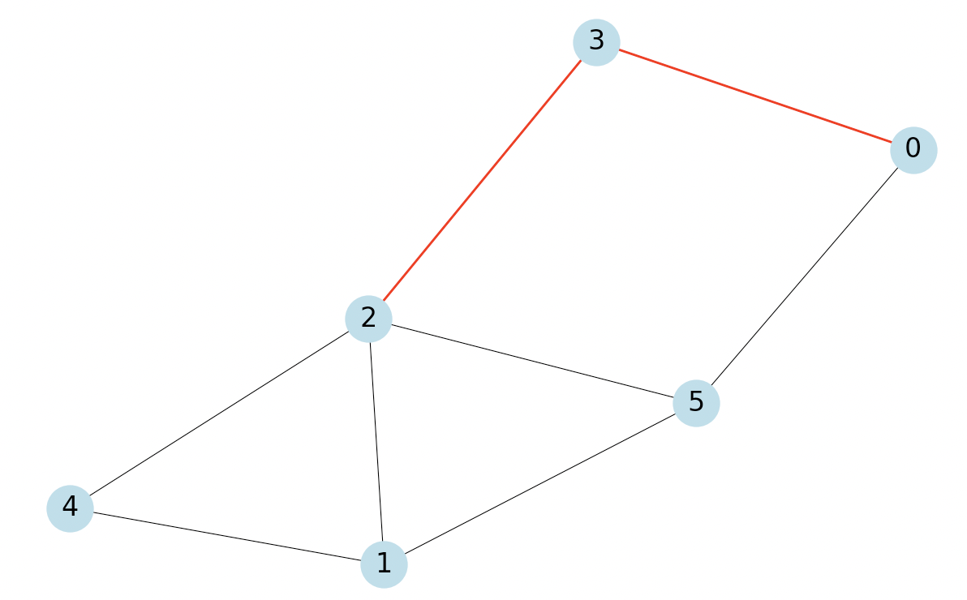
Incremental-BFS(G, u, v, d(u, ·)):
unweighted undirected graph G
two vertices u, v ∈ V [G]
d(u,w) for all w ∈ V [G]
L[i]: set of nodes in BFS level i.
N(v): set of vertices adjacent to vertex v
Adj_lists: adjacency lists of G
3. Remove nodes in L′(i) that occur in L(i − 1) ∪ L(i − 2):
Parallel scan L′(i), L(i−1) and L(i−2).
The result set is the L(i) we want.
w
u
v
i = 2, V = 2
L(i) = [0]

Slide 23
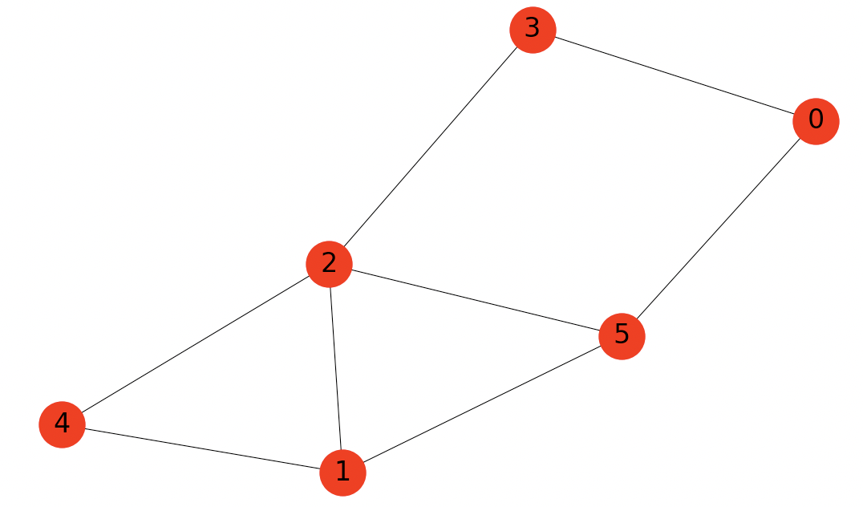
Incremental-BFS(G, u, v, d(u, ·)):
unweighted undirected graph G
two vertices u, v ∈ V [G]
d(u,w) for all w ∈ V [G]
L[i]: set of nodes in BFS level i.
N(v): set of vertices adjacent to vertex v
Adj_lists: adjacency lists of G
We can easily obtain the shortest path between source node s and any other node n∈G.
Output: {-1:[], 0:[2], 1:[1,3,4,5], 2:[0], 3:[], 4:[], 5:[]}

Slide 24
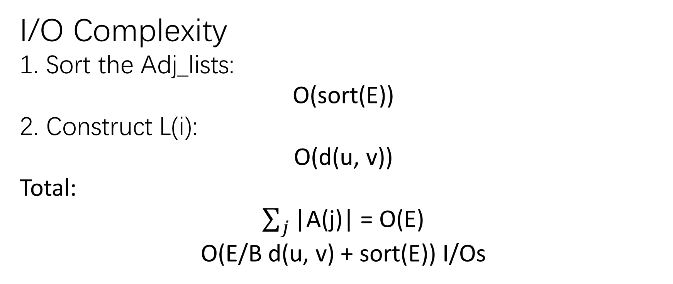
I/O Complexity
1. Sort the Adj_lists:
O(sort(E))
2. Construct L(i):
O(d(u, v))
Total:
$\sum_{j}{\text{|}\text{A}\text{(}\text{j}\text{)}\text{|}}$ = O(E)
O(E/B d(u, v) + sort(E)) I/Os

Slide 25
Incremental-BFS performs BFS I/O-efficiently from all v ∈ V [G].
Observation 4:
If ET is an Euler Tour of a spanning tree of an unweighted undirected graph G:
the number of edges between any two vertices x and y on ET is an upper bound on d(x, y) in G
ET has O(V ) edges
each vertex of V [G] appears at least once in ET
Ensures that BFS will be
performed from each v ∈ V [G].

Slide 26
Put things together, we made it!
Just do a simple
DFS traversal!
1. Find a sequence of the nodes using Euler Tour of the Spanning Tree of G, marked as
2. Apply MR-BFS on v1
3. Apply Incremental-BFS on the rest of nodes.
Now we have solved the APSP problem!

Slide 27
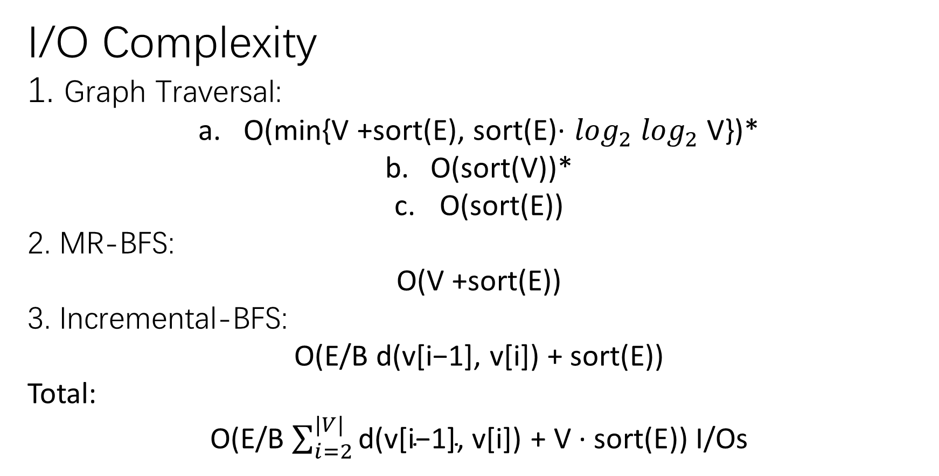
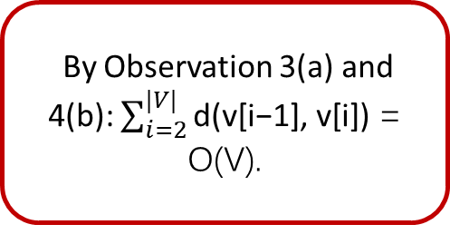
I/O Complexity
1. Graph Traversal:
O(min{V +sort(E), sort(E)· $\log_{2}$ $\log_{2}$ V})*
O(sort(V))*
O(sort(E))
2. MR-BFS:
O(V +sort(E))
3. Incremental-BFS:
O(E/B d(v[i−1], v[i]) + sort(E))
Total:
O(E/B $\sum_{i=2}^{|V|}{\text{d}\text{(}\text{v}\text{[}\text{i}\text{−1}\text{]}\text{, }\text{v}\text{[}\text{i}\text{]}\text{)}}$ $\text{+ }\text{V}\text{ · }\text{sort}\text{(}\text{E}$)) I/Os
By Observation 3(a) and 4(b): $\sum_{i=2}^{|V|}{\text{d}\text{(}\text{v}\text{[}\text{i}\text{−1}\text{]}\text{, }\text{v}\text{[}\text{i}\text{]}\text{)}}$ = O(V).
*: Cache-oblivious priority queue and graph algorithm applications. 2002

Slide 28
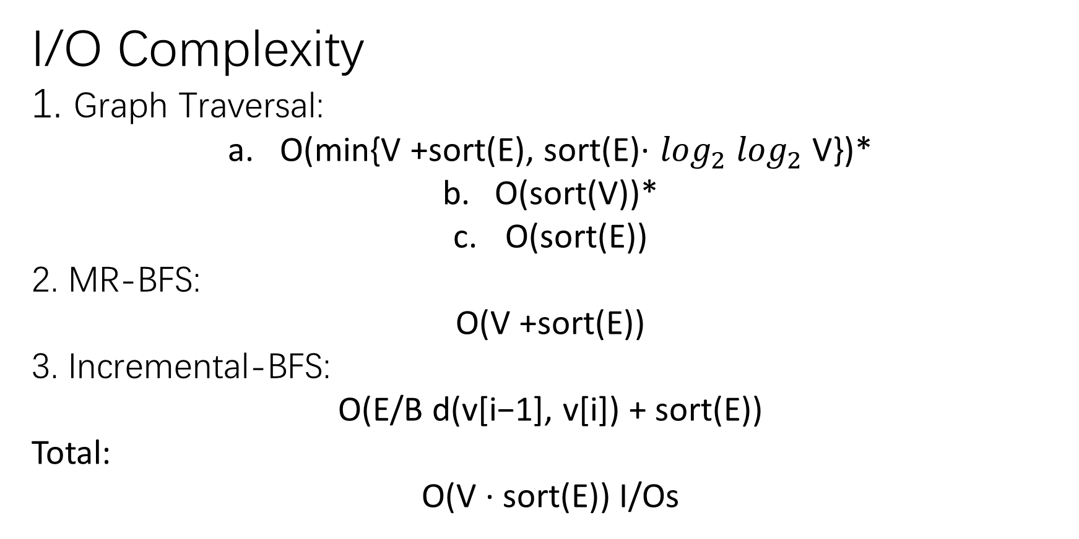
I/O Complexity
1. Graph Traversal:
O(min{V +sort(E), sort(E)· $\log_{2}$ $\log_{2}$ V})*
O(sort(V))*
O(sort(E))
2. MR-BFS:
O(V +sort(E))
3. Incremental-BFS:
O(E/B d(v[i−1], v[i]) + sort(E))
Total:
O($\text{V}\text{ · }\text{sort}\text{(}\text{E}$)) I/Os
*: Cache-oblivious priority queue and graph algorithm applications. 2002

Slide 29
Questions you may ask
Why use spanning tree and Euler Tour? Why not use random sequence of nodes?
How does the presented algorithm improve the known solution of the APSP problem?
How doss the algorithm achieve these improvements?

Slide 30
Why use spanning tree and Euler Tour?

Slide 31
How does the presented algorithm improve the known solution?

Slide 32
How doss the algorithm achieve these improvements?

