Slide 1
Analysis on “External-Memory Exact and Approximate All-Pairs Shortest-Paths in Undirected Graphs”
Team DD

Slide 2
The paper discusses 3 main contributions.
A cache-oblivious exact algorithm for APSP in unweighted undirected graphs.
A cache-aware approximate algorithm for APSP in undirected graphs.
A cache-aware exact algorithm for APSP in weighted undirected graphs.

Slide 3
MR-BFS(Graph G, source node s): computes the BFS level of each node with respect to s
L[i]: set of nodes in BFS level i.
N(v): set of vertices adjacent to vertex v
Start with L[-1] = [], L[0] = [s], i = 1:
For each i < V:
Compute L[i]
MR-BFS 1: a graph
highlight source node s
Put example here

Slide 4
MR-BFS(Graph G, source node s):
L[i]: set of nodes in BFS level i.
N(v): set of vertices adjacent to vertex v
1. Construct N(L(i − 1)):
For each v ∈ L(i−1), accesses to its adjacency lists.
MR-BFS 1: a graph
highlight source node s
Put example here

Slide 5
MR-BFS(Graph G, source node s):
L[i]: set of nodes in BFS level i.
N(v): set of vertices adjacent to vertex v
2. Remove duplicates from N(L(i − 1)):
Sort the nodes in N(L(i−1)).
scan and compaction.
denote the result by L′(i).
MR-BFS 1: a graph
highlight source node s
Put example here

Slide 6
MR-BFS(Graph G, source node s):
L[i]: set of nodes in BFS level i.
N(v): set of vertices adjacent to vertex v
3. Remove nodes in L′(i) that occur in L(i − 1) ∪ L(i − 2):
Parallel scan L′(i), L(i−1) and L(i−2).
The result set is the L(i) we want.
MR-BFS 1: a graph
highlight source node s and node in bfs level 1
Put example here

Slide 7
MR-BFS(Graph G, source node s):
L[i]: set of nodes in BFS level i.
N(v): set of vertices adjacent to vertex v
We can easily obtain the shortest path between source node s and any other node n∈G.
MR-BFS 1: a graph
highlight all node
Put example here

Slide 8
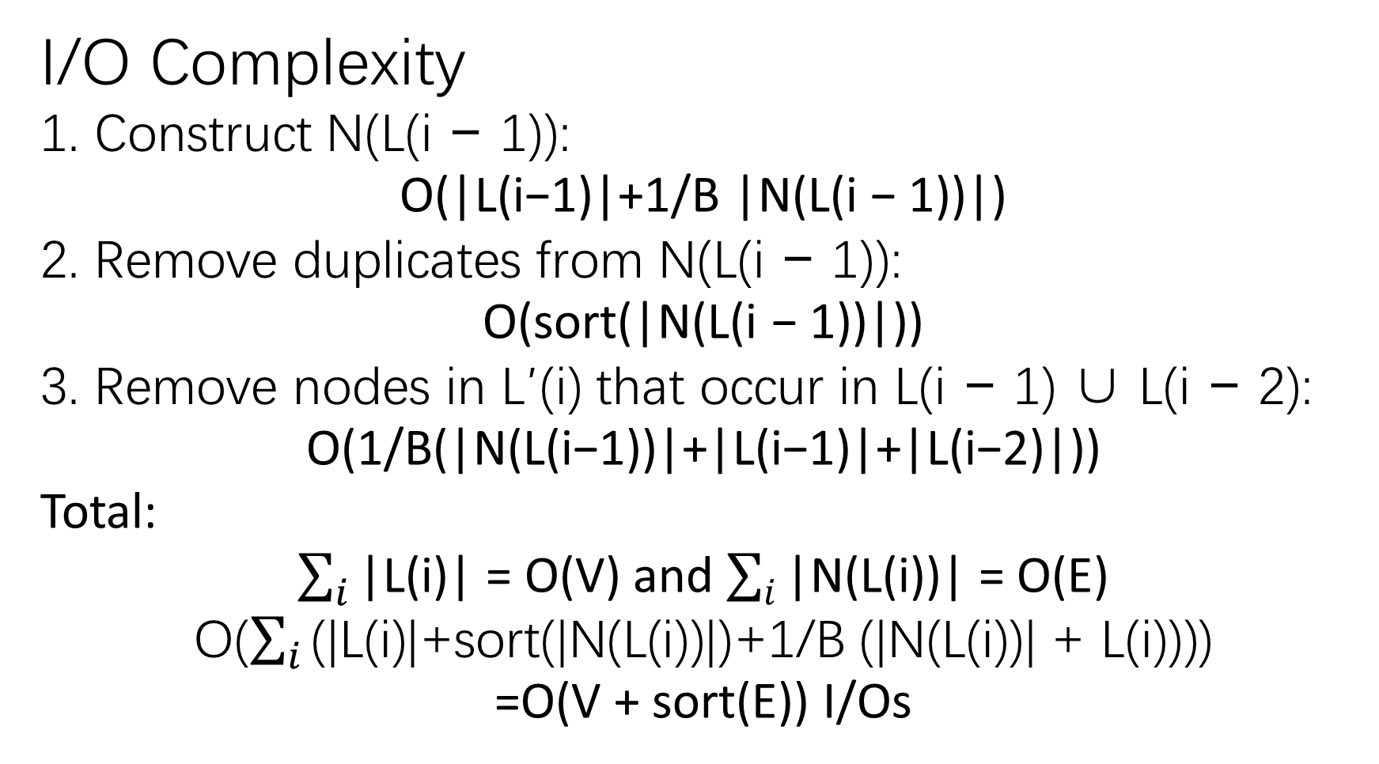
I/O Complexity
1. Construct N(L(i − 1)):
O(|L(i−1)|+1/B |N(L(i − 1))|)
2. Remove duplicates from N(L(i − 1)):
O(sort(|N(L(i − 1))|))
3. Remove nodes in L′(i) that occur in L(i − 1) ∪ L(i − 2):
O(1/B(|N(L(i−1))|+|L(i−1)|+|L(i−2)|))
Total:
$\sum_{i}{\text{|}\text{L}\text{(}\text{i}\text{)}\text{|}}$ = O(V) and $\sum_{i}{\text{|}\text{N}\text{(}\text{L}\text{(}\text{i}\text{))|}}$ = O(E)
O($\sum_{i}{\text{(|}\text{L}\text{(}\text{i}\text{)|+}\text{sort}\text{(|}\text{N}\text{(}\text{L}\text{(}\text{i}\text{))|)+1/}\text{B}\text{ (|}\text{N}\text{(}\text{L}\text{(}\text{i}\text{))| + }\text{L}\text{(}\text{i}\text{)))}}$)
=O(V + sort(E)) I/Os

Slide 9
For unweighted undirected graphs:
Observation 1:
d(u, v) = d(v, u)
Demo for ob 2
Observation 2:
d(u,w) − d(u, v) ≤ d(v,w) ≤ d(u,w) + d(u, v).
Triangle Inequality

Slide 10
Sort the adjacency lists in non-decreasing order by d(u, ·)
A(j): portion of the sorted list which contains adjacency lists of vertices w with d(u,w) = j
Observation 3:
The adjacency list of any vertex w with d(v,w) = i must reside in some A(j) where
i − d(u, v) ≤ j ≤ i + d(u, v)
With this observation, we have the next BFS algorithm.

Slide 11
Incremental-BFS(G, u, v, d(u, ·)): computes
d(v, w) for all w ∈ V [G]
unweighted undirected graph G
two vertices u, v ∈ V [G]
d(u,w) for all w ∈ V [G]
L[i]: set of nodes in BFS level i.
N(v): set of vertices adjacent to vertex v
Adj_lists: adjacency lists of G
1. Sort the Adj_lists:
d(u, x) ≤ d(u, y) ∧ x < y
Construct A(i): portion of Adj_lists with exactly distance i from u.
Incremental-BFS 1: a graph
highlight edge from u to w and node v
Put example here

Slide 12
Incremental-BFS(G, u, v, d(u, ·)):
unweighted undirected graph G
two vertices u, v ∈ V [G]
d(u,w) for all w ∈ V [G]
L[i]: set of nodes in BFS level i.
N(v): set of vertices adjacent to vertex v
Adj_lists: adjacency lists of G
2. Construct N(L(i − 1)):
For j ← max{0, i−1−d(u, v)} to min{|V |−1, i−1+d(u, v)} do:
Extract the adjacency list of each w ∈ V [G]
that appears in L(i − 1) and
whose adjacency list appears in A(j)
Put example here
By Observation 3

Slide 13
Incremental-BFS(G, u, v, d(u, ·)):
unweighted undirected graph G
two vertices u, v ∈ V [G]
d(u,w) for all w ∈ V [G]
L[i]: set of nodes in BFS level i.
N(v): set of vertices adjacent to vertex v
Adj_lists: adjacency lists of G
2. Remove duplicates from N(L(i − 1)):
scan and compaction.
denote the result by L′(i).
Incremental-BFS 1: a graph
highlight edge from u to w and node v
Put example here

Slide 14
Incremental-BFS(G, u, v, d(u, ·)):
unweighted undirected graph G
two vertices u, v ∈ V [G]
d(u,w) for all w ∈ V [G]
L[i]: set of nodes in BFS level i.
N(v): set of vertices adjacent to vertex v
Adj_lists: adjacency lists of G
3. Remove nodes in L′(i) that occur in L(i − 1) ∪ L(i − 2):
Parallel scan L′(i), L(i−1) and L(i−2).
The result set is the L(i) we want.
Incremental-BFS 1: a graph
highlight edge from u to w and node v to w
Put example here

Slide 15
Incremental-BFS(G, u, v, d(u, ·)):
unweighted undirected graph G
two vertices u, v ∈ V [G]
d(u,w) for all w ∈ V [G]
L[i]: set of nodes in BFS level i.
N(v): set of vertices adjacent to vertex v
Adj_lists: adjacency lists of G
We can easily obtain the shortest path between source node s and any other node n∈G.
MR-BFS 1: a graph
highlight all node
Put example here

Slide 16
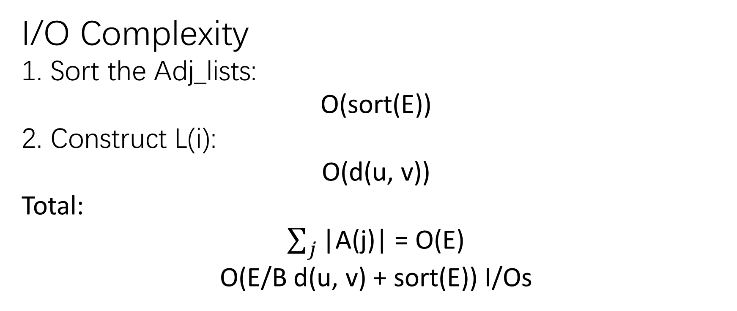
I/O Complexity
1. Sort the Adj_lists:
O(sort(E))
2. Construct L(i):
O(d(u, v))
Total:
$\sum_{j}{\text{|}\text{A}\text{(}\text{j}\text{)}\text{|}}$ = O(E)
O(E/B d(u, v) + sort(E)) I/Os

Slide 17
Incremental-BFS performs BFS I/O-efficiently from all v ∈ V [G].
Observation 4:
If ET is an Euler Tour of a spanning tree of an unweighted undirected graph G:
the number of edges between any two vertices x and y on ET is an upper bound on d(x, y) in G
ET has O(V ) edges
each vertex of V [G] appears at least once in ET
ET example
Ensures that BFS will be
performed from each v ∈ V [G].

Slide 18
Put things together:
Find all vertices of G
Select a source node n
Perform MR-BFS on the n
For rest vertices, perform Incremental-BFS for I/O efficiency

Slide 19
AP-BFS(G): computes all path shortest path of graph G
unweighted undirected graph G
1. Traversal the graph:
Find a spanning tree T of G
Construct an Euler Tour ET for T
Mark the first occurrence of each vertex on ET and denote by v(i)
Just do a simple
DFS traversal!
AP-BFS 1: a graph
Highlight spanning tree
Put example here

Slide 20
AP-BFS(G): computes all path shortest path of graph G
unweighted undirected graph G
2. Run MR-BFS with v[1] as the source node
Compute d(v[1],w) for all w ∈ V [G].
AP-BFS 1: a graph
Highlight source node v1
Show d(v1,w)
Put example here

Slide 21
AP-BFS(G): computes all path shortest path of graph G
unweighted undirected graph G
3. Run Incremental-BFS on rest vertices.
Compute d(v[i],w) for all w ∈ V [G].
AP-BFS 1: a graph
Highlight source node v2
Show d(v2,w)
Put example here

Slide 22
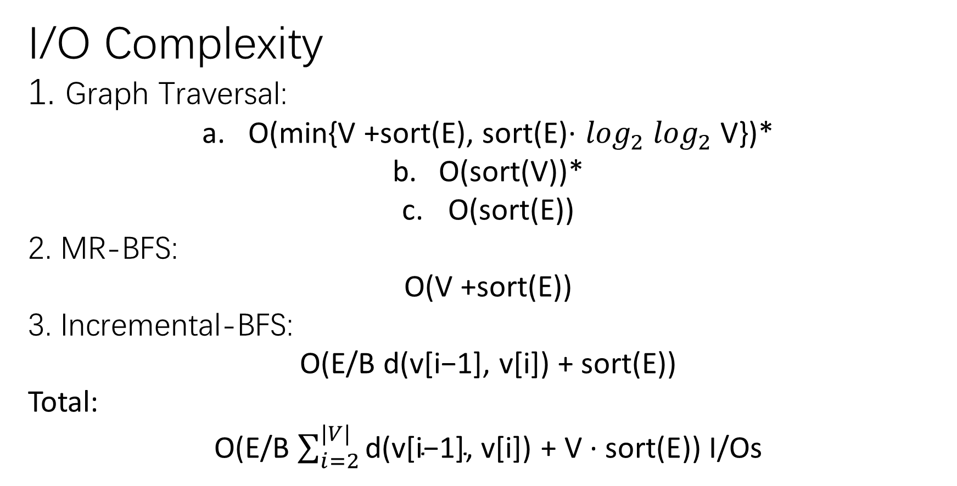
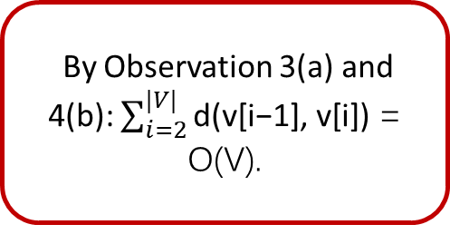
I/O Complexity
1. Graph Traversal:
O(min{V +sort(E), sort(E)· $\log_{2}$ $\log_{2}$ V})*
O(sort(V))*
O(sort(E))
2. MR-BFS:
O(V +sort(E))
3. Incremental-BFS:
O(E/B d(v[i−1], v[i]) + sort(E))
Total:
O(E/B $\sum_{i=2}^{|V|}{\text{d}\text{(}\text{v}\text{[}\text{i}\text{−1}\text{]}\text{, }\text{v}\text{[}\text{i}\text{]}\text{)}}$ $\text{+ }\text{V}\text{ · }\text{sort}\text{(}\text{E}$)) I/Os
By Observation 3(a) and 4(b): $\sum_{i=2}^{|V|}{\text{d}\text{(}\text{v}\text{[}\text{i}\text{−1}\text{]}\text{, }\text{v}\text{[}\text{i}\text{]}\text{)}}$ = O(V).
*: Cache-oblivious priority queue and graph algorithm applications. 2002

Slide 23
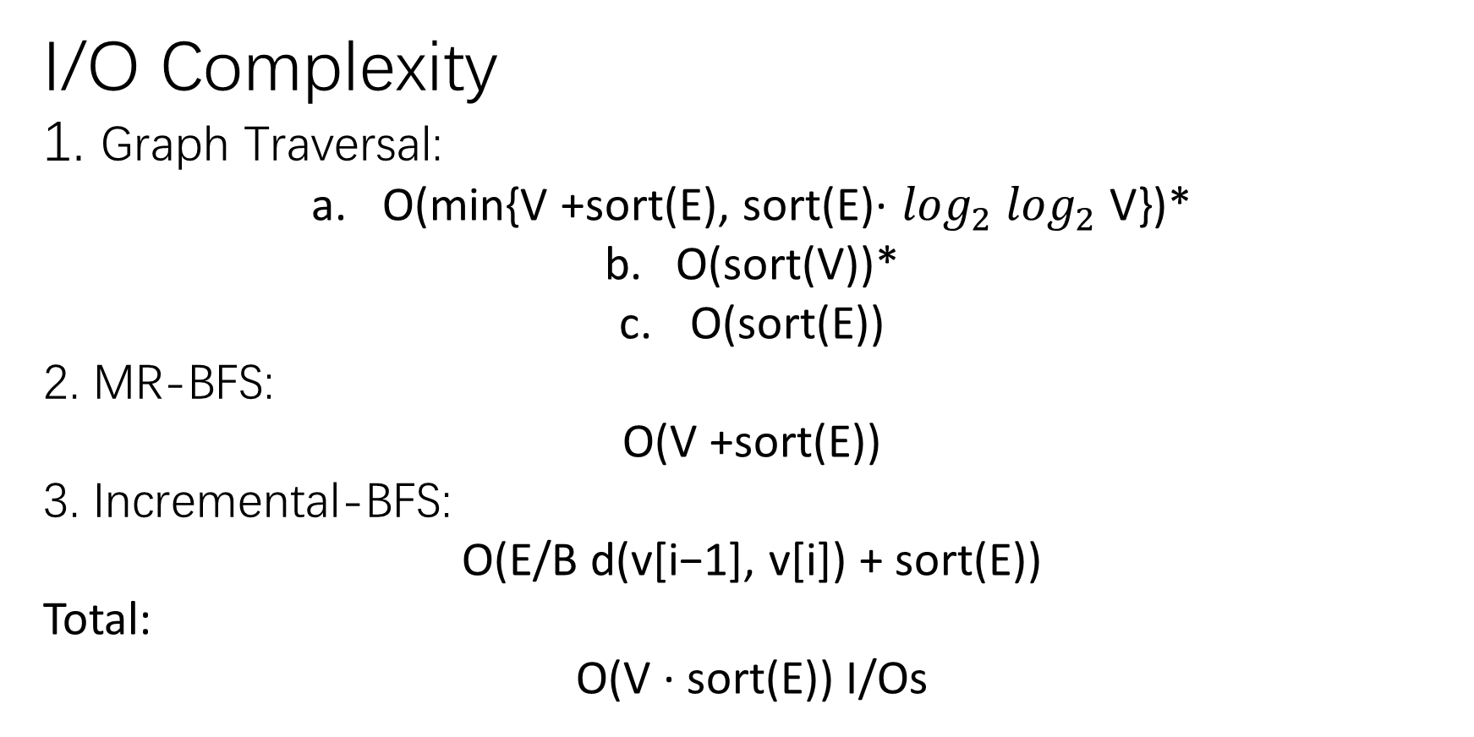
I/O Complexity
1. Graph Traversal:
O(min{V +sort(E), sort(E)· $\log_{2}$ $\log_{2}$ V})*
O(sort(V))*
O(sort(E))
2. MR-BFS:
O(V +sort(E))
3. Incremental-BFS:
O(E/B d(v[i−1], v[i]) + sort(E))
Total:
O($\text{V}\text{ · }\text{sort}\text{(}\text{E}$)) I/Os
*: Cache-oblivious priority queue and graph algorithm applications. 2002

