Slide 1
Twitter Check-ins NYC

Slide 2

Data & Feature Engineering
Dataset 1:
Twitter Check-Ins NYC
- Collected from April 2012 – February 2013
Merged Dataset
Dataset 2:
Twitter User Profiles
Important Features
Social Status
Calculated as: $\frac{\#Followers}{\#Following}$
Popularity
- Social status > 1 = popular
Social status < 1 = non-popular
Time of day
- Morning, Midday, Afternoon, Evening, Night

Slide 3
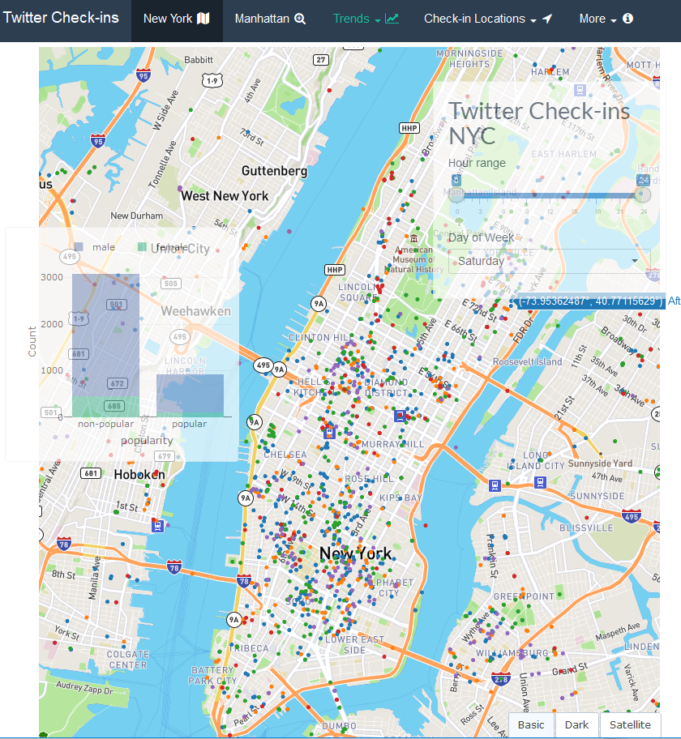
The Shiny App
Thoughts behind the structure
Helicopter perspective of Twitter Users Check-ins in NYC
Decompose the detail level into 1) Gender 2) Popularity
Link

Slide 4
Backup slides

Slide 5
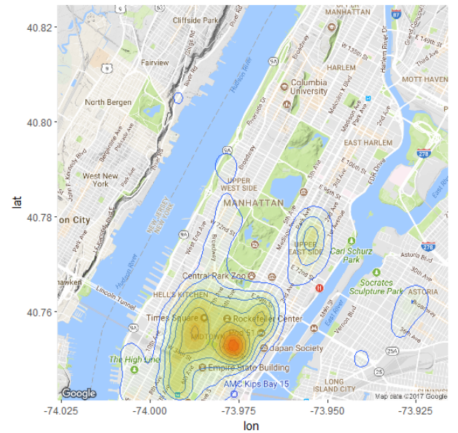
Manhattan

Slide 6
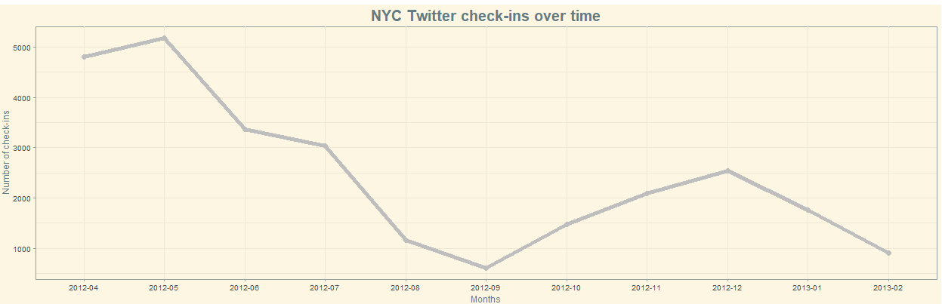
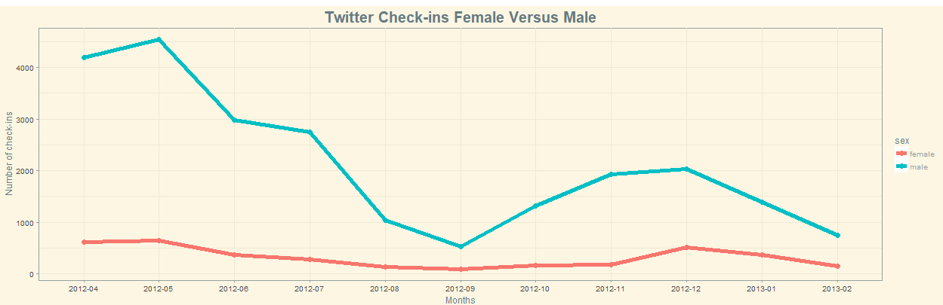
Twitter Check-ins are declining

Slide 7
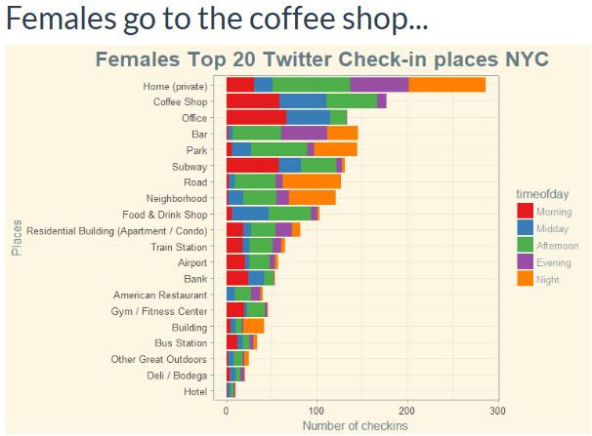
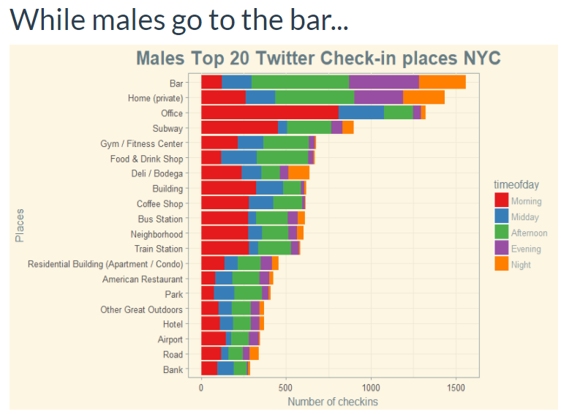

Slide 8
Utilizing Twitter Check-ins
Business Perspective
- Venues:
Who are the customers (Gender, popular)?
Window of opportunity: Free advertisement
When are customer checking in (time of the day)?
General:
Which areas are attractive in respect to marketing
User Perspective
When are where to go based on individual preferences?

Slide 9
Take away
Lower Manhattan seems to be the place where people are more likely to check-in
Twitter Check-ins are declining
Males are significantly more active on Twitter in respect to check-ins
Peoples social status seems to influence the number of check-ins on Twitter

