Slide 1

Vivekanand Education Society’s Institute Of Technology Department Of Information Technology
DSA mini Project
Title: FOOTBALL STADIUM Ticket Booking Syste^{A}m ^{.Y. 2025-26}
Sustainability Goal :
Domain: Data structure & algorithms
Member: Kshitij Gawad
Mentor Name: Kajal jewani

Slide 2




*uauudo ao a Qa qe"!el5°S°°9
S1Ë0319B0153H1

Slide 3

Content
Introduction to the Project
Problem Statement
Objectives of the Project
Scope of the Project
Requirements of the System (Hardware, Software)
ER Diagram of the Proposed System
Data Structure & Concepts Used
Time and Space Complexity
Front End
Implementation
11, Output Screenshots
12, Conclusion
13. References (in IEEE Format)

Slide 4
Introduction to Project
🏟️ Introduction
The Football Stadium Ticket Booking System is a console-based mini project developed in C programming language using the principles of Data Structures and Algorithms (DSA). This project aims to simplify and automate the manual process of booking tickets for football matches in a stadium.
In traditional systems, ticket booking is handled manually, which can lead to confusion, duplicate bookings, and difficulty in tracking available seats. To overcome these problems, this program provides a simple, user-friendly computerized solution that allows users to view available seats, book or cancel tickets, and check the overall booking summary in real time.
The stadium seating arrangement is represented using a 2D array, where each element represents a seat. A structure is used to store the details of each seat, such as the seat number, booking status, and the customer’s name. This program also includes features to store the stadium name and match details, making it flexible for different matches or events.

Slide 5
Problem Statement
Problem Statement
Managing ticket bookings for football matches manually is often inefficient and prone to human error. Traditional methods such as maintaining registers or spreadsheets make it difficult to track which seats are available, which are booked, and who has booked them. This leads to problems like:
Double booking of seats
Difficulty in cancelling or modifying reservations
Lack of real-time information on seat availability
Time-consuming management for large stadiums
To overcome these issues, there is a need for a computerized system that can automate the entire booking process. The Football Stadium Ticket Booking System aims to provide a simple and efficient way to manage seat reservations for football matches using C programming language.
The system should allow the user to:
Enter the stadium name and match name,
Display all seats showing which are booked and which are available,
Book a seat by seat number and record the customer’s name,
Cancel an existing booking, and
Show a summary of total, booked, and available seats.
This project provides an interactive, menu-driven program that uses data structures (arrays and structures) to store and manage seat information, ensuring faster processing, better organization, and an error-free booking experience.

Slide 6
Objectives of the project
The main objectives of the FOOTBALL STADIUM Ticket Booking System are:
To develop a simple and user-friendly program for booking movie tickets using the C language.
To allow users to view available movies and their showtimes easily.
To display seat availability and enable customers to select seats of their choice.
To generate a unique booking ID for each confirmed ticket.
To maintain a record of all bookings made during the session.
To demonstrate the use of basic C programming concepts such as structures, arrays, and functions in a real-world application.

Slide 7
Requirements of the system (Hardware,
software)
Hardware Requirements
Processor:- intel core i3 or higher
Ram:- minimum 2 GB (4GBrecommended)
Storage:- minimum 100 MB of free space
Display:- standard VGA or higher resolution
Input dvices:- keyboard (for data entry), mouse (optional)
Output device:- monitor or console output screen
Software Requirements
Operating System: Windows, Linux, or macOS
Compiler: GCC (GNU Compiler Collection) or any C compiler (e.g., Turbo C, Code::Blocks, Dev-C++)
Editor/IDE: Code::Blocks, Dev-C++, Turbo C, or Visual Studio Code
Console/Terminal: To execute and test the program

Slide 8
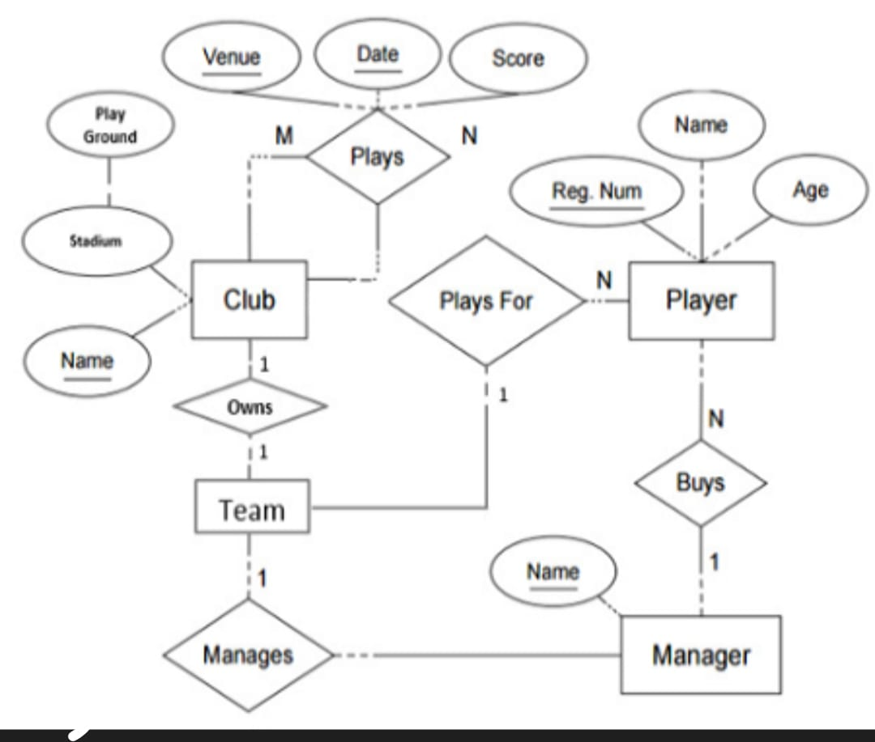
ER diagram of the proposed system

Slide 9
Front End
The project uses basic C programming concepts to manage matches and booking data efficently.
Structures: used to group related data for matches and bookings.
Arrays : Store multiple match records,seat status and bookings.
Loops & conditionals:control program flow and check seat avaibality.
Functions:Divide the program into logical modules(e.g, booking,viewing matches).

Slide 10
Time and Space Complexity
Time Complexity:
The Football Stadium Ticket Booking System is designed using a 2D array to manage seat availability, which makes the program both efficient and easy to understand. The time complexity of the system varies based on different operations. For displaying the seating arrangement or counting the number of empty seats, the program must traverse the entire 2D array of seats. Hence, these operations have a time complexity of O(n × m), where n represents the number of rows and m represents the number of seats in each row. On the other hand, operations such as booking a seat or canceling a booking are performed directly by accessing specific array indices, resulting in a constant O(1) time complexity. This ensures that the most frequently used actions are completed quickly and efficiently.
Space Complexity:
The space complexity of the program mainly depends on the size of the 2D array used to represent the seating arrangement. Since each element in the array stores the status of a seat (booked or available), the total space required is O(n × m). Apart from the seating array, a small and constant amount of additional space is used for variables like stadium name, match name, and user inputs, contributing an O(1) space. Therefore, the overall space complexity of the system remains O(n × m).

Slide 11
Implementation
Steps of Implementation 1.Initialization
Define the matches on particular day
Each movie has match limited 50 seats available
Display Menu
Show a menu with options: View match, View Seats, Book Ticket, View All Bookings, Exit.
View Movies
Display the matches with their kickoff time.
View Seat Availability
Show which seats are available or booked for a selected match.

Slide 12
Implementation
Book Ticket
Ask the user to choose a match and a seat number.
Check if the seat is available (linear search).
If available, store the booking details (customer name, seat, match) and mark the seat as booked.
View Bookings
Display all the booked tickets with customer name, match, and seat number.
Exit
End the program when the user selects the exit option.
The system uses linear search to find available seats and unique booking IDs to track each booking.

Slide 13
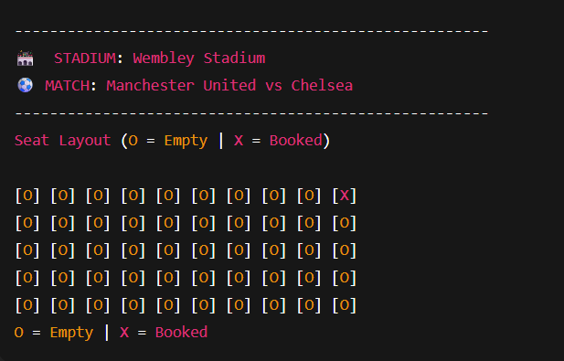
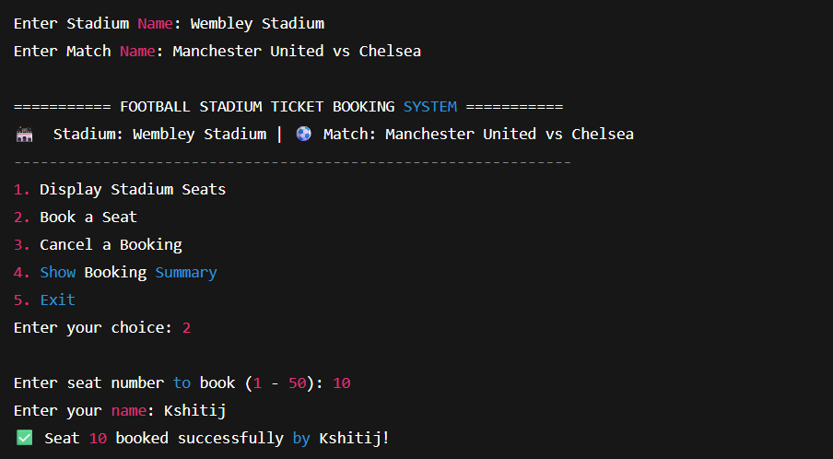
Output

Slide 14
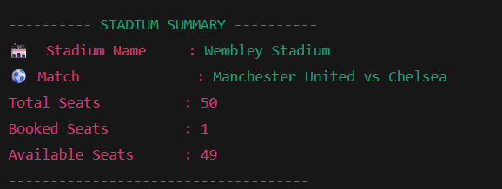


Output

Slide 15

Conclusion
The football stadium Ticket Booking System is a simple and efficient program developed in C to simulate the process of booking match tickets. It allows users to view available match, check seat availability, and book tickets with unique booking IDs.
The project demonstrates the use of arrays, structures, functions, and basic programming logic to manage and organize data effectively. It provides a foundation for understanding real-world ticket booking systems and can be further enhanced by adding features like different seat category, or multiple match support.
Overall, the project successfully achieves its goal of simplifying the ticket booking process and offers a clear example of structured programming in C.

Slide 16
References
https://medium.com/@shimaaaboelmagd257/how-to-build-a-movie- ticket-booking-system-in-c-using-menu-navigation-c0582fdf4d0c
https://www.tutorialspoint.com/cprogramming/c_linke d_list_algorithm.htm
https://www.geeksforgeeks.org/stack-data-structure/

