Slide 1
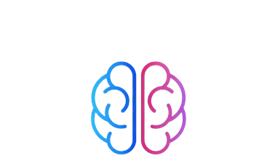

FutureMinds

Slide 2
Table of contents:
1
3
Our Team
Used Technologies​
2
Stages of Realization​

Slide 3
Our Team
1

Slide 4
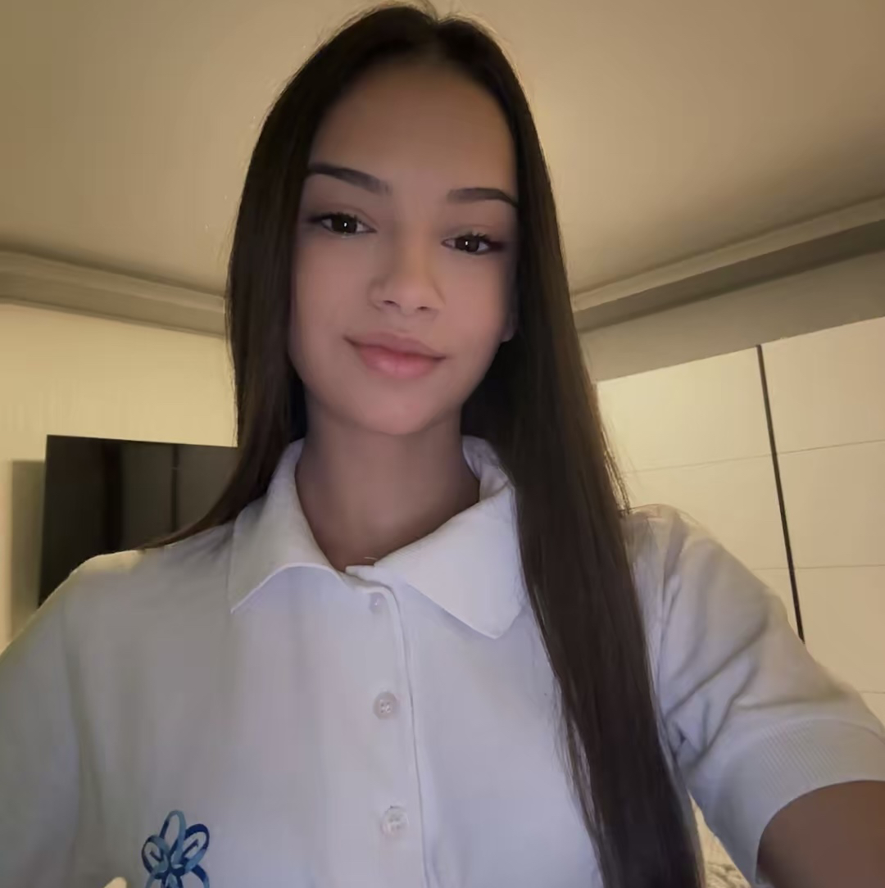
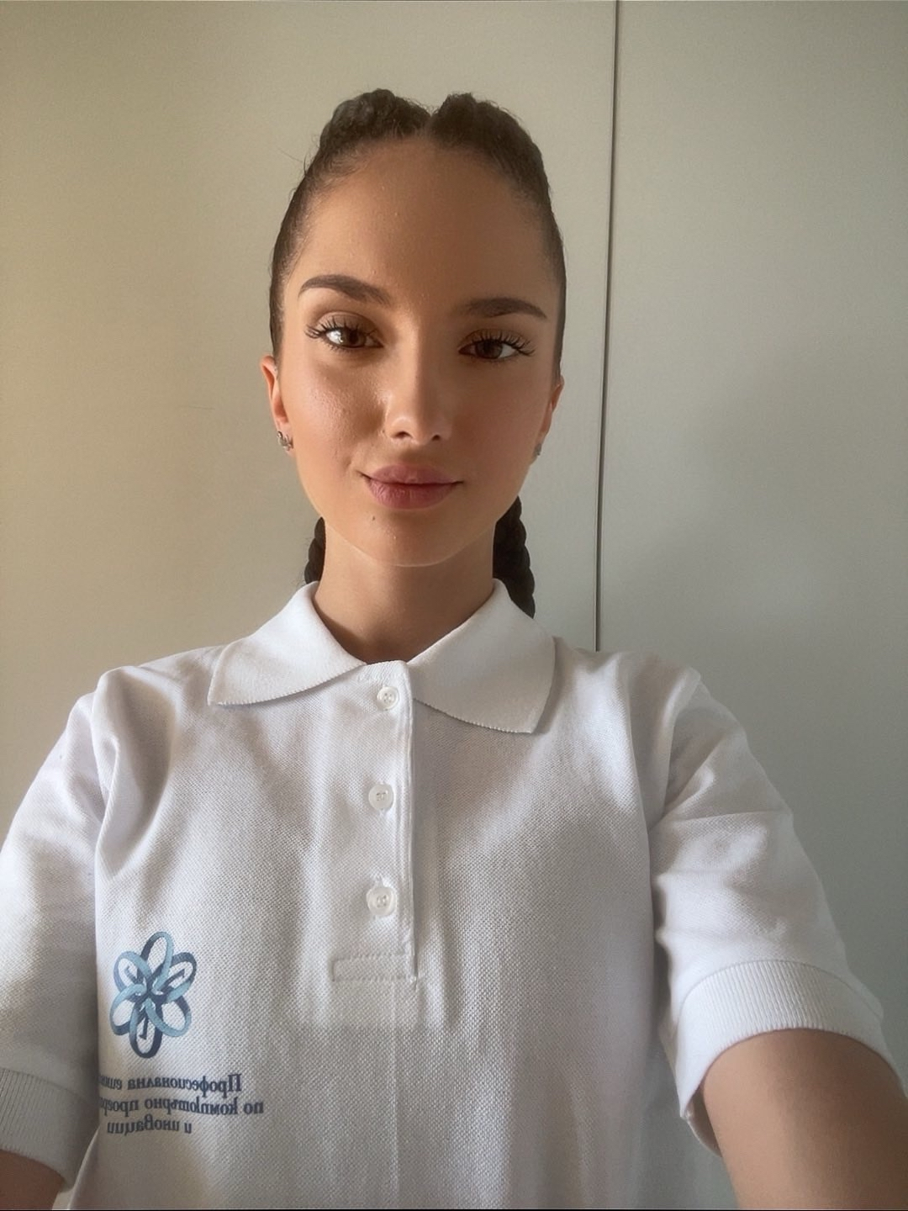
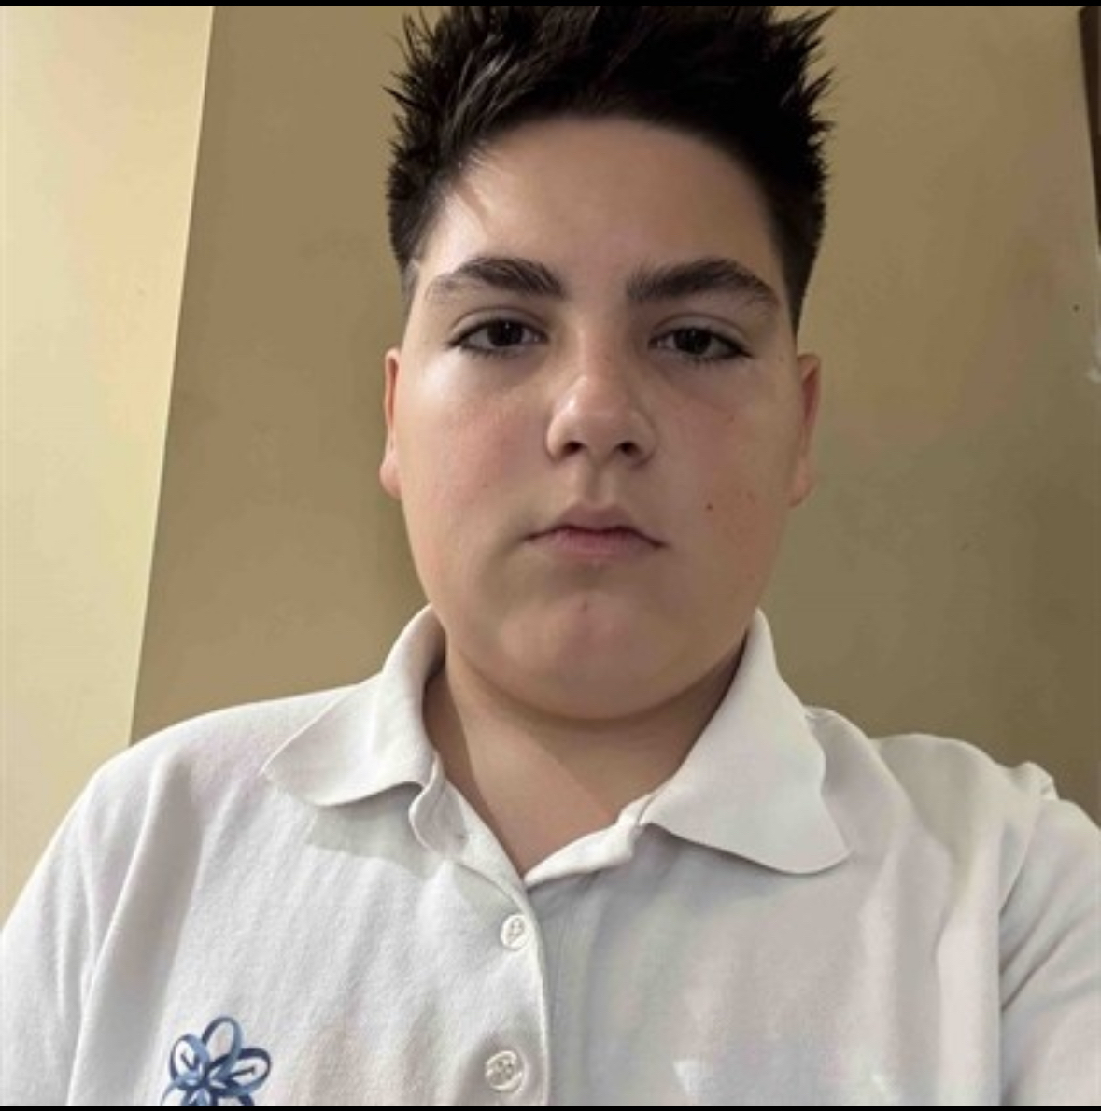
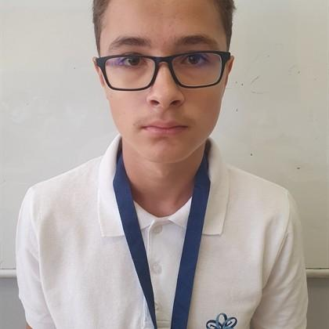
01. Our team
Developer Backend
Developer Backend
Scrum Trainer
Developer Frontend

Slide 5
Stages of Realisation​
2

Slide 6

02. Stages of Realisation​
Our project is an e-school platform developed in C++ that allows users to log in with different roles, such as students and teachers, each with their own functions and permissions. We worked as a team, writing well-organized code and regularly uploading our progress to GitHub. We also created documentation explaining the system’s main features. Each team member had a specific role, which helped us stay organized and successfully complete the project.

Slide 7
3
Used technologies​

Slide 8
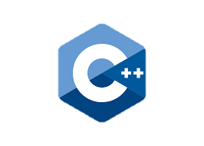








Slide 9

Let’s move to the DEMONSTARTION

