Slide 1

CPG 221
Selective Knowledge Erasure
in Large Language Models
A Representation-Aware Unlearning Framework
Team Members
Mentor
Rishabh Garg (102317044) | Karanvir Singh (102317045)
Dr. Suresh Kumar Chaudhary
Kalpesh Paliwal (102317087) | Rujul Ganjoo (102317200)
Assistant Professor – I
Pranav Goyal (102303829)
Deptartment of Computer Science & Engineering
March 2026

Slide 2
Project Overview & Need Analysis
Overview
Gradient Ascent Fails
Obfuscation ≠ True Erasure
LLMs encode sensitive & hazardous knowledge across billions of parameters
GDPR mandates post-hoc right-to-erasure for deployed AI systems
LLM Unlearning: modify Pθ → Pθ* without retraining from scratch
Key gap: existing methods produce obfuscation, not true erasure
Goal: representation-aware, durable, specificity-preserving framework
Cannot suppress logically related knowledge outside the forget-set — UIPE [4]
Surface refusal hides latent traces — KIF [5] shows Type II failure in prior methods
Specificity Loss
Adversarial Vulnerability
Adjacent knowledge erased inadvertently — PISCES [3] achieves 31% ↑ specificity
Fine-tuning attacks recover 'erased' knowledge — parameter-level editing is needed

Slide 3
Related Work / Literature Survey
ELM [2]
PISCES [3]
UIPE [4]
Erasing Conceptual Knowledge
Precise In-Parameter Erasure
Parameter Extrapolation Unlearning
Self-classification: novice vs expert prefix shifts output distribution. LoRA on early layers. Near-random WMDP accuracy post-erasure; some specificity degradation.
SAE disentangler decomposes MLP vectors into features. VocabProj identifies concept directions. Ablates activations in-place — 31% ↑ specificity, 38% ↑ robustness vs ELM.
Related knowledge shares gradient cosine similarity. Amplifies update vector v by scalar α — extends forgetting to related set without additional training data.
KIF [5]
Steer [1]
Activation-Signature Erasure
Steering Latent Representations
Mines subject signatures via Cohen's d; Suppression Capsules gate parallel activations; UPU Loop distils into LoRA. FQ ≈ 0.99, MU = 0.62 — near-oracle on TOFU forget-10.
Proves weight-level changes alone ≠ true erasure. Validates the need for dual-metric evaluation (SMR + EL10). Motivates representation-aware approaches such as KIF.

Slide 4
Problem Statement & Objectives
Problem Statement
LLMs retain latent traces of erased knowledge (obfuscation ≠ true erasure), reconstruct forgotten facts via related knowledge, and degrade utility on unrelated tasks — demanding a verifiable, representation-aware, specificity-preserving unlearning framework.
O1
Survey & Comparative Analysis
O2
Dual-Metric Evaluation Framework
Systematic comparison of ELM, PISCES, UIPE, KIF & steering methods on TOFU / WMDP — efficacy, specificity, coherence, robustness
SMR + EL10 protocol: classify outcomes as Type I (true erasure), Type II (obfuscation), or Type III (instability)
O3
Related-Knowledge-Aware Unlearning
O4
Representation-Aware Integration
Parameter extrapolation θ_{uipe} = θ_{un} + α·v extends forgetting to logically related knowledge without extra training data
Unify activation-signature extraction, Suppression Capsules, and UPU Loop into a single LoRA-based durable erasure framework

Slide 5


Assumptions & Constraints
Assumptions
Constraints
Open-source LLMs (Llama-3.1-8B, Mistral-7B) available under public licences
Compute
NVIDIA A100/A6000 (40 GB VRAM); 7B–8B models primary; larger models conditionally
Knowledge is partially localised in MLP layers — consistent with causal-tracing evidence
Data
Public benchmark datasets only — no PII or proprietary training data processed
Related knowledge exhibits higher gradient cosine similarity to the forget-set target
Scope
English-language models only; cross-lingual generalisation deferred to future work
TOFU, WMDP-Bio, WMDP-Cyber are representative of practical unlearning scenarios
Time
Bounded by academic semester; model count and benchmarks limited per the work plan
4-bit quantised models yield qualitatively consistent results vs full-precision
Ethics
No harmful content created; targets limited to TOFU / WMDP / public entities only

Slide 6
Project Execution Plan (Methodology)
Phase 1
Phase 2
Phase 3
Phase 4
Baseline Reproduction
Related-Knowledge Unlearning
Representation-Aware Framework
Integrated Evaluation & Report
Reproduce ELM, PISCES, RMU on TOFU-forget10 & WMDP
Implement SMR + EL10 dual-metric evaluator
Classify results: Type I / II / III
Ablation: isolate contribution of each loss term
Build synthetic dataset (k_{i} ↔ k′_{i} via GPT-4o)
Measure gradient cosine similarity empirically
Apply UIPE extrapolation: θ_{uipe} = θ_{un} + α·v
Ablation over amplification coefficient α
Extract MLP activation signatures via Cohen's d
Implement Knowledge Suppression Capsules
Train UPU Loop: DPO + NTUL + KL + EWC
Distil into global LoRA adapter & merge
Evaluate on TOFU, WMDP, RWKU (4-subject)
Zero-shot: ARC, HellaSwag, WinoGrande, TruthfulQA
Compile and analyse full results table
Write final report & prepare panel presentation

Slide 7



Project Requirements
Software & Platforms
Hardware
Models & Datasets
Python 3.10+ / PyTorch 2.x
HuggingFace Transformers + PEFT
lm-evaluation-harness (EleutherAI)
SAELens / TransformerLens
ROUGE-L / BERTScore
Git / GitHub
LaTeX (Overleaf)
NVIDIA A100 / A6000 — 40 GB VRAM
4-bit quantised inference (primary)
Multi-GPU cluster (preferred)
Model range: 7B – 8B parameters
~500 GB storage (models + datasets)
Llama-3.1-8B-Instruct
Mistral-7B-v0.1 | Zephyr-7B-beta
TOFU (forget01 / 05 / 10)
WMDP-Bio & WMDP-Cyber
RWKU (4-subject evaluation subset)
Synthetic dataset (GPT-4o generated)

Slide 8
Project Outcomes
01
Benchmark Report
02
Unlearning Framework
03
Evaluation Protocol
04
Report & Presentation
Structured comparison of ELM, PISCES, UIPE, RMU & KIF on TOFU and WMDP under dual-metric evaluation (SMR + EL10)
Modular Python codebase: activation-signature pipeline, Suppression Capsules, UPU Loop, UIPE parameter extrapolation
Reusable module: SMR, EL10, ROUGE-L, MMLU zero-shot, ARC-Challenge, HellaSwag, TruthfulQA assessment pipeline
Formal technical report + panel presentation covering literature survey, methodology, experiments, and conclusions
Expected Research Contribution
Robustness to re-learning attacks compared with fine-tuning-based baselines (PISCES / KIF approach)
Specificity degradation on semantically adjacent concepts compared with ELM
Forget quality on WMDP when related-knowledge extrapolation (UIPE) is applied to GA variants
Type I (true erasure) classification on standard foundation models under dual-metric SMR + EL10 protocol

Slide 9
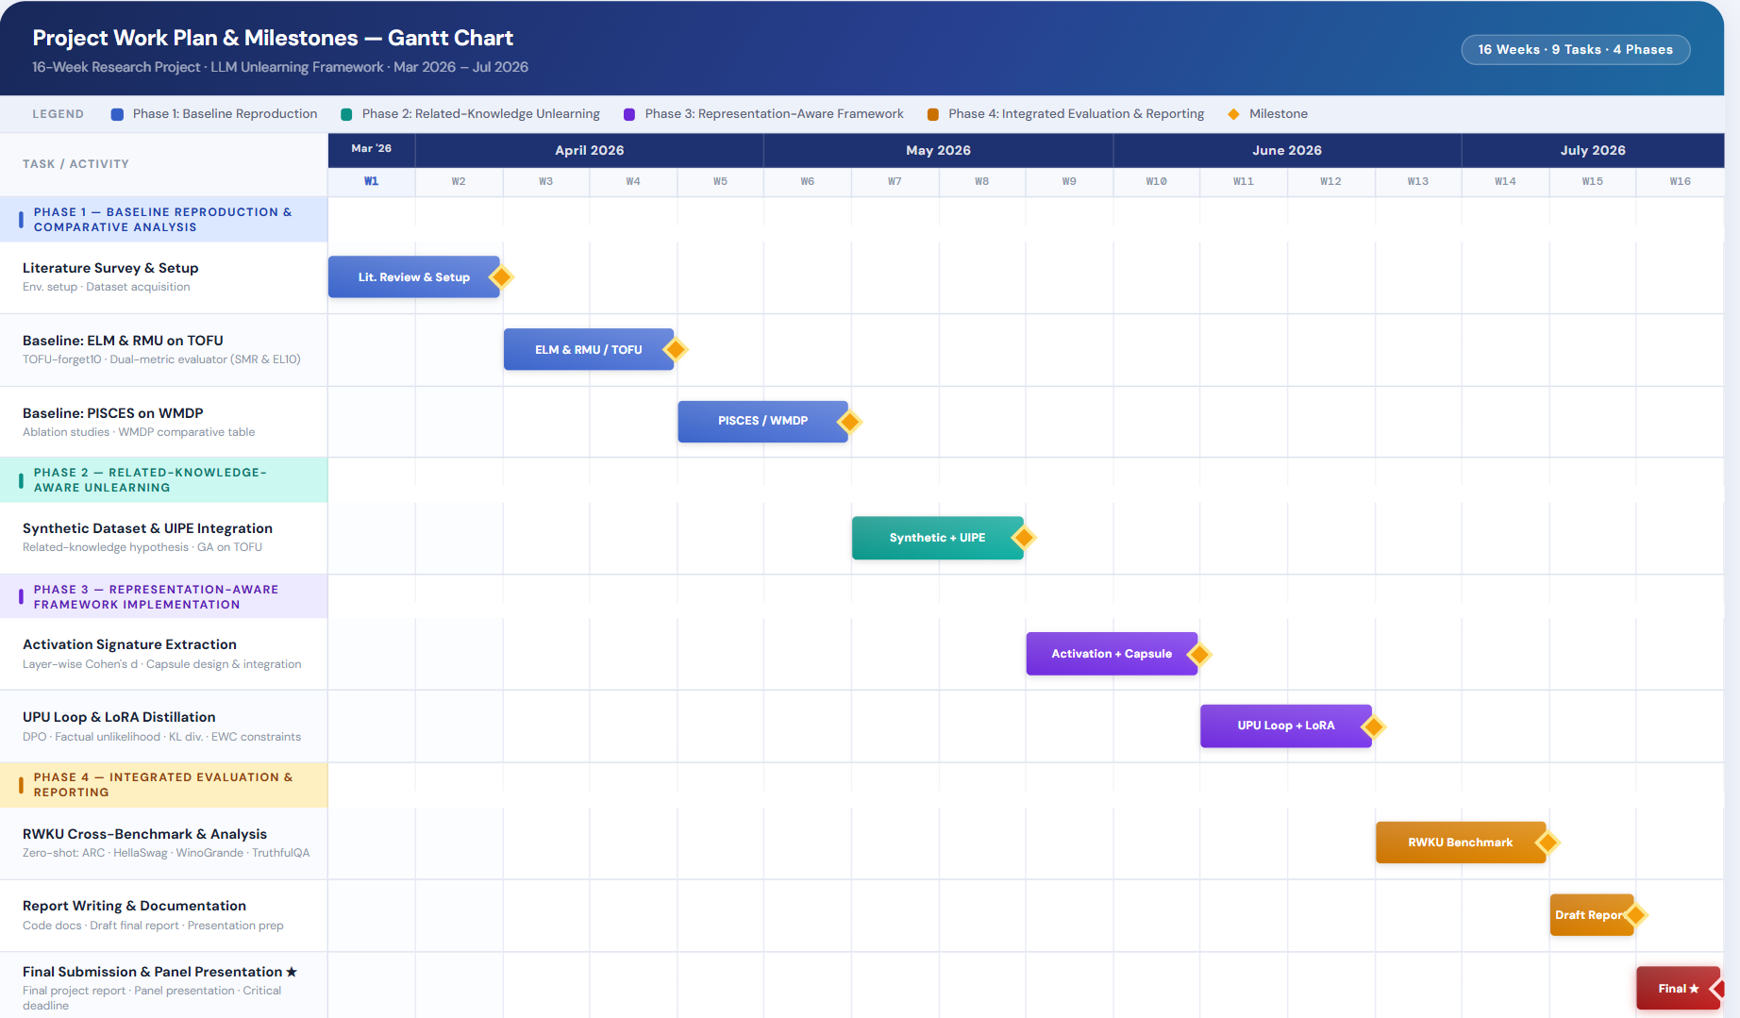
Work Plan

Slide 10

Team Roles & Contributions
R
Rishabh Garg
K
Karanvir Singh
K
Kalpesh Paliwal
102317044
102317045
102317087
Lead core research and model development
Collaborating on understanding neural networks and LLM concepts
Working on data handling, preprocessing and basic analysis
Contributing to implementation of basic model experiments
Assisting in model implementation
Contributing to experiments and documentation
Guiding team discussions
Model experimentations and debugging
Interpretation of results using DS techniques
R
Rujul Ganjoo
P
Pranav Goyal
102317200
102303146
Assisting in Machine Learning Experiments
Developing the platform to present model result
Evaluation of model outputs
Handling documentation
Comparing results across different approach
Organizing project findings
All members jointly contribute to code reviews, discussions, and panel presentation preparation.

Slide 11
References
[1]
Qin, H., Zhang, B., & Ji, H. (2024). On Effects of Steering Latent Representation for Large Language Model Unlearning. arXiv:2408.06223.
[2]
Gandikota, R., Feucht, S., Marks, S., & Bau, D. (2025). Erasing Conceptual Knowledge from Language Models. NeurIPS 2025.
[3]
Gur-Arieh, Y., Suslik, C., Hong, Y., Barez, F., & Geva, M. (2025). Precise In-Parameter Concept Erasure in Large Language Models. EMNLP 2025, pp. 18986–19006.
[4]
Wang, W., Zhang, M., Ye, X., Ren, Z., Ren, P., & Chen, Z. (2025). UIPE: Enhancing LLM Unlearning by Removing Knowledge Related to Forgetting Targets. Findings of ACL: EMNLP 2025.
[5]
Mahmood, S. N. et al. (2026). Representation-Aware Unlearning via Activation Signatures: From Suppression to Knowledge-Signature Erasure. arXiv:2601.10566v4.

Slide 12
Thank You
CPG 221 · Dept. of Computer Science & Engineering · March 2026

