Slide 1

COMP 6321 Machine Learning
Exploring the Role of Optimizers and Architectures in Active Learning
Khadiza Sarwar Moury (40343620)
Md Hasibul Hasan Shovo (40329539)
Syed Abdullah Ali (40333397)
Youssef Midra (40341729)
Notes:
NOTE:
To change the image on this slide, select the picture and delete it. Then click the Pictures icon in the placeholder to insert your own image.

Slide 2
Introduction: The Challenge
The Problem
Deep learning models require massive amounts of labeled data, but labeling is:
Expensive - costly to obtain
Time-consuming - requires significant effort
Expert-dependent - needs domain specialists (medical, satellite imagery)
The Solution
Active Learning: Intelligently select the most informative samples for labeling
→ Achieve high accuracy with fewer labeled samples

Slide 3
Research Objectives
1. Optimizer Impact
How do different optimizers (SGD, Adam, AdamW, RMSProp) perform in active learning?
2. Architecture Effects
How do ResNet variants (ResNet18, ResNet34, ResNet50) impact learning efficiency?
3. Sample Efficiency
Which combinations achieve highest accuracy under fixed labeling budget?

Slide 4
Methodology: Active Learning Framework
Iterative Learning Process
1. Cold Start: 1,000 random samples
Initialize with random selection
2. Active Cycles: 9 iterations × 1,000 samples
Query most informative samples using Loss Prediction
3. Total Budget: 10,000 labeled samples
Retrain from scratch after each cycle
Dataset: CIFAR-10 (60,000 images, 10 classes)
Strategy: Loss Prediction Module for uncertainty sampling

Slide 5
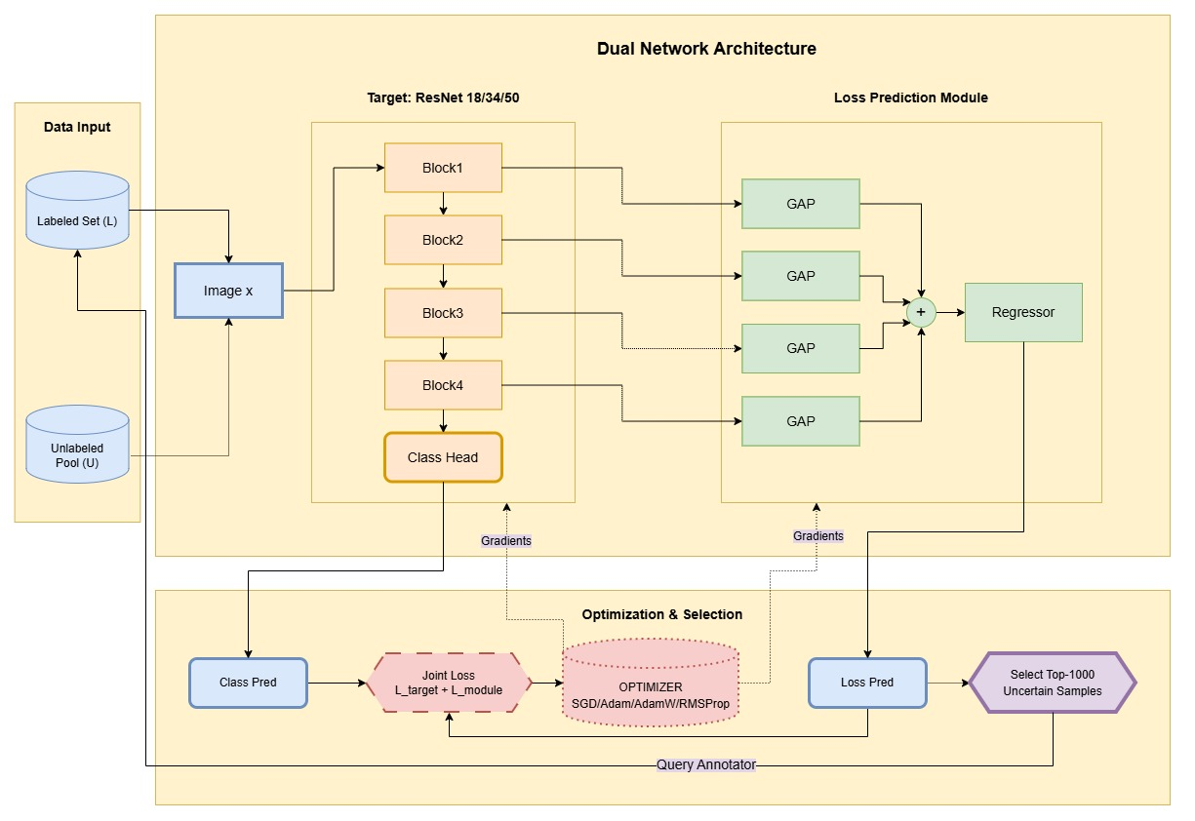
Methodology: Active Learning Framework
Fig 1: Active Learning diagram

Slide 6
Methodology: ResNet Architectures
11M parameters
✓ Lightweight baseline
✓ Fast training
✓ Resource-efficient
✓ Minimal overfitting
ResNet34
21M parameters
✓ Increased depth
✓ Balanced trade-off
✓ Better features
✓ Moderate cost
ResNet50
25M parameters
✓ Bottleneck blocks
✓ Deepest model
✓ High-level features
✓ Best for complex tasks
ResNet18
Key Feature: Residual Connections
Skip connections mitigate vanishing gradients, enabling stable training of deep networks

Slide 7
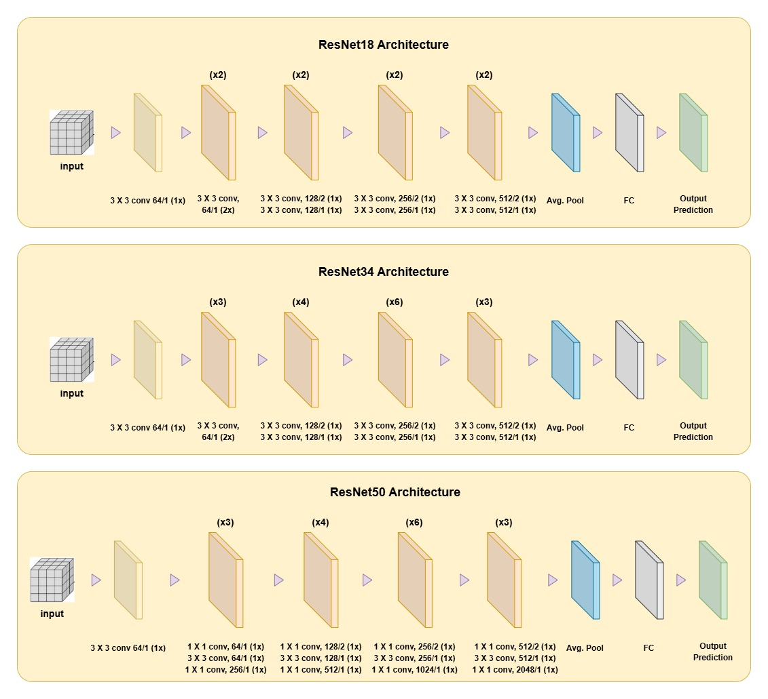
Methodology: ResNet Architectures
Fig 2: ResNet-18/34/50 architectures

Slide 8
Methodology: Optimizers
SGD
Stochastic Gradient Descent
Classical optimizer with momentum (0.9). Finds flatter minima → better generalization
ADAM
Adaptive Moment Estimation
Adaptive learning rates. Fast convergence but may overfit with limited data
ADAMW
Adam with Weight Decay
Decouples weight decay from gradient update. Better stability & generalization
RMSProp
Root Mean Square Propagation
Adapts learning rate per parameter. Fast convergence, robust to noise

Slide 9
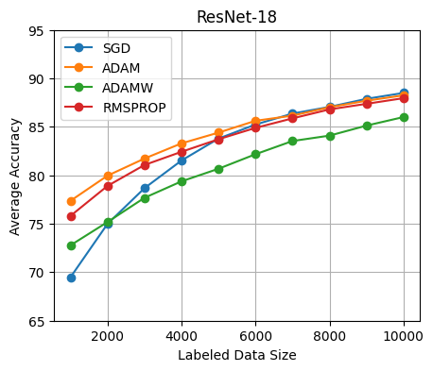
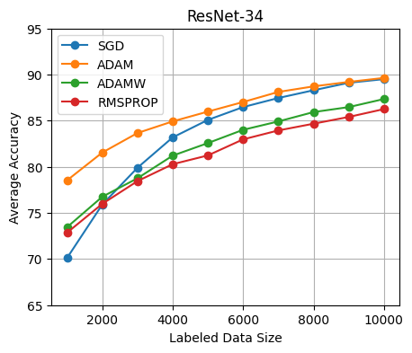
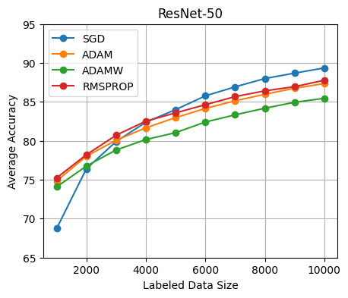
Results Analysis
Fig 3: Average accuracy vs labeled data for different models and optimizers for 5 trials

Slide 10
Results Analysis: Key Findings
The Trade-off Discovery
Early Phase (≤4,000 samples)
Winner: Adaptive Optimizers
✓ Adam, AdamW excel
✓ Faster convergence
✓ Better sample efficiency
ResNet-18 + Adam: ~77%
Late Phase (10,000 samples)
Winner: SGD
✓ Steeper learning curve
✓ Superior generalization
✓ Highest final accuracy
ResNet-50 + SGD: ~90%
Critical Insight: No single "best" optimizer for all stages!

Slide 11
Results Analysis: Performance Across Architectures
ResNet-18 & ResNet-34
All optimizers converged to similar range: 86-89.5% accuracy
Relatively shallow models show less optimizer sensitivity
ResNet-50: The Star Performer
• Cold Start: SGD lagged significantly (<70% at 1,000 samples)
• Mid-Stage: Steepest improvement curve observed
• Final Result: Overtook all adaptive optimizers → ~90% accuracy
Key Observation
Deeper architectures require longer "warm-up" but deliver highest performance with SGD when sufficient data is available

Slide 12
Conclusion
Recommended Strategy
Hybrid Optimization Approach:
1. Start with Adam/AdamW for initial cycles (rapid acquisition)
2. Switch to SGD in later cycles (maximize final accuracy)
Future Work
• Test on complex datasets (ImageNet, medical imaging)
• Implement fine-tuning to reduce computational cost
• Explore semi-supervised learning integration
Key Takeaways
✓ Optimizer choice matters throughout active learning lifecycle
✓ Adaptive optimizers excel in low-data regimes
✓ SGD provides superior generalization with sufficient data
✓ Deeper models (ResNet-50) benefit most from SGD at scale
✓ Hybrid strategies could optimize both phases
Applications
Medical imaging, satellite imagery, industrial quality control—anywhere labeling is expensive

Slide 13
Thank you
Code available on Github!

