Slide 1
3D reconstruction from images taken with a coaxial camera rig
Richard Kirby and Ross Whitaker
University of Utah

Slide 2
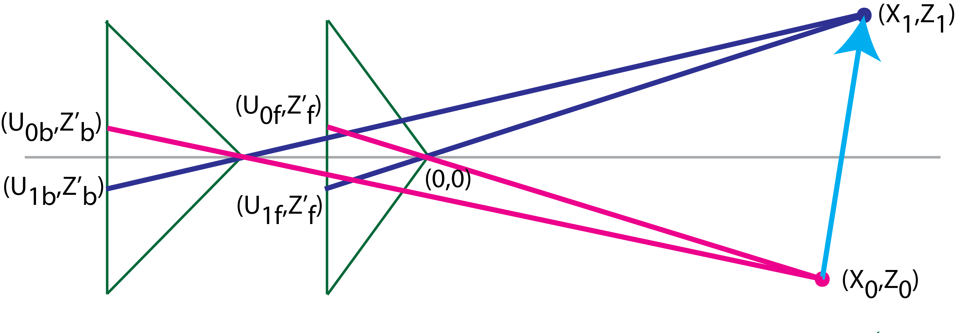
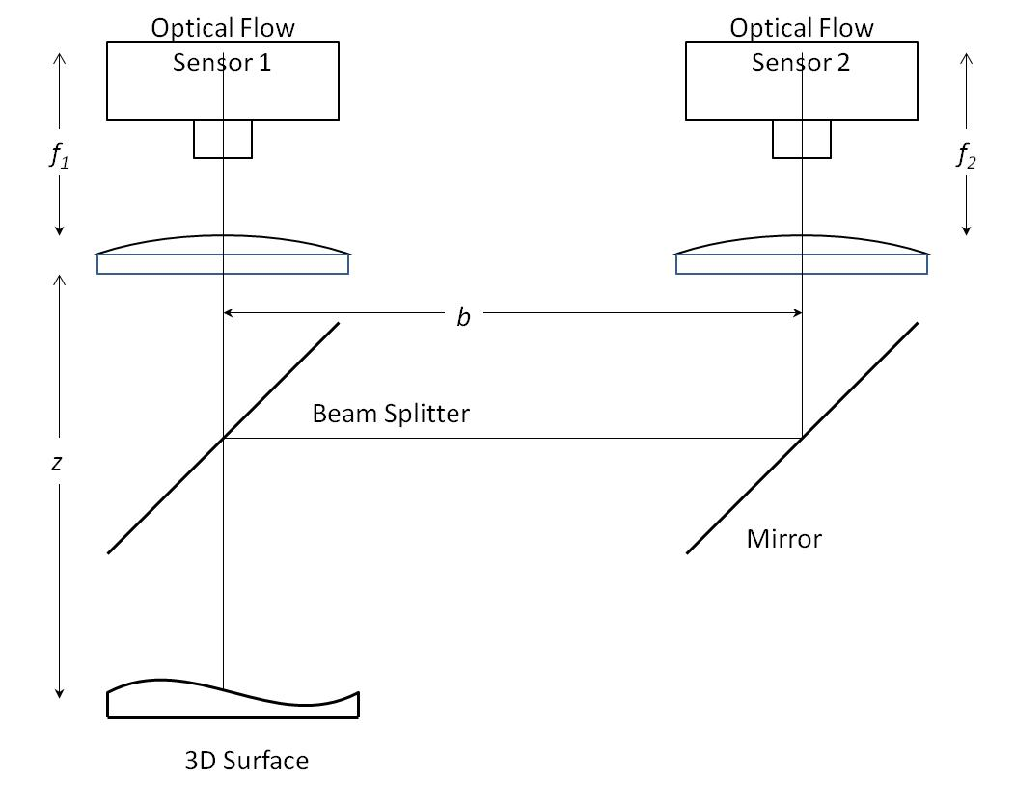
What is a coaxial camera rig?
Notes:
Cameras have different focal lengths and different distances to the scene.
Baseline can be vertical or horizontal.

Slide 3
Why use a coaxial camera rig?
Advantages:
Common center point, provides one known correspondence.
Epipolar lines are radial lines even with different focal length cameras
Baseline can be wrapped up inside the camera.
Substantial reduction of occlusions vs. binocular stereo
No minimum working distance vs. binocular stereo
Disadvantage:
No pixel disparity in center region – “unrecoverable point problem”
Notes:
Common center point doesn’t sound like a big deal, but it provides excellent initialization.
Wrapped baseline means single entry point for light.

Slide 4
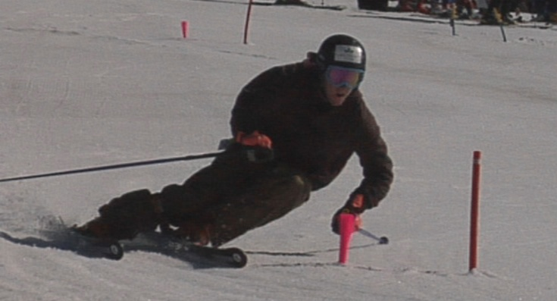
Original Motivation

Slide 5
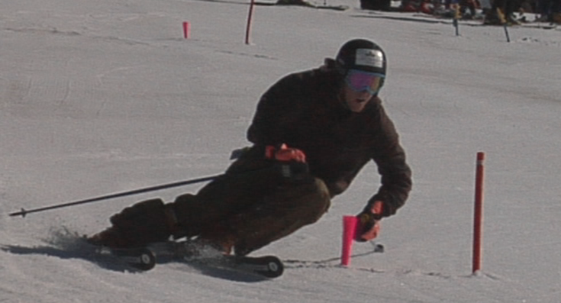
Original Motivation

Slide 6
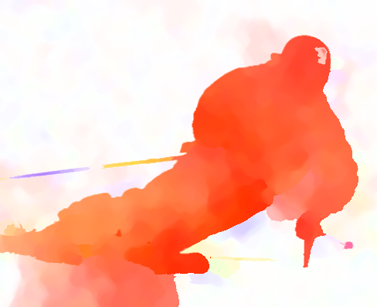
Original Motivation
Notes:
Skier moving one direction
Poles following there own path
Spray following its own path
But not scaled and no Z velocity information.

Slide 7
Can 3D velocity be estimated directly from flow fields?
If the answer is yes:
We bypass stereo correspondence finding.
Solve the unrecoverable point problem in coaxial camera rigs which leads to:
Smaller more portable camera
Fewer occlusions
Maybe, faster than binocular stereo??
Notes:
This flow image of a skier begs the question:
Can 3D velocity be estimate directly from flow fields with a coaxial camera
If it works with a coaxial camera rig it would probably work with a stereo rig, but the coaxial rig has some additional advantages for studying skiers.

Slide 8
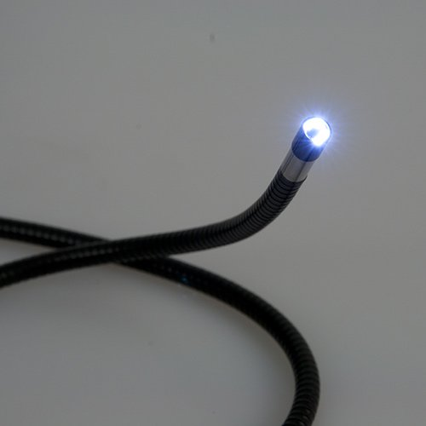
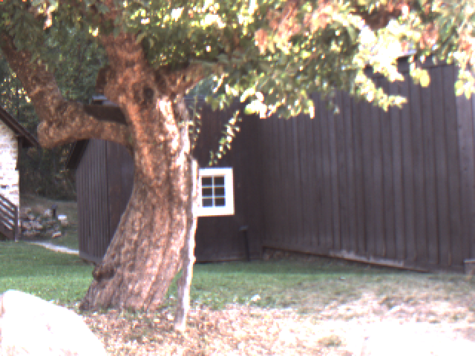
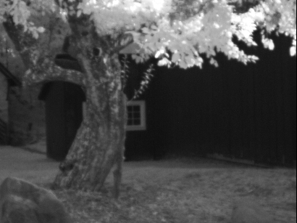
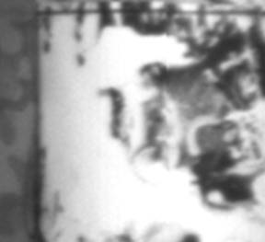
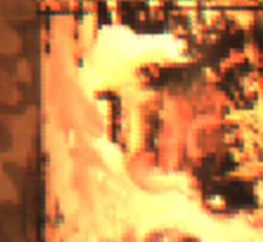
Applications
3D velocity measuring camera
3D Endoscope/borescope
Multi-modal cameras
Notes:
3D velocity, much better than radar!
Zero working distance

Slide 9
Assumptions
Scene is smoothly deformable
Optical flow need not be an accurate projection of the 3D motion field, but errors in optical flow computation should be consistent with projection equations.
Scene must have enough visual texture to generate optical flow (same issue for binocular stereo).
Notes:
Moving shadow or aperture problem

Slide 10
General Idea Register flow fields to estimate depth
3D Reconstruction
I1_front
I1_back
Front Flow
Back Flow
I0_front
I0_back
Notes:
Once the flow fields are registered you have a dense depth map which permits 3D reconstruction.
Depth allows the estimation of a dense delta Z map
Combine the dense depth map and dense delta Z map and you get a reconstructed dense 3D image with dense 3D velocity

Slide 11
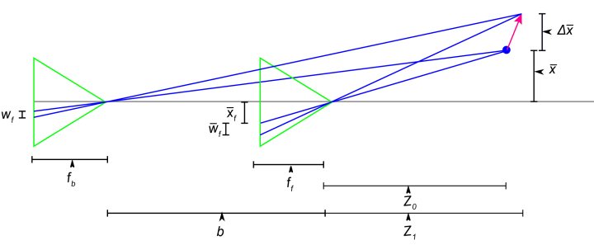
Derivation Definitions
Notes:
Right side is scene in capitals. This is a cross section with the horizontal axis being Z and the vertical axis being X. Y goes straight into the slide.
Baseline is distance between optical centers.

Slide 12
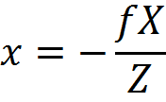
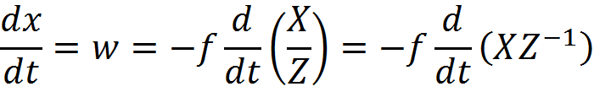
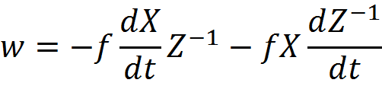
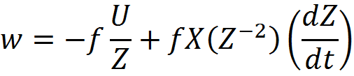
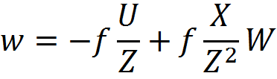
Energy derivation – Optical Flow
Relationship between 3D motion field
and 2D optical flow for ideal flow
Notes:
Is there enough info to solve this?
Solve for one camera only for clarity.
Start with the projection equation and assume pinhole camera.
Using the product rule and chain rule. dX/dt replaced with U and dZ/dt replaced with W.

Slide 13
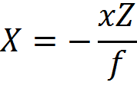
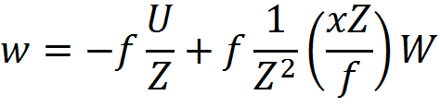
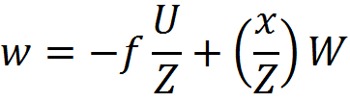
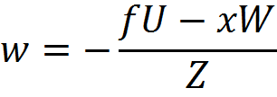
Energy derivation Optical Flow (continued)
Notes:
There are two of the last equation one for the x axis and one along the y axis.

Slide 14
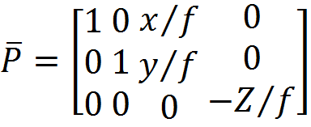
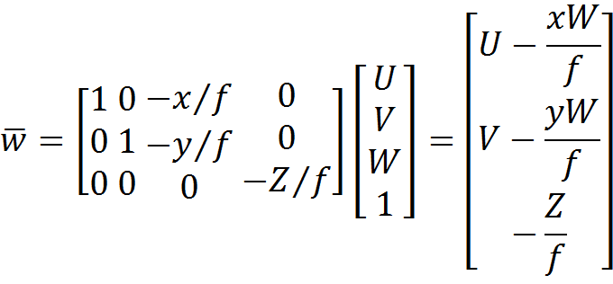
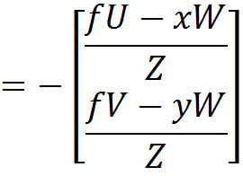
Energy derivation – Optical Flow Linear algebra form
Projection matrix
This represents four
equations with four
unknowns U, V, W,
and Z.
Notes:
Four equations and four unknowns, w is a 2 by vector, U, V, W, and Z are unknowns

Slide 15

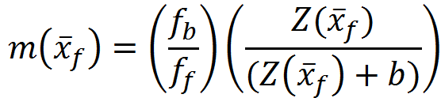
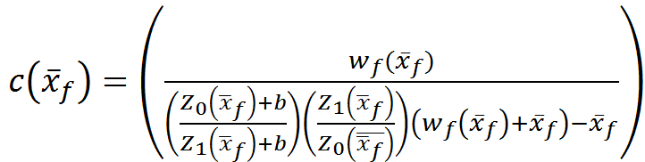
Energy minimization Relationship between flow fields
Note: in a coaxial camera epipolar lines are radial lines.
This results in a 1D optimization, similar to binocular stereo
using pixel correspondences.
Notes:
Change to left and right camera terminology with time 0 and 1
M is the ratio of the optical flow at each pixel
C is a “correction” for the parallax introduced by delta Z, c = 1 if delta Z = 0.

Slide 16

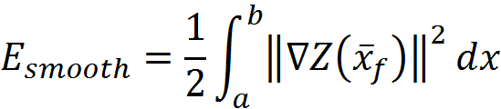

Energy derivation – energy functional to minimize
Regularization/smoothness term: penalty for
discontinuities.
Note: the regularization/smoothness term is 2D, along the epipolar line
and between epipolar lines. We adjust alpha independently
for along and perpendicular to epipolar lines.
Notes:
Change to left and right camera terminology with time 0 and 1

Slide 17


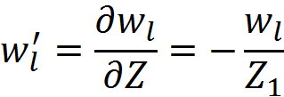
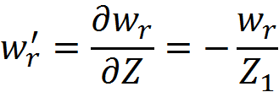
Numerical Solution Euler-Lagrange
Solve using standard gradient decent algorithm.
Notes:
First variation

Slide 18
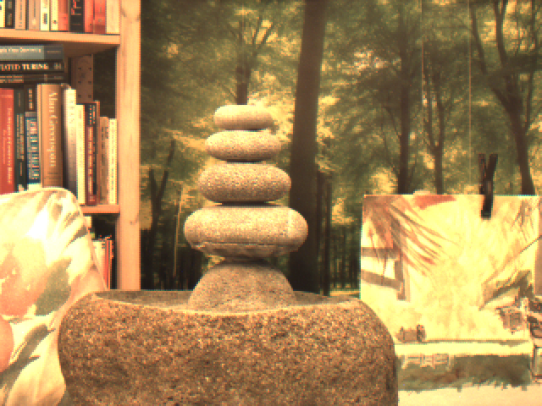

Slide 19
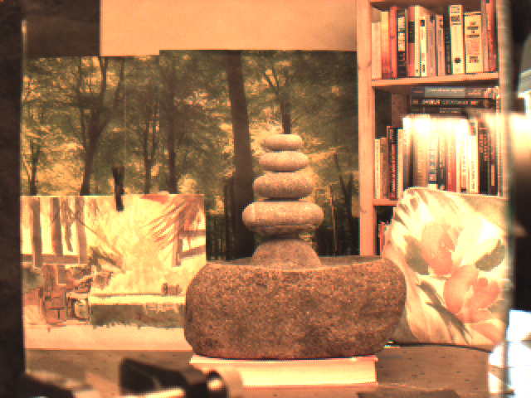
Notes:
Show some real image sequences with graphics along radial line to give an idea of how this actually works.

Slide 20


Slide 21

Notes:
Notice that the gaps between the rocks is somewhat filled in, the top rock is a bit lopsided, and there is some filling in between the water color and the fountain.

Slide 22
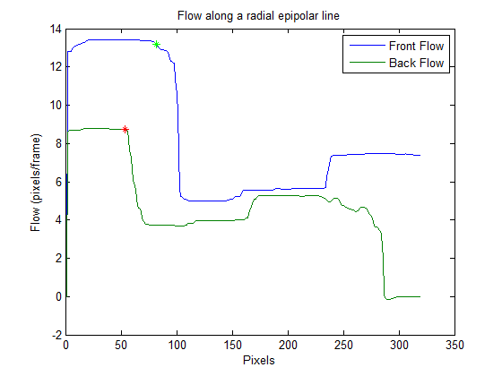
Optimization along epipolar lines
Notes:
This is a horizontal radial line at zero degrees.
The curved fountain gets for shortened.

Slide 23
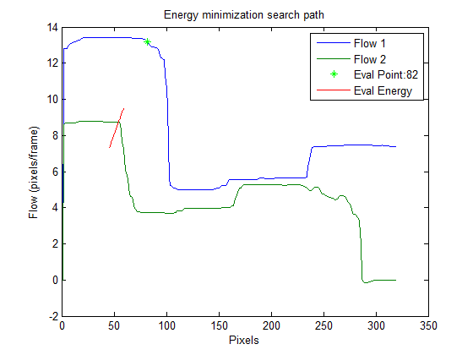
Optimization along epipolar lines
Disparity and magnitude are adjusted simultaneously for each
Z estimate. Gradient decent stops when error is sufficiently small.
Notes:
Eval energy represents the gradient descent coming from above or below.

Slide 24
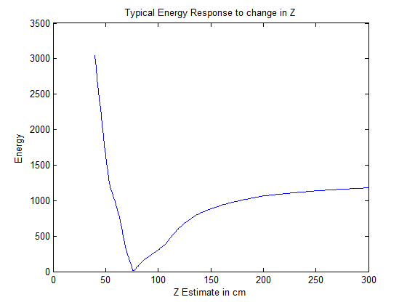
Energy vs. Z estimate
Note: gradient decent stops before error starts to increase.

Slide 25
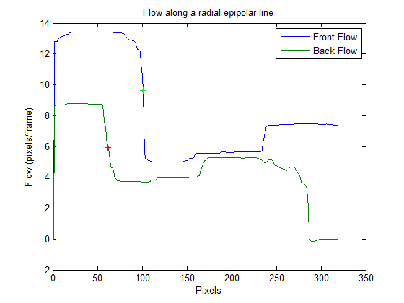
Optimization along epipolar lines

Slide 26
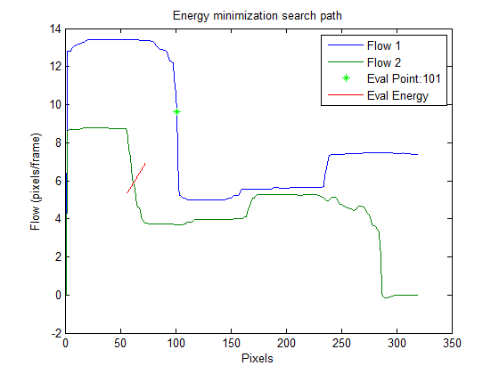
Optimization along epipolar lines

Slide 27
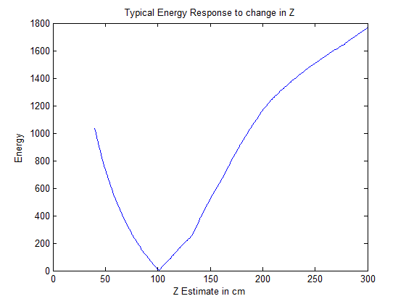
Energy vs. Z estimate

Slide 28

Optimization along epipolar lines

Slide 29
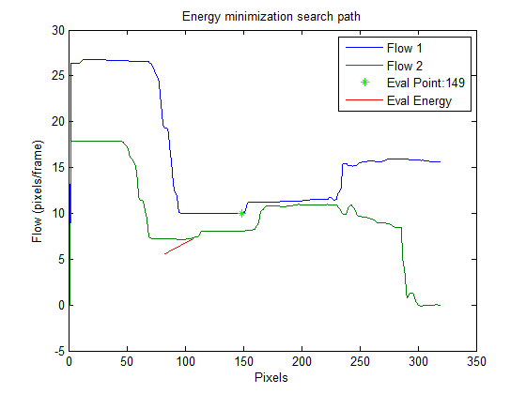
Optimization along epipolar lines

Slide 30
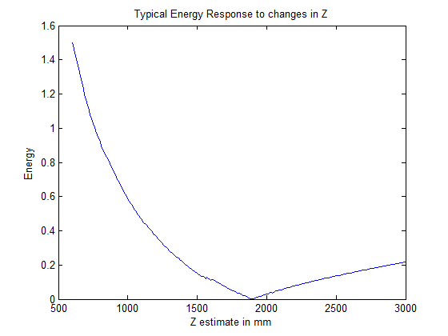
Energy vs. Z estimate

Slide 31
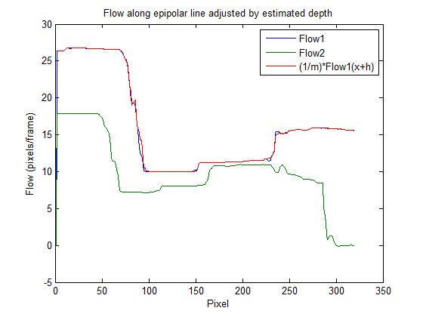
Results of optimization
RMS error = 0.078 pixels!!!
Notes:
Using m and c found using the gradient descent we warp the back flow to match the front flow.
The RMS error in the registration is surprising good and would translate into excellent 3D construction if the optical flow were ideal, but..

Slide 34
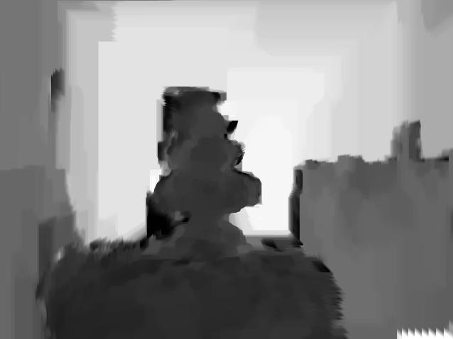
Notes:
depthMap_10_90_5_2
3D reconstruction with no pixel or feature based correspondences.

Slide 35
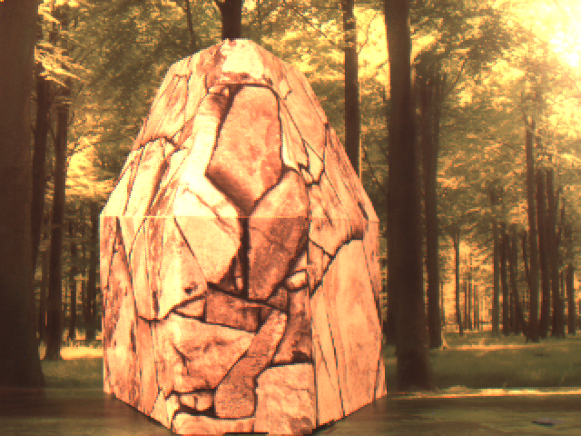

Slide 36
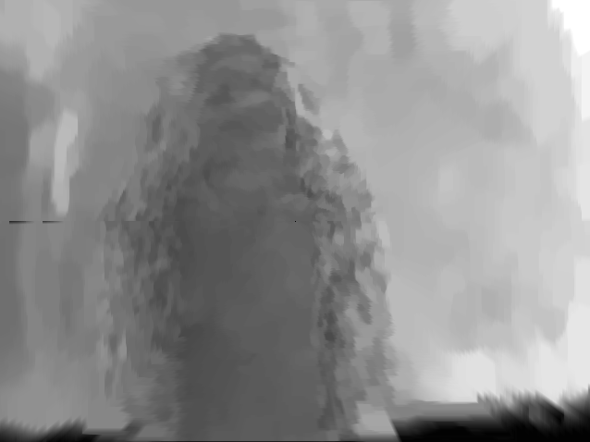
Notes:
depthMap-1-90-5-2
The mottled look comes from small variations in the optical flow, could be substantial removed by smoothing, but then you could lose some fine features.

Slide 37
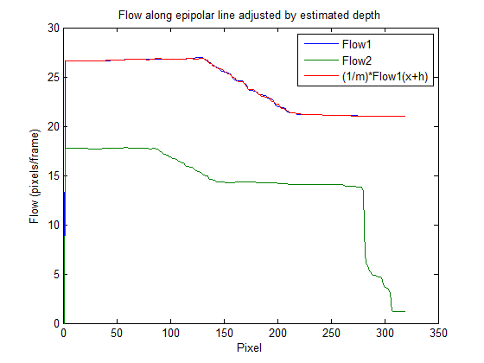
Notes:
depthMap-1-90-5-2

Slide 38
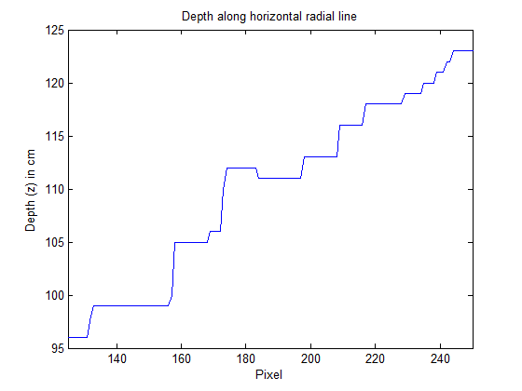
Notes:
depthMap-10-400-15-2

Slide 39
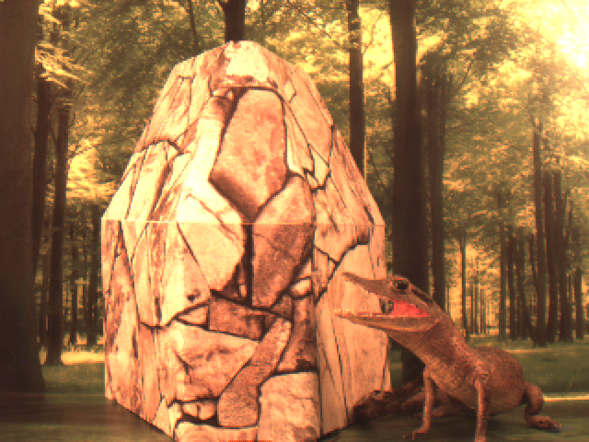

Slide 40
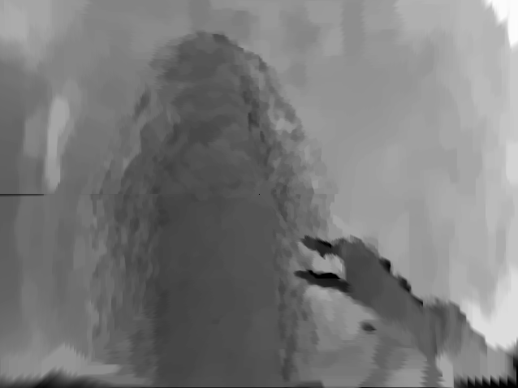
Notes:
depthMap-1-90-5-2
Fine features turn out surprising well.

Slide 41
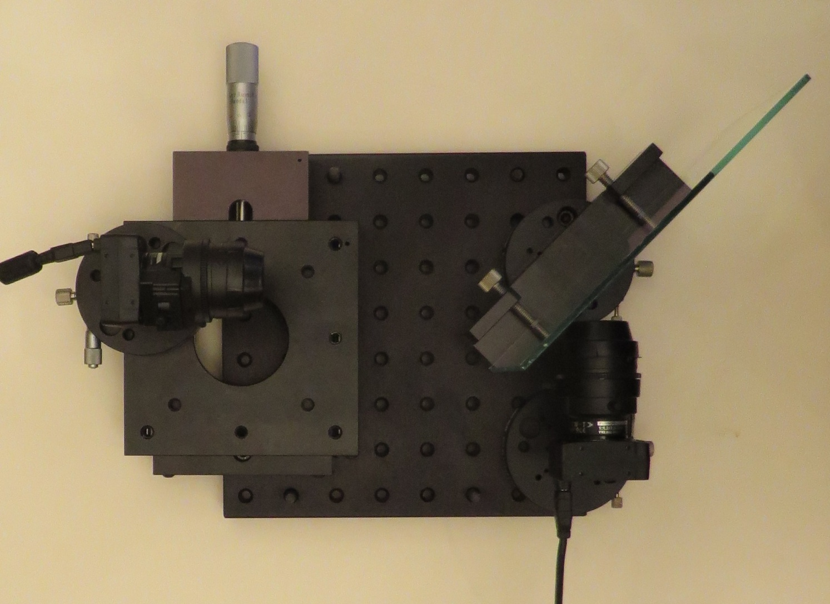
Camera Rig
Notes:
All the work was done on an optical breadboard with controlled movement using a large X-Y stage.

Slide 42
Conclusions
Overcomes the unrecoverable point problem with coaxial camera.
3D reconstruction is as good as the optical flow it is derived from.
Dense depth map without using intra-camera pixel/feature correspondences.
Sufficient for motion analysis of large smoothly deformable bodies, like skiers.
Notes:
Second point suggests that as optical flow improves this technique will get better as well.

Slide 43
Thank you and Questions

