Slide 1

Robotics Engineers
A SITE TO UPDATE YOU ON THE LATEST ROBOT TECH THAT HELPS
HUMANS AND/OR NATURE

Slide 2
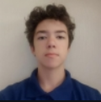
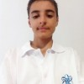


Meet our team!
Kaloyan Petrov – Scrum trainer
Ivailo Lalev - Developer
Gabriel Ianchev - Designer
Kristian Rusev - Developer

Slide 3






Used programmes

Slide 4
ALRIGHT, NOW LET'S JUMP INTO THE SITE!

