Slide 1
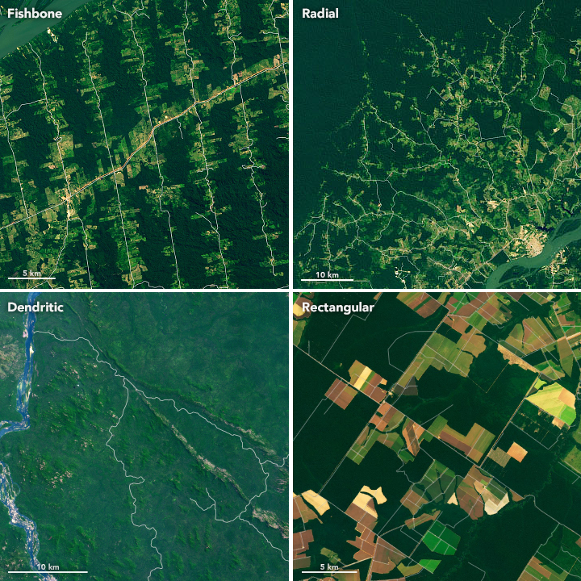

PROJECT PRESENTATION
IMAGE CLASSIFICATION – AMAZON FOREST
- KULDEEP SINGH

Slide 2
Contents
Description of Dataset
Methodology
Model Architecture
Result & Conclusion

Slide 3
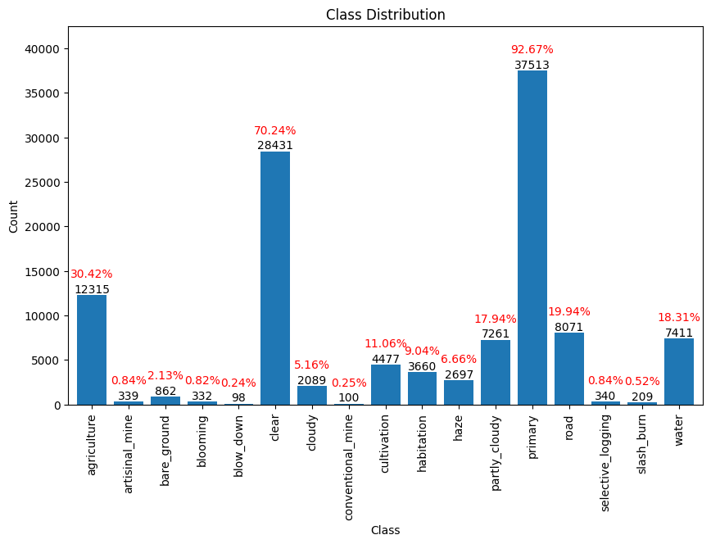
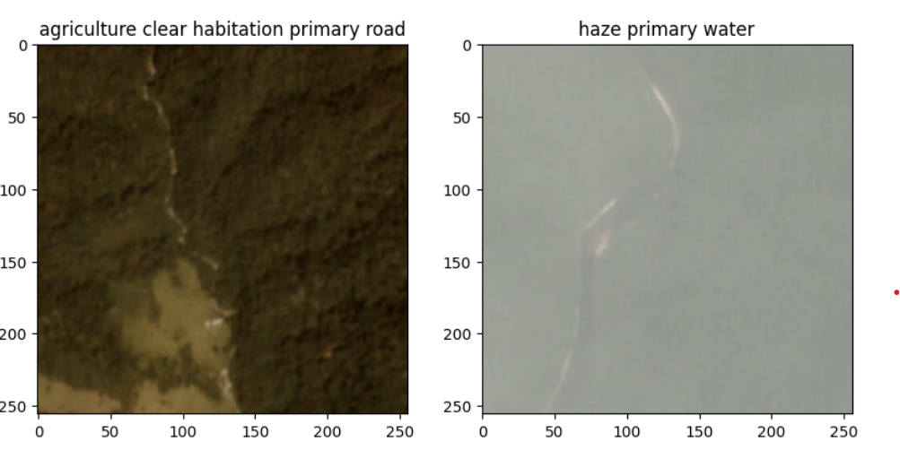
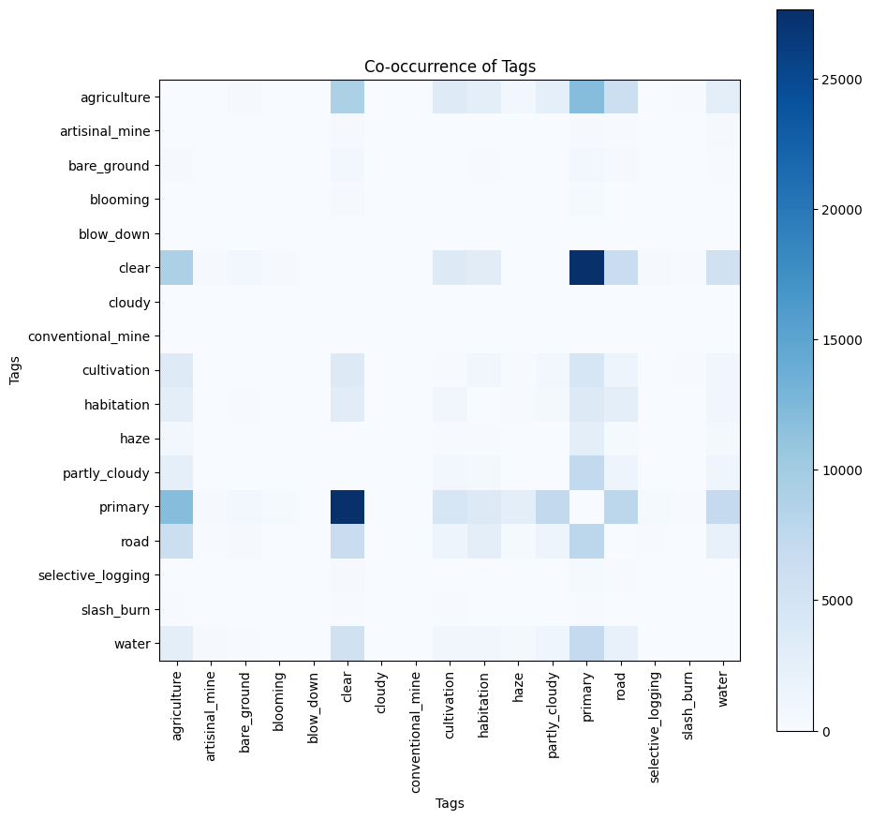
Dataset
40439 coloured jpg images of size 256 X 256
CSV file with multiclass labels
17 unique types of label

Slide 4
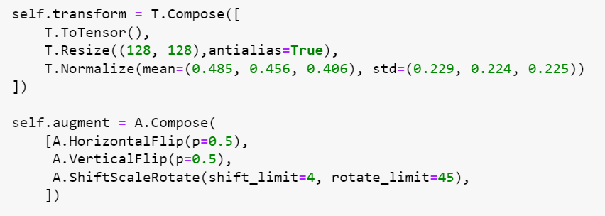
Methodology
Pre-processing
Loaded 40000 images into array
Converted labels to one hot vector of size 17
80:20 Train-Test split
Create Dataset class
- Pre-processing (augment only for train)
Create train and test Dataloaders
Models:
Vanilla CNN – 8,787,217 trainable parameters
Transfer Model with VGG16
Frozen upper layers – 2,106,385 trainable parameters
Unfrozen upper layers – All 134,330,193 trainable parameters
Hyperparameters
Loss - BinaryCrossentropy
Accuracy - Weighted Fbeta Score
Batch size - 128
Dropout - 0.5
Learning rate - 0.01/0.001
Optimizer – SGD
Epochs - 20

Slide 5
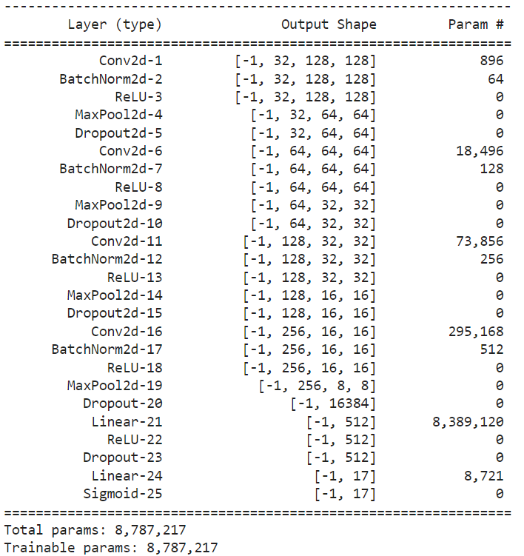
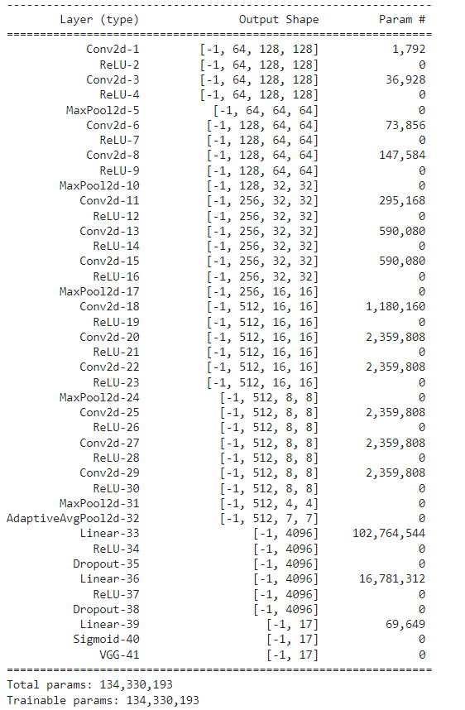
Model Architecture
Vanilla CNN
Transfer Model VGG16

Slide 6
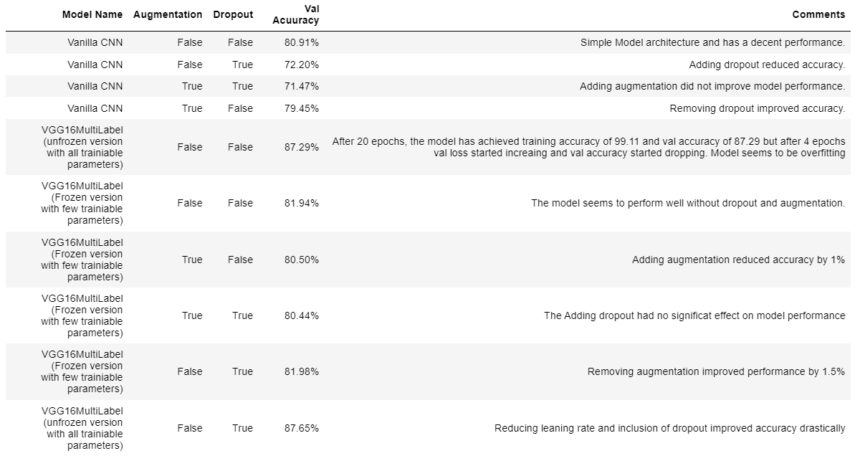
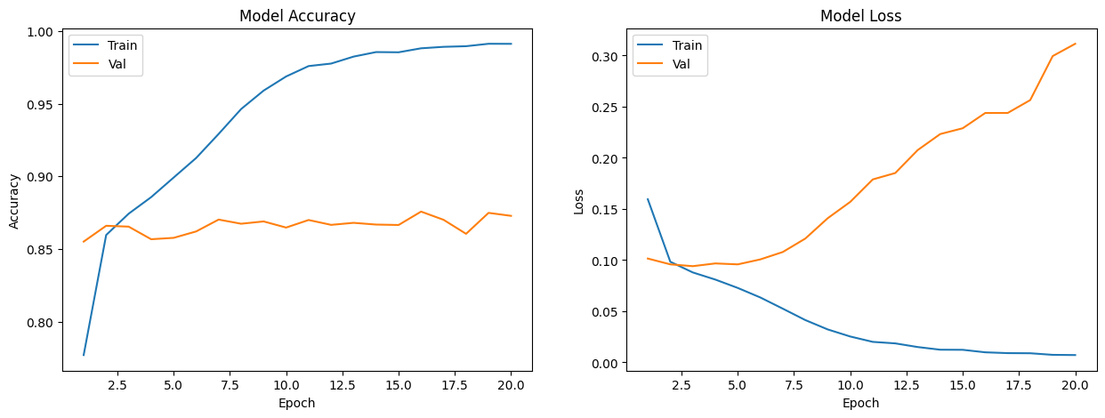
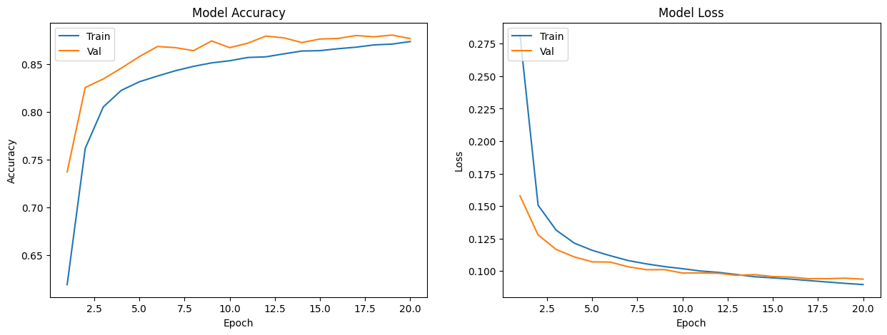
Results and Conclusion
Fit Function: fit(augmentation=True, transfer=True, use_dropout=True, opt=config['optimizer'], epochs=config['epochs’], lr=config['lr'])

Slide 7
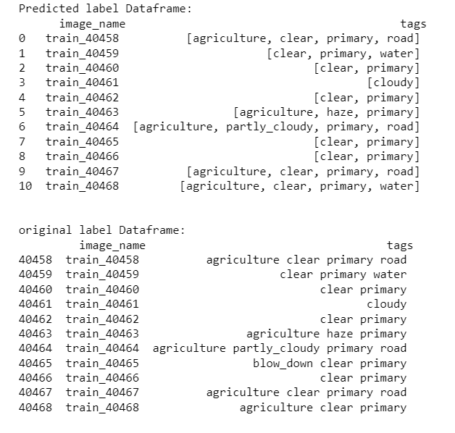
Visual Comparison of Results
Thank you !!

