Slide 1
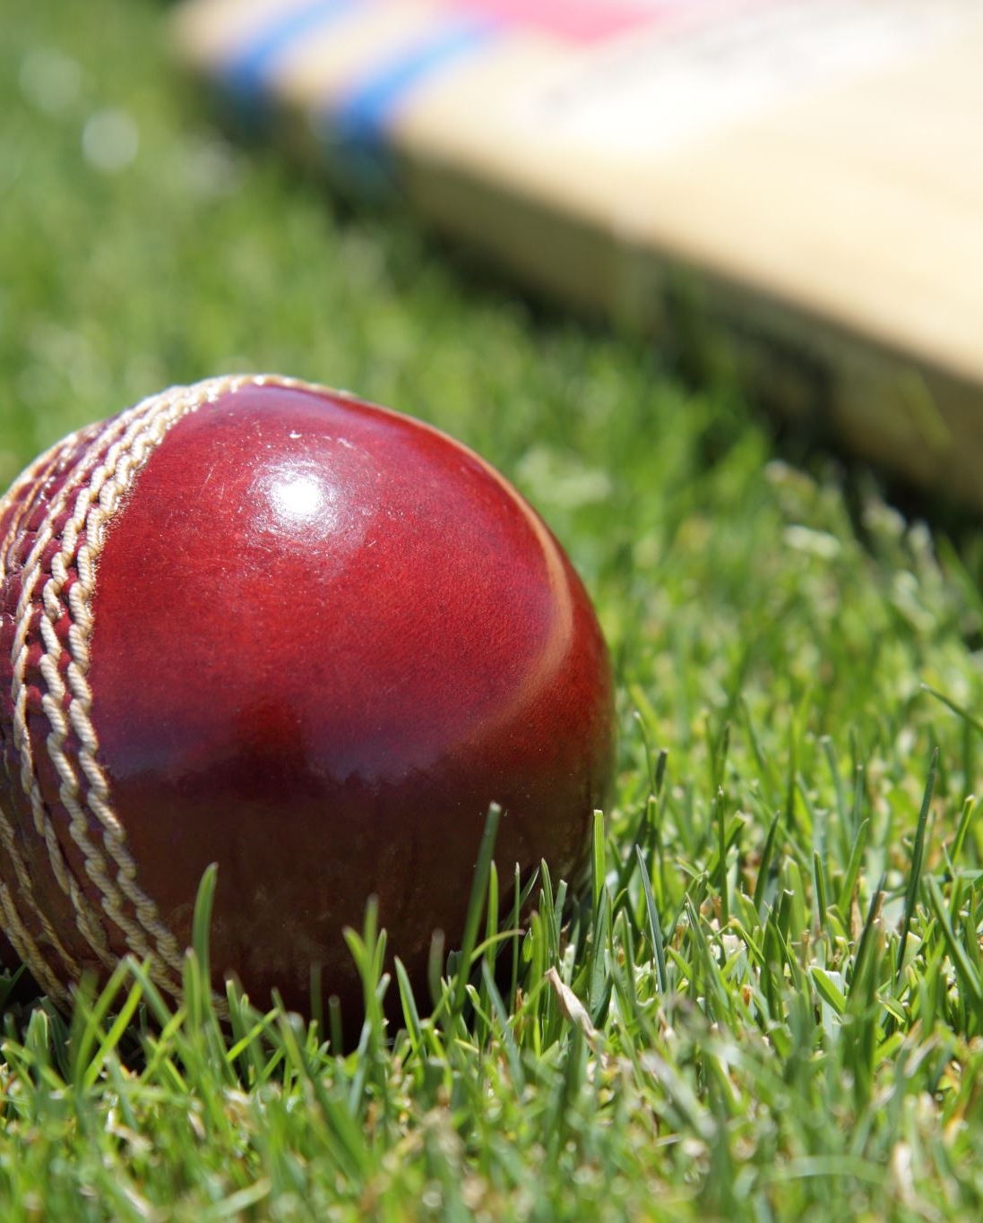
IPL DATA ANALYSIS
Done By: -
MTV Soumith(2010030097) Team Lead
C.Koushik Reddy(2010030027)
D.Chaitanya(2010030045)

Slide 2
Table of Contents
Introduction
Project Area
Literature survey
Analysis
Problem Statement
Methodologies and tools
Conclusion
Work Allocation

Slide 3
Introduction
In 2008, the BCCI launched the Indian Premier League (IPL), a 20-over cricket competition. IPL is a major professional cricket league in India, contested by eight teams representing different cities in India. This IPL analysis task focuses on analysing the performance of the eight competing IPL teams.

Slide 4
Project Area
We are going to use machine learning algorithms to set the matter of predicting match results supported historical matches information. ML is used to predict the match result variable by developing classification models based on certain freelance variables like player’s position, their batting and bowling performances, weather, location, etc.

Slide 5
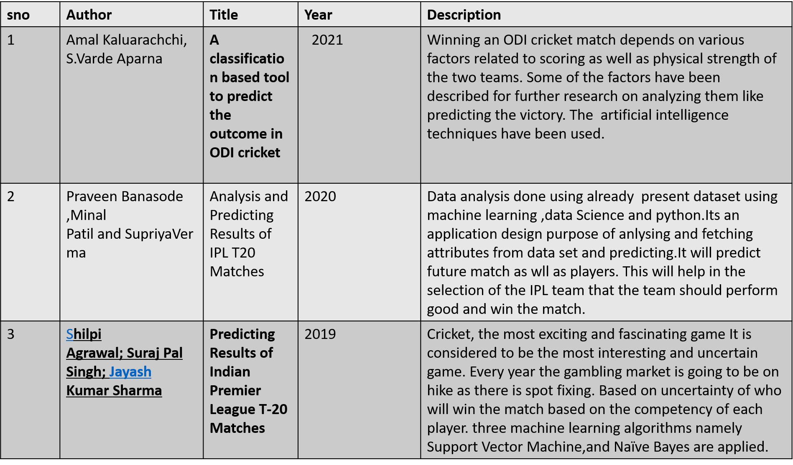
Literature Survey

Slide 6
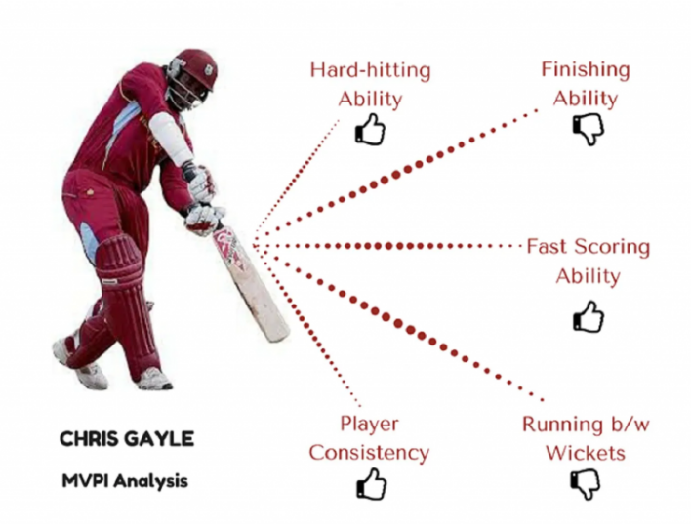
What we are going to analyze..?
Tosses and Matches won by each team
Stadiums with maximum match occurance
Count of bat/bowl decision by each team on winning the toss
Top run scorers
Number of matches played by each team
Probablity of winning the match by winning the toss
Percentage of teams electing to bat in every season
Number of man of the match awards received by each player
Strike Rate of batsmen
Average score of batsmen
Season wise wins of all teams

Slide 7
Problem Statement
In this analysis of IPL matches from 2008 to 2017 is done using python packages like pandas, matplotlib and seaborn. This Exploratory Data Analysis will help us to find patterns in data, determining relationships in data. We will try to identify the team that has more chance to win the upcoming seasons by finding observations like success rate of each team, identify the team that has won maximum seasons, best defending and chasing team and analyse the toss decisions etc.

Slide 8
Methodologies and tools
Data collection
Data Pre-Processing
Data Cleaning
Data Visualization
Python
Power-bi
Notes:
(These don’t have designer IDs since they were based off the default master slides already in the deck.

Slide 9
Conclusion
All this work aims at understanding the dataset of past 10 years history of the IPL data. Selection of the best team for a match plays a major role for the team’s finish. The main goal of our is to analyse the IPL cricket data and predict the end result of a match. Here, 2 classification algorithms are used.

Slide 10
Work Allocation
MTV Soumith: - Literature Survey
D. Chaitanya: - Dataset and Problem Statement
C.Koushik reddy :- Dataset and Problem Statement

