Slide 1
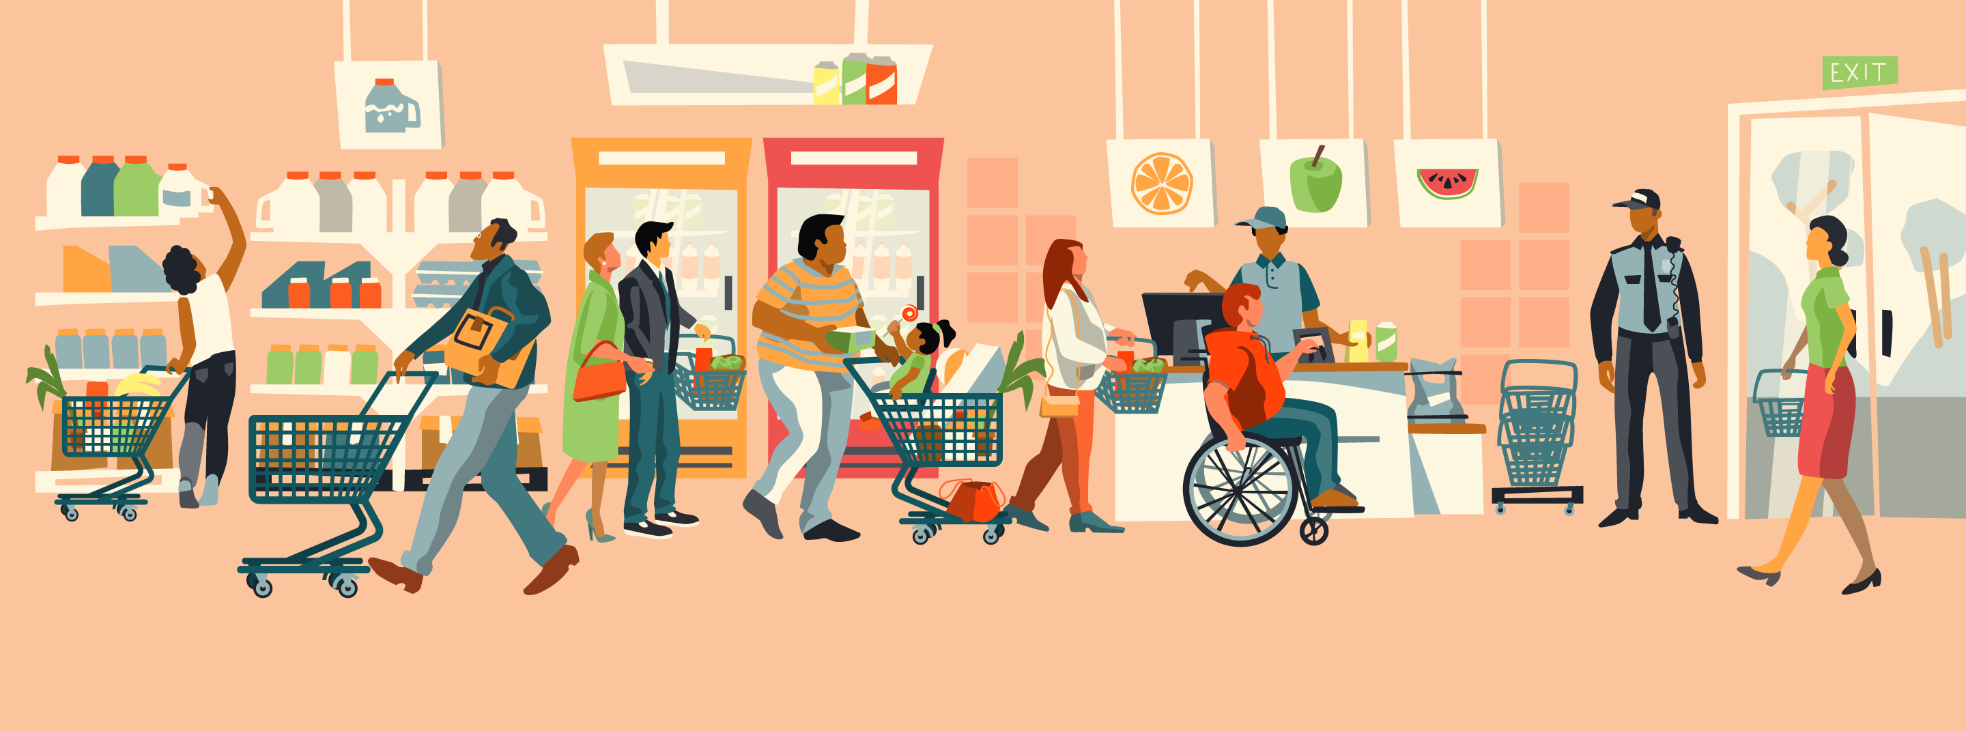
Done by:
C Koushik Reddy
TSS Subramanyam
PS Yeshwanth
Vaibhav Venkateswaran

Slide 2

Table of contents
Introduction
Literature survey
Project Area
Problem statements
Conclusion

Slide 3

What is Market Basket Analysis?
Introduction
Market Basket Analysis is a data mining technique it is commonly used by retailers for increasing their sales by analyzing the customer purchase patterns. Market Basket Analysis requires large amounts of data sets as we need to know the historical purchase data so that we can cluster items into different categories like which items are bought the most and which are bought the least and, we can analyze the products which are likely to be bought together. Instead of handwritten records digital records generated by point of sale(POS) system is very useful to perform analysis and get insights. To implement the Market Basket Analysis at the backend we need statistical analysis and data science.

Slide 4
S.no | Author name | Title | Description
1 | S. S. Al-Fahdawi and S. H. Ahmed | Survey of Market Basket Analysis Methods | Several market basket analysis methods, such as association rule mining, clustering, and sequential pattern mining, are thoroughly reviewed in this literature assessment. It also goes over their uses in many fields as well as their advantages and disadvantages.
2 | M. A. Al-"A Ghamdi | Study of Market Basket Analysis and Recommendations | An overview of market basket analysis methods and how they are used in the e-commerce sector is provided by this literature review. Additionally, it analyses the drawbacks and restrictions of market basket analysis and suggests some solutions.
3 | P. Singh and P. Kumar | Market Basket Analysis in Retail Industry: A Review | This review of the literature offers a thorough study of market basket analysis methods and retail business applications. It also covers the difficulties retailers have implementing market basket analysis and suggests some ways to get around those difficulties.
4 | M. A. Al-Ghamdi and M. A. Al-Rodhaan | A Study of Association Rule Mining for Market Basket Analysis | This review of the literature offers an overview of association rule mining methods for market basket analysis, such as FP-Growth, Eclat, and Apriori. It also goes over their uses in many fields as well as their advantages and disadvantages.
Literature Survey

Slide 5
The project area for a market basket analysis project would involve statistical analysis techniques such as association rules, clustering, and classification.
In a market basket analysis project, you would typically work with transactional data that contains information on customer purchases such as item codes, purchase dates, and transaction amounts. You would use statistical software such as R or Python to preprocess the data, analyze it, and visualize the results.
Some of the statistical techniques that you might use in a market basket analysis project include:
Association rules: These are rules that describe the relationships between products in a customer's basket. For example, a customer who buys bread is likely to also buy butter.
Classification: This is a technique that predicts which products a customer is likely to purchase based on their previous buying behavior. This can help retailers personalize their offers and promotions to individual customers.
Overall, a market basket analysis project would involve statistical analysis techniques that help identify patterns and relationships in customer purchasing behavior.
Project Area

Slide 6
Problem statement
Understanding how customers relate to the things they buy and seeing trends in their purchasing behaviour are typical problems for market basket analyses. The problem statement may call for more precise responses to issues like:
What are the most popular products in our shop?
Based on their purchase habits, are there any client segments that we can identify?
How can we use this knowledge to strengthen our sales and marketing tactics?
Can we determine which products a customer would most likely buy based on their past purchasing habits?
How can we best position products in the store to boost sales?
Finding these connections and patterns through market basket research will help to strengthen business plans, boost sales, and improve the entire customer experience.

Slide 7
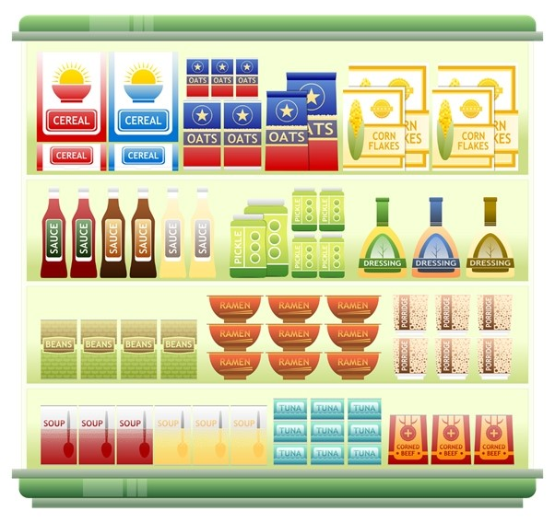
Conclusion
Market basket analysis is an unsupervised machine learning technique that can be useful for finding patterns in transactional data. It can be a very powerful tool for analyzing the purchasing patterns of consumers.

Slide 8
THANK YOU

