Slide 1
NITRiders
Experience
NIT Rourkela
Santanu Senapati : sntnsenapati@gmail.com
Arnab Paikaray : arnabgudu.gs@gmail.com
Ishaan Desai : ishaandesai48@gmail.com

Slide 2
Problem Statement :
E-Commerce sites are becoming highly popular for fashion and trends nowadays, but every year it tends to bear higher losses because of increasing returns, reverse pickup cost, and product verification cost.
Ill-fitting clothes due to size chart parity across different brands.
The product doesn’t meet expectations when not tried in person or bought by viewing catalogs.
Increased returns result in added costs and that ultimately leads to lagging back in competition among other E-Commerce sites.

Slide 3
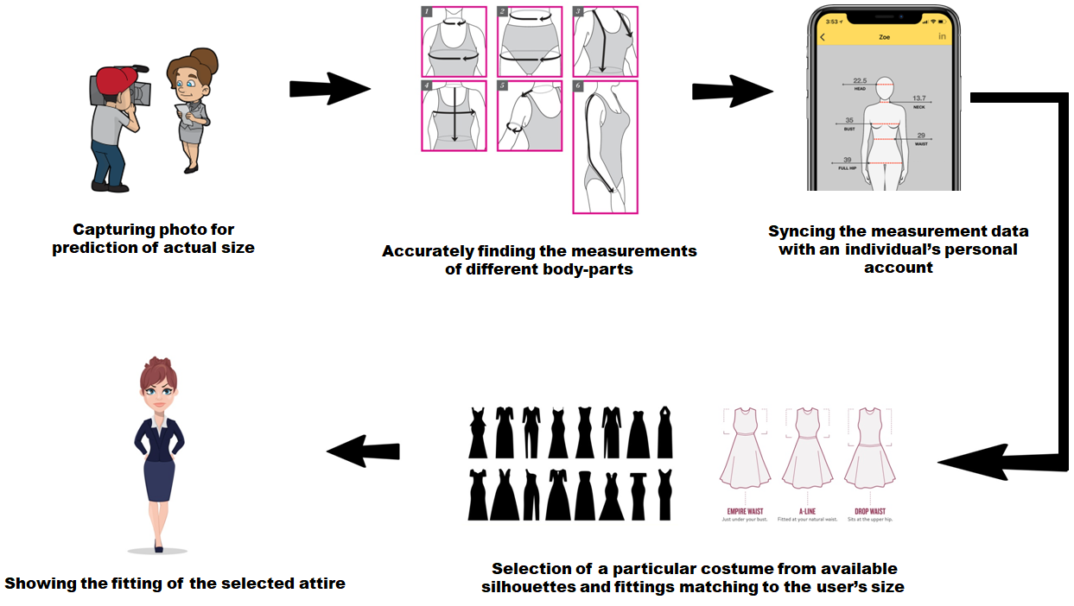
Proposed Solution :

Slide 4
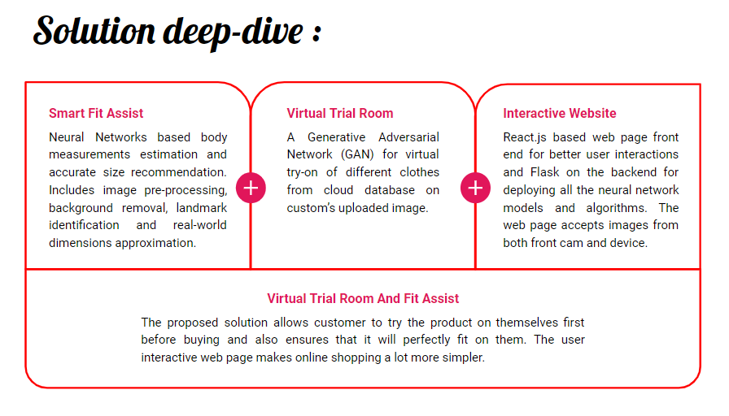

Slide 5
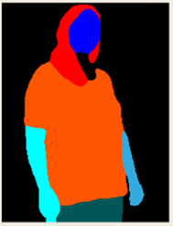
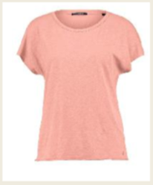
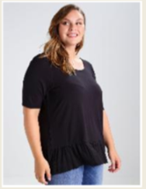
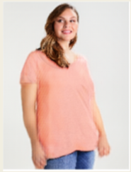
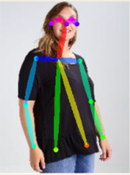
Selected garment
Performing image segmentation
Input photo of the user
Virtual try-on experience
Pose estimation of the user

Slide 6

Impact :-
Impact on E-Commerce sites:
Reduced returns, reverse pickup, and product verification costs.
Reduced time and investment in cataloging, hiring models, and crew to perform photo shoots for upcoming fashion events.
Provides edge over other competitors with smart technologies.
Impact on Customers:
Simplifies online shopping experience from home with interactive UI and Fit Assist.
Allow customers to virtually try-on clothes before purchase. The Fit assist will ensure they buy the right clothes that fit perfectly.
Lower added costs by the E-Commerce sites.

Slide 7
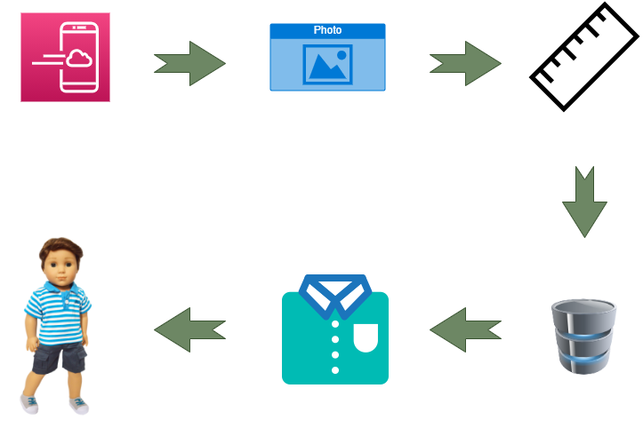
Implementation :
Web/App based platform
Uploading user’s photo
Predicting the measurements
Displaying the available options
Finding the best matching size
Cloth-fitting of the selected apparel

Slide 8
Thank You

