Slide 1
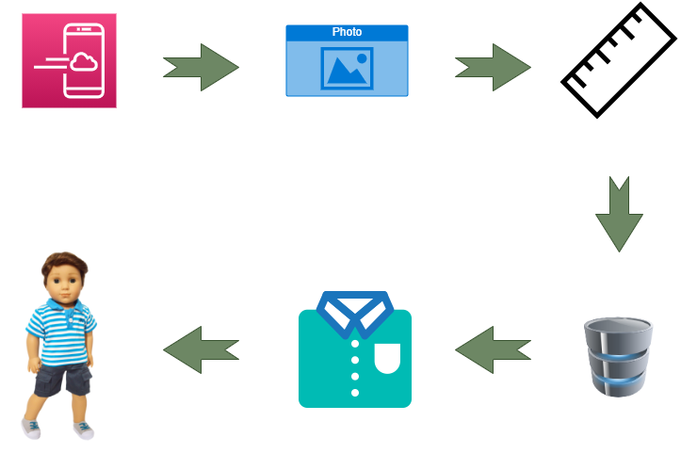
Solution Pipeline :
Web/App based platform
Uploading user’s photo
Predicting the measurements
Displaying the available options
Finding the best matching size
Cloth-fitting of the selected apparel

Slide 2
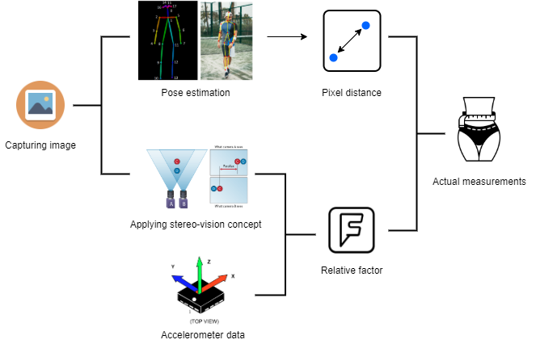
Size Estimation :

Slide 3
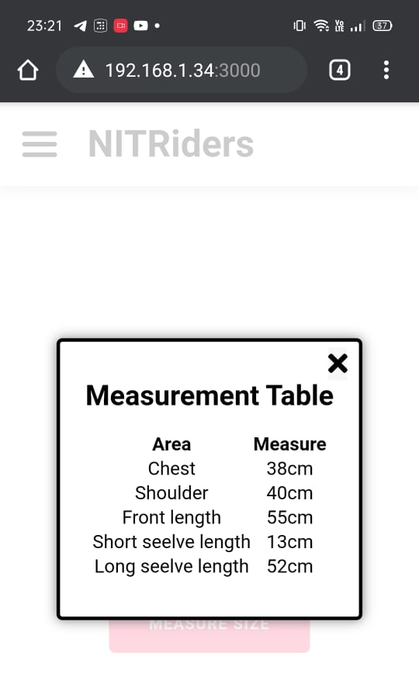
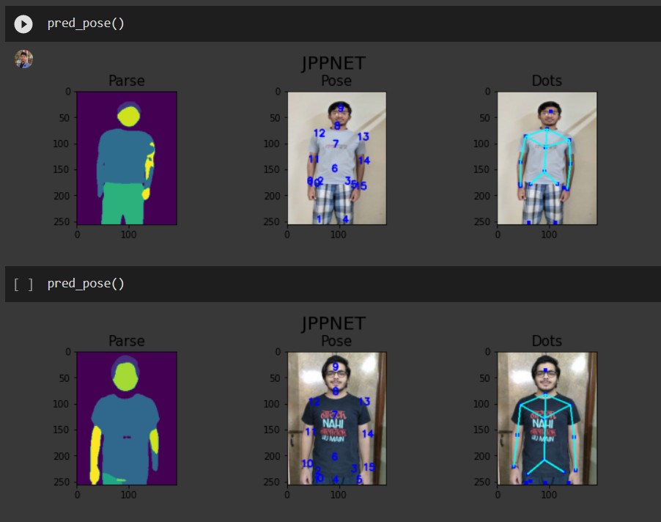
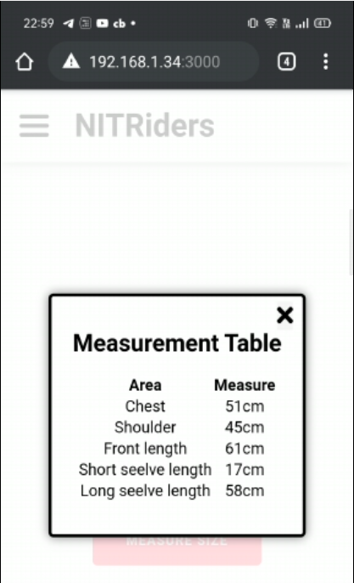
Size Prediction results :

Slide 4
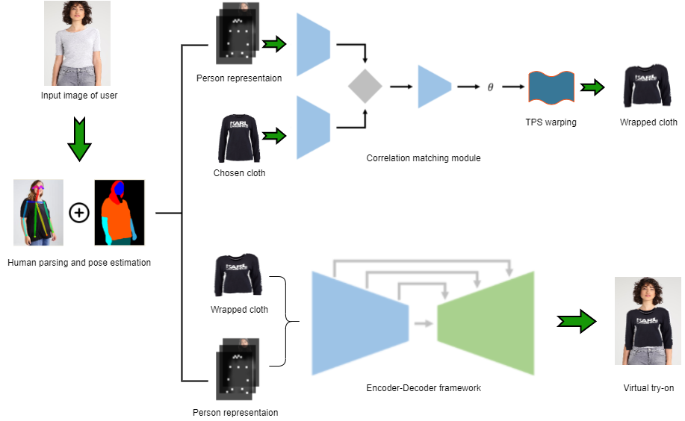
Cloth Fitting :

Slide 5
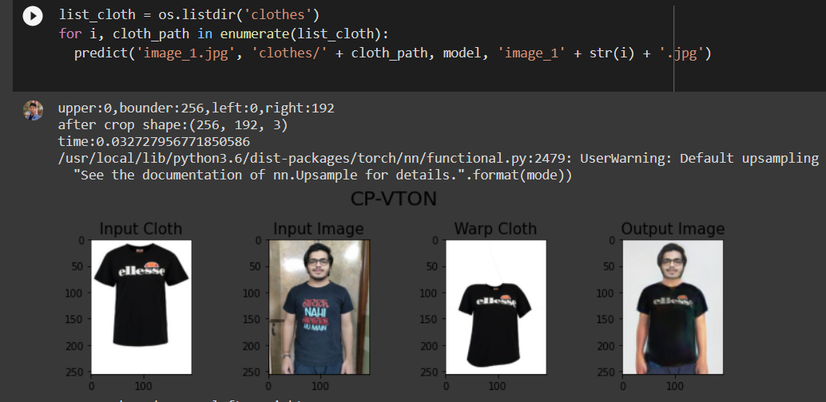
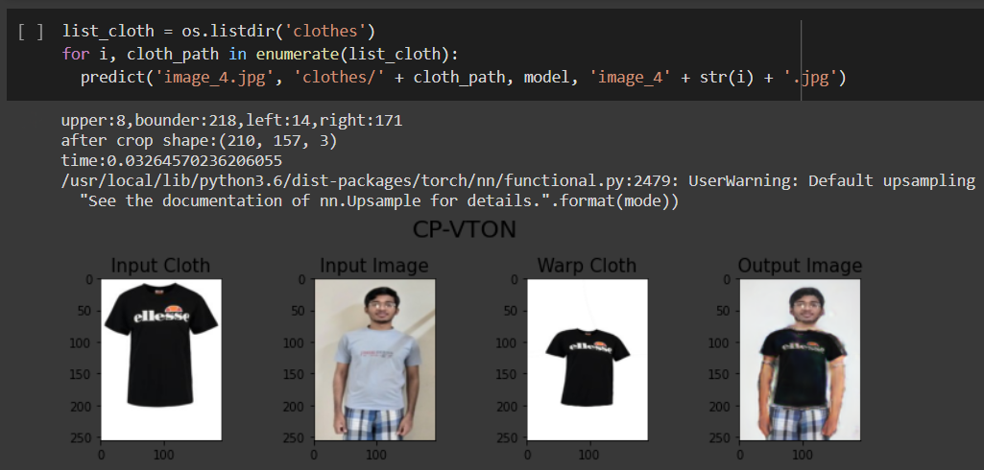
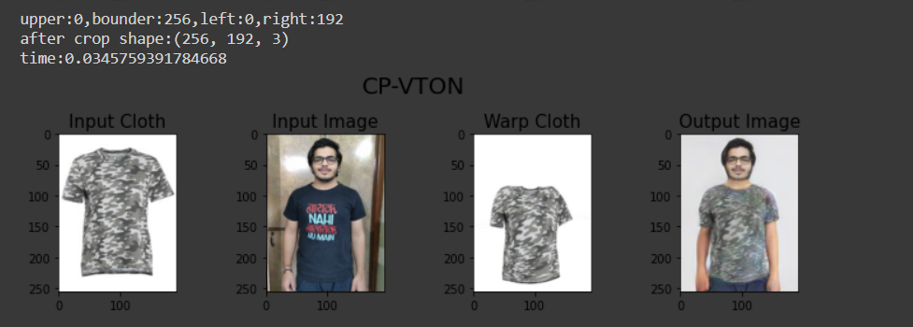
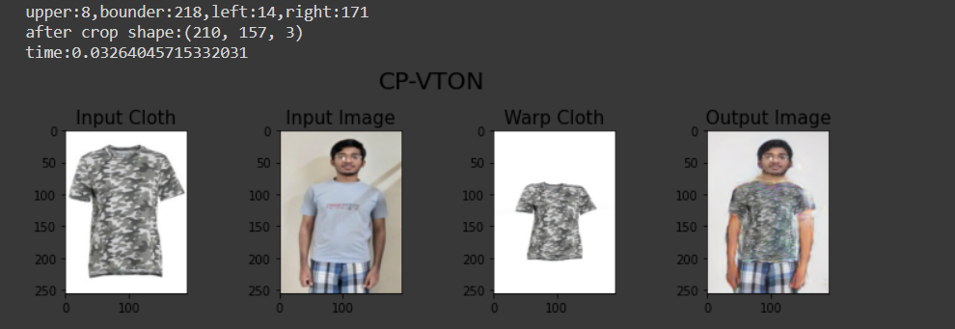
Virtual Try-ON results :
NOTE: The inference time for obtaining the output from this model is around 0.03 seconds which makes this approach to be implemented easily

