Slide 1



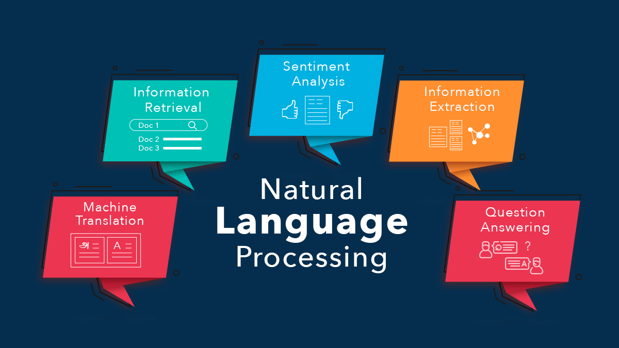
introduction to Natural language processing

Slide 2

Text Analytics
Introduction:
According to industry estimates, only 21% of the available data is present in structured form. Data is being generated as we speak, as we tweet, as we send messages on WhatsApp and in various other activities. Majority of this data exists in the textual form, which is highly unstructured in nature.
Few examples include – tweets / posts on social media, user to user chat conversations, news, blogs and articles, product or services reviews and patient records in the healthcare sector. A few more recent ones includes chatbots and other voice driven bots.
Despite having high dimension data, the information present in it is not directly accessible unless it is processed (read and understood) manually or analyzed by an automated system.
In order to produce significant and actionable insights from text data, it is important to get acquainted with the techniques and principles of NLP.

Slide 3
Text Analytics
Natural Language Processing:
usually shortened as NLP, is a branch of artificial intelligence that deals with the interaction between computers and humans using the natural language.
The ultimate objective of NLP is to read, decipher, understand, and make sense of human languages in a valuable manner.
NLP is a branch of data science that consists of systematic processes for analyzing, understanding, and deriving information from the text data in a smart and efficient manner.
By utilizing NLP and its components, one can organize the massive chunks of text data, perform numerous automated tasks and solve a wide range of problems.
such as – automatic summarization, machine translation, named entity recognition, relationship extraction, sentiment analysis, speech recognition, and topic segmentation etc.

Slide 4
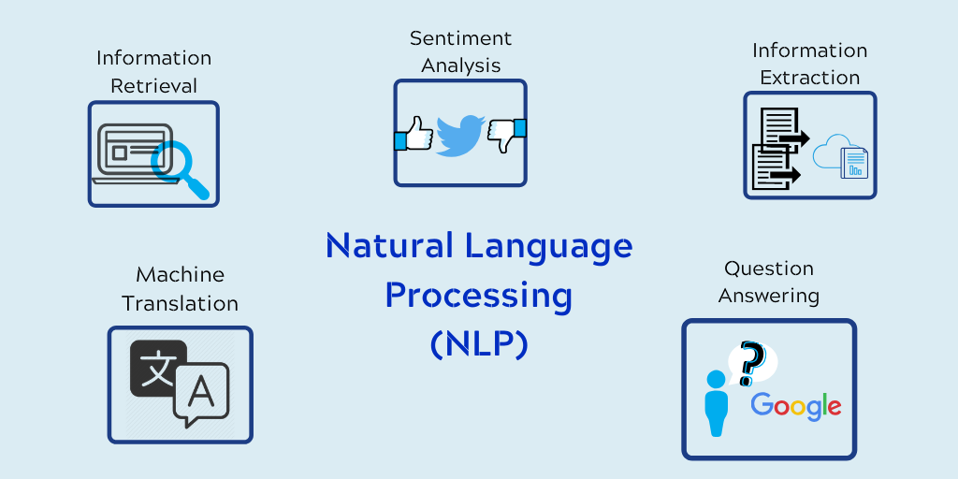
Text Analytics

Slide 5
Text Analytics
Text Preprocessing:
Since, text is the most unstructured form of all the available data, various types of noise are present in it and the data is not readily analyzable without any pre-processing.
The entire process of cleaning and standardization of text, making it noise-free and ready for analysis is known as text preprocessing.
Why text preprocessing?
As we know Machine Learning needs data in numeric form. We basically use the encoding technique (BagOfWord, Bi-gram, n-gram, TF-IDF, Word2Vec) to encode text into a numeric vector.
But before encoding, we first need to clean the text data and this process to prepare(or clean) text data before encoding is called text preprocessing, this is the very first step to solve the NLP problems.

Slide 6
Text Analytics
Types of text preprocessing techniques:
There are different ways to preprocess text. Here are some of the approaches that we should know such as
Lowercasing:
Lower casing is one of the simplest and most effective forms of text preprocessing.
It is applicable to most text mining and NLP problems and can help in cases where your dataset is not very large and significantly helps with the consistency of expected output.
Tokenization:
Tokenization is one of the most common tasks when it comes to working with text data. But what does the term ‘tokenization’ actually mean?
Tokenization is essentially splitting a phrase, sentence, paragraph, or an entire text document into smaller units, such as individual words or terms. Each of these smaller units is called a token.

Slide 7
Text Analytics
Stop words removal:
Stop words are a set of commonly used words in a language. Examples of stop words in English are “a”, “the”, “is”, “are” and etc. The intuition behind using stop words is that, by removing low information words from the text, we can focus on the important words instead.
Stemming:
Stemming is the process of reducing inflexion in words (e.g. troubled, troubles) to their root form (e.g. trouble). The “root” in this case may not be a real root word, but just a canonical form of the original word.
Lemmatization:
Lemmatization on the surface is very similar to stemming, where the goal is to remove inflexions and map a word to its root form. The only difference is that lemmatization tries to do it the proper way.
It doesn’t just chop things off, it actually transforms words to the actual root. For example, the word “better” would map to “good”. It may use a dictionary such as wordnet for mappings.

Slide 8
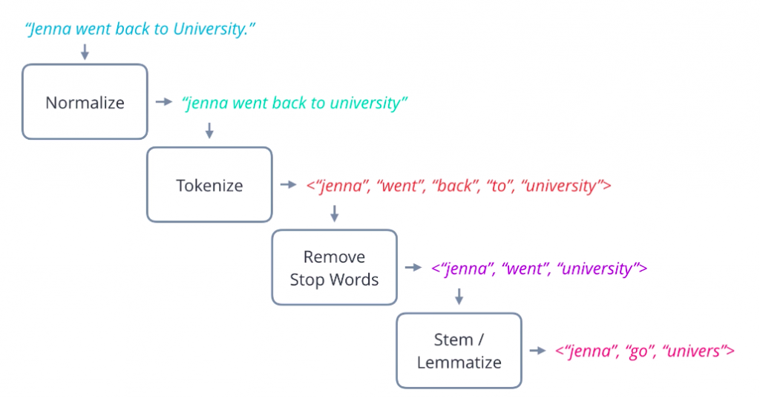
Text Analytics

Slide 9
Text Analytics
Stop words: are a set of commonly used words in a language. Examples of stop words in English are “a”, “the”, “is”, “are” and etc. The intuition behind using stop words is that, by removing low information words from the text, we can focus on the important words.
Code:
from nltk.corpus import stopwords
text = "the great aim of education is not knowledge but action“
words =text.split()
print(words)
stop_words = stopwords.words(‘english’)
no_stop_words = [word for word in words if word not in stop_words )]
print(no_stop_words )

Slide 10
Text Analytics
Tokenization: a technique that’s used to split the text into smaller elements. These elements can be characters, words, sentences, or even paragraphs depending on the application you’re working on.
To tokenize words, you can use the split() method that just splits text into white spaces, by default. This method doesn’t always give good results.
You are better off using NLTK’s tokenizer which handles various complexities of the text.
In NLTK, you also have different types of tokenizers present that you can use in different applications. The most popular tokenizers are:
Word tokenizer splits text into different words.
Sentence tokenizer splits text in a different sentence.
Tweet tokenizer handles emojis and hashtags that you see in social media texts

Slide 11
Text Analytics
Tokenization:
1. Word tokenizer:
document = "At nine o'clock I visited him myself. It looks like religious mania, and he'll soon think that he is God.“
from nltk.tokenize import word_tokenize
words = word_tokenize(document)
2. Sentence tokenizer:
from nltk.tokenize import sent_tokenize
sentences = sent_tokenize(document)
3. Tweet tokenizer:
from nltk.tokenize import TweetTokenizer
tknzr = TweetTokenizer()
tknzr.tokenize(document)

Slide 12
Text Analytics
Stemming: Stemming means reducing a word to its ‘root form’.
Stemming makes sure that different variations of a word, say ‘warm’, warmer’, ‘warming’ and ‘warmed,’ are represented by a single token - ‘warm’ because they all represent the same information (represented by the 'stem' of the word).
stemmer will convert all the variants of ‘drive’ and ‘racing’ to those root forms only. So, it will convert ‘drive’, ‘driving’, etc. to ‘driv’, and ‘race’, ‘racer’, etc. to ‘rac’.
Porter stemmer: This was developed in 1980 and works only on English words.
Code:
from nltk.stem.porter import PorterStemmer
stemmer = PorterStemmer()
stemmed = [stemmer.stem(token) for token in tokens]
print(stemmed)

Slide 13
Text Analytics
Lemmatization:
This is a more sophisticated technique (and perhaps more 'intelligent') in the sense that it doesn’t just chop off the suffix of a word.
Instead, it takes an input word and searches for its base word by going recursively through all the variations of dictionary words.
The base word in this case is called the lemma. Words such as ‘feet’, ‘drove’, ‘arose’, ‘bought’, etc. can’t be reduced to their correct base form using a stemmer.
But a lemmatizer can reduce them to their correct base form. The most popular lemmatizer is the WordNet lemmatizer created by a team of researchers at the Princeton university.
A lemmatizer is slower because of the dictionary lookup but gives better results than a stemmer. Now, as a side note, it is important to know that for a lemmatizer to perform accurately, you need to provide the part-of-speech tag of the input word.

Slide 14
Text Analytics
from nltk library
wordnetnltk.download('wordnet’)
# Importing the lemmatizer
from nltk.stem import WordNetLemmatizer
# Initialize the Wordnet
Lemmatizerlemmatizer =WordNetLemmatizer()
# Lemmatizing a single word
lemmatizer.lemmatize("dances")
# Initialize the Wordnet
wordnet_lemmatizer = WordNetLemmatizer()
# Lemmatizing multiple words.
lemmatized = [wordnet_lemmatizer.lemmatize(token) for token in tokens]
print(lemmatized)

Slide 15
Text Analytics
Bag-of-words representation:
The Bag of Words (Bow) model is the simplest form of text representation in numbers. Like the term itself, we can represent a sentence as a bag of words vector (a string of numbers).
After learning all the preprocessing steps such as tokenization, removal of stop words, stemming and lemmatization.
The next thing we need to learn is changing the text from a textual form to a tabular form.
It could be done using the bag-of-words representation, also called a bag-of-words model.
where each row of the table represents each document. And the columns represent the vocabulary of the text.

Slide 16
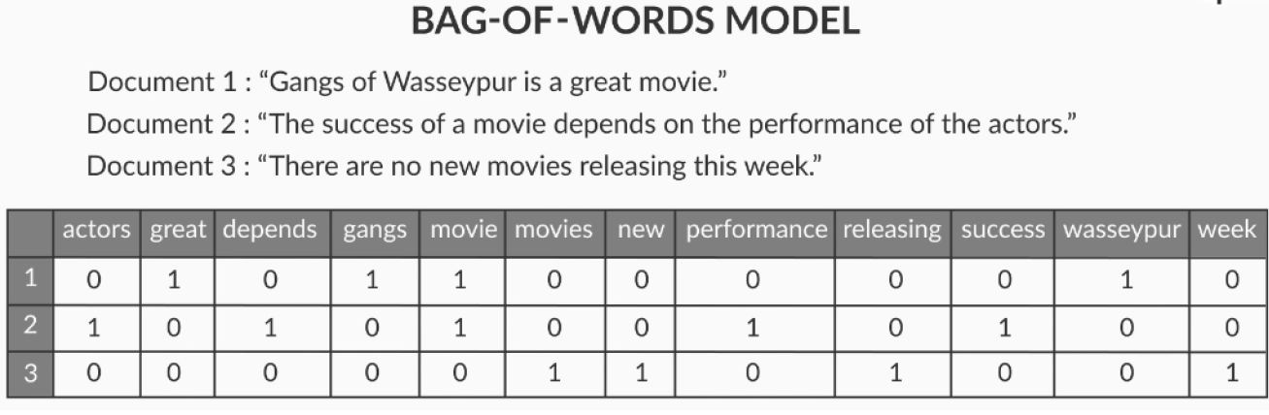
Text Analytics
Bag-of-Words Representation:
In the model, all the stop words have been removed.
The values in the cell represent the number of times a term ‘t’ is present in the document ‘d’, that is, the values represent the term frequencies.
example, the term ‘actors’ is has occurred a single time in document, whereas the term ‘great’ is absent in the second document.
You can also create a matrix with binary values – 0 and one where 0 signifies absence and 1 signifies the presence of the term in a document.

Slide 17
Text Analytics

Slide 18
Text Analytics
tf-idf model :
Instead of just having the word frequencies in the table that you created for the bag-of-words model.
you could have something that represents the word importance in a more meaningful way.
To calculate the tf-idf representation or tf-idf model, you need to calculate a tf-idf score for each word in each document.
The tf-idf score comprises of two terms – the ‘tf’ (term frequency), and the ‘idf’ (inverse document frequency).

Slide 19
Text Analytics
Code:

Slide 20
Text Analytics
Topic modelling:
The topic modelling task is to extract the 'topics being talked about in a given set of Documents.
Topic modelling is a method for unsupervised classification of documents, similar to clustering, topic modelling finds some natural groups of items (topics).
Latent Dirichlet Allocation(LDA) is a popular algorithm for topic modelling with excellent implementations in Python’s Genism package.
A technique used for topic modelling is Latent Dirichlet Allocation (LDA). an automated algorithm that can read through the text documents and automatically output the topics discussed.

Slide 21
Text Analytics
Basic idea:
Topics and their discovery.
The main idea being discussed in the text.
Identifying the topics discussed in the text.
This is the UN-supervised learning approach.
The input to a topic model is the corpus of documents, for e.g. a set of customer reviews, research papers etc.
There are two outputs of a topic model - 1. The distribution of topics in a document and 2. The distribution of words in a topic.
extract the volume and percentage contribution of each topic to get an idea of how important a topic is.

Slide 22
Text Analytics
LDA:
Each document is made up of various words, and each topic also has various words belonging to it. The aim of LDA is to find topics a document belongs to, based on the words in it.
In LDA, we assume that the document-topic and topic-term distributions are Dirichlet distributions (parameterized by some variables), and we want to infer these two distributions.
Generative process: each document is a distribution of topics and each topic is a distribution of terms.
Dirichlet Distribution: Both document-topic and topic-term distributions come from a Dirichlet distribution. (Distribution of a Distribution is a Dirichlet Distribution).
To summarize, the generative process is assumed to be as follows: For each term in a document, you first pick a topic from the document-topic distribution, then from the chosen topic, you pick a term from the topic-term distribution. You do this for all documents to create the corpus.

Slide 23
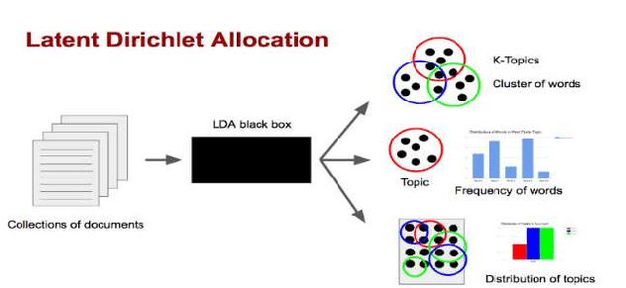
Text Analytics

Slide 24
Text Analytics
Python Implementation:
Once cleaning and pre-processing are finished.
Preparing document term matrix is the next step. First, it need corpus as a dictionary of id word mapping (identifiers for the words), also needs corpus as a term frequency matrix.
The (3, 7) represents the fact that the word with id=3 appears 7 times in the document.
Feed your model with the data.
Build your model. (parameters are important inside your function – number of topics – we define upfront, Choose a number of topics, start with 10 and improvise.
Measure coherence score – if in a topic the words are very related and occurring together then that topic is coherent. A score is between 0 and 1. here 1 is the best and 0 is bad.

Slide 25

THANK YOU

