Slide 1

Product: Senior Wellness
Authored by the team:
Sai Tarun Kovelamudi
Aishwarya Borde
Gladwin Isaac
FUXI401 – Capstone Project UX/UI & Product Design

Slide 2
OBJECTIVE

Slide 3
APPROACH

Slide 4
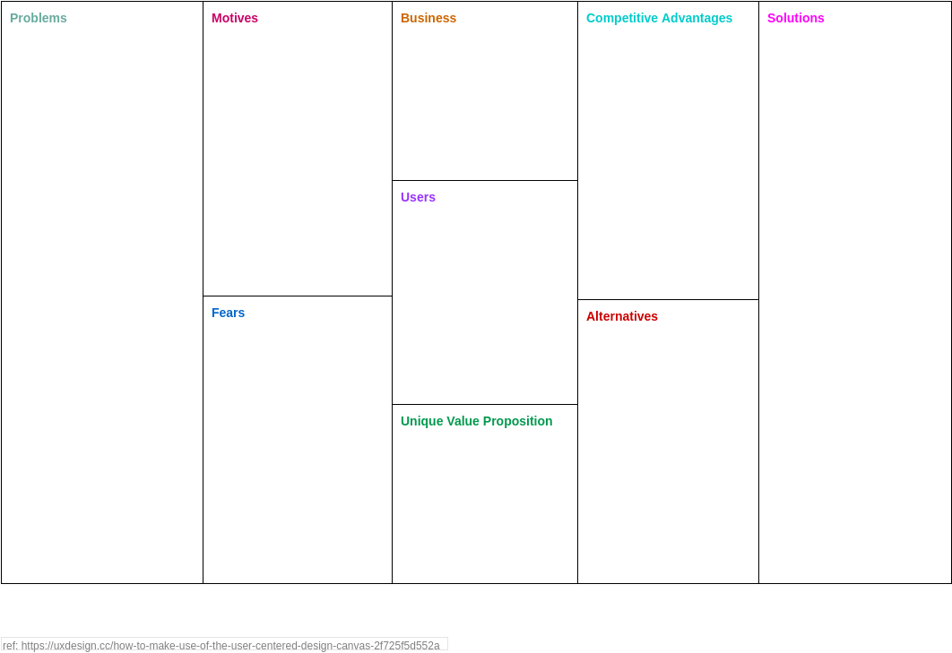

PHASE 1 – STRATEGY – USER CENTRIC DESIGN (UCD) CANVAS
Checking the health parameters regularly by visiting the doctor.
Monitoring blood sugar levels regularly for someone who is diabetic.
Keeping a log of blood sugar levels regularly after check-up.
Aassistance's in case of emergencies or occasional support as needed.
Visiting hospitals for each and every health parameter checkup regularly.
Tracking sleep patterns
Could not predict the health issues.
Falling unconscious sometimes and could not notify anyone.
In case of an emergency, alerting emergency services or caretaker could be life saving.
Promote senior citizens health, well-being, and independence.
By incorporating health monitoring features, medication reminders, and emergency assistance, the smartwatch and app aim to help seniors maintain an active lifestyle while ensuring their safety.
Smartwatch + mobile app that seamlessly syncs data with good user experience. The smartwatch should track health and fitness metrics. The mobile application should enable users to get notified and view data.
Intuitive and user-friendly interface to meet the needs and preferences.
The emphasis on health monitoring, medication management, fall detection, and emergency assistance features.
Integration with caregiver support.
Remote monitoring, real-time alerts.
Smart watch:
Tracking heartrate, Blood pressure, Step count, Tracking ECG, Tracking sleep patterns, fall detection, Emergency alert, Monitor Glucose reading in real-time.
Mobile Application:
App collects data from smart watch.
Prediction of unusual activity.
Manage medications effectively.
Turn on camera automatically during fall detection to capture images.
Automatically Capture images via smart watch during unconscious time and detect indoor or outdoor environment.
Access to health data, location tracking, and alerts in case of emergencies.
Users of the product are senior citizens and their partners, relatives, caregivers or their children
Using the smartwatch and app will be complicated.
Ability to learn and adapt to new technology.
Assurances regarding privacy and security.
Worry about unintentionally causing disruptions.
Accuracy and reliability of health monitoring features or emergency assistance.
Generic smartwatches
Health Monitoring Devices: Standalone health monitoring devices.
Dedicated Monitoring Systems at Home: These systems often include wearable devices or sensors in the home.
A smart watch + App Users will have Improved health outcomes, It has an intelligence of Fall detection & alerts, Users can Enhance their quality of life.

Slide 5
USER INTERVIEWS

Slide 6
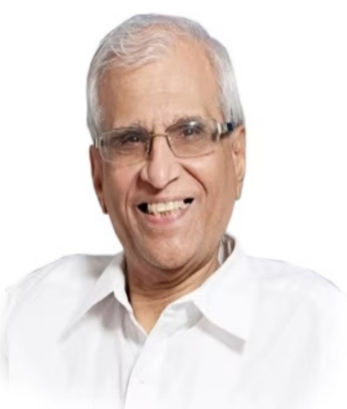
STRATEGY – TARGET USER PERSONA
Bio
Mr Raja is a 63-year-old retired accountant who lives in a quiet suburban neighbourhood with his wife of 40 years,
he suffers from diabetes. He walks daily and eats healthy. He wants to monitor his health regularly, so he is interested in using a smartwatch, he may want to consider one that is designed specifically for seniors and offers features such as fall detection and emergency alerts.
Pain points
Aassistance's in case of emergencies or occasional support as needed.
Keeping a log of blood sugar levels regularly after check-up.
Checking the health parameters regularly by visiting the doctor.
Behaviours
Raja
Raja takes a proactive approach to his health by monitoring it closely and seeking regular check-ups with his doctor.
He maintains a healthy lifestyle by eating a balanced diet, exercising regularly, and getting enough sleep.
He tracks his exercise and diet using fitness tracker, to ensure he is meeting his health goals.
Age
35
Gender
Female
Status
Married
Goals and Aspirations
To track physical activity and monitor heartrate, BP, Sleep, sugar level & other health parameters.
Utilising wearable technology to monitor health.
Assistance from someone in case of an emergency situations.
Alerting nearby relatives or partner or emergency services during emergency could be lifesaving.
Location
Hyderabad

Slide 7
CUSTOMER JOURNEY

Slide 8
USER FLOW

Slide 9
CARD SORTING

Slide 10
USER STORIES

Slide 11
WIRE FRAME

Slide 12
PROTO TYPE

