Slide 1


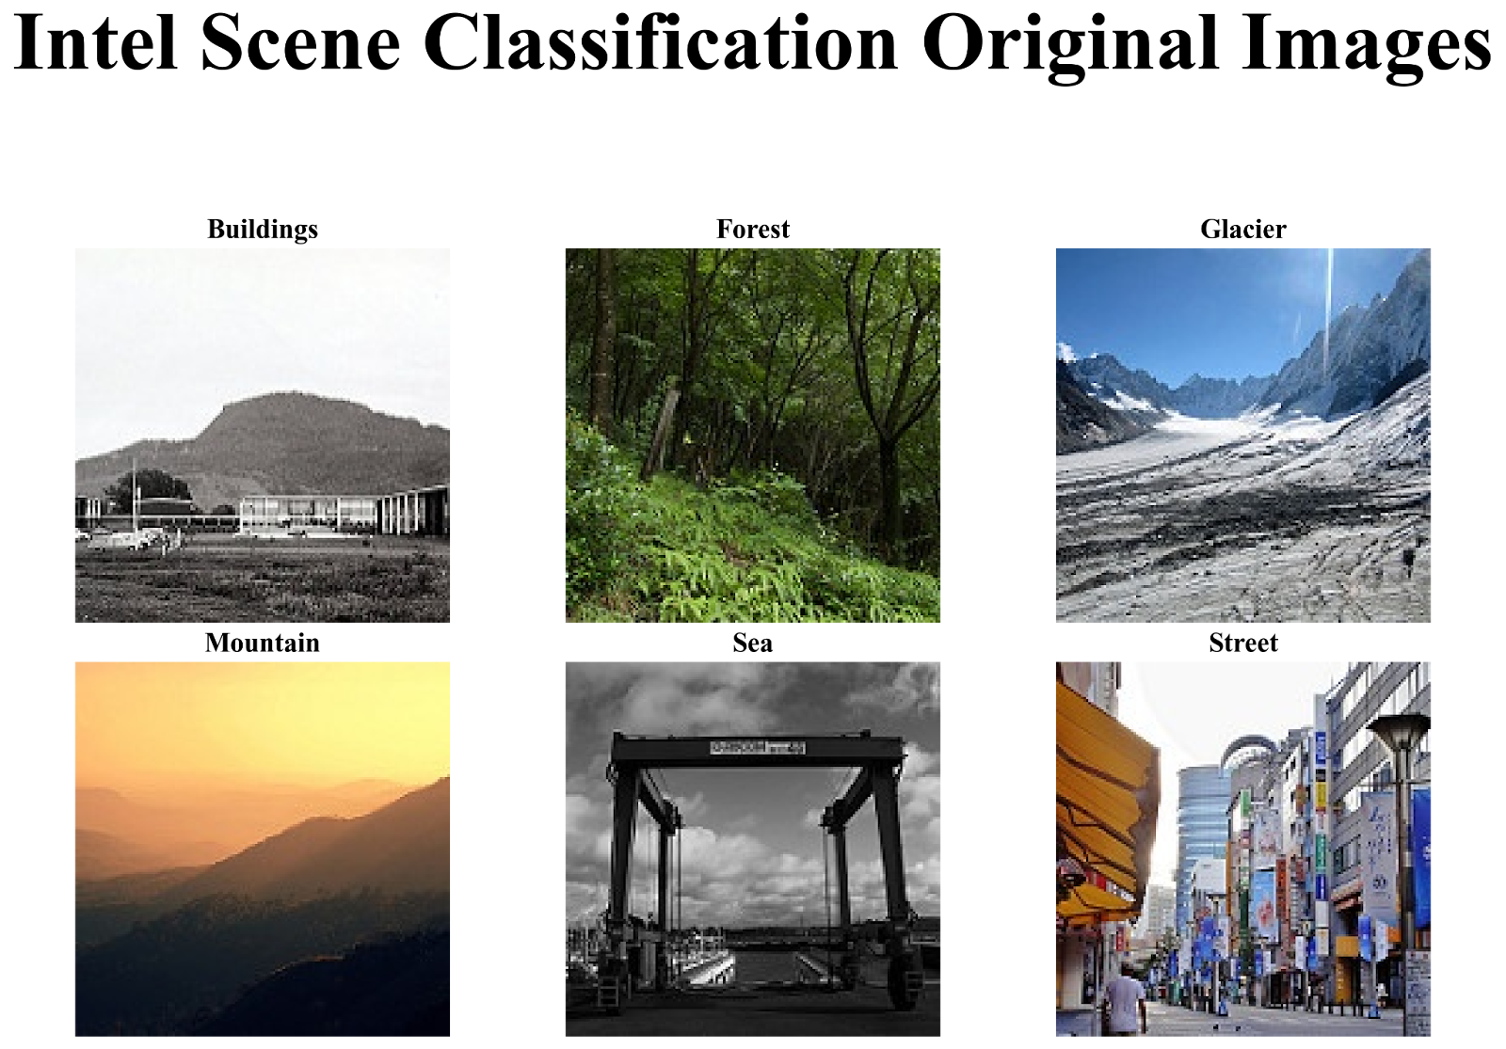
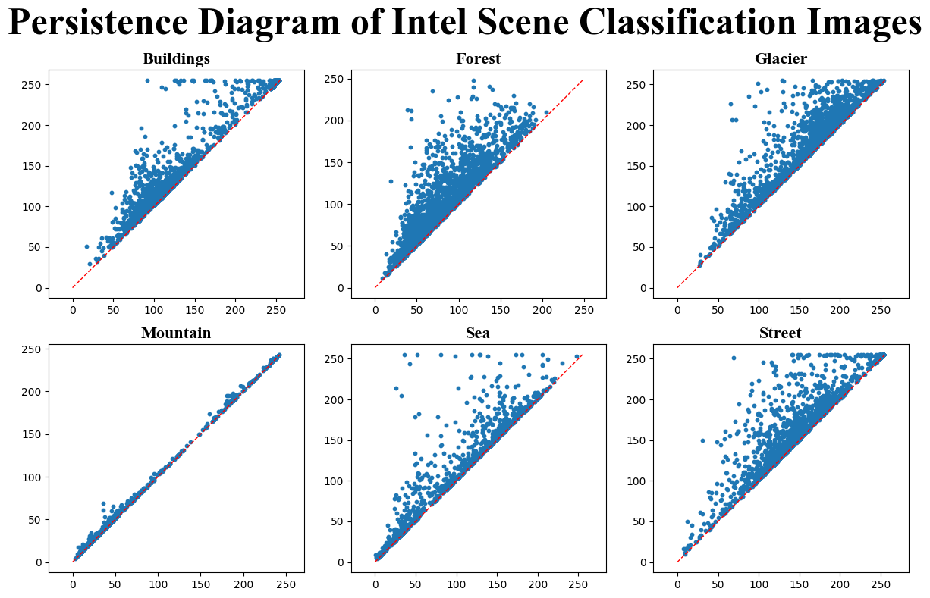
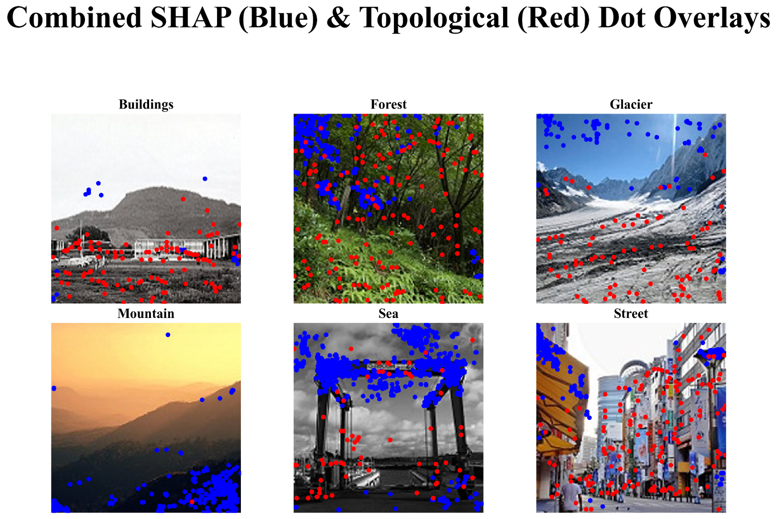
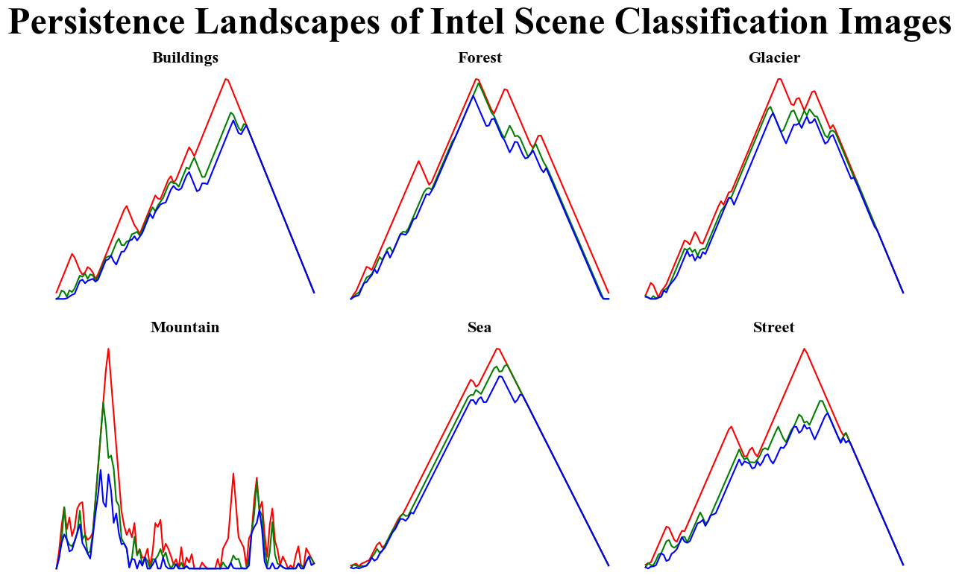
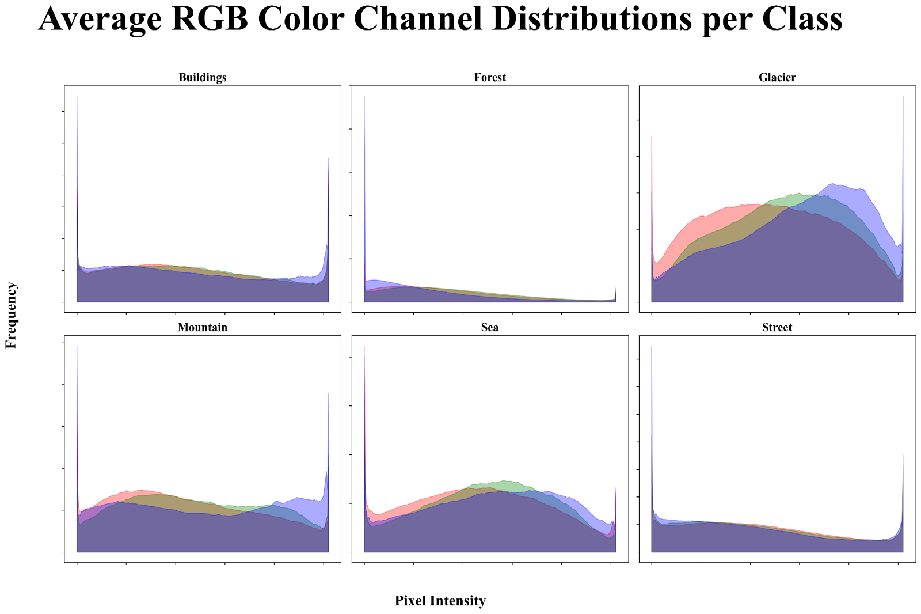
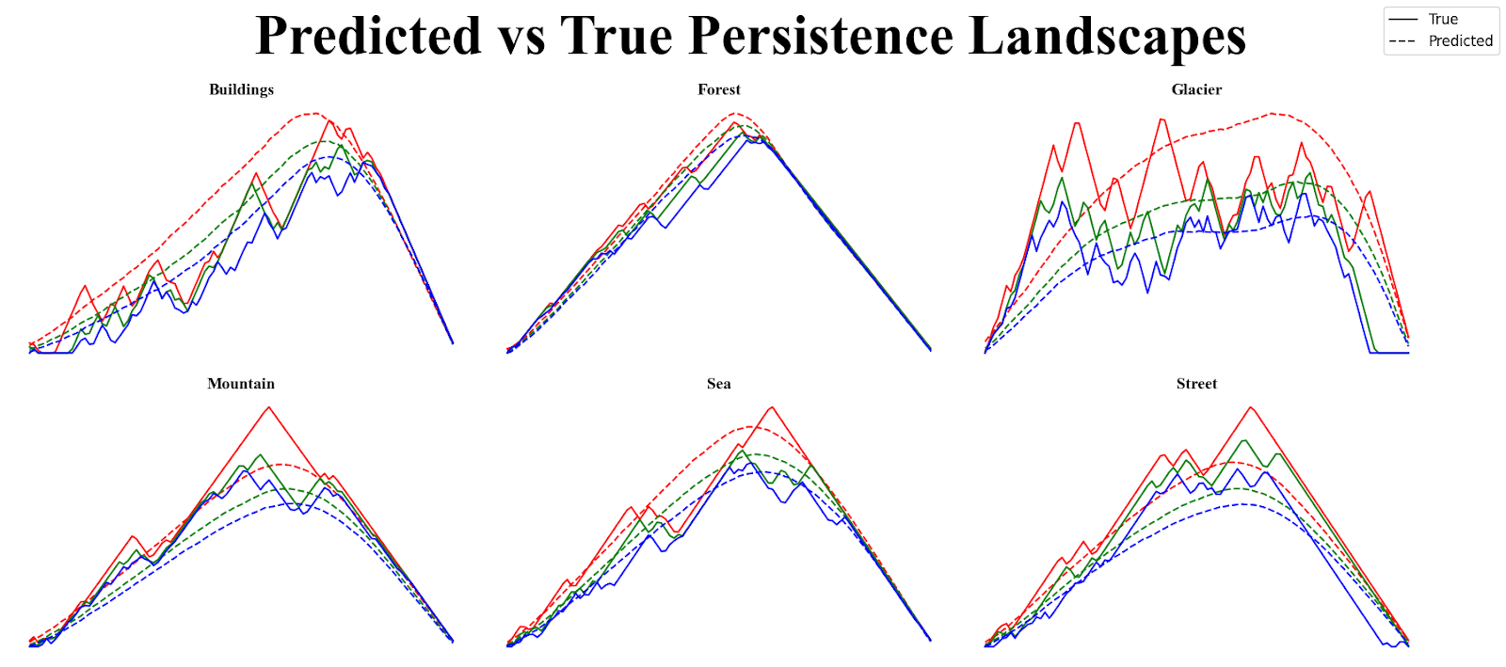
SHAP-Explainable Image-to-Topology Regression
Charles Fanning
Supervisor: Dr. Bin Luo
INTRODUCTION
METHODS
RESULTS & DISCUSSION
Figure 1. Samples from the Intel Scene Classification dataset, each from one of the six scene categories: Buildings, Forest, Glacier, Mountain, Sea, and Street.
Figure 3. Persistence diagrams for one representative image from each class in the Intel Scene Classification dataset. Each point represents the birth and death times of a topological feature, plotted on the horizontal and vertical axes, respectively.
Figure 5. SHAP explanations for images from the Intel Scene Classification dataset. Pixels with SHAP values above a threshold are marked with dots (blue). Topological hole locations from persistent homology. Red dots mark pixels corresponding to 1-dimensional features (holes) with lifetimes above a threshold. Combined overlay of SHAP (blue) and topological (red) dot positions for each scene category.
Intel Scene Classification Dataset
~25,000 color images of natural and urban scenes
Six categories: Buildings, Forest, Glacier, Mountain, Sea, Street
Most images are 150 × 150 pixels (minor outliers excluded)
Originally released for an Analytics Vidhya challenge by Intel
Commonly used for scene classification benchmarks
Pre-split into: • ~14,000 training • ~7,000 validation • ~3,000 test
Discussion
The predicted persistence landscapes from the DenseNet‑121 model are significantly different from those produced by persistent homology. The persistence landscapes generated through persistent homology are rigid and exhibit many local minima and maxima. The predicted ones tend to be smoother and either unimodal or bimodal.
There is also very little overlap between the SHAP-identified pixels (blue) and the locations of 1-dimensional topological features — holes (red) across all scene categories. This implies that the deep learning approach is influenced far less by the regions that are directly contributing to persistence and far more by unrelated pixels.
There are also significant differences in threshold behaviors between the two approaches. The number of persistent features — features that contribute significantly to persistent homology — vary independently of each other. That is, the number of persistent features detected via SHAP is not determined or even dependent on the number of persistent features determined by persistent homology.
Figure 4. Persistence landscapes for representative images from each class in the Intel Scene Classification dataset. Each plot shows the first three landscape functions.
Future Directions
With our current implementation, it is computationally infeasible to compute SHAP values for all validation or test images for a complete comparison. However, doing so would allow for a quantitative comparison between SHAP-based explanations and persistent homology–based ground truth.
Future work could involve quantifying the error between importance masks using each method. From there, we could not only quantify overall differences but also compare class-wise differences.
Figure 2. Average pixel-intensity histograms for the Red, Green, and Blue channels across the entire dataset.
Sources
Motivation
Previous work has used deep learning models to predict persistent homology–based representations of data. However, we still are not sure whether these models actually learn topological structure or are just overfit to the output vectorization. We evaluate this by analyzing which input regions most influence the predicted persistence landscape using SHAP.
We train a DenseNet‑121 model to predict 300-dimensional persistence landscape vectors derived from cubical filtrations on grayscale versions of scene images. We then compare the SHAP attribution maps to the hole locations extracted from persistent homology alone.
Figure 5. Predicted vs. true persistence landscapes for representative images from each class in the Intel Scene Classification dataset. Each plot shows the first three landscape functions (red, green, and blue, respectively), with the model’s predicted curves (solid) compared to the ground truth (dotted).
Code

