Slide 1


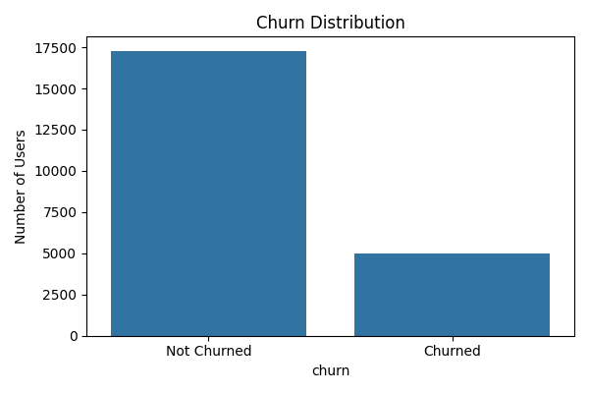
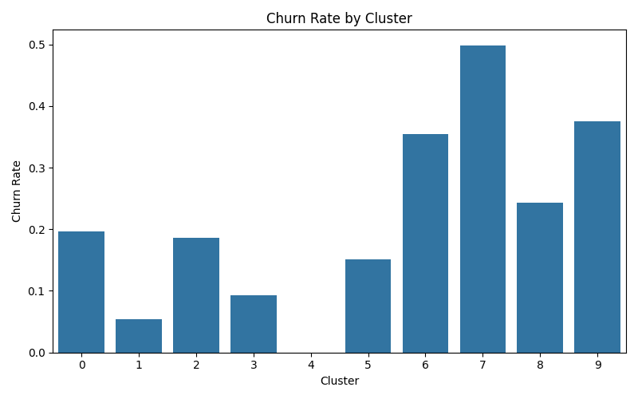
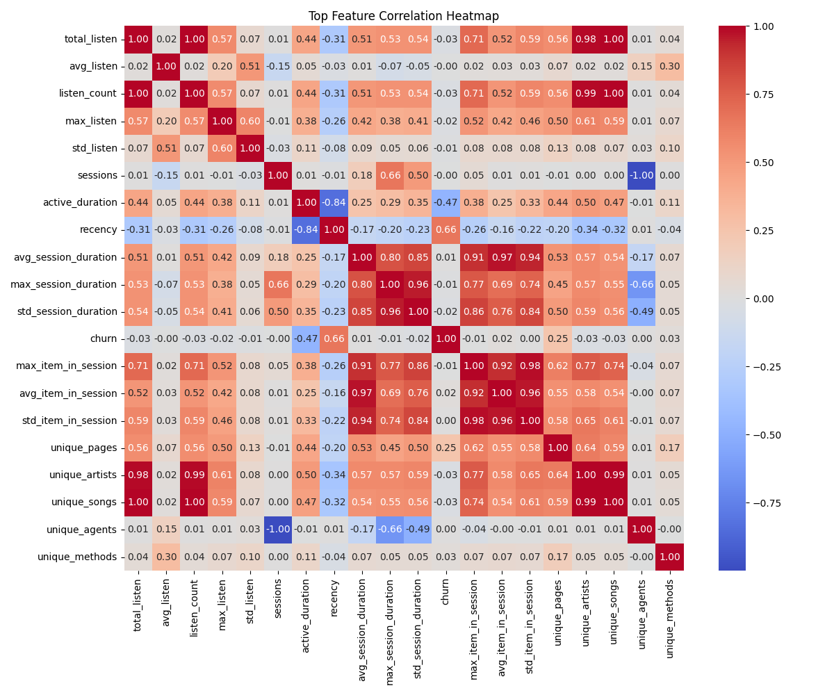
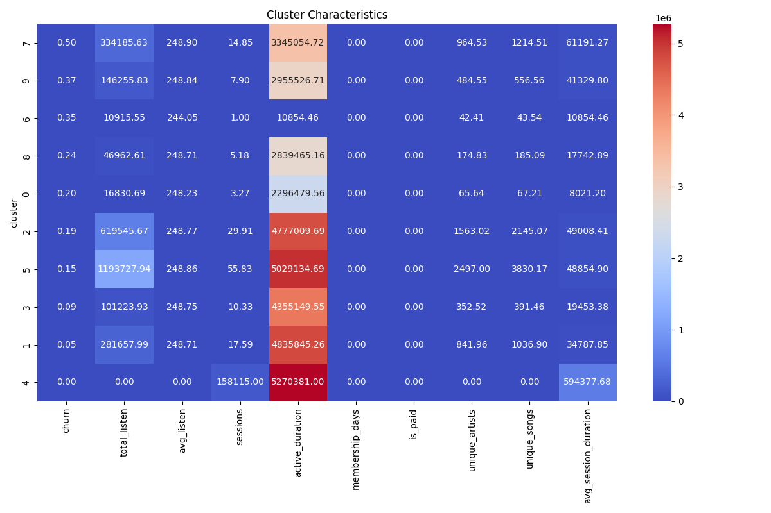
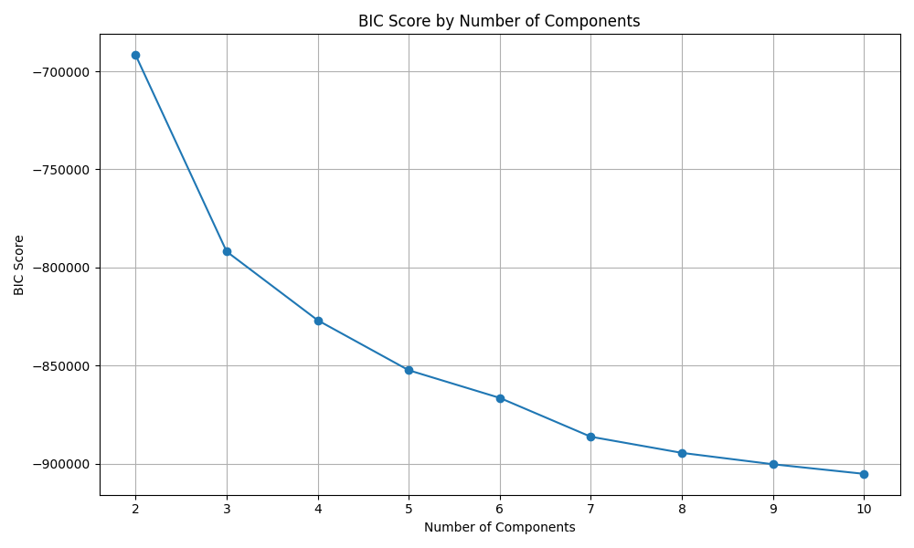
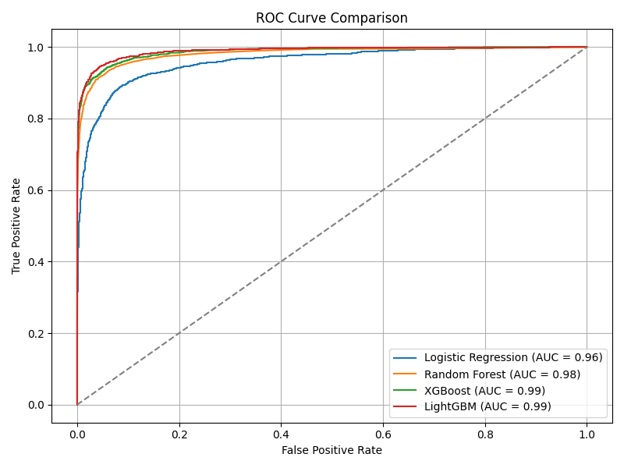

Predicting User Churn in Music Streaming Services​
Sharanya Dambe Vasudeva and Qiuyuan Zhang
INTRODUCTION
Dr. Bin Luo
DISCUSSION
In today’s digital economy, retaining users is just as important—if not more so—than acquiring them. For music streaming platforms, where users can easily switch services, customer churn poses a significant risk to growth and revenue. Understanding the reasons why users leave and predicting churn before it occurs can empower businesses to take strategic and proactive actions. This project aims to create a comprehensive end-to-end Customer Churn Prediction and Analysis System.
We focused on training and fine-tuning a variety of models, including Logistic Regression, Random Forest, XGBoost, and LightGBM, to significantly improve prediction accuracy. A key aspect of our approach was placing a strong emphasis on feature importance and interpretability, which allowed us to gain valuable insights into the primary factors driving user churn. By understanding these key drivers, businesses can take more informed actions to mitigate loss and enhance customer satisfaction. Additionally, our pipeline incorporates thorough performance evaluation and model comparison, as well as result visualization, which collectively supports actionable decision-making processes. The ultimate goal is to ensure that our system can be seamlessly integrated into existing business operations, serving as a valuable tool for proactive customer retention and long-term success.
Figure 1. Distribution of Churned vs. Retained Users
Figure 2. Behavioral Characteristics of Identified Clusters
METHODS
Data Collection:
The Customer Churn Dataset on IEEE DataPort is a valuable resource for analyzing customer retention and churn behaviors. It consists of a 12.5 GB JSON file with over 26 million records across 18 fields, including user demographics and interaction details such as userId, artist, gender, length, sessionId, song, and timestamp. This dataset enables in-depth analysis of user behaviors and is essential for developing strategies to enhance customer retention.
2. Data Preprocessing:
Data preprocessing for this project involved preparing raw user activity logs for analysis. We corrected missing or invalid entries, converted timestamps into datetime objects for feature engineering, and encoded categorical fields for numerical analysis. User-level aggregations summarized behaviors like total listening time and engagement ratios, while additional features captured nuances in user experience. Finally, we addressed missing and infinite values to ensure model compatibility, establishing a solid foundation for clustering and churn prediction.
3.Clustering:
Clustering segmented users into behavioral groups using Gaussian Mixture Models (GMM) based on engagement features. The optimal number of clusters was determined with the Bayesian Information Criterion (BIC). This analysis revealed key insights into churn rates and user activity, enabling targeted retention strategies.
RESULTS
The project results illustrate the effectiveness of churn prediction models in identifying users at risk of leaving the platform. LightGBM performed the best with a ROC AUC score of 0.989, closely followed by XGBoost at 0.987. Logistic Regression and Random Forest also showed strong performances with scores of 0.958 and 0.982, respectively. These results remained consistent even when using only the top 10 features, highlighting the models' ability to capture key behavioral patterns. Both LightGBM and XGBoost exhibited balanced precision and recall, minimizing false positives and negatives. The ROC curve plots revealed significant separation from the diagonal baseline, showcasing the robustness of the models. Overall, these findings confirm the effectiveness of machine learning in predicting churn and provide a solid foundation for customer retention strategies.
Figure 3. Churn Rate Across User Clusters
Figure 4. Correlation Heatmap of Engineered Features
REFERENCES
1. https://ieeexplore.ieee.org/document/10530632
The QR code below to learn more about the workflow of our project by viewing our code.
Figure 5. BIC Scores for Varying Numbers of Clusters
Figure 6. ROC Curve Comparison Across Models

