Slide 1
ARA
The AI Resume Analyst
By Karan Shrivastava and Alexander Krajewski

Slide 2

Hey y’all!
We’re Alex and Karan!
We’re 2 Software engineers in the making with a keen interest in AI and Cloud computing. We are partners on this project and great friends in real life!

Slide 3
Introduction:
01
The current job market.
How Resumes make or break a deal.
7 seconds, can you catch the attention?
How AI can help?
How we can help?
Notes:
Navigating the world of recruiters and companies is difficult and competition is fierce
Resumes are arguably the most important part of a candidate’s tool set
A good resume could be the difference between a job offer or another rejection email
Recruiters only spend 7 seconds on a resume so creating a resume that is not only strong but also ATS compliant is crucial
Qualified candidates sometimes find themselves overlooked so having an AI powered analyst to look over their resume and generate suggestions, cover letters, and answer questions that recruiters have would not only speed up an application process but also help them get the position

Slide 4
Potential Problems
uh oh…
Differences in Resumes and different layouts and formats.
Various different types of questions by employers posing a repetitive chore.
AI Hallucinations (AI daydreams too?)
Typos and differences in terminology.

Slide 5
Project Overview
So what is this all about?
…and how does it work?
Resume Parsing and Information Extraction
ATS Compliance Check
Customized Cover Letter Generation
"Why Me?" Question Answering
Technologies Used: Python, Tkinter, Regular Expressions
Key Features: File Selection, Display, Editing
Continuous Learning and Adaptation
Notes:
We have developed a software tool to parse and extract information from resumes. After that, it checks if the resume is ATS compliant or not.
The program also has the functionality to develop a customized cover letter for different job titles and answer the infamous “Why me?" question.
Technologies used: Python, Tkinter, regular expressions.
Features: File selection, parsing, display of extracted information, editing, cover letter generation, and ATS compliance check.
The program continuously learns and adapts to different resumes and different job profiles, continuously bettering itself.
This will save a user a considerable amount of time.

Slide 6
Artificial intelligence is growing up fast, as are robots whose facial expressions can elicit empathy and make your mirror neurons quiver.
Diana Ackerman

Slide 7
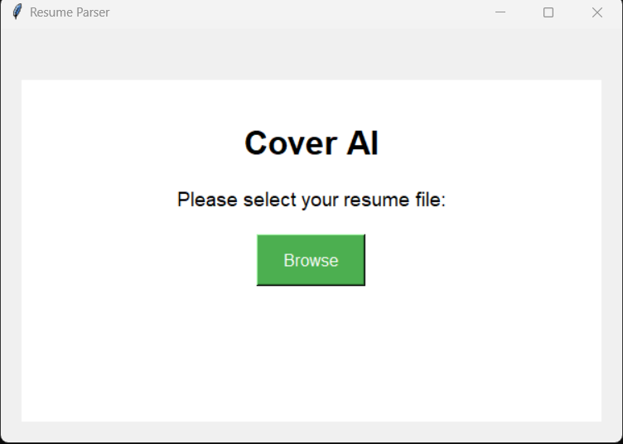
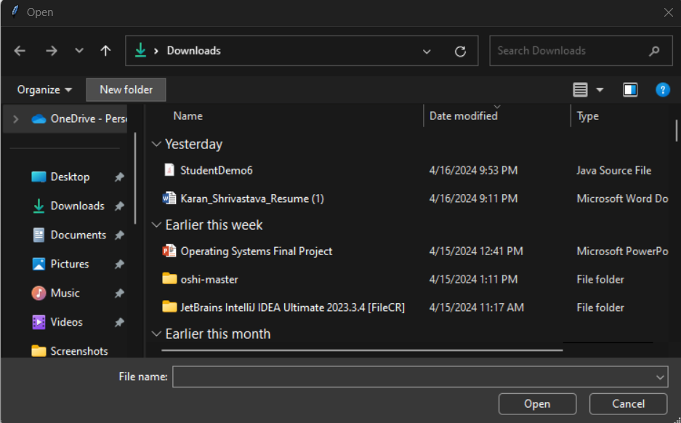
Demo: Selecting a Resume

Slide 8
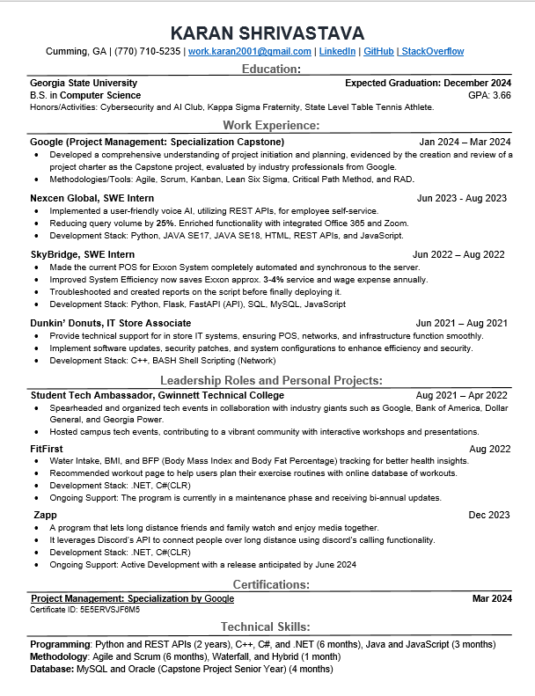
Resume fields parsed and saved:
Personal Details
Education
Work Experience
LeaderShip Roles and Personal Projects
Certifications
Technical Skills
Demo: Parsing a Resume

Slide 9
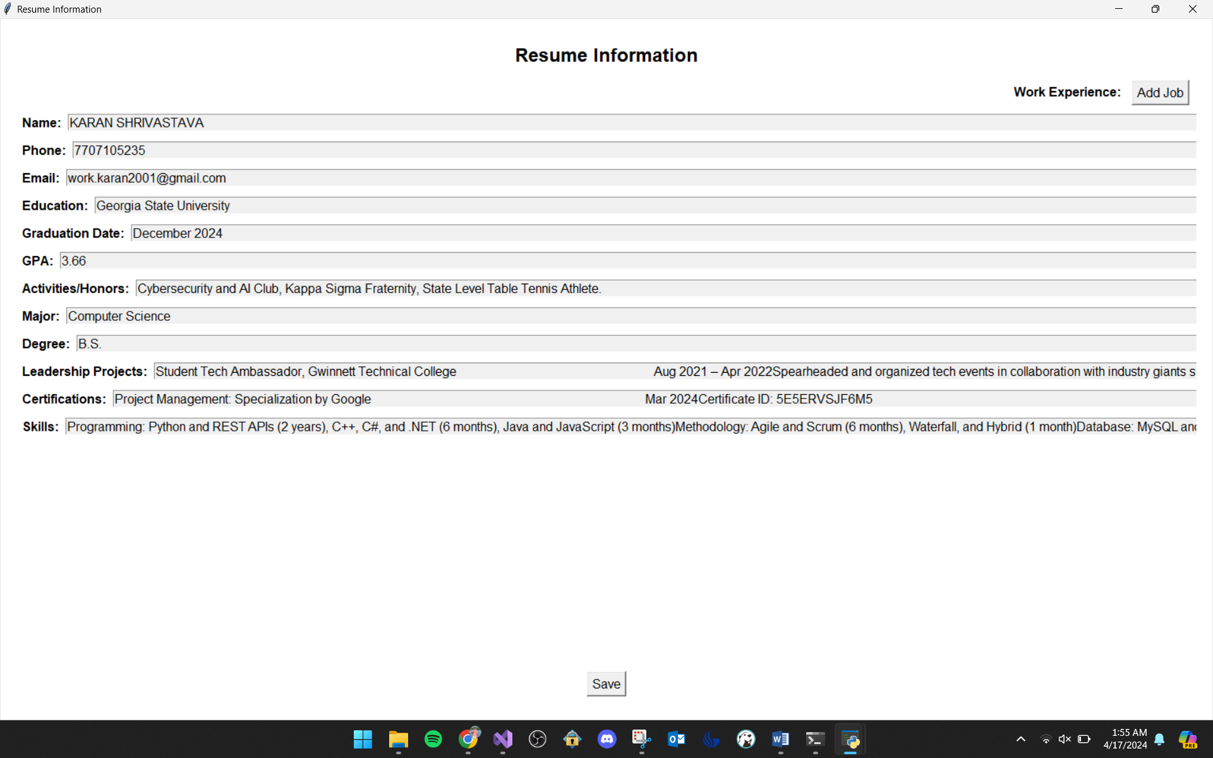
Displaying and Editing the extracted information.

Slide 10
Generating Cover Letter
Ouuu fun stuff!
This is M A G I C
Automated Resume Parser Features
Dynamic Cover Letter Generation
Utilized Components
Customization Options
Time-Saving & Consistency
Versatile Application
Notes:
Our automated resume parser goes beyond just extracting information. It can also generate personalized cover letters.
The program utilizes the extracted information from the resume to dynamically generate a customized cover letter.
Key components used in generating the cover letter: "Template engine, dynamic content insertion, user preferences."
Options for users to customize the cover letter template or content
Saves time, ensures consistency, increases personalization.
Job applications, internship applications, career fairs

Slide 11


Leveraging NLP for Cover Letter Personalization
NLP: Natural Language Processing
Faster and more efficient!
1. Dynamic Content Generation
2. Personalized Tailoring
3. Compelling "Why Me?" Responses
4. Streamlined Automation
5. Optimized Content
Notes:
- Dynamic Content Generation: NLP will dynamically generate cover letter content by analyzing user data, job descriptions, and company culture.
- Personalization: NLP techniques will tailor each cover letter to match the user's qualifications, skills, and experiences with specific job requirements.
- NLP models will assist in crafting compelling responses to "Why me?" questions by aligning user qualifications with employer preferences.
- NLP-driven automation will streamline the cover letter writing process, saving users time and effort in customizing each application.
- NLP algorithms will optimize cover letter content for relevance, tone, and language, increasing the chances of capturing the hiring manager's attention.

Slide 12
Handling errors?!
Data Variability
Ambiguity Resolution
Error Handling
Structured Data Extraction
Notes:
Data Variability: Implement robust regex patterns and natural language processing (NLP) techniques to handle variations in resume formats, layouts, and language styles.
Error Handling: Employ exception handling mechanisms to gracefully manage errors during the parsing process, providing informative feedback to users when issues arise.
Ambiguity Resolution: Utilize context-aware algorithms to disambiguate ambiguous terms or phrases, ensuring accurate extraction of information such as job titles, company names, and dates.
Structured Data Extraction: Implement algorithms to extract structured data from unstructured text, leveraging named entity recognition (NER) and semantic analysis to identify key resume sections and their contents.

Slide 13
ARA’s Benefits
Efficient Applying
A candidate can use ARA to apply to multiple positions in a fraction of the time it takes to apply to one.
ATS Compatibility Checker
Check if a resume is ATS compatible, a more compliant resume leads to more calls and more interview opportunities.
Fast Personalized Cover Letters
Generate professional cover letters in seconds. Stand out to employers and apply to more jobs.

Slide 14



Use Cases
Erika
John
Marie
Erika is a student in a masters program looking to reenter the workforce. After updating her resume she isn't getting as many interview opportunities as expected.
John is an experienced professional with work experience in many different fields. It takes a lot of time to write cover letters catered to each position especially as someone who was diagnosed with Carpal Tunnel Syndrome.
Marie is a busy undergrad who is looking forward to graduation but doesn't have much time to sit down for hours tirelessly applying to jobs that all ask the same questions.
Notes:
A candidate just updated their resume and wants to see if it is ATS compliant so they upload their resume to ARA
A candidate needs a cover letter so ARA is given the job description and using the already provided resume, generates a custom cover letter
A candidate is on a employers application portal and ARA auto fills all the questions

Slide 15
So what does the future hold? 👀
June 2024
Dec 2024
April 2025
User Feedback Integration.
Regular Updates
Customizable Parsing
Expanding into other utilities.
Oct 2024
March 2025
Enhanced NLP Models.
Multilingual Support
Tips and Tricks
Rewrite Functionality
Notes:
User Feedback Integration: Incorporate user feedback mechanisms to continuously improve parsing accuracy, allowing users to correct parsing errors and refine extracted information.
Regular Updates: Stay abreast of industry trends and evolving resume formats to regularly update parsing algorithms, ensuring compatibility with the latest resume standards and conventions.
Enhanced NLP Models: Upgrade to advanced NLP models like BERT and GPT for better accuracy in parsing complex resume structures.
Multilingual Support: Extend parsing capabilities to handle resumes in multiple languages, incorporating language detection and translation.
Customizable Parsing: Allow users to create custom parsing rules tailored to their recruitment needs for greater flexibility.
Providing tips and potentially rewriting a resume to highlight strengths
Expand out into auto filling capabilities especially handling application questions a primitive auto filler couldn’t handle such as “Why me?” questions.

Slide 16

Conclusion
ARA could be a huge time saver to a notoriously tedious process. The ability to apply to 10 times as many jobs with high quality cover letters and stand out resumes cuts down time between employment, improves efficiently, and saves resources.

Slide 17
Questions
& Answers

