Slide 1
How To Create Basic
Stata Commands
Chuck Huber
StataCorp
chuber@stata.com
Stata Webinar
August 4, 2020

Slide 2
Download Website
You can download all of the slides, datasets and do-files here:
https://tinyurl.com/StataProgramming

Slide 3
Why Create Your Own Commands?
You may have tasks that are unique to your workflow and you do those tasks often:
Data management
Data summaries
Specialty graphs
Postestimation calculations

Slide 4
Custom Data Management

Slide 5
Custom Data Summaries

Slide 6
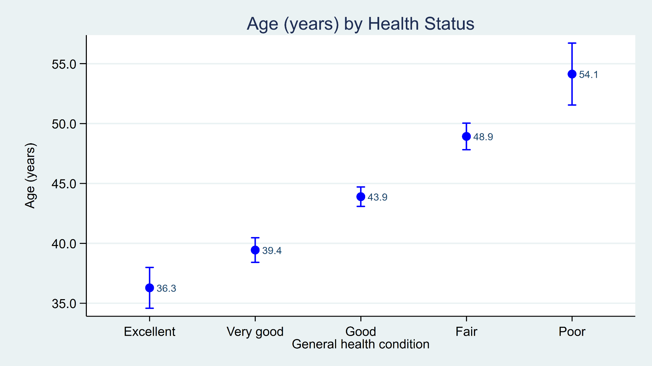
Custom Graphs
ciplot2 age, by(healthstat) title("Age (years) by Health Status")

Slide 7
Custom Postestimation Commands

Slide 8
Simple Programs Are Easy to Create

Slide 9
Introduction to Stata Programming
Data Management Examples
BMI Calculator
BMI Generator
Create Standardized Variables
A Data Summary Example
A Graphics Example
A Postestimation Example

Slide 10
Data Management Examples
program
version
args and syntax
local macros
scalars
tokenize
return
if / else

Slide 11
A Data Management Example
program myprogram
// DEFINE THE INPUT SYNTAX
// DO SOMETHING WITH THE INPUT
// (CALCULATIONS OR GRAPHS)
// DISPLAY AND/OR RETURN RESULTS
end

Slide 12
A Data Management Example
Define a command named calcbmi
program calcbmi
display "BMI = ?"
end
Run calcbmi

Slide 13
A Data Management Example
Redefine a command named calcbmi
capture program drop calcbmi
program calcbmi
display "BMI = ?"
end
Run calcbmi

Slide 14
Redefine a command named calcbmi
capture program drop calcbmi
program calcbmi
version 16
display "BMI = ?"
end
Run calcbmi

Slide 15
Redefine a command named calcbmi
capture program drop calcbmi
program calcbmi
version 16
args height weight
display "BMI = ?"
end
Run calcbmi

Slide 16
Redefine a command named calcbmi
capture program drop calcbmi
program calcbmi
version 16
args height weight
display "Height = " `height’
display "Weight = " ‘weight’
end
Run calcbmi

Slide 17

Local Macros
display "Height = " `height’

Slide 18
Redefine a command named calcbmi
capture program drop calcbmi
program calcbmi
version 16
args height weight
scalar height_m = `height’*0.0254
scalar weight_kg = `weight’*0.453592
scalar bmi = weight_kg / height_m^2
display "BMI = " bmi
end
Run calcbmi

Slide 19
Redefine a command named calcbmi
capture program drop calcbmi
program calcbmi, rclass
version 16
args height weight
scalar height_m = `height’*0.0254
scalar weight_kg = `weight’*0.453592
scalar bmi = weight_kg / height_m^2
display "BMI = " bmi
return scalar bmi = bmi
end
Run calcbmi
(see next slide)

Slide 20
Redefine a command named calcbmi
(see previous slide)
Run calcbmi

Slide 21
Save calcbmi.ado
c:\ado\personal\calcbmi.ado
program calcbmi, rclass
version 16
args height weight
scalar height_m = `height’*0.0254
scalar weight_kg = `weight’*0.453592
scalar bmi = weight_kg / height_m^2
display "BMI = " bmi
return scalar bmi = bmi
end

Slide 22
adopath

Slide 23
which

Slide 24
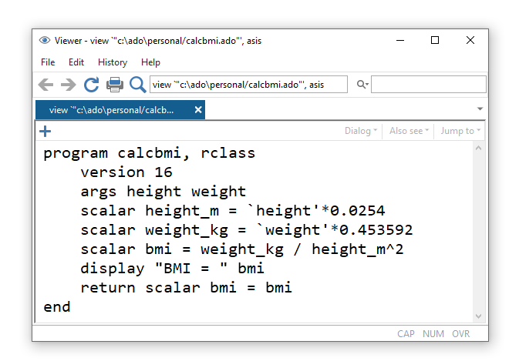
viewsource
viewsource calcbmi.ado

Slide 25

Introduction to Stata Programming
Data Management Examples
BMI Calculator
BMI Generator
Create Standardized Variables
A Data Summary Example
A Graphics Example
A Postestimation Example

Slide 26
How to Calculate BMI Using Variables

Slide 27
Redefine a command named genbmi
capture program drop genbmi
program genbmi
version 16
syntax varlist
end
Run genbmi

Slide 28
Redefine a command named genbmi
capture program drop genbmi
program genbmi
version 16
syntax varlist
display "varlist = `varlist'"
end
Run genbmi

Slide 29
Redefine a command named genbmi
capture program drop genbmi
program genbmi
version 16
syntax varlist(min=2 max=2 numeric)
display "varlist = `varlist'"
end
Run genbmi

Slide 30
Redefine a command named genbmi
capture program drop genbmi
program genbmi
version 16
syntax varlist(min=2 max=2 numeric)
tokenize `varlist'
display "variable 1 = `1'"
display "variable 2 = `2'"
end
Run genbmi

Slide 31
Redefine a command named genbmi
capture program drop genbmi
program genbmi
version 16
syntax varlist(min=2 max=2 numeric)
tokenize `varlist'
local height = "`1'"
local weight = "`2'"
end
Run genbmi

Slide 32
Redefine a command named genbmi
capture program drop genbmi
program genbmi
version 16
syntax varlist(min=2 max=2 numeric)
tokenize `varlist'
local height = "`1'"
local weight = "`2'"
generate bmi_new = `weight' / (`height'/100)^2
end
Run genbmi
(see next slide)

Slide 33
Redefine a command named genbmi
(see previous slide)
Run genbmi

Slide 34
Redefine a command named genbmi
capture program drop genbmi
program genbmi
version 16
syntax varlist(min=2 max=2 numeric), GENerate(string)
tokenize `varlist'
local height = `1'
local weight = `2'
generate `generate' = `weight' / (`height'/100)^2
end
Run genbmi
(see next slide)

Slide 35
Redefine a command named genbmi
(see previous slide)
Run genbmi

Slide 36
Redefine a command named genbmi
program genbmi
version 16
syntax varlist(min=2 max=2 numeric) [, GENerate(string)]
tokenize `varlist'
local height = `1'
local weight = `2'
if "`generate'" != "" {
generate `generate' = `weight' / (`height'/100)^2
}
else {
generate bmi_default = `weight' / (`height'/100)^2
}
end
Run genbmi
(see next slide)

Slide 37
Redefine a command named genbmi
(see previous slide)
Run genbmi

Slide 38
Save genbmi.ado
c:\ado\personal\genbmi.ado
program genbmi
version 16
syntax varlist(min=2 max=2 numeric) [, GENerate(string)]
tokenize `varlist'
local height = `1'
local weight = `2'
if "`generate'" != "" {
generate `generate' = `height' / (`weight'/100)^2
}
else {
generate bmi_default = `height' / (`weight'/100)^2
}
end

Slide 39
Introduction to Stata Programming
Data Management Examples
BMI Calculator
BMI Generator
Create Standardized Variables
A Data Summary Example
A Graphics Example
A Postestimation Example

Slide 40
Another Data Management Example
foreach
quietly
return

Slide 41
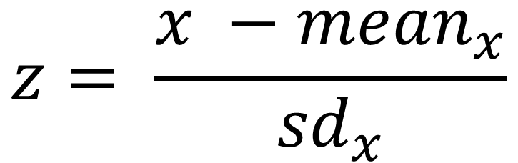
How to Calculate Standardized Variables
$$z= \frac{x −{mean}_{x}}{{sd}_{x}}$$

Slide 42
return list

Slide 44
Define a command named stdize
program stdize
version 16
syntax varlist(numeric)
foreach var in `varlist’ {
display "var = `var'"
}
end
Run stdize

Slide 45
Redefine a command named stdize
capture program drop stdize
program stdize
version 16
syntax varlist(numeric)
foreach var in `varlist’ {
quietly summarize `var'
quietly generate std_`var' = (`var'-r(mean))/r(sd)
}
end
Run stdize

Slide 46
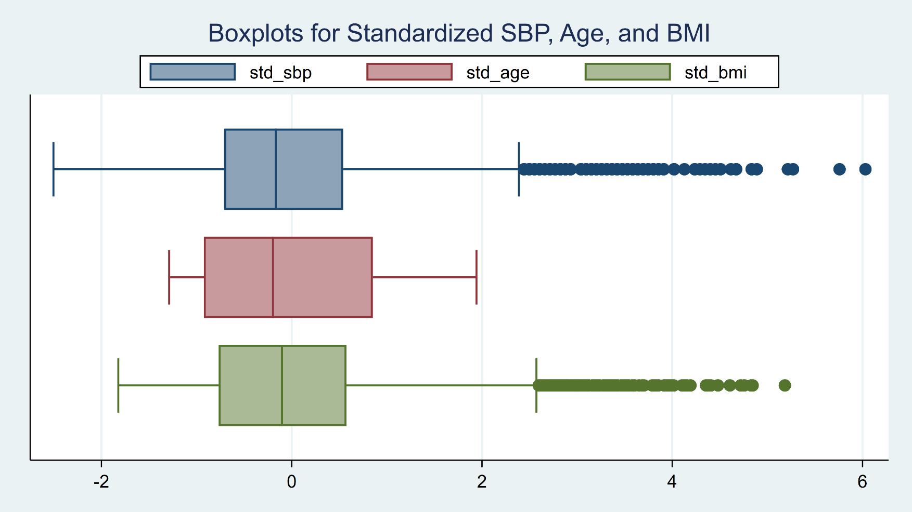
How to Calculate Standardized Variables
graph hbox std_sbp std_age std_bmi, ///
title("Boxplots for Standardized SBP, Age, and BMI") ///
legend(rows(1) position(12))

Slide 47
Save stdize.ado
c:\ado\personal\stdize.ado
program stdize
version 16
syntax varlist(numeric)
foreach var in `varlist’ {
quietly summarize `var'
quietly generate std_`var' = (`var' - r(mean)) / r(sd)
}
end

Slide 48
Introduction to Stata Programming
Data Management Examples
BMI Calculator
BMI Generator
Create Standardized Variables
A Data Summary Example
A Graphics Example
A Postestimation Example

Slide 49
A Data Summary Example
[if] [in]
marksample
`touse’
byable
sortpreserve

Slide 50
Custom Data Summaries

Slide 51
Custom Data Summaries

Slide 53
Define a command named mysumm
program mysumm
version 16
syntax varlist(numeric)
tabstat `varlist', ///
columns(statistics) ///
statistics(count mean median sd ///
skewness kurtosis min max) ///
pwcorr `varlist'
end
Run mysumm

Slide 54
Redefine a command named mysumm
capture program drop mysumm
program mysumm
version 16
syntax varlist(min=1 numeric) [if] [in]
marksample touse
tabstat `varlist' if `touse', ///
columns(statistics) ///
statistics(count mean median sd ///
skewness kurtosis min max ) ///
pwcorr `varlist' if `touse'
end
Run mysumm
(see next slide)

Slide 55
Redefine a command named mysumm
(see previous slide)
Run mysumm

Slide 56
Redefine a command named mysumm
(see previous slide)
Run mysumm

Slide 57
Redefine a command named mysumm
capture program drop mysumm
program mysumm, byable(recall) sortpreserve
version 16
syntax varlist(min=1 numeric) [if] [in]
marksample touse
tabstat `varlist' if `touse', ///
columns(statistics) ///
statistics(count mean median sd ///
skewness kurtosis min max ) ///
pwcorr `varlist' if `touse'
end
Run mysumm
bysort female: mysumm sbp age bmi
(output on next slide)

Slide 59
Save mysumm.ado
c:\ado\personal\mysumm.ado
program mysumm, byable(recall) sortpreserve
version 16
syntax varlist(min=1 numeric) [if] [in]
marksample touse
tabstat `varlist' if `touse', ///
columns(statistics) ///
statistics(count mean median sd ///
skewness kurtosis min max )
pwcorr `varlist' if `touse'
end

Slide 60
Introduction to Stata Programming
Data Management Examples
BMI Calculator
BMI Generator
Create Standardized Variables
A Data Summary Example
A Graphics Example
A Postestimation Example

Slide 61
Custom Graphs
ciplot2 age, by(healthstat) title("Age (years) by Health Status")

Slide 62
Custom Graphs

Slide 63
Custom Graphs

Slide 64
Custom Graphs

Slide 65
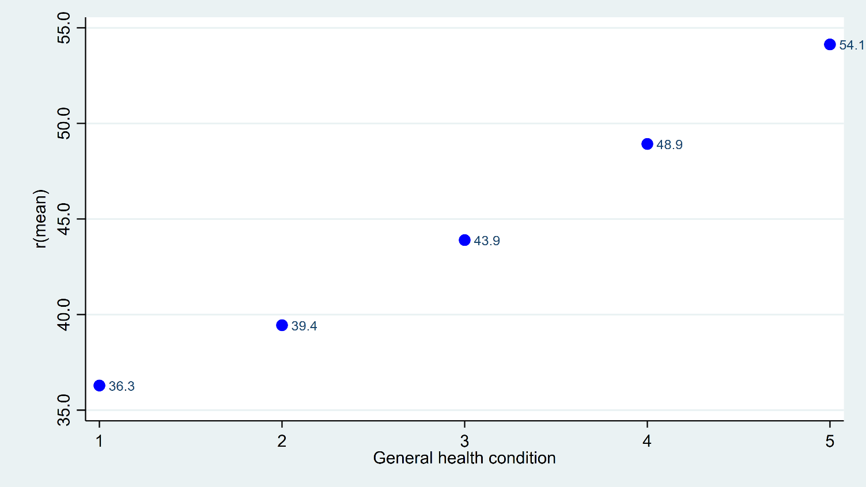
twoway (scatter mean healthstat, mcolor(blue) mlabel(mean))

Slide 66
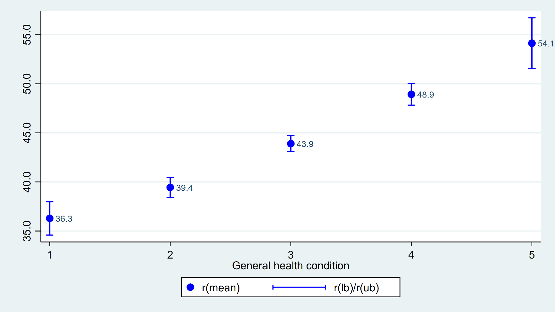
twoway (scatter mean healthstat, mcolor(blue) mlabel(mean)) ///
(rcap lb ub healthstat, lcolor(blue))

Slide 67
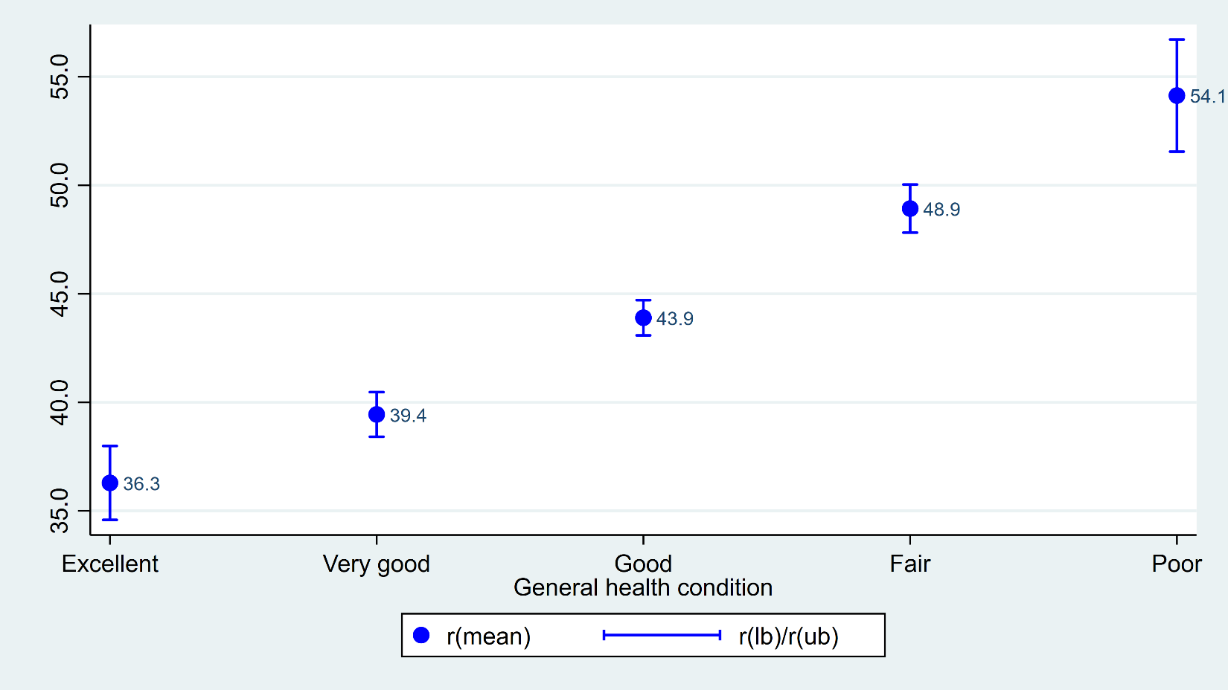
twoway (scatter mean healthstat, mcolor(blue) mlabel(mean)) ///
(rcap lb ub healthstat, lcolor(blue)), ///
xlabel(, valuelabel)

Slide 68
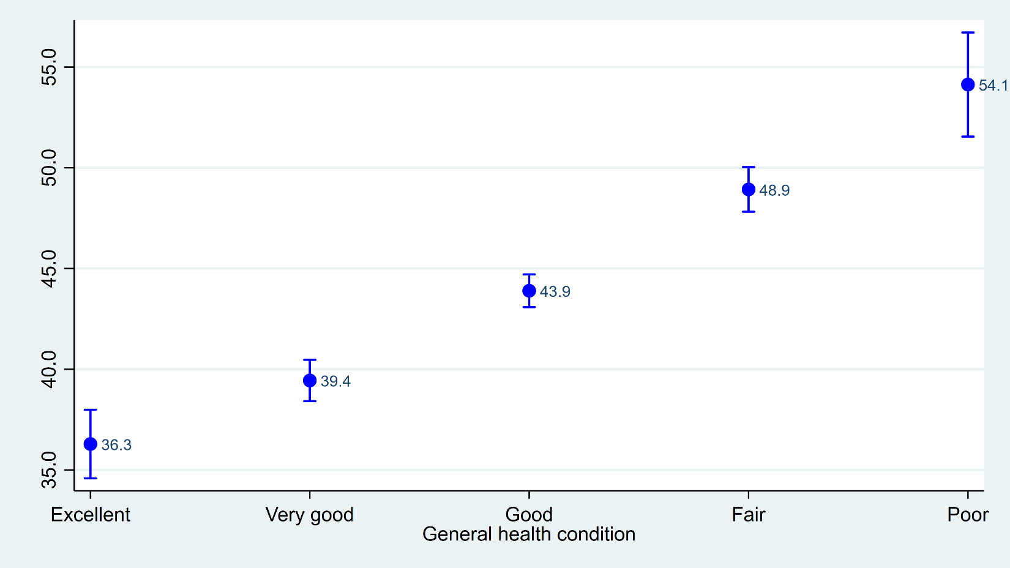
twoway (scatter mean healthstat, mcolor(blue) mlabel(mean)) ///
(rcap lb ub healthstat, lcolor(blue)), ///
xlabel(, valuelabel) legend(off)

Slide 69
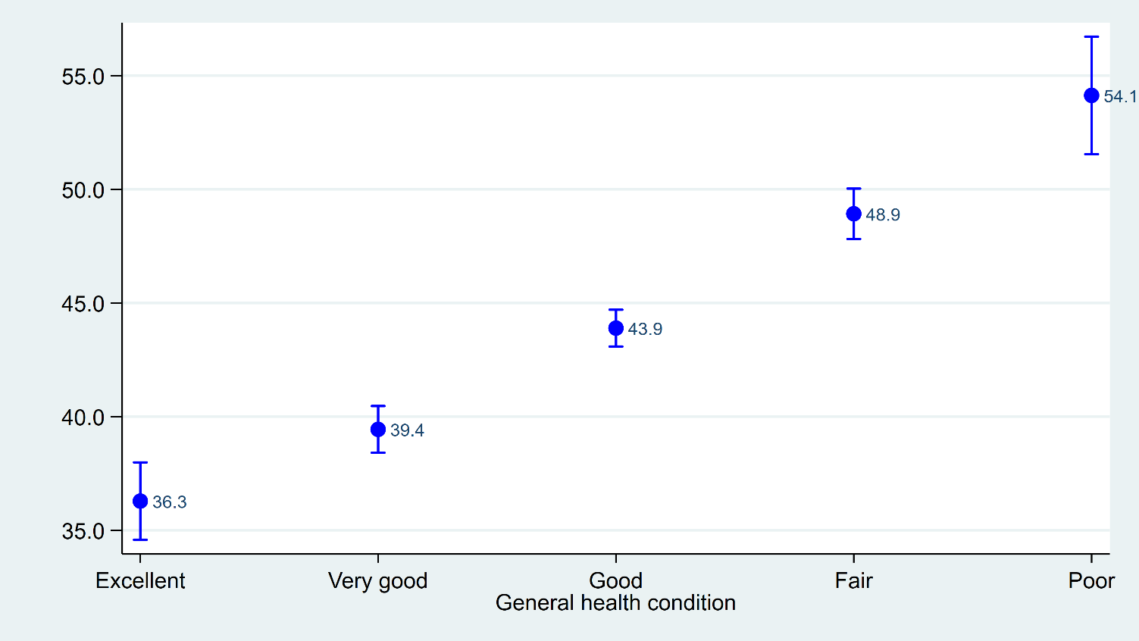
twoway (scatter mean healthstat, mcolor(blue) mlabel(mean)) ///
(rcap lb ub healthstat, lcolor(blue)), ///
xlabel(, valuelabel) legend(off) ///
ylabel(, angle(horizontal))

Slide 70
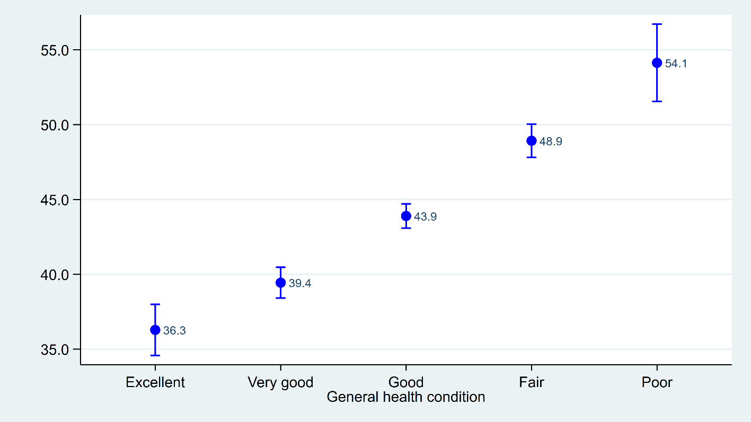
summarize healthstat
twoway (scatter mean healthstat, mcolor(blue) mlabel(mean)) ///
(rcap lb ub healthstat, lcolor(blue)), ///
xlabel(, valuelabel) legend(off) ///
ylabel(, angle(horizontal)) ///
plotregion(margin(l=10 r=10))

Slide 71
Define a command named ciplot
capture program drop ciplot
program ciplot
version 16
syntax varlist(min=1 max=1 numeric), BY(varname min=1 numeric)
display "varlist = `varlist'"
display "by = `by'"
end
Run ciplot

Slide 72
Define a command named ciplot
capture program drop ciplot
program ciplot
version 16
syntax varlist(min=1 max=1 numeric), BY(varname min=1 numeric)
statsby mean=r(mean) lb=r(lb) ub=r(ub), ///
by(`by') nodots clear: ci means `varlist'
end
Run ciplot

Slide 73
Define a command named ciplot
capture program drop ciplot
program ciplot
version 16
syntax varlist(min=1 max=1 numeric), BY(varname min=1 numeric)
statsby mean=r(mean) lb=r(lb) ub=r(ub), ///
by(`by') nodots clear: ci means `varlist‘
format %9.1f mean lb ub
end
Run ciplot

Slide 74
Define a command named ciplot
capture program drop ciplot
program ciplot
version 16
syntax varlist(min=1 max=1 numeric), BY(varname min=1 numeric)
preserve
statsby mean=r(mean) lb=r(lb) ub=r(ub), ///
by(`by') nodots clear: ci means `varlist'
format %9.1f mean lb ub
end
Run ciplot

Slide 75
Define a command named ciplot
capture program drop ciplot
program ciplot
version 16
syntax varlist(min=1 max=1 numeric), BY(varname min=1 numeric)
preserve
statsby mean=r(mean) lb=r(lb) ub=r(ub), ///
by(`by') nodots clear: ci means `varlist'
format %9.1f mean lb ub
twoway (scatter mean `by', mcolor(blue) mlabel(mean)) ///
(rcap lb ub `by', lcolor(blue)), ///
xlabel(, valuelabel) legend(off) ///
ylabel(, angle(horizontal)) ///
plotregion(margin(l=10 r=10))
end

Slide 76

ciplot age, by(healthstat)

Slide 77
Define a command named ciplot
capture program drop ciplot
program ciplot
version 16
syntax varlist(min=1 max=1 numeric), BY(varname min=1 numeric) *
preserve
statsby mean=r(mean) lb=r(lb) ub=r(ub), ///
by(`by') nodots clear: ci means `varlist'
format %9.1f mean lb ub
twoway (scatter mean `by', mcolor(blue) mlabel(mean)) ///
(rcap lb ub `by', lcolor(blue)), ///
xlabel(, valuelabel) legend(off) ///
ylabel(, angle(horizontal)) ///
plotregion(margin(l=10 r=10)) `options’
end

Slide 78
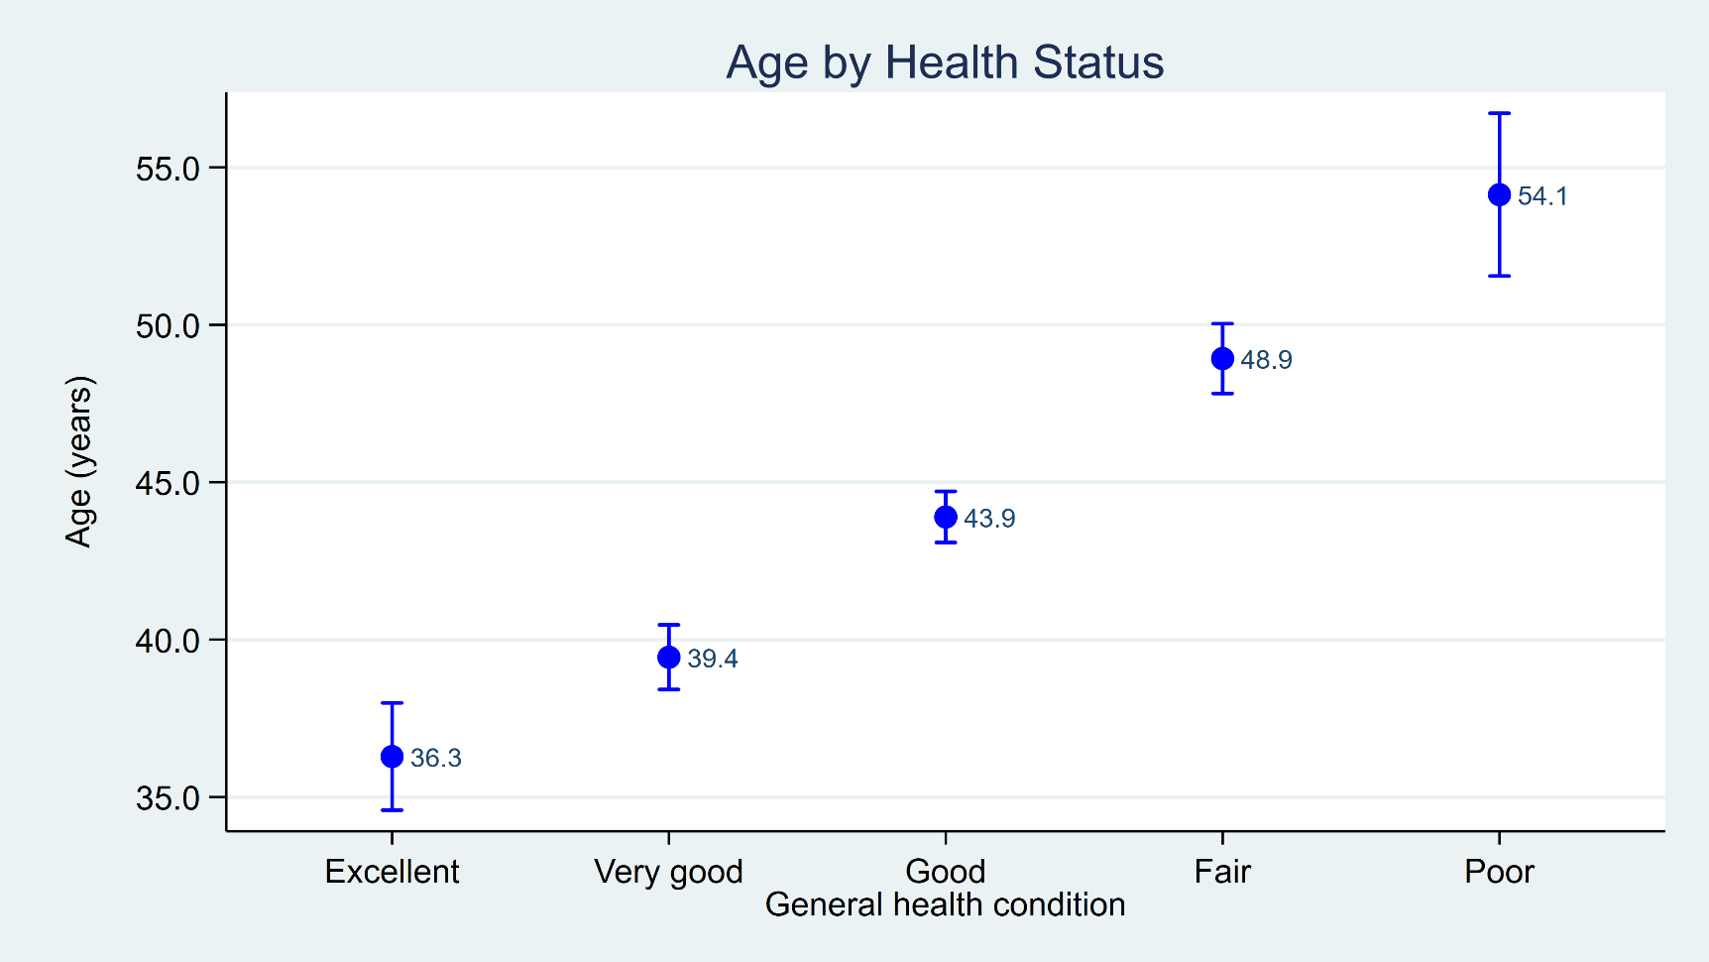
ciplot age, by(healthstat) ///
ytitle("Age (years)") ///
title("Age by Health Status")

Slide 79
Define a command named ciplot
capture program drop ciplot
program ciplot
version 16
syntax varlist(min=1 max=1 numeric), BY(varname min=1 numeric) *
quietly {
preserve
statsby mean=r(mean) lb=r(lb) ub=r(ub), ///
by(`by') nodots clear: ci means `varlist'
format %9.1f mean lb ub
twoway (scatter mean `by', mcolor(blue) mlabel(mean)) ///
(rcap lb ub `by', lcolor(blue)), ///
xlabel(, valuelabel) legend(off) ///
ylabel(, angle(horizontal)) ///
plotregion(margin(l=10 r=10)) `options’
}
end

Slide 80
c:\ado\personal\ciplot.ado
program ciplot
version 16
syntax varlist(min=1 max=1 numeric), BY(varname min=1 numeric) *
quietly {
preserve
statsby mean=r(mean) lb=r(lb) ub=r(ub), ///
by(`by') nodots clear: ci means `varlist'
format %9.1f mean lb ub
twoway (scatter mean `by', mcolor(blue) mlabel(mean)) ///
(rcap lb ub `by', lcolor(blue)), ///
xlabel(, valuelabel) legend(off) ///
ylabel(, angle(horizontal)) ///
plotregion(margin(l=10 r=10)) `options'
}
end

Slide 81
Introduction to Stata Programming
Data Management Examples
BMI Calculator
BMI Generator
Create Standardized Variables
A Data Summary Example
A Graphics Example
A Postestimation Example

Slide 82
Custom Postestimation Commands

Slide 83
Partial list of scalars and macros stored after logistic
. quietly logistic diabetes age bmi
. ereturn list
scalars:
e(N) = 8752
e(ll) = -2025.754856034168
e(ll_0) = -2676.209626934271
e(r2_p) = .2430507552000816
macros:
e(cmdline) : "logistic diabetes age bmi"
e(cmd) : "logistic"

Slide 84
Partial list of scalars and macros stored after logistic

Slide 85
Define a command named pseudor2
program pseudor2
version 16
scalar mcfadden = 1-(e(ll)/e(ll_0))
scalar coxsnell = 1 - exp(2*(e(ll_0) - e(ll))/e(N))
display "McFadden's pseudo r-squared = " mcfadden
display "Cox-Snell pseudo r-squared = " coxsnell
end
Run pseudor2

Slide 86
Define a command named pseudor2
program pseudor2
version 16
if "`e(cmd)'" == "logistic" {
scalar mcfadden = 1-(e(ll)/e(ll_0))
scalar coxsnell = 1 - exp(2*(e(ll_0) - e(ll))/e(N))
display "McFadden's pseudo r-squared = " mcfadden
display "Cox-Snell pseudo r-squared = " coxsnell
}
else {
display as error "The preceding command must be -logistic-"
}
end
Run pseudor2

Slide 87
Save pseudor2.ado
c:\ado\personal\pseudor2.ado
program pseudor2
version 16
if "`e(cmd)'" == "logistic" {
scalar mcfadden = 1-(e(ll)/e(ll_0))
scalar coxsnell = 1 - exp(2*(e(ll_0) - e(ll))/e(N))
display "McFadden's pseudo r-squared = " mcfadden
display "Cox-Snell pseudo r-squared = " coxsnell
}
else {
display as error "The preceding command must be logistic"
}
end

Slide 88
Introduction to Stata Programming
Data Management Examples
BMI Calculator
BMI Generator
Create Standardized Variables
A Data Summary Example
A Graphics Example
A Postestimation Example

Slide 89
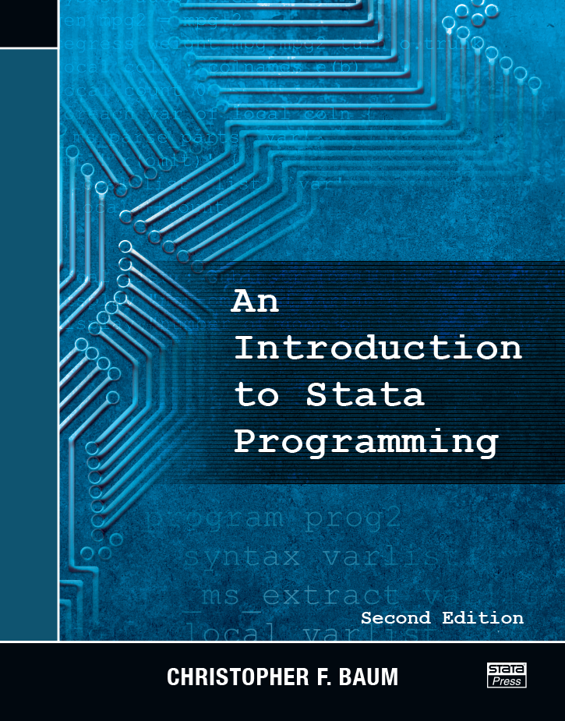
Other Resources
https://www.stata.com/bookstore/introduction-stata-programming/

Slide 90
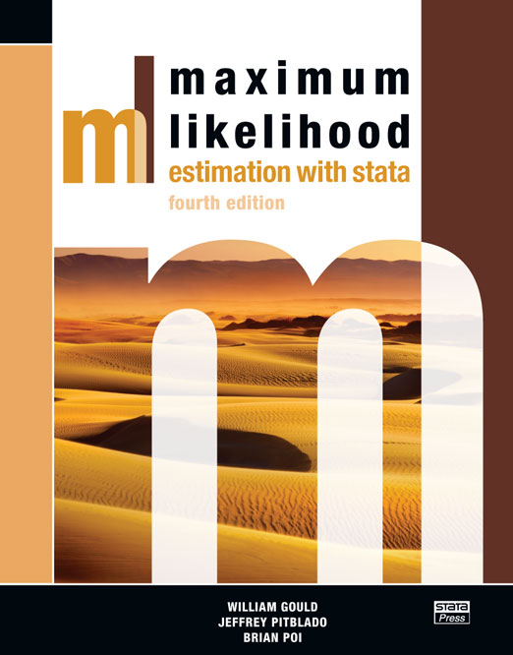
Other Resources
https://www.stata.com/bookstore/maximum-likelihood-estimation-stata/

Slide 91

Other Resources
https://www.stata.com/bookstore/mata-book/

Slide 92
Questions?
You can download the slides, dataset, and do-file here:
https://tinyurl.com/StataProgramming
My email address is:
chuber@stata.com

