Slide 1
"Data Insights Unveiled: Data Science Job Analysis"
Name : Sachintha Umesh
Date : 10/21/2023
Data Source : Kaggle

Slide 2

INTRODUCTION
As a newcomer to the world of data analysis, I've intentionally shifted from a different career path. Armed with a series of relevant certificate courses, my goal is to excel in the fast-changing tech Industry, where data analysis plays a important role in informed decision-making.
To better comprehend the evolution of data-related job fields and understand the dynamics of this rapidly growing industry, I embarked on an exploratory journey. I set out to uncover insights into the field's growth, emerging trends, and the opportunities it offers. To achieve this, I delved into a dataset focused on data analysis jobs.

Slide 3
KEY OBJECTIVES
This Analysis will explore the following questions.
How has data related job growth been in the past few years?
Job growth by experience and job category?
Which job category has the highest number of positions?
How do job positions vary in relation to the size of the companies
How does salary vary across different job positions and salary ranges?

Slide 4

DATA SOURCE
The data source is a dataset sourced from Kaggle.
This small dataset contains three years of data.

Slide 5
DATA WRANGLING
Downloaded and loaded to the Excel.
Found 42 duplicate rows and removed.
565 unique row values.
Checked for null values.
Renamed few column values to make more readable and understandable.
The analysis was conducted in Microsoft Excel using pivot tables and charts.
Finally, the presentation done using Microsoft Power Point.

Slide 6
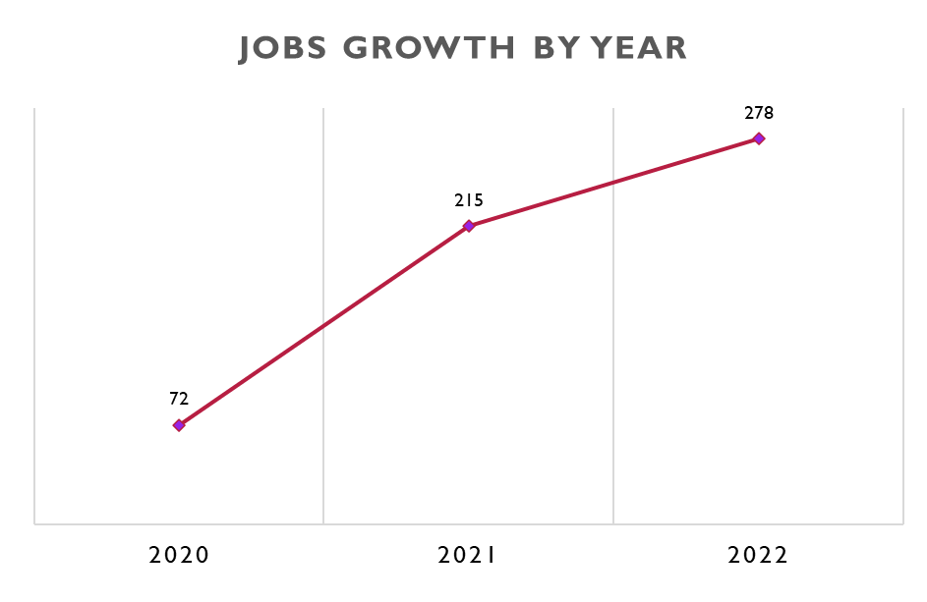
The chart shows the rapid growth of the industry.

Slide 7
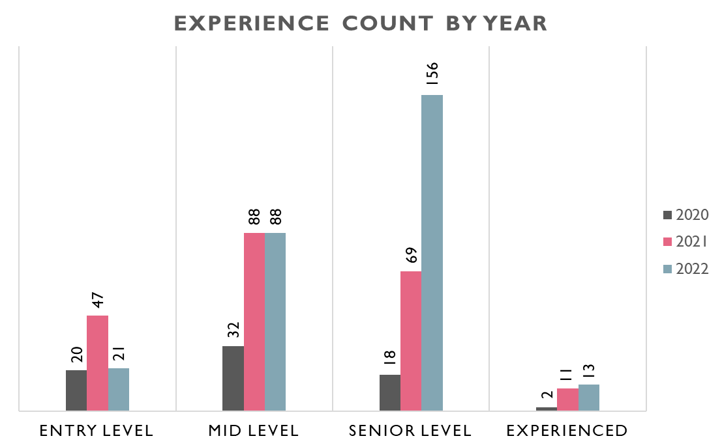
We can clearly see that there is a higher growth in Senior Level.
The annual job growth is attributed to Senior Level positions.

Slide 8
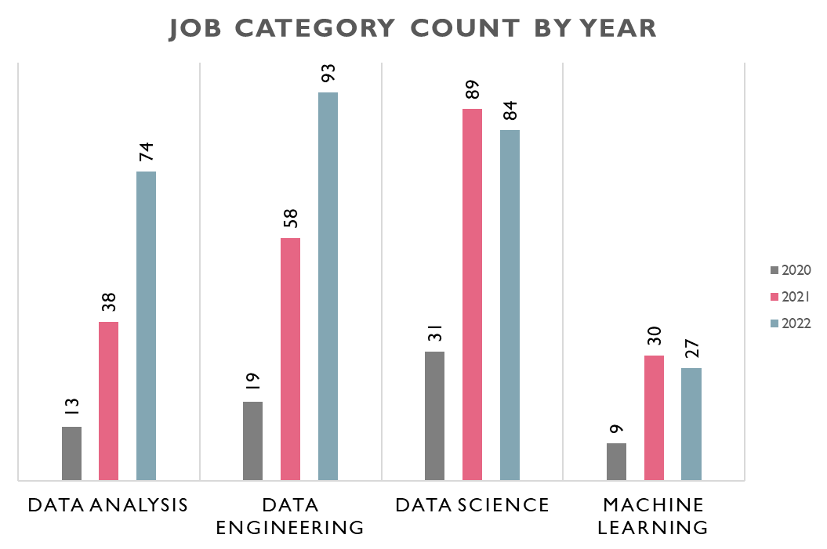
Data analysis and data engineering have experienced significant growth over the years.
Data science and Machine learning had a high number of jobs in 2021 and maintained stability.

Slide 9
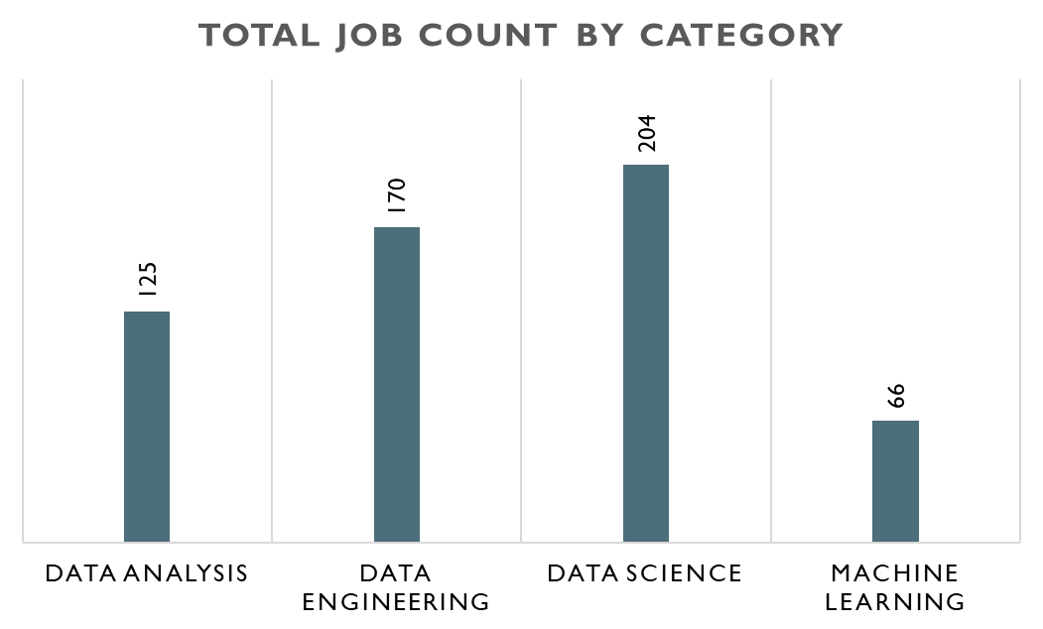
There is more demand in Data Science jobs than other fields.
Least demand job field is Machine learning.

Slide 10
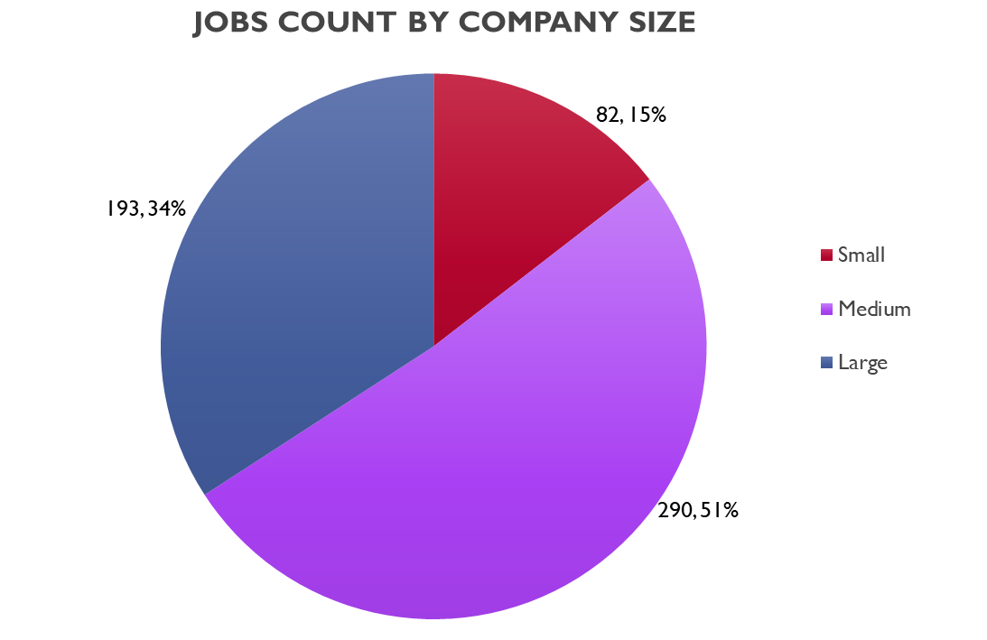
51% Job positions are from medium size companies and 34% from Large companies.

Slide 11
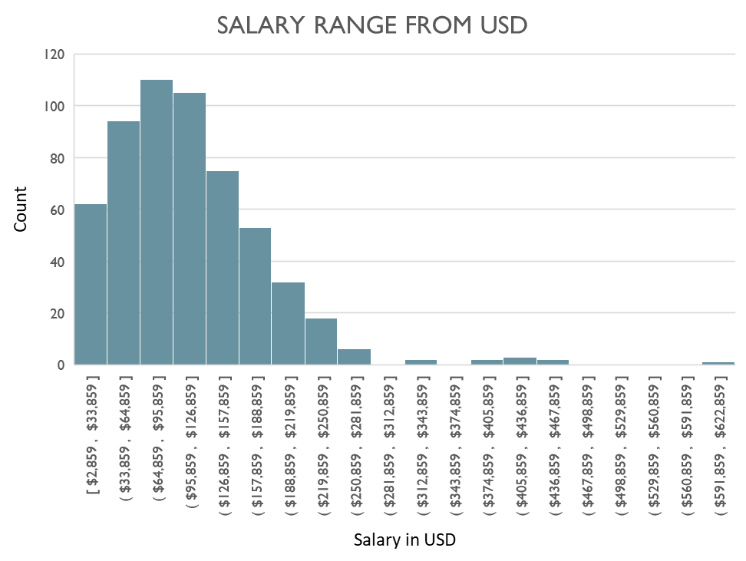
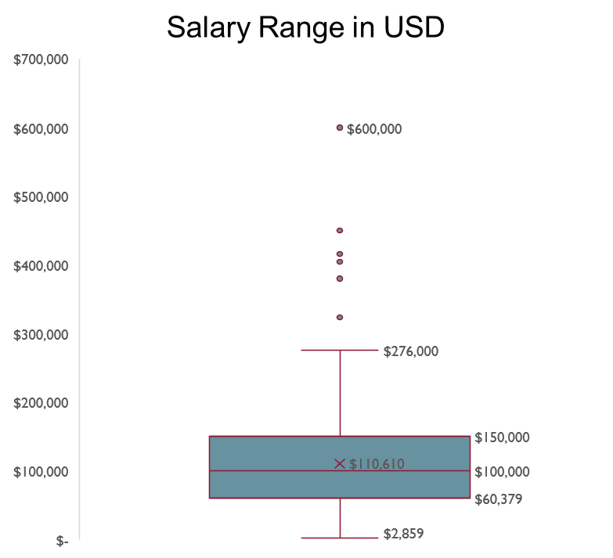
From above charts we can see that most of salaries are between $69k and $150k. Furthermore Lowest salary $2859 and highest salary $600K.
Average salary is $110k.

Slide 12
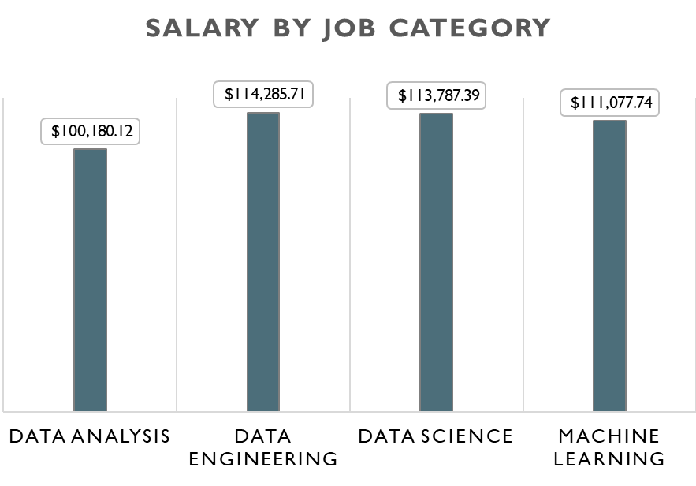
Data analysis has the lowest average salary at $100k, while the other categories have nearly similar averages.

Slide 13
CONCLUSIONS
Data-related jobs have experienced rapid growth over the years.
Mid Level and Senior Level have highest job positions.
Data Analysis and Data Engineering have significant growth over the years and Data science have Highest Positions.
One might expect to see the majority of job positions coming from larger companies, but in reality, most job positions are offered by medium-sized companies.
Data analysis typically offers lower salaries compared to other fields, but the average is still around $100k.

