Slide 1
DS307 Computer Vision · Assignment 2 · Project 26
Two-Stage vs One-Stage Object Detection: Faster R-CNN vs YOLO for Speed and Accuracy
{{NAME_1}} · {{NAME_2}} · {{NAME_3}} · {{NAME_4}}
Faculty: {{FACULTY_NAME}} · Faculty of Science & Technology, IFHE University, Hyderabad · Nov 2026
Notes:
Introduce the team and the question: is the classic rule 'two-stage = accurate, one-stage = fast' still true for current models? We test it with real measurements.

Slide 2
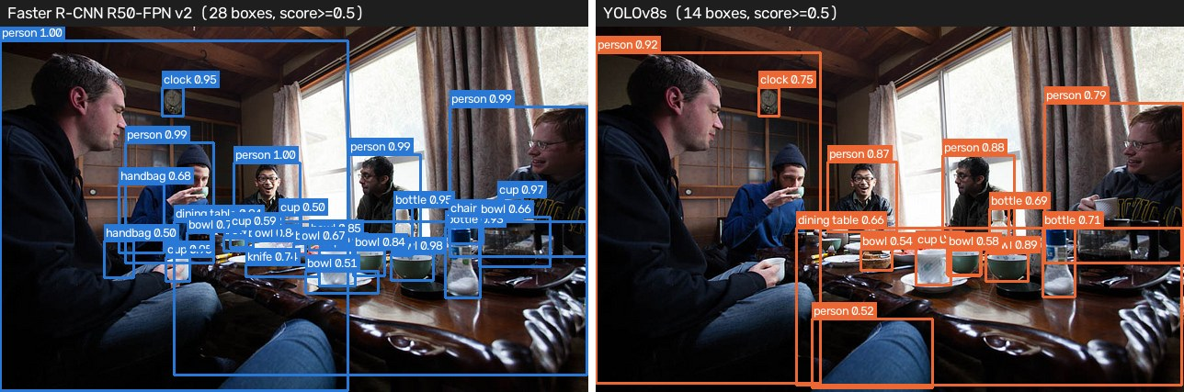
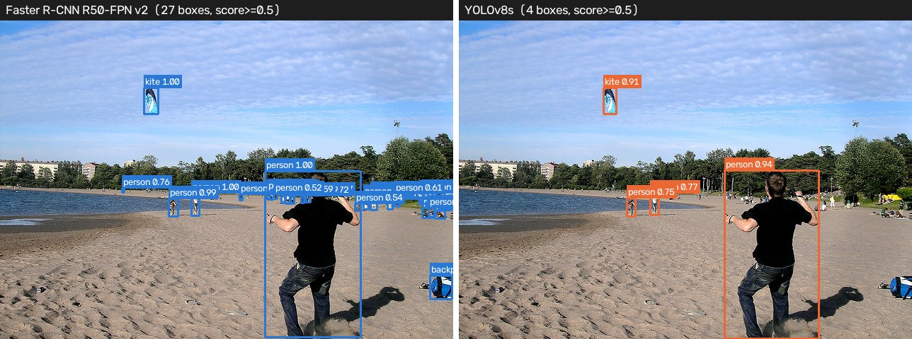
How much accuracy does speed cost?
• Two-stage (R-CNN family): propose regions first, then classify and refine each region
• One-stage (YOLO family): predict all boxes and classes in one pass over the image
• Classic belief: two-stage is more accurate (especially on small objects), one-stage is faster
• Our test: 4 pretrained COCO models, same 100 COCO val2017 images, batch size 1, same evaluation
• Measured: latency, FPS, parameters, weight size, COCO mAP (overall and by object size)
COCO val2017: Faster R-CNN (left, blue) vs YOLOv8s (right, orange)
2
Notes:
Explain the two families in one sentence each. Then state exactly what we measured and that the conditions were identical for every model, which makes the comparison fair.

Slide 3
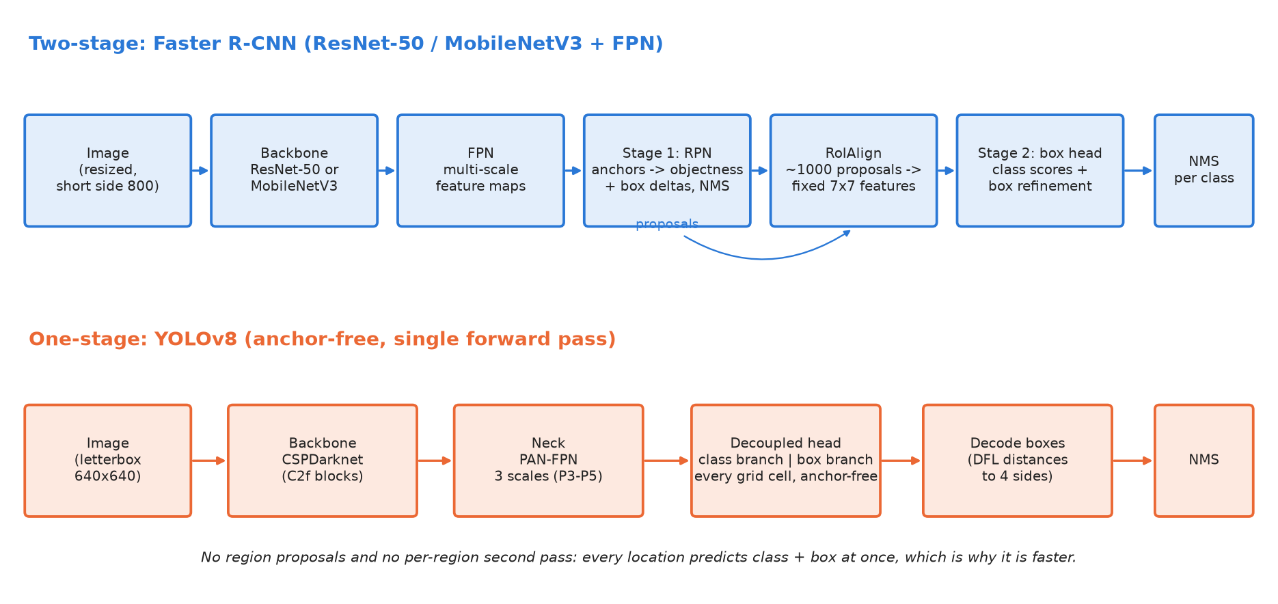
Two architectures, one goal
3
Notes:
Top: Faster R-CNN. Backbone + FPN give multi-scale features. The RPN puts anchors at every position, scores objectness and regresses boxes, keeps about 1000 proposals after NMS. RoIAlign crops a 7x7 feature for each proposal and the box head classifies and refines it. Bottom: YOLOv8. CSPDarknet backbone, PAN-FPN neck, and an anchor-free decoupled head that predicts class and box at every grid cell in one pass. The per-proposal second stage is the main reason Faster R-CNN is slower.

Slide 4
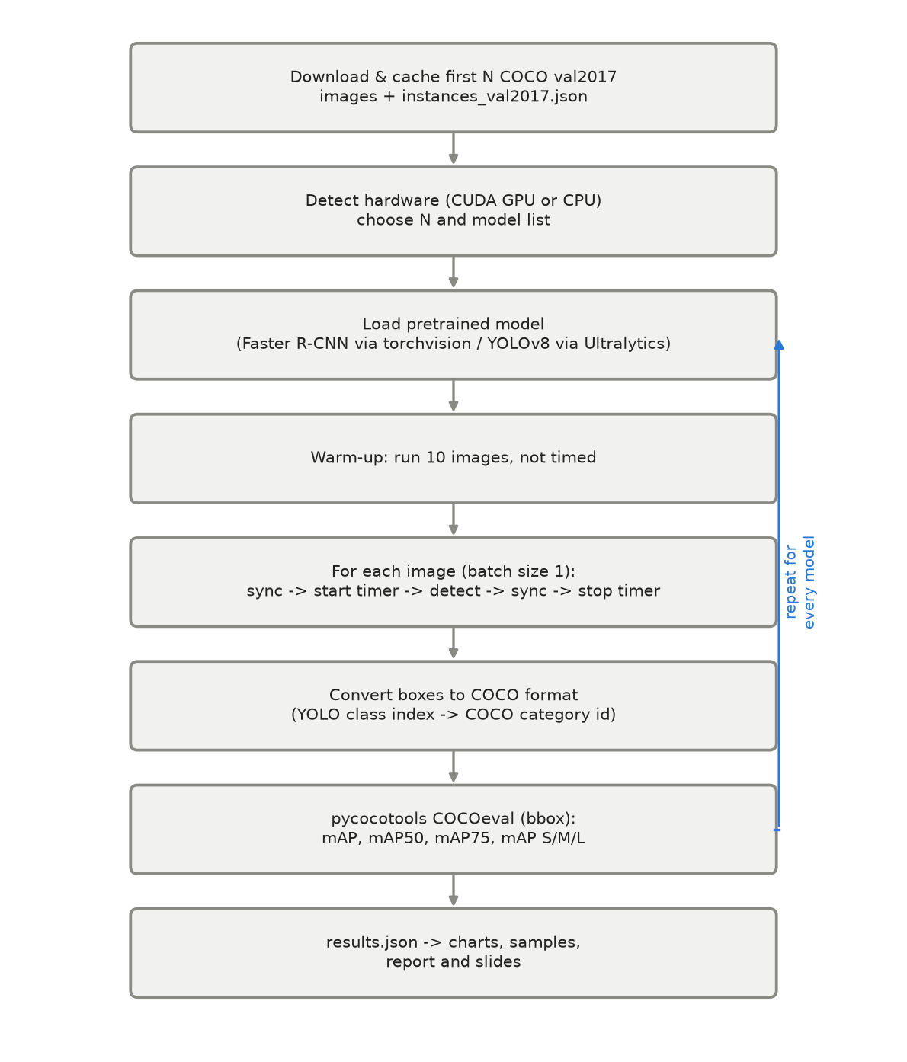
Fair benchmarking methodology
Same data
First 100 COCO val2017 images, 709 ground-truth boxes
Fair timing
10 warm-up images; batch 1; CUDA sync on GPU; disk I/O excluded
Fair accuracy
pycocotools COCOeval, score threshold 0.001, max 100 boxes
Hardware
CPU (x86_64, 4 threads)
4
Notes:
Warm-up removes one-time costs such as memory allocation. On a GPU, kernels are asynchronous, so we synchronise before stopping the timer. Low score threshold 0.001 keeps the full precision-recall curve for mAP. YOLO class indices 0-79 are mapped to COCO category ids. No CUDA GPU found: ran on CPU with N=100 images and skipped YOLOv8m (largest YOLO model).

Slide 5
Results: speed and accuracy
Model | Family | Params (M) | Latency (ms) | FPS | mAP | mAP50 | mAP small
FasterRCNN-R50-FPN-v2 | two-stage | 43.7 | 4411 ± 651 | 0.23 | 0.560 | 0.770 | 0.401
FasterRCNN-MobileNetV3-FPN | two-stage | 19.4 | 736 ± 123 | 1.36 | 0.391 | 0.594 | 0.205
YOLOv8n | one-stage | 3.2 | 53 ± 9 | 18.69 | 0.453 | 0.621 | 0.290
YOLOv8s | one-stage | 11.2 | 133 ± 22 | 7.52 | 0.538 | 0.693 | 0.366
COCO val2017, first 100 images, CPU (x86_64, 4 threads). mAP = COCO mAP@[.5:.95]. Bold = best in column.
0.560
18.7 FPS
0.538
highest mAP: FasterRCNN-R50-FPN-v2
fastest: YOLOv8n
best balance: YOLOv8s, most accurate model at 5+ FPS (7.5 FPS)
5
Notes:
Read the table from top to bottom. Best mAP: FasterRCNN-R50-FPN-v2 (0.560). Fastest: YOLOv8n (18.7 FPS). Latency is mean ± standard deviation over 100 images.

Slide 6
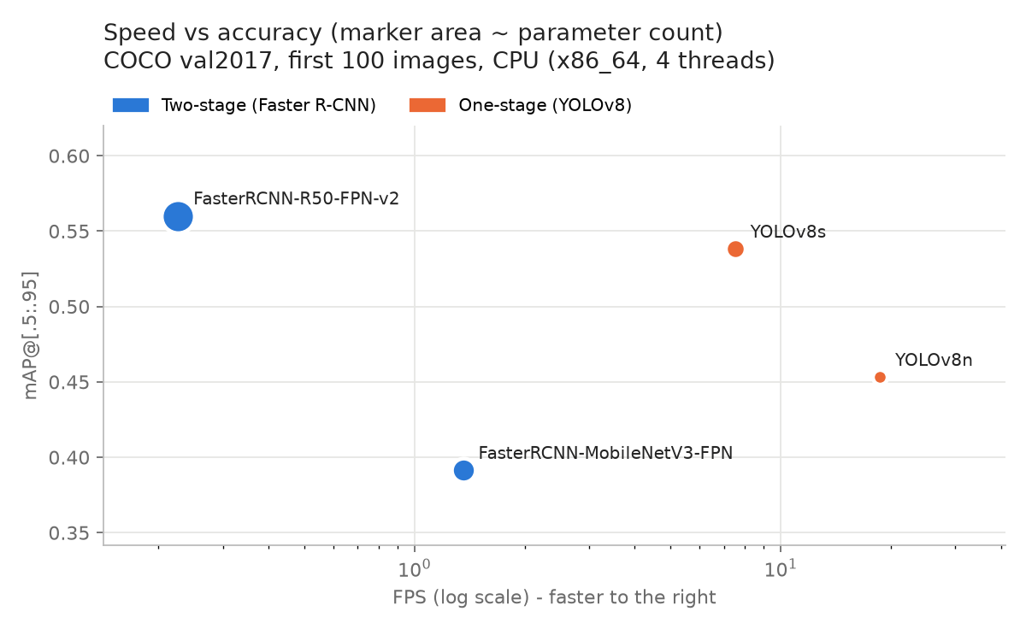
The speed-accuracy trade-off
33.2x
YOLOv8s throughput vs Faster R-CNN R50-FPN v2
-2.2 pts
mAP difference, YOLOv8s minus Faster R-CNN (0.538 vs 0.560)
3.9x
fewer parameters in YOLOv8s
6
Notes:
Up and to the right is better. Pareto-optimal models (nothing is both faster and more accurate): FasterRCNN-R50-FPN-v2, YOLOv8n, YOLOv8s. One-stage is faster because there is no per-proposal second stage and the input is 640 instead of 800 pixels.

Slide 7
Object size matters most
• Small objects (< 32x32 px) are hardest for every model
• Best small-object mAP: FasterRCNN-R50-FPN-v2 (0.401)
• Faster R-CNN R50 beats YOLOv8s on small objects (0.401 vs 0.366)
• Two-stage helps through 800-px input, a stride-4 FPN level and per-region refinement, but backbone and training recipe matter just as much
7
Notes:
Caution: only 100 images, so per-size numbers have high variance. Explain why small objects are hard: few pixels, features vanish after down-sampling, and a one-pixel box error is a large IoU error.

Slide 8
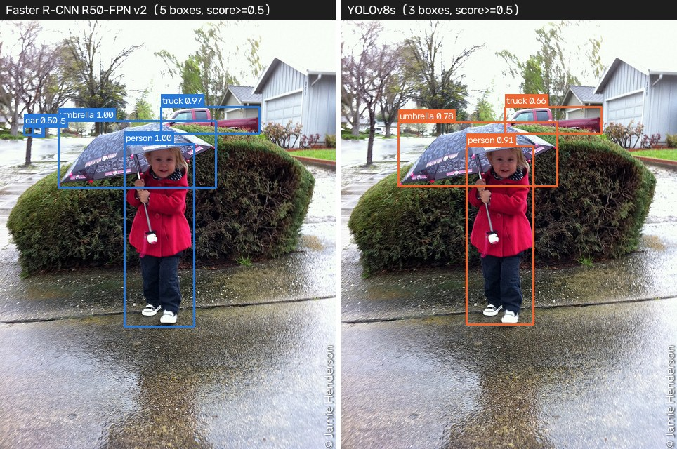
What the detectors see
Small objects
16 ground-truth objects (15 small)
Faster R-CNN: 27 boxes
YOLOv8s: 4 boxes
score ≥ 0.5
Typical scene
4 ground-truth objects (1 small)
Faster R-CNN: 5 boxes
YOLOv8s: 3 boxes
score ≥ 0.5
8
Notes:
Blue boxes: Faster R-CNN (left). Orange boxes: YOLOv8s (right). Point out missed small objects and merged boxes in crowded areas. More examples are in the report (results/sample1-4.jpg).

Slide 9
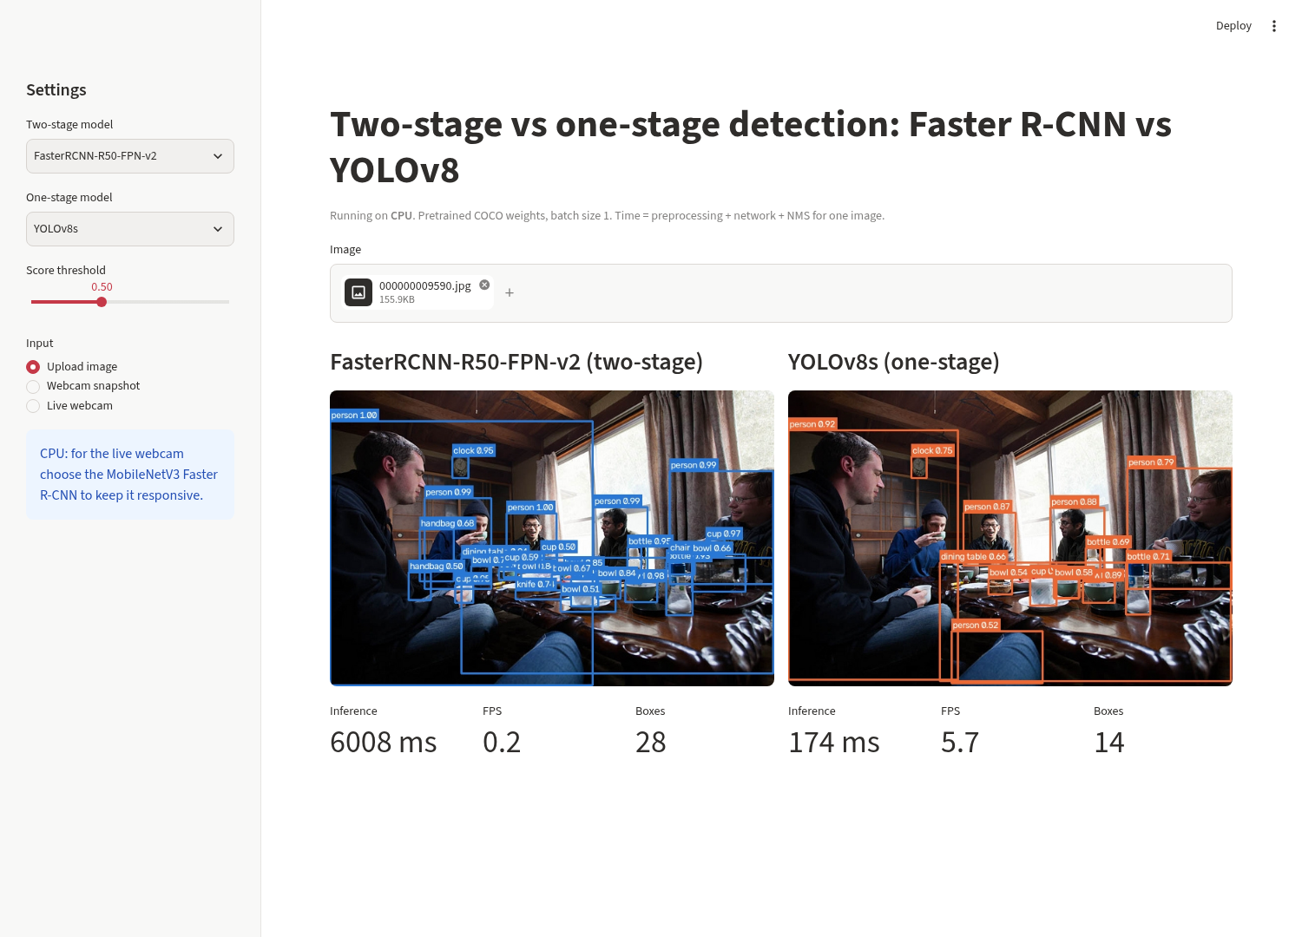
Live demo
uv run demo
• Pick a two-stage and a one-stage model
• Input: uploaded image, webcam snapshot or live webcam
• Both models run on the same frame
• Shows boxes, labels, inference time, FPS and box count for each model
9
Notes:
Switch to the browser. 1) Upload a photo (e.g. a crowded street) and show both outputs and timings. 2) Take a webcam snapshot. 3) Live webcam with MobileNet Faster R-CNN vs YOLOv8n to show the FPS gap. Backup if the browser fails: uv run demo --image data/val2017/<file>.jpg

Slide 10
Conclusion
• YOLOv8s: 33.2x faster than Faster R-CNN R50-FPN v2, mAP 0.538 vs 0.560
• Most accurate: FasterRCNN-R50-FPN-v2 · fastest: YOLOv8n
• "Two-stage = accurate, one-stage = fast" still holds in direction, but the accuracy margin (2.2 mAP points) is small next to the 33x speed gap
• Limitations: 100-image subset, pretrained only, timings depend on hardware, no TensorRT/ONNX
• Next: full val2017 on GPU, ONNX/TensorRT, equal input sizes, fine-tuning on one custom dataset
Thank you. Questions?
10
Notes:
Summarise in three sentences, then invite questions.

