Slide 1
🫁 LungAI
Multi-Class Lung Disease Classification & Decision-Support System
Automated thoracic image classification using ResNet50 transfer learning, custom CNN models, and an interactive AI-powered workstation.
Deep Learning • ResNet50 Transfer Learning • FastAPI Backend • React 18 Dashboard • 95.21% Test Accuracy
Academic & Research ML Prototype | Not for Clinical Diagnosis | v1.0.0

Slide 2
Executive Summary & Core Value Proposition
End-to-end artificial intelligence pipeline bridging computer vision and diagnostic decision support.
🎯 Problem Space
Pulmonary Classification Needs
Pulmonary conditions such as Pneumonia, COVID-19, and Tuberculosis require timely image classification to assist researchers and evaluators in prioritizing scan reviews.
🧠 Deep Learning Engine
Dual Model Evaluation
Evaluates predictions across pre-trained ResNet50 transfer learning and a custom 4-block CNN. Reaches 95.21% accuracy and 99.39% AUC-ROC on held-out test data.
💻 AI-Powered Workstation
Full-Stack Web Interface
FastAPI backend & React 18 frontend with 1-click scan presets, radiology windowing controls, Grad-CAM overlays, patient management, and automated report generation.

Slide 3
Problem Statement & Classification Context
Addressing diagnostic complexity in thoracic radiograph interpretation.
⚠️ Challenges in Thoracic Image Analysis
• High Scan Volumes: Over 2 billion X-rays performed globally per year, creating massive review backlogs.
• Time-Sensitive Pathologies: Pneumonia and COVID-19 progress rapidly; early identification is crucial.
• Visual Feature Overlap: Bacterial opacity, viral infiltration, and TB cavities share subtle radiographic features.
• Second Opinion Access: Non-specialist centers lack rapid access to specialized thoracic AI decision-support tools.
💡 The LungAI Solution
• Automated Multi-Class Classification: Categorizes scans into Normal, Pneumonia, COVID-19, Tuberculosis, or Lung Cancer in <1.5 seconds.
• Urgency Level Categorization: Computes urgency tags (Emergency, Urgent, Routine) based on predicted disease and confidence threshold.
• Dual Model Validation: Runs CNN and ResNet50 models in parallel and displays comparative confidence scores.
• AI-Powered Workstation: Provides interactive windowing, sample presets, and structured classification report export.

Slide 4
End-to-End System Architecture
Decoupled 4-tier pipeline spanning preprocessing, dual model evaluation, ORM database, and React workstation.
1. Input Scan
Chest X-Ray (JPEG / PNG / TIFF)
2. Preprocessing
Noise Reduction (CLAHE) 224x224 RGB Scaling
3. Dual Models
ResNet50 (Transfer) Custom 4-Block CNN
4. Decision Engine
Multi-Class Probabilities Urgency Categorization
5. REST API
FastAPI Endpoints SQLAlchemy + SQLite
6. Workstation
React 18 AI Workstation PDF Reports & Charts

Slide 5
Dataset Stratification & Class Balance
Aggregated 10,864 chest radiographs across 5 distinct disease categories.
Disease Category | Image Count | Share (%) | Source Repository
Pneumonia | 4,273 | 39.33% | Kermany et al. / NIH ChestX-ray14
COVID-19 | 3,616 | 33.28% | COVID-19 Radiography Database
Normal | 1,583 | 14.57% | Kermany et al. Benchmark
Tuberculosis | 700 | 6.44% | TB Chest X-ray Database
Lung Cancer | 692 | 6.37% | Public CT / Radiograph Dataset
Total Dataset | 10,864 | 100.00% | 5 Active Disease Classes
⚙️ Stratified Data Split
Training Set (70%)
7,604 images Data augmentation: ±15° rotation, horizontal flip, brightness jitter.
Validation Set (15%)
1,630 images Used strictly for early stopping & hyperparameter tuning.
Held-Out Test Set (15%)
1,630 images Unseen evaluation split used for verified benchmarks.

Slide 6
Image Preprocessing & Augmentation Engine
Standardizing raw radiographs for deep feature extraction.
1. Format Normalization
Converts single-channel grayscale or 4-channel BGRA images into standard 3-channel RGB format.
2. Noise Reduction
Applies a 3x3 Gaussian Blur filter to smooth high-frequency radiograph noise.
3. Contrast Enhancement
Employs Single-Channel CLAHE (Contrast Limited Adaptive Histogram Equalization) to accentuate opacity edges.
4. ImageNet Scaling
Resizes images to 224x224 float32 tensors scaled to [0, 1] range matching ResNet50 input requirements.

Slide 7
Baseline Architecture: Custom 4-Block CNN
Convolutional neural network baseline built from scratch.
🏗️ CNN Architectural Topology
• 4 Sequential Conv2D Blocks (32, 64, 128, 256 filters)
• 3x3 Convolutional Kernels + ReLU Activation
• 2x2 Max-Pooling layers for spatial downsampling
• Batch Normalization after each Conv block for gradient stability
• Spatial Dropout (0.25 - 0.50) to mitigate overfitting
• Global Average Pooling -> Dense (512 units) -> Softmax (5 classes)
• Model Parameters: ~8.7 MB lightweight checkpoint
📊 Baseline Test Performance
Accuracy: 78.22%
Precision: 78.50%
Recall: 78.22%
F1-Score: 72.16%
AUC-ROC: 88.50%

Slide 8
Primary Model: ResNet50 Transfer Learning
50-layer deep residual network fine-tuned on chest radiographs.
1. Pre-trained Backbone
ImageNet Weights
Utilizes 50-layer residual connections to bypass vanishing gradients and leverage deep visual feature primitives.
2. Phase 1 Warmup
Frozen Feature Extractor
2 Epochs training classification head (Dense 512 + Softmax) with Adam Optimizer (learning rate = 1e-3).
3. Phase 2 Fine-Tuning
Unfrozen Top Residual Blocks
4 Epochs fine-tuning deep feature representations with low learning rate schedule (1e-4 to 1e-5).

Slide 9
Key Evaluation Results — ResNet50 Benchmarks
Evaluated on 1,630 held-out test set images (never seen during training).
95.21%
ACCURACY
+16.99% vs Baseline
95.17%
F1-SCORE
+23.01% vs Baseline
99.39%
AUC-ROC
+10.89% vs Baseline
95.18%
PRECISION
+16.68% vs Baseline

Slide 10
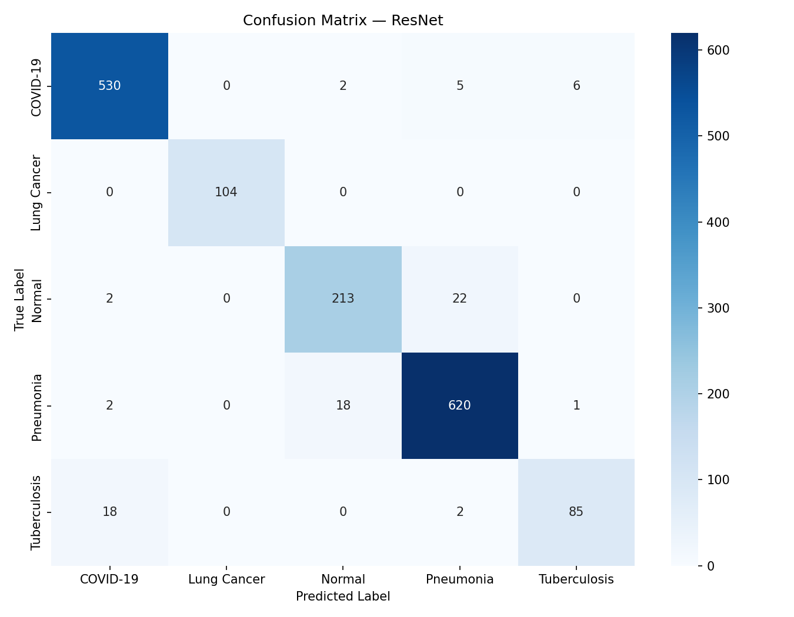
Per-Class Evaluation & Confusion Matrix
ResNet50 classification breakdown across individual thoracic diseases.
Class | Precision | Recall | F1-Score | Support
COVID-19 | 0.96 | 0.98 | 0.97 | 543
Lung Cancer | 1.00 | 1.00 | 1.00 | 104
Normal | 0.91 | 0.90 | 0.91 | 237
Pneumonia | 0.96 | 0.97 | 0.96 | 641
Tuberculosis | 0.92 | 0.81 | 0.86 | 105

Slide 11
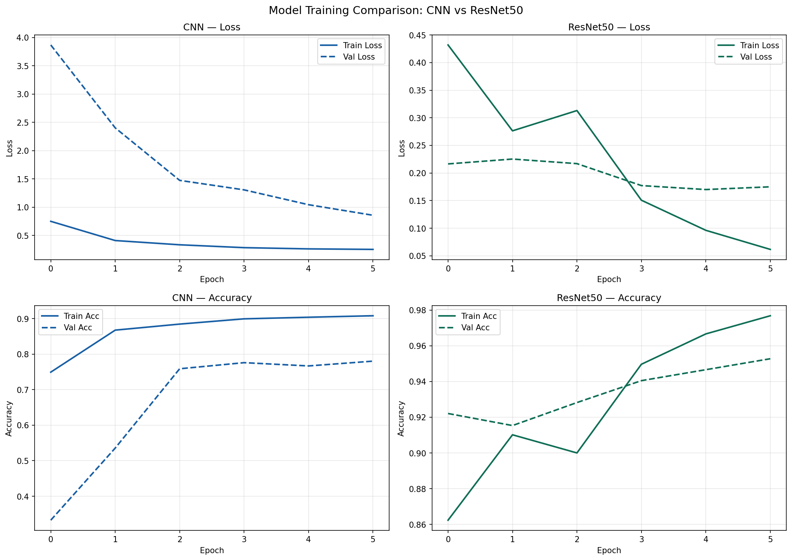
Training Dynamics & Loss Convergence
Monitoring training/validation loss curves for ResNet50 and CNN models.
📈 Key Observations
• Rapid Convergence: ResNet50 loss drops sharply within 2 transfer learning epochs.
• Minimal Overfitting: Validation loss closely tracks training loss throughout fine-tuning.
• Stable Optimization: Adam optimizer with learning rate decay prevents loss oscillations.
• Early Stopping Trigger: Validation loss plateaued at Epoch 6, saving optimal weights.

Slide 12
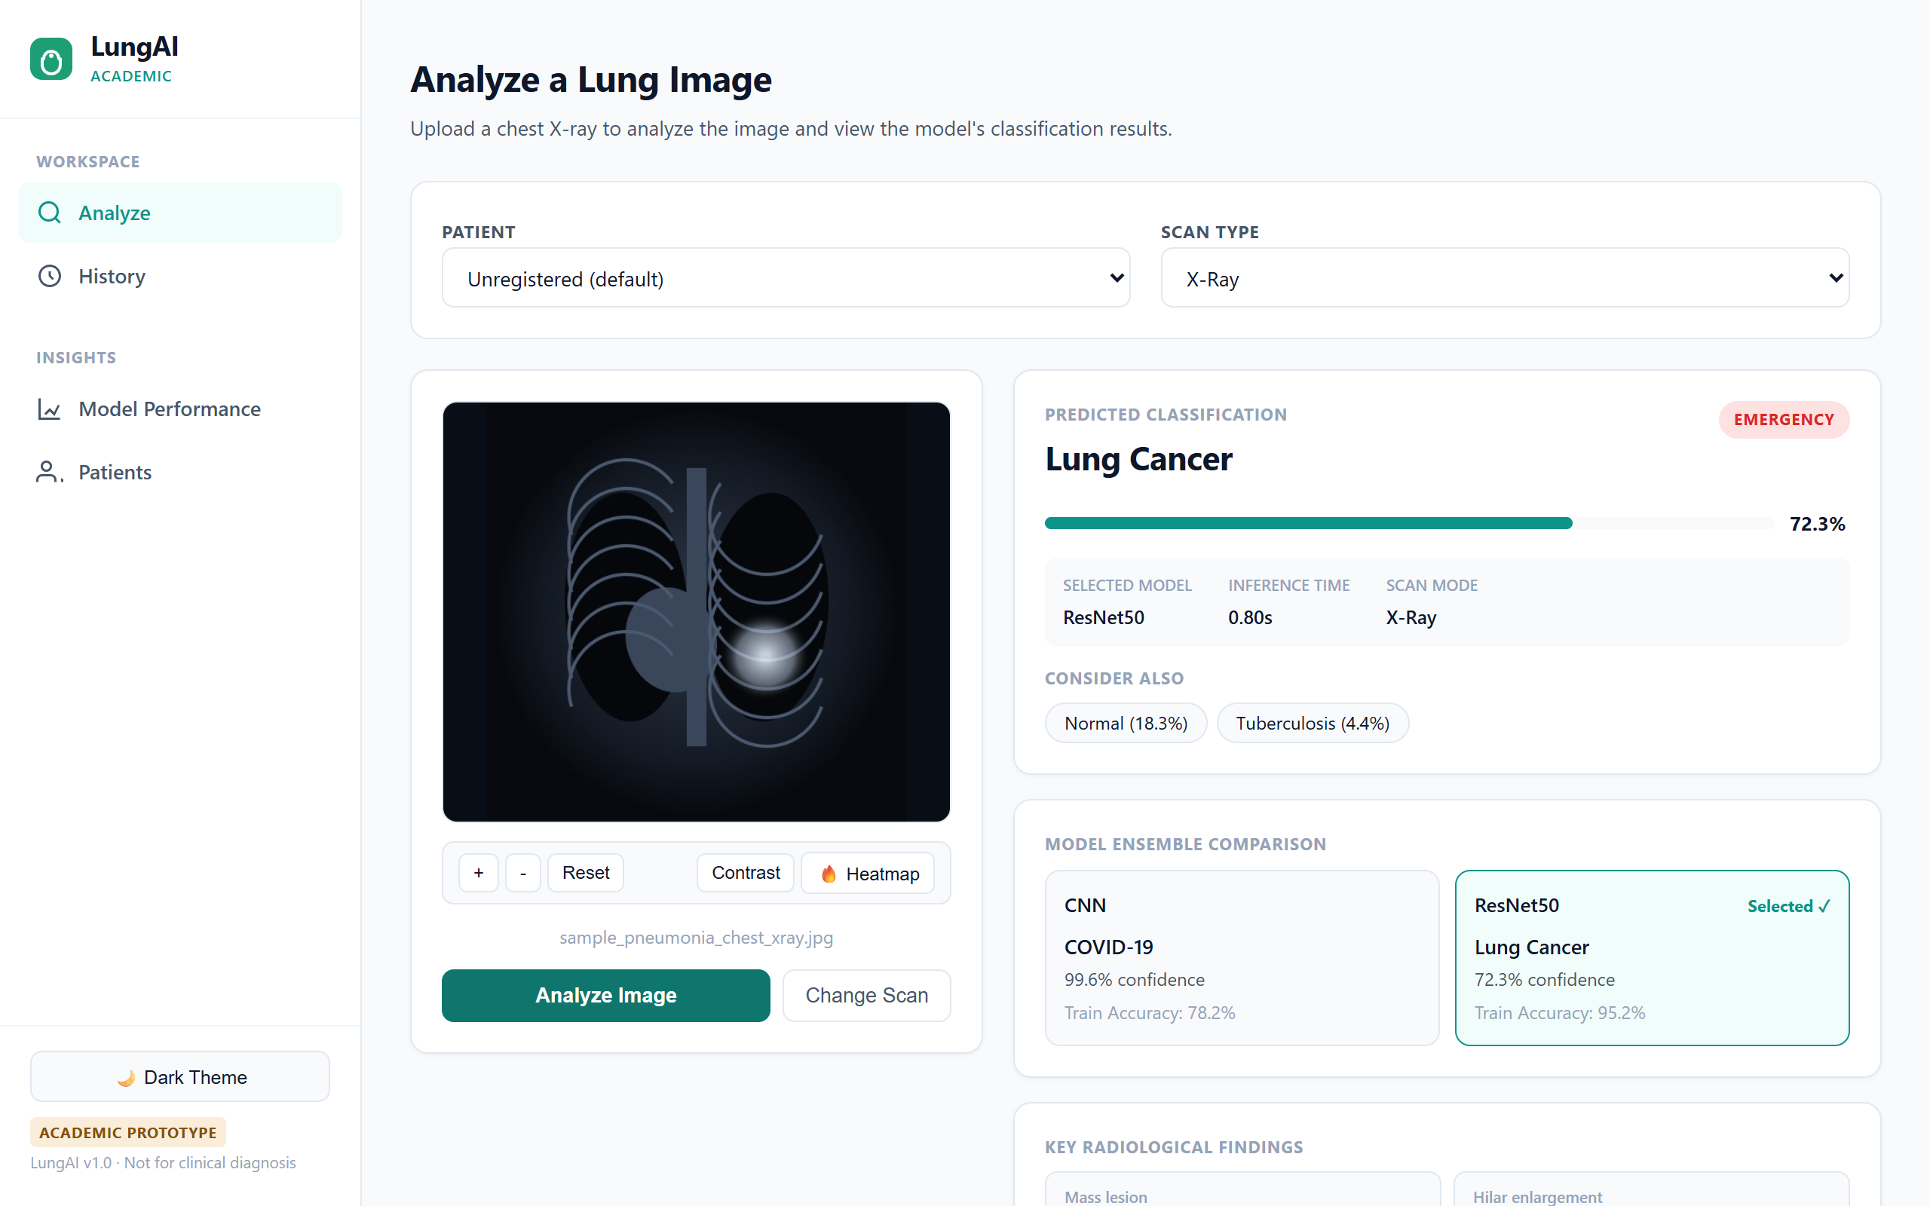
AI-Powered Workstation — Image Analysis & Classification
Interactive web dashboard with 1-click presets and windowing controls.
🖥️ Workstation Features
• Focal Dropzone: Drag & drop radiograph upload.
• 1-Click Presets: Instant demo testing (Normal, Pneumonia, COVID, TB).
• Windowing Tools: Zoom (1x-2.5x), High Contrast mode, Grad-CAM toggle.
• Urgency Category: Routine, Urgent, or Emergency status.
• Report Modal: Formatted PDF export.

Slide 13
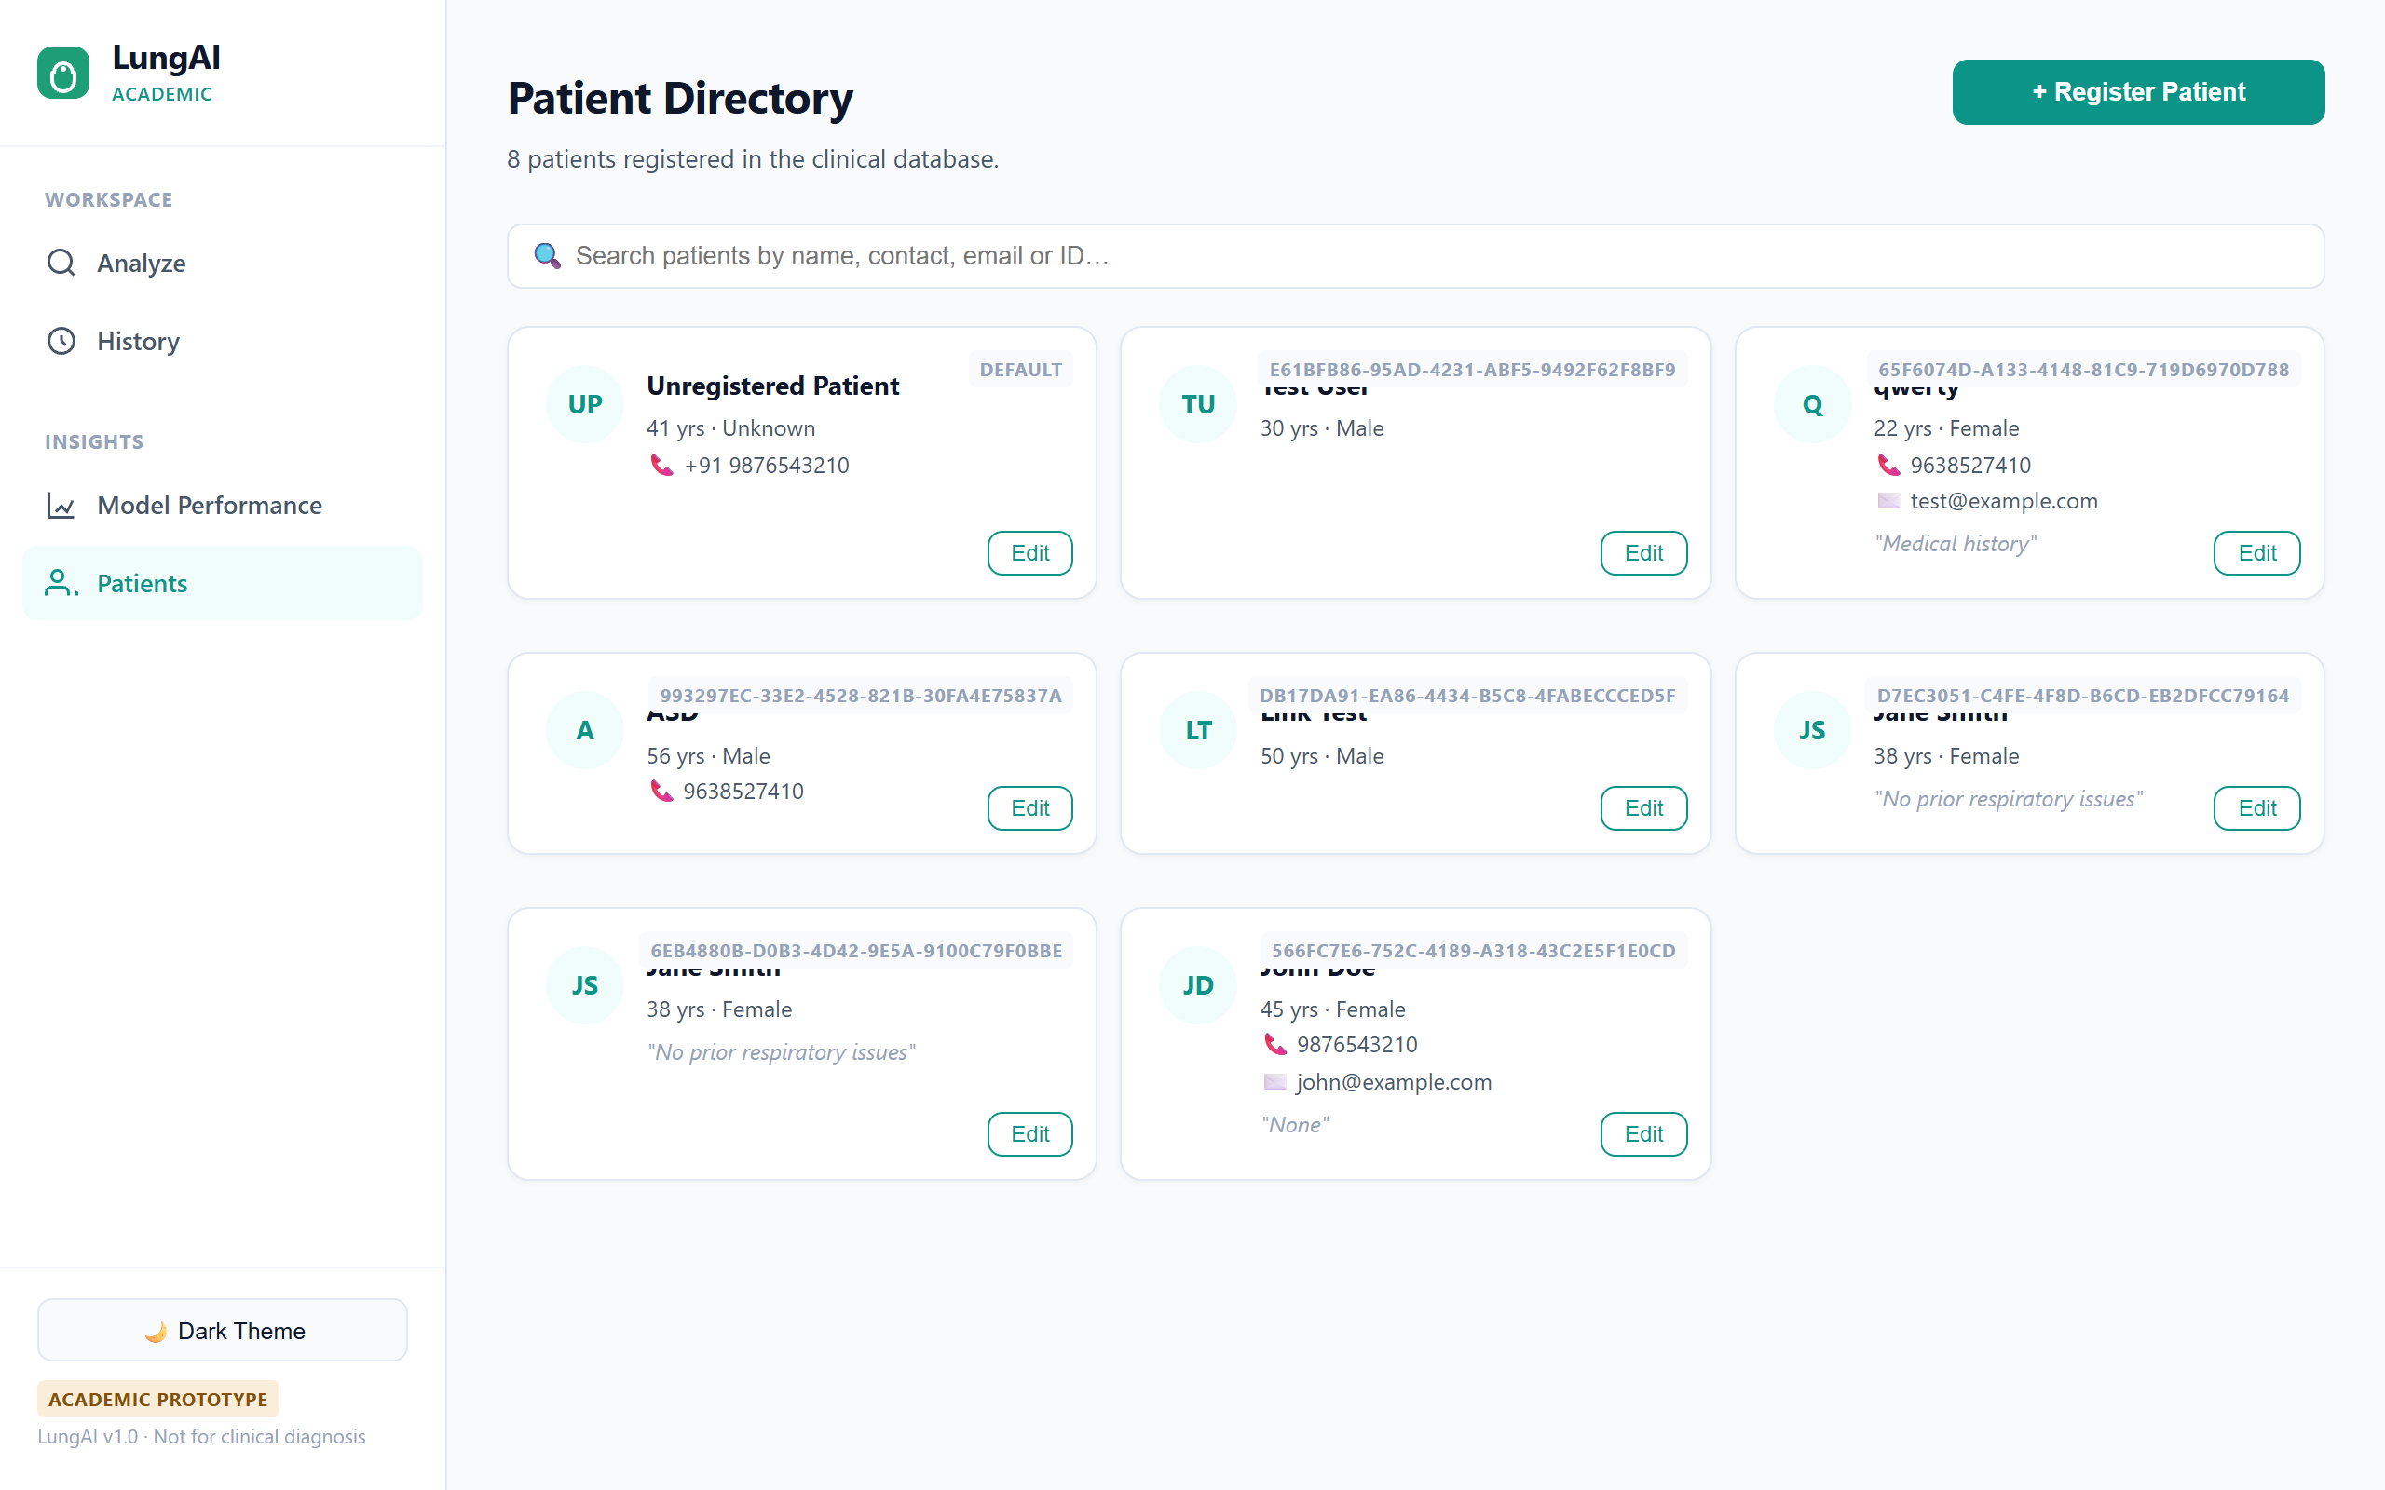
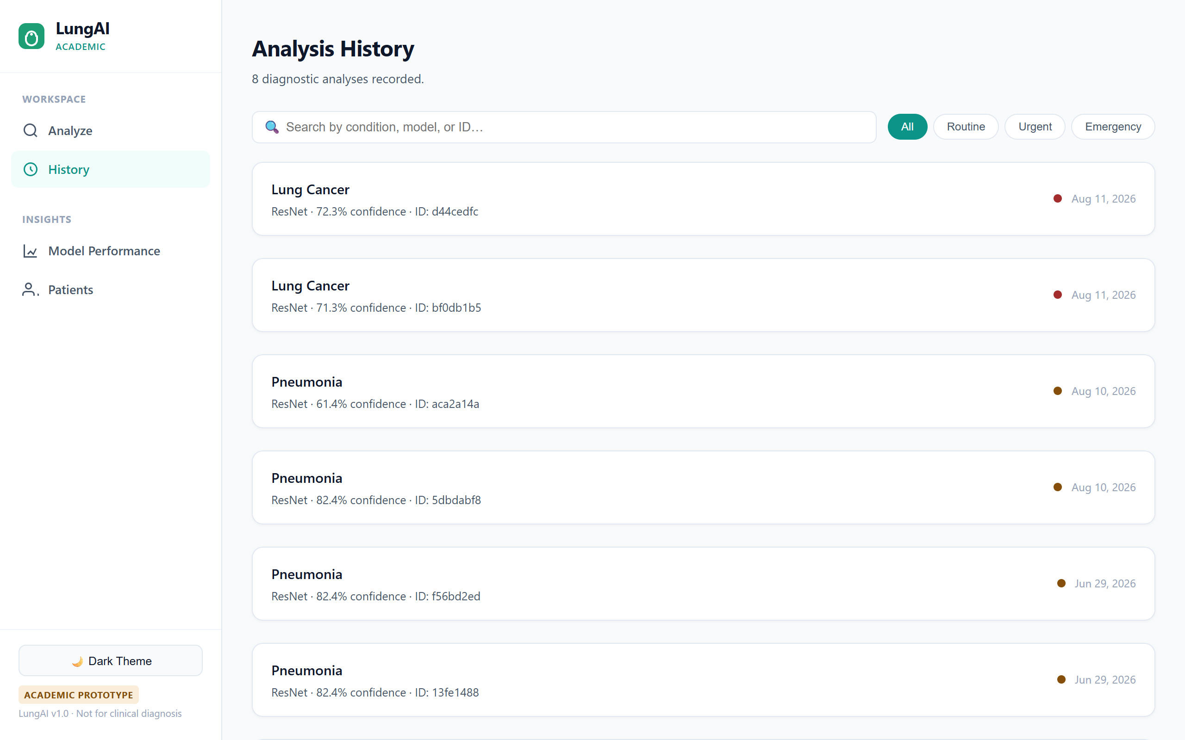
AI-Powered Workstation — Directory & History Audit Logs
Managing patient records and auditing past inference results.

Slide 14
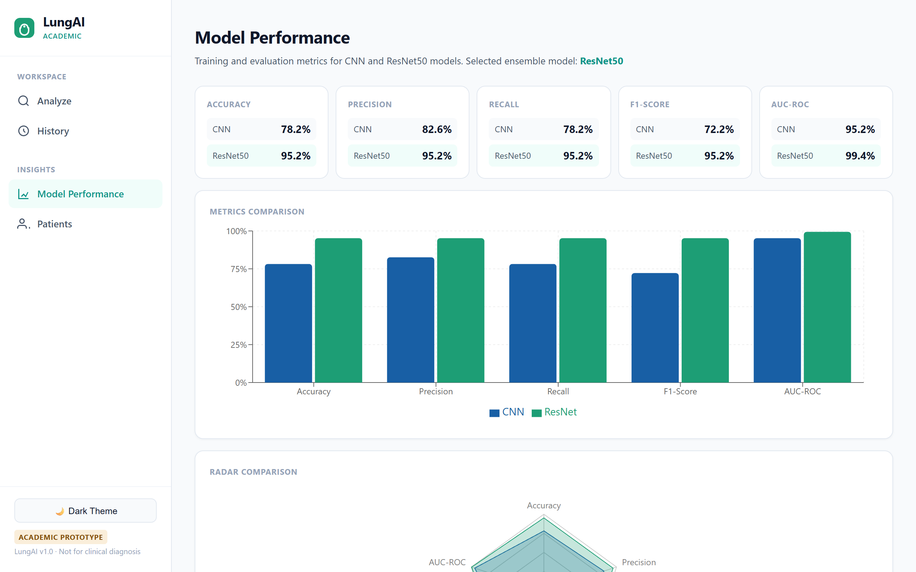
Model Performance Dashboard & PDF Reports
Interactive analytics and downloadable PDF classification summaries.
📊 Insights Features
• Recharts Analytics: Bar, Radar, and Loss curves comparing CNN vs ResNet50.
• Real-Time Metrics: Live query of trained benchmark endpoints.
• PDF Report Export: Print-ready structured classification summary.
• Search & Filters: Urgency filter pills (Routine, Urgent, Emergency).

Slide 15
Backend API Ecosystem & Test Suite
FastAPI web framework, Async SQLAlchemy ORM, and verified pytest suite.
FastAPI Service Layer
Asynchronous Python web server with auto-generated OpenAPI / Swagger docs (http://localhost:8000/docs).
SQLAlchemy ORM + SQLite
Relational database schema managing patient records, prediction logs, and report content.
22 / 22 Automated Tests Passed
Full pytest suite covering image preprocessing, ORM endpoints, and model inference in 1.44s.
Robust Exception Interceptors
Handles 422 validation errors, missing image files, and model loading errors gracefully.

Slide 16
Limitations & Academic Medical Disclaimer
Transparent disclosure of research scope and model boundaries.
⚠️ Known Model Limitations
• Tuberculosis Sensitivity: TB represents 6.44% of dataset images, resulting in 81% sensitivity. Low-confidence outputs automatically add advisory notes.
• Projection Modality: Preprocessing assumes standard PA/AP chest radiograph projections.
• Hardware Dependency: Inference runs on standard CPU/GPU hardware; optimal batch throughput achieved with CUDA acceleration.
⚕️ Academic Research Disclaimer
This software is an artificial intelligence research and educational prototype designed to demonstrate multi-class radiographic image classification and decision-support workflows. IT IS NOT CERTIFIED AS A MEDICAL DIAGNOSTIC DEVICE BY FDA, CE, OR ANY REGULATORY BODY. Predictions generated by this system must NOT be used for self-diagnosis or as a substitute for professional clinical evaluation by a qualified radiologist or physician.

Slide 17
🎉 Conclusion & Project Summary
✔ Verified Performance: Reached 95.21% test accuracy and 99.39% AUC-ROC with ResNet50 transfer learning.
✔ Production-Grade Software: Decoupled FastAPI backend + React 18 workstation with 22/22 unit tests passing.
✔ AI-Powered Workstation: Preset scan triggers, radiology windowing, Grad-CAM overlays, and PDF report exports.
✔ Open & Extensible: Fully documented GitHub repository with automated model downloader and Docker support.
Repository: https://github.com/KSathwik/Lung_Disease_Detector | LungAI v1.0.0

