Slide 1
LungAI DenseNet-121: Six-Class Chest X-Ray Classifier
An auditable, leakage-controlled rebuild with patient-grouped evaluation
Katkam Sathwik
Roll No. 24567T7604 | M.Tech, Computer Science and Engineering
Department of Computer Science and Engineering
KUCE&T (Kakatiya University College of Engineering and Technology)
Kakatiya University, Warangal, Telangana, India
Guide: Prof. Nagavelli Ramana, Principal and Head of the Department (CSE & IT), KUCE&T
Supporting faculty: Dr. P. Tirupathi, Assistant Professor, CSE, JNTUH University College of Engineering, Manthani
Dr. K. Srinivas, Assistant Professor, CSE, Swathi Reddy Institute of Technology for Women, Warangal
KUCE&T (Kakatiya University College of Engineering and Technology), Kakatiya University | M.Tech CSE | 2026
1
Notes:
Good morning. I am Katkam Sathwik, and this is my M.Tech project review under the guidance of Prof. Nagavelli Ramana. The project is LungAI, a six-class chest X-ray classifier with a web application. Its main point is not a high accuracy number but an evaluation that can be trusted: data rebuilt from official sources, patient-grouped splits and a once-only test. I will take about twenty minutes and then welcome questions.

Slide 2
Outline
Motivation, problem statement and objectives
Literature review and research gap
Audit of the earlier V5 model
Methodology: data, preprocessing, model, training, evaluation
System implementation and the CXR input gate
Results, demo, limitations, conclusion and future scope
KUCE&T (Kakatiya University College of Engineering and Technology), Kakatiya University | M.Tech CSE | 2026
2
Notes:
This is the plan of the talk. First I explain why the problem matters and what was wrong with the earlier version of the system. Then I describe the V6 method in the order in which it was executed: data, preprocessing, model, training and evaluation. After the application, I present results, limitations and the way forward.

Slide 3
Motivation
Chest X-ray (CXR) is the most widely available imaging test for lung disease
Radiologist access is limited, especially outside large centres
Public CXR datasets make deep-learning decision-support research feasible [wang2017chestxray8, rajpurkar2017chexnet]
Reported accuracies often fail to carry over to new hospitals [zech2018variable]
A decision-support tool is only useful if its evaluation is honest
KUCE&T (Kakatiya University College of Engineering and Technology), Kakatiya University | M.Tech CSE | 2026
3
Notes:
Chest radiography is cheap and common, but reading it needs trained radiologists who are not available everywhere. Large public datasets have made research on automatic CXR classification possible. However, studies show that models often lose performance on data from another hospital. So the motivation is twofold: build a working tool, and make the evaluation trustworthy enough that its numbers mean something.

Slide 4
Problem statement and objectives
Classify a frontal CXR into six exclusive classes: COVID-19, Normal, Pleural Effusion, Pneumonia, Pulmonary Nodule / Mass, Tuberculosis
O1-O2: rebuild the data from official sources with rule-based labels; patient-grouped splits; leakage checks pass (identity unknown for two sources)
O3-O4: train DenseNet-121 reproducibly; evaluate once on test and on an external cohort, with confidence intervals
O5: end-to-end application (FastAPI, React, Grad-CAM, SQLite)
O6: report limitations without overclaiming
KUCE&T (Kakatiya University College of Engineering and Technology), Kakatiya University | M.Tech CSE | 2026
4
Notes:
The problem is single-label, six-class classification of chest X-rays. The classes are treated as mutually exclusive, which is itself a limitation I return to. The harder part is methodological: traceable labels, no patient crossing splits, and an external cohort. O1 and O2 are about data integrity, O3 and O4 about training and evaluation, O5 the software, O6 honest reporting. The model is a research prototype, not a clinical device.

Slide 5
Literature review in brief
Theme | Representative works (citation keys)
Large CXR datasets | wang2017chestxray8, irvin2019chexpert, johnson2019mimic, nguyen2022vindr
TB and pneumonia sets | jaeger2014two, liu2020rethinking, kermany2018identifying
COVID-19 CXR classifiers | wang2020covidnet, apostolopoulos2020covid, chowdhury2020can
Backbones and tools | huang2017densely, deng2009imagenet, selvaraju2017gradcam
Pitfalls and shortcuts | zech2018variable, degrave2021ai, geirhos2020shortcut, roberts2021common, maguolo2020critic
Dataset quality, bias | oakdenrayner2020exploring, seyyedkalantari2021underdiagnosis, wynants2020prediction
KUCE&T (Kakatiya University College of Engineering and Technology), Kakatiya University | M.Tech CSE | 2026
5
Notes:
The literature falls into six groups. Large public datasets enabled the field, and DenseNet with ImageNet pretraining is a common backbone. A second body of work warns that results on COVID-19 and other CXR tasks are often inflated by shortcuts, duplicate patients or source differences. We build on the datasets and the backbone, and we take the warnings as design requirements. Full citations are in the references slide and the report.

Slide 6
Research gap
Some CXR studies report results on a random image-level split
Patient identity and label provenance are often undocumented
External evaluation is often missing, and specificity is not always reported with sensitivity [roberts2021common, zech2018variable]
Source and acquisition shortcuts are not always tested [degrave2021ai, geirhos2020shortcut]
Some projects do not release an auditable pipeline from raw data to served metrics
KUCE&T (Kakatiya University College of Engineering and Technology), Kakatiya University | M.Tech CSE | 2026
6
Notes:
The gap is not a missing architecture. DenseNet-121 is well known. The gap is in evaluation hygiene: patient-grouped splits, documented label rules, external testing and a reproducible path from raw data to the numbers shown in the application. Our contribution is therefore a leakage-controlled, auditable rebuild rather than a new network. We make no claim of novelty beyond that.

Slide 7
Why rebuild? Audit of the V5 model
V5 recorded 82.9% internal accuracy (N = 1,570 test images)
Patient leakage: 154 test images (9.8%) shared a patient with training
Proxy labels: half of "Pneumonia" was TBX11K "sick but not TB"; 124 TB labels were latent TB
External check on Montgomery: 0 of 80 normal scans called Normal
V5 checkpoint is lost, so it cannot be re-evaluated; V6 starts from the raw sources
KUCE&T (Kakatiya University College of Engineering and Technology), Kakatiya University | M.Tech CSE | 2026
7
Notes:
Before this project's V6, an earlier model reported nearly 83 percent internal accuracy. My audit found that 154 of its 1,570 test images came from patients also present in training, that several labels were proxies rather than true diagnoses, and that on an external cohort it called none of 80 normal scans normal. The V5 checkpoint was lost, so I could not re-evaluate it. These findings motivated rebuilding everything from official sources with patient-grouped splits.

Slide 8
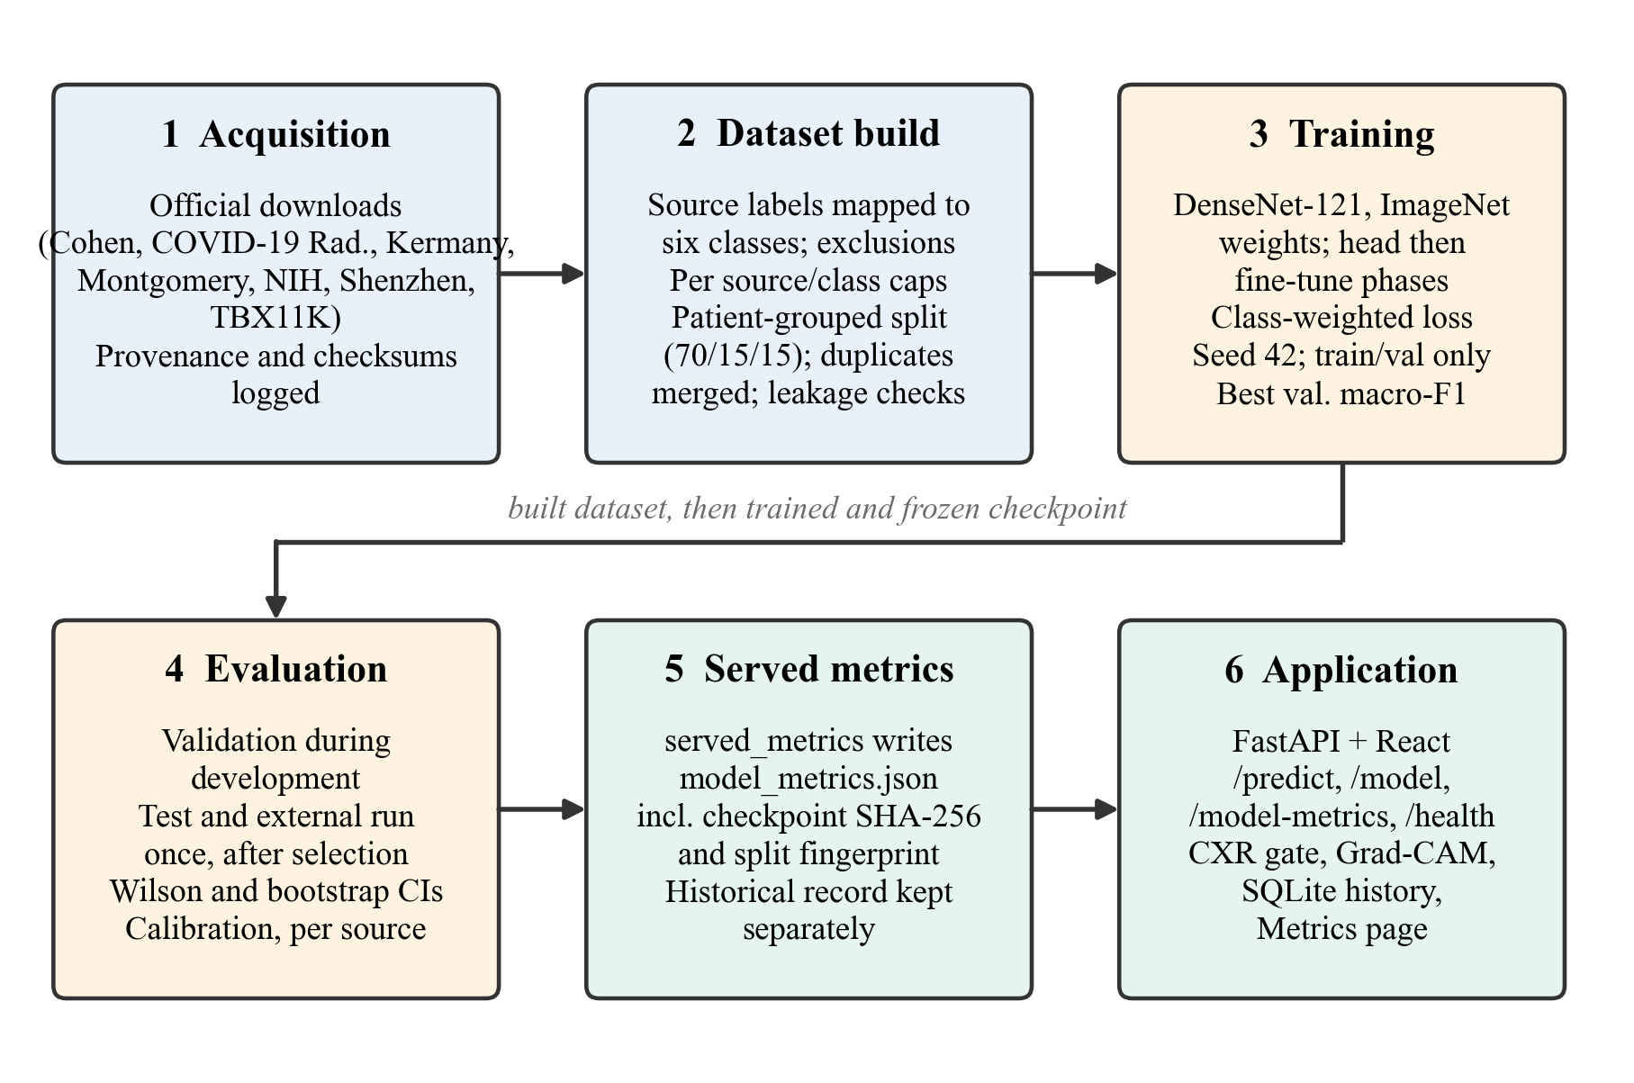
Methodology: end-to-end pipeline
Acquisition, build (labels, caps, grouped split, leakage checks), training, once-only evaluation, served metrics.
KUCE&T (Kakatiya University College of Engineering and Technology), Kakatiya University | M.Tech CSE | 2026
8
Notes:
This is the whole pipeline. Raw data is acquired from official sources with recorded hashes. The build step applies label rules, per-class caps, a patient-grouped split and leakage checks. Training sees only the train and validation splits. Test and external data are evaluated once. The final metrics file is what the web application serves, so the numbers in the app are the numbers in the report.

Slide 9
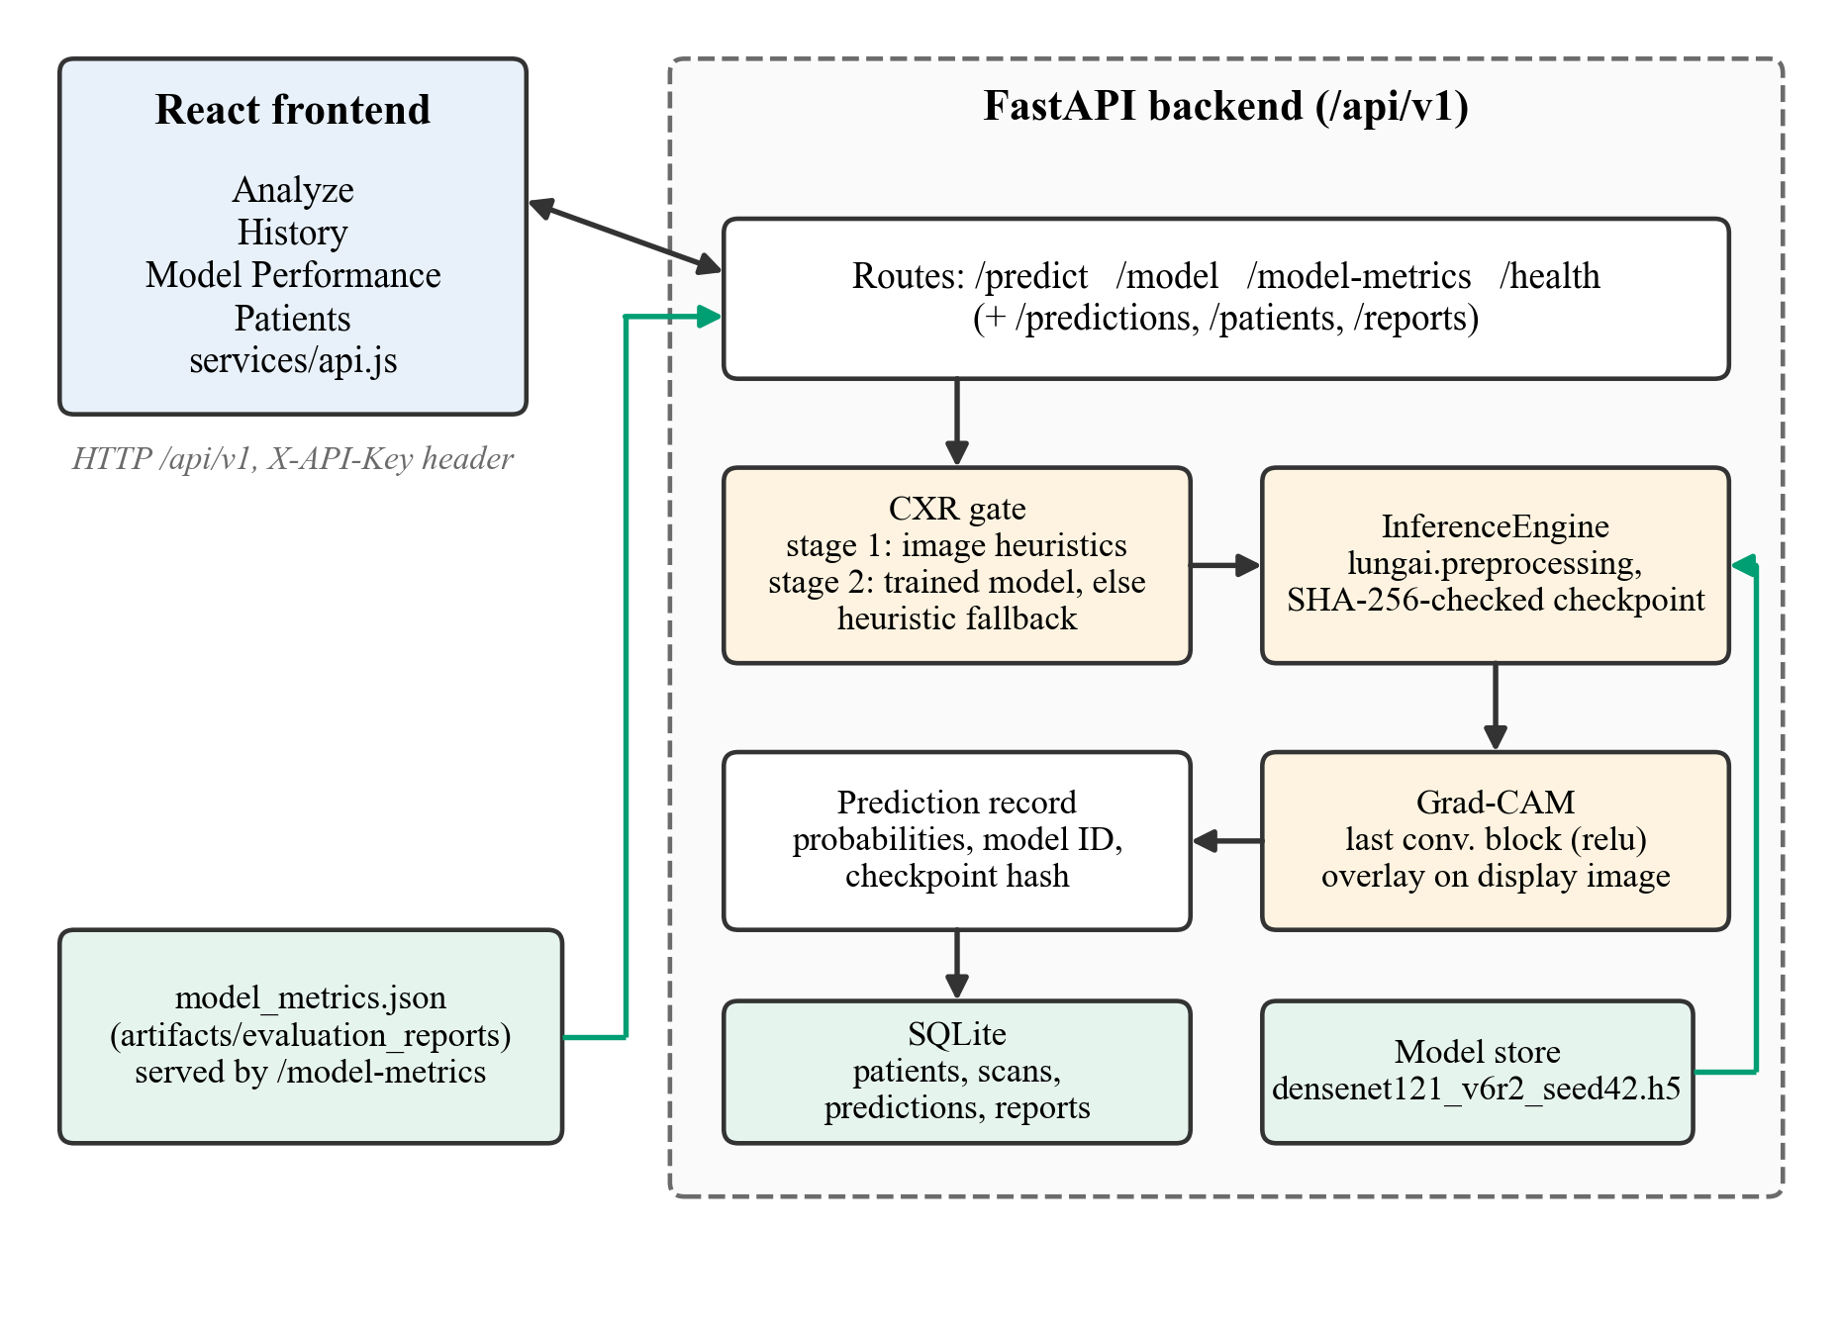
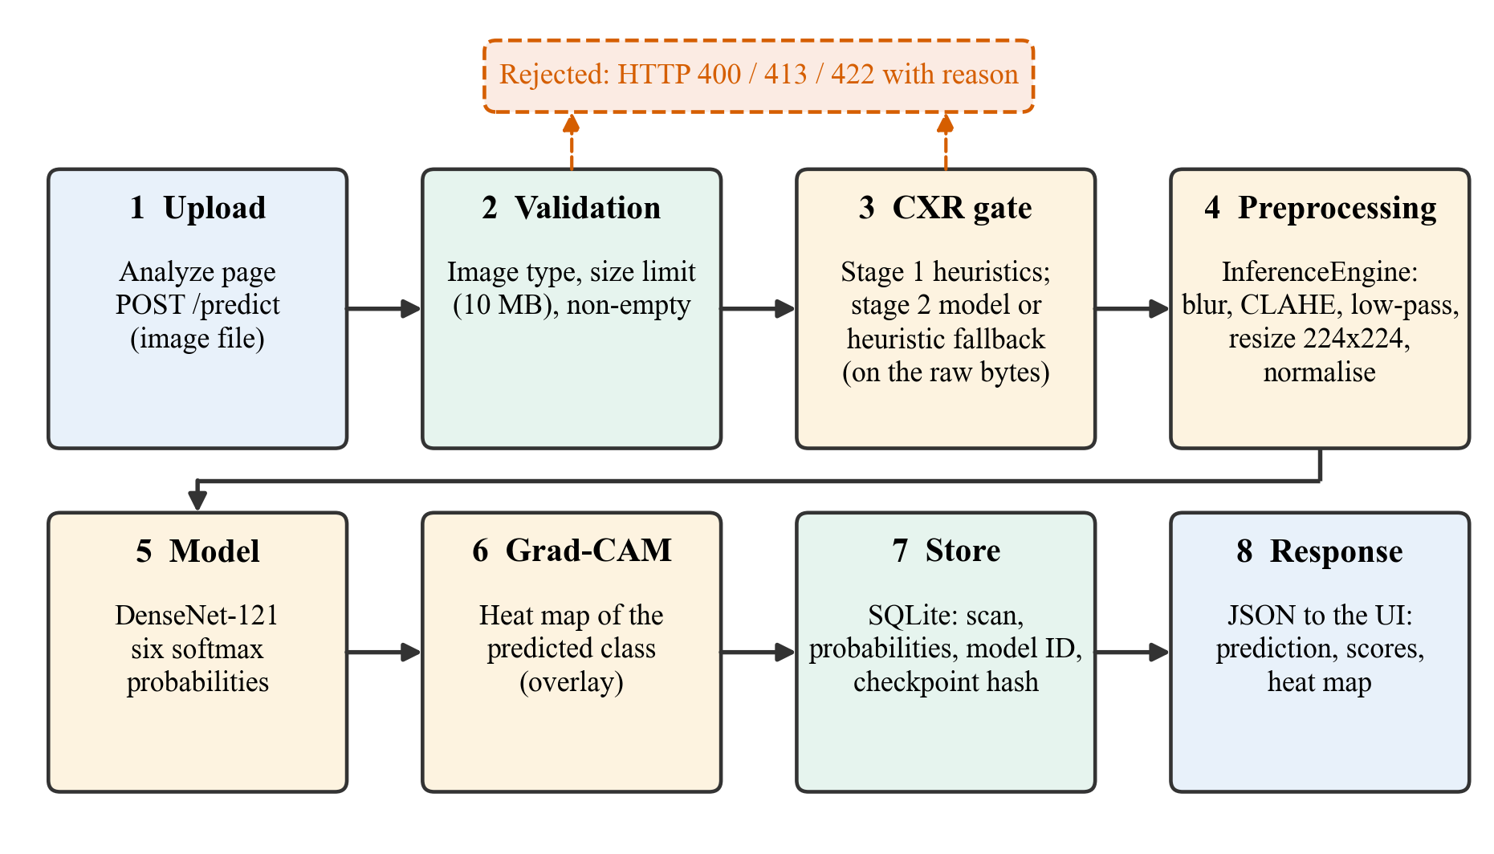
System architecture and request data flow
Left: frontend, backend, CXR gate, inference, Grad-CAM, SQLite. Right: one prediction request from upload to interface.
KUCE&T (Kakatiya University College of Engineering and Technology), Kakatiya University | M.Tech CSE | 2026
9
Notes:
The application has a React frontend and a FastAPI backend. The backend validates the upload, runs the CXR gate, preprocesses the image and calls the inference engine. Grad-CAM is computed from the last convolutional block and results are stored in SQLite. The checkpoint is verified by SHA-256 before loading. The right diagram follows one request: upload, validation, gate, preprocessing, model, Grad-CAM, database, interface. Using identical preprocessing code for training and serving avoids train-serve mismatch.

Slide 10
Datasets and sources
Source | Used for | Notes
NIH ChestX-ray14 [wang2017chestxray8] | Normal, Effusion, Nodule/Mass, Pneumonia | One finding only; one image per patient
Kermany paediatric CXR [kermany2018identifying] | Normal, Pneumonia | Mendeley v2
Shenzhen (NLM) [jaeger2014two] | Normal, Tuberculosis | Source label only
TBX11K [liu2020rethinking] | Normal, active TB | Run 2; patient identity unknown
COVID-19 data [cohen2020covid, chowdhury2020can] | COVID-19 | Radiography Database added in run 2
Montgomery [jaeger2014two] | External cohort only | 138 images; never in training
KUCE&T (Kakatiya University College of Engineering and Technology), Kakatiya University | M.Tech CSE | 2026
10
Notes:
The training data comes from public, official sources only. NIH ChestX-ray14 supplies effusion, nodule or mass, pneumonia and normal images; Shenzhen and TBX11K supply tuberculosis. VinDr-CXR and JSRT could not be obtained in time, so effusion and nodules come from NIH alone. Montgomery is held out as an external cohort and never enters development. TBX11K and the COVID-19 Radiography Database have no patient identity, so each image is its own group, which I state as a limitation.

Slide 11
Cleaning, label rules, grouped split, leakage checks
Every image records its rule ID, or the reason it was excluded; TB label only from a TB source label
Excluded: multi-finding NIH images, TBX11K "sick but non-TB" and latent TB, Rahman TB archive
Split by patient group: train 10,957, validation 2,348, test 2,350 (final build)
Checks: disjoint groups, MD5/SHA-256 duplicates, perceptual-hash near-duplicates; build stops on a violation
Residual risk: unknown identity (grouped per image) for TBX11K and COVID-19 Radiography rows
KUCE&T (Kakatiya University College of Engineering and Technology), Kakatiya University | M.Tech CSE | 2026
11
Notes:
Labelling rules were fixed before any training, in a configuration file. Each image keeps its source label, the rule that produced the class, and a hash of the raw file. I excluded images whose label would be a proxy, such as sick-but-not-TB, and an aggregated archive whose provenance was unclear. Splitting is on patient groups, and the builder checks leakage automatically: disjoint groups, exact hashes and perceptual hashes. The split fingerprint and manifest hash are saved with each run. For sources without patient identity the group is the image itself, which cannot detect hidden duplicates of one patient. I state that residual risk openly.

Slide 12
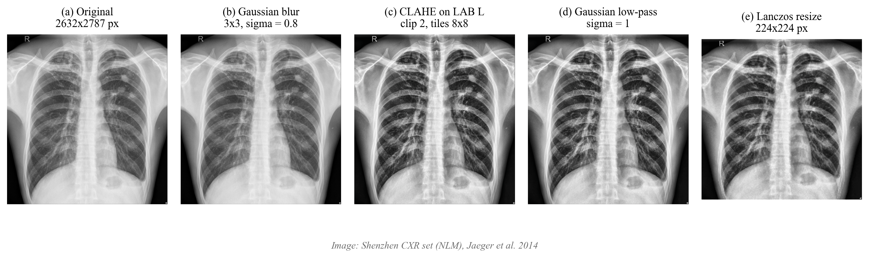
Preprocessing
One radiograph through blur, CLAHE, low-pass filter and resize to 224 x 224.
KUCE&T (Kakatiya University College of Engineering and Technology), Kakatiya University | M.Tech CSE | 2026
12
Notes:
Preprocessing has four steps: a light Gaussian blur, contrast-limited adaptive histogram equalisation on the luminance channel, a Gaussian low-pass filter, and resize to 224 by 224. CLAHE improves local contrast [zuiderveld1994contrast, pizer1987adaptive]. The filters run at native resolution before resizing, which makes the effective filter resolution dependent. This is a documented limitation. Training and serving use the same code.

Slide 13
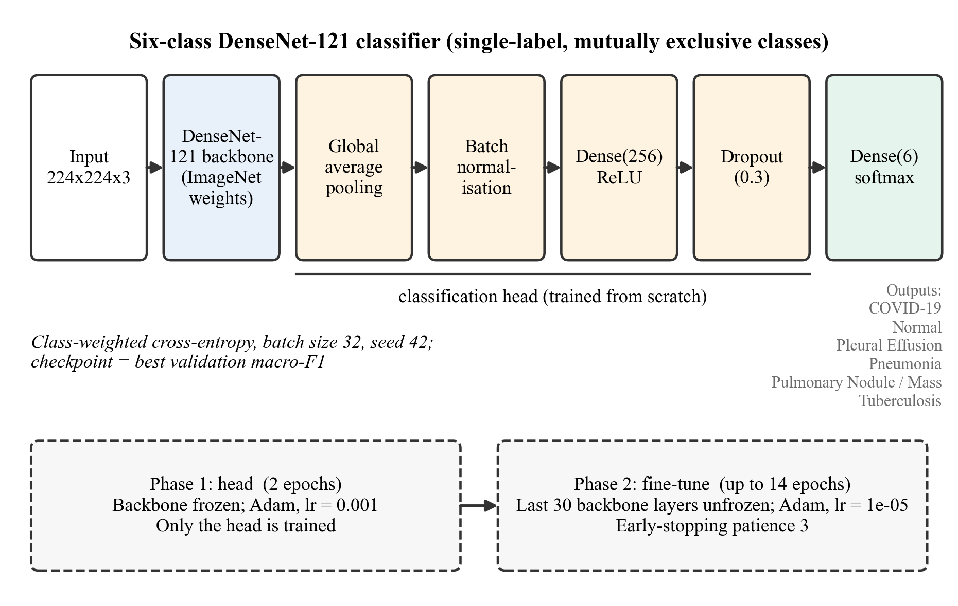
Model architecture
DenseNet-121, global average pooling, BatchNorm, Dense(256), Dropout(0.3), Dense(6, softmax).
KUCE&T (Kakatiya University College of Engineering and Technology), Kakatiya University | M.Tech CSE | 2026
13
Notes:
The model is DenseNet-121 pretrained on ImageNet [huang2017densely, deng2009imagenet]. On top we add global average pooling, batch normalisation, a 256-unit dense layer with dropout 0.3, and a six-way softmax. Training is in two phases: first only the head, then the last 30 backbone layers. Grad-CAM uses the last convolutional activations of the backbone [selvaraju2017gradcam].

Slide 14
Training protocol
Phase 1: 2 epochs, backbone frozen, Adam, learning rate 1e-3 [kingma2015adam]
Phase 2: last 30 layers trainable, learning rate 1e-5, early stopping (patience 3)
Batch 32, class-balanced sample weights, flip and 10 degree rotation
Checkpoint selected on validation macro-F1 only (tie: validation AUC)
Final model: seed 42; seeds 43 and 44 and a no-filter ablation are on the robustness slide; CPU only, time-boxed
Final model (run 2): 16 epochs trained, best validation macro-F1 at epoch 16 (the last)
KUCE&T (Kakatiya University College of Engineering and Technology), Kakatiya University | M.Tech CSE | 2026
14
Notes:
Training has two phases, a frozen backbone followed by gentle fine-tuning. The checkpoint is chosen by validation macro-F1, never by test results. Because this was done on a laptop CPU with a time limit, the final model is a single run with seed 42. Two further seeds and one ablation run were done afterwards and are shown on the robustness slide. Run 2, the final model, completed its full schedule; the best epoch was the last one and validation was still rising slightly. I do not claim longer training would help.

Slide 15
Evaluation protocol
Test split and external cohort are each evaluated once, after model selection
Accuracy; per-class precision, recall, specificity, F1; macro ROC-AUC, PR-AUC
95% Wilson confidence intervals for proportions [wilson1927probable]
Calibration: ECE and reliability diagram [guo2017calibration]
External cohort is binary (normal vs TB); sensitivity always with specificity
No comparison with other papers' numbers on different test sets
KUCE&T (Kakatiya University College of Engineering and Technology), Kakatiya University | M.Tech CSE | 2026
15
Notes:
The evaluation protocol is deliberately strict. Test and external data are used exactly once. Proportions carry Wilson intervals, and calibration is reported because probabilities are shown to users. Montgomery has only normal and TB scans, so external evaluation is binary. Sensitivity without specificity is meaningless for a screening tool, so they are always shown together. I do not compare my numbers with published numbers, since test sets differ.

Slide 16
Implementation and the CXR gate
Backend: FastAPI; checkpoint SHA-256 check; predict, health, metrics endpoints
Frontend: React upload page, probabilities, Grad-CAM overlay, history; SQLite storage
Gate: heuristic fallback (trained gate model absent); non-radiographs get HTTP 422
Threshold 0.83 rejected 1,494/2,350 (63.6%) of build-2 test radiographs; recalibrated to 0.703 on validation
Same split after: 218/2,350 (9.3%); Montgomery 83 to 18 of 138
All synthetic non-radiographs are still rejected; no real non-radiograph set exists
KUCE&T (Kakatiya University College of Engineering and Technology), Kakatiya University | M.Tech CSE | 2026
16
Notes:
The backend is FastAPI and the frontend is React. The backend refuses a checkpoint whose hash does not match the recorded one. The input gate is a heuristic, because a trained gate model is not available. The problem was first noticed on the build-1 test split, where the original threshold rejected 1,096 of 1,724 genuine radiographs; on the build-2 test split it rejects 1,494 of 2,350, so the application would refuse most real X-rays. I recalibrated the threshold from 0.83 to 0.703 on validation radiographs. On the same build-2 test split, rejection fell from 63.6 to 9.3 percent, and on Montgomery (the same set) from 60.1 to 13.0 percent; the validation pass rate rose from 38.7 to 91.0 percent. All synthetic non-radiographs are still rejected, but there is no real set of non-radiographs, so the gate remains a limited safeguard, and the model metrics are computed without it.

Slide 17
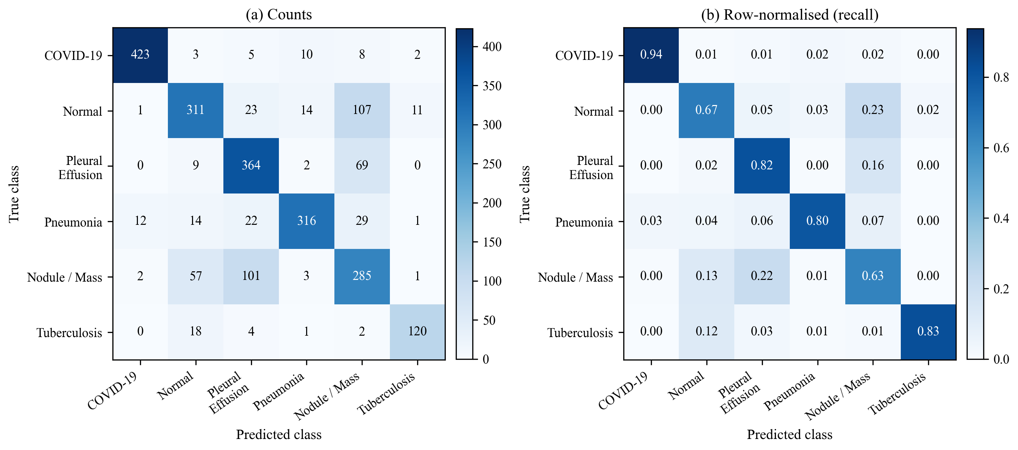
Results: internal test (final model v6.1, run 2)
Metric | Value
Test images | 2,350
Accuracy | 77.4% (95% Wilson CI 75.7-79.0)
Macro-F1 | 78.8%
Macro recall | 78.1%
Macro ROC-AUC | 0.955
Macro PR-AUC | 0.849
Errors concentrate in Nodule / Mass and Normal, the weakest classes
Test confusion matrix (evaluated once).
KUCE&T (Kakatiya University College of Engineering and Technology), Kakatiya University | M.Tech CSE | 2026
17
Notes:
These are the internal test results of the final model, v6.1, which is run 2 with seed 42. The test split was evaluated once. The 95% Wilson interval is shown for accuracy only (the percentile bootstrap gives 75.8 to 79.1); no interval is shown for macro-F1. Macro ROC-AUC is higher than accuracy because AUC measures ranking, not the decision threshold. The confusion matrix shows that errors concentrate on Pulmonary Nodule / Mass and Normal. Nodule/Mass and Pleural Effusion are NIH-only classes with NLP-mined labels. These are internal numbers; the external cohort later shows they overstate behaviour on an unseen hospital.

Slide 18
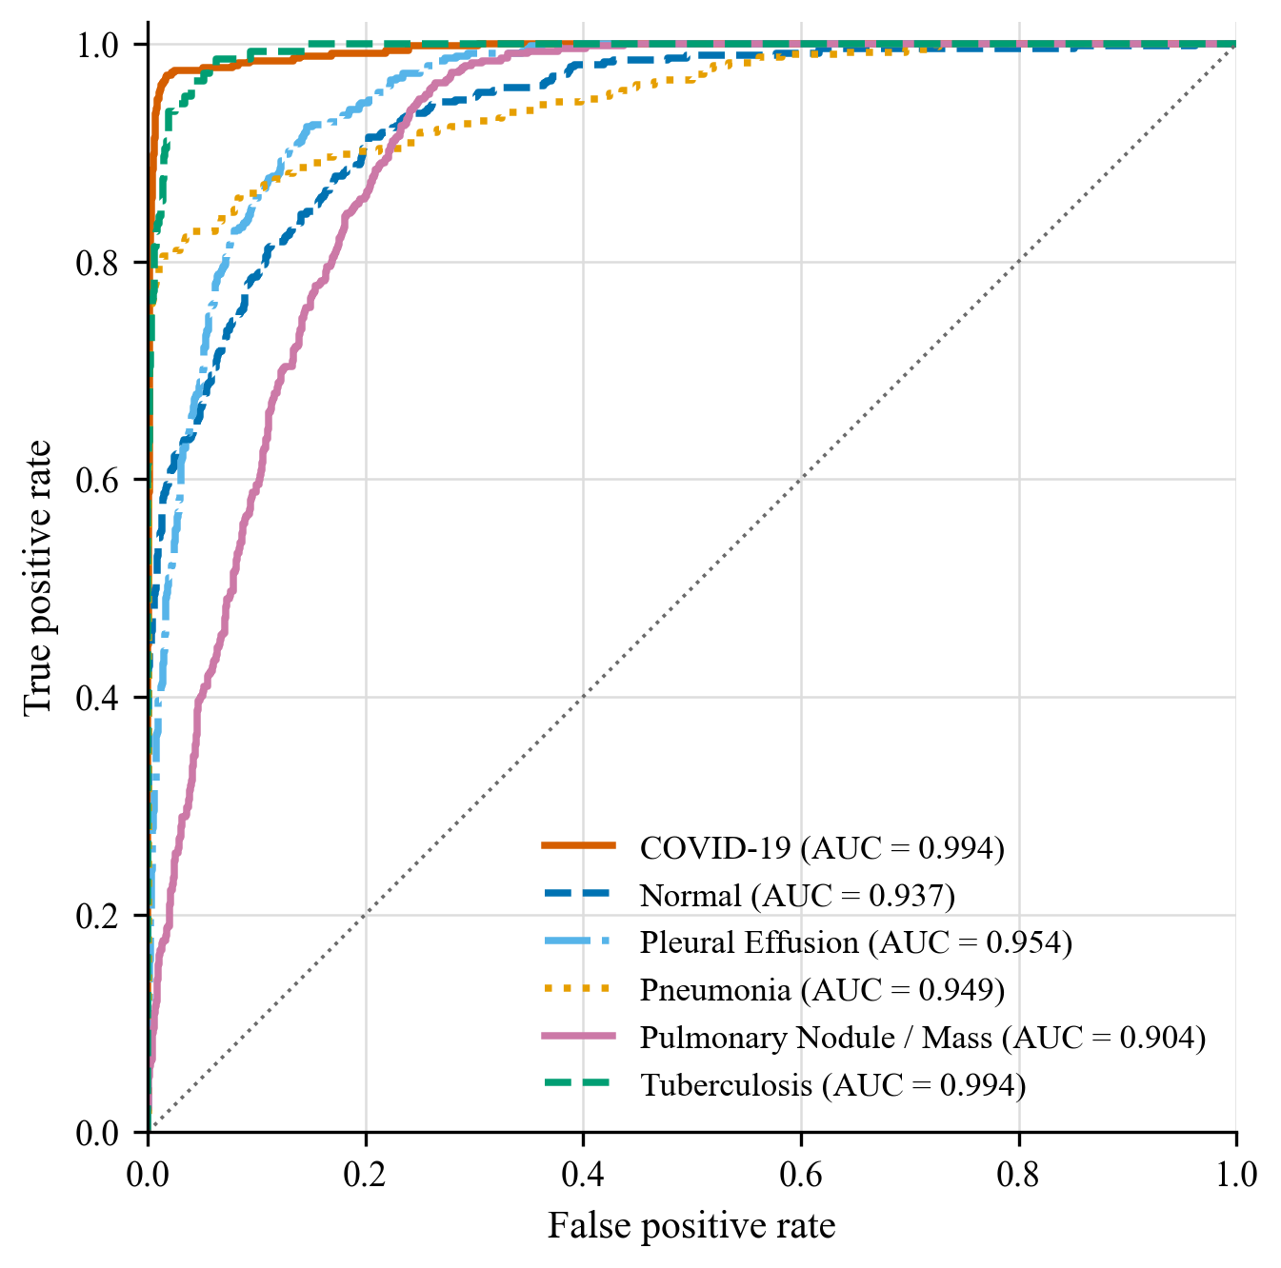
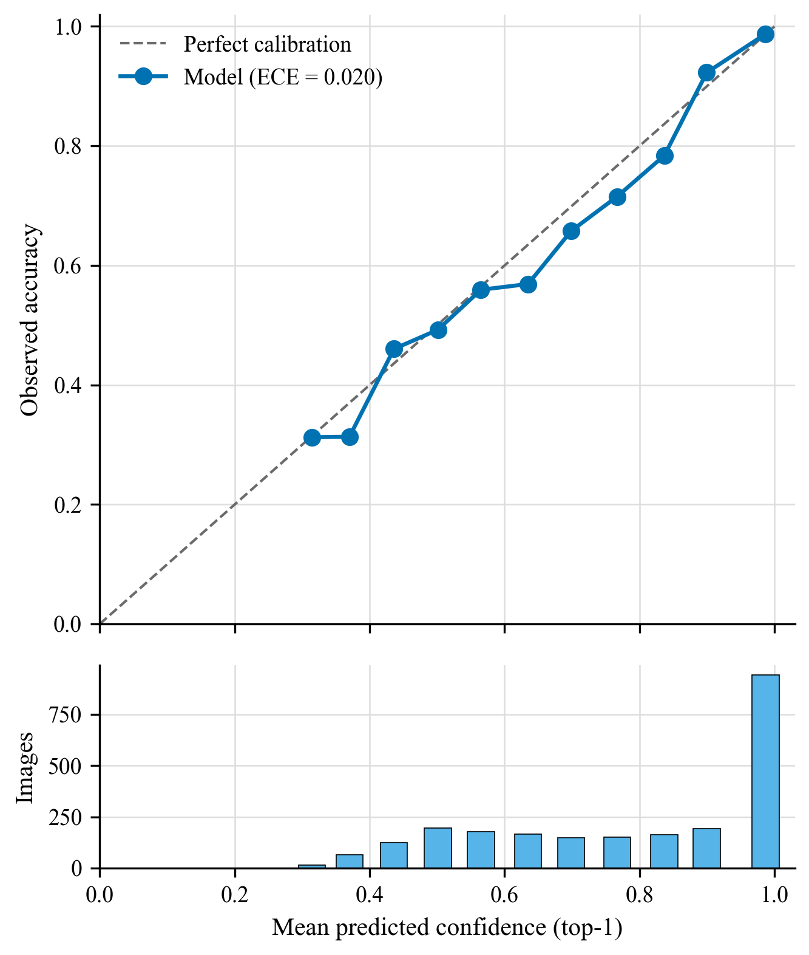
ROC curves and calibration
One-vs-rest ROC curves (left); reliability diagram on the test split (right), ECE 0.020.
AUC highest: COVID-19 0.994, TB 0.994; lowest: Normal 0.937, Nodule 0.904
KUCE&T (Kakatiya University College of Engineering and Technology), Kakatiya University | M.Tech CSE | 2026
18
Notes:
The left panel shows one-versus-rest ROC curves on the test split. By ROC-AUC, COVID-19 (0.994) and Tuberculosis (0.994) are highest, then Pleural Effusion (0.954) and Pneumonia (0.949); Normal (0.937) and Pulmonary Nodule / Mass (0.904) are lowest. The right panel is the reliability diagram: predicted confidence against observed accuracy, with expected calibration error 0.020 in the caption. Calibration matters because the application shows probabilities to users. Per-class precision, recall and F1 follow in the next table.

Slide 19
Per-class results (test, final model v6.1)
Class | n | Precision % | Recall % | F1 % | AUC
COVID-19 | 451 | 96.6 | 93.8 | 95.2 | 0.994
Normal | 467 | 75.5 | 66.6 | 70.8 | 0.937
Pleural Effusion | 444 | 70.1 | 82.0 | 75.6 | 0.954
Pneumonia | 394 | 91.3 | 80.2 | 85.4 | 0.949
Nodule / Mass | 449 | 57.0 | 63.5 | 60.1 | 0.904
Tuberculosis | 145 | 88.9 | 82.8 | 85.7 | 0.994
Best F1: COVID-19, Tuberculosis, Pneumonia; weakest: Nodule / Mass (60.1%), Normal (70.8%)
Source is confounded with class (next slides): high scores are not proof of reliability
KUCE&T (Kakatiya University College of Engineering and Technology), Kakatiya University | M.Tech CSE | 2026
19
Notes:
This table gives precision, recall, F1 and AUC per class. Support differs a lot between classes, so some estimates are less certain than others. The strongest classes by F1 are COVID-19, Tuberculosis and Pneumonia; the weakest are Pulmonary Nodule / Mass and then Normal. I do not rank sources by data quality. High class scores do not by themselves show clinical reliability, because source differences can act as shortcuts, as the next slides examine.

Slide 20
External evaluation (Montgomery, final model, binary)
Measure | Value | 95% Wilson CI
Sensitivity (TB scans called abnormal) | 55/58 = 94.8% | 85.9-98.2%
Specificity (normal scans called normal) | 19/80 = 23.8% | 15.8-34.1%
Binary AUC | 0.809 | not computed
Exact TB class on TB scans | 0/58 = 0.0% | not computed
Run 1: 71 of 138 scans called COVID-19, 43/80 normals Normal. Run 2: 3 COVID-19, 19/80 Normal
Run 1's COVID-19 calls fell with build 2 (which adds several sources), but errors moved to other abnormal classes: consistent with, not proof of, a source shortcut; V5 specificity was 0/80
KUCE&T (Kakatiya University College of Engineering and Technology), Kakatiya University | M.Tech CSE | 2026
20
Notes:
The external cohort is Montgomery, with 58 TB and 80 normal scans, evaluated as a binary task. Each model was evaluated on it once. Sensitivity is only meaningful with specificity. Specificity is low: the model would flag most healthy patients from this hospital as abnormal. Exact TB recognition is 0 of 58. Run 1 called 71 of 138 scans COVID-19 and 43 of 80 normals Normal (run-1 external evaluation). Run 2 calls 3 COVID-19 and 19 of 80 Normal. Interpretation: run 1's COVID-19 calls fell sharply when build 2 was used, but the external errors shifted to other abnormal classes, mostly Pneumonia and Nodule/Mass. Build 2 changed several sources at once (TBX11K, COVID-19 Radiography, two more NIH archives), so this is consistent with, but does not prove, a source shortcut; the evidence is indirect. Internal gains did not translate into better external specificity or any TB recognition.

Slide 21
Model selection: run 1 vs run 2 on a common validation set
Measure | Run 1 | Run 2
Common validation images | 2,018 | 2,018
Macro-F1 | 59.4% | 79.6%
Accuracy | 63.5% | 77.0%
Macro ROC-AUC | 0.880 | 0.957
Shared sources only (n = 1,392): accuracy | 67.6% | 67.8%
Shared sources only: macro-F1 | 62.2% | 68.5%
Caveat: much of run 2's edge is on TBX11K and COVID-19 Radiography images, in-distribution for run 2 only
McNemar discordant pairs 132 vs 404, exact p = 4.57e-33 (descriptive)
KUCE&T (Kakatiya University College of Engineering and Technology), Kakatiya University | M.Tech CSE | 2026
21
Notes:
Run 2 is the final model, v6.1, chosen by a rule fixed before its results were seen. The comparison uses 2,018 validation images that neither build used for training or testing. Run 2 is ahead on macro-F1, accuracy and AUC. The McNemar discordant pairs and exact p-value are descriptive. The caveat matters: on the 1,392 images from the four sources both runs trained on, accuracy is almost equal and the macro-F1 gap is smaller. Much of run 2's advantage is on sources in-distribution for run 2 only. Also, run 2 was started after run 1's external results were known; the timeline is in the selection protocol document.

Slide 22
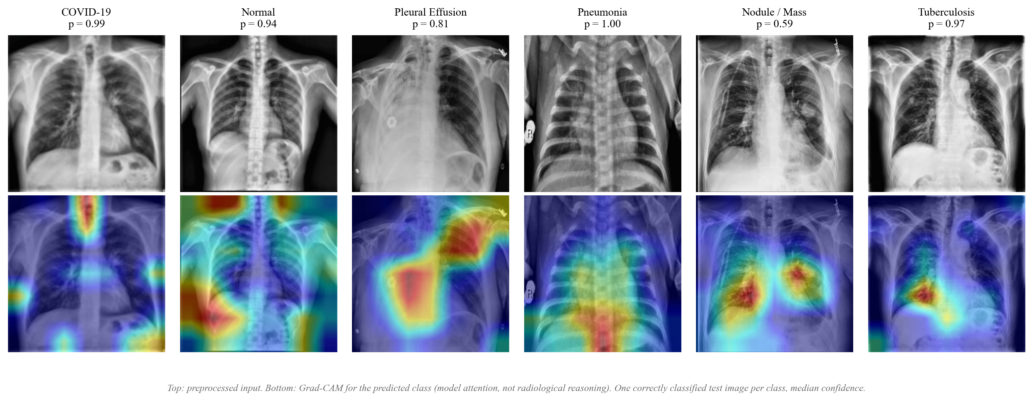
Source confounding: Grad-CAM examples
Grad-CAM, one correctly classified median-confidence test image per class (rule fixed before viewing).
Source probe: balanced accuracy 93.8% (ImageNet features), 93.8% (model backbone); chance 16.7%
KUCE&T (Kakatiya University College of Engineering and Technology), Kakatiya University | M.Tech CSE | 2026
22
Notes:
A linear probe on frozen features predicts a test image's source with balanced accuracy 93.8 percent using ImageNet features and 93.8 percent using the trained backbone; chance is 16.7 percent over 6 sources. Within one class the source is still identifiable: Normal 97.2 percent (chance 20.0), Tuberculosis 98.9, Pneumonia 89.1, COVID-19 89.0. Fine-tuning unfroze the last 30 backbone layers, 17 of which carry weights, so only those changed. So source and class are confounded and source information is linearly available, which makes a shortcut possible. This is indirect evidence, not proof that the model uses source cues. Grad-CAM, one image per class, illustrative only: COVID-19 and Normal heatmaps concentrate on neck, shoulders and image borders; Nodule/Mass and Tuberculosis fall inside the lung fields; Pneumonia (a paediatric image) is diffuse. Together with the external result this supports the concern.

Slide 23
Robustness: seeds and ablation
Seeds (runs 2 to 4) | Mean ± SD | Range
Test accuracy % | 77.1 ± 0.3 | 76.9 to 77.4
Test macro-F1 % | 78.4 ± 0.4 | 77.9 to 78.8
Test macro ROC-AUC | 0.954 ± 0.001 | 0.953 to 0.955
Ext. specificity % | 27.1 ± 3.8 | 23.8 to 31.2
Exact TB recall % | 0.0 | 0.0 to 0.0
Ablation (seed 42) | Run 2 (filters) | Run 5 (none)
Test accuracy % | 77.4 | 74.1
Test macro-F1 % | 78.8 | 75.8
Ext. specificity % | 23.8 | 23.8
Exact TB recall % | 0.0 | 8.6
Served run is the highest of three seeds (spread under one point); external failure recurs in every seed
Without filters, internal scores are lower than the seed range; external specificity unchanged
Run 5's few correct Montgomery TB calls: one run, observation only
KUCE&T (Kakatiya University College of Engineering and Technology), Kakatiya University | M.Tech CSE | 2026
23
Notes:
I repeated the final recipe with seeds 43 and 44 on the same split. Internal accuracy has mean 77.1 and standard deviation 0.3 percent. The served run 2 is the highest of the three seeds, within a spread of under one percentage point; a small favourable draw cannot be ruled out. The standard deviation comes from only three runs, so it is rough, and it covers the seed only, not other splits, data or architectures. Runs 3 and 4 stopped early by the same patience rule; run 2 completed its schedule. External specificity ranges from 23.8 to 31.2 percent and no seed names any Montgomery TB scan Tuberculosis, so the external failure is not a one-seed artefact. The ablation, run 5, uses the same split, seed and schedule as run 2, without blur, CLAHE and low-pass filter. Internal accuracy is 74.1 against 77.4 percent, a gap larger than the seed spread, so the run with the filters scored higher internally in this single comparison. Run 5 selected its last epoch (16 of 16, validation still rising), so a convergence-speed difference cannot be excluded. External specificity is the same. Exact TB recall is 8.6 percent without filters against 0.0: a handful of scans from one run, an observation and not an effect. One ablation seed cannot support a general claim about preprocessing.

Slide 24
Extension: where does source information live?
Question: is source information in CXR features tied to particular frequency bands, and is it entangled with disease information?
Six octave bands A-F; band-pass and band-stop images; linear probes for source and for disease (macro-F1 within source) on frozen DenseNet-121 features
Linear source erasure (INLP, LEACE) on the same features, then re-scoring disease
Leave-one-source-out: train the head on five sources, score the sixth
Rules, thresholds and the C2 go/no-go fixed in advance and recorded in the repository
Diagnostic study: no new architecture, served model untouched
KUCE&T (Kakatiya University College of Engineering and Technology), Kakatiya University | M.Tech CSE | 2026
24
Notes:
This extension asks a diagnostic question about the shortcut concern from the previous slides: where in the image spectrum is source information, and can it be separated from disease information? The cached 224 by 224 images are split into six octave bands, A to F. For each band I build band-pass and band-stop variants and fit linear probes on frozen DenseNet-121 features: one probe for the source, one for disease, scored as macro-F1 within each source so source cues cannot buy the score. Two published erasure methods, INLP and LEACE, are applied as a measurement on frozen features; I make no novelty claim for them. Leave-one-source-out trains the linear head on five sources and scores the held-out one. The analysis rules and the go/no-go criteria for a possible band-suppression training experiment (C2) were fixed in advance and recorded in the repository, not registered externally. Within the searches described in the roadmap, I am not aware of prior work that quantifies source versus disease information band by band; this is no stronger than that.

Slide 25
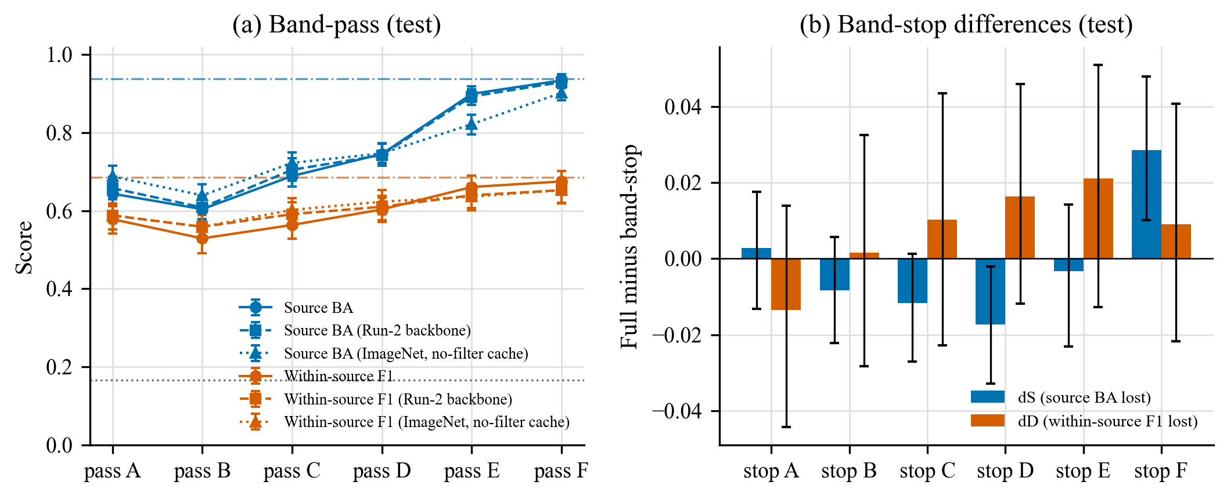
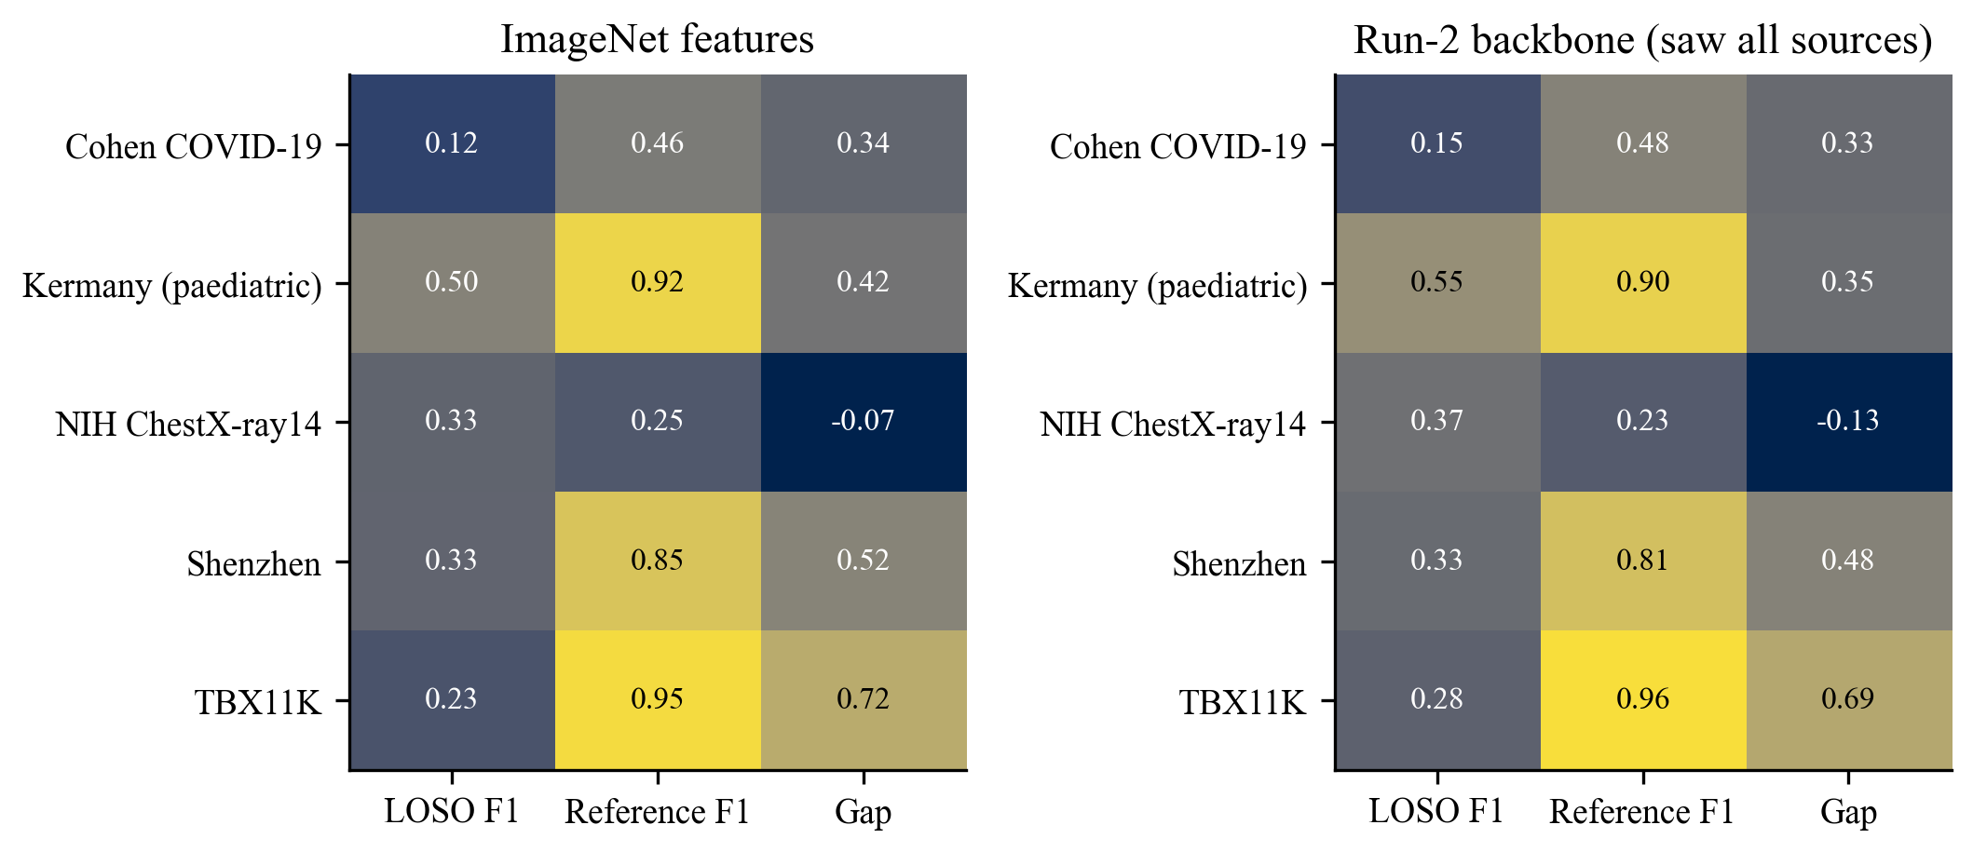
Extension results: spectral map and leave-one-source-out
Left: source and disease information per band. Right: held-out-source macro-F1 (ImageNet features, linear head).
Full-image source accuracy 93.8% (chance 16.7%); held-out TBX11K macro-F1 22.7%
KUCE&T (Kakatiya University College of Engineering and Technology), Kakatiya University | M.Tech CSE | 2026
25
Notes:
Left: with frozen ImageNet features on the test sample, the full image gives source balanced accuracy 93.8 percent against chance of 16.7, and within-source disease macro-F1 68.6 percent. Source is readable in every band-pass image, from 64.4 percent in band A to 93.4 percent in band F, and both source and disease information are highest in bands E and F. No band stands out as the carrier; that null result is stated plainly. Removing a single band barely changes source accuracy: the largest change is 2.9 points (band F), and the disease intervals all include zero. Right: when a source is left out, a linear head scores far below its in-distribution reference on four of five sources, for example TBX11K 22.7 percent, a gap of 72.3 points, and Shenzhen 33.1 percent. NIH shows a negative gap (-7.5) only because its reference is low with two testable classes; that is not better generalisation. Cohen has very few images and is very uncertain. Caveats: F1, the cache is resampled to 224 by 224 after filtering, so band maps partly reflect resampling and the pre-filters. F2, the trained backbone saw all six sources and is not held out. F3, class and source are confounded (Effusion and Nodule/Mass exist only in NIH), so the within-source score is primary. F5, intervals cover test-sample variation only; samples are small. Patient-identity caveat: 4,130 TBX11K and COVID-19 Radiography rows are grouped per image. Test was scored once; Montgomery was not untouched in the extension and these are not external validation. Availability in frozen features is indirect evidence, not proof that the trained model uses it.

Slide 26
Extension takeaway: erasure costs disease performance
Source information is spread across all bands and not concentrated in one
Linear erasure (INLP, 20 steps): source accuracy 95.8% to 73.8%, but disease macro-F1 within source also falls (-4.7 points)
One-step LEACE: six-class macro-F1 falls -25.2 points: source and disease are entangled
Sharp drop when a source is held out (gap 72.3 points for TBX11K)
C2 band suppression: NO-GO; no band meets the rule fixed in advance. Future work, no C2 number exists
KUCE&T (Kakatiya University College of Engineering and Technology), Kakatiya University | M.Tech CSE | 2026
26
Notes:
The takeaway is a diagnostic one. Source information is available in every band and is redundant across bands, so no single band is a carrier to suppress. Erasing it linearly with INLP lowered the source accuracy a fresh probe can recover from 95.8 to 73.8 percent after 20 steps, which is not chance, and disease measures fell too: within-source macro-F1 by -4.7 points. LEACE, which removes all linearly decodable source information in one step, lowered six-class macro-F1 by -25.2 points. This is consistent with source and disease information being entangled in these features. I do not present removing the shortcut as an achievement. The C2 go/no-go decision is NO-GO: removing the best band, band F, lowered source accuracy by a few points, below the 5-point threshold fixed in advance, and 0 bands satisfied the first criterion. Only a frozen-feature linear head was examined, so band-suppression training is future work and nothing here says it works or fails for a trained network. Caveats: one run, no seeds; INLP and LEACE are published methods applied as measurements; the served model, gate, backend and frontend are untouched; Montgomery was not untouched; patient-identity caveat as before.

Slide 27
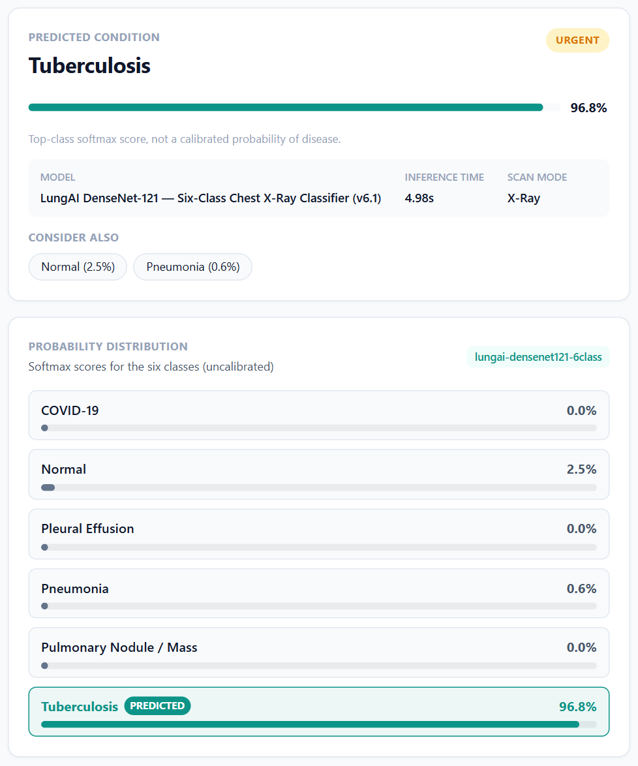
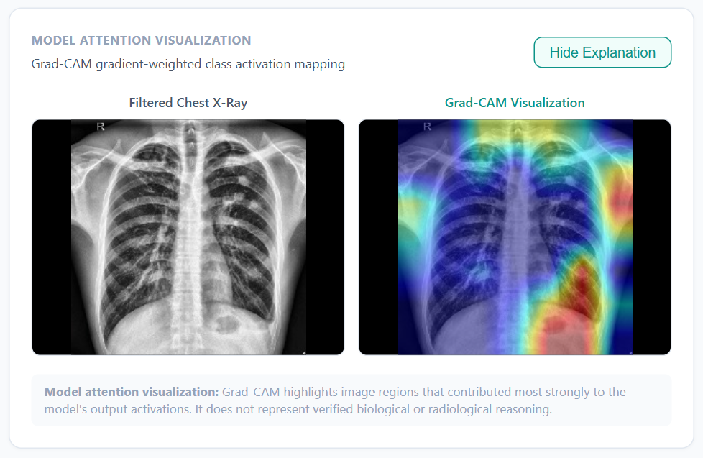
Application demo (model v6.1)
Test-split Shenzhen radiograph (true label Tuberculosis). Left: prediction and scores. Right: Grad-CAM overlay.
KUCE&T (Kakatiya University College of Engineering and Technology), Kakatiya University | M.Tech CSE | 2026
27
Notes:
These are screenshots of the running application with the final model, not mock-ups. The image comes from the held-out test split of the final dataset, and its true label is Tuberculosis. The left panel shows the predicted class with its top-class score and all six softmax scores; the same values are returned by the API and stored in the history. The right panel shows the Grad-CAM overlay. It shows image regions that influenced the score; it is not radiological reasoning, and on this image part of the attention falls outside the lung fields. One correctly classified example is not evidence of accuracy; the test and external results on the previous slides are. Full-page captures of the upload, metrics and history pages are in docs/figures/screenshots/ if the live demo is not possible.

Slide 28
Limitations
Three seeds for the served recipe (SD is rough), one ablation seed; CPU, time-boxed
Classes assumed mutually exclusive; co-findings not modelled
Patient identity unknown for TBX11K and COVID-19 Radiography rows
Effusion and nodule data from NIH only; VinDr-CXR and JSRT not available
External cohort is binary and small (138 scans)
Heuristic CXR gate; Grad-CAM is not clinical reasoning; no clinical validity claimed
KUCE&T (Kakatiya University College of Engineering and Technology), Kakatiya University | M.Tech CSE | 2026
28
Notes:
I want to be clear about what this work does not show. Variability is measured with only three seeds, and the ablation is a single run. Labels are single and exclusive, patient identity is unknown for two sources, and some classes rely on one source dataset. The external cohort is small, and the gate is a heuristic. Nothing here establishes clinical validity.

Slide 29
Conclusion
Rebuilt a six-class CXR benchmark from official sources with patient-grouped splits
Delivered a reproducible pipeline from raw data to served metrics, and a working application
Showed how leakage and proxy labels inflated the earlier V5 result
Final model v6.1: 77.4% internal accuracy, but external specificity 19/80 and TB recall 0/58: internal metrics overstate behaviour
Class-source confounding is strong; build 2 changed where external errors fall, not the external gap (indirect evidence of a source shortcut)
Extension: source information is spread across bands and entangled with disease; erasure costs disease performance; C2 band suppression is NO-GO
Not shown: clinical utility, superiority over other methods, causal effect of preprocessing (one ablation seed), robustness beyond the training seed
KUCE&T (Kakatiya University College of Engineering and Technology), Kakatiya University | M.Tech CSE | 2026
29
Notes:
The extension adds a diagnostic result, not an improvement: source information is available in every band, linear erasure lowers disease scores too, and held-out sources score far lower. It is indirect evidence about frozen features, not proof about the trained model. To conclude, the contribution is an auditable rebuild and a reproducible pipeline, together with evidence of how an earlier pipeline overstated its results. The final model is v6.1, run 2. Its internal accuracy is good, but on the external cohort specificity is low and no TB scan is recognised as TB, so internal metrics overstate generalisation. With build 2 the COVID-19 calls fell but the external gap remained; this is consistent with a source shortcut, not proof of one. Across three seeds the internal results are stable and the external gap persists; the single-seed ablation shows lower internal scores without the filters. The claim I can defend is about evaluation method, not about clinical accuracy.

Slide 30
Future scope
Add VinDr-CXR and JSRT after access to strengthen effusion and nodule classes
Multi-label formulation for co-findings
Several seeds and a larger, multi-site external cohort
Train a CXR gate on real radiographs and non-radiographs
Band-suppression training (C2): not started; the go/no-go gave NO-GO, so it needs a new decision
Clinician-reviewed prospective evaluation, reported per TRIPOD+AI and CLAIM [collins2024tripodai, mongan2020claim]
KUCE&T (Kakatiya University College of Engineering and Technology), Kakatiya University | M.Tech CSE | 2026
30
Notes:
Band-suppression training, C2, is future work: the criteria fixed in advance were not met on frozen features, and it is not started without a new decision. Future work follows the limitations. The most useful steps are better data, a multi-label formulation, repeated runs for variance, and a larger multi-site external cohort. A trained gate would fix the weakest part of the application. Any clinical use would need prospective evaluation with clinicians and reporting following TRIPOD+AI and CLAIM.

Slide 31
Publications plan
Conference (IEEE EMBC) and journal drafts in preparation; not submitted [AUTHORS TO CONFIRM]
Journal target: Informatics in Medicine Unlocked (Elsevier); fallback BSPC (decision 2026-11-04: diagnostic study after C2 NO-GO)
Author order: K. Sathwik, N. Ramana, P. Tirupathi, K. Srinivas; corresponding author [TO BE CONFIRMED]
KUCE&T (Kakatiya University College of Engineering and Technology), Kakatiya University | M.Tech CSE | 2026
31
Notes:
I plan one conference paper and one journal paper from this work. The author order is confirmed by the project owner. The corresponding author is still to be confirmed, and all authors must verify contributions and approve the manuscripts before submission. On 2026-11-04 the target journal became Informatics in Medicine Unlocked, with Biomedical Signal Processing and Control as fallback, because the work is now a diagnostic study after the C2 no-go. The EMBC conference plan is unchanged. Nothing has been submitted yet; the venue comparison is maintained separately.

Slide 32
Key references
wang2017chestxray8: Wang et al., ChestX-ray8, CVPR 2017
kermany2018identifying: Kermany et al., Cell 2018
jaeger2014two: Jaeger et al., QIMS 2014
liu2020rethinking: Liu et al., TBX11K, CVPR 2020
cohen2020covid: Cohen et al., COVID-19 collection, 2020
chowdhury2020can: Chowdhury et al., IEEE Access 2020
huang2017densely: Huang et al., DenseNet, CVPR 2017
deng2009imagenet: Deng et al., ImageNet, CVPR 2009
selvaraju2017gradcam: Selvaraju et al., Grad-CAM, ICCV 2017
zech2018variable: Zech et al., PLoS Med 2018
degrave2021ai: DeGrave et al., Nat. Mach. Intell. 2021
geirhos2020shortcut: Geirhos et al., Nat. Mach. Intell. 2020
roberts2021common: Roberts et al., Nat. Mach. Intell. 2021
oakdenrayner2020exploring: Oakden-Rayner, Acad. Radiol. 2020
guo2017calibration: Guo et al., ICML 2017
wilson1927probable: Wilson, JASA 1927
kingma2015adam: Kingma and Ba, ICLR 2015
collins2024tripodai: Collins et al., TRIPOD+AI, BMJ 2024
mongan2020claim: Mongan et al., CLAIM, Radiol. AI 2020
Full verified list: docs/manuscripts/shared/references.bib
KUCE&T (Kakatiya University College of Engineering and Technology), Kakatiya University | M.Tech CSE | 2026
32
Notes:
These are the main works cited in the talk, by BibTeX key. The complete list, with verification status, is in the shared references file of the repository. I can discuss any of them during questions.

Slide 33
Thank you
Questions and discussion
KUCE&T (Kakatiya University College of Engineering and Technology), Kakatiya University | M.Tech CSE | 2026
33
Notes:
Thank you for your attention. I would be glad to answer questions about the data audit, the evaluation protocol, the application or the limitations. If asked about accuracy, I will point to the confidence intervals and to the external cohort, and note that clinical validity is not claimed.

