Slide 1

EMPOWERING INDIAN LEGAL NLP : ADVERSARIAL SAMPLING AND MULTI LABEL CLASSIFICATION WITH LARGE LANGUAGE MODELS
Department of Information Technology
Final Review
3rd May 2024
Batch 2020 - 2024
Team Members:
K Shanmukha Naveen- 205002087
Sharon Roshini S - 205002088
BTech IT
Project Guide:
Dr. S. Karthika Associate Professor Department of IT

Slide 2
PROBLEM STATEMENT
In the Indian legal context, classification of relevant cases for court judgments create inefficiencies which makes decision-making process difficult.
While significant advancements have been made in Legal NLP for tasks like legal statute identification, summarization and classification a critical gap remains in ensuring the robustness of these models against adversarial sampling.
Here, we have come up with four models (QUANTUM BERT, BERT , BiLSTM , GRU) which performs multi label text classification with better accuracies even after adversarial sampling .

Slide 3
DATASET
We use a standard dataset called ILSI (Indian Legal Statute Identification) to find the specific laws that apply to a given description of facts or evidence in a legal case.
This dataset focuses on the 100 most frequently cited sections of the Indian Penal Code (IPC) as labels, extracted from factual portions of 66,000 legal case documents originating from the Supreme Court and 6 High Courts of India. These labels correspond to specific statutes within the IPC.
IPC ACT
CHAPTER
SECTION
ARTICLE

Slide 4
DATASET : WOMEN RELATED SECTIONS
This dataset specifically focuses on the criminal offenses
described in the Indian Penal Code (IPC)
under 100 specific sections out of around 500 sections.
IPC
500 SECTION
ILSI
100 SECTION
SUBSET OF ILSI
5 SECTIONS
SECTION 354 , 326 , 370 , 376 , 509

Slide 5
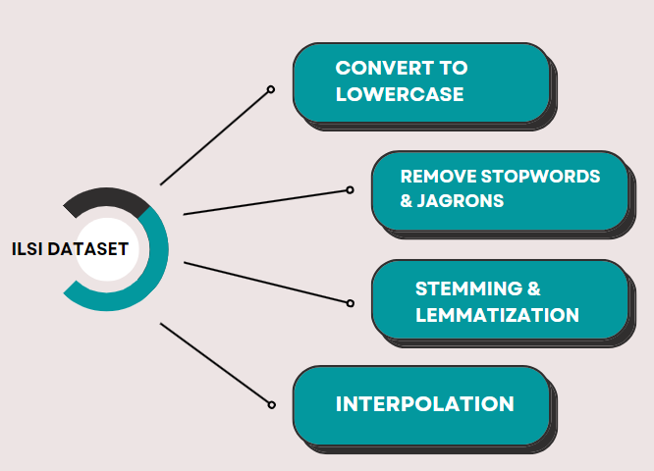
DATASET PREPROCESSING

Slide 6
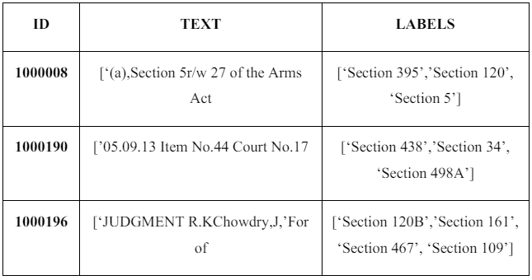
BEFORE PREPROCESSING
.

Slide 7
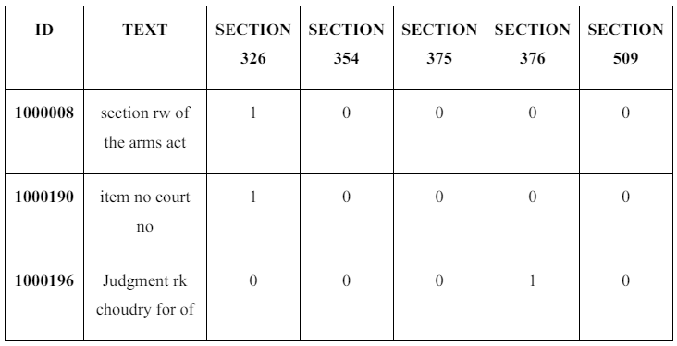
AFTER PREPROCESSING
.

Slide 8
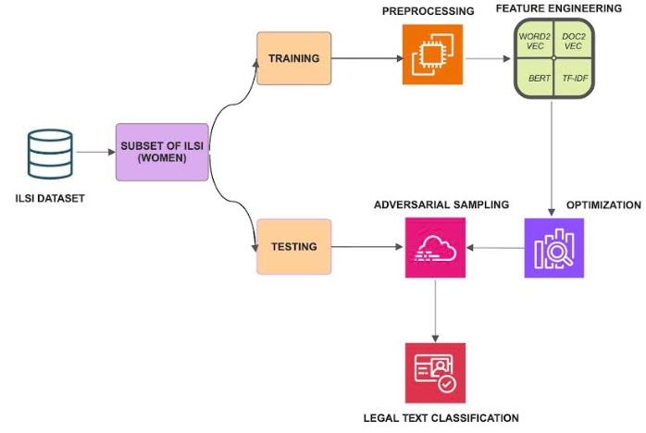
PROPOSED WORK

Slide 9
MODEL IMPLEMENTATION
WOMEN DATASET – MODEL RUN RESULTS :
MODEL | BATCH SIZE | LEARNING RATE | EPOCHS | ACCURACY
BERT | 32 | 2e-5 | 10 | 81.9
BIDIRECTIONAL LSTM | 32 | 0.0001 | 10 | 90.2
GRU | 16 | 0.001 | 5 | 56.7
QUANTUM BERT | 32 | 1e-2 | 10 | 85.9

Slide 10
ADVERSARIAL SAMPLING
Input: Original text data + Model's predicting word
Tokenization: Text split into subwords
Importance Score Calculation: Assign importance scores to subwords
Greedy Search: Iteratively replace subwords to alter prediction
Word with highest score is chosen and replaced with synonyms
Output: Adversarial text with changed prediction

Slide 11
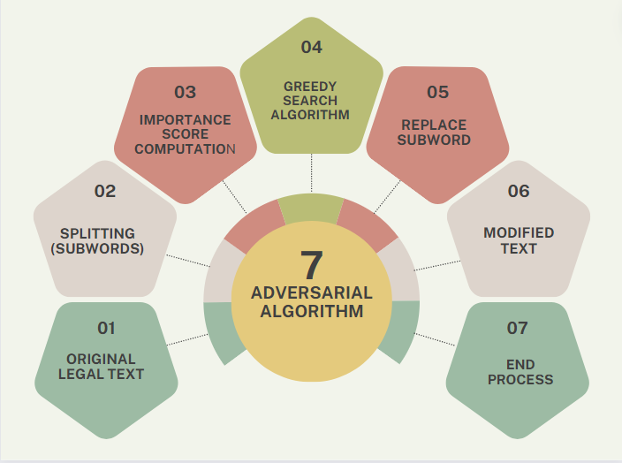
ADVERSARIAL SAMPLING
.

Slide 12
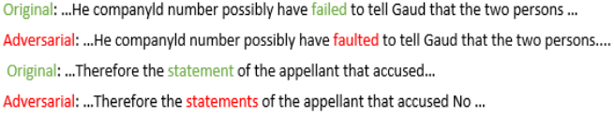
ADVERSARIAL TEXT - SAMPLE

Slide 13
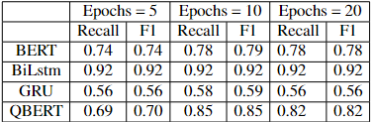
EXPERIMENTAL RESULTS
QUANTUM BERT – with accuracy of 0. 85, after fine tuning hyperparameters has best performance with adversarial sampling.

Slide 14
CONCLUSION
In this work , it is demonstrated that QuantumBERT performed well with best accuracy of 0.86 which can withstand any adversarial sampling whereas pre-existing models depicted poor performance against adversarial attacks.
In future, many other tasks including judgment prediction, identification and summarization has to be tested with adversarial attacks so as to check the robustness of the model and their performance.
This would be crucial for evaluating the robustness of different models and their ability to maintain performance when faced with deliberately crafted inputs designed to deceive them.

Slide 15
REFERENCES
Paul, S., Goyal, P., & Ghosh, S. (2021). *LeSICiN: A Heterogeneous Graph-based Approach for Automatic Legal Statute Identification from Indian Legal Documents.* arXiv preprint arXiv:2112.14731. [Link](https://arxiv.org/abs/2112.14731)
Malik, V., Sanjay, R., Nigam, S. K., Ghosh, K., Guha, S. K., Bhattacharya, A., & Modi, A. (2021). *ILDC for CJPE: Indian Legal Documents Corpus for Court Judgment Prediction and Explanation.* arXiv preprint arXiv:2105.13562. [Link](https://arxiv.org/abs/2105.13562)
Paul, S., Mandal, A., Goyal, P., & Ghosh, S. (2023). *Pre-trained Language Models for the Legal Domain: A Case Study on Indian Law.* In Proceedings of 19th International Conference on Artificial Intelligence and Law - ICAIL 2023. [Link](https://arxiv.org/abs/2209.06049)
Shaheen, Z., Wohlgenannt, G., & Filtz, E. (2020). *Large Scale Legal Text Classification Using Transformer Models.* arXiv preprint arXiv:2010.12871. [Link](https://arxiv.org/abs/2010.12871)

Slide 16
THANK YOU

