Slide 1
Software Engineering for Distributed Systems Course Code:Comp ****
Unit 2: Characterization and Models of Distributed Systems
Hatem Hamad
IT Building – I 216, 12.3.2014
Modified By Dr. Fatma Omara
Computer Science Dept.
Faculty of Computers and Artificial Intelligence
Cairo University

Slide 2




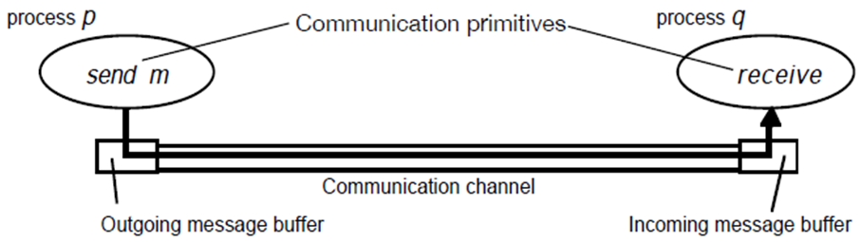
Processes and Channels
Lack of Shared Memory
Communicate by Sending Messages
Software Engineering for Distributed Systems

Slide 3
Primitives for InterProcess Communication (IPC)
• Message Passing
  Among the IPC primitives- Send & Receive
• Remote Procedure Call (RPC)
  – Process interaction at language level
  – Type checking
• Transactions
  Support for operations and their synchronization on shared Objects
  Lack of shared memory communicate by sending messages
Software Engineering for Distributed Systems

Slide 4
Communication Primitives - 1
Reliable – e.g.; TCP
  Ack
  Ordered
  Guaranteed delivery
Unreliable – e.g.; UDP
  No ack
  No guarantee delivery
  No ordering
  (bottles in the ocean)
Software Engineering for Distributed Systems

Slide 5
Communication Primitives - 2
Blocking/non-blocking
Buffered/unbuffered
  Send_get (sender is blocked)
  Get_request
  Send_reply (original sender is unblocked)
Software Engineering for Distributed Systems

Slide 6
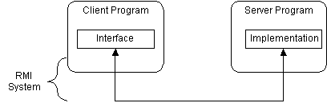
Communication Methods
Shared variables - coherence??
Message passing
  RPC – Remote Procedure Call
    Very good for Client-server
    Hides message passing
  RMI – Remote Method Invocation (also Remote Object Invocation)
    Like RPC, but with system-wide objects
    objects existing on one machine (server) may be accessed from another machine through regular method call.
    Java server implements a Security Manager & registry
Software Engineering for Distributed Systems

Slide 7
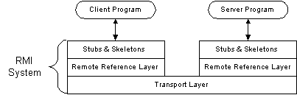
Communication Methods
  MOM – Message Oriented Middleware
Streams (TCP/IP)
  Needed for continuous information flow (video, audio)
Software Engineering for Distributed Systems

Slide 8
Remote Procedure Call (RPC)
  Mechanism to call procedures on other machines
  Goal: it should appear to the programmer that a normal call is taking place
  Implementing RPC
    Create stub functions to make it appear to the user that the call is local
    Stub function contains the function’s interface
Software Engineering for Distributed Systems

Slide 9
Stub functions
1. Client calls Client stub (parameters on stack)
client functions
server functions
client stub
server stub
(skeleton)
network routines
network routines
client
server
Software Engineering for Distributed Systems

Slide 10
Stub functions
2. Stub marshals parameters (build message)
client functions
server functions
client stub
server stub
(skeleton)
network routines
network routines
client
server
Software Engineering for Distributed Systems

Slide 11
Stub functions
3. Network message sent to server
client functions
server functions
client stub
server stub
(skeleton)
network routines
network routines
client
server
Software Engineering for Distributed Systems

Slide 12
Stub functions
4. Receive message: send to server stub
client functions
server functions
client stub
server stub
(skeleton)
network routines
network routines
client
server
Software Engineering for Distributed Systems

Slide 13
Stub functions
5. Unmarshal (unpacks) parameters, call server function
client functions
server functions
client stub
server stub
(skeleton)
network routines
network routines
client
server
Software Engineering for Distributed Systems

Slide 14
Stub functions
6. Server does work, Return results to stub
client functions
server functions
client stub
server stub
(skeleton)
network routines
network routines
client
server
Software Engineering for Distributed Systems

Slide 15
Stub functions
7. Server stub Marshal (Pack) results into message and send it
client functions
server functions
client stub
server stub
(skeleton)
network routines
network routines
client
server
Software Engineering for Distributed Systems

Slide 16
Stub functions
8. Transfer message over network
client functions
server functions
client stub
server stub
(skeleton)
network routines
network routines
client
server
Software Engineering for Distributed Systems

Slide 17
Stub functions
9. Receive message: direct to Client stub
client functions
server functions
client stub
server stub
(skeleton)
network routines
network routines
client
server
Software Engineering for Distributed Systems

Slide 18
Stub functions
10. Unmarshal return, return to client code
client functions
server functions
client stub
server stub
(skeleton)
network routines
network routines
client
server
Software Engineering for Distributed Systems

Slide 19
RPC Protocols
Requestor Receiver (server)
Request
Ack
Ack
Reply
Request
Ack
Reply
Request
Reply
T_{n}
Software Engineering for Distributed Systems

Slide 20
Marshaling
Heterogeneous systems
  No guarantee of data conformity
  No guarantee of directionality (endian-ness)
Data must be converted
Data format must be standardized
Communication types
  Virtual circuits –reliable, flow controlled
  Datagrams unreliable, no TCP “connect”
Software Engineering for Distributed Systems

Slide 21
Benefits of RPC
Procedure call interface
Writing applications is simplified
  RPC hides all network code into stub functions
  Application programmers don’t have to worry about details
    Sockets, port numbers, byte ordering
RPC: presentation layer in Open System Interface (OSI) model
Software Engineering for Distributed Systems

Slide 22
When things go wrong
Semantics of remote procedure calls
  Local procedure call: exactly once
A remote procedure call may be called:
  0 times:
    server crashed or server process died before executing server code
  1 time:
    everything worked well
  1 or more:
    excess latency or lost reply from server and client retransmission
Software Engineering for Distributed Systems

Slide 23
RPC Semantics
Most RPC systems will offer either:
  at least once semantics
  or at most once semantics
Understand application:
  idempotent functions: may be run any number of times without harm
  non-idempotent functions: side-effects
Software Engineering for Distributed Systems

Slide 24
More issues
Performance
  RPC is slower … a lot slower
Security
  messages visible over network
  Authenticate client
  Authenticate server
Software Engineering for Distributed Systems

Slide 25
Transaction Concept
A transaction is a unit of program execution that accesses and possibly updates various data items.
Two main issues to deal with:
    Failures of various kinds, such as hardware failures and system crashes
    Concurrent execution of multiple transactions
Software Engineering for Distributed Systems

Slide 26
Required Properties of a Transaction
Atomicity requirement
  If the transaction fails after step 3 and before step 6, money will be “lost” leading to an inconsistent database state
    Failure could be due to software or hardware
  The system should ensure that updates of a partially executed transaction are not reflected in the database (Rollback)
Durability requirement
  once the user has been notified that the transaction has completed (i.e., the transfer of the $50 has taken place), the updates to the database by the transaction must persist even if there are software or hardware failures.
Software Engineering for Distributed Systems

Slide 27
Required Properties of a Transaction
Consistency requirement :
  Consistency requirements include
A transaction, when starting to execute, must see a consistent database.
During transaction execution the database may be temporarily inconsistent.
When the transaction completes successfully the database must be consistent
Isolation requirement
Isolation can be ensured trivially by running transactions serially
    That is, one after the other.
However, executing multiple transactions concurrently has significant benefits, as we will see later.
Software Engineering for Distributed Systems

Slide 28
ACID Properties of Transaction
A transaction is a unit of program execution that accesses and possibly updates various data items. To preserve the integrity of data the database system must ensure:
Atomicity. Either all operations of the transaction are properly reflected in the database or none are.
Consistency. Execution of a transaction in isolation preserves the consistency of the database.
Isolation. Although multiple transactions may execute concurrently, each transaction must be unaware of other concurrently executing transactions. Intermediate transaction results must be hidden from other concurrently executed transactions.
  That is, for every pair of transactions T_{i} and T_{j}, it appears to T_{i} that either T_{j} , finished execution before T_{i} started, or T_{j} started execution after T_{i} finished.
Durability. After a transaction completes successfully, the changes it has made to the database persist, even if there are system failures.
Software Engineering for Distributed Systems

Slide 29

Transaction State
Active – the initial state; the transaction stays in this state while it is executing
Partially committed – after the final statement has been executed.
Failed -- after the discovery that normal execution can no longer proceed.
Aborted – after the transaction has been rolled back and the database restored to its state prior to the start of the transaction. Two options after it has been aborted:
  Restart the transaction
    can be done only if no internal logical error
  Kill the transaction
Committed – after successful completion.
Software Engineering for Distributed Systems

Slide 30
Naming

Slide 31
****What is a name?
Basic objects
  File
  Value
  Program
Data structures across a network
  How to reference
  How to modify
Types
  Human readable
  Machine readable
Software Engineering for Distributed Systems

Slide 32
Synchronization

Slide 33
Mechanisms
Explicit signals
  Semaphores, conditions, events
Test and Set shared variables
  Consider chip cycle vs. bus cycle
Software Engineering for Distributed Systems

Slide 34
Problems
Race conditions - cause loss of data
Action sequences - hierarchy to be maintained
Data protection
Software Engineering for Distributed Systems

Slide 35
Consistency and Replication

Slide 36
World View
Users must see same data at all times
Updates must be controlled
Rollbacks must maintain consistency
Software Engineering for Distributed Systems

Slide 37
Fault Tolerance
Software Engineering for Distributed Systems

Slide 38
Partitioning
Problem: when is the system partitioned?
  Response time?
  Keep-alive?
  Other? (load balance, Cost, etc…)
Solutions
  Rollback?
  Re-start?
  Cut-off?
  Other?
Software Engineering for Distributed Systems

Slide 39
Security
Software Engineering for Distributed Systems

Slide 40
Whose data is it?
Must protect data and programs
  Viruses
  Worms
  Errors
  Theft
Software Engineering for Distributed Systems

Slide 41
Virtualization
Software Engineering for Distributed Systems

Slide 42
Problems
Hardware differences on ends of real systems (Heterogeneity)
Time delays cannot be simulated (no common clock)
Software Engineering for Distributed Systems

Slide 43
Topic 2
Architectural Models
Material from:
http://eb.njit.edu/~gblank/cis633/
Software Engineering for Distributed Systems

Slide 44
Architectural Modeling
Architecture details a system by the organization of its components.
The components might be nodes on a network, layers of software, collections of services, or other ways of partitioning the system.
For example, one way of partitioning a system is to classify processes as client processes, server processes or peer processes.
Software Engineering for Distributed Systems

Slide 45
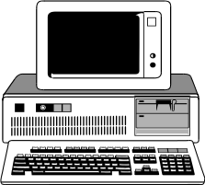
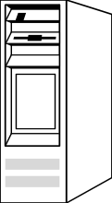
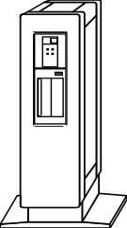
Architectural Views
System Architecture
Application Architecture
Business Architecture
Presentation
Layer
Business
Application
Layer
Product
Information
Layer
Service
Resource
Support
Physical Architecture
Operations Architecture
Software Engineering for Distributed Systems

Slide 46
Modeling
Modeling is based on abstraction.
We can ignore some parts and details of a system to concentrate on others.
Software Engineering for Distributed Systems

Slide 47
Questions for a Model
What are the main entities in a system?
How do those entities interact with each other?
What characteristics affect the individual entity and collective behavior of those entities?
Software Engineering for Distributed Systems

Slide 48
Purpose of a Model
Make explicit all of the relevant * assumptions about a system.
Make generalizations about what is possible or impossible to accomplish based on those assumptions.
Note that:
it is a real challenge to include everything that matters while excluding everything that does not matter!
Software Engineering for Distributed Systems

Slide 49
Architectural Models
In complex systems, it is necessary to organize the complexity by partitioning.
    Architectural models are ways to organize the parts and structure the relationships between them.
Two fundamental architectural models:
    the Client/Server model
    the Peer-to-Peer model
Software Engineering for Distributed Systems

Slide 50
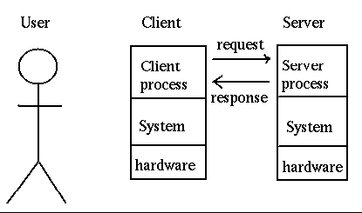
Client-Server Models
The application is modelled as a set of services that are provided by servers and a set of clients that use these services
Clients know of servers but servers need not know of clients
Clients and servers are logical processes
The mapping of processors to processes is not necessarily 1 : 1
Software Engineering for Distributed Systems

Slide 51
The Client/Server Models
The client/server model is organized around clients that request services and servers that provide services.
    Services might include information (such as the current weather) or computational services (such as complex calculations).
There may be intermediate layers between the client and server that perform a portion of the task of locating and providing services.
Software Engineering for Distributed Systems

Slide 52
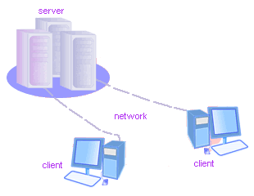
The Client/Server Models
Client usually invoked by end users when they require service
Server usually waits for incoming requests
Server can have many clients making concurrent requests
Server is usually a program with special privileges
Software Engineering for Distributed Systems

Slide 53
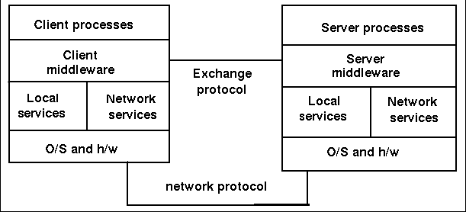
Middleware
Processes or Objects
Abstractions over
  Remote method invocation
  Group of processes
  Notification of events
  Replication of shared data
  Real-time transmission of multimedia streams
Client-Server Models
Client and Server Functions:
Clients
interacts with users through a user interface
performs application functions
interacts with client middleware using middleware API
receives response and displays it if needed
Servers
implement services
invoked by server middleware
provide error-recovery and failure-handling services
Software Engineering for Distributed Systems

Slide 54
Architectural Models
Performance, scalability and mobility of the client/server model can be improved by
    Partitioning or replicating data on servers
    Caching data at proxy servers or clients
    Using mobile code and mobile agents
    Adding and removing mobile devices
Software Engineering for Distributed Systems

Slide 55
Architectural Models
Communications
Probably the key concern of a distributed system is the communication between nodes of the system.
It can be argued that computers are improperly named. While they can and do provide computations, their dominant use is to provide information, so communicator might be a more accurate description than computer.
Software Engineering for Distributed Systems

Slide 56
What is the Architecture Analogy?
Just as we need many views to construct a house
  site plan, floor plans, wiring and plumbing diagrams, etc.
Software development benefits from a similar approach
Time tested designs, methods, and approaches to improve quality and performance
Architecture helps us to
  understand the system, organize development, faster reuse, and evolve the system
Software Engineering for Distributed Systems

Slide 57
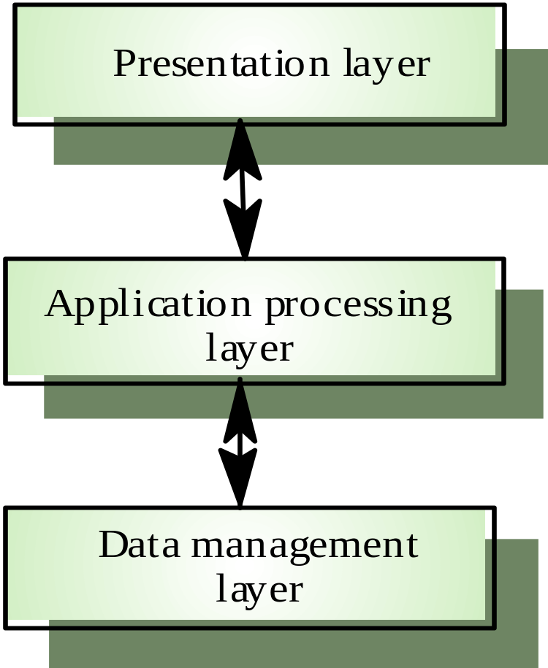
Layered Application Architecture
Presentation layer Concerned with
  Presenting the results of a computation to system users and
  Collecting user inputs
Application processing layer Concerned with:
  Providing application specific functionality
    e.g., in a banking system, banking functions such as open account, close account, etc...
Data management layer Concerned with: managing the system databases
Software Engineering for Distributed Systems

Slide 58
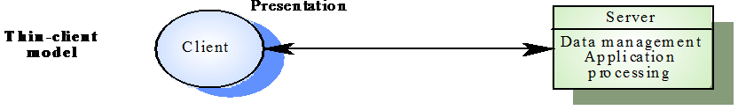
Some Client/Server Architectural Patterns
Thin-Client Model:
All application processing and data management by server only.
While presentation layer on the clients
It is considered Two-tier Configurations
Software Engineering for Distributed Systems
Notes:
Thanks to Nick Panagopolis for the slides on Client Server Configurations

Slide 59
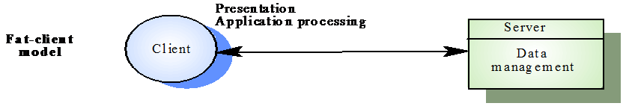
Some Client/Server Architectural Patterns
Fat-Client Model :
Server only responsible for data management.
The client machine implements application logic and interactions with user.
It is considered Two-tier Configurations
Software Engineering for Distributed Systems
Notes:
Thanks to Nick Panagopolis for the slides on Client Server Configurations

Slide 60
Some Client/Server Architectural Patterns
Three-Tier Client-Server:
Includes another server that offloads certain functions from either the client and/or the server.
Each of the application architecture layers may execute on a separate server
Allows better performance than a thin-client approach and is simpler to manage than a fat-client approach
A more scalable architecture - as demands increase, extra servers can be added
    Since there can be many intermediate servers
    This may also be called n-tier.
Client
(e.g. User
Interface)
Mid-tier
for Application
processing
Server
Data Management
Software Engineering for Distributed Systems
Notes:
Thanks to Nick Panagopolis for the slides on Client Server Configurations

Slide 61
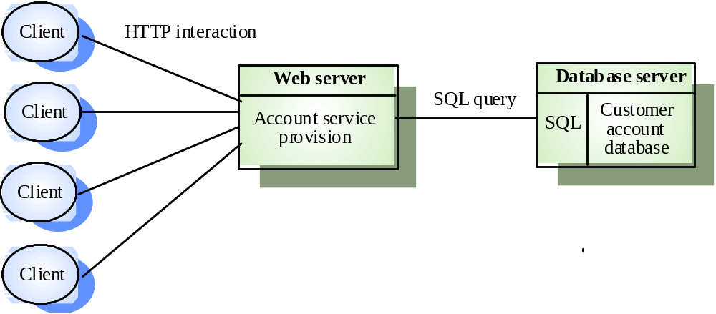
Three-tier Example
An internet banking system
Software Engineering for Distributed Systems

Slide 62
Some Client/Server Architectural Patterns
N-Tier Client Server: a type of three-tier set up that includes multiple intermediate servers.
Client
Mid-tier
Server
(e.g. Data)
Mid-tier
Client
Mid-tier
Processing and data storage can occur on any node,
N-Tier refers typically to web applications which further forward their requests to other enterprise services.
Software Engineering for Distributed Systems

Slide 63
Multi-Tier Client-Server
Application processing
Presentation
Data management
Client
Client
(browser)
Client
HTTP
Web Server(s)
CGI
Internet
Database Server
ASP
CF
WS
ODBC
Intranet
HTTP
Client
ODBC-Open Database Connectivity
CGI – Common Gateway Interface
ASP –Active server pages (Microsoft)
CF - Cold Fusion (Allaire Corp.)
Web Sphere – (IBM Corp.)
Client
Fire Wall
(security)
Client
(browser)
Software Engineering for Distributed Systems

Slide 64
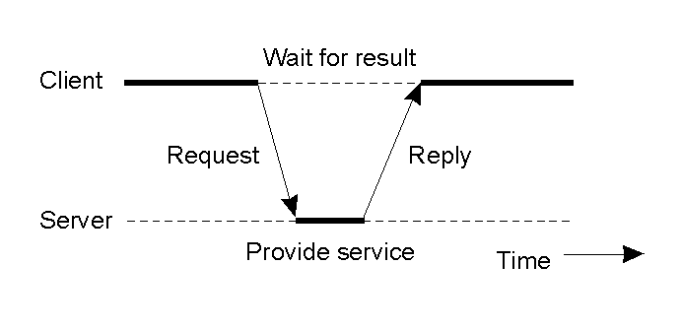
Client-Server interaction (I)
Remote Procedure Call
Software Engineering for Distributed Systems

Slide 65
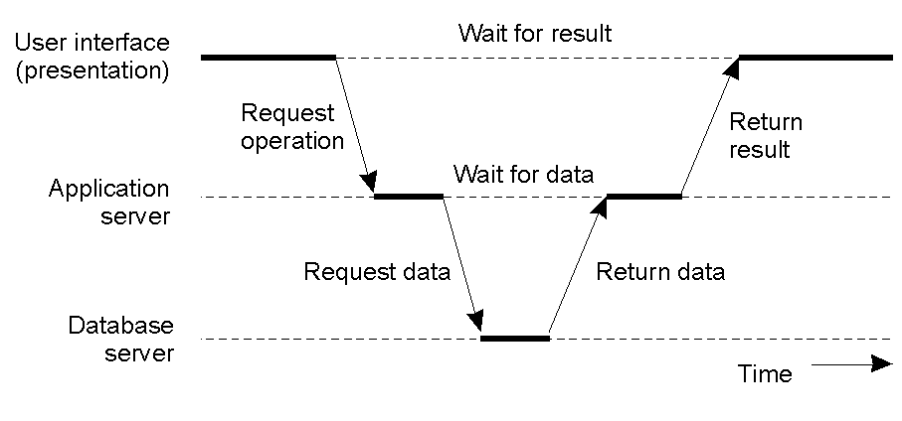
Client-Server interaction (II)
Multi-Tier Architectures
Software Engineering for Distributed Systems

Slide 66
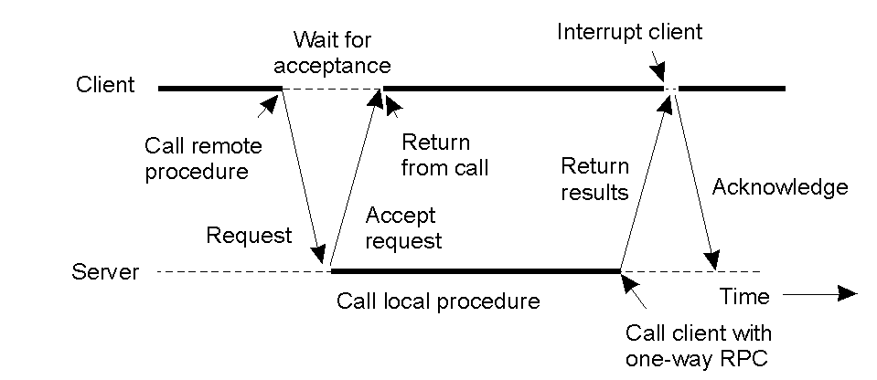
Client-Server interaction (III)
Asynchronous Remote Procedure Call
Software Engineering for Distributed Systems

Slide 67
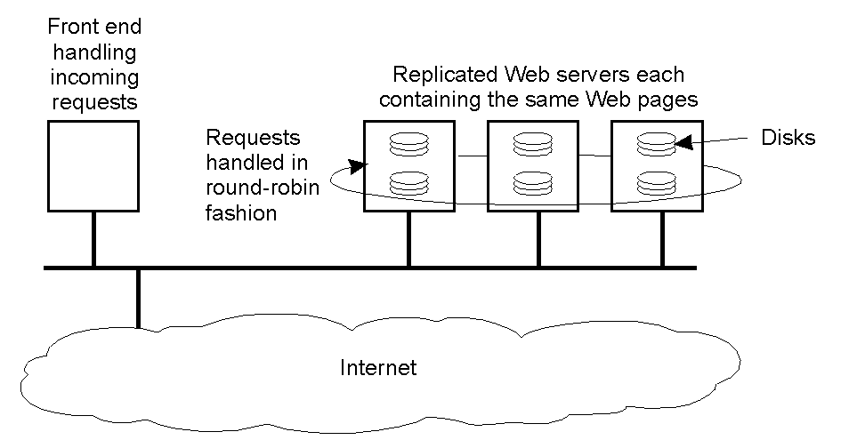
Client-Server Interaction (IV)
Software Engineering for Distributed Systems

Slide 68
***More Architectural Patterns for Distributed Software Systems
    Loose / Tight Coupling Multiprocessor:
    Common for large real-time systems and critical systems to improve performance and resilience of the system.
Distributed Object:
Removes the distinction between client and server.
The fundamental system components are:
  Objects provide interface to a set of services.
  Objects call these services with no logical distinction between the provider and receiver.
Peer-to-Peer:
Similar to distributed objects, except that components are systems, not objects.
Software Engineering for Distributed Systems

Slide 69
Loosely/Tightly Coupled (Cluster)
Refers to a set of highly integrated machines that run the same process in parallel by subdividing the task in parts that are made individually by each one, and then put back together to make the final result.
The components of a cluster are commonly and homogenous (but not always).
Components connected to each other through fast local area networks.
Clusters are usually deployed to improve performance and/or availability over that provided by a single computer.
Software Engineering for Distributed Systems

Slide 70
Distributed Object Architectures
Grid Architecture
There is no distinction in a distributed object architectures between clients and servers
Each distributable entity is an object that provides services to other objects, objects receive services from other objects
Object communication is through a middleware system called an Object Request Broker (software bus)
However, more complex to design than C/S systems
Software Engineering for Distributed Systems

Slide 71
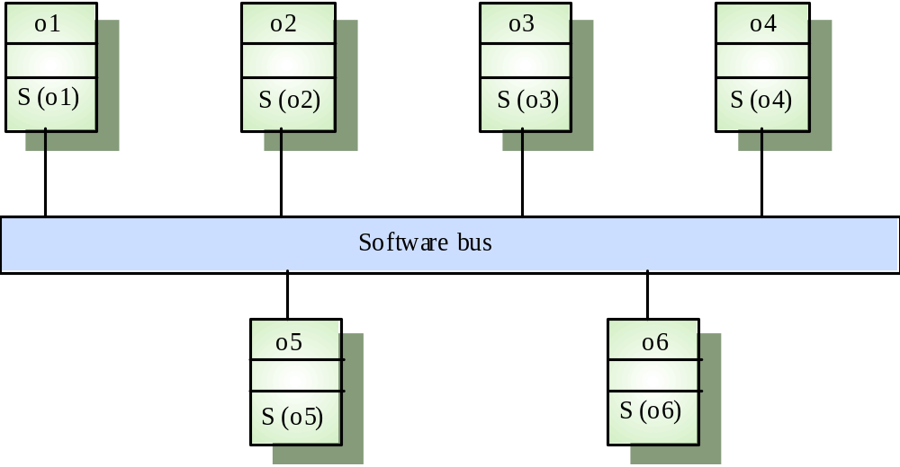
Distributed Object Architecture-Cont...
Software Engineering for Distributed Systems

Slide 72
Distributed Object Architecture-Cont...
Advantages of Distributed Object Architecture:
It allows the system designer to delay decisions on where and how services should be provided
It is an open system architecture that allows new resources to be added to it as required
The system is flexible and scalable
It is possible to reconfigure the system dynamically with objects migrating across the network as required
Software Engineering for Distributed Systems

Slide 73
Uses of Distributed Object Architecture
As a logical model that allows developer to structure and organise the system. In this case, he thinks about
  how to provide application functionality solely in terms of services and combinations of services
The logical model of the system is a client-server model but both clients and servers are realised as distributed objects communicating through a software bus
Software Engineering for Distributed Systems

Slide 74
The Peer-to-Peer Model (P2P)
In peer-to-peer models, each node of a distributed system is capable of requesting and providing services.
    Most of the services are available from several or even many nodes.
    Nodes tend to come and go from the network frequently, but redundancy tends to keep most services available.
P2P networks are useful for:
    Sharing files containing audio, video, data or anything in digital format,
    Passing real time data, such as telephony traffic.
Software Engineering for Distributed Systems

Slide 75
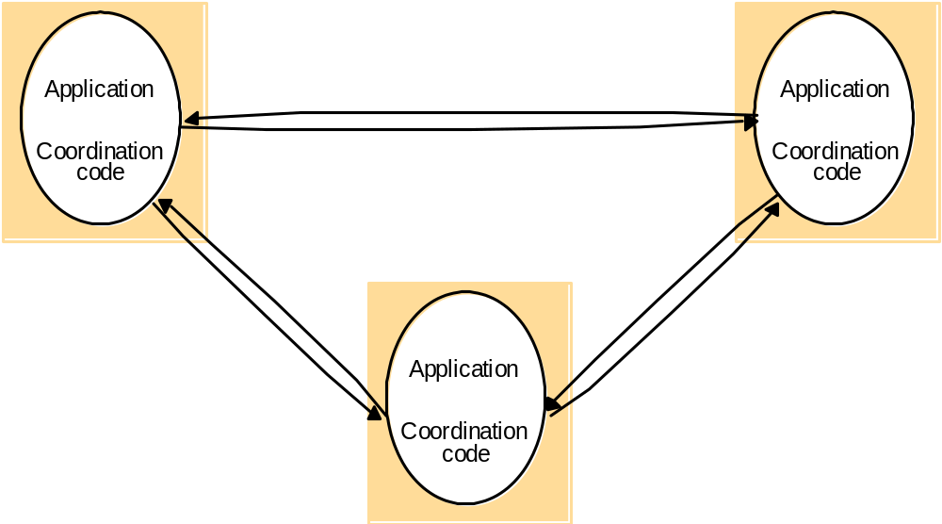
Peer-to-Peer Coordination
Software Engineering for Distributed Systems

Slide 76
Typical Layers in a Distributed System
Architectural Models
Applications and Services
Middleware
Operating System
Computer and Network Hardware
Software Engineering for Distributed Systems

Slide 77
Structure of Traditional Distributed Applications
Architectural Models
The application includes the application logic and two types of networking code:
  Application protocol support code.
    Example: The X protocol for transmitting graphical images.
  Transport Interface Code
    makes the appropriate network calls to send and receive the messages that make up the application protocol over a specific network transport.
Software Engineering for Distributed Systems

Slide 78
Architectural Models
Node 1
Node 2
Appl. Program1
Appl. Program2
Appl. Protocol
Support Code
Appl. Protocol
Support Code
Transport
Interface Code
Transport
Interface Code
Traditional Distributed Applications
Appl. Protocol
Transport Protocol
Software Engineering for Distributed Systems

Slide 79
Distributed System Variations- I
Multiple Servers:
Services with large demands, such as search engines, may have many servers dedicated to a particular task.
Proxy Servers and Caches:
Data likely to be needed again may be stored in memory or on local for fast retrieval.
Mobile Code:
Code may be retrieved from a server for execution on a client system. A common example of this is a Java Applet.
Software Engineering for Distributed Systems

Slide 80
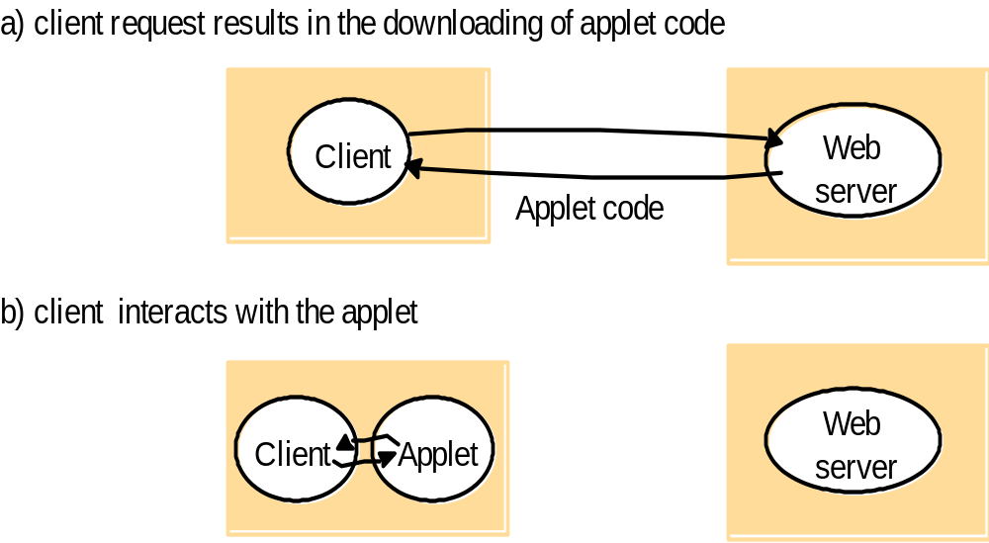
Mobile Code Example: Applet
Software Engineering for Distributed Systems

Slide 81
Distributed System Variations- II
Mobile Agents:
A running program including code and data may run on remote systems.
This may be a security problem, as such agents include worms, viruses, and web crawlers.
Network Computers:
All code and data may be stored on a server and moved to a local thin client temporarily for execution.
It is different from Mobile Code where code is the only compound is transferred to the Client from server
Only the code necessary to retrieve the programs and data is stored on the network appliance.
Software Engineering for Distributed Systems

Slide 82
Distributed System Variations- III
Thin Clients:
Most of the processing may be done on a remote server, with little more than a client interface,
  Most commonly a Web Browser, running on the client.
Mobile Clients and Spontaneous Interoperation:
Transient mobile devices such as laptop, cell phones and PDAs may connect to the network using technologies such as GSM, 3G, WiFi, and Bluetooth.
Software Engineering for Distributed Systems

Slide 83
Topic 3
Fundamental Models
Material from:
http://eb.njit.edu/~gblank/cis633/
Software Engineering for Distributed Systems

Slide 84
Dependability Issues
Correctness is ensuring that data is up to date and accurate.
Fault tolerance is ensuring that when something goes wrong, the system can recover or bypass the fault rapidly without loss of information.
Security includes identifying users, determining privileges and protection of systems and data.
Software Engineering for Distributed Systems

Slide 85
Fundamental Models
Fundamental models describe properties common to all architectural models often focusing on communications between nodes
  The interaction model manages performance and time limits
  The failure model specifies faults and defines reliable communication
  The security model describes threats to processes and communication channels
Software Engineering for Distributed Systems

Slide 86
Interaction Model Concerns
Performance of communication channels
Computer clocks and timing events
  Synchronous distributed systems
  Asynchronous distributed systems
Event ordering
Software Engineering for Distributed Systems

Slide 87
Failure Model Concerns
Process omission failures
Communication omission failures
Arbitrary failures
Timing failures
Masking failures
Communication Reliability
  Validity
  Integrity
Software Engineering for Distributed Systems

Slide 88
Process Failure Modes
Class of failure
Affects
Description
Fail-stop
Process
Process halts and remains halted. Other processes
may detect this state.
Crash
Process
Process halts and remains halted. Other processes may
not be able to detect this state.
Omission
Channel
A message inserted in an outgoing message buffer never
arrives at the other end’s incoming message buffer.
Send-omission
Process
A process completes a send ,
but the message is not put
in its outgoing message buffer.
Receive-omission
Process
A message is put in a process’s incoming message
buffer, but that process does not receive it.
Process or
Process/channel exhibits arbitrary behaviour: it may
Arbitrary
send/transmit arbitrary messages at arbitrary times,
(Byzantine)
commit omissions; a process may stop or take an
channel
incorrect step.
Software Engineering for Distributed Systems

Slide 89
Security Model Concerns
Protecting objects
Securing processes and their communications
Defeating security threats
  Cryptography and shared secrets
  Authentication and Authorization
  Secure channels
  Denial of service
  Mobile code
Software Engineering for Distributed Systems

Slide 90
Topic 4
Design Requirements
Material from:
http://eb.njit.edu/~gblank/cis633/
Software Engineering for Distributed Systems

Slide 91
Design Requirements
There are many challenges in designing distributed systems. Some of those challenges include:
    Performance
    Quality of service
    Caching and Replication
    Dependability
Software Engineering for Distributed Systems

Slide 92
Design Requirements-Cont…
Performance Issues
Responsiveness: Users want both speed and consistency.
Throughput: IT systems are expensive, and are often sold on the basis of their ability to perform the most work for the least money.
Load balancing: High potential throughput can be defeated if the work is not distributed to make maximum use of potential because some of the system is idle.
Software Engineering for Distributed Systems

Slide 93
Quality of Service
Design Requirements-Cont…
Performance is one aspect of quality of service.
Others include:
Reliability: this includes availability (“uptime”) and freedom from errors.
Security: this is protection from compromise or loss of information or investment.
Time Criticality: some information must be available in the right place at the right time. This is a major concern in designing networks.
Software Engineering for Distributed Systems

Slide 94
Caching and Replication
Design Requirements-Cont…
One tool for increasing throughput, availability and time critical sensitivity is storing extra copies of data in memory (caching) or on a local disk (replication).
Data stored can be small (translated web addresses) or large (multiple copies of corporate databases).
There are many challenges in managing data that can be changed in one place while having copies in other places (inconsistence problem).
Software Engineering for Distributed Systems

Slide 95
Topic 5
Client-Server System for Banking
Material from:
http://www2.imm.dtu.dk/courses/02220/2014/
Software Engineering for Distributed Systems

Slide 96
Problem:
Design of a Client-Server System
• Input: an informal description of an application (e.g., banking application)
Presentation
Application
processing
Data
management
concerned with user interface
concerned with the detailed application-speciﬁc
processing associated with the application
concerned with the persistent storage of the application (typically a DBMS)
• Output: client-server implementation of the application
Software Engineering for Distributed Systems

Slide 97

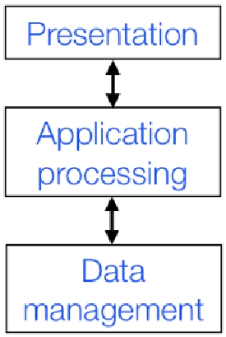

Solution 1:
Two-Tier Client-Server Architecture
• Application organized as a server and a set of clients
• Two kinds of machines: client machines and server machines
how to map
3 application layers
into a 2-tier architecture?
Software Engineering for Distributed Systems

Slide 98
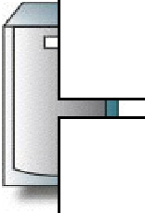

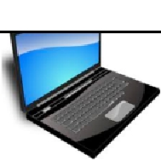
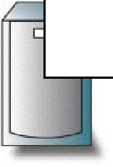


Thin VS Thick Client Model
Presentation
Presentation
Application
processing
Application
processing
Data
management
Data
management
Thin
Client
Thick
Client
Software Engineering for Distributed Systems

Slide 99
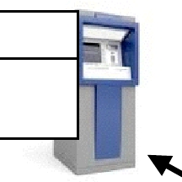
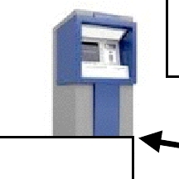
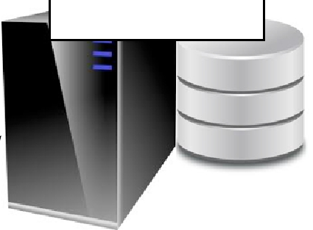
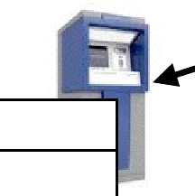
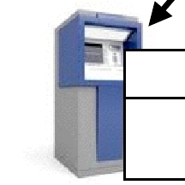
Example of Thick Client: ATM Banking System
Presentation
ATM client
Application
processing
Customer Account Server
Data management
Presentation
Application
processing
Presentation
Application
processing
account
database
Transaction
manager
Presentation
Application
processing
Software Engineering for Distributed Systems

Slide 100
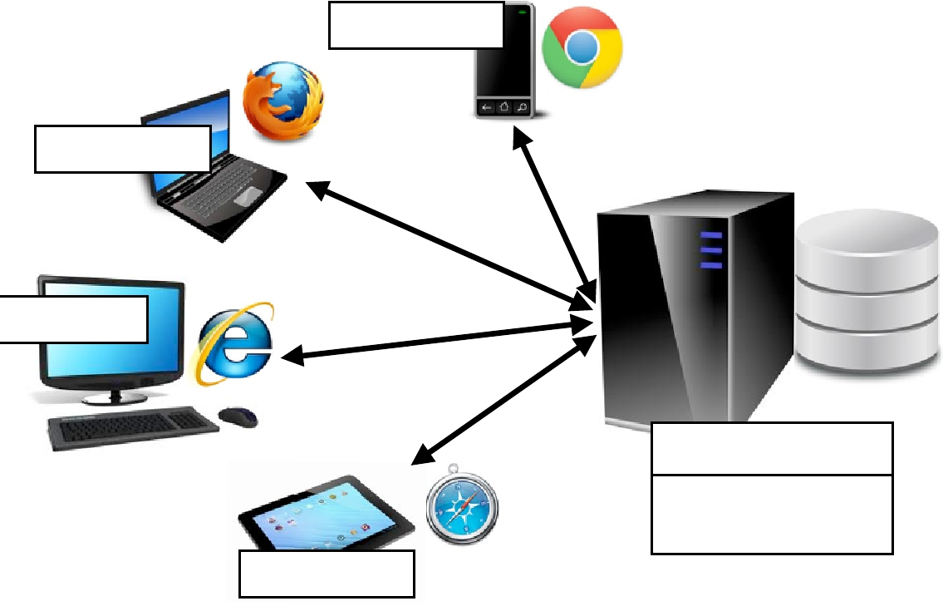
Examples of Thin Client: Internet Banking System
Presentation
client (Web browser)
Presentation
Customer Account Server
HTTP
Account
service
provision
account
database
Presentation
(Web server)
Data management
Application
processing
Presentation
Software Engineering for Distributed Systems

Slide 101
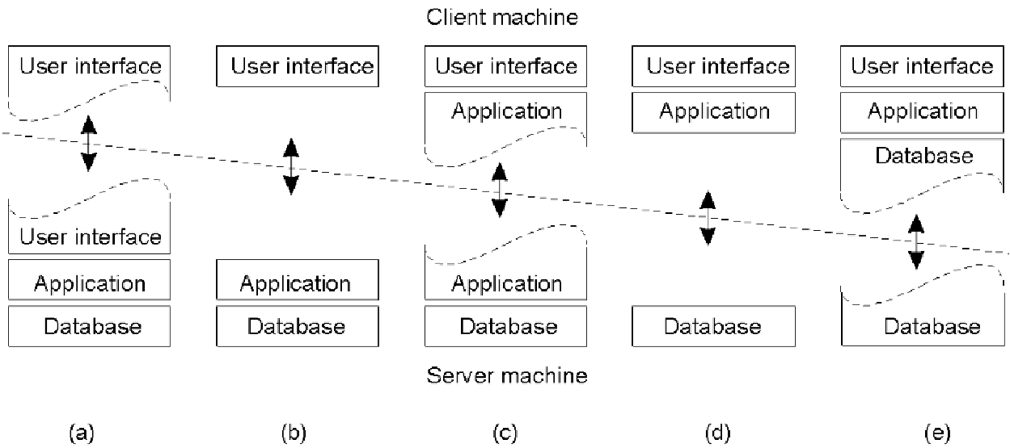



Alternative Two-Tier Client Server Organizations
terminals Web apps
Cloud computing
Thin Client
mobile computing
Thick Client
mobile games
word processor
Hybrid Client
Software Engineering for Distributed Systems

Slide 102
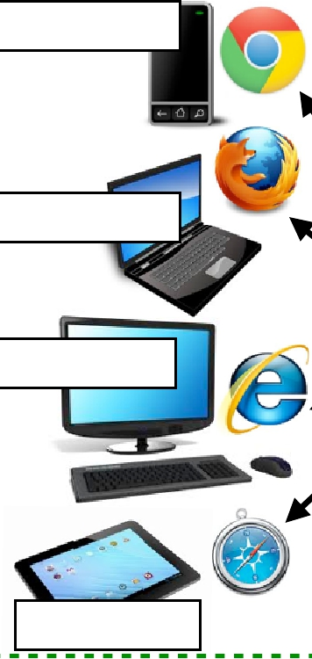
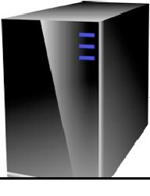
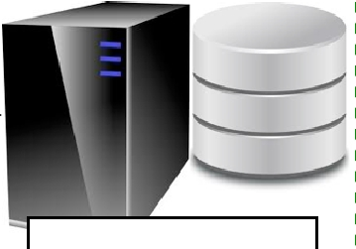
Internet Banking System... in Practice
Presentation
HTTP
Presentation
Web server
Database server
SQL
Account
service
provision
query
account
database
Presentation
SQL
server
Application
processing
Tier 2
Data management
Tier
Presentation
Tier 1
3
Software Engineering for Distributed Systems

Slide 103
Thin or Thick? Thin
Pros
• Devices signiﬁcantly enhanced with a plethora of networked services
• Access to legacy systems
• System management and administration
  from admin perspective: system maintenance, security
  from user perspective: not hassle with administrative aspects or constant upgrades
  More security
  Green IT (power saving --> cost saving)
Software Engineering for Distributed Systems

Slide 104
Thin or Thick? Thin
Cons
Heavy processing load on both server and network)
Less client-perceived performance (in highly interactive graphical activities such as CAD and image processing)
Need to be always connected
Software Engineering for Distributed Systems

Slide 105
Thin or Thick? Thick
Pros
• Better client-perceived performance (especially, in terms of image & video processing)
• (Partly) available oﬄine
• Distributed computing (no single point of failures)
• Devices are becoming ever faster and cheaper:
what is the point of oﬀ-loading computation on a server when the client is amply capable of performing it without burdening the server or forcing the user to deal with network latencies?
Software Engineering for Distributed Systems

Slide 106
Thin or Thick? Thick
Cons
System management and related costs
Having more functionality on the client makes client-side software more prone to errors and more dependent on the client’s underlying platform
Software Engineering for Distributed Systems

Slide 107
Use of Client–Server Architectural Patterns
Two-tier client-server architecture with thin clients
Legacy system applications that are used when separating application processing and data management is impractical; clients may access these as services.
Computationally intensive applications such as compilers with little or no data management
Data-intensive applications (browsing and querying) with non-intensive application processing (example: browsing the Web)
Software Engineering for Distributed Systems

Slide 108
Use of Client–Server Architectural Patterns
Two-tier client-server architecture with fat clients
Applications where application processing is provided by oﬀ-the-shelf software (e.g., Microsoft Excel) on the client
Applications where computationally intensive processing of data (e.g., data visualization) is required
Mobile applications where internet connectivity cannot be guaranteed
Some local processing using cached information from the database is therefore possible
Software Engineering for Distributed Systems

Slide 109
Use of Client–Server Architectural Patterns
Multi-tier client-server architecture
Large-scale applications with hundreds or thousands of clients
Applications where both the data and the application are volatile
Applications where data from multiple sources are integrated
Software Engineering for Distributed Systems

Slide 110
References
George Coularis, Jean Dollimore and Tim Kindberg, Distributed Systems, Concepts and Design, Addison Wesley, Fifth Edition, 2011. Chapter 2 Andrew Tannenbaum and Maarten Steen, Distributed Systems, Principles and Paradigms, Prentice Hall, 2007. Chapter 2 http://ece842.com/S13/ http://eb.njit.edu/~gblank/cis633/ http://www2.imm.dtu.dk/courses/02220/2014/
Software Engineering for Distributed Systems

Slide 111
Classroom Team Exercise
Create an architectural diagram of the systems you have used so far for this class. Include only one wired and one wireless connection from a student computer. Use a cloud to represent the Internet and circles for the AFS and PC networks at the university, connecting hosts with links to the circles.
Software Engineering for Distributed Systems

Slide 112
Some Review questions
What are the parts of a typical client/server system for corporate transaction processing?
How can a search engine coordinate searching for current data with constant updates from web crawlers on data that is replicated many times?
What is the difference between a buffer and a cache?
What applications are best for mobile code?
Can you think of other technological examples of the law of unintended consequences?
Software Engineering for Distributed Systems

Slide 113
Some Review questions
6. What are issues to measure the performance of the distributed systems ?
7. Specify three examples of security threats and how to prevent them ?
8.What is the Interaction Model of the distributed system ?
9. How can we improve the performance of the client / sever model ?
Software Engineering for Distributed Systems

Slide 114
Thank you for
your attention.

