Slide 1
Software Engineering for Distributed Systems Course Code:Comp **** Unit 2: Characterization and Models of Distributed Systems
Modified By Dr. Fatma Omara
Computer Science Dept.
Faculty of Computers and Artificial Intelligence
Cairo University
Notes:
‹#›

Slide 2
Course Title: Software Engineering for Distributed Systems Course
Characterization and Models of Distributed Systems
Software Engineering for Distributed Systems
‹#›

Slide 3
Introduction
Define characterization and models of distributed systems
Discuss challenges in designing distributed systems.
Explain different architectural models of the Distributed Systems.
Explain fundamental models related to interaction, failure and security concerns.
Explain the design requirements that reserve performance, quality and dependability .
Finally, Discuss a client-server system for banking system as an example.
Software Engineering for Distributed Systems
‹#›

Slide 4
Objectives
Students will have deeper understanding of the Challenges in distributed systems and the different models related to the architecture of the distributed system , fundamentals models and design requirements.
Students will have deeper understanding of how to design a distributed system that provides best performance , quality and security
Software Engineering for Distributed Systems
‹#›

Slide 5
Unit 1: List of topics
Topic # | Topic
Topic 1 | Challenges in Distributed Systems
Topic 2 | Architectural Models
Topic 3 | Fundamental Models
Topic 4 | Design Requirements
Topic 5 | Client-Server System for Banking
Software Engineering for Distributed Systems
‹#›

Slide 6
Topic 1
Challenges in Distributed Systems
Material from:
Distributed Systems: Concepts and Design, 5th edition. Coulouris, et. Al
Prof. Bill Nace’ http://ece842.com/S13/
Dr. Rajkumar Buyya, http://www.cloudbus.org/652
Ian Sommerville, Software Engineering,
Software Engineering for Distributed Systems
‹#›

Slide 7
Concepts Parallel and Distributed Systems

Slide 8
Parallel & Distributed Models
Multiprocessor systems come in many different flavors, but there are two basic categories:
Parallel Systems and Distributed Systems.
These two terms are used with some overlap, but
Parallel System is usually one in which the processors are closely connected, while
Distributed System has processors that are more independent of each other.
A parallel computer is implicitly a distributed system.
Software Engineering for Distributed Systems
‹#›

Slide 9
Parallel Computing
Parallel Computer is a collection of processing elements that communicate and cooperate to solve large problems fast (HPC).
In a parallel computer, the processors are closely connected. Frequently, all processors share the same memory, and the processors communicate by accessing this shared memory.
Examples of parallel computers include:
Multicore processors found in many computers today (even cheap ones), as well as
Many graphics processing units (GPUs).
Software Engineering for Distributed Systems
‹#›

Slide 10
Parallel Computing-Cont.
Shared Memory Access
An important design constraint in a shared-memory system is how programs are allowed to access the same memory address simultaneously.
There are three basic approaches; CRCW, CREW, EREW, ERCW
Software Engineering for Distributed Systems
‹#›

Slide 11
Parallel Computing-Cont.
CRCW: Concurrent Read, Concurrent Write.
Simultaneous reads and writes are allowed to a memory cell.
The model must indicate how simultaneous writes are handled:
Common Write: If processors write simultaneously, they must write same value.
Priority Write: Processors have priority order, and the highest-priority processor's write wins in case of conflict.
Arbitrary Write: In case of conflict, one of the requested writes will succeed. But the outcome is not predictable, and the program must work regardless of which processor wins.
Combining Write: Simultaneous writes are combined with some function, such as adding values together.
‹#›
Software Engineering for Distributed Systems

Slide 12
Parallel Computing-Cont.
CREW: Concurrent Read, Exclusive Write
Here different processors are allowed to read the same memory cell simultaneously, but writing a program must guarantee that only one processor can write to any memory cell at a time.
EREW: Exclusive Read, Exclusive Write
The program must be written so that no memory cell is accessed simultaneously in any way.
ERCW: Exclusive Read, Concurrent Write
There is no reason to consider this possibility.
Software Engineering for Distributed Systems
‹#›

Slide 13
Distributed System Definitions
“A collection of independent computers that appears to its users as a single coherent system”.
“A system in which hardware or/and software components located at networked computers communicate and coordinate their actions only by “message passing.”
“A system that consists of a collection of two or more independent computers which coordinate their processing through the exchange of “synchronous or asynchronous message passing”.
“A distributed system is a collection of autonomous computers linked by a network with software designed to produce an “integrated computing facility.”
‹#›
Software Engineering for Distributed Systems

Slide 14
Distributed System Architectures
Architectural design for software that executes on more than one processor
Distributed software engineering is now very important
Software Engineering for Distributed Systems
‹#›

Slide 15

Construction of Distributed Systems
Units of a Distributed System:
Units/Nodes (Computers, sensors, … )
Network
Software
network
Software Engineering for Distributed Systems
‹#›

Slide 16
What Is Distribute Systems?
There is no unique definition for distributed systems. Similar terms are
Networked system
parallel systems
Concurrent systems
Decentralized systems
Enslow’s Definition
Distributed System = Distributed hardware + Distributed control + Distributed data
Software Engineering for Distributed Systems
‹#›

Slide 17
What Is Distribute Systems?
Distributed Hardware
Physically distributed memory
processor
processor
processor
memory
memory
memory
Network
Distributed System Software
Cooperating the actions of units (computers, sensors, …)
Supporting system resources (hardware and software) sharing.
Supporting data sharing.
Software Engineering for Distributed Systems
‹#›

Slide 18
What Is Distribute Systems?
Distributed Control
Master/Slave (fixed/dynamic)
Multi control points (homogenous/heterogeneous)
Distributed Data
Copies: Processors hold data copies.
Divided data: Data are divided and distributed to processors.
Software Engineering for Distributed Systems
‹#›

Slide 19
Parallel versus Distributed System
 | Parallel | Distributed
Hardware | identical processors regular interconnection | different types of processors Networks
Memory | Shared memory | Distributed memory
Control | synchronized (global clock) | A synchronized execution of tasks (no global clock)
Main focus | Performance | Information/resource sharing Reliability/availability,….
Homogeneity | tasks perform similar functions | Inhomogeneity, tasks perform different functions
Software Engineering for Distributed Systems
‹#›

Slide 20
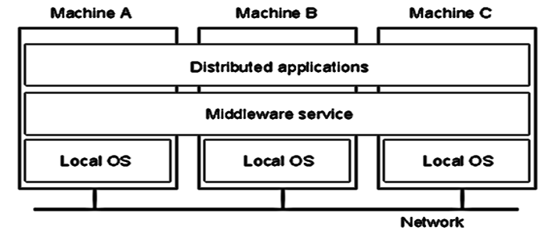
Abstract View Distributed Systems
Each host executes components and operates a distribution middleware.
Middleware enables the components to coordinate their activities.
Users perceive the system as a single, integrated computing facility.
Software Engineering for Distributed Systems
‹#›

Slide 21
Middleware
Software that manages and supports the different components of a distributed system. In essence, it sits in the middle of the system
Middleware is usually off-the-shelf rather than specially written software
Examples
Transaction Processing Monitors (TPM)
Data convertors
Communication controllers
Software Engineering for Distributed Systems
‹#›

Slide 22
Middleware
Building blocks
in the form of processes or objects
Abstractions
Remote method invocation
Group of processes
Notification of events
Replication of shared data
Real-time transmission of multimedia streams
Software Engineering for Distributed Systems
‹#›

Slide 23
Distributed Operating Systems
• Requirements:
– Provide user with convenient virtual computer.
– Hide distribution of resources.
– Mechanisms for protecting resources.
– Secure communication.
• Definition
Distributed OS looks to user like ordinary centralized OS, but runs on multiple, independent CPUs.
– Use of multiple processors is invisible.
– User views system as virtual uniprocessor.
Software Engineering for Distributed Systems
‹#›

Slide 24
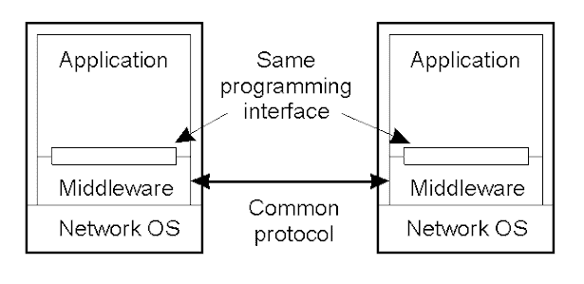
Middleware and Openness
In an open middleware-based distributed system, the protocols used by each middleware layer should be the same, as well as, the interfaces they offer to applications.
‹#›
Software Engineering for Distributed Systems

Slide 25
Types of Distributed systems
Client-Server
Peer-To- peer
Processor Pool
Network Operating Systems
Software Engineering for Distributed Systems
‹#›

Slide 26
Examples of Distributed Systems
An "ATM machine"
A remote file access mechanism
A database
A chat room
A computing "grid" (like SETI), Cloud
Software Engineering for Distributed Systems
‹#›

Slide 27
Distributed System Reasons
Functional distribution:
Computers have different functional Capabilities:
– Client / server
– Host / terminal
– Data gathering / data processing
Sharing of resources:
with specific functionalities
Inherent distribution:
stemming from the application domain, e.g.
– Cash register and inventory systems for supermarket chains
– Computer supported collaborative work
Load distribution / balancing:
assign tasks to processors such that the overall system performance is optimized (Parallel Processing).
Software Engineering for Distributed Systems
‹#›

Slide 28
Distributing Systems Reasons-Cont…
Replication of processing power:
Independent processors working on the same/different task
Distributed systems consisting of collections of microcomputers may have processing powers that no supercomputer will ever Achieve
10000 CPUs, each running at 50 MIPS, yields 500000 MIPS, then
* Instruction to be executed in 0.002 nsec
* Any processor chip of that size would melt immediately
Physical Separation:
Systems that rely on the fact that computers are physically separated (e.g., to satisfy reliability requirements).
Software Engineering for Distributed Systems
‹#›

Slide 29
***Why Distributed Systems and not isolated hardware?
Need to share data and resources amongst users
Enhance person-to-person communication
Flexibility:
– Different computers with different capabilities can be shared amongst users
Economics
– Many microprocessors cooperatively work together offer better price/performance then a single large mainframe computer
Speed
– Distributed system may have more total computing power than a mainframe
Inherent Distribution
– Some applications involve spatially separated machines
Reliability
– If one machine crashes, the system as a whole can still survive
Incremental Growth
– Computing power can be added in small increments
Software Engineering for Distributed Systems
‹#›
Notes:
‹#›

Slide 30
Distributed System Applications
Computing Dominated Problems (Distributed Computing): [HPC] Mathematical Computations, Environmental and Biological Modeling, Economic and Financial modeling, Graphics rendering for visualization, Network Simulations. Storage Dominated Problems (Distributed Data): Data Mining, Image Processing, Information retrieval, Insurance Analysis, IOT. Communications Dominated Problems (Network Computing): Transaction processing, Video on Demand, E-com, Electronic banking, electronic shopping
Software Engineering for Distributed Systems
‹#›

Slide 31
Features& Goals of Distributed Systems
Resource sharing:
hardware, software, data
Openness:
openness of main interface of the system, scalability of the current system
Concurrency:
Concurrent execution of the processes, high performance, nice rate of price and performance (PC cluster = poor man’s supercomputer)
Fault Tolerance:
Ability to tolerate the fault of system units, availability (using potential redundancy to overcome the system fault).
Transparency:
A distributed system can be looked as one computer (access transparency, position transparency, parallel transparency,….)
‹#›
Software Engineering for Distributed Systems

Slide 32
Advantages and Disadvantages of Distributed Systems
Advantages
Resource Sharing
Expandability
Local autonomy
Improved performance
Improved reliability and availability
Potential cost reductions
Disadvantages
Network reliance
Complexities
Security
Multiple point of failure
Manageability
Unpredictability
‹#›
Software Engineering for Distributed Systems

Slide 33
Distributed Computational models
Processes: never mind in which unit they are.
Communicating links: communication channels
Communication link
Computer
process
‹#›

Slide 34
Distributed Computational Models-Cont..
Process
Generalized RAM (Random Access Machine)
CPU with program
Infinite memory
Message changeable with adjacent processes
Each process has a distinct ID.
Without fault (it will be considered in the model with fault).
Software Engineering for Distributed Systems
‹#›

Slide 35
Distributed Computational models-Cont..
Communication Links
Bidirectional
Asynchronous
Infinite FIFO queue
Without fault (no massage losing, alteration)
Sending in order of A,B,C
Receiving in order of A,B,C
Software Engineering for Distributed Systems
‹#›

Slide 36
Distributed Computational Models-Cont..
Synchronism Computational Model
Running speed of each process
Transmission delay
Speed of the local clock in each process:
Constant upper and lower bounds
Typical synchronous distributed model:
Round Model
Processes execute each round synchronously
Each round consists of message receiving, computation, and message sending
Processes accept the message sent from the previous round.
Software Engineering for Distributed Systems
‹#›

Slide 37
Distributed Computational Models-Cont..
Complete Asynchronous Model
No assumption for the speed of processes.
No assumption for the transmission delay of communication links.
No assumption for the speed of local clocks.
Software Engineering for Distributed Systems
‹#›

Slide 38
Distributed Systems Consequences
♦ Distributed systems are concurrent systems;
– Every software or hardware component is autonomous in the sequel, we will call such an autonomous component a “process”
- Difference process/program
– Components execute concurrent tasks:
If A and B are concurrent if either A can happen before B, or B can happen before A (nondeterministic)
– Synchronization and coordination by message passing
– Sharing of resources
– Typical problems of concurrent systems
Deadlocks
Life locks
Unreliable communication
‹#›
Software Engineering for Distributed Systems

Slide 39
Distributed Systems Consequences-Cont…
Absence of a global clock
Due to asynchronous message passing there are limits on the precision with which processes in a distributed system can synchronize their clocks.
Absence of a global state
In the general case, there is no single process in the distributed system that would have a knowledge of the current global state of the system
Due to concurrency and message passing communication
Specific failure modes
Processes run autonomously, in isolation
Failures of individual processes may remain undetected.
Individual processes may be unaware of failures in the system context
Software Engineering for Distributed Systems
‹#›

Slide 40
Distributed Computing
Basic Idea:
Many systems loosely coupled by a scheduler to work on related problems
Communication between processes (on the same or different computer) using message passing technologies is the basis of distributed computing
Run scheduler across systems to runs processes on least-used systems first
Maximize resource utilization
Minimize turnaround time
Satisfy Load Balance
Have to load executable and input files to selected resource
Shared file system (Hdoop Files System (HFS))
File transfers upon resource selection (P2P)
Software Engineering for Distributed Systems
‹#›

Slide 41
Generally
We want a distributed system to appear as one large non-distributed system from the users perspective
Sometimes we want distributed systems to be act as parallel machines to run parallel algorithms (HPC)

Slide 42
Challenges in Distributed Systems
Concurrency
Heterogeneity
Openness
Security
Scalability
Failure handling
Transparency
Software Engineering for Distributed Systems
‹#›

Slide 43
Challenges : Concurrency
Single processor:
Multi threaded programming
Concurrency: non real
Jobs : Parallel cooperating threads
Execution: interleaved
Communicate: via shared memory
Clock: single
=> events can be ordered
Software Engineering for Distributed Systems
‹#›

Slide 44
Challenges : Concurrency
Multiprocessor:
Parallel Computing
Tightly Coupling
Concurrency: real
Job: execution of one program
Execution: cooperating threads
Communicate: via shared memory
Clock: single
events can be ordered
Software Engineering for Distributed Systems
‹#›

Slide 45
Challenges : Concurrency
MultiComputer:
Distributed Computing
Lossely Coupling
Concurrency: real
Job: execution of many remote procedures
Execution: cooperating many remote tasks
Communicate: via message passing or remote invocation
Clock: multiple
=> only partial order for events
Software Engineering for Distributed Systems
‹#›

Slide 46
Challenges : Heterogeneity
Distributed systems developed to many different kinds of software and hardware.
Heterogeneity at many levels:
Network: different kinds of software and hardware
Operating system: different APIs to internet
Programming languages: many different Programming Languages
Data: different representations of data (Big Indian, Small Indian)
Hardware: Different clock cycles and memory capacity
Data structures: Implementations by different developer
Software Engineering for Distributed Systems
‹#›

Slide 47
Challenges : Heterogeneity
Heterogeneity (Solution)
Middleware layer: (e.g., CORBA)
integrates many computing devices to act as a coordinated computational resource and hides different topologies, communication networks and computing devices .
Services that can be regarded as middleware:
MOM: message oriented middleware
ORBs: object request brokers
ESB: enterprise service bus
Uniform high level API.
Software Engineering for Distributed Systems
‹#›

Slide 48
Challenges : Openness
Open systems:
Enables interacting with services from other open systems, independent of the underlying environment
Enables adding system extensions without disruption or duplication of existing services.
How?
Uniform communication mechanism (Protocols) (e.g., TCP/IP)
Standard published well-defined interfaces
Support portability of applications
Systems should easily interoperate
Result
Open distributed systems
Heterogeneous hardware possible
Software Engineering for Distributed Systems
‹#›

Slide 49
Challenges : Openness
Achieving Openness
At least make the distributed system independent from heterogeneity of the underlying environment:
Hardware
Platforms
Languages
Software Engineering for Distributed Systems
‹#›

Slide 50
Challenges: Security
Attacks against
Confidentiality/privacy
Protection against unauthorized individuals
Integrity
Authentication of user
Protection against alteration or corruption
Availability : Protection of resources
Accessing Data, Services, …
Denial of service: blocking server by overwhelming it with pointless requests
Mobile code performing unauthorized operations
Software Engineering for Distributed Systems
‹#›

Slide 51
Challenges: Scalability
A system is scalable if it allows significantly scaling up the number and types of resources and the number of users while keeping the same software effective.
Scalability
Scalability along several dimensions:
Number of users and/or processes (size scalability)
Maximum distance between nodes (geographical scalability)
Number of administrative domains (administrative scalability)
Challenges:
Cost of physical resources
Performance loss
Performance bottlenecks
Scalable System?!
Software Engineering for Distributed Systems
‹#›

Slide 52
Scale in Distributed Systems
Observation
Most systems account only for size scalability.
The (non) solution:
Powerful servers.
Today, the challenge lies in
Geographical and administrative scalability
Software Engineering for Distributed Systems
‹#›

Slide 53
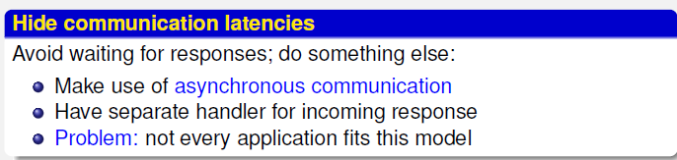
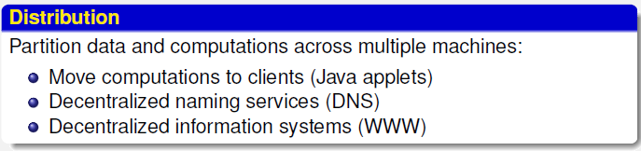
Techniques for Scaling
Software Engineering for Distributed Systems
‹#›

Slide 54
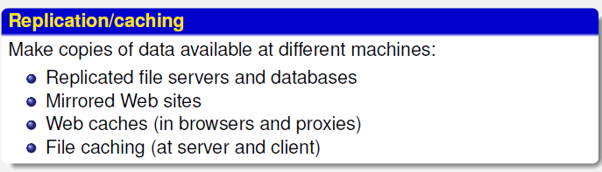
Techniques for Scaling (Cont..)
General Techniques:
Data
Replication & partitioning
Caching
multiple servers
Software Engineering for Distributed Systems
‹#›

Slide 55
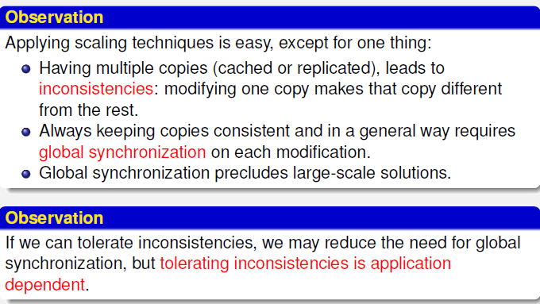
Scaling – The Problem
Software Engineering for Distributed Systems
‹#›

Slide 56
Challenges: Failure Handling
Incorrect results:
Failure in hardware or software may produce incorrect results.
Partial failures:
Processes, computers or networks may fail independently of the others
Therefore failures in distributed systems are particularly difficult to handle
Software Engineering for Distributed Systems
‹#›

Slide 57
Challenges: Failure Handling
Failure model:
Defines the ways in which failures may occur in
Provides an understanding of the effects of failures
Example of taxonomy of failures [Hadzilacos and Toueg, 1994]:
Omission failures: a process or communication channel fails to perform actions that it is supposed to do
Arbitrary failures: any type of error may occur
Timing failures: applicable in synchronous distributed systems.
Software Engineering for Distributed Systems
‹#›

Slide 58
Challenges: Failure Handling
Techniques used:
Checksum: detecting failures
Message retransmission: masking failures
Redundancy: replicating services
Software Engineering for Distributed Systems
‹#›

Slide 59
Omission and Arbitrary Failures
Class of failure | Affects | Description
Fail-stop | Process | Process halts and remains halted. Other processes may detect this state.
Crash | Process | Process halts and remains halted. Other processes may not be able to detect this state.
Omission | Channel | A message inserted in an outgoing message buffer never arrives at the other end’s incoming message buffer.
Send-omission | Process | A process completes a send but the message is not put in its outgoing message buffer.
Receive-omission | Process | A message is put in a process’s incoming message buffer, but that process does not receive it.
Arbitrary (Byzantine) | Process or Channel | Process/channel exhibits arbitrary behavior: it may send/transmit arbitrary messages at arbitrary times, commit omissions; a process may stop or take an incorrect step.
‹#›
Software Engineering for Distributed Systems

Slide 60
Timing Failures:
Applicable in synchronous distributed systems
Class of Failure | Affects | Description
Clock | Process | Process’s local clock exceeds the bounds on its rate of drift from real time.
Performance | Process | Process exceeds the bounds on the interval between two steps.
Performance | Channel | A message’s transmission takes longer than the stated bound.
Software Engineering for Distributed Systems
‹#›

Slide 61
Arbitrary Failures
(Byzantine failure)
Describe the worst possible failure semantics, in which any type of error may occur
Process (arbitrary failure):
The process arbitrarily omits intended processing steps or takes unintended processing steps
Communication channel (arbitrary failures):
corrupted message contents or non-existent messages may be delivered or real messages may be delivered more than once
Software Engineering for Distributed Systems
‹#›

Slide 62
Challenges: Transparency
Transparency:
A system is transparent for a feature if the feature is unobservable for the user, so that the system is perceived as a whole rather than a collection of independent Components
Aim:
to make certain aspects of distribution invisible to the application programmer user so that they see it as non distributed application
Software Engineering for Distributed Systems
‹#›

Slide 63
Challenges: Transparency
Concealing the heterogeneous and distributed nature of the system so that it appears to the user like one system.
Transparency categories (according to ISO's Reference Model for ODP)
- Access: access local and remote resources using identical operations
* e.g., network mapped drive using Samba server, NFS
Mounts
- Location: access without knowledge of location of a resource
e.g., URLs, email addresses
Concurrency: allow several processes to operate concurrently using shared resources in a consistent fashion
Software Engineering for Distributed Systems
‹#›

Slide 64
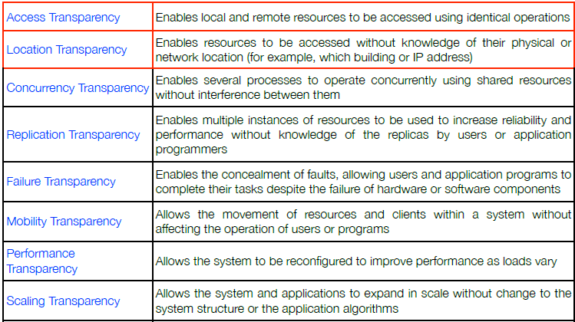
The 8 Forms of Transparency
Software Engineering for Distributed Systems
‹#›

Slide 65
Autonomy and Interdependence
• Disadvantage generated by interdependence:
– Cannot work stand-alone
– Globally controlled
– Difficult to identify source of authority and responsibility
– what about mutual suspicion?
• Reasons for autonomy:
– Policy freedom
– Robustness
– Cooperation between mutually suspicious users
Software Engineering for Distributed Systems
‹#›

Slide 66
Fundamental Components of The Distributed systems
Personal computers and powerful server computers,
Local and fast wide area networks, internet, and
Systems, in particular distributed operating systems, and application software.
Software Engineering for Distributed Systems
‹#›

Slide 67
Building a Distributed System
Everyone, when they first build a distributed system, makes the following eight assumptions. referred to as "8 Fallacies".
The network is reliable.
Latency is zero.
Bandwidth is infinite.
The network is secure.
Topology doesn't change.
There is one administrator.
Transport cost is zero.
The network is homogeneous.
Latency:
time between initiating a request for data and starting the actual data transfer.
Bandwidth:
A measure of the capacity of a communications channel. Topology:
different configurations adopted in building networks (e.g., a ring, bus, star or meshed).
Homogeneous network:
network running a single network protocol.
Software Engineering for Distributed Systems
‹#›

Slide 68
Research and Design Issues
• There are many design issues that are important when considering how to achieve a single system image in a distributed environment
Transparency
System designers “fool” users into thinking a collection of computers is a single timesharing system
Flexibility
System should be able to be logically configured in a flexible manner
Reliability
Failures of nodes/links, loss of messages
System should be able to tolerate one or more failures in the distributed environment
Software Engineering for Distributed Systems
‹#›

Slide 69
Research and Design Issues- Cont..
Scalability
System should scale well and limit the amount of central control
Communication model
Communication is costly in large volumes
Paradigms for process interaction
Heterogeneity
Software Engineering for Distributed Systems
‹#›

Slide 70
Research and Design Issues- Cont..
Lack of global knowledge
No perfect (shared) clock
Autonomy and/or interdependence
Replication
Mobility
Some nodes may be mobile – Not easy to find and communicate with moving nodes
Software Engineering for Distributed Systems
‹#›

Slide 71
Issues in distributed system design
Design issue | Description
Quality of service | The quality of service offered by a system reflects its performance, availability and reliability. Service quality is affected by a number of factors such as the allocation of processes to processers in the system, the distribution of resources across the system, the network and the system hardware and the adaptability of the system.
Software architectures | The software architecture describes how the application functionality is distributed over a number of logical components and how these components are distributed across processors. Choosing the right architecture for an application is essential to achieve the desired quality of service.
Software Engineering for Distributed Systems
‹#›
Notes:
‹#›

Slide 72
Issues in distributed system design
Design issue | Description
Resource identification | The resources in a distributed system are spread across different computers and a naming scheme has to be devised so that users can discover and refer to the resources that they need. An example of such a naming scheme is the URL (Uniform Resource Locator) that is used to identify WWW pages. If a meaningful and universally understood identification scheme is not used then many of these resources will be inaccessible to system users.
Communications | The universal availability of the Internet and the efficient implementation of Internet TCP/IP communication protocols means that, for most distributed systems, these are the most effective way for the computers to communicate. However, where there are specific requirements for performance, reliability etc. alternative approaches to communications may be used.
Software Engineering for Distributed Systems
‹#›

Slide 73
Distributed Systems Design Issues
Reliability
Availability: fraction of time system is usable
Achieve with redundancy
Reliability: data must not get lost
Includes security
Performance
Communication network may be slow and/or unreliable
Flexibility
- System should able to logically configured in a flexible manner
Scalability
Distributable vs. centralized algorithms
Can we take advantage of having lots of computers?
Software Engineering for Distributed Systems
‹#›

Slide 74
Future of Distributed Systems
Large scale systems
Old theory assumes few nodes knowing each other
Dynamic (Mobile) systems
Nodes joining, leaving, and failing
Examples
Skype, BitTorrent, ppLive…
Software Engineering for Distributed Systems
‹#›

Slide 75
***Service Models
Centralized Model
No networking
Traditional time-sharing system
Direct connection of user terminals to system
One or several CPUs
Not easily scalable
Limiting factor:
Number of CPUs in system
Contention for same resources
Notes:
‹#›

Slide 76
Service Models- Cont..
Client-Server Model
Environment consists of clients and servers
Service: task machine can perform
Server: machine that performs the task
Client: machine that is requesting the service
Directory server
Print server
File server
client
client
Workstation model
assume client is used by one user at a time
Notes:
‹#›

Slide 77

Multi-Tier Client-Server Architectures
Two-Tier Architecture
Common from mid 1980’s-early 1990’s
User Interface on user’s desktop
Application services on server
client
back-end
User interface
queuing/scheduling of user requests
transaction processor (TP)
Connection mgmt
- Database - Legacy application processing
Notes:
‹#›

Slide 78
Multi-Tier Client-Server Architectures
Three-Tier Architecture
client
middle tier
back-end
User interface
- some data validation/ formatting
queuing/scheduling of user requests
transaction processor (TP)
Connection mgmt
Format conversion
Database
Legacy application processing
Notes:
‹#›

Slide 79
Multi-Tier Client-Server Architectures
Beyond Three Tiers
Most architectures are multi-tiered
database
Java application server
load
balancer
web server
client
firewall
firewall
Object
Store
Notes:
‹#›

Slide 80
Service Models- Cont..
Peer To Peer Model
Each machine on network has (mostly) equivalent capabilities
No machines are dedicated to serving others
E.g., collection of PCs:
Access other people’s files
Send/receive email (without server)
Gnutella-style content sharing
SETI@home computation
Notes:
‹#›

Slide 81
Service Models- Cont..
Processor Pool Model
What about idle workstations (computing resources)?
Let them sit idle
Run jobs on them
Alternatively…
Collection of CPUs that can be assigned processes on demand
Users won’t need heavy duty workstations
GUI on local machine
Computation model of Plan
Notes:
‹#›

Slide 82
Service Models- Cont..
Utility Computing (Grid , Cloud)
Provide users with seamless access to:
Storage capacity
Processing
Network bandwidth
Heterogeneous and geographically distributed systems
Notes:
‹#›

Slide 83
Thank you for
your attention.
Notes:
‹#›

