Slide 1
IBM Cloud - Paas

Slide 2

What is IBM Cloud?
-> It is a set of cloud computing services provided by IBM

Slide 3



Cloud Computing

Slide 4
Some Benefits of IBM Cloud:
Provides Solutions that enable higher levels of:
Security
Compliance
Management
With proven architecture methods and patterns for
rapid delivery for running mission-critical workloads.

Slide 5
IBM Cloud offers the most
open and secure public cloud for business.
Solutions are available depending on your needs for
working in the public cloud, on-premises, or a combination:
Public Cloud
Hybrid Cloud Solution
Support for Multicloud and Hybrid Cloud
IBM Cloud Paks
Virtual Private Cloud (VPC)

Slide 6
Combines
Platform as a service
Infrastructure as a service

Slide 7
What is Paas(Platform as a service)?
Cloud Computing model.
Usually needed for application development.
How does Paas works?
Provided through a cloud service provider’s hosted infrastructure.
Uses public, private and hybrid clouds.

Slide 8
Examples of Paas services:
Development team collaboration.
Application design and development.
Application testing and deployment.
Web service integration.
Information security.
Database integration.

Slide 9
What is the three main categories of cloud computing services?
Iaas(Infrastructure as a service).
Ex: AWS and Google Compute Engine(GCE).
Paas(Platform as a service).
Ex: AWS Elastic Beanstalk and Google App Engine.
Saas(Software as a service).
Ex: Dropbox and Google Workspaces.

Slide 10
Paas pros and cons:
Simplicity and convenience.
Accessible anywhere through a web browser.
Service availability and resilience.
Internal changes to a Paas product.

Slide 11
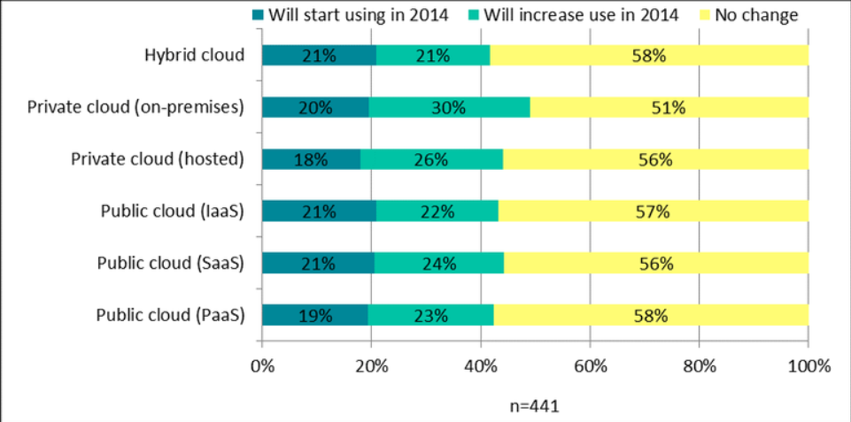
Types of Paas:
Public Paas.
Private Paas.
Hybrid Paas.
Communication Paas.
Mobile Paas.
Open Paas.

Slide 12
Paas uses:
Mobile Development.
Cross-platform apps.
DevOps tools.
Reducing an application’s time to market.
Decreasing infrastructure management.
Removes the complexities of load balancing, scaling and distributing new dependent services.

Slide 13
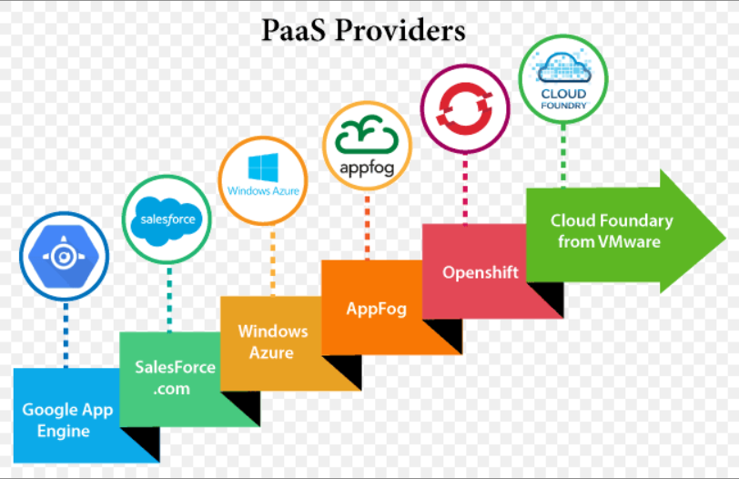
Paas examples(Products and vendors):
Google.
Microsoft.
Amazon Web Service(AWS).
IBM.
Red Hat.
SalseForce.
Enginge Yard.
Oracle.

Slide 14
What is Included in a platform as a service?
Infrastructure.
Application design and, testing and development tools.
Middleware.
Operating systems.
Databases.

Slide 15

Questions?

