Slide 1
Zoho
(SaaS)

Slide 2
Content
What is Zoho
Background
Zoho apps
Zoho CRM
Zoho bugtracker
Zoho creator
Zoho project
More applications
Zoho one
Achievements

Slide 3
What is Zoho?
ZOHO is a website that offers wide range of applications and online programs that used in growing business all over the world.
Customers use Zoho Application to run their business processes, manages their information and making their business more productive without having to worry about expensive cost of hardware and software.

Slide 4
Background
Zoho corporation (formerly adventNet) founded 1996, based in India.
The company started as network framework provider for telecom equipment vendors.
In 2003 zoho corp. diversified into it Management Software with manage engine.
In 2005 it launched Zoho Office Suite with a web based word predecessor , later expanded to offer other applications including spreadsheets , Mail , a calendar and other business oriented applications

Slide 5
Zoho Apps
Zoho applications distributed as Software as Services (SaaS)
Zoho uses an open application programming interface for its apps like writer ,show , creator and more.
It also has plugins into Microsoft word , excel ,Firefox and other famous apps and systems.
Zoho serve wide range of business operations…

Slide 6
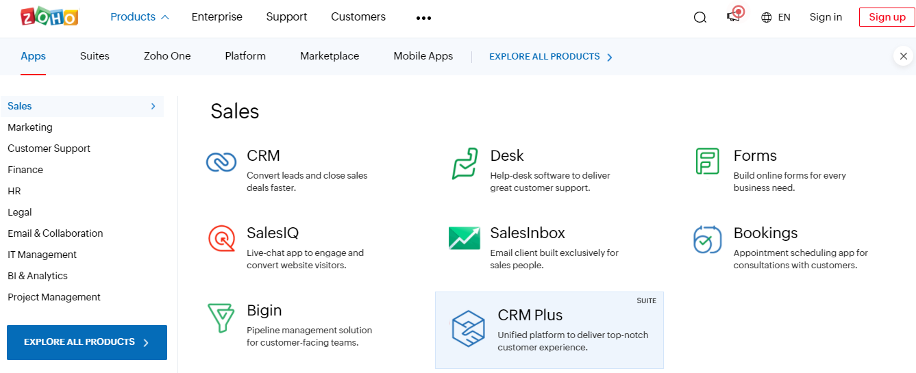
Zoho Apps

Slide 7
ZOHO CRM
What is a CRM?
Customer relationship management is a process in which a business or other organization administers its interactions with leads and existing customers, typically using data analysis to study large amounts of information.
CRM goal is to improve through customer retention and acquisition .

Slide 8
ZOHO CRM
Why use CRM ?
Better data organization
Enhanced communication
Sharing information
Catching all leads
Know your numbers

Slide 9
ZOHO CRM
A survey of user who have a CRM system in place stated that 67% said using a CRM system helped them better follow up on opportunities and leads
56% improved customer relationships because all customer interaction are accessible in 1 place

Slide 10
ZOHO CRM
Automatic workflow rules
Automated actions and messages which are triggered by certain events
Makes sure that interaction with protentional customers don’t fall through
Saves time from having to repeat same steps over and over again.

Slide 11
Zoho bug tracker
An online bug tracking tool .
Designed to help quality assurance and programmers keep track of reported software bugs in the work .
Can record bugs based on specific criteria , creating custom view to focus on the more time critical ones and setting rules for triggering updates.
Customizable bug tracker interface.

Slide 12
Zoho creator
Platform to create and run powerful custom application
Zoho Creator is a low-code application development platform that gives you the power to consolidate all your data management, workflow automation, and business intelligence needs in one place.

Slide 13
Zoho creator
Accelerated development : With the Zoho Creator platform, you get the ability to build custom business applications without having to spend the long project timelines of traditional development methods.
Simplified automation :Automating your business processes has never been this easy. Zoho Creator's low-code capabilities allow you to create workflows visually, simplifying the whole process.
Seamless integration : A digital system is very important to interlink with other systems. Zoho Creator comes with 500+ pre-built connectors in its arsenal which is unmatched by any platform in the space.

Slide 14
Zoho creator
Shareable insights Visualizing data and gathering insights is a necessity for any business. Convert raw data to intelligence with the help of visualization tools that let you build reports and dashboards.
Top-notch security so data is encrypted at rest, in transit, and during backup, with strong ciphers like AES_CBC/AES_GCM, 256 bit/128 bit keys, and TLS 1.2 protocols
Contextual scalability Growth is natural to any business and a good technology platform should have the capability to support your growth. Zoho Creator’s auto-scaling feature makes sure that your data load is not a stress on your business

Slide 15
Zoho creator
Zoho Creator has a free plan. This plan comes with a limited feature set and only has 1 user, 1 application access, 25MB storage, and 1000 records. However, you have the option to upgrade it to the paid plan whenever you wish.
Zoho creator offers first of it kind drag in drop in interface to create tables and forms designs and to schedule workflow and perform variety of automated actions.

Slide 16
Zoho project
Zoho project is an online project management solution with a mix between collaboration and management function.
Zoho project goes way beyond standard project management solution utilize the power of social software to manage online. Aside from web project planning and reporting capability, Zoho projects aim to bring everyone in the project together and helps them get project done.

Slide 17
Zoho project
Create milestones , task lists , assign tasks , set tasks dependencies
Break your existing tasks into sub tasks to gain insights into progress of your work
Organize and manage all types of files from centralized document area
Communicates effectively with your member using chats and forums
Submit, track and fix bugs fast with intuitive bug tracker
Gantt and resource utilization charts provide bird’s eye view about the progress.

Slide 18
More applications
Zoho Writer : a powerful word processor available across all devices. Support simultaneous collaboration between different user so you can collaborate with teammates in real-time to create elegant, inspiring documents for free. It support wide range of formats including .doc, .docx, .odt, as well as embedded media from hosting sites as YouTube , Vimeo ,etc.
Zoho Show : Zoho Show lets you create, collaborate, present, broadcast and publish presentations, it is an online presentation program that allow user to create or import different types of presentations formats allowing users to share and collaborate on presentation and do remote presentation to clients

Slide 19
More applications
Zoho People : on demand HRIS and applicant tracking System
Zoho invoice : Zoho invoice is the invoicing solution for zoho range’s of applications. It enables users to create , send , manage invoices, track expenses, receive, online payment and generating reports.
Zoho lens:An interactive remote assistance platform that allows technicians to provide real-time guidance to end-users, using a smartphone camera or smart glass at the remote end.

Slide 20
Zoho One
Zoho One includes more than 40 applications with complementary mobile apps so, you can run your entire business on one suite.
You're getting full-featured, enterprise editions of the entire Zoho suite. That means being able to reach customers, grow sales, balance your books, and work in productive and collaborative ways from any device—all with a single login and password.

Slide 21


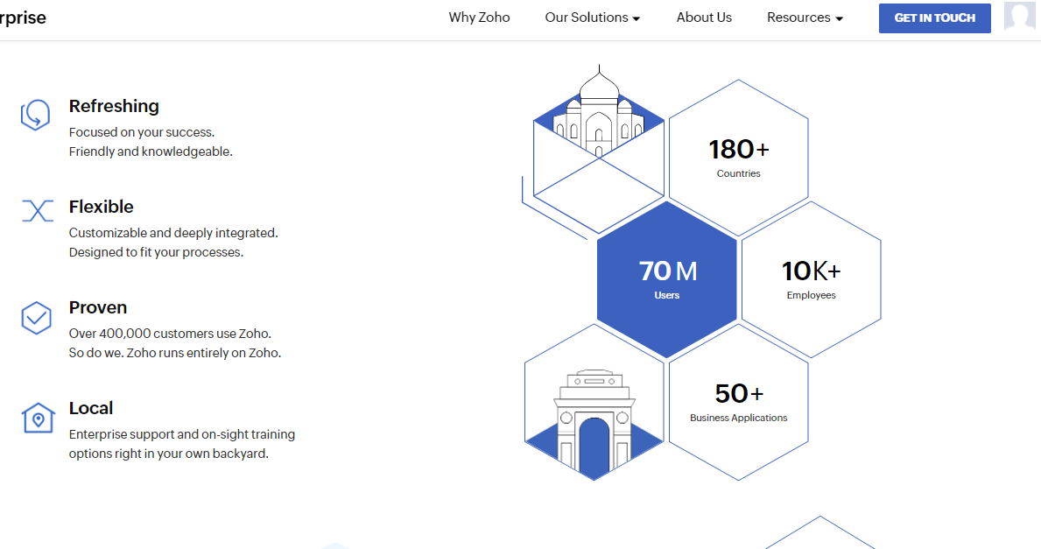



Achievements
Zoho have been able to reach out to :
180 countries
70 million users
10 thousand employees
Offering more than 50 different business application

