Slide 1
Genetic algorithms (Soft Computing)
Lecture 1: Genetic Algorithms Introduction
Dr. Samar Hesham
Department of Computer Science Faculty of Computers and Artificial Intelligence
Cairo University
Egypt

Slide 2
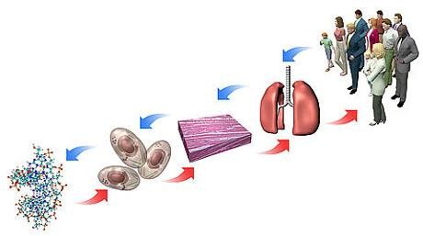
Human Body
Human
Organs
Tissues
Cells
Genome
9/27/2022
2

Slide 3
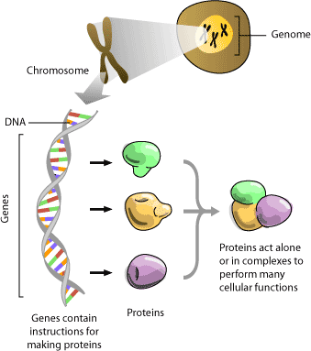
Genome
9/27/2022
3

Slide 4
Evolution in the real world
Each cell of a living thing contains chromosomes - strings ofDNA
Each chromosome contains a set of genes - blocks of DNA
Each gene determines some aspect of the organism (like eye colour)
A collection of genes is sometimes called a genotype
A collection of aspects (like eye colour) is sometimes called a phenotype
Reproduction involves recombination of genes from parents and then small amounts of mutation (errors) in copying.
The fitness of an organism is how much it can reproduce before it dies.
Evolution based on “survival of the fittest”

Slide 5
Motivation
Suppose you have a problem with some search space
You don’t know how to solve it
What can you do?
Can you use a computer to somehow find a solution for you?
This would be nice! Can it be done?
Davidhales.name

Slide 6
A dumb solution = Random Search
A “blind generate and test” algorithm:
Repeat
Generate a random possible solution Test the solution and see how good it is
Until reaching a solution that is good enough

Slide 7
Can we use this dumb idea?
Sometimes - yes:
if there are only a few possible solutions
and you have enough time
then such a method could be used
For most problems - no:
many possible solutions
with no time to try them all
so this method can not be used

Slide 8
A “less-dumb” idea (GA)
Generate a set of random solutions Repeat
Test each solution in the set (rank them) Remove some bad solutions from set Duplicate some good solutions
Make small changes to some of them
Until reaching a solution that is good enough

Slide 9
Classes of Search Techniques
Search Techniques
Calculus Base Techniques
Guided random search techniques
Enumerative Techniques
Fibonacci
Sort
DFS
Dynamic Programming
BFS
Tabu Search
Simulated Annealing
Evolutionary Algorithms
Hill Climbing
Genetic
Programming
Genetic
Algorithms
12

Slide 10
Genetic Algorithms - History
A class of Evolutionary optimization algorithms
Inspired from (Biological) Evolution Process
– Uses concepts of “Natural Selection” and “Genetic Inheritance”
Can be used to solve a variety of problems that are not easy to be solved using traditional techniques

Slide 11
Genetic Algorithms - History
“Genetic Algorithms are good at taking large, potentially huge search spaces and navigating them, looking for optimal combinations of things, solutions you might not otherwise find in a lifetime.”
- Salvatore Mangano
Computer Design, May 1995

Slide 12
Biological Evolution Process
“Natural Selection” + “Genetic Inheritance”

Slide 13
Principle Of Natural Selection
IF there are organisms that reproduce, and
IF offsprings inherit traits from their progenitors, and
IF there is variability of traits, and
IF the environment cannot support all members of a growing population,
THEN those members of the population with less-adaptive traits (determined by the environment) will die out, and
THEN those members with more-adaptive traits (determined by the environment) will survive
The result is the evolution of species.

Slide 14
Basic Idea of Principle of Natural Selection
“Select The Best, Discard The Rest”

Slide 15
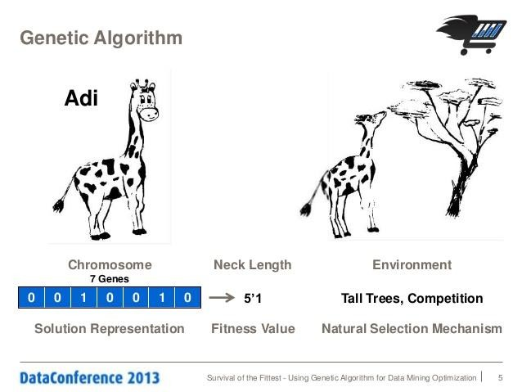
An Example of Natural Selection
Giraffes have long necks.
Giraffes with slightly longer necks could feed on leaves of higher branches
when all lower ones had been eaten off.
→ They had a better chance of survival.
→ Favorable characteristic propagated through generations of giraffes.
→ Now, evolved species has long necks.
NOTE: Longer necks may have been a deviant characteristic (mutation) initially, but since it was favorable, was propagated over generations. Now an established trait.
So, some mutations are beneficial.

Slide 16
Evolution Through Natural Selection
Initial Population Of Animals
Struggle For Existence-Survival Of the Fittest
Surviving Individuals Reproduce, Propagate Favorable Characteristics
Millions Of Years
Evolved Species
(Favorable Characteristic Now A Trait Of Species)
CS.Stonybrook.edu

Slide 17
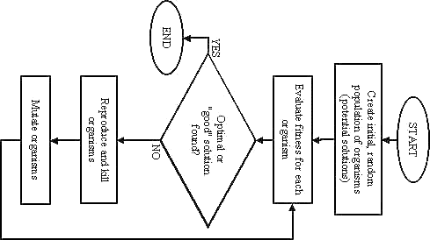
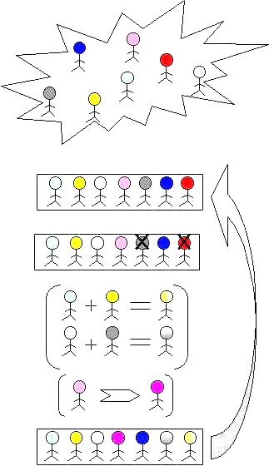

Slide 18
What Are Genetic Algorithms (GAs)?
Genetic Algorithms are search and optimization techniques based on Darwin’s Principle of Natural Selection.
Genetic Algorithms implement optimization strategies by simulating evolution of species through natural selection.

Slide 19
Some Definitions
Chromosomes: an individual in the population in GA is composed of an array of bits (genes) that takes a value for each chromosome represents a solution to problem under consideration.
Gene: a particular bit in a chromosome that takes a value and model a specific trait in a solution.
Population: is a constant size number of chromosomes and represents a pool of feasible solutions.
Genotype: is a genetic structure (bits organization) of an individual solution.
Phenotype: it’s the actual solution itself.

