Slide 1
Managing Persistence
Chapter 4

Slide 2
Persistence
When an application stores data in a permanent store like a flat file, XML file, or a database for durability, it is known as persistence.
Business data in a Java EE enterprise application is defined as Java objects.
These objects are preserved in corresponding database tables.
Java objects and database tables use different data types, such as a String in Java and Varchar in a database, to store business data.
This is called as impedance mismatch.

Slide 3
Impedance mismatch
Application developers must write code to account for it if the mismatch is not already handled by the persistence provider.

Slide 4
Object Relational Mapping (ORM)
The technique to automate bridging the impedance mismatch is known as Object Relational Mapping (ORM).
ORM software uses metadata to describe mapping between the classes defined in an application and the schema of a database table.
Mapping is provided in XML configuration files or annotations.
For example, you want to store TodoItem class objects in the TodoItem database table; ORM maps the Java class name to a database table name and the attributes in the class are mapped to the corresponding fields in the table automatically.

Slide 5
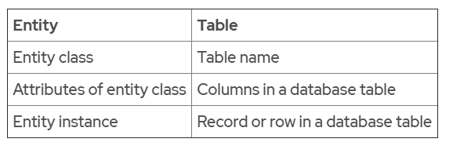
Default Entity to Table Mapping

Slide 6
Java Persistence API (JSR 338)
Java EE provides the Java Persistence API (JSR 338) specification that is implemented by various ORM providers.
The three key concepts related to the Java Persistence API are entities, persistence units, and persistence context.

Slide 7
Entity Class and Annotations
An entity is a lightweight domain object that is persist-able. An entity class is mapped to a table in a relational database.
Each instance of an entity class has a primary key field.
The primary key field is used to map an entity instance to a row in a database table.
In Java, an entity is a Plain Old Java Object (POJO) class that is annotated with @Entity annotation.

Slide 8
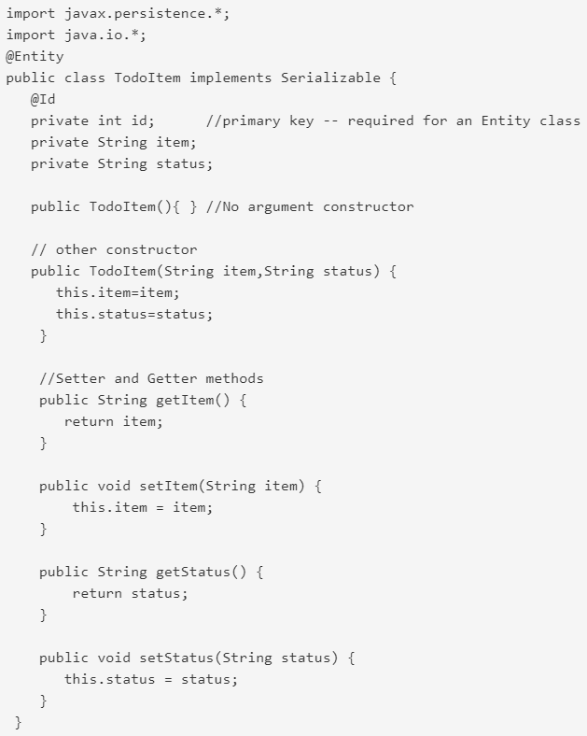
Declaring Entity Class

Slide 9
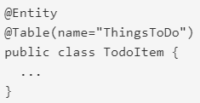
JPA Annotations
@Entity
specifies that a class is an entity.
@Table
when the name of an entity class is different from the name of a table in the database.

Slide 10


JPA Annotations
@Column
to map a field or property to a column in the database if their names are different.
@Temporal
used with a Date type of attribute. Database stores a date in a different way than Java classes. Temporal annotation manages mapping for a java.util.Date or java.util.Calendar type.

Slide 11
JPA Annotations
@Transient
to specify a non-persistent field.
@Id
to specify the primary key.
@EmbeddedId or @IdClass
to specify the composite primary key.

Slide 12
ID Generation
A simple primary key should be one of the following types:
Java primitive types: byte, short, int, long, or char
The java.lang.String type
Java Wrapper classes for primitive types: Byte, Short, Integer, Long, or Character
Temporal types: java.util.Date, or java.sql.Date
@Id annotation is used to specify a simple primary key. @GeneratedValue annotation is applied to the primary key field or property to specify the primary key generation strategy.
@GeneratedValue annotation provides a GenerationType element of the enum type.
There are four primary key generation strategies.

Slide 13
Four Generation Types
GenerationType.AUTO
GenerationType.SEQUENCE
GenerationType.IDENTITY
GenerationType.TABLE

Slide 14
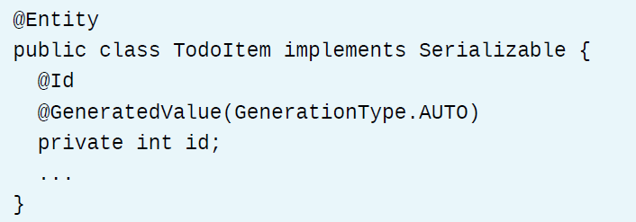
GenerationType.AUTO
the JPA provider uses any strategy of its choice to generate the primary key.
Notes:
If we're using the default generation type, the persistence provider will determine values based on the type of the primary key attribute.

Slide 15
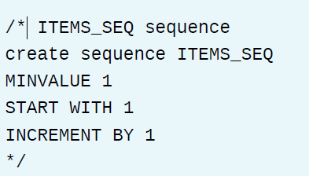
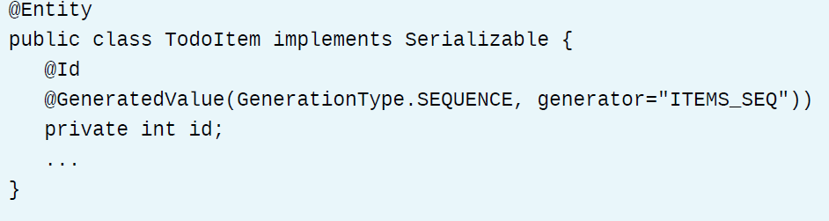
GenerationType.SEQUENCE

Slide 16
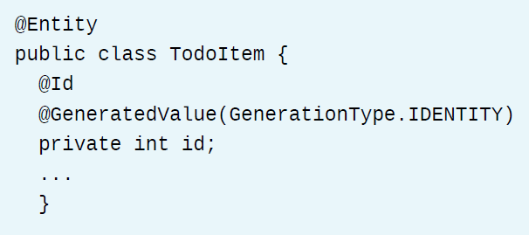
GenerationType.IDENTITY
Notes:
The IDENTITY strategy means that the JPA provider uses the database identity column to
generate the primary key.
An identity column is a column (also known as a field) in a database table that is made up of values generated by the database. This is much like an AutoNumber field in Microsoft Access or a sequence in Oracle

Slide 17
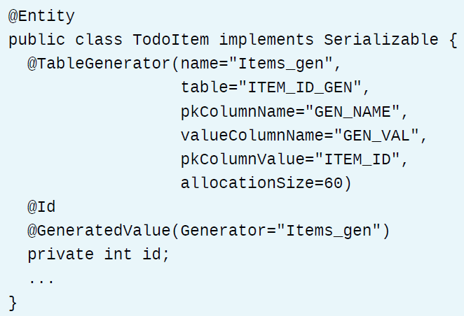
GenerationType.TABLE
Notes:
The TABLE strategy means that the JPA provider uses database ID generation table. This is a
separate table that is used to generate the ID value. The ID generation table has two columns. The
first column is a string that identifies the generator sequence, and the second column is an integer
value that stores the ID sequence.

Slide 18
Describing Entity Manager
The EntityManager API is defined to perform persistence operations.
An entity manager obtains the reference to an entity and performs the actual CRUD (Create, Read, Update, and Delete) operations on the database.
An EntityManager instance can be obtained from an EntityManagerFactory object.

Slide 19
Describing Entity Manager
An entity manager works within a set of managed entity instances. These managed entity instances are known as the entity manager's persistence context.
You can think of a persistence context as a unique instance of a persistence unit.
A persistence AD183-unit is a collection of all entity classes and a persistence.xml file stored in an application archive.
The persistence.xml is a configuration file that contains information about the entity classes, data source, transaction type, and other configuration information.

Slide 20
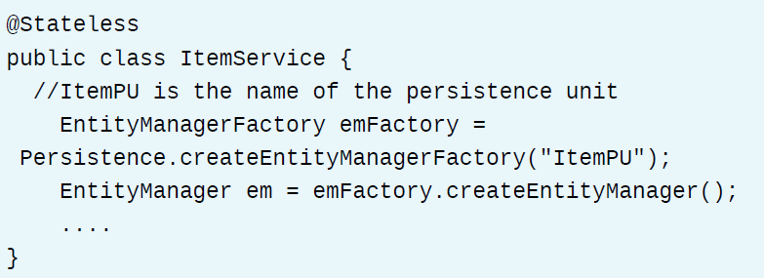
Creating Entity Manager in EJB

Slide 21
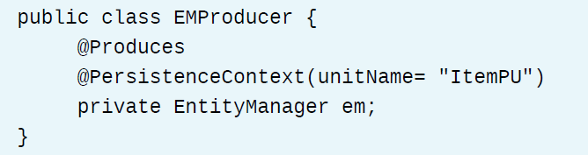
Another way – using annotations

Slide 22
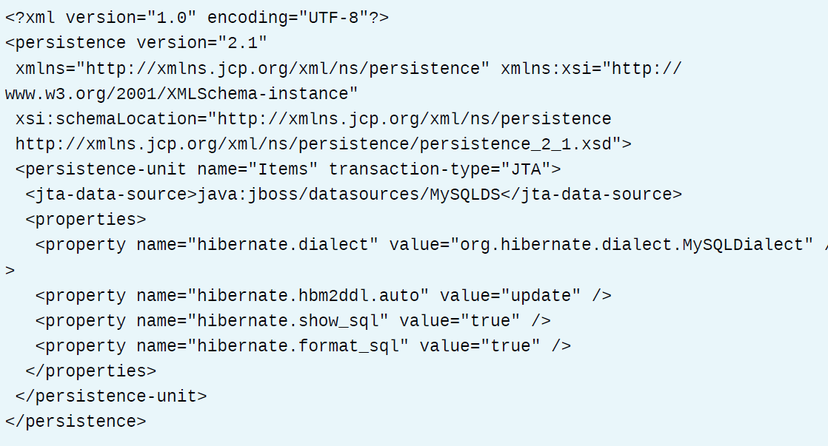
Describing Persistence Unit
A Persistence unit contains information about the persistence unit name, data source, and transactions type.

Slide 23
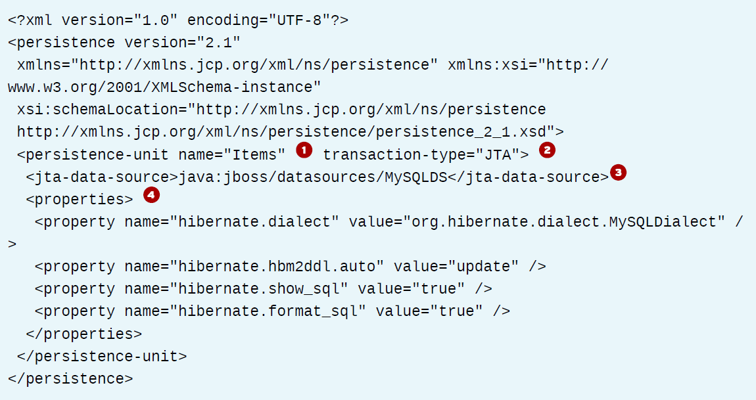
Important Tags of persistence.xml File
Notes:
persistence-unit name is the name of the persistence unit. The name of the persistence
unit is used to obtain the EntityManager.
transaction-type can be JTA or RESOURCE_LOCAL. Transaction type defines what
type of transactions an application intends to perform. Container transactions use Java
Transaction API (JTA), provided in every Java EE application server. In JTA type transactions,
a container is responsible for creating and tracking the entity manager. In RESOURCE_LOCAL,
you are responsible for creating and tracking the entity manager.
jta-data-source is the name of the data source. Each persistence unit must have a
database connection. The JPA provider finds the data source by name with JNDI lookup
service on startup.
Additional standard or vendor-specific properties can be set in the properties
element. The hibernate.Dialect property specifies which database is used. The
hibernate.hbm2ddl.auto property with an update value updates the schema
automatically. The hibernate.show-sql property with a value as true enables logging of
SQL statements to the console.

Slide 24
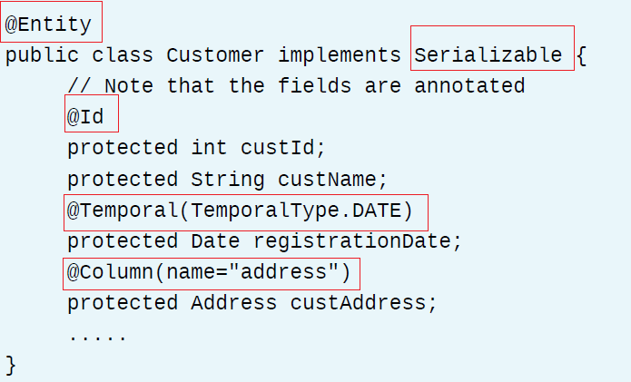
Code Sample

Slide 25
EntityManager Interface and Key Methods
persist()
entityManager.persist(customer);
find()
customer = entityManager.find(Customer.class,custId);
contains()
return entityManager.contains(customer);

Slide 26
EntityManager Interface and Key Methods
merge()
entityManager.merge(customer);
remove()
entityManager.remove(customer);
clear()
entityManager.clear();
refresh()
entityManager.refresh(customer);
Notes:
The clear() method clears the persistence context. After this operation, all managed entities are
in the detached state.
refresh()
The refresh() method refreshes the state of an entity instance from a database table. The
current data in an entity instance is overwritten by the data fetched from a database table.

Slide 27
Entity States
Notes:
New State: An entity instance created using Java's new operator is in a new or transient
state. An entity instance does not have a persistent identity and is not yet associated with the
persistence context.
• Managed State: An entity instance with a persistent identity and that is associated with a
persistence context is in a managed or persistent state. When a change is made to the data in
managed entity fields, it is synchronized with the database table data. An entity instance is in
the managed state after an application calls the persist, find, or the merge method of an
entity manager.
• Removed State: A persistent entity can be removed from the database table in many ways.
A managed entity instance can be removed from the database table when a transaction is
committed, or when a remove method of an entity manager is called. An entity is then in the
removed state.
• Detached State: An entity has a persistent entity identity but is not associated with the
persistence context. This can happen when the entity is serialized or at the end of a transaction.
This state is known as a detached state of an entity.

Slide 28
Demo – Persisting Data – Page 157
[student@workstation ~]$ demo persist-data setup
https://rha.ole.redhat.com/rha/app/courses/ad183-7.0/e25f4717-0494-4858-98d2-a93391a0cd40/pages/ch04s03

Slide 29
Guided Exercise
[student@workstation ~]$ lab persist-entity setup
https://rha.ole.redhat.com/rha/app/courses/ad183-7.0/e25f4717-0494-4858-98d2-a93391a0cd40/pages/ch04s04

Slide 30
Annotating Classes to Validate Beans
Bean validation is a model for validating data in Java objects by using built-in and custom annotations that can apply predefined constraints.
Validation constraints are the rules that are applied to validate data.
These constraints are applied in the form of annotations to attributes, methods, properties, or constructors.
The javax.validation.constraints package contains several built-in constraints.

Slide 31
All Annotations
https://rha.ole.redhat.com/rha/app/courses/ad183-7.0/e25f4717-0494-4858-98d2-a93391a0cd40/pages/ch04s05

Slide 32
Homework– Page 174
[student@workstation ~]$ lab validate-data setup
https://rha.ole.redhat.com/rha/app/courses/ad183-7.0/e25f4717-0494-4858-98d2-a93391a0cd40/pages/ch04s06

Slide 33
Creating Queries
Java Persistence Query Language (JPQL) is a platform-independent query language defined as a part of the JPA specification to perform queries on entities in an object-oriented manner.
JPQL is similar to SQL in syntax, but JPQL queries are expressed in terms of Java entities rather than database tables and columns.
JPQL supports the SELECT, UPDATE, and DELETE statements.
The EntityManager API supports methods for creating queries.

Slide 34
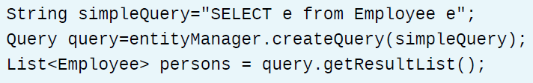
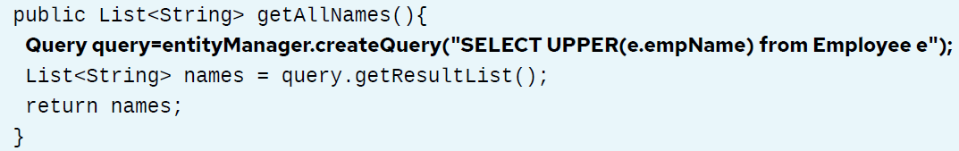
Simple Query example
LOWER, UPPER, LENGTH

Slide 35
Typed Query
JPA also supports the TypedQuery<?> class, which allows static typing of queries to avoid any issues with casting results.
To create a TypedQuery, pass the class that should match the type of the query results into the createQuery method.

Slide 36
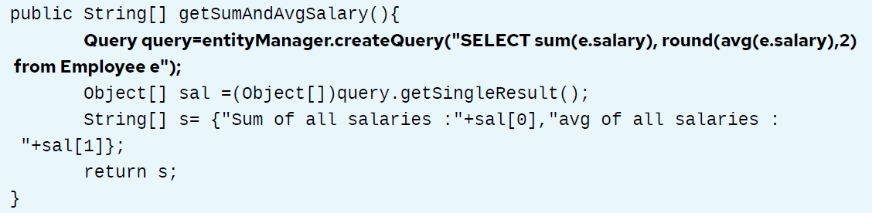
Using arithmetic functions

Slide 37
Some Operations
• <, =, >, <=, >=, <> are used to compare the arithmetic values.
• IN and NOT IN are used for all types. IN operator is used to determine whether the data in a field is one of the values provided in a list of values.
• LIKE and NOT LIKE are used for string values. It is used to determine whether data in a field matches a sequence of characters provided in the string.
• BETWEEN and NOT BETWEEN are used for arithmetic, date, time, and string values. It is used to determine whether data in a field lies in a certain range of values.
• MEMBER OF, NOT MEMBER OF, IS EMPTY, and IS NOT EMPTY are used for Collection types.

Slide 38
An example

Slide 39
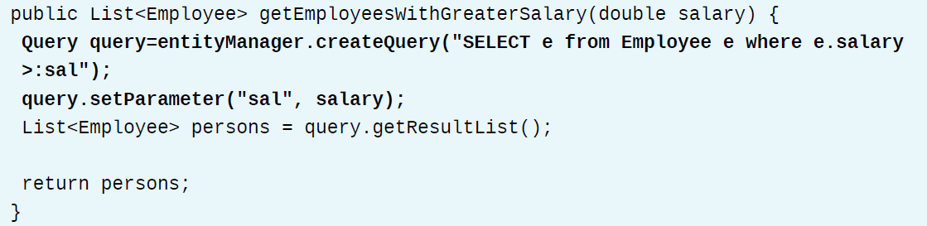
Named Parameters in Queries

Slide 40
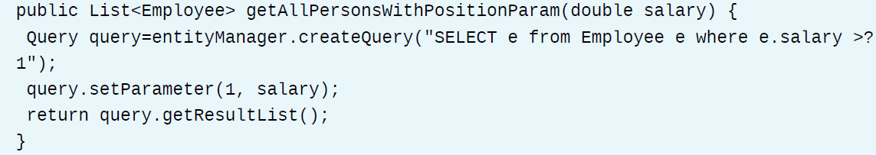
Positional Parameters in Queries

Slide 41
Named Queries
A named query is a predefined query attached to an entity.
An advantage is that the code and the queries are separate.
Named queries are defined by using the javax.persistence.NamedQuery annotation.
The @NamedQuery annotation can be applied at the entity's class level.
The @NamedQuery annotation has four elements: name, query, hints, and lockMode.

Slide 42
Named Queries Elements
A name is a required element of the NamedQuery annotation. It defines the name that is used by the EntityManager methods to refer to a query.
The query is a required element of the NamedQuery annotation and represents the JPQL query string.
The hints element is an optional element of the NamedQuery annotation. It represents query hints and properties.
The lockMode element is an optional element of the NamedQuery annotation. It represents the lock mode type to use in query execution. When lock mode type is defined as anything other than NONE, the query must be executed in a transaction.

Slide 43
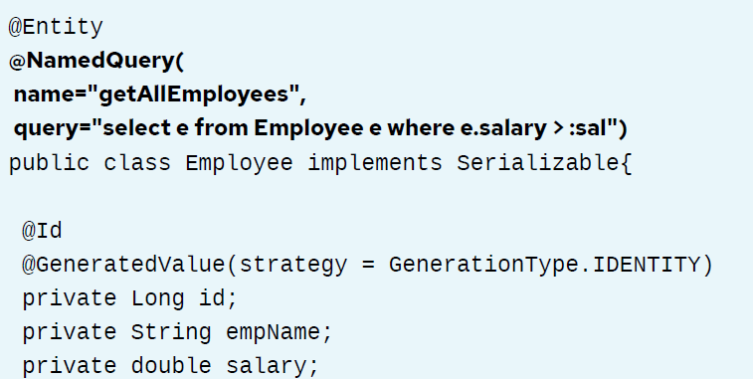
An Example

Slide 44
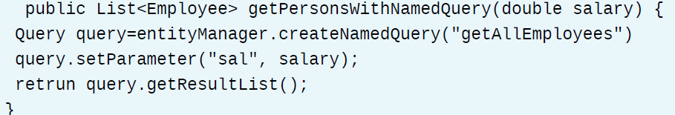
Cont. Example

Slide 45
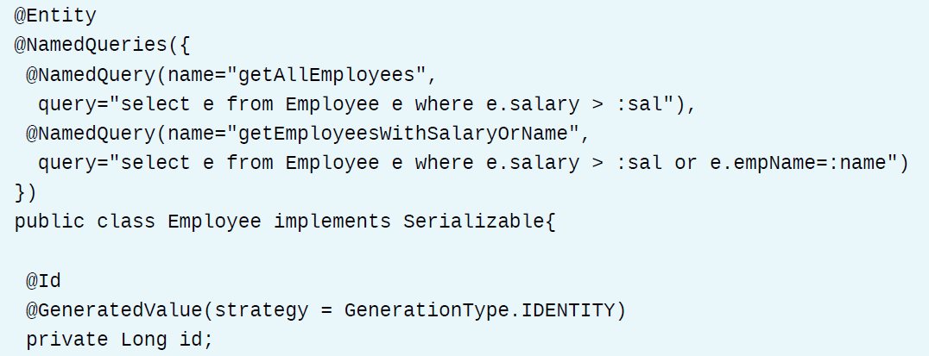
Named Querie(s)

Slide 46
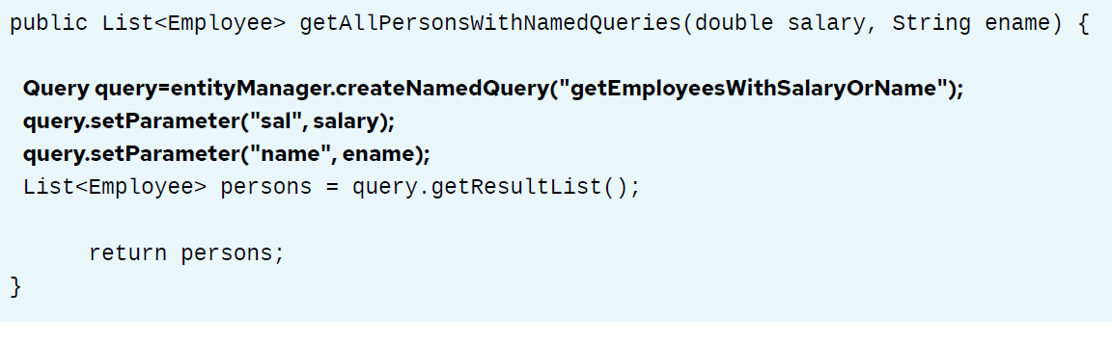
Named Queries

Slide 47
Guided Exercise – Page 186
[student@workstation ~]$ lab create-queries setup
https://rha.ole.redhat.com/rha/app/courses/ad183-7.0/e25f4717-0494-4858-98d2-a93391a0cd40/pages/ch04s08

Slide 48
Lab Task – Page 192
[student@workstation ~]$ lab persistence-lab setup
https://rha.ole.redhat.com/rha/app/courses/ad183-7.0/e25f4717-0494-4858-98d2-a93391a0cd40/pages/ch04s09

