Slide 1
Lecture 6: Genetic Algorithms
Schema Theory
Dr. Samar Hesham
Department of Computer Science
Faculty of Computers and Artificial Intelligence Cairo University
Egypt
11/20/2020
1

Slide 2
Why do Genetic Algorithms work?
Schema Theory
Schema theory seeks to give a theoretical justification for the efficacy of the field of genetic algorithms.
What is a Schema:
a template
the new gene alphabet ⇒ {0,1,*} where * is a don’t care
* * 1 1 0 * * 1 1 * * *
Schema is favorable traits in a solution, where a favorable schema is called an above average schema
represents all matching strings
11/20/2020
‹#›

Slide 3
Why do Genetic Algorithms work?
Schema Theory
Example:
the schema (* 1 1 1 1 0 0 1 0 0) matches two strings:
(0 1 1 1 1 0 0 1 0 0) and
(1 1 1 1 1 0 0 1 0 0)
Q. which strings does this schema match? (0 1 1 * 1 0 1 1 * *)
A schema matches 2^{r} strings
r: # of (*) in the schema
11/20/2020
‹#›

Slide 4
Schema Properties
Order of schema S: o(S)
number of fixed (non-*) positions S1 = **11**101**
12 345
o(S1) = 5
Defining length of schema S: d(S)
distance between first and last fixed string positions
S1 = **11**101**
S2= **101***
3 5
d(S2)=?
3 9
above d(S1) = 9-3= 6
11/20/2020
‹#›

Slide 5
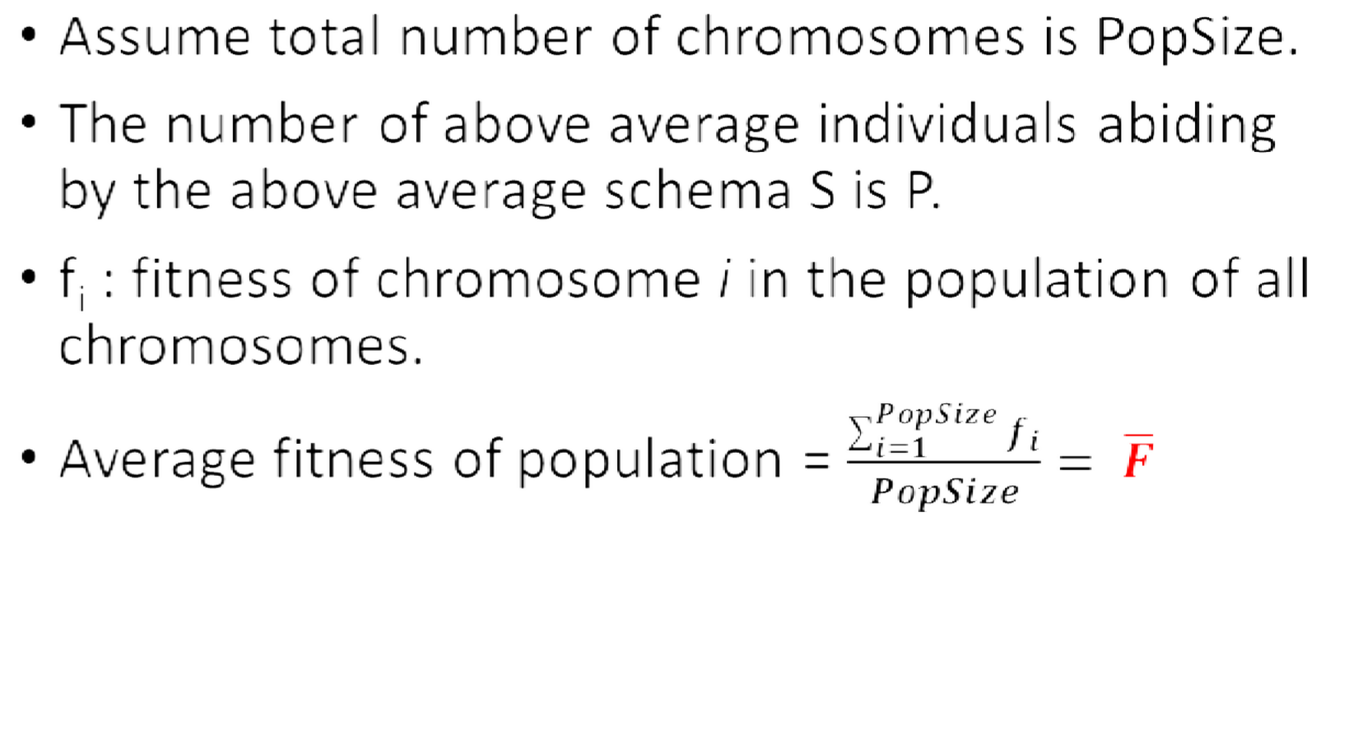
Effect of Operators on Schema 1-Selection
11/20/2020
‹#›

Slide 6
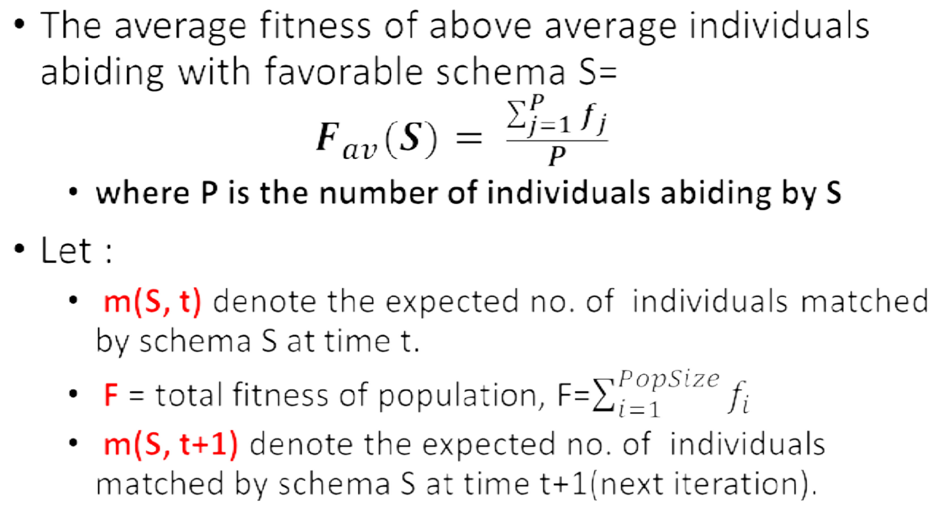
Effect of Operators on Schema 1-Selection
11/20/2020
‹#›

Slide 7
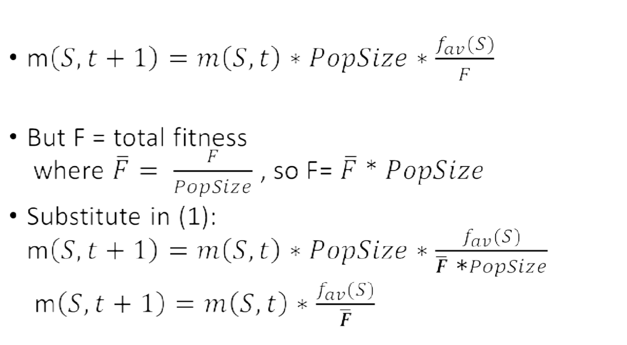
Effect of Operators on Schema 1-Selection
1
2
11/20/2020
‹#›

Slide 8
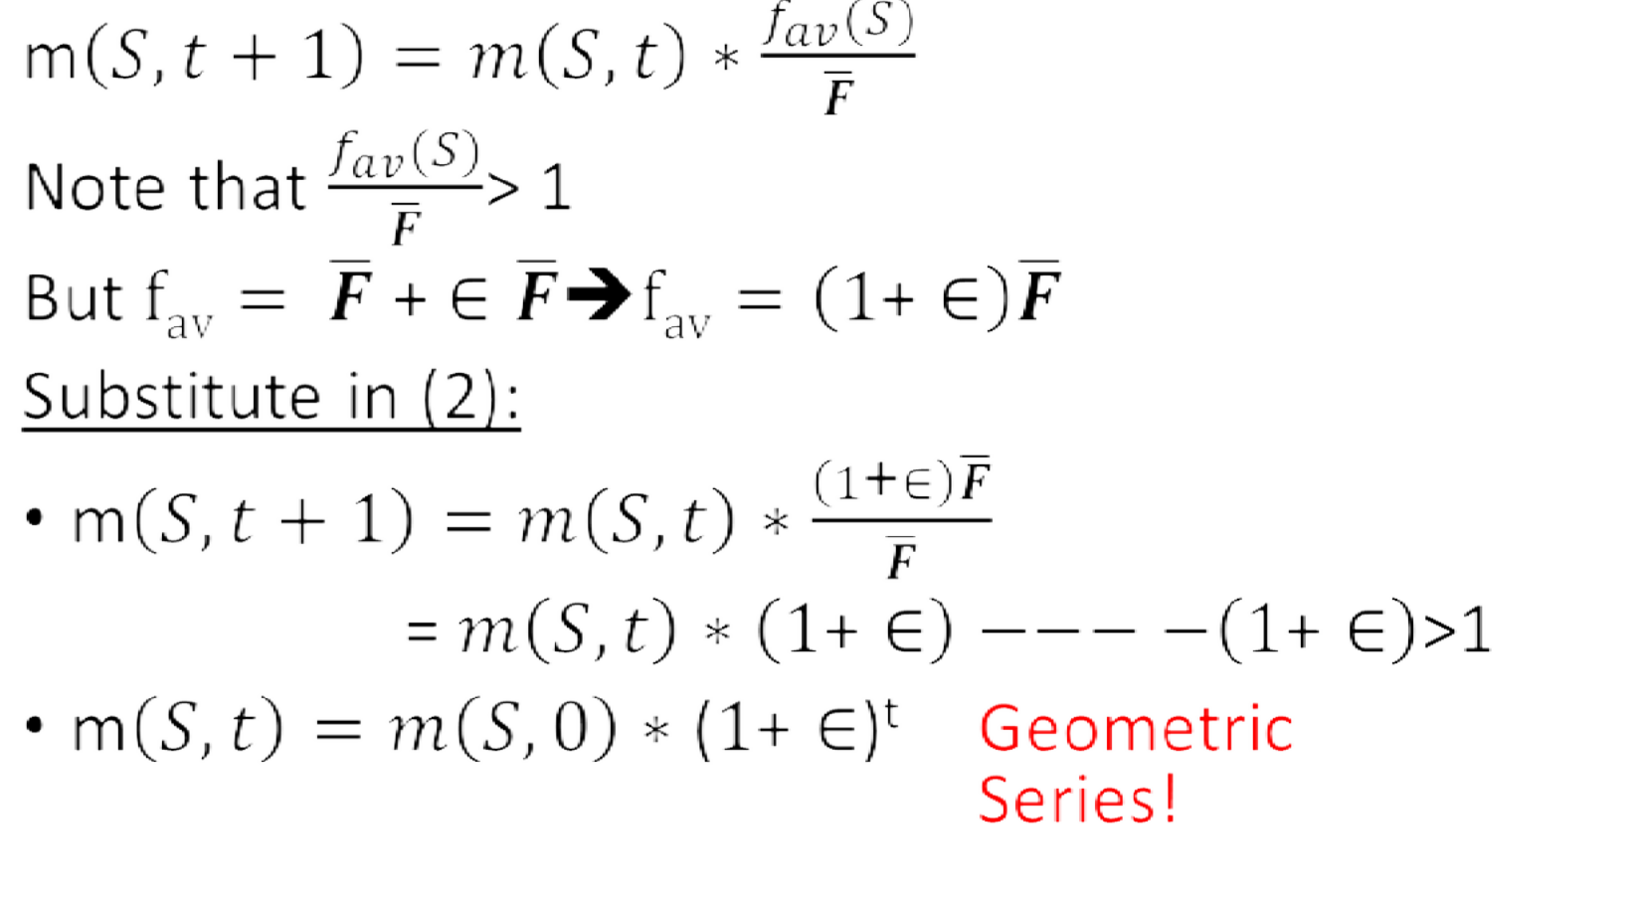
Effect of Operators on Schema 1-Selection
2

Slide 9
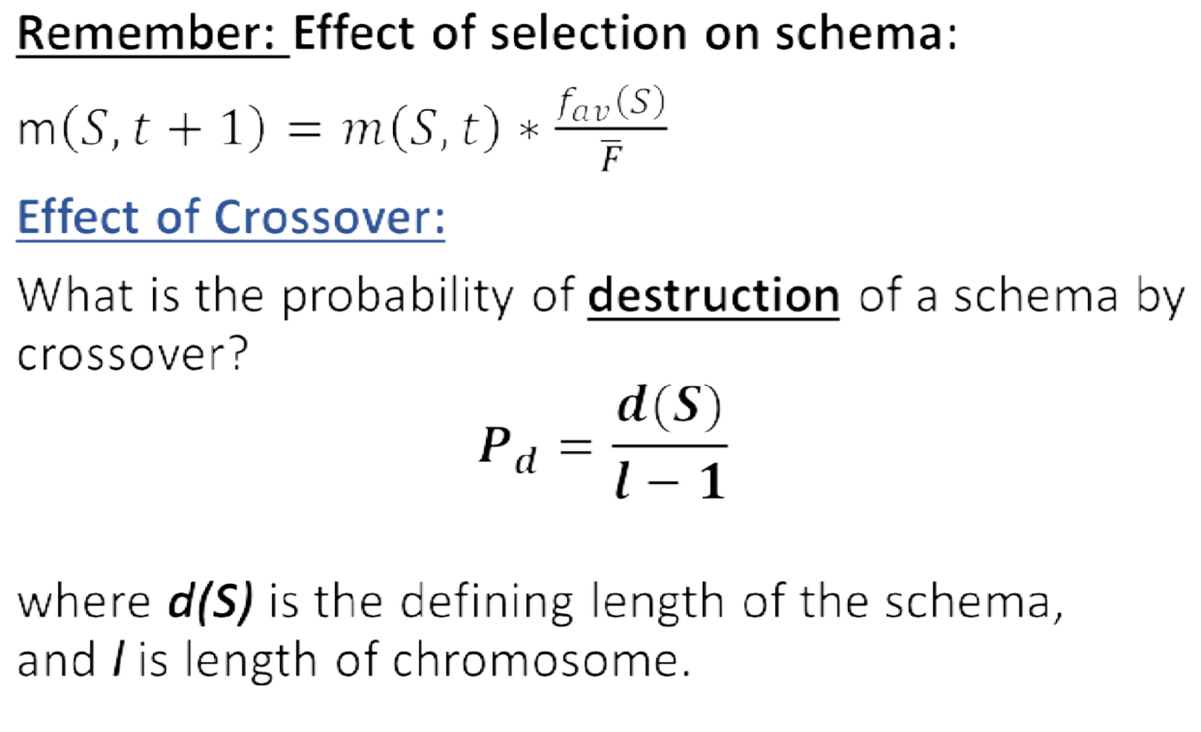
Effect of Operators on Schema 2-Crossover
1
* | * | 1 | * | 0 | 1 | *
d(S)=6-3
l=7

Slide 10
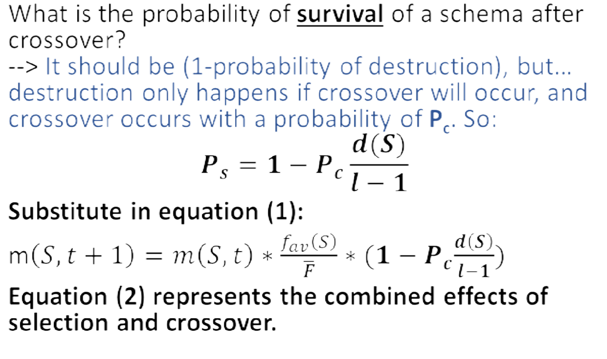
Effect of Operators on Schema 2-Crossover
2

Slide 11
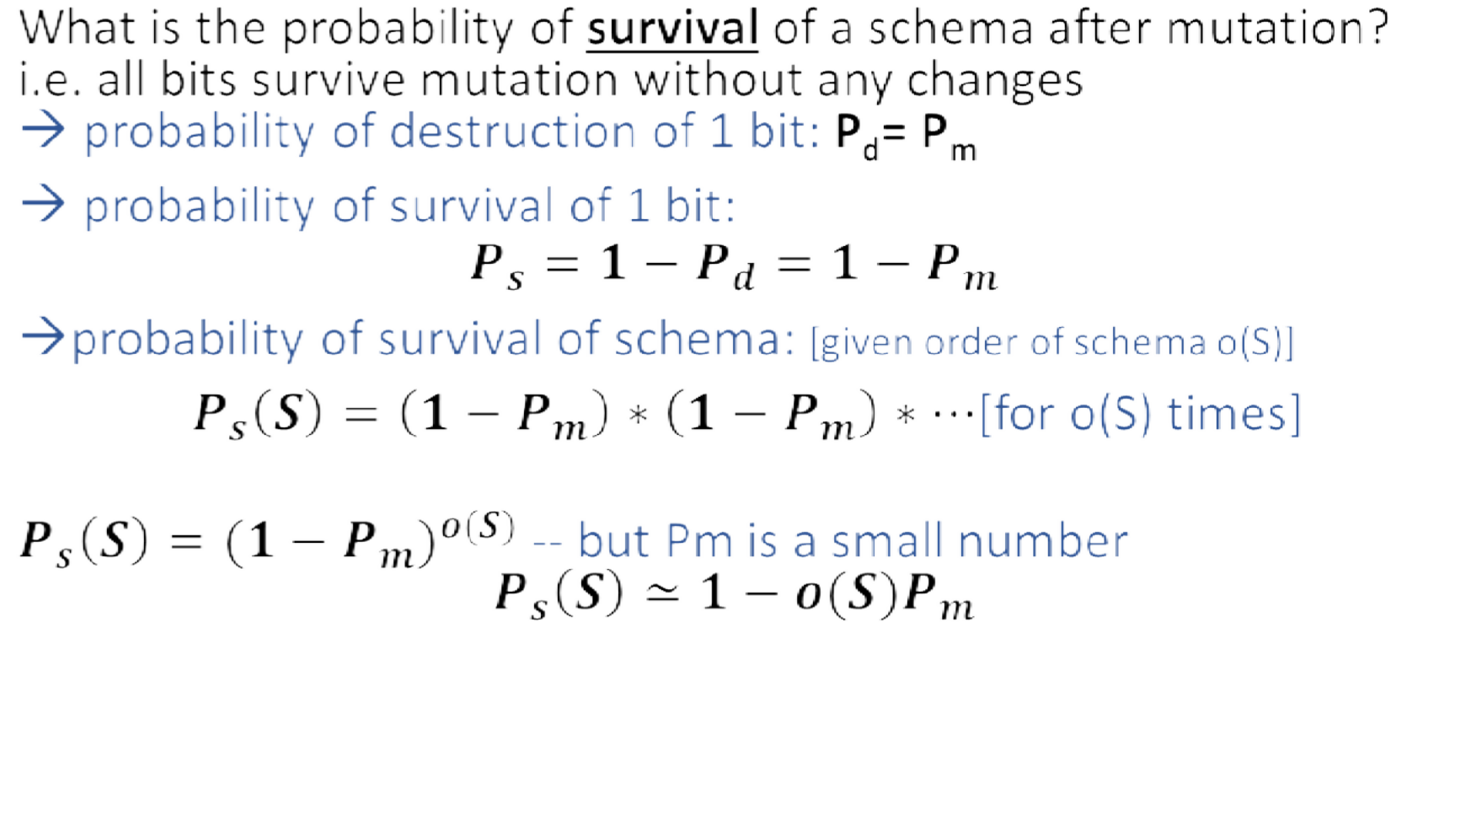

Effect of Operators on Schema 3-Mutation
o(S) = 3

Slide 12
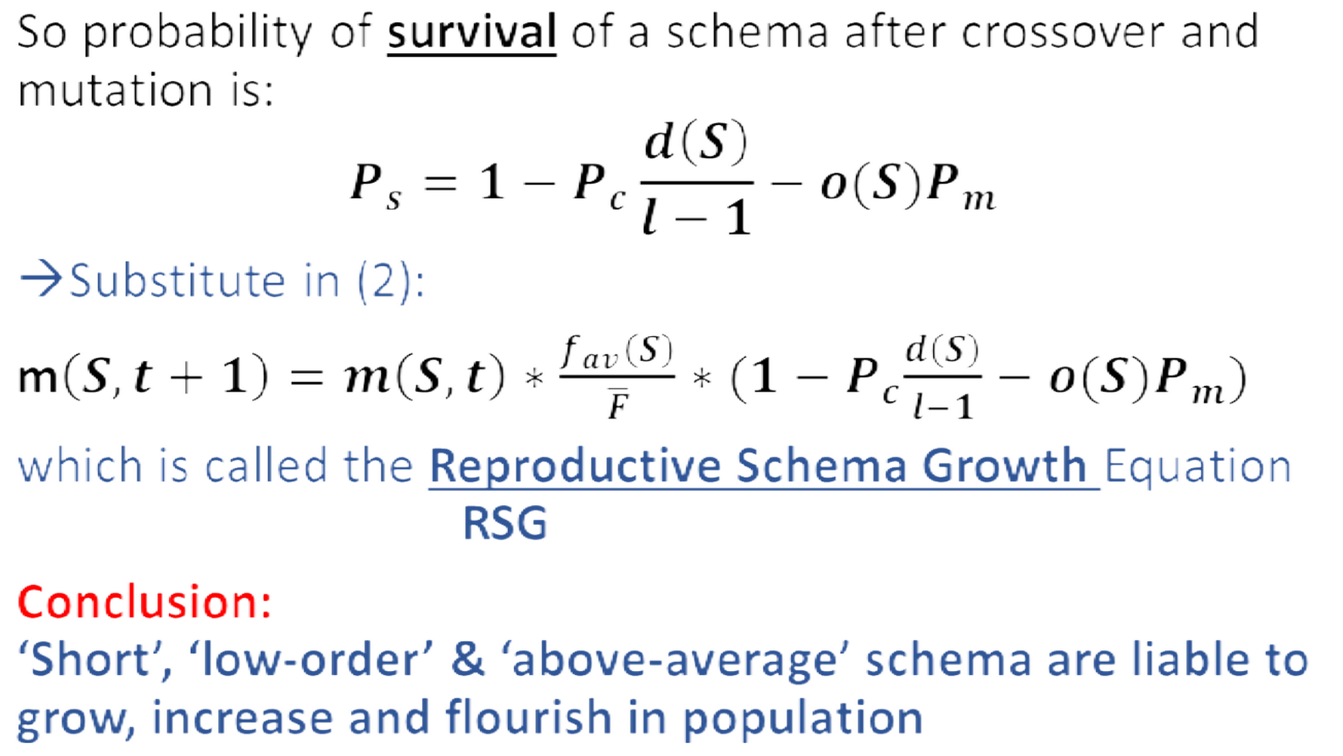
Effect of Operators on Schema 3-Mutation

Slide 13
Exercise
Given the following schema ‘S’:
1 | 0 | 0 | * | 1 | * | * | *
A- What is the probability of schema S survival after crossover knowing that Pc = 0.8?
B- What is the probability of schema S survival after mutation knowing that Pm = 0.1?

