Slide 1
Lab 3
Chapter 3

Slide 2
Outline
Managing the Life Cycle of Containers
Attaching Persistent Storage to Containers
Accessing Containers

Slide 3
Container life cycle
Podman, implemented by the podman command, provides a set of subcommands to create and manage containers.
Developers use those subcommands to manage the container and container image life cycle.

Slide 4
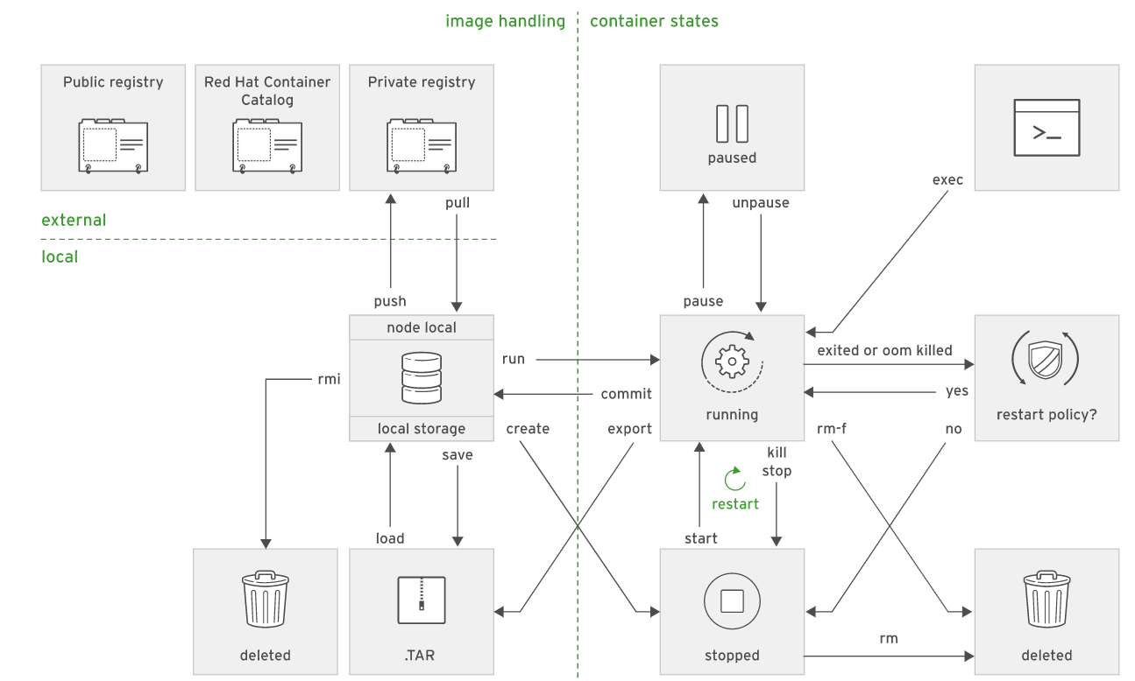

Slide 5
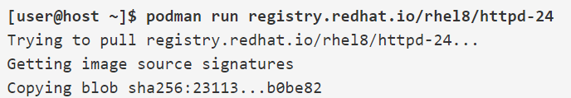
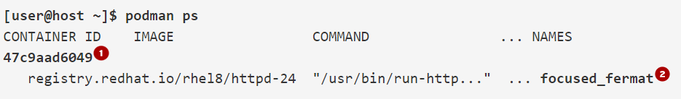
Podman Commands
Creating Containers
Display containers’ Ids and names

Slide 6


Podman Commands
Define an explicit container name
Override the container entry point
Starting a bash shell
Notes:
The -t and -i options enable terminal redirection for interactive text-based programs. The -t option allocates a pseudo-tty (a terminal) and attaches it to the standard input of the container. The -i option keeps the container's standard input open, even if it was detached, so the main

Slide 7

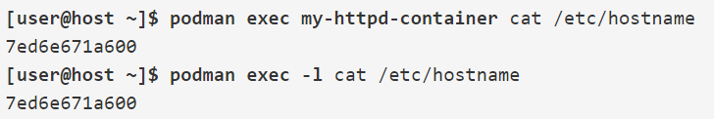
Running Commands in a Container
When a container starts, it executes the entry point command. However, it may be necessary to execute other commands to manage the running container.
The podman exec command starts an additional process inside an already running container:
Podman remembers the last container created. the -l (or --latest) option:

Slide 8
Managing Containers
The podman ps command displays the container ID and names for all actively running containers:
podman ps
CONTAINER ID IMAGE COMMAND ... NAMES
47c9aad6049 rhscl/httpd-24-rhel7 "httpd -D FOREGROUND" ... focused_fermat
podman ps -a
List all local containers including the stopped ones
Notes:
Each container, when created, gets a container ID, which is a hexadecimal number. This ID looks like an image ID but is unrelated.
The IMAGE field indicates container image that was used to start the container.
The COMMAND field indicates command executed when the container started.
The CREATED field indicates date and time the container was started.
The STATUS field indicates total container uptime, if still running, or time since terminated.
The PORTS field indicates ports that were exposed by the container or any port forwarding that might be configured.
The NAMES field indicates the container name.

Slide 9
Stop a container : podman stop my-httpd-container
Kills a container: podman kill my-httpd-container
Restart a container: podman restart my-httpd-container
Remove one container: podman rm my-httpd-container
Remove all containers: podman rm -a
Stop all containers: podman stop -a

Slide 10
Inspect a container
Show All info about the latest running container
sudo podman inspect -l
Or inspect specific container
sudo podman inspect my-httpd-container
To fetch certain info use -f
sudo podman inspect -l -f "{{.NetworkSettings.IPAddress}}"
Notes:
sudo podman inspect -l -f "{{.NetworkSettings.IPAddress}}"
curl http://10.88.0.3:27017

Slide 11
we can pass environment variable using -e option.
sudo podman run --name mysql-custom \
> -e MYSQL_USER=redhat -e MYSQL_PASSWORD=r3dh4t \
> -d rhmap47/mysql:5.5

Slide 12
Guided Exercise: Managing a MySQL Container
https://rha.ole.redhat.com/rha/app/courses/do180-4.10/52f11f0e-a277-4441-9d11-e3d56d7defca/pages/ch03s02
[student@workstation ~]$ lab manage-lifecycle start

Slide 13
Attaching Persistent Storage to Containers(volumes)
When the container is created, temporary storage is added to manage all subsequent file changes such as log files and application data.
The problem is that if the container is destroyed e.g. scaled to zero, updated or moved to a different node, all of the written data will disappear.
To prevent this happening, we need to store our data in persistent storage.

Slide 14
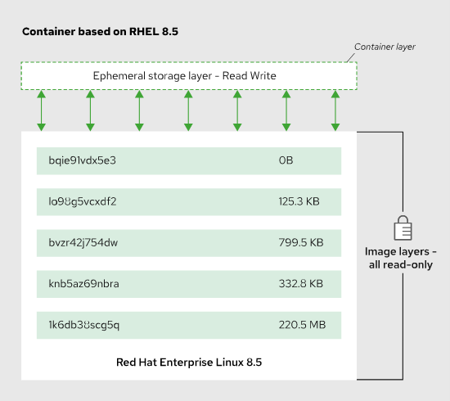
Layering
Notes:
running container gets a new layer over its base container image, and this layer is the container storage. At first, this layer is the only read/write storage available for the container, and it is used to create working files, temporary files, and log files. Those files are considered volatile. An application does not stop working if they are lost. The container storage layer is exclusive to the running container, so if another container is created from the same base image, it gets another read/write layer. This ensures the each container's resources are isolated from other similar containers.
Ephemeral container storage is not sufficient for applications that need to keep data beyond the life of the container, such as databases. To support such applications, the administrator must provide a container with persistent storage.

Slide 15
Mounting the host directory
Podman can mount host directories inside a running container.
The containerized application sees these host directories as part of the container storage, much like regular applications.
The host directory must be configured with ownership and permissions allowing access to the container.

Slide 16
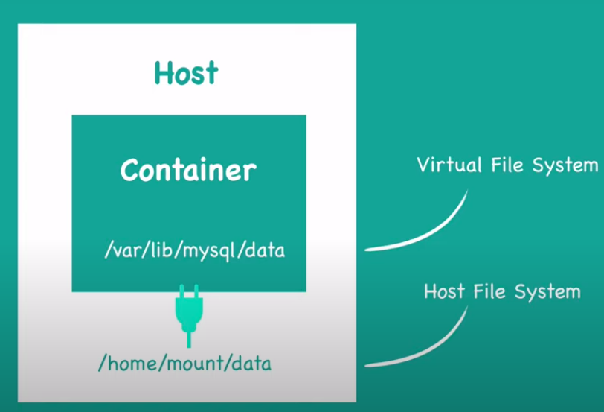
Notes:
Default volume directory in host machine : cd /var/lib/docker/volumes

Slide 17
Steps to mount on the host
Create a directory:
mkdir /home/student/dbfiles
Apply the container_file_t context to the directory (and all subdirectories)
podman unshare chown -R 27:27 /home/student/dbfiles
Provide a session to a user id to execute commands
sudo semanage fcontext -a -t container_file_t '/home/student/dbfiles(/.*)?'
Apply the SELinux container policy that you set up in the first step to the newly created directory
sudo restorecon -Rv /home/student/dbfiles
Mounting a volume
podman run -v /home/student/dbfiles:/var/lib/mysql rhmap47/mysql
Notes:
Mysql without volum
1- sudo docker run -p 3310:3306 --name sql_db -e MYSQL_ROOT_PASSWORD=123456 -e MYSQL_DATABASE=root -d mysql
2-open mysql workbench
3- create
create schema university;
CREATE TABLE `university`.`student` (
`id` INT NOT NULL AUTO_INCREMENT,
`name` VARCHAR(45) NULL,
`class` VARCHAR(45) NULL,
PRIMARY KEY (`id`));
3- sudo docker ps
4- sudo docker rm f0b693b7d553
5- sudo docker run -v "/data2":/var/lib/mysql -p 3320:3306 --name sql_db_with_vol -e MYSQL_ROOT_PASSWORD=123456 -e MYSQL_DATABASE=root -d mysql

Slide 18
Guided Exercise: Create MySQL Container with Persistent Database
https://rha.ole.redhat.com/rha/app/courses/do180-4.10/52f11f0e-a277-4441-9d11-e3d56d7defca/pages/ch03s04
[student@workstation ~]$ lab manage-storage start

Slide 19

Accessing Containers
When Podman creates containers on the same host, it assigns each container a unique IP address and connects them all to the same software-defined network.
These containers can communicate freely with each other by IP address.
Container software-defined network is only accessible from the container host.
So we use port forwarding rules to allow external access to a container service using -p option.
Notes:
This example creates an externally accessible container. The value 8080 colon 8080 specifies that any requests to port 8080 on the host are forwarded to port 8080 within the container.

Slide 20
Guided Exercise: Loading the Database
https://rha.ole.redhat.com/rha/app/courses/do180-4.10/52f11f0e-a277-4441-9d11-e3d56d7defca/pages/ch03s06
[student@workstation ~]$ lab manage-networking start

Slide 21
Lab Task: Managing Containers
https://rha.ole.redhat.com/rha/app/courses/do180-4.10/52f11f0e-a277-4441-9d11-e3d56d7defca/pages/ch03s07
[student@workstation ~]$ lab manage-review start

