Slide 1
Lab 4
Chapter 4 and Chapter 5

Slide 2
Chapter 4: Managing Container Images
What is Image registries?
Public registries vs private registries?
Give examples for public registries?
Which commands used to search in registries?

Slide 3
Image registries
Image registries are services offering container images to download. They allow image creators and maintainers to store and distribute container images to public or private audiences.
Public registries: images that are publicly available to be downloaded. Examples: Quay.io , Red Hat Container Catalog and docker hub
Private registries: Private registries give image creators the control about their images placement, distribution and usage.
podman search {image name}

Slide 4

Configuring Registries in Podman
To configure registries for the podman command, you need to update the /etc/containers/registries.conf file

Slide 5
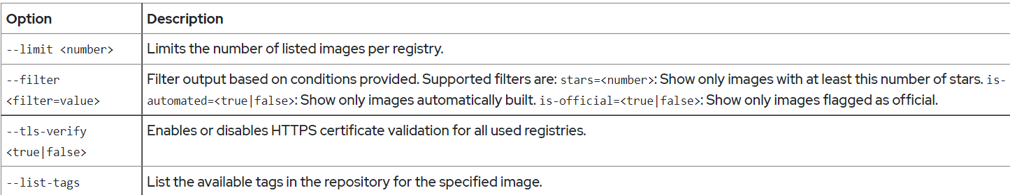
Extra options when searching commands

Slide 6

Registry Authentication
Some container image registries require access authorization. The podman login command allows username and password authentication to a registry:

Slide 7
Pulling Images
To pull container images from a registry, use the podman pull command:
podman pull quay.io/bitnami/nginx

Slide 8

Listing Local Copies of Images
Any container image downloaded from a registry is stored locally on the same host where the podman command is executed. This behavior avoids repeating image downloads and minimizes the deployment time for a container. Podman also stores any custom container images you build in the same local storage.

Slide 9
Image Tags
An image tag is a mechanism to support multiple releases of the same image. This feature is useful when multiple versions of the same software are provided
registry_name/user_name/image_name:tag
Pull image: podman pull rhscl/mysql-57-rhel7:5.7
Start a container: podman run rhscl/mysql-57-rhel7:5.7

Slide 10
Q: which command is used to get an image?
Q: which command is used to list local images?
Q: which command is used to create a container from an image?
Q: what is the image tag?

Slide 11
Saving and Loading Images
2 ways to manage image containers:
1- Save the container image to a .tar file.
2- Publish (push) the container image to an image registry (not the best way …Why?).

Slide 12
Save and Load images
The following example saves the previously downloaded MySQL container image from the Red Hat Container Catalog to the mysql.tar file:
Save image:
podman pull registry.access.redhat.com/rhscl/mysql-57-rhel7:5.7
podman save -o mysql.tar registry.access.redhat.com/rhscl/mysql-57-rhel7:5.7
Load image:
podman load -i mysql.tar

Slide 13
Q: Which command is used to delete images?

Slide 14
Deleting Images
An image can be referenced using its name or its ID for removal purposes.
Podman cannot delete images while containers are using that image.
You must stop and remove all containers using that image before deleting it.
Podman keeps any image downloaded in its local storage, even the ones currently unused by any container. However, images can become outdated, and should be subsequently replaced.

Slide 15
Deleting Images
The rmi subcommand has the --force option. This option forces the removal of an image even if that the image is used by several containers or these containers are running.
Podman stops and removes all containers using the forcefully removed image before removing it.
Delete all images: podman rmi -a -f
Delete one image: podman rmi IMAGE

Slide 16
Modifying Images
all container images should be built using a Dockerfile, in order to create a clean, lightweight set of image layers without log files, temporary files, or other artifacts created by the container customization.
As an alternative approach to creating new images ---> change a running container in place and save its layers to create a new container image.
The podman commit command provides this feature.

Slide 17

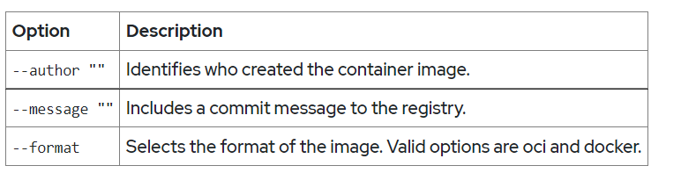
Podman commit

Slide 18
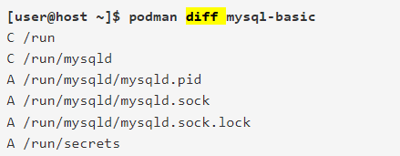
Diff subcommand
To identify which files were changed, created, or deleted since the container was started, use the diff subcommand.
This subcommand only requires the container name or container ID.

Slide 19
Guided Exercise: Creating a Custom Apache Container Image
https://rha.ole.redhat.com/rha/app/courses/do180-4.10/52f11f0e-a277-4441-9d11-e3d56d7defca/pages/ch04s04
[student@workstation ~]$ lab image-operations start

Slide 20
Lab: Managing Images
https://rha.ole.redhat.com/rha/app/courses/do180-4.10/52f11f0e-a277-4441-9d11-e3d56d7defca/pages/ch04s05
[student@workstation ~]$ lab image-review start

Slide 21
Chapter 5: Creating Custom Container Images
Designing Custom Container Images
Building Custom Container Images with Containerfiles

Slide 22
Dockerfile / Containerfile
Dockerfile is used to create a custom Docker image, in other words to define your custom environment to be used in a Docker container.
The Dockerfile contains a list of instructions that Docker will execute when you issue the docker build command

Slide 23

To create a custom image
Create a working directory
Write the Dockerfile
Build the image with Podman
Create a text file with name Dockerfile or Containerfile with no extension
Write the commands that are required to build the image, follow the syntax
Notes:
The working directory is the directory containing all files needed to build the image. Creating an empty working directory is good practice to avoid incorporating unnecessary files into the image. For security reasons, the root directory, /, should never be used as a working directory for image builds.

Slide 24
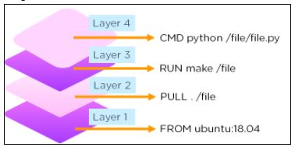
Each Dockerfile instruction runs in an
independent container using an
intermediate image built from every
previous command. This means each
instruction is independent from other
instructions in the Dockerfile.
Podman build

Slide 25
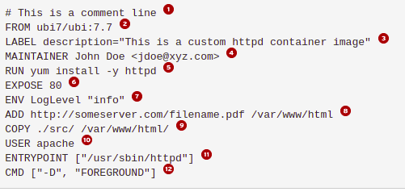
Sample file
Notes:
Lines that begin with a hash, or pound, sign (#) are comments.
The FROM instruction declares that the new container image extends ubi8/ubi:8.5 container base image. Containerfiles can use any other container image as a base image, not only images from operating system distributions. Red Hat provides a set of container images that are certified and tested and highly recommends using these container images as a base.
The LABEL is responsible for adding generic metadata to an image. A LABEL is a simple key-value pair.
MAINTAINER indicates the Author field of the generated container image's metadata. You can use the podman inspect command to view image metadata.
RUN executes commands in a new layer on top of the current image. The shell that is used to execute commands is /bin/sh.
EXPOSE indicates that the container listens on the specified network port at runtime. The EXPOSE instruction defines metadata only; it does not make ports accessible from the host. The -p option in the podman run command exposes container ports from the host.
ENV is responsible for defining environment variables that are available in the container. You can declare multiple ENV instructions within the Containerfile. You can use the env command inside the container to view each of the environment variables.
ADD instruction copies files or folders from a local or remote source and adds them to the container's file system. If used to copy local files, those must be in the working directory. ADD instruction unpacks local .tar files to the destination image directory.
COPY copies files from the working directory and adds them to the container's file system. It is not possible to copy a remote file using its URL with this Containerfile instruction.
USER specifies the username or the UID to use when running the container image for the RUN, CMD, and ENTRYPOINT instructions. It is a good practice to define a different user other than root for security reasons.
ENTRYPOINT specifies the default command to execute when the image runs in a container. If omitted, the default ENTRYPOINT is /bin/sh -c.
CMD provides the default arguments for the ENTRYPOINT instruction. If the default ENTRYPOINT applies (/bin/sh -c), then CMD forms an executable command and parameters that run at container start.

Slide 26
Contents of a containerfile
Lines that begin with a hash, or pound, sign (#) are comments.
The FROM instruction declares that the new container image extends ubi7/ubi:7.7 container base image.
LABEL is responsible for adding generic metadata to an image. A LABEL is a simple key-value pair.
MAINTAINER indicates the Author field of the generated container image's metadata.
RUN executes commands in a new layer on top of the current image. The shell that is used to execute commands is /bin/sh.
EXPOSE indicates that the container listens on the specified network port at runtime.

Slide 27
Contents of a containerfile
ENV is responsible for defining environment variables that are available in the container.
ADD instruction copies files or folders from a local or remote source and adds them to the container's file system. If used to copy local files, those must be in the working directory.
COPY copies files from the working directory and adds them to the container's file system. It is not possible to copy a remote file using its URL with this Containerfile instruction.
USER specifies the username or the UID to use when running the container image for the RUN, CMD, and ENTRYPOINT instructions.
ENTRYPOINT specifies the default command to execute when the image runs in a container. If omitted, the default ENTRYPOINT is /bin/sh -c.
CMD provides the default arguments for the ENTRYPOINT instruction. If the default ENTRYPOINT applies (/bin/sh -c), then CMD forms an executable command and parameters that run at container start.

Slide 28
Guided Exercise: Creating a Basic Apache Container Image
https://rha.ole.redhat.com/rha/app/courses/do180-4.10/52f11f0e-a277-4441-9d11-e3d56d7defca/pages/ch05s04
[student@workstation ~]$ lab dockerfile-create start

Slide 29
Lab: Creating Custom Container Images
https://rha.ole.redhat.com/rha/app/courses/do180-4.10/52f11f0e-a277-4441-9d11-e3d56d7defca/pages/ch05s05
[student@workstation ~]$ lab dockerfile-review start

Slide 30
Google Classroom
https://classroom.google.com/c/NDkxODU1NjEwNDI2?cjc=hth6isq
Invitation code: hth6isq

