Slide 1
Lecture 2: Genetic Algorithms Introduction
Dr. Samar Hesham
Department of Computer Science
Faculty of Computers and Artificial Intelligence Cairo University
Egypt

Slide 2
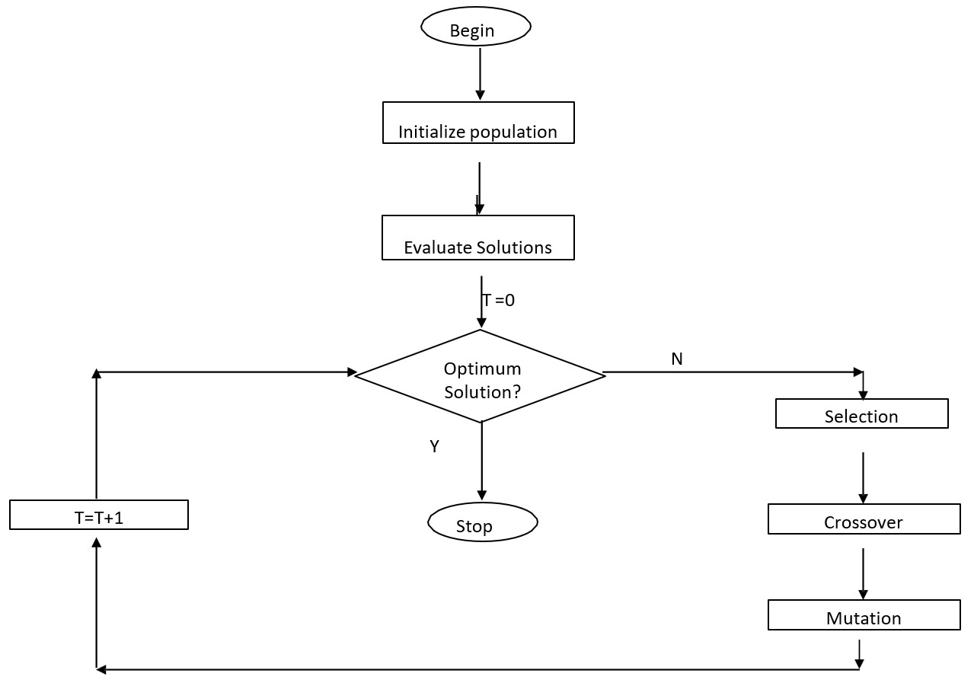
Working Mechanism Of GAs

Slide 3
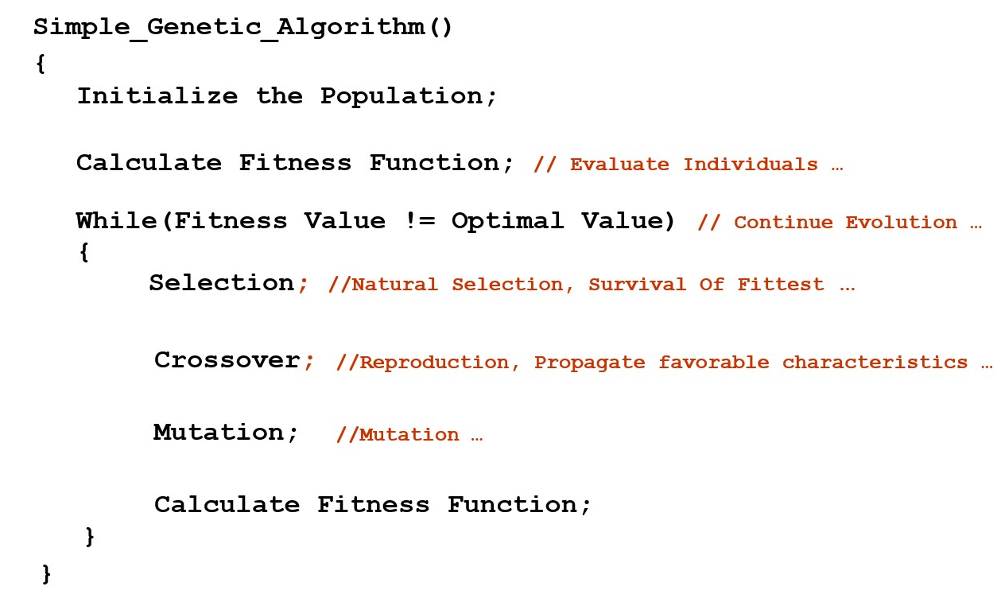
Simple Genetic Algorithm

Slide 4

Nature to Computer Mapping
Nature | Computer
Environment Population Individual Fitness/Survival Degree Chromosome Gene Reproduction Evolution | Problem to be optimized. Set of candidate solutions. One candidate solution to a problem. Quality of a solution. Encoding of a Solution to another format (For example, bit string, floating point array). Part of the encoded solution. Crossover Mutation(s) happen to individual(s)

Slide 5
Components of a GA
A problem to solve, and ...
Encoding technique
Initialization procedure
Evaluation function
Selection of parents
(gene, chromosome)
(creation)
(environment)
(reproduction)
Genetic operators
Parameter settings
(recombination, mutation)
(practice and art)

Slide 6
Example 1: A Very Simple Example
Generate a bit string for the decimal number 31.
Traditional Technique:
– Start by 00000 till reaching 11111
GA Steps:
Build an initial population of random individuals (chromosomes or initial solutions)
Evaluate fitness of individuals
Select some individuals to
Apply Crossover and Mutation
Build next generation
Go to step 2.

Slide 7
Example 1: GA Step 1
Build an initial population of random individuals
^{G}01 ^{G}02 ^{G}03 ^{G}04
00100 10100 01011 00101
G₀
Generation 0

Slide 8
Example 1: GA Step 2
Evaluate fitness of individuals
^{G}01 ^{G}02 ^{G}03
00100 10100 01011
4 20 11
^{G}04
G₀
00101
5
Fitness can be calculated as the decimal value of each bit string

Slide 9
Example 1: GA Step 3
Select some individuals to apply crossover and mutation
^{G}01
^{G}02
^{G}03
^{G}04
G₀
00100
10100
01011
00101
4 20 11
Individual with good fitness should be selected for crossover and mutation.
5

Slide 10
Example 1: GA Step 3
Select some individuals to apply crossover and mutation
^{G}01
^{G}02
^{G}03
^{G}04
G₀
00100
10100
01011
00101
4
20
11
5
Individual with good fitness should be selected for crossover and mutation.
10/31/2020

Slide 11
Example 1: GA Step 3
Select some individuals to apply crossover and mutation
^{G}01
^{G}02
^{G}03
^{G}04
G₀
00100
10100
01011
00101
How to apply crossover between these 2 parents?
Single point? Multiple point? Lovation?
It depends on your implementation parameters
Crossover may happen or not according to the probability of crossover

Slide 12
Example 1: GA Step 3 – Trial 1
Select some individuals to apply crossover and mutation
^{G}01
^{G}02
10100
^{G}11
^{G}03
01011
^{G}12
^{G}04
G₀
00100
00101
10011 01100
Single point crossover after 2 bits (Genes)
10/31/2020

Slide 13
Example 1: GA Step 3 – Trial 1
Select some individuals to apply crossover and mutation
20
11
^{G}01
^{G}02
10100
^{G}11
^{G}03
01011
^{G}12
^{G}04
G₀
00100
00101
^{G}14
^{G}13
G₁
00100
10011
01100
00101
4
19
12
5
Fitness?
10/31/2020

Slide 14
Example 1: GA Step 3 – Trial 2
Select some individuals to apply crossover and mutation
^{G}01
^{G}02
^{G}03
^{G}04
G₀
00100
10100
01011
00101
^{G}11
^{G}12
10111 01000
Single point crossover after 3 bits
10/31/2020

Slide 15
Example 1: GA Step 3 – Trial 2
Select some individuals to apply crossover and mutation
20
11
^{G}01
^{G}02
^{G}03
^{G}04
G₀
00100
10100
01011
00101
^{G}14
^{G}11
^{G}12
^{G}13
00100
10111
01000
00101
4
23
8
5
Fitness?
10/31/2020

Slide 16
Example 1: GA Step 3 – Trial 2
Select some individuals to apply crossover and mutation
20
11
^{G}01
^{G}02
^{G}03
^{G}04
G₀
00100
10100
01011
00101
^{G}14
^{G}11
^{G}12
^{G}13
00100
1100111111
0011000000
00101
4 5
23
8
23
8
How to apply a mutation over some individual?
– For bit strings, and according to the mutation probability of your
_{10/31/2020}implementation, one bit might be flipped!
18

Slide 17

Example 1: GA Step 3 – Trial 2
Select some individuals to apply crossover and mutation
20
11
^{G}01
^{G}02
^{G}03
^{G}04
G₀
00100
10100
01011
00101
^{G}13
^{G}11
^{G}12
^{G}14
G₁
00100
11111
01000
00101
4
31
8
5
23
OUR OBJECTIVE!
10/31/2020

Slide 18
Does it really cost one iteration?
Real world problems are not that easy.
You could have:
Hundreds of individuals (chromosomes)
Huge search space
You might perform thousands of iterations (have thousands of generations) before reaching your objective!
10/31/2020

Slide 19

Example 1: GA Step 3 – Trial 4
Select ALL individuals to apply crossover and mutation
^{G}01 ^{G}02 ^{G}03 ^{G}04
00100 10100 01011 00101
4 20 11 5
^{G}11 ^{G}12
00011 01100
G₀
3
12
10/31/2020

Slide 20




Example 1: GA Step 3 – Trial 4
Select ALL individuals to apply crossover and mutation
^{G}01 ^{G}02 ^{G}03 ^{G}04
00100 10100 01011 00101
4 20 11 5
^{G}11 ^{G}13 ^{G}12 ^{G}14
00011 10101 01100 00100
G₀
3
21
12
4
^{G}11
^{G}13
^{G}12
^{G}14
00011
11101
01100
00110
3
21→29
12
4→6
10/31/2020

Slide 21
Example 1: GA Step 4
Build next generation .. Full Replacement or Mix?
^{G}01 ^{G}02 ^{G}03 ^{G}04
00100 10100 01011 00101
4 20 11 5
^{G}11 ^{G}13 ^{G}12 ^{G}14
00011 10101 01100 00100
G₀
3
21
12
4
^{G}11
^{G}13
^{G}12
^{G}14
00011
11101
01100
00110
3
29
12
6
10/31/2020

Slide 22



Example 1: GA Step 4
Build next generation .. Mixing
^{G}02 ^{G}03 ^{G}11
^{G}13
G₁
10100 01011 00011
11101
20 11 3
29
^{G}02 ^{G}03
10100 01011
20 11
^{G}21
^{G}22
00001
11111
1
31
^{G}02 ^{G}03
10100 11011
^{G}21
^{G}22
00000
11111
20
27
0
31
OUR OBJECTIVE!
10/31/2020

Slide 23
How do you encode a solution?
Obviously this depends on the problem!
GA’s often encode solutions as fixed length “bitstrings” (e.g. 101110, 111111, 000101)
Each bit represents some aspect of the proposed solution to the problem
For GA’s to work, we need to be able to “test” any string and get a “score” indicating how “good” that solution is (Fitness).
Sometimes, your solutions (chromosomes) will be used in their original format (floating point numbers or alphabetical strings)
Davidhales.name

Slide 24
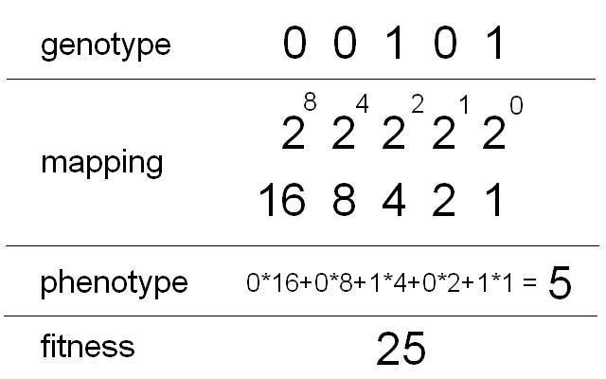
Example 2: f(x) = x²
Finding the maximum of a function:
– f(x) = x²
Range [0, 31] → Goal/Objective: find max (31² = 961)
Binary representation: string length 5 → 32 numbers (0-31)
= f(x)

Slide 25
Initial Random Population
f(x) = x²
 | binary | value | fitness
String 1 | 00110 | 6 | 36
String 2 | 00011 | 3 | 9
String 3 | 01010 | 10 | 100
String 4 | 10101 | 21 | 441
String 5 | 00001 | 1 | 1
STRI, University of Hertfordshire

Slide 26
f(x) = x²
Selection
 | binary | value |  | fitness
String 1 | 00110 |  | 6 | 36
String 2 | 00011 |  | 3 | 9
String 3 | 01010 |  | 10 | 100
String 4 | 10101 |  | 21 | 441
String 5 | 00001 |  | 1 | 1
Worst one can be removed

Slide 27
f(x) = x²
Selection
 | binary | value | fitness
String 1 | 00110 | 6 | 36
String 2 | 00011 | 3 | 9
String 3 | 01010 | 10 | 100
String 4 | 10101 | 21 | 441
String 5 | 00001 | 1 | 1
Best individual: can be reproduced twice → keep population size constant

Slide 28
f(x) = x²
Selection
 | binary | value | fitness
String 1 | 00110 | 6 | 36
String 2 | 00011 | 3 | 9
String 3 | 01010 | 10 | 100
String 4 | 10101 | 21 | 441
String 5 | 00001 | 1 | 1
All others are reproduced once

Slide 29
f(x) = x²
Recombination
Parents and x-position randomly selected (equal recombination)
 | partner | x-position
String 1 | String 2 | 4
String 3 | String 4 | 2
0 | 0 | 1 | 1 | 0
0 | 0 | 0 | 1 | 1
0 | 0 | 1 | 1 | 1
String 1:
String 2:
0 | 0 | 0 | 1 | 0
34

Slide 30
f(x) = x²
Recombination
Parents and x-position randomly selected (equal recombination)
 | partner | x-position
String 1 | String 2 | 4
String 3 | String 4 | 2
0 | 1 | 0 | 1 | 0
1 | 0 | 1 | 0 | 1
0 | 1 | 1 | 0 | 1
String 3:
String 4:
1 | 0 | 0 | 1 | 0
STRI, University of Hertfordshire
35

Slide 31
f(x) = x²
Mutation
bit-flip:
– Offspring-String 1:
00111 (7) → 10111 (23)
– String 5:
10101 (21) → 10001 (17)
STRI, University of Hertfordshire
36

Slide 32
Old Generation
f(x) = x²
 | binary | value | fitness
String 1 | 00110 | 6 | 36
String 2 | 00011 | 3 | 9
String 3 | 01010 | 10 | 100
String 4 | 10101 | 21 | 441
String 5 | 00001 | 1 | 1
STRI, University of Hertfordshire

Slide 33
f(x) = x² New Generation
All individuals in the parent population are replaced by offspring in the new generation
(generations are discrete!)
New population (Offspring):
 | binary | value | fitness
String 1 | 10111 | 23 | 529
String 2 | 00010 | 2 | 4
String 3 | 01101 | 13 | 169
String 4 | 10010 | 18 | 324
String 5 | 10001 | 17 | 289

Slide 34
f(x) = x² When to stop?
Iterate until termination condition reached, e.g.:
Number of generations
Best fitness
Process time
No improvements after a number of generations
Result after one generation:
Best individual: 10111 (23) – fitness 529

Slide 35
Conclusion
A genetic algorithm maintains a population of candidate solutions for the problem at hand, and makes it evolve by iteratively applying
a set of stochastic operators.
40

Slide 36

An Abstract Example
Distribution of Individuals in Generation 0
Distribution of Individuals in Generation N

