Slide 1
Lecture 3: Genetic Algorithms Operators and More Examples
Dr. Samar Hesham
Department of Computer Science
Faculty of Computers and Artificial Intelligence Cairo University
Egypt
10/31/2020
1

Slide 2
The simple GA
Has been subject of many (early) studies
still often used as benchmark for novel GAs
Shows many shortcomings, e.g.
Representation is too restrictive
Mutation & crossovers only applicable for bit-string & integer representations
Selection mechanism sensitive for converging populations with close fitness values

Slide 3
Various Strategies for the Genetic Operators
Different GAs use different ……… strategies.
Representation (encoding/decoding)
Selection
Crossover
Mutation
Replacement

Slide 4
Representation
String Array? Character Array? Floating Point?
Integer?
Phenotype space
Genotype space =
{0,1}^{L}
Encoding
(representation)
10010001
10010010
010001001
011101001
Decoding
(inverse representation)

Slide 5
English Word Generation
Generate valid English word of length 5 characters
Objective fn
Crossover
t h
t h
w
w
Dictionary
o
o
r e s
Chr 1
f s e
r e s
f s e
Chr N
. . .
. .
. . . .
6 / 76

Slide 6
English Word Generation
Generate valid English word of length 5 characters
Objective fn
Mutation
t h r e s
Chr 1
t h e s e
w
w
Dictionary
o
o
r d s
f s e
Chr N
. . .
. .
. . . .
7 / 76

Slide 7










Selection - Survival of The Strongest
Previous generation
0.93
0.51
0.72
0.31
0.12
0.64
Next generation
0.93
0.72
0.64
8 / 76

Slide 8

Selection - Some Weak Solutions Survive
Previous generation
0.93
0.51
0.72
0.31
0.12
0.64
Next generation
0.93
0.72
0.64
0.12
Why ??
9 / 76

Slide 9

Roulette Wheel Selection
Main idea: better individuals get higher chance
Chances proportional to fitness
Implementation: Roulette Wheel technique
» Assign to each individual a part of the roulette wheel
1/6 = 17%
B
C
2/6 = 33%
» Spin the wheel n times to select n individuals
A
3/6 = 50%
fitness(A) = 3
fitness(B) = 1
fitness(C) = 2

Slide 10
Roulette Wheel Selection
Each current string in the population has a slot assigned to it which is in proportion to it’s fitness.
We spin the weighted roulette wheel thus defined n times (where n is the total number of solutions).
Each time Roulette Wheel stops, the string corresponding to
that slot is created.
Strings that are fitter are assigned a larger slot and hence have
a better chance of appearing in the new population.
11

Slide 11




Example Of Roulette Wheel Selection
No. | String | Fitness | % Of Total
1 | 01101 | 169 | 14.4
2 | 11000 | 576 | 49.2
3 | 01000 | 64 | 5.5
4 | 10011 | 361 | 30.9
Total |  | 1170 | 100.0
12

Slide 12
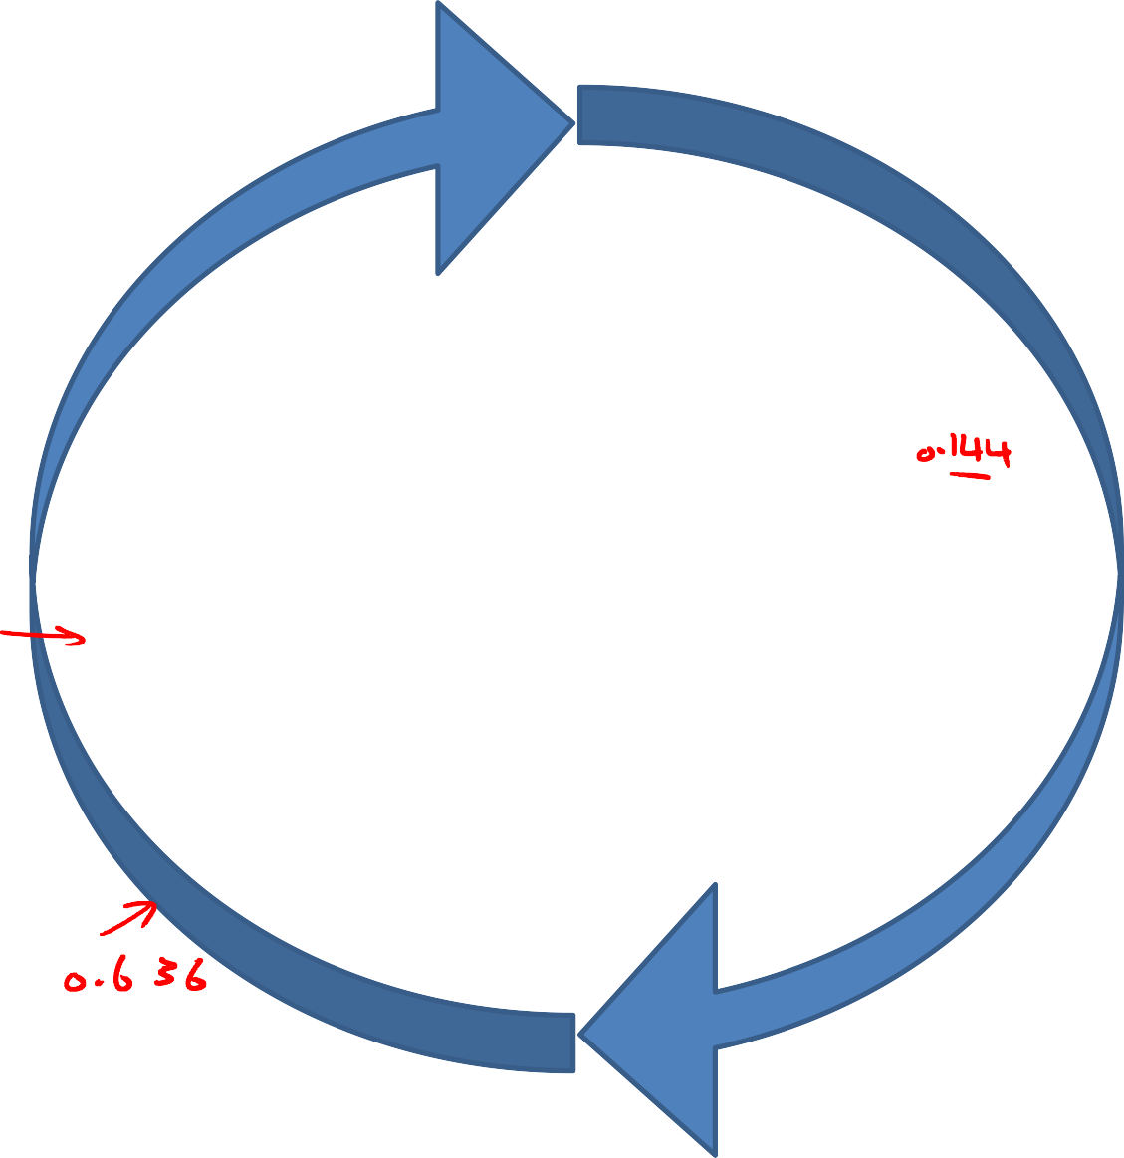
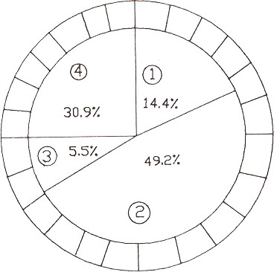

Roulette Wheel Example
1.00
0.00
Spinning the wheel:
– The bigger the area of one player, the higher the chance/probability that the ball will stop in his/her area
… so, the higher the chance he/she wins.
In GA:
– A random number between
0.00 and 1.00 is generated.
– The individual/chromosome whose range covers this random number will be selected for further operations.
10/31/2020 Author: Dr Mohammad Nassef
0.50
13

Slide 13
Roulette Wheel Selection
10/31/2020
©http://www.softchitech.com/ec_intro_html
Author: Dr Mohammad Nassef
14

Slide 14
Any other Selection Techniques?
Let’s see
15

Slide 15
Example 3: Traveling Salesman Problem
The Traveling Salesman Problem is defined as:
‘We are given a set of cities and a symmetric distance matrix that indicates the cost of travel from each city to every other city.
The goal is to find the shortest circular tour, visiting every city exactly once, so as to minimize the total travel cost, which includes the cost of traveling from the last city back to the first city’.
Traveling Salesman Problem
16

Slide 16
Encoding
Each city can be represented by an integer .
Consider the 6 Indian cities –
Mumbai, Nagpur , Calcutta, Delhi , Bangalore and Chennai and assign a number to each.
Mumbai Nagpur Calcutta Delhi Bangalore Chennai
1
2
3
4
5
6
17

Slide 17
Encoding (cont’d)
Thus a path would be represented as a sequence of integers from 1 to 6.
for example: the path [1 2 3 4 5 6 ] represents a path from Mumbai to Nagpur, Nagpur to Calcutta, Calcutta to Delhi, Delhi to Bangalore, Bangalore to Chennai, and finally from Chennai to Mumbai.
This is an example of Permutation Encoding as the position of the elements determines the fitness of the solution.
18

Slide 18
Distance/Cost Matrix For TSP
 | 1 | 2 | 3 | 4 | 5 | 6
1 | 0 | 863 | 1987 | 1407 | 998 | 1369
2 | 863 | 0 | 1124 | 1012 | 1049 | 1083
3 | 1987 | 1124 | 0 | 1461 | 1881 | 1676
4 | 1407 | 1012 | 1461 | 0 | 2061 | 2095
5 | 998 | 1049 | 1881 | 2061 | 0 | 331
6 | 1369 | 1083 | 1676 | 2095 | 331 | 0
Cost matrix for six city example.
Distances in Kilometers
19

Slide 19
Fitness Function
The fitness function will be the total cost of the tour represented by each chromosome.
This can be calculated as the sum of the distances traversed in each travel segment.
The Smaller The Sum, The Better The Solution Represented By That Chromosome.
20

Slide 20
Fitness Function (cont’d)
So, for a chromosome
[4 1 3 2 5 6], the total cost of travel or fitness will be calculated as shown below
Fitness = 1407 + 1987 + 1124
+ 1049 + 331+ 2095
= 7993 kms.
Since our objective is to Minimize the distance, the smaller the total distance, the better the solution.
 | 1 | 2 | 3 | 4 | 5 | 6
1 | 0 | 863 | 1987 | 1407 | 998 | 1369
2 | 863 | 0 | 1124 | 1012 | 1049 | 1083
3 | 1987 | 1124 | 0 | 1461 | 1881 | 1676
4 | 1407 | 1012 | 1461 | 0 | 2061 | 2095
5 | 998 | 1049 | 1881 | 2061 | 0 | 331
6 | 1369 | 1083 | 1676 | 2095 | 331 | 0
21

Slide 21
Selection Operator
We will use Tournament Selection.
As the name suggests tournaments are played between two solutions and the better solution is chosen and placed in the mating pool.
Two other solutions are picked again and another slot in the
mating pool is filled up with the better solution.
22

Slide 22
Tournament Selection (cont’d)
Mating Pool
7993
4 1 3 2 5 6
6872
4 3 2 1 5 6
6872
4 3 2 1 5 6
8971
3 6 4 1 2 5
8673
5 2 6 4 3 1
8673
5 2 6 4 3 1
8971
3 6 4 1 2 5
7993
4 1 3 2 5 6
8479
6 3 4 5 2 1
8142
2 6 3 4 5 1
7993
4 1 3 2 5 6
8142
2 6 3 4 5 1
6872
4 3 2 1 5 6
8479
6 3 4 5 2 1
6872
4 3 2 1 5 6
8673
5 2 6 4 3 1
8142
2 6 3 4 5 1
8142
2 6 3 4 5 1
23

Slide 23
Why can’t we use single-point crossover?
Single point crossover method randomly selects a crossover point
in the string and swaps the substrings.
This may produce some invalid offsprings as shown below.
4 | 1 | 3 | 2 | 5 | 6
4 | 1 | 3 | 1 | 5 | 6
4 | 3 | 2 | 1 | 5 | 6
4 | 3 | 2 | 2 | 5 | 6
24

Slide 24
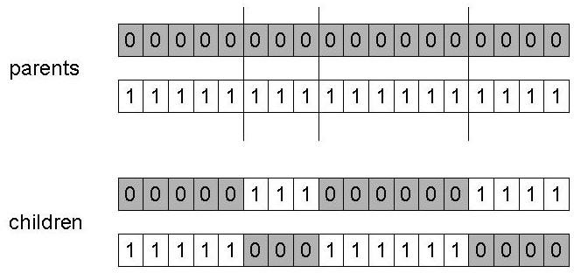
n-point crossover
Choose n random crossover points
Split along those points
Glue parts, alternating between parents

Slide 25
Order-1 crossover
Idea is to preserve relative order that elements occur
Informal procedure:
Choose an arbitrary part from the first parent
Copy this part to the first child
Copy the numbers that are not in the first part, to the
first child:
starting right from cut point of the copied part,
using the order of the second parent
and wrapping around at the end
Analogous for the second child, with parent roles reversed

Slide 26
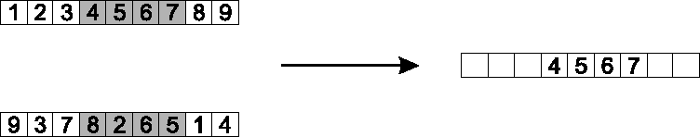




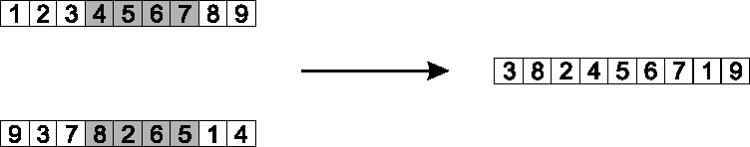
Order 1 crossover example
Copy randomly selected set from first parent
Copy rest from second parent in order 1,9,3,8,2

