Slide 1

Creating Enterprise Java Beans
Chapter 3

Slide 2
What is an EJB
An Enterprise Java Bean (EJB) is a Java EE component typically used to encapsulate business logic in an enterprise application.
Unlike simple Java beans in Java SE, where concepts such as multi-threading, concurrency, transactions, and security have to be explicitly implemented by the developer.
In an EJB, the application server provides these features at runtime and enables the developer to focus on writing the business logic for the application.

Slide 3
Accessing EJBs
A bean in EJB is a component offering one or more business interfaces to potential clients of that component.
Interfaces can be either remote, requiring the use of appropriate communication middleware (such as RMI or JMS), or local, in which case more direct, and hence efficient, bindings are possible.
EJB supports required interfaces (Dependency Injection)

Slide 4
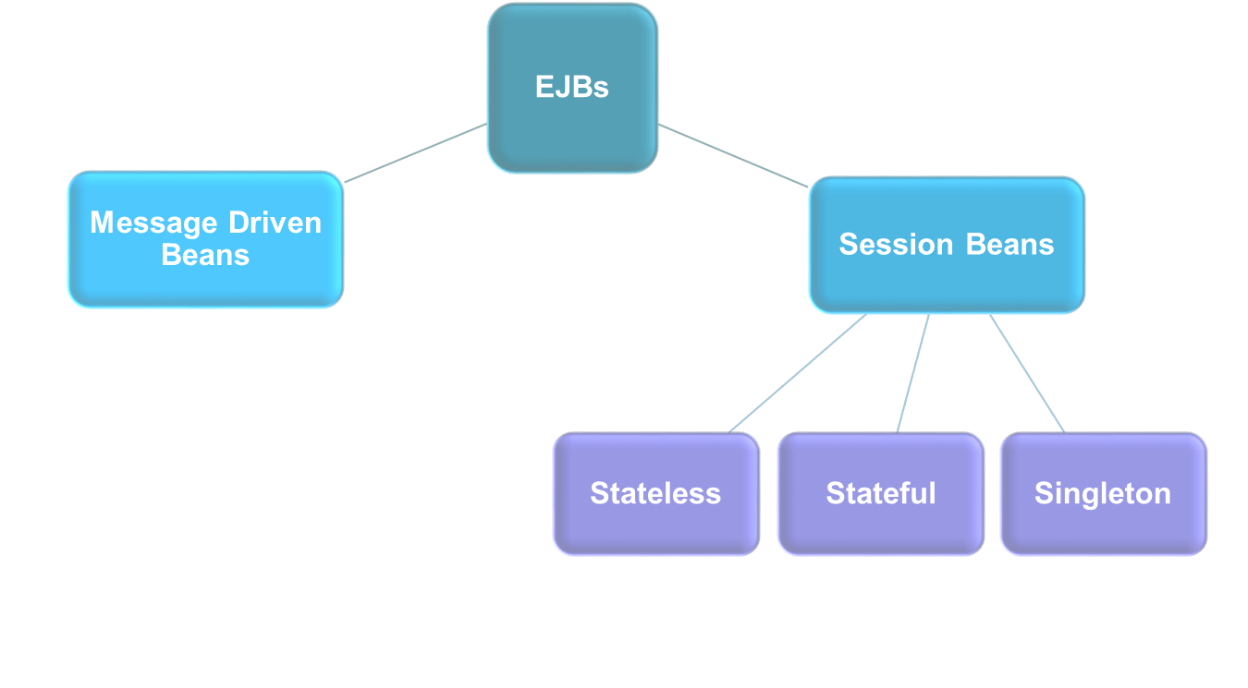
Types of EJBs

Slide 5
Session Beans
A Session Bean provides an interface to clients and encapsulates business logic methods that can be invoked by multiple clients either locally or remotely over different protocols.
Session EJBs can be clustered and deployed across multiple machines in a client transparent manner.
Types:
  Stateless Session Beans (SLSB)
  Stateful Session Beans (SFSB)
  Singleton

Slide 6
Stateless Session Beans (SLSB)
A stateless session bean does not maintain state with clients between calls.
When clients interact with the stateless session bean and invoke methods on it, the application server allocates an instance from a pool of stateless session beans, which are pre-instantiated.
Once a client completes the invocation and disconnects, the bean instance is either released back into the pool or destroyed.
Notes:
A stateless session bean is a type of enterprise bean, which is normally used to perform independent operations. A stateless session bean as per its name does not have any associated client state, but it may preserve its instance state. EJB Container normally creates a pool of few stateless bean's objects and use these objects to process client's request. Because of pool, instance variable values are not guaranteed to be same across lookups/method calls.

Slide 7
Stateless Session Beans (SLSB)
A stateless session bean is useful in scenarios where the application has to serve a large number of clients concurrently accessing the bean's business methods.
Each bean can be accessed or invoked my multiple clients.
Example: “search” in a shopping website without login.

Slide 8
Stateful Session Beans (SFSB)
Stateful session beans maintain state with clients across multiple calls.
There is a one-to-one relationship between the number of Stateful bean instances and the number of clients.
When a client completes the interaction with the bean and disconnects, the bean instance is destroyed.
A new client results in a new stateful bean with its own unique state.

Slide 9
Stateful Session Beans (SFSB)
The application server ensures that each client receives the same instance of a stateful session bean for each method call.
Example: “add to cart” in a shopping website

Slide 10
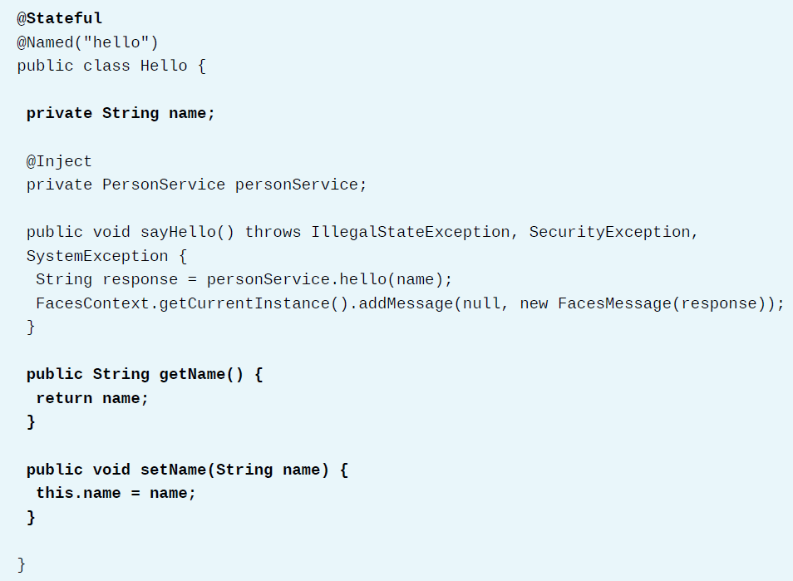
Stateful Session Bean Example

Slide 11
Singleton Session Beans
Singleton session beans are instantiated once per application and exists for the lifecycle of the application.
Every client request for a singleton bean goes to the same instance.
Singleton session beans are used in scenarios where a single enterprise bean instance is shared across multiple clients.
For example, database connections, JNDI lookups, JMS remote connection factory creation, and many more.

Slide 12
Types of EJBs

Slide 13
Message Driven Beans
A Message Driven Bean (MDB) enables Java EE applications to process messages asynchronously.
Once deployed on an application server, it listens for JMS messages and for each message received, it performs an action (the onMessage() method of the MDB is invoked).
MDBs provide an event driven model for application development.

Slide 14
Message Driven Beans
The MDB is stateless and does not maintain any state with clients.
The application server maintains a pool of MDBs and manages their lifecycle by assigning and returning instances from and to the pool.
For example: two systems can communicate by passing messages in an asynchronous manner, which ensures that the two systems can independently evolve without impacting each other.

Slide 15
Generate EJB using JBoss Developer Studio
Please refer to the steps in textbook page 85.

Slide 16
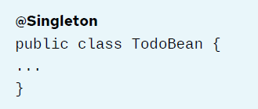
Convert a POJO to an EJB
Just add @Stateless, or @Stateful, or @Singleton annotation before the class definition.

Slide 17
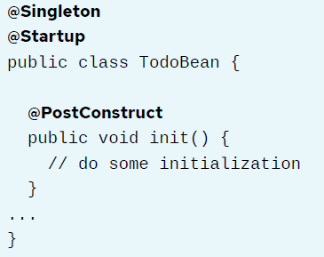
SomeAnnotations
@Startup
  to perform some initialization before starting to service client requests
@PostConstruct
  tells the EJB container to call that method immediately after instantiating the EJB.

Slide 18
Note
EJBs are instantiated by the EJB container, so they cannot use a constructor that relies on arguments.

Slide 19
Demo
Convert a POJO to an EJB
demo convert-ejb setup
Page 89

Slide 20
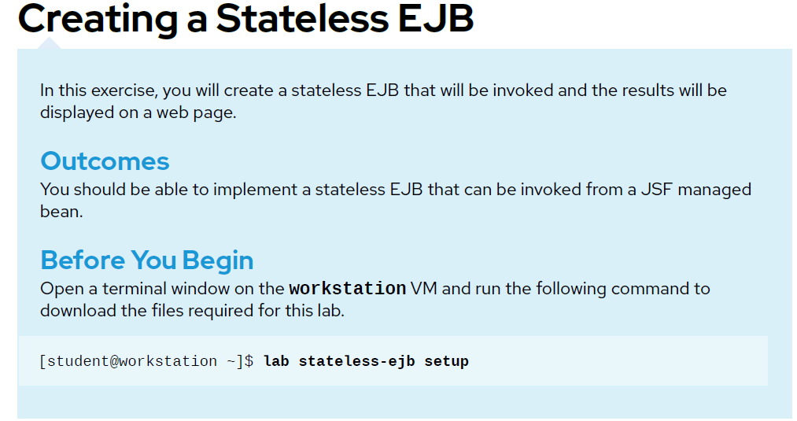
Lab Task– page 94

