Slide 1

Creating Enterprise Java Beans
Chapter 3

Slide 2
In last lab, we covered…
Bean Types
How to create an EJB
How to convert a POJO to an EJB

Slide 3
In this lab
Accessing EJBs either locally or remotely
Life Cycle of an EJB
Transaction Management

Slide 4
Accessing EJBs
An EJB is a portable component containing business logic running on an application server.
Clients can access EJBs either locally, if the client and EJB are part of the same application, or through a Remote Interface, if the EJB is running remotely.

Slide 5
Accessing EJBs
If the client and EJB are local, the client can invoke all public methods in the EJB.
If the EJB is remote, a simple Java interface that exposes the business methods of an EJB, has to be provided.
  The EJB class implements the methods in the remote interface and its implementation details are hidden from the clients.

Slide 6
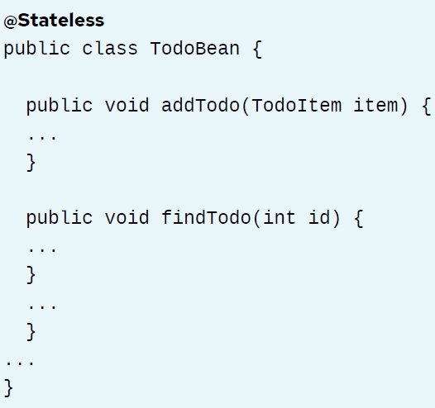
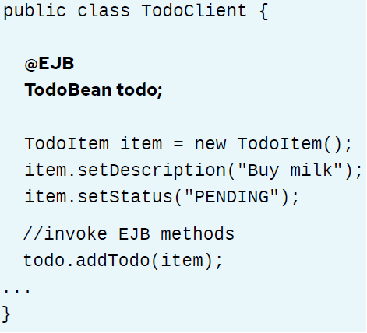
Access EJBs Locally
Using @EJB annotation

Slide 7
Access EJBs Remotely
Declare an interface listing the business methods of the EJB.
Let the EJB implement and override these methods.
Use JNDI to lookup the EJB.

Slide 8
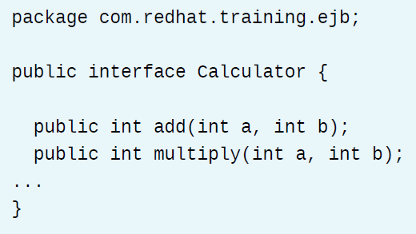
Access EJBs Remotely – Step 1

Slide 9
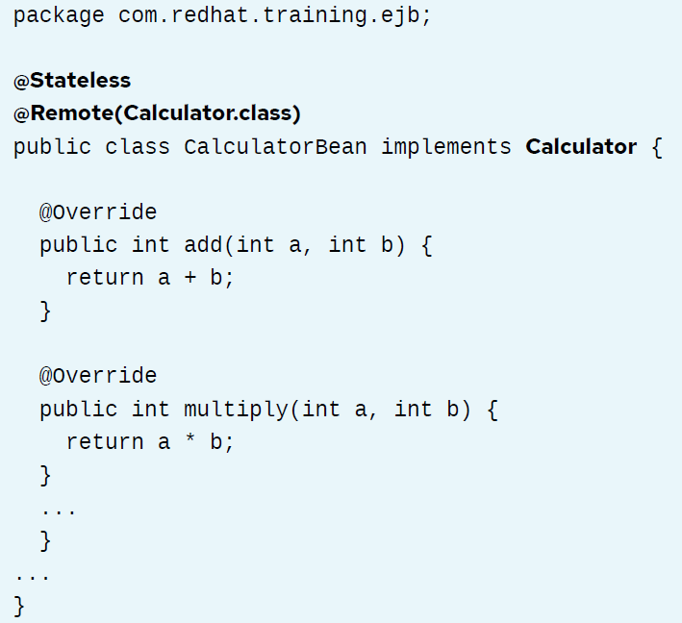
Access EJBs Remotely – Step 2
Notes:
Your EJB is now ready to be packaged and deployed on an application server and can serve
remote clients.

Slide 10
Access EJBs Remotely – Step 3
Looking Up Remote EJBs Using JNDI
Java EE specified a standard JNDI lookup scheme for clients to look up EJBs
application-name: The application name is the name of the EAR that the EJB is deployed in. If the EJB JAR is not deployed in an EAR, then this is blank.
module-name: By default, the module name is the name of the EJB JAR file.
bean-name: The name of the EJB to be invoked (the implementation class).
fully-qualified-interface-name: The fully-qualified class name of the remote interface. Include the full package name.
/<application-name>/<module-name>/<bean-name>!<fully-qualified-interface-name>

Slide 11
Access EJBs Remotely – Step 3
Considering the calculator example, assuming that the EJB is packaged inside a file called calculator-ejb.jar, which is further packaged into an EAR file called myapp.ear.
Clients can look up the EJB using the following lookup string:
myapp/calculator-ejb/CalculatorBean!com.redhat.training.ejb.Calculator

Slide 12
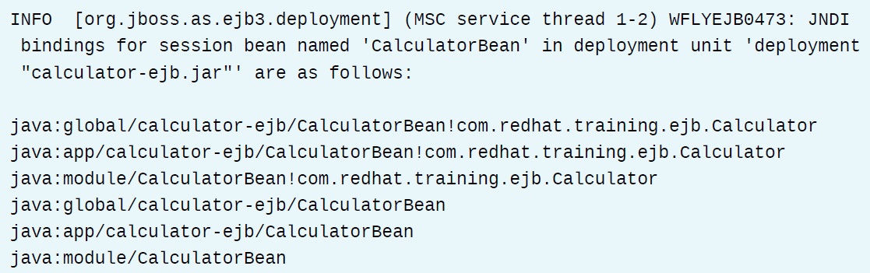
Access EJBs Remotely – Step 3
The application server lists the different JNDI bindings for the EJB in the server logs.

Slide 13
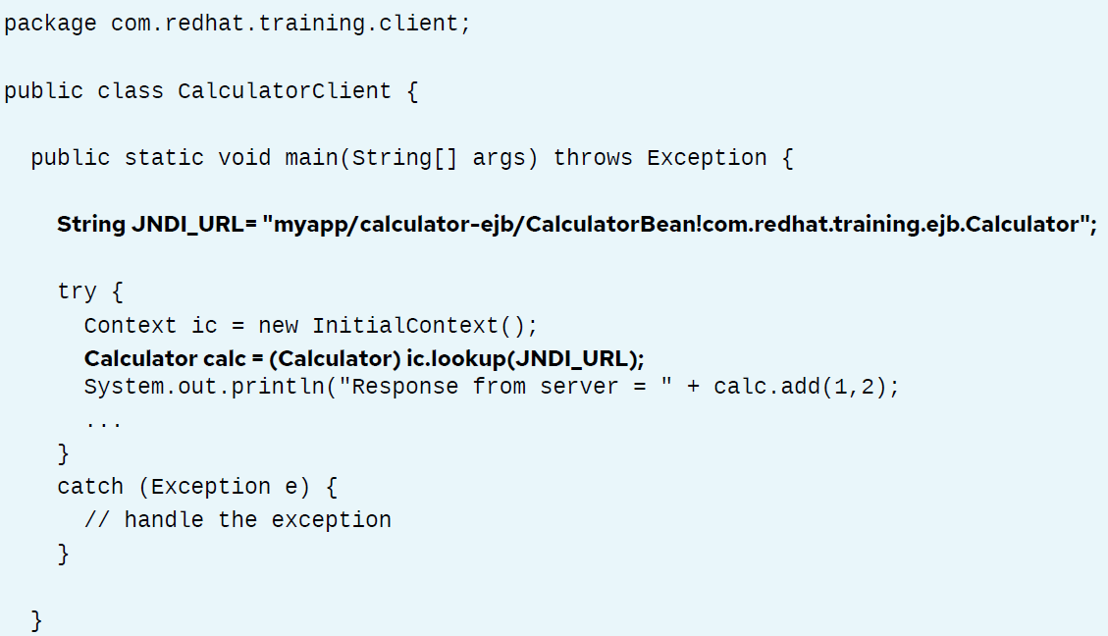
A sample program
A JNDI client program that uses the JNDI naming scheme to look up the remote EJB

Slide 14
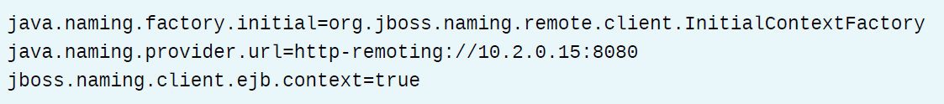
A last step
You also need to provide a file called jndi.properties in the class path of the client program,with the host name, IP address, port, and security details (if secured for remote access) of the remote application server where the EJB is running.

Slide 15
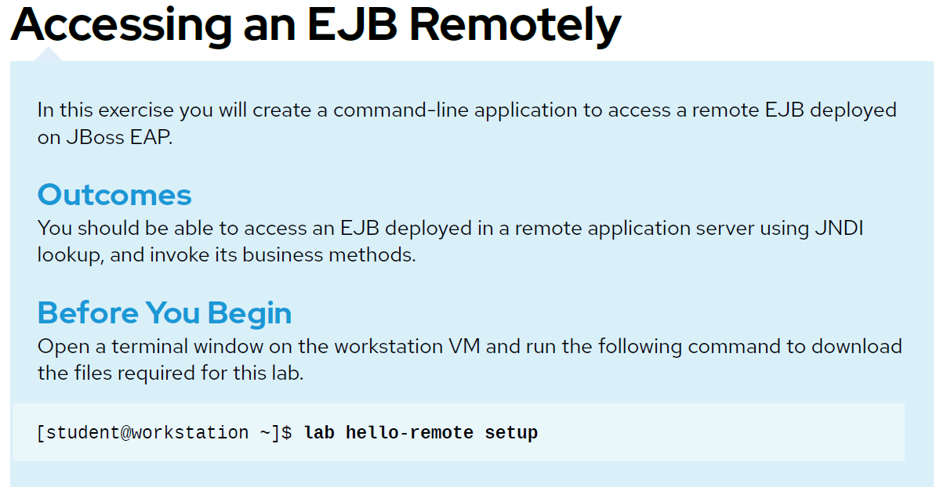
Guided Exercise – page 105

Slide 16
Life Cycle of an EJB
The container is responsible for managing the life cycle (creation, execution and destruction) of the EJB's.
Each of the different types of EJBs (Stateless, Stateful, Singleton, MDB) have their own life cycle.

Slide 17
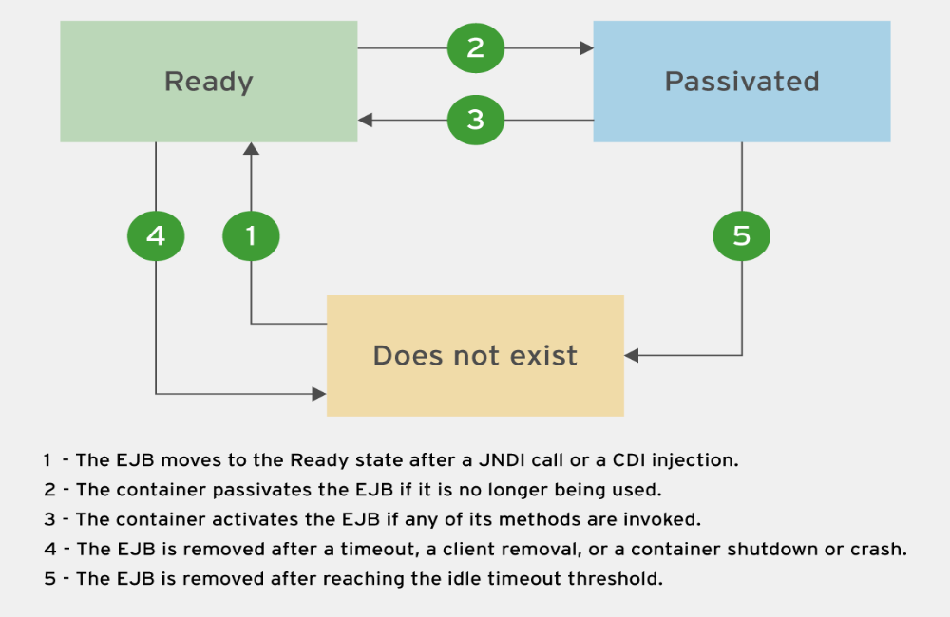
Stateful Session Bean Life Cycle

Slide 18
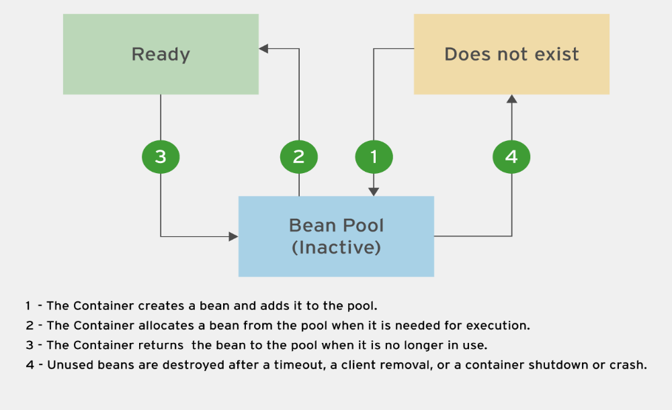
Stateless Session Bean Life Cycle

Slide 19
Singleton Session Bean Life Cycle
Does Not Exist: The singleton is not created and does not exist in application server memory.
Ready: The singleton EJB (a single object) is created in application server memory at startup, or by CDI injection and is ready to have its business methods invoked by clients.
Notes:
Since there is just one instance of the EJB for the duration of its life cycle, there is no concept of a
pool. Concurrent access policies on the bean can be controlled by deployment descriptors or code
level annotations.

Slide 20
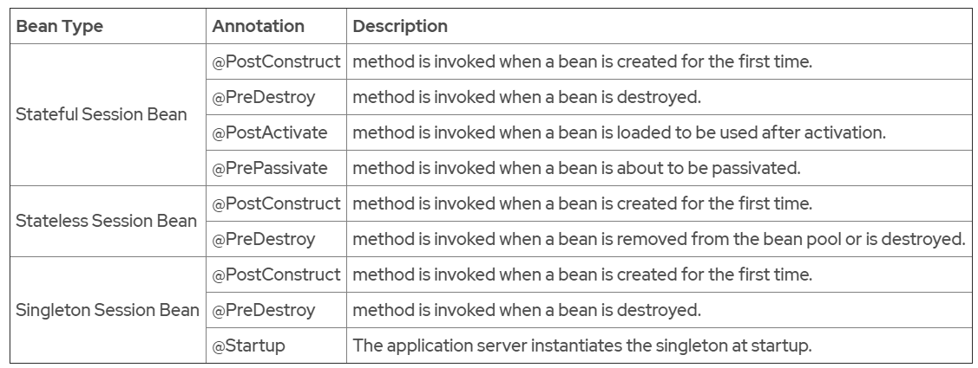
The Bean Life Cycle Annotations

Slide 21
Quiz
Page 116

Slide 22
Transactions
A Transaction is a series of actions that must be executed as a single atomic unit.
It follows an "all or nothing" approach.
Transactions ensure that data integrity is maintained by controlling concurrent access to the data.
Transactions ensure that a failed business transaction does not leave the system in an inconsistent or invalid state.

Slide 23
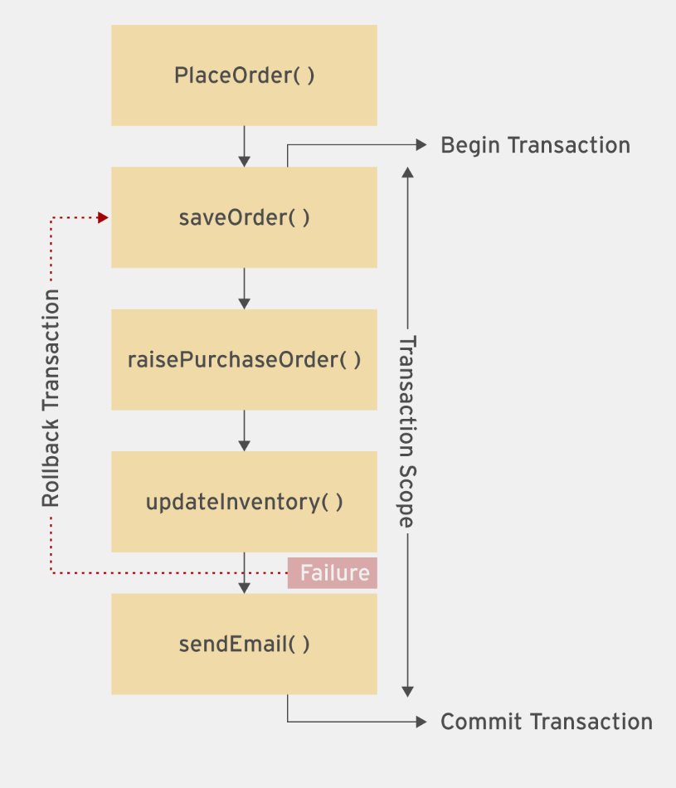
Transactions

Slide 24
Implicit and Explicit transactions
Implicit or Container Managed Transaction (CMT):
  The application server manages the transaction boundary and automatically commits and rolls back transactions without the developer writing code for managing transactions.
  This is the default option unless explicitly overridden by the developer.
Explicit or Bean Managed Transaction (BMT):
  The transactions are managed by the developer in code at the bean level (in EJBs). The developer is responsible for controlling the transaction scope and boundary explicitly.

Slide 25
CMT
In CMT, the application server implicitly begins a transaction at the beginning of an EJB method and commits the transaction at the end of the method.
If an exception occurs, the transaction is rolled back. Runtime exceptions automatically trigger a rollback by the application server.
Nesting of transactions within a single bean method is not allowed.
You can’t use the begin(), commit(), and rollback() methods from the javax.transaction.UserTransaction interface.
A developer can override the default transactional behavior at the method level with annotations called Transaction Attributes.

Slide 26
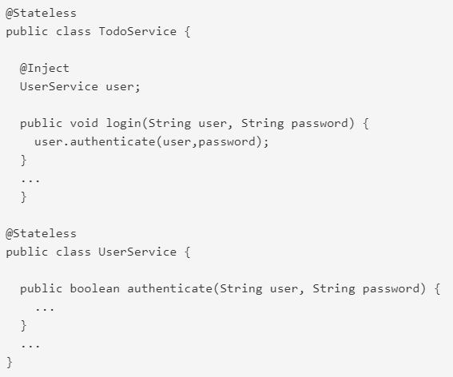
CMT Transaction Attributes
Notes:
Refer to the video in this part

Slide 27
TransactionAttributeType.REQUIRED
@TransactionAttribute(TransactionAttributeType.REQUIRED)
  If the login() method is running within a transaction and calls the authenticate() method in the UserService class, then the authenticate() executes within the same transaction.
  If there is no transaction when authenticate() is called, then the application server starts a new transaction before executing authenticate().

Slide 28
TransactionAttributeType.REQUIRES_NEW
@TransactionAttribute(TransactionAttributeType.REQUIRES_NEW)
  If the login() method is running within a transaction and calls the authenticate() method in the UserService class, then the application server suspends the transaction and starts a new transaction before executing authenticate().
  Once authenticate() finishes executing, control moves back to login() and the suspended transaction resumes. If there is no transaction when authenticate() is called, then the application server starts a new transaction before executing authenticate().
  This attribute ensures that your method always runs with a new transaction.

Slide 29
TransactionAttributeType.MANDATORY
@TransactionAttribute(TransactionAttributeType.MANDATORY)
  If the login() method is running within a transaction and calls the authenticate() method in the UserService class, then the authenticate() executes within the same transaction.
  If there is no transaction when authenticate() is called, then the application server throws a TransactionRequiredException.
  Use the this attribute if you want a method to always execute in the transaction context of the calling client.

Slide 30
TransactionAttributeType.NOT_SUPPORTED
@TransactionAttribute(TransactionAttributeType.NOT_SUPPORTED)
  If the login() method is running within a transaction and calls the authenticate() method in the UserService class, then the application server suspends the transaction and runs authenticate() without any transaction context.
  Once authenticate() finishes executing, control moves back to login() and the suspended transaction resumes.
  If there is no transaction when authenticate() is called, then the application server does not start a new transaction before executing authenticate().
  Use this attribute for methods that don't need transactions.

Slide 31
TransactionAttributeType.SUPPORTS
@TransactionAttribute(TransactionAttributeType.SUPPORTS)
  If the login() method is running within a transaction and calls authenticate(), then authenticate() executes within the same transaction.
  If there is no transaction when authenticate() is called, then the application server does NOT start a new transaction before executing authenticate().

Slide 32
TransactionAttributeType.NEVER
@TransactionAttribute(TransactionAttributeType.NEVER)
  If the login() method is running within a transaction and calls the authenticate() method in the UserService class, then the application server throws a RemoteException.
  If there is no transaction when authenticate() is called, then the application server does not start a new transaction before executing authenticate().

Slide 33
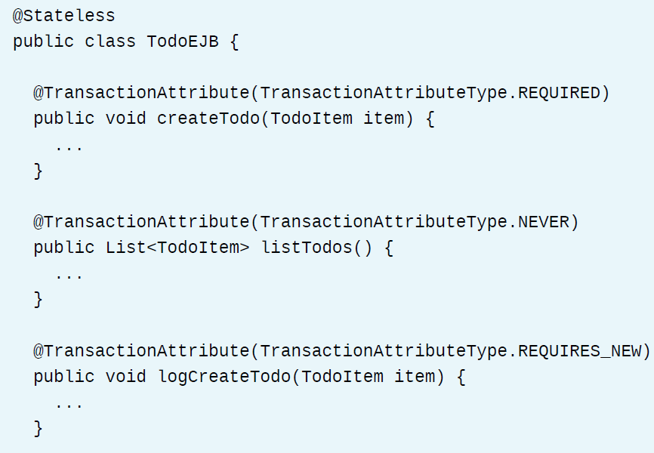
An example
The listTodos() method is annotated with the NEVER transaction attribute, because this method simply does a read-only operation from the database and does not insert, delete, or update any data.
The logCreateTodo() method is annotated with the REQUIRES_NEW transaction attribute, which ensures that this method is always executed with a new transaction, even if it is called from another method executing with its own transaction context.

Slide 34
BMT
You have fine-grained control over when a transaction begins and ends, and control when to commit and rollback.
You can use the begin(), commit(), and rollback() methods from the javax.transaction.UserTransaction interface to control the transaction boundaries and scope explicitly.

Slide 35
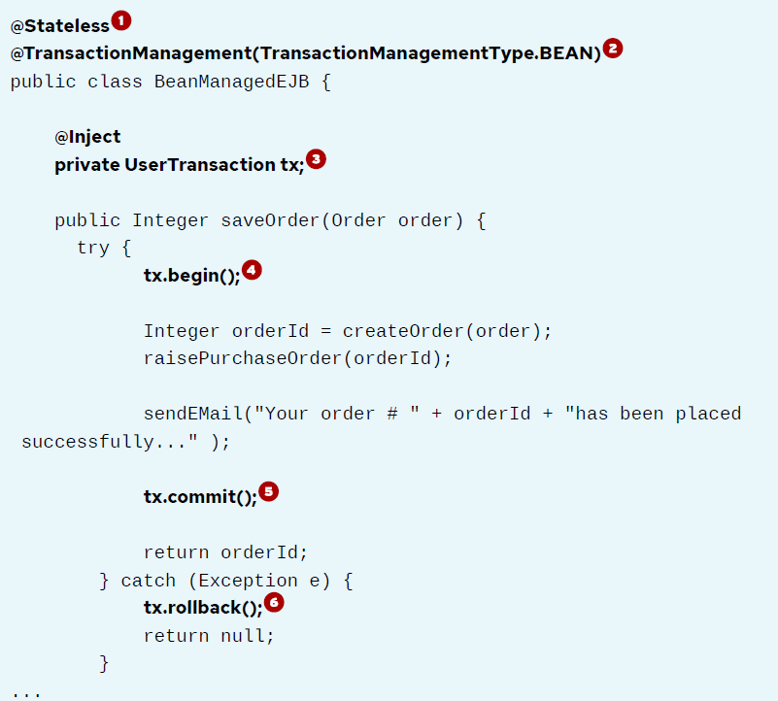
An example
Notes:
1. This class is a stateless EJB.
2. Mark this EJB as bean managed by using the @TransactionManagement(TransactionManagementType.BEAN) annotation.
3. Inject a UserTransaction object. This is used for beginning, committing, and rolling back transactions in this EJB.
4. Begin a transaction.
5. If all the methods execute successfully without any errors, commit the transaction.
6. If there is an exception due to some failure, perform a rollback of the transaction.

Slide 36
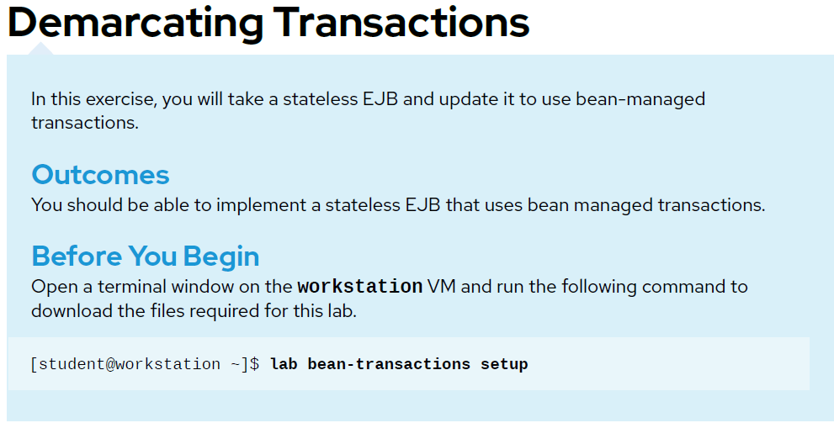
Guided Exercise – page 126

Slide 37
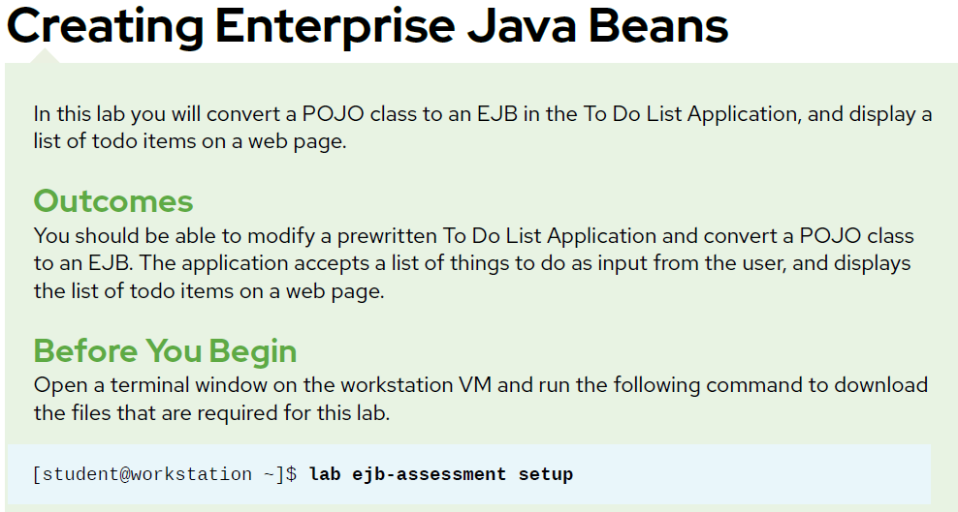
Lab Task – page 131

