Slide 1
Chapter 9
Securing Java EE Applications

Slide 2
Java EE Security
When building enterprise applications that access sensitive data, security must be a top priority for developers.
Defining which users have access to an application is known as authentication, while defining the permissions within the application for those users is known as authorization
To customize authorization in an application, restrictions are applied to a user, which represents an individual, or to a role, which refers to a defined group of users.

Slide 3
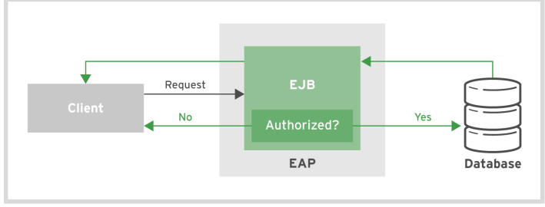
Notes:
For example, consider an online bookstore web application where customers purchase books
online, and the store owner manages the inventory. The user shadowman is a customer accessing
the site and has the role customer. The site administrator with the user name redhat has the
role admin. The server authenticates the users shadowman and redhat to ensure that each user
matches its password. Once authenticated, the EJB methods are annotated to restrict access to
individual user roles. Because customers are not allowed to manage the inventory of the store, the
users with the role customer are not able to invoke methods that manage the inventory, while the
users with the role admin can make inventory changes.

Slide 4
JAAS
Java Authentication and Authorization Service (JAAS) is a security API that is used to implement user authentication and authorization in Java applications
It provides declarative role-based security in the JBoss Enterprise Application Platform.
Declarative security separates security concerns from application code by using the container to manage security.
The container provides an authorization system based on annotations and XML descriptors within the application code that secures resources.

Slide 5
Declarative Security
Deployment descriptors are needed for managing authentication and authorization
They determine how an application server deploys the application and how the server secures the application.
Developers use the web.xml or jboss-web.xml file to define which resources in an application should be secured how they are secured, and what data is used to validate the credentials.

Slide 6
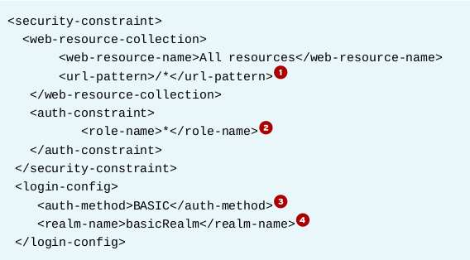
Notes:
1- The resources that the security constraint applies to. The "/*" indicates that all resources are
secured.
2-The roles that are authorized to access the resources. In this instance, all roles may access the
application.
3-The method the application uses to access the credentials of a user. BASIC prompts the user
in a pop-up window as soon as the application is accessed.
4-The name of the realm that stores the user credential information. This topic is discussed
further in the next section.

Slide 7
Annotations that can be used to secure an EJB:
@SecurityDomain: Located at the beginning of the class, this annotation defines the security domain by name to use for the EJB.
@DeclareRoles: Located at the beginning of the class, this annotation defines the roles that are tested for permissions in the class. If this annotation is not used, the roles are checked based on the presence of the @RolesAllowed annotations.

Slide 8
Permissions
@RolesAllowed: Located before class or method to define a list of one or more roles allowed to access a method.
@PermitAll: Located before class or method specifies all roles are allowed to access a method.
@DenyAll: Located before class or method specifies that NO roles are allowed to access a method.
@RunAs: Located before class or method specifies the role used when running a method. This annotation is useful when an EJB is calling another EJB and needs to take on a new role for security restrictions in another EJB.

Slide 9
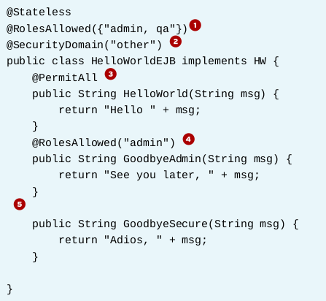
Notes:
1 The HelloWorldEJB class defaults to restricting all of its methods to only being available to
the admin and qa users.
2 The class is leveraging the other security domain. In this case, this security domain utilizes
the property files that store the role information.
3The HelloWorld method is available to all roles, not just admin and qa.
4The GoodbyeAdmin method is available only to users authenticated as the role admin.
5The GoodbyeSecure method is available to only admin and qa as the method defaults to the
RolesAllowed defined at the class level.

Slide 10
Programmatic Security
In some cases, declarative security is not enough to meet all security requirements for an application.
Developers may prefer also using programmatic security to have more control over authentication and authorization decisions within the application

Slide 11
Programmatic Security
EJBContext object contains information about the current security context
getCallerPrincipal(): Returns the currently authenticated user.
isCallerInRole(String role): Returns a boolean indicating whether a user belong to a given role.

Slide 12
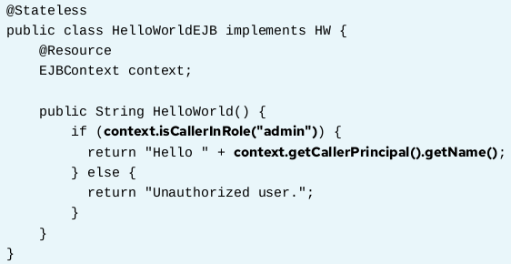

Slide 13
Configuring a Security Domain in JBoss EAP
EAP and other application servers provide utilities and predefined default configurations that help manage authentication and authorization.
EAP manages the user security information in security realms.
By default, EAP defines the ApplicationRealm, which uses 2 files to store the users and roles
• application-users.properties: This file stores user names and passwords as a key-value pair, for example: <username>=<password>
• application-roles.properties:This file stores users and roles as key-value pairs using the following syntax: <role>=<user1>,<user2>..
Notes:
A realm is a security policy domain defined for a web or application server. ... For a web application, a realm is a complete database of users and groups identified as valid users of a web application or a set of web applications and controlled by the same authentication policy.

Slide 14
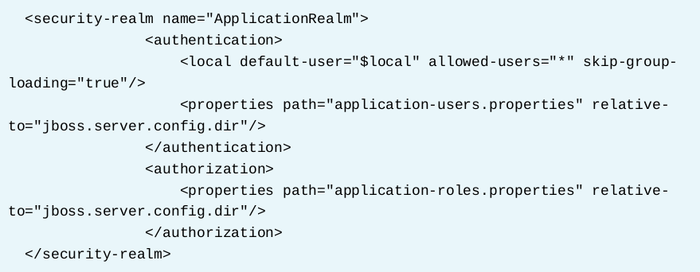
Define ApplicationRealm

Slide 15
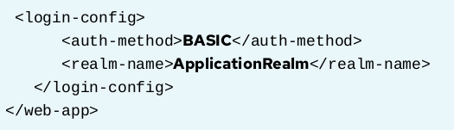
Login module
EAP includes several built-in login modules that developers can use for authentication within a security domain. These login modules include the ability to read user information from a relational database, an LDAP server, or flat files. It is also possible to build a custom module depending on the security requirements of the application.

Slide 16
Guided Exercise – Page 366
[student@workstation ~]$ lab security-domain setup
https://rha.ole.redhat.com/rha/app/courses/ad183-7.0/e25f4717-0494-4858-98d2-a93391a0cd40/pages/ch09s04

Slide 17

Securing a REST API
Similar to defining security in an EJB, a REST API is secured either with annotations or programmatically.
To enable role-based security for REST APIs, update the web.xml to contain the following <context-param>

Slide 18
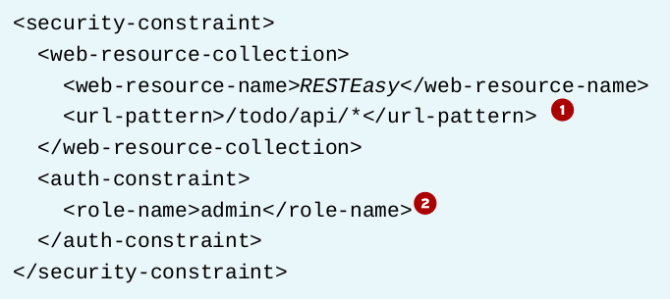
Set the path
After setting the resteasy.role.based.security, update the web.xml file with a security constraint set to the path of the RESTEasy service

Slide 19
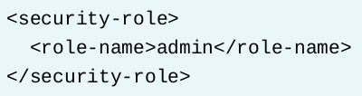
Set the roles
Each role listed in the security constraint also needs to be defined in the web.xml as a <security-role>

Slide 20
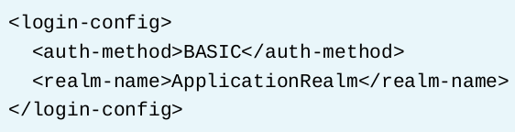
Set login configuration
Complete the web.xml file by defining the login-config

Slide 21
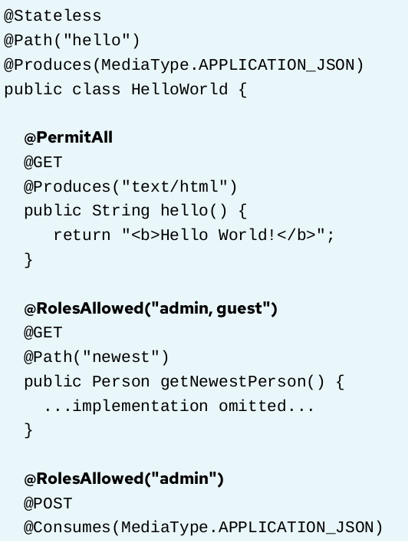
Securing endpoints

Slide 22
Guided Exercise – Page 377
[student@workstation ~]$ lab rest-annotations setup
https://rha.ole.redhat.com/rha/app/courses/ad183-7.0/e25f4717-0494-4858-98d2-a93391a0cd40/pages/ch09s06

Slide 23
Lab – Page 384
[student@workstation ~]$ lab securing-lab setup
https://rha.ole.redhat.com/rha/app/courses/ad183-7.0/e25f4717-0494-4858-98d2-a93391a0cd40/pages/ch09s07

