Slide 1
LECTURE 5:
REACTIVE AND HYBRID
ARCHITECTURES
An Introduction to MultiAgent Systems
http://www.csc.liv.ac.uk/~mjw/pubs/imas

Slide 2
Reactive Architectures
There are many unsolved (some would say insoluble) problems associated with symbolic AI
These problems have led some researchers to question the viability of the whole paradigm, and to the development of reactive architectures
Although united by a belief that the assumptions underpinning mainstream AI are in some sense wrong, reactive agent researchers use many different techniques
In this presentation, we start by reviewing the work of one of the most vocal critics of mainstream AI: Rodney Brooks

Slide 3
Brooks – behavior languages
Brooks has put forward three theses:
  Intelligent behavior can be generated without explicit representations of the kind that symbolic AI proposes
  Intelligent behavior can be generated without explicit abstract reasoning of the kind that symbolic AI proposes
  Intelligence is an emergent property of certain complex systems

Slide 4
Brooks – behavior languages
He identifies two key ideas that have informed his research:
  Situatedness and embodiment: ‘Real’ intelligence is situated in the world, not in disembodied systems such as theorem provers or expert systems
  Intelligence and emergence: ‘Intelligent’ behavior arises as a result of an agent’s interaction with its environment. Also, intelligence is ‘in the eye of the beholder’; it is not an innate, isolated property

Slide 5
Brooks – behavior languages
To illustrate his ideas, Brooks built some based on his subsumption architecture
A subsumption architecture is a hierarchy of task-accomplishing behaviors
Each behavior is a rather simple rule-like structure
Each behavior ‘competes’ with others to exercise control over the agent
Lower layers represent more primitive kinds of behavior (such as avoiding obstacles), and have precedence over layers further up the hierarchy
The resulting systems are, in terms of the amount of computation they do, extremely simple
Some of the robots do tasks that would be impressive if they were accomplished by symbolic AI systems

Slide 6
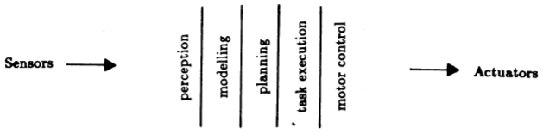
A Traditional Decomposition of a Mobile Robot Control System into Functional Modules
From Brooks, “A Robust Layered Control System for a Mobile Robot”, 1985

Slide 7
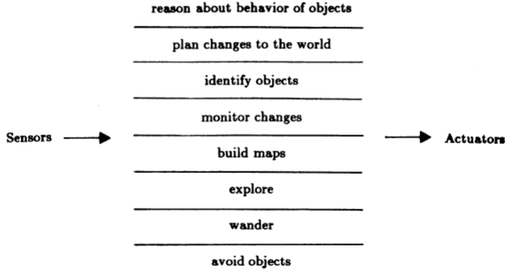
A Decomposition of a Mobile Robot Control System Based on Task Achieving Behaviors
From Brooks, “A Robust Layered Control System for a Mobile Robot”, 1985

Slide 8
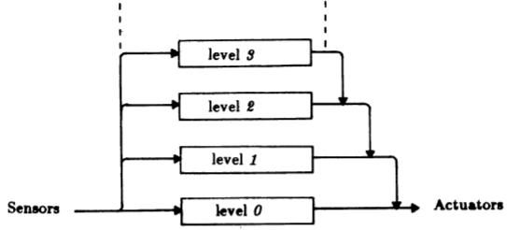
Layered Control in the Subsumption Architecture
From Brooks, “A Robust Layered Control System for a Mobile Robot”, 1985

Slide 9
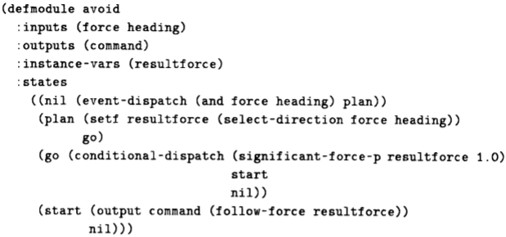
Example of a Module – Avoid
From Brooks, “A Robust Layered Control System for a Mobile Robot”, 1985

Slide 10
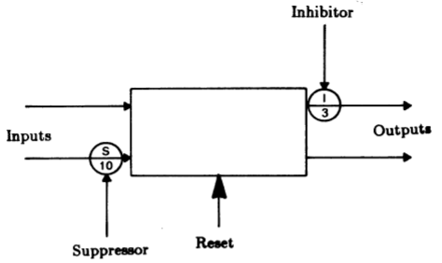
Schematic of a Module
From Brooks, “A Robust Layered Control System for a Mobile Robot”, 1985

Slide 11
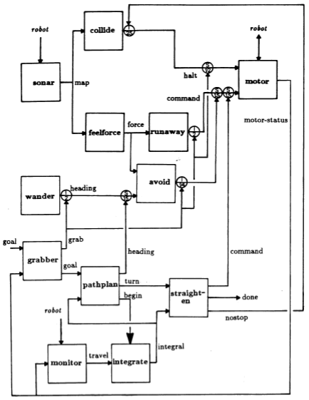
Levels 0, 1, and 2 Control Systems
From Brooks, “A Robust Layered Control System for a Mobile Robot”, 1985

Slide 12
Steels’ Mars Explorer
Steels’ Mars explorer system, using the subsumption architecture, achieves near-optimal cooperative performance in simulated ‘rock gathering on Mars’ domain:
The objective is to explore a distant planet, and in particular, to collect sample of a precious rock. The location of the samples is not known in advance, but it is known that they tend to be clustered.

Slide 13
Steels’ Mars Explorer Rules
For individual (non-cooperative) agents, the lowest-level behavior, (and hence the behavior with the highest “priority”) is obstacle avoidance:
if detect an obstacle then change direction (1)
Any samples carried by agents are dropped back at the mother-ship:
if carrying samples and at the base
then drop samples (2)
Agents carrying samples will return to the mother-ship:
if carrying samples and not at the base
then travel up gradient (3)

Slide 14
Steels’ Mars Explorer Rules
Agents will collect samples they find:
if detect a sample then pick sample up (4)
An agent with “nothing better to do” will explore randomly:
if true then move randomly (5)

Slide 15
Situated Automata
A sophisticated approach is that of Rosenschein and Kaelbling
In their situated automata paradigm, an agent is specified in a rule-like (declarative) language, and this specification is then compiled down to a digital machine, which satisfies the declarative specification
This digital machine can operate in a provable time bound
Reasoning is done off line, at compile time, rather than online at run time

Slide 16
Situated Automata
The logic used to specify an agent is essentially a modal logic of knowledge
The technique depends upon the possibility of giving the worlds in possible worlds semantics a concrete interpretation in terms of the states of an automaton
“[An agent]…x is said to carry the information that P in world state s, written s╞ K(x,P), if for all world states in which x has the same value as it does in s, the proposition P is true.”
[Kaelbling and Rosenschein, 1990]

Slide 17
Situated Automata
An agent is specified in terms of two components: perception and action
Two programs are then used to synthesize agents
  RULER is used to specify the perception component of an agent
  GAPPS is used to specify the action component

Slide 18
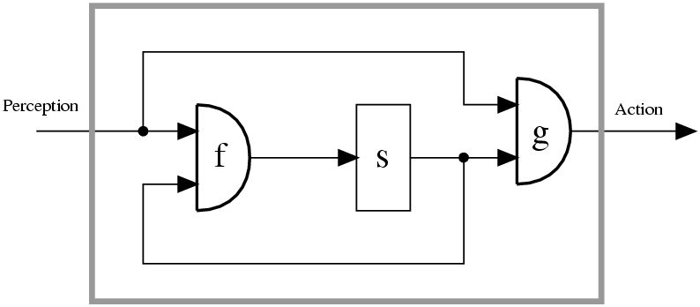
Circuit Model of a Finite-State Machine
f = state update function
s = internal state
g = output function
From Rosenschein and Kaelbling,
“A Situated View of Representation and Control”, 1994

Slide 19
RULER – Situated Automata
RULER takes as its input three components
“[A] specification of the semantics of the [agent's] inputs (‘whenever bit 1 is on, it is raining’); a set of static facts (‘whenever it is raining, the ground is wet’); and a specification of the state transitions of the world (‘if the ground is wet, it stays wet until the sun comes out’). The programmer then specifies the desired semantics for the output (‘if this bit is on, the ground is wet’), and the compiler ... [synthesizes] a circuit whose output will have the correct semantics. ... All that declarative ‘knowledge’ has been reduced to a very simple circuit.” [Kaelbling, 1991]

Slide 20
GAPPS – Situated Automata
The GAPPS program takes as its input
  A set of goal reduction rules, (essentially rules that encode information about how goals can be achieved), and
  a top level goal
Then it generates a program that can be translated into a digital circuit in order to realize the goal
The generated circuit does not represent or manipulate symbolic expressions; all symbolic manipulation is done at compile time

Slide 21
Circuit Model of a Finite-State Machine
GAPPS
RULER
“The key lies in understanding how a process can naturally mirror in its states subtle conditions in its environment and how these mirroring states ripple out to overt actions that eventually achieve goals.”
From Rosenschein and Kaelbling,
“A Situated View of Representation and Control”, 1994

Slide 22
Situated Automata
The theoretical limitations of the approach are not well understood
Compilation (with propositional specifications) is equivalent to an NP-complete problem
The more expressive the agent specification language, the harder it is to compile it
(There are some deep theoretical results which say that after a certain expressiveness, the compilation simply can’t be done.)

Slide 23
Advantages of Reactive Agents
Simplicity
Economy
Computational tractability
Robustness against failure
Elegance

Slide 24
Limitations of Reactive Agents
Agents without environment models must have sufficient information available from local environment
If decisions are based on local environment, how does it take into account non-local information (i.e., it has a “short-term” view)
Difficult to make reactive agents that learn
Since behavior emerges from component interactions plus environment, it is hard to see how to engineer specific agents (no principled methodology exists)
It is hard to engineer agents with large numbers of behaviors (dynamics of interactions become too complex to understand)

Slide 25
Hybrid Architectures
Many researchers have argued that neither a completely deliberative nor completely reactive approach is suitable for building agents
They have suggested using hybrid systems, which attempt to marry classical and alternative approaches
An obvious approach is to build an agent out of two (or more) subsystems:
  a deliberative one, containing a symbolic world model, which develops plans and makes decisions in the way proposed by symbolic AI
  a reactive one, which is capable of reacting to events without complex reasoning

Slide 26
Hybrid Architectures
Often, the reactive component is given some kind of precedence over the deliberative one
This kind of structuring leads naturally to the idea of a layered architecture, of which TOURINGMACHINES and INTERRAP are examples
In such an architecture, an agent’s control subsystems are arranged into a hierarchy, with higher layers dealing with information at increasing levels of abstraction

Slide 27
Hybrid Architectures
A key problem in such architectures is what kind of control framework to embed the agent’s subsystems in, to manage the interactions between the various layers
Horizontal layering
Layers are each directly connected to the sensory input and action output.
In effect, each layer itself acts like an agent, producing suggestions as to what action to perform.
Vertical layering
Sensory input and action output are each dealt with by at most one layer each

Slide 28
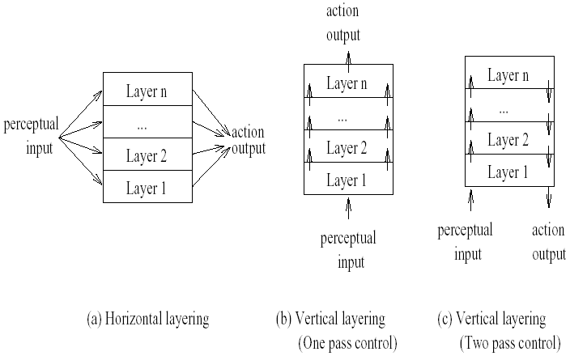
Hybrid Architectures
m possible actions suggested by each layer, n layers
m^{n} interactions
m²(n-1) interactions
Introduces bottleneck
in central control system
Not fault tolerant to layer failure

Slide 29
Ferguson – TOURINGMACHINES
The TOURINGMACHINES architecture consists of perception and action subsystems, which interface directly with the agent’s environment, and three control layers, embedded in a control framework, which mediates between the layers

Slide 30
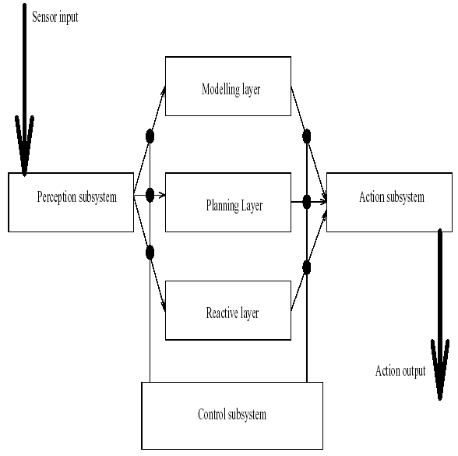
Ferguson – TOURINGMACHINES

Slide 31
Ferguson – TOURINGMACHINES
The reactive layer is implemented as a set of situation-action rules, a la subsumption architecture
Example:
rule-1: kerb-avoidance
if
is-in-front(Kerb, Observer) and
speed(Observer) > 0 and
separation(Kerb, Observer) < KerbThreshHold
then
change-orientation(KerbAvoidanceAngle)
The planning layer constructs plans and selects actions to execute in order to achieve the agent’s goals

Slide 32
Ferguson – TOURINGMACHINES
The modeling layer contains symbolic representations of the ‘cognitive state’ of other entities in the agent’s environment
The three layers communicate with each other and are embedded in a control framework, which use control rules
Example:
censor-rule-1:
if
entity(obstacle-6) in perception-buffer
then
remove-sensory-record(layer-R, entity(obstacle-6))

Slide 33
Müller –InteRRaP
Vertically layered, two-pass architecture
cooperation layer
social knowledge
plan layer
planning knowledge
behavior layer
world model
world interface
perceptual input
action output

