Slide 1
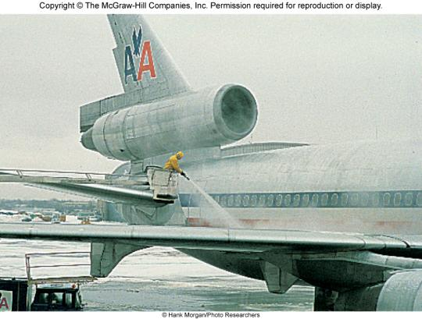


Physical Properties of Solutions
Chapter 12
Copyright © The McGraw-Hill Companies, Inc. Permission required for reproduction or display.

Slide 2
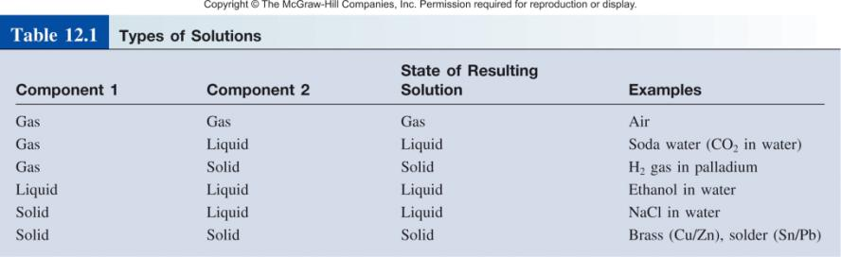
A solution is a homogenous mixture of 2 or more substances
The solute is(are) the substance(s) present in the smaller amount(s)
The solvent is the substance present in the larger amount

Slide 3
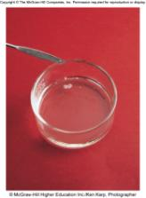
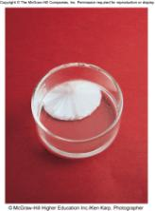
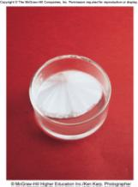
A saturated solution contains the maximum amount of a solute that will dissolve in a given solvent at a specific temperature.
An unsaturated solution contains less solute than the solvent has the capacity to dissolve at a specific temperature.
A supersaturated solution contains more solute than is present in a saturated solution at a specific temperature.
Sodium acetate crystals rapidly form when a seed crystal is
added to a supersaturated solution of sodium acetate.

Slide 4
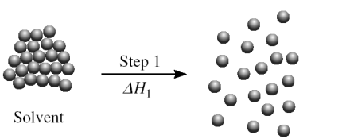
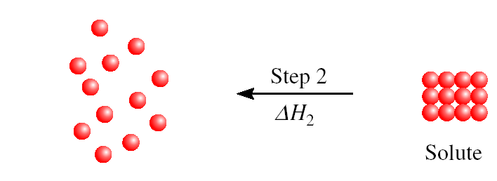
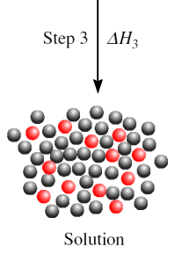
Three types of interactions in the solution process:
solvent-solvent interaction
solute-solute interaction
solvent-solute interaction
Molecular view of the formation of solution
ΔH_{soln} = ΔH₁ + ΔH₂ + ΔH₃

Slide 5
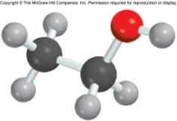
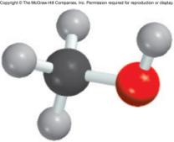
“like dissolves like”
Two substances with similar intermolecular forces are likely to be soluble in each other.
non-polar molecules are soluble in non-polar solvents
    CCl₄ in C₆H₆
polar molecules are soluble in polar solvents
    C₂H₅OH in H₂O
ionic compounds are more soluble in polar solvents
    NaCl in H₂O or NH₃ (l)

Slide 6
12.1
Predict the relative solubilities in the following cases:
Bromine (Br₂) in benzene (C₆H₆, μ = 0 D) and in water (μ = 1.87 D)
KCl in carbon tetrachloride (CCl₄, μ = 0 D) and in liquid ammonia (NH₃, μ = 1.46 D)
formaldehyde (CH₂O) in carbon disulfide (CS₂, μ = 0 D) and in water

Slide 7
12.1
Strategy In predicting solubility, remember the saying: Like dissolves like. A nonpolar solute will dissolve in a nonpolar solvent; ionic compounds will generally dissolve in polar solvents due to favorable ion-dipole interaction; solutes that can form hydrogen bonds with the solvent will have high solubility in the solvent.
Solution
(a) Br₂ is a nonpolar molecule and therefore should be more soluble in C₆H₆, which is also nonpolar, than in water. The only intermolecular forces between Br₂ and C₆H₆ are dispersion forces.

Slide 8
12.1
(b) KCl is an ionic compound. For it to dissolve, the individual K⁺ and Cl⁻ ions must be stabilized by ion-dipole interaction. Because CCl₄ has no dipole moment, KCl should be more soluble in liquid NH₃, a polar molecule with a large dipole moment.
(c) Because CH₂O is a polar molecule and CS₂ (a linear molecule) is nonpolar, the forces between molecules of CH₂O and CS₂ are dipole-induced dipole and dispersion. On the other hand, CH₂O can form hydrogen bonds with water, so it should be more soluble in that solvent.

Slide 9
Concentration Units
The concentration of a solution is the amount of solute present in a given quantity of solvent or solution.
Percent by Mass
mass of solute
% by mass =
x 100%
mass of solute + mass of solvent
mass of solute
=
x 100%
mass of solution
Mole Fraction (X)
moles of A
X_{A} =
sum of moles of all components

Slide 10
12.2
A sample of 0.892 g of potassium chloride (KCl) is dissolved in 54.6 g of water.
What is the percent by mass of KCl in the solution?

Slide 11
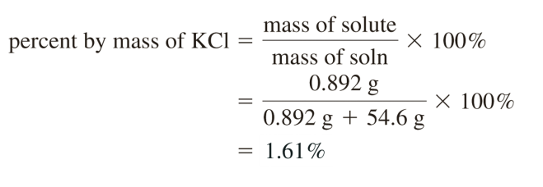
12.2
Strategy We are given the mass of a solute dissolved in a certain amount of solvent. Therefore, we can calculate the mass percent of KCl using Equation (12.1).
Solution We write

Slide 12
Concentration Units Continued
Molarity (M)
moles of solute
M =
liters of solution
Molality (m)
moles of solute
m =
mass of solvent (kg)

Slide 13
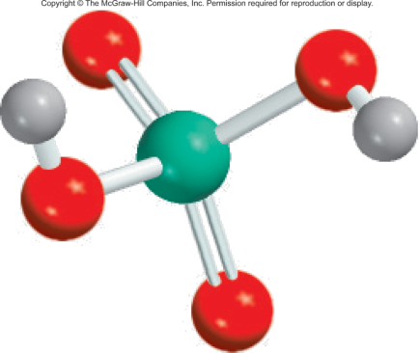
12.3
Calculate the molality of a sulfuric acid solution containing 24.4 g of sulfuric acid in 198 g of water.
The molar mass of sulfuric acid is 98.09 g.

Slide 14

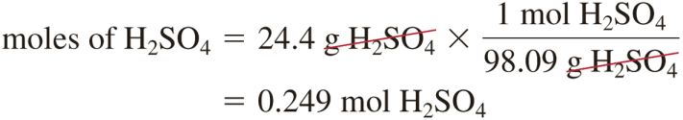
12.3
Strategy To calculate the molality of a solution, we need to know the number of moles of solute and the mass of the solvent in kilograms.
Solution The definition of molality (m) is
First, we find the number of moles of sulfuric acid in 24.4 g of the acid, using its molar mass as the conversion factor.

Slide 15
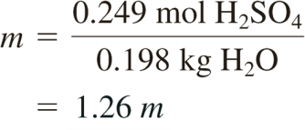
12.3
The mass of water is 198 g, or 0.198 kg. Therefore,

Slide 16
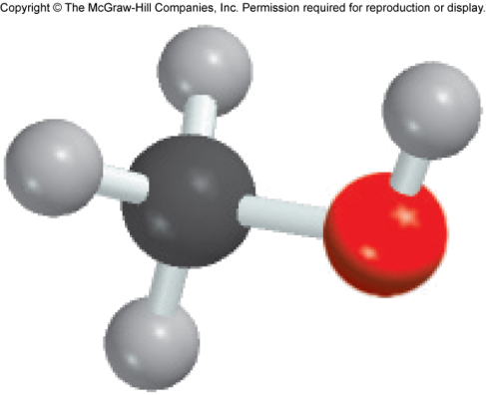
12.4
The density of a 2.45 M aqueous solution of methanol (CH₃OH) is 0.976 g/mL. What is the molality of the solution? The molar mass of methanol is 32.04 g.

Slide 17
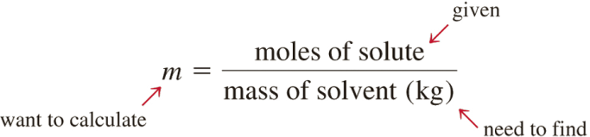
12.4
Strategy To calculate the molality, we need to know the number of moles of methanol and the mass of solvent in kilograms. We assume 1 L of solution, so the number of moles of methanol is 2.45 mol.

Slide 18

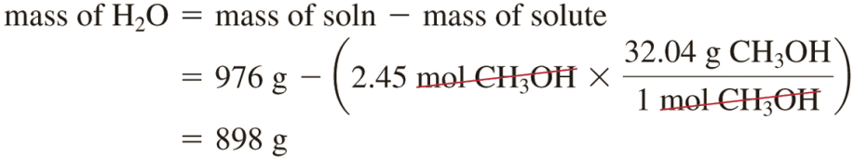
12.4
Solution Our first step is to calculate the mass of water in 1 L of the solution, using density as a conversion factor. The total mass of 1 L of a 2.45 M solution of methanol is
Because this solution contains 2.45 moles of methanol, the amount of water (solvent) in the solution is

Slide 19
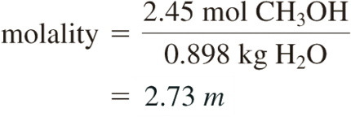
12.4
The molality of the solution can be calculated by converting 898 g to 0.898 kg:

Slide 20
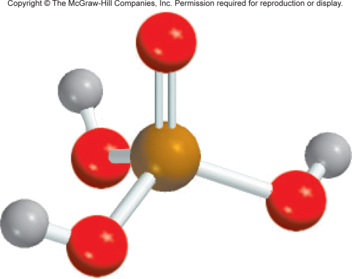
12.5
Calculate the molality of a 35.4 percent (by mass) aqueous solution of phosphoric acid (H₃PO₄).
The molar mass of phosphoric acid is 97.99 g.

Slide 21
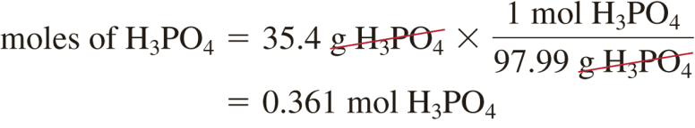
12.5
Strategy In solving this type of problem, it is convenient to assume that we start with a 100.0 g of the solution. If the mass of phosphoric acid is 35.4 percent, or 35.4 g, the percent by mass and mass of water must be 100.0% − 35.4% = 64.6% and 64.6 g.
Solution From the known molar mass of phosphoric acid, we can calculate the molality in two steps, as shown in Example 12.3. First we calculate the number of moles of phosphoric acid in 35.4 g of the acid

Slide 22
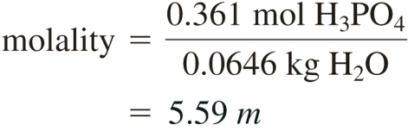
12.5
The mass of water is 64.6 g, or 0.0646 kg. Therefore, the molality is given by

Slide 23
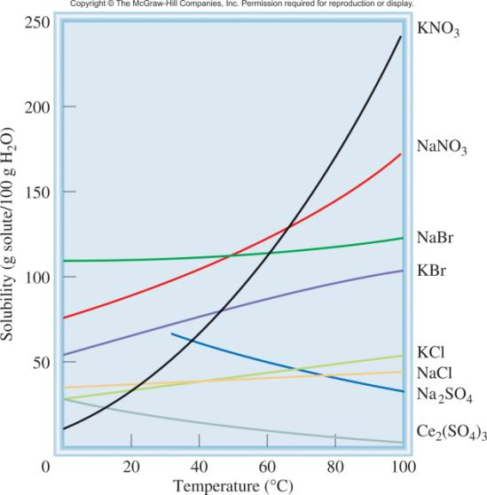
Temperature and Solubility
Solid solubility and temperature
solubility increases with increasing temperature
solubility decreases with increasing temperature

Slide 24
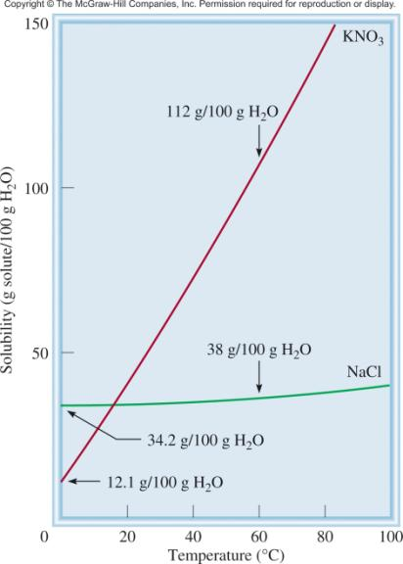
Fractional crystallization is the separation of a mixture of substances into pure components on the basis of their differing solubilities.
Suppose you have 90 g KNO₃ contaminated with 10 g NaCl.
Fractional crystallization:
Dissolve sample in 100 mL of water at 60⁰C
Cool solution to 0⁰C
All NaCl will stay in solution (s = 34.2g/100g)
78 g of PURE KNO₃ will precipitate (s = 12 g/100g). 90 g – 12 g = 78 g

Slide 25
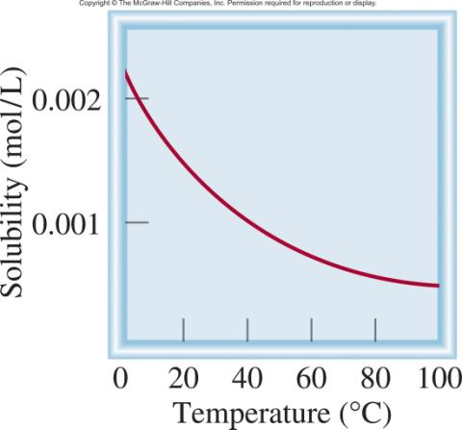
Temperature and Solubility
O₂ gas solubility and temperature
solubility usually decreases with increasing temperature

Slide 26
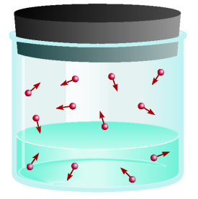
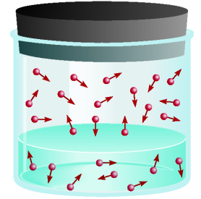
Pressure and Solubility of Gases
The solubility of a gas in a liquid is proportional to the pressure of the gas over the solution (Henry’s law).
c is the concentration (M) of the dissolved gas
c = kP
P is the pressure of the gas over the solution
k is a constant for each gas (mol/L•atm) that depends only on temperature
low P
high P
low c
high c

Slide 27
12.6
The solubility of nitrogen gas at 25°C and 1 atm is 6.8 × 10⁻⁴ mol/L.
What is the concentration (in molarity) of nitrogen dissolved in water under atmospheric conditions?
The partial pressure of nitrogen gas in the atmosphere is 0.78 atm.

Slide 28
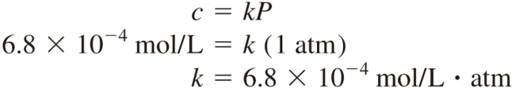
12.6
Strategy The given solubility enables us to calculate Henry’s law constant (k), which can then be used to determine the concentration of the solution.
Solution The first step is to calculate the quantity k in Equation (12.3):

Slide 29
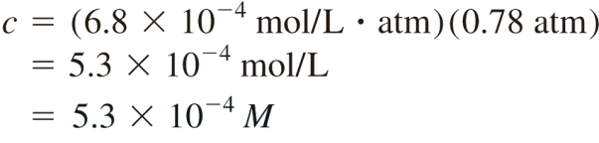
12.6
Therefore, the solubility of nitrogen gas in water is
The decrease in solubility is the result of lowering the pressure from 1 atm to 0.78 atm.
Check
The concentration ratio [(5.3 × 10⁻⁴ M/6.8 × 10⁻⁴ M) = 0.78] should be equal to the ratio of the pressures (0.78 atm/1.0 atm = 0.78).

Slide 30
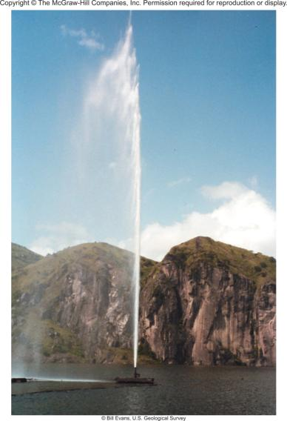
Chemistry In Action: The Killer Lake
8/21/86
CO₂ Cloud Released
1700 Casualties
Trigger?
earthquake
landslide
strong Winds
Lake Nyos, West Africa

Slide 31
Colligative Properties of Nonelectrolyte Solutions
Colligative properties are properties that depend only on the number of solute particles in solution and not on the nature of the solute particles.
Vapor-Pressure Lowering
0
0
P ₁
= vapor pressure of pure solvent
P₁ = X₁ P ₁
Raoult’s law
X₁ = mole fraction of the solvent
If the solution contains only one solute:
X₁ = 1 – X₂
0
- P₁ = ΔP = X₂
0
X₂ = mole fraction of the solute
P ₁
P ₁

Slide 32
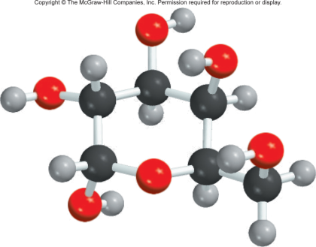
12.7
Calculate the vapor pressure of a solution made by dissolving 218 g of glucose (molar mass = 180.2 g/mol) in 460 mL of water at 30°C.
What is the vapor-pressure lowering?
The vapor pressure of pure water at 30°C is given in Table 5.3 (p. 199). Assume the density of the solvent is 1.00 g/mL.

Slide 33
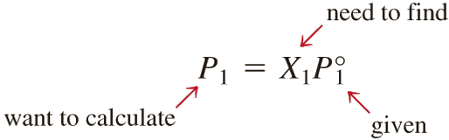
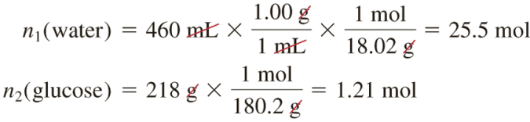
12.7
Strategy We need Raoult’s law [Equation (12.4)] to determine the vapor pressure of a solution. Note that glucose is a nonvolatile solute.
Solution The vapor pressure of a solution (P₁) is
First we calculate the number of moles of glucose and water in the solution:

Slide 34
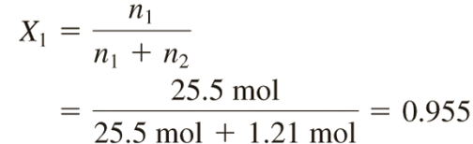
12.7
The mole fraction of water, X₁, is given by
From Table 5.3, we find the vapor pressure of water at 30°C to be 31.82 mmHg. Therefore, the vapor pressure of the glucose solution is
Finally, the vapor-pressure lowering (ΔP) is (31.82 − 30.4) mmHg, or 1.4 mmHg.
P₁ = 0.955 × 31.82 mmHg
= 30.4 mmHg

Slide 35
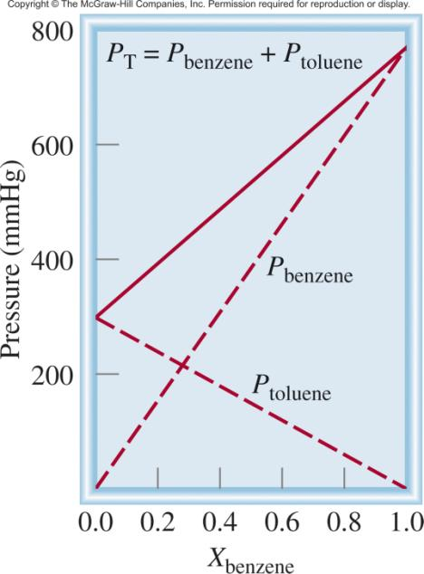
0
P_{A} = X_{A} P _{A}
Ideal Solution
0
P_{B} = X_{B} P _{B}
P_{T} = P_{A} + P_{B}
0
0
P_{T} = X_{A} P _{A}
+ X_{B} P _{B}

Slide 36
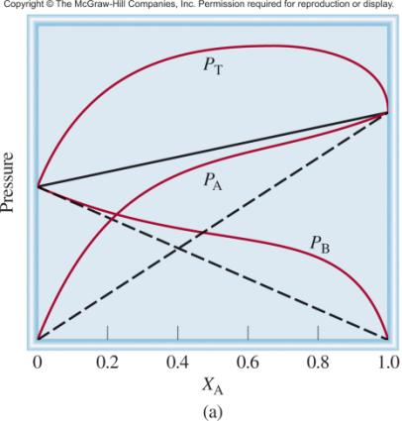
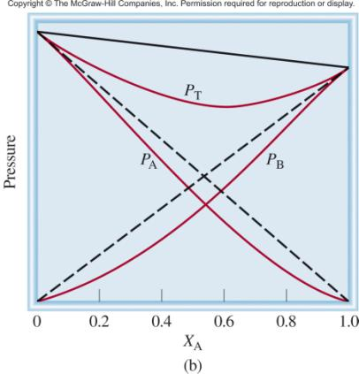
P_{T} is greater than
predicted by Raoult’s law
P_{T} is less than
predicted by Raoult’s law
Force
A-B
Force
A-A
Force
B-B
Force
A-B
Force
A-A
Force
B-B
<
&
>
&

Slide 37
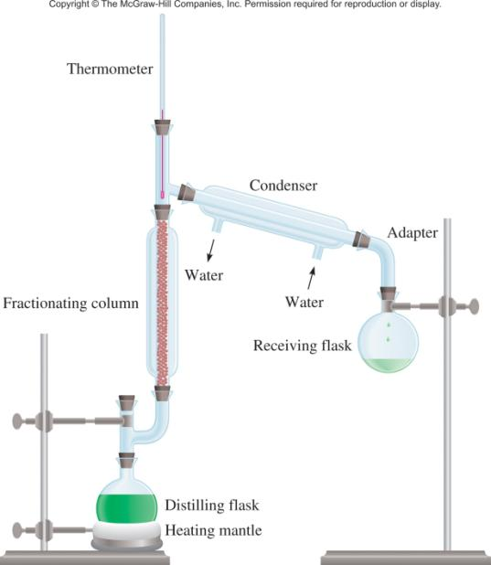
Fractional Distillation Apparatus

Slide 38
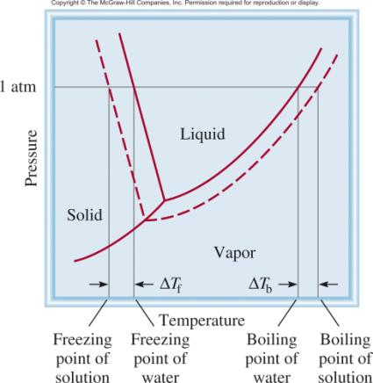
Boiling-Point Elevation
0
ΔT_{b} = T_{b} – T _{b}
0
T _{b} is the boiling point of
the pure solvent
T _{b} is the boiling point of
the solution
0
ΔT_{b} > 0
T_{b} > T _{b}
ΔT_{b} = K_{b} m
m is the molality of the solution
K_{b} is the molal boiling-point
elevation constant (⁰C/m)
for a given solvent

Slide 39
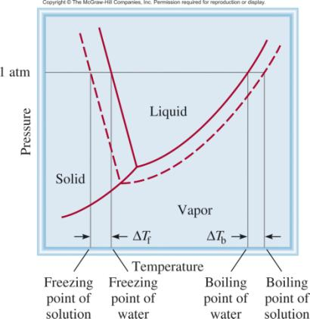
Freezing-Point Depression
0
ΔT_{f} = T _{f} – T_{f}
0
T _{f} is the freezing point of
the pure solvent
T _{f} is the freezing point of
the solution
0
ΔT_{f} > 0
T _{f} > T_{f}
ΔT_{f} = K_{f} m
m is the molality of the solution
K_{f} is the molal freezing-point
depression constant (⁰C/m)
for a given solvent

Slide 40
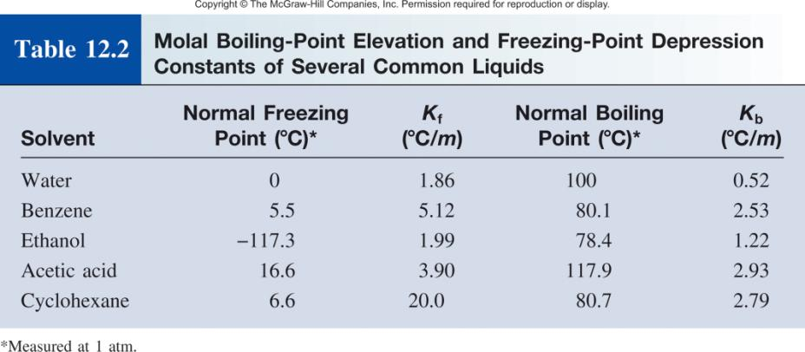

Slide 41
12.8
Ethylene glycol (EG), CH₂(OH)CH₂(OH), is a common automobile antifreeze. It is water soluble and fairly nonvolatile (b.p. 197°C).
Calculate the freezing point of a solution containing 651 g of this substance in 2505 g of water.
Would you keep this substance in your car radiator during the summer?
The molar mass of ethylene glycol is 62.01 g.

Slide 42
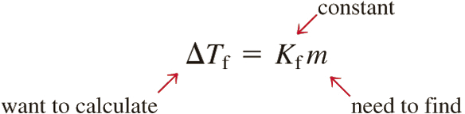
12.8
Strategy This question asks for the depression in freezing point of the solution.
The information given enables us to calculate the molality of the solution and we refer to Table 12.2 for the K_{f} of water.
Solution To solve for the molality of the solution, we need to know the number of moles of EG and the mass of the solvent in kilograms.

Slide 43
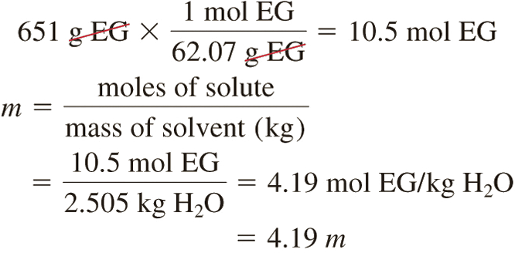
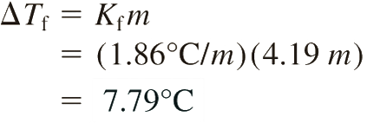
12.8
We find the molar mass of EG, and convert the mass of the solvent to 2.505 kg, and calculate the molality as follows:
From Equation (12.7) and Table 12.2 we write

Slide 44
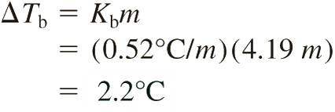
12.8
Because pure water freezes at 0°C, the solution will freeze at (0 − 7.79)°C or 27.79°C.
We can calculate boiling-point elevation in the same way as follows:
Because the solution will boil at (100 + 2.2)°C, or 102.2°C, it would be preferable to leave the antifreeze in your car radiator in summer to prevent the solution from boiling.

Slide 45
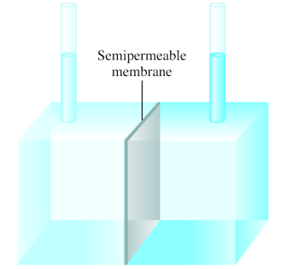
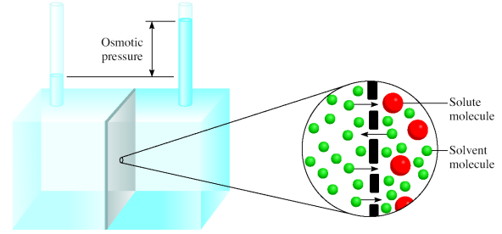
Osmotic Pressure (π)
Osmosis is the selective passage of solvent molecules through a porous membrane from a dilute solution to a more concentrated one.
A semipermeable membrane allows the passage of solvent molecules but blocks the passage of solute molecules.
Osmotic pressure (π) is the pressure required to stop osmosis.
more
concentrated
dilute

Slide 46
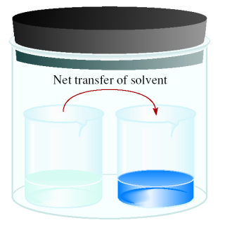
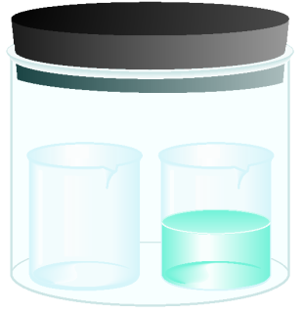
Osmotic Pressure (π)
time
solvent
solution
High
P
Low
P
π = MRT
M is the molarity of the solution
R is the gas constant
T is the temperature (in K)

Slide 47
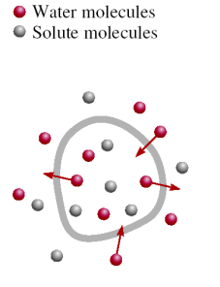
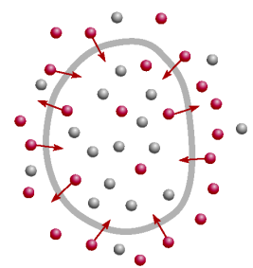




A cell in an:
isotonic
solution
hypotonic
solution
hypertonic
solution

Slide 48
Colligative Properties of Nonelectrolyte Solutions
Colligative properties are properties that depend only on the number of solute particles in solution and not on the nature of the solute particles.
0
Vapor-Pressure Lowering
P₁ = X₁ P ₁
Boiling-Point Elevation
ΔT_{b} = K_{b} m
Freezing-Point Depression
ΔT_{f} = K_{f} m
Osmotic Pressure (π)
π = MRT

Slide 49

12.9
The average osmotic pressure of seawater, measured in the kind of apparatus shown in Figure 12.11, is about 30.0 atm at 25°C. Calculate the molar concentration of an aqueous solution of sucrose (C₁₂H₂₂O₁₁) that is isotonic with seawater.

Slide 50

12.9
Strategy When we say the sucrose solution is isotonic with seawater, what can we conclude about the osmotic pressures of these two solutions?
Solution A solution of sucrose that is isotonic with seawater must have the same osmotic pressure, 30.0 atm. Using Equation (12.8).

Slide 51
12.10
A 7.85-g sample of a compound with the empirical formula C₅H₄ is dissolved in 301 g of benzene.
The freezing point of the solution is 1.05°C below that of pure benzene.
What are the molar mass and molecular formula of this compound?

Slide 52
12.10
Strategy Solving this problem requires three steps. First, we calculate the molality of the solution from the depression in freezing point.
Next, from the molality we determine the number of moles in 7.85 g of the compound and hence its molar mass.
Finally, comparing the experimental molar mass with the empirical molar mass enables us to write the molecular formula.
Solution The sequence of conversions for calculating the molar mass of the compound is

Slide 53


12.10
Our first step is to calculate the molality of the solution. From Equation (12.7) and Table 12.2 we write
Because there is 0.205 mole of the solute in 1 kg of solvent, the number of moles of solute in 301 g, or 0.301 kg, of solvent is

Slide 54


12.10
Thus, the molar mass of the solute is
Now we can determine the ratio
Therefore, the molecular formula is (C₅H₄)₂ or C₁₀H₈ (naphthalene).

Slide 55
12.11
A solution is prepared by dissolving 35.0 g of hemoglobin (Hb) in enough water to make up 1 L in volume.
If the osmotic pressure of the solution is found to be 10.0 mmHg at 25°C, calculate the molar mass of hemoglobin.

Slide 56
12.11
Strategy We are asked to calculate the molar mass of Hb. The steps are similar to those outlined in Example 12.10.
From the osmotic pressure of the solution, we calculate the molarity of the solution.
Then, from the molarity, we determine the number of moles in 35.0 g of Hb and hence its molar mass. What units should we use for π and temperature?
Solution The sequence of conversions is as follows:

Slide 57

12.11
First we calculate the molarity using Equation (12.8)
The volume of the solution is 1 L, so it must contain 5.38 × 10⁻⁴ mol of Hb.

Slide 58

12.11
We use this quantity to calculate the molar mass:

Slide 59
Colligative Properties of Electrolyte Solutions
0.1 m NaCl solution
0.1 m Na⁺ ions & 0.1 m Cl⁻ ions
Colligative properties are properties that depend only on the number of solute particles in solution and not on the nature of the solute particles.
0.1 m NaCl solution
0.2 m ions in solution
actual number of particles in soln after dissociation
van’t Hoff factor (i) =
number of formula units initially dissolved in soln
i should be
nonelectrolytes
1
NaCl
2
CaCl₂
3

Slide 60

Colligative Properties of Electrolyte Solutions
Boiling-Point Elevation
ΔT_{b} = i K_{b} m
Freezing-Point Depression
ΔT_{f} = i K_{f} m
Osmotic Pressure (π)
π = iMRT

Slide 61
12.12
The osmotic pressure of a 0.010 M potassium iodide (KI) solution at 25°C is 0.465 atm.
Calculate the van’t Hoff factor for KI at this concentration.

Slide 62
12.12
Strategy Note that KI is a strong electrolyte, so we expect it to dissociate completely in solution. If so, its osmotic pressure would be
However, the measured osmotic pressure is only 0.465 atm. The smaller than predicted osmotic pressure means that there is ion-pair formation, which reduces the number of solute particles (K⁺ and I⁻ ions) in solution.

Slide 63

12.12
Solution From Equation (12.12) we have

Slide 64


A colloid is a dispersion of particles of one substance throughout a dispersing medium of another substance.
Colloid versus solution
colloidal particles are much larger than solute molecules
colloidal suspension is not as homogeneous as a solution
colloids exhibit the Tyndall effect

Slide 65


Slide 66


Hydrophilic and Hydrophobic Colloids
Hydrophilic: water-loving
Hydrophobic: water-fearing
Stabilization of a hydrophobic colloid

Slide 67





The Cleansing Action of Soap

