Slide 1
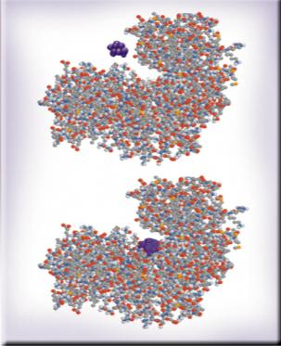


Chemical Kinetics
Chapter 13
Copyright © The McGraw-Hill Companies, Inc. Permission required for reproduction or display.

Slide 2
Chemical Kinetics
Thermodynamics – does a reaction take place?
Kinetics – how fast does a reaction proceed?
Reaction rate is the change in the concentration of a reactant or a product with time (M/s).
A B
Δ[A]
Δ[A] = change in concentration of A over
time period Δt
rate = -
Δt
Δ[B]
Δ[B] = change in concentration of B over
time period Δt
rate =
Δt
Because [A] decreases with time, Δ[A] is negative.

Slide 3
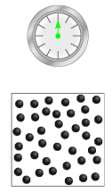
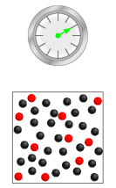
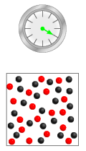
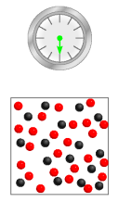
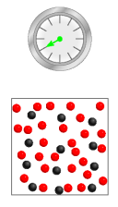
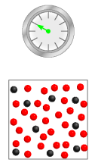
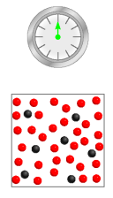
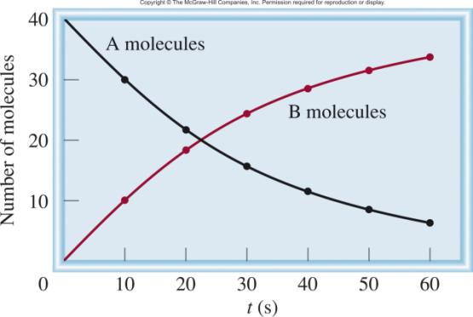
A B
Δ[A]
rate = -
Δt
Δ[B]
rate =
Δt

Slide 4
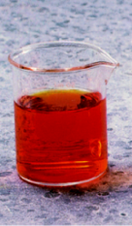
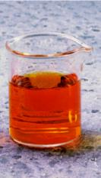
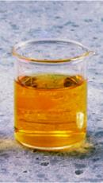
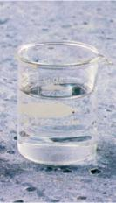

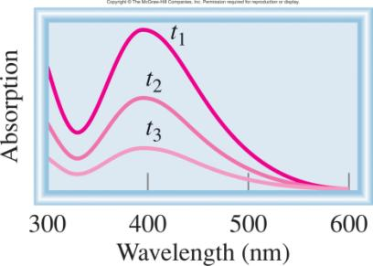

red-brown
Br₂ (aq) + HCOOH (aq) 2Br⁻ (aq) + 2H⁺ (aq) + CO₂ (g)
time
t₁< t₂ < t₃
393 nm
Detector
light
Δ[Br₂] α Δ Absorption

Slide 5
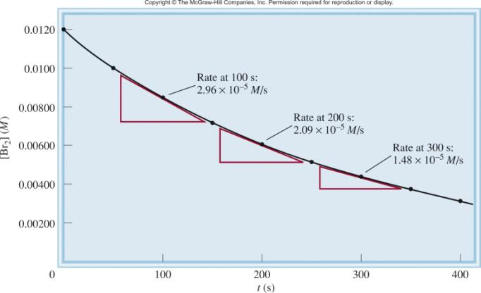
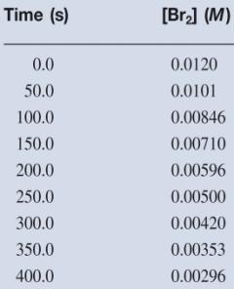
Br₂ (aq) + HCOOH (aq) 2Br⁻ (aq) + 2H⁺ (aq) + CO₂ (g)
slope of
tangent
slope of
tangent
slope of
tangent
Δ[Br₂]
[Br₂]_{final} – [Br₂]_{initial}
average rate = -
= -
Δt
t_{final} - t_{initial}
instantaneous rate = rate for specific instance in time

Slide 6
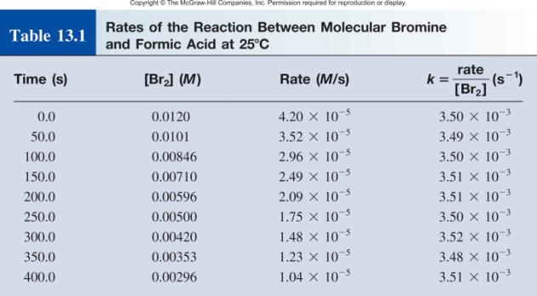
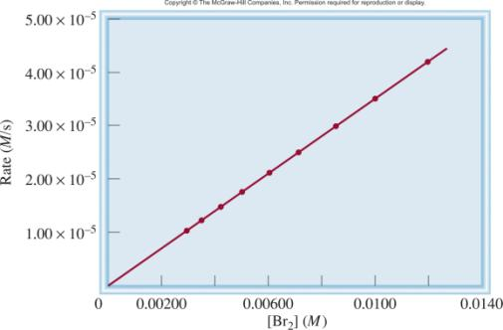
rate α [Br₂]
rate = k [Br₂]
rate
k =
= rate constant
[Br₂]
= 3.50 x 10⁻³ s⁻¹

Slide 7
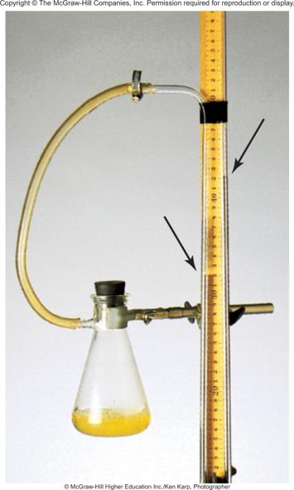
2H₂O₂ (aq) 2H₂O (l) + O₂ (g)
PV = nRT
n
P = RT = [O₂]RT
V
1
[O₂] = P
RT
Δ[O₂]
1
ΔP
rate =
=
Δt
RT
Δt
measure ΔP over time

Slide 8
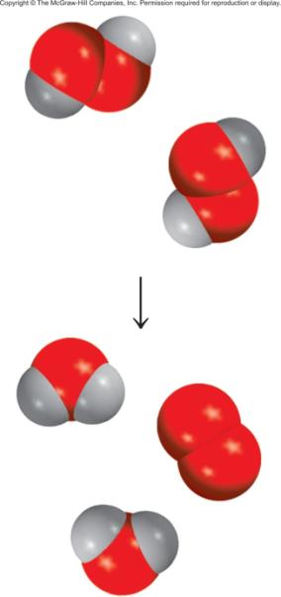
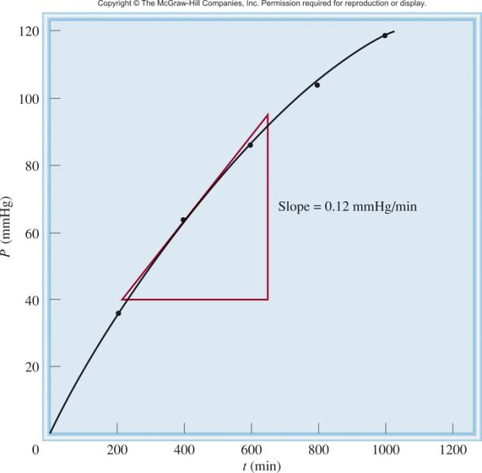

Slide 9
Reaction Rates and Stoichiometry
2A B
Two moles of A disappear for each mole of B that is formed.
1
Δ[A]
Δ[B]
rate = -
rate =
2
Δt
Δt
aA + bB cC + dD
1
Δ[A]
1
Δ[B]
1
Δ[C]
1
Δ[D]
rate = -
= -
=
=
a
Δt
b
Δt
c
Δt
d
Δt

Slide 10
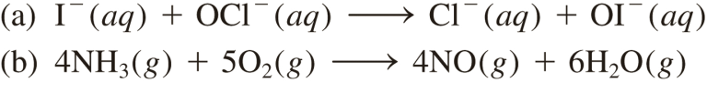
13.1
Write the rate expressions for the following reactions in terms of the disappearance of the reactants and the appearance of the products:

Slide 11
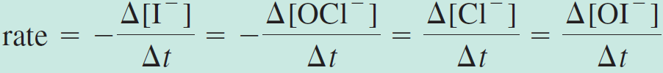
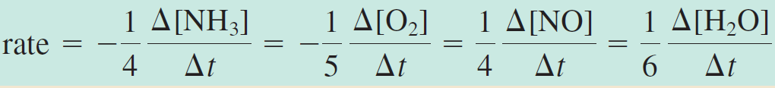
13.1
Strategy To express the rate of the reaction in terms of the change in concentration of a reactant or product with time, we need to use the proper sign (minus or plus) and the reciprocal of the stoichiometric coefficient.
Solution
Because each of the stoichiometric coefficients equals 1,
Here the coefficients are 4, 5, 4, and 6, so

Slide 12
13.2
Consider the reaction
Suppose that, at a particular moment during the reaction, molecular oxygen is reacting at the rate of 0.024 M/s.
At what rate is N₂O₅ being formed?
At what rate is NO₂ reacting?

Slide 13

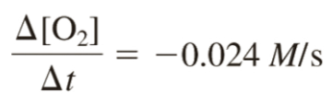
13.2
Strategy To calculate the rate of formation of N₂O₅ and disappearance of NO₂, we need to express the rate of the reaction in terms of the stoichiometric coefficients as in Example 13.1:
We are given
where the minus sign shows that the concentration of O₂ is decreasing with time.

Slide 14


13.2
Solution
From the preceding rate expression we have
Therefore

Slide 15
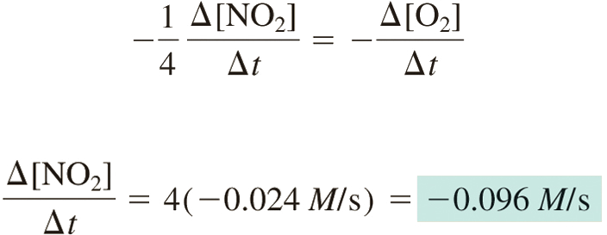
13.2
(b) Here we have
so

Slide 16
The Rate Law
The rate law expresses the relationship of the rate of a reaction to the rate constant and the concentrations of the reactants raised to some powers.
aA + bB cC + dD
Rate = k [A]^{x}[B]^{y}
Reaction is xth order in A
Reaction is yth order in B
Reaction is (x +y)th order overall

Slide 17
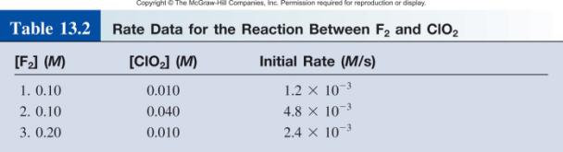
F₂ (g) + 2ClO₂ (g) 2FClO₂ (g)
rate = k [F₂]^{x}[ClO₂]^{y}
Double [F₂] with [ClO₂] constant
Rate doubles
x = 1
rate = k [F₂][ClO₂]
Quadruple [ClO₂] with [F₂] constant
Rate quadruples
y = 1

Slide 18
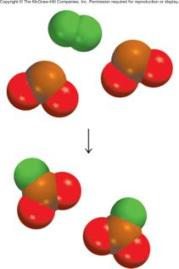
Rate Laws
Rate laws are always determined experimentally.
Reaction order is always defined in terms of reactant (not product) concentrations.
The order of a reactant is not related to the stoichiometric coefficient of the reactant in the balanced chemical equation.
F₂ (g) + 2ClO₂ (g) 2FClO₂ (g)
rate = k [F₂][ClO₂]
1

Slide 19
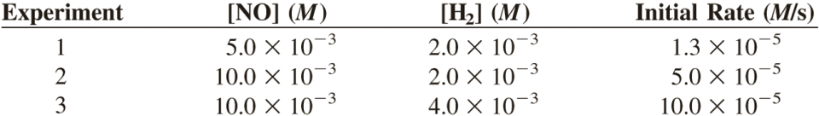
13.3
The reaction of nitric oxide with hydrogen at 1280°C is
From the following data collected at this temperature, determine
(a) the rate law
(b) the rate constant
(c) the rate of the reaction when [NO] = 12.0 × 10⁻³ M and [H2] = 6.0 × 10 ⁻³ M

Slide 20
13.3
Strategy We are given a set of concentration and reaction rate data and asked to determine the rate law and the rate constant.
We assume that the rate law takes the form
rate = k[NO]^{x} [H₂]^{y}
How do we use the data to determine x and y?
Once the orders of the reactants are known, we can calculate k from any set of rate and concentrations.
Finally, the rate law enables us to calculate the rate at any concentrations of NO and H₂.

Slide 21
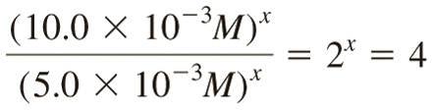
13.3
Solution (a) Experiments 1 and 2 show that when we double the concentration of NO at constant concentration of H₂, the rate quadruples. Taking the ratio of the rates from these two experiments
Therefore,
or x = 2, that is, the reaction is second order in NO.

Slide 22
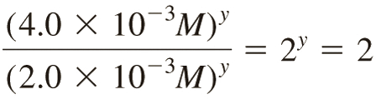

13.3
Experiments 2 and 3 indicate that doubling [H₂] at constant [NO] doubles the rate. Here we write the ratio as
Therefore,
or y = 1, that is, the reaction is first order in H₂. Hence the rate law is given by
which shows that it is a (2 + 1) or third-order reaction overall.

Slide 23
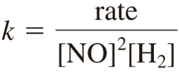
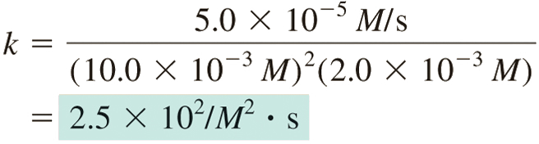
13.3
(b) The rate constant k can be calculated using the data from any one of the experiments. Rearranging the rate law, we get
The data from experiment 2 give us

Slide 24
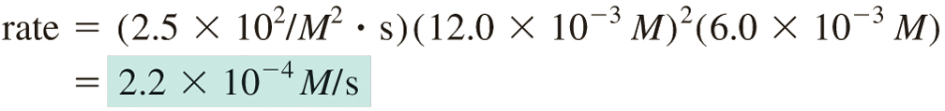
13.3
(c) Using the known rate constant and concentrations of NO and H₂, we write
Comment Note that the reaction is first order in H₂, whereas the stoichiometric coefficient for H₂ in the balanced equation is 2. The order of a reactant is not related to the stoichiometric coefficient of the reactant in the overall balanced equation.

Slide 25
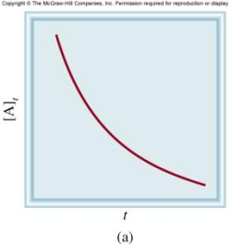
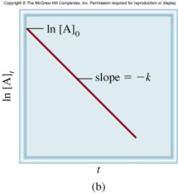
First-Order Reactions
Δ[A]
A product
rate = -
rate = k [A]
Δt
Δ[A]
rate
M/s
-
= k [A]
k =
=
= 1/s or s⁻¹
Δt
[A]
M
[A] is the concentration of A at any time t
[A]₀ is the concentration of A at time t=0
[A] = [A]₀e^{−kt}
ln[A] = ln[A]₀ - kt

Slide 26
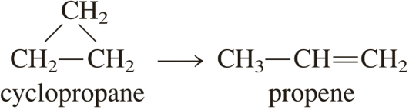
13.4
The conversion of cyclopropane to propene in the gas phase is a first-order reaction with a rate constant of 6.7 × 10⁻⁴ s⁻¹ at 500°C.
If the initial concentration of cyclopropane was 0.25 M, what is the concentration after 8.8 min?
How long (in minutes) will it take for the concentration of cyclopropane to decrease from 0.25 M to 0.15 M?
How long (in minutes) will it take to convert 74 percent of the starting material?

Slide 27
13.4
Strategy The relationship between the concentrations of a reactant at different times in a first-order reaction is given by Equation (13.3) or (13.4).
In (a) we are given [A]₀ = 0.25 M and asked for [A]_{t} after 8.8 min.
In (b) we are asked to calculate the time it takes for cyclopropane to decrease in concentration from 0.25 M to 0.15 M.
No concentration values are given for (c). However, if initially we have 100 percent of the compound and 74 percent has reacted, then what is left must be (100% − 74%), or 26%. Thus, the ratio of the percentages will be equal to the ratio of the actual concentrations; that is, [A]_{t}/[A]₀ = 26%/100%, or 0.26/1.00.

Slide 28

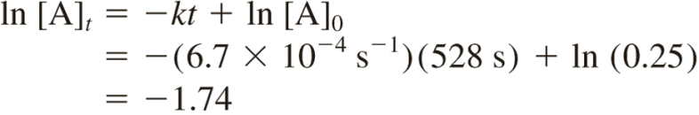

13.4
Solution (a) In applying Equation (13.4), we note that because k is given in units of s⁻¹, we must first convert 8.8 min to seconds:
We write
Hence,
Note that in the ln [A]₀ term, [A]₀ is expressed as a dimensionless quantity (0.25) because we cannot take the logarithm of units.

Slide 29
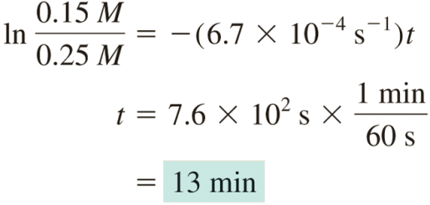
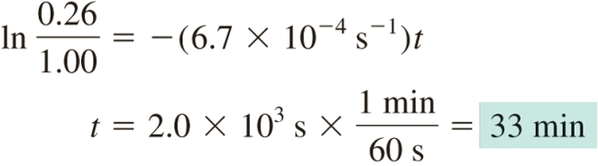
13.4
(b) Using Equation (13.3),
(c) From Equation (13.3),

Slide 30
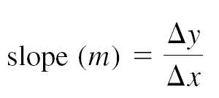
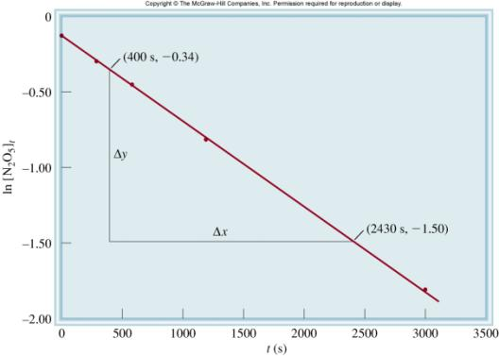




Graphical Determination of k
2N₂O₅ 4NO₂ (g) + O₂ (g)

Slide 31
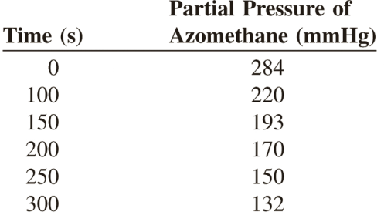
13.5
The rate of decomposition of azomethane (C₂H₆N₂) is studied by monitoring the partial pressure of the reactant as a function of time:
The data obtained at 300°C are shown in the following table:
Are these values consistent with first-order kinetics? If so, determine the rate constant.

Slide 32


13.5
Strategy To test for first-order kinetics, we consider the integrated first-order rate law that has a linear form, which is Equation (13.4)
If the reaction is first order, then a plot of ln [A]_{t} versus t (y versus x) will produce a straight line with a slope equal to 2k. Note that the partial pressure of azomethane at any time is directly proportional to its concentration in moles per liter (PV = nRT, so P ∝ n/V). Therefore, we substitute partial pressure for concentration [Equation (13.5)]:
where P₀ and P_{t} are the partial pressures of azomethane at t = 0 and t = t, respectively.

Slide 33
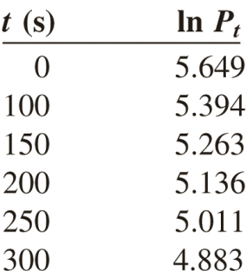

13.5
Solution First we construct the following table of t versus ln P_{t}.
Figure 13.11, which is based on the data given in the table, shows that a plot of ln P_{t} versus t yields a straight line, so the reaction is indeed first order. The slope of the line is given by

Slide 34
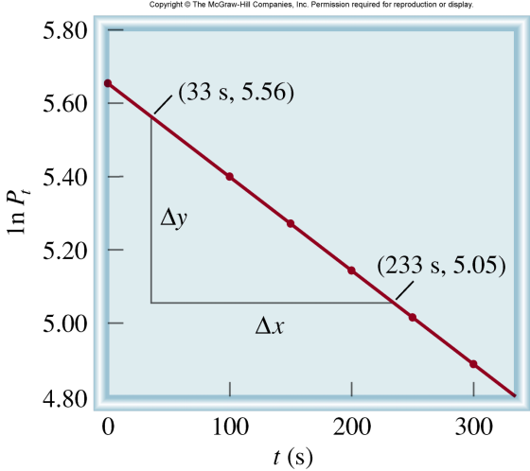
13.5
According to Equation (13.4), the slope is equal to −k, so k = 2.55 × 10⁻³ s⁻¹ .

Slide 35
First-Order Reactions
The half-life, t_{½}, is the time required for the concentration of a reactant to decrease to half of its initial concentration.
t_{½} = t when [A] = [A]₀/2
[A]₀
ln
[A]₀/2
ln 2
0.693
t_{½}
=
=
=
k
k
k

Slide 36
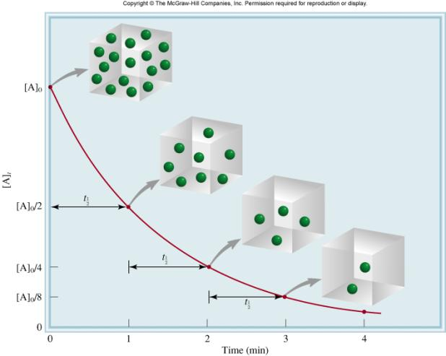
First-order reaction
A product
# of
half-lives
[A] = [A]₀/n
1
2
2
4
3
8
4
16

Slide 37
13.6
The decomposition of ethane (C₂H₆) to methyl radicals is a first-order reaction with a rate constant of 5.36 × 10⁻⁴ s⁻¹ at 700°C:
Calculate the half-life of the reaction in minutes.

Slide 38
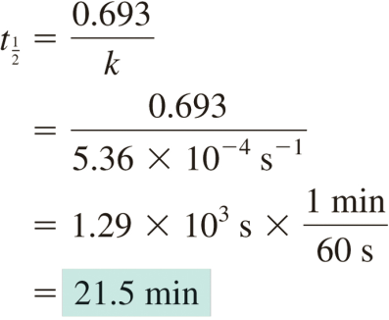
13.6
Strategy To calculate the half-life of a first-order reaction, we use Equation (13.6). A conversion is needed to express the half-life in minutes.
Solution For a first-order reaction, we only need the rate constant to calculate the half-life of the reaction. From Equation (13.6)

Slide 39
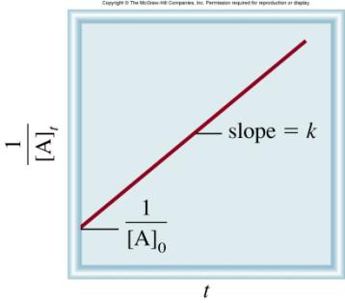
Second-Order Reactions
Δ[A]
A product
rate = -
rate = k [A]²
Δt
rate
M/s
Δ[A]
k =
=
= 1/M•s
-
= k [A]²
[A]²
M²
Δt
1
1
[A] is the concentration of A at any time t
=
+ kt
[A]
[A]₀
[A]₀ is the concentration of A at time t=0
t_{½} = t when [A] = [A]₀/2
1
t_{½} =
k[A]₀

Slide 40

13.7
Iodine atoms combine to form molecular iodine in the gas phase
This reaction follows second-order kinetics and has the high rate constant 7.0 × 10⁹/M · s at 23°C.
If the initial concentration of I was 0.086 M, calculate the concentration after 2.0 min.
Calculate the half-life of the reaction if the initial concentration of I is 0.60 M and if it is 0.42 M.

Slide 41
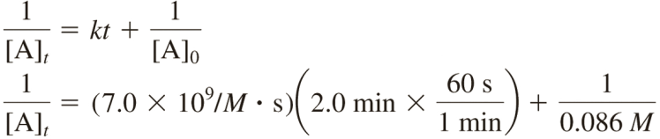
13.7
Strategy
The relationship between the concentrations of a reactant at different times is given by the integrated rate law. Because this is a second-order reaction, we use Equation (13.7).
We are asked to calculate the half-life. The half-life for a second-order reaction is given by Equation (13.8).
Solution (a) To calculate the concentration of a species at a later time of a second−order reaction, we need the initial concentration and the rate constant. Applying Equation (13.7)

Slide 42

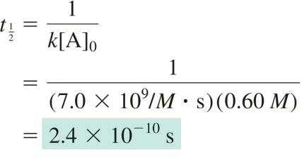
13.7
where [A]_{t} is the concentration at t = 2.0 min. Solving the equation, we get
This is such a low concentration that it is virtually undetectable. The very large rate constant for the reaction means that nearly all the I atoms combine after only 2.0 min of reaction time.
(b) We need Equation (13.8) for this part.
For [I]₀ = 0.60 M

Slide 43

13.7
For [I]₀ = 0.42 M
Check These results confirm that the half-life of a second-order reaction, unlike that of a first-order reaction, is not a constant but depends on the initial concentration of the reactant(s).
Does it make sense that a larger initial concentration should have a shorter half-life?

Slide 44

Zero-Order Reactions
Δ[A]
A product
rate = -
rate = k [A]⁰ = k
Δt
rate
Δ[A]
k =
= M/s
-
= k
[A]⁰
Δt
[A] is the concentration of A at any time t
[A] = [A]₀ - kt
[A]₀ is the concentration of A at time t = 0
t_{½} = t when [A] = [A]₀/2
[A]₀
t_{½} =
2k

Slide 45
Summary of the Kinetics of Zero-Order, First-Order
and Second-Order Reactions
Concentration-Time Equation
Order
Rate Law
Half-Life
[A]₀
0
rate = k
[A] = [A]₀ - kt
t_{½} =
2k
ln 2
1
rate = k [A]
ln[A] = ln[A]₀ - kt
t_{½}
=
k
1
1
1
2
rate = k [A]²
=
+ kt
t_{½} =
[A]
[A]₀
k[A]₀

Slide 46


A + B AB C + D
⁺
⁺
Exothermic Reaction
Endothermic Reaction
The activation energy (E_{a} ) is the minimum amount of energy required to initiate a chemical reaction.

Slide 47


Temperature Dependence of the Rate Constant
(Arrhenius equation)
E_{a} is the activation energy (J/mol)
R is the gas constant (8.314 J/K•mol)
T is the absolute temperature
A is the frequency factor
Alternate format:
E_{a}
1
ln k = -
+ lnA
R
T

Slide 48

13.8
The rate constants for the decomposition of acetaldehyde
were measured at five different temperatures. The data are shown in the table. Plot ln k versus 1/T, and determine the activation energy (in kJ/mol) for the reaction. Note that the reaction is “3/2” order in CH₃CHO, so k has the units of 1/M^{½} ·s.

Slide 49


13.8
Strategy Consider the Arrhenius equation written as a linear equation
A plot of ln k versus 1/T (y versus x) will produce a straight line with a slope equal to −E_{a}/R. Thus, the activation energy can be determined from the slope of the plot.

Slide 50


13.8
Solution First we convert the data to the following table
A plot of these data yields the graph in Figure 13.18. The slope of the line is calculated from two pairs of coordinates:

Slide 51

13.8
From the linear form of Equation (13.13)
Check It is important to note that although the rate constant itself has the units 1/M^{½} · s, the quantity ln k has no units (we cannot take the logarithm of a unit).

Slide 52


Alternate Form of the Arrhenius Equation
At two temperatures, T₁ and T₂
or

Slide 53
13.9
The rate constant of a first-order reaction is 3.46 × 10⁻² s⁻¹ at 298 K.
What is the rate constant at 350 K if the activation energy for the reaction is 50.2 kJ/mol?

Slide 54


13.9
Strategy A modified form of the Arrhenius equation relates two rate constants at two different temperatures [see Equation (13.14)]. Make sure the units of R and E_{a} are consistent.
Solution The data are
Substituting in Equation (13.14),

Slide 55

13.9
We convert E_{a} to units of J/mol to match the units of R. Solving the equation gives
Check The rate constant is expected to be greater at a higher temperature. Therefore, the answer is reasonable.

Slide 56





Importance of Molecular Orientation
effective collision
ineffective collision

Slide 57
Reaction Mechanisms
The overall progress of a chemical reaction can be represented at the molecular level by a series of simple elementary steps or elementary reactions.
The sequence of elementary steps that leads to product formation is the reaction mechanism.
2NO (g) + O₂ (g) 2NO₂ (g)
N₂O₂ is detected during the reaction!
Elementary step:
NO + NO N₂O₂
+
Elementary step:
N₂O₂ + O₂ 2NO₂
Overall reaction:
2NO + O₂ 2NO₂

Slide 58




2NO (g) + O₂ (g) 2NO₂ (g)
Mechanism:

Slide 59
Intermediates are species that appear in a reaction mechanism but not in the overall balanced equation.
An intermediate is always formed in an early elementary step and consumed in a later elementary step.
Elementary step:
NO + NO N₂O₂
+
Elementary step:
N₂O₂ + O₂ 2NO₂
Overall reaction:
2NO + O₂ 2NO₂
The molecularity of a reaction is the number of molecules reacting in an elementary step.
Unimolecular reaction – elementary step with 1 molecule
Bimolecular reaction – elementary step with 2 molecules
Termolecular reaction – elementary step with 3 molecules

Slide 60
Rate Laws and Elementary Steps
Unimolecular reaction
A products
rate = k [A]
Bimolecular reaction
A + B products
rate = k [A][B]
Bimolecular reaction
A + A products
rate = k [A]²
Writing plausible reaction mechanisms:
The sum of the elementary steps must give the overall balanced equation for the reaction.
The rate-determining step should predict the same rate law that is determined experimentally.
The rate-determining step is the slowest step in the sequence of steps leading to product formation.

Slide 61



Sequence of Steps in Studying a Reaction Mechanism

Slide 62

13.10
The gas-phase decomposition of nitrous oxide (N₂O) is believed to occur via two elementary steps:
Experimentally the rate law is found to be rate = k[N₂O].
Write the equation for the overall reaction.
Identify the intermediate.
What can you say about the relative rates of steps 1 and 2?

Slide 63
13.10
Strategy
Because the overall reaction can be broken down into elementary steps, knowing the elementary steps would enable us to write the overall reaction.
What are the characteristics of an intermediate? Does it appear in the overall reaction?
What determines which elementary step is rate determining? How does a knowledge of the rate-determining step help us write the rate law of a reaction?

Slide 64


13.10
Solution
Adding the equations for steps 1 and 2 gives the overall reaction
Because the O atom is produced in the first elementary step and it does not appear in the overall balanced equation, it is an intermediate.
If we assume that step 1 is the rate-determining step, then the rate of the overall reaction is given by
and k = k₁.

Slide 65
13.10
Check There are two criteria that must be met for a proposed reaction mechanism to be plausible.
The individual steps (elementary steps) must sum to the corrected overall reaction.
The rate-determining step (the slow step) must have the same rate law as the experimentally determined rate law.

Slide 66


A catalyst is a substance that increases the rate of a chemical reaction without itself being consumed.
E_{a}
k
Uncatalyzed
Catalyzed
rate_{catalyzed} > rate_{uncatalyzed}
′
E_{a} < E_{a}

Slide 67
In heterogeneous catalysis, the reactants and the catalysts are in different phases.
Haber synthesis of ammonia
Ostwald process for the production of nitric acid
Catalytic converters
In homogeneous catalysis, the reactants and the catalysts are dispersed in a single phase, usually liquid.
Acid catalysis
Base catalysis

Slide 68



Haber Process
Fe/Al₂O₃/K₂O
N₂ (g) + 3H₂ (g) 2NH₃ (g)
catalyst

Slide 69

Ostwald Process
Pt catalyst
4NH₃ (g) + 5O₂ (g) 4NO (g) + 6H₂O (g)
2NO (g) + O₂ (g) 2NO₂ (g)
2NO₂ (g) + H₂O (l) HNO₂ (aq) + HNO₃ (aq)
Pt-Rh catalysts used
in Ostwald process

Slide 70


Catalytic Converters
catalytic
CO + Unburned Hydrocarbons + O₂
CO₂ + H₂O
converter
catalytic
2NO + 2NO₂
2N₂ + 3O₂
converter

Slide 71



Enzyme Catalysis

Slide 72


Binding of Glucose to Hexokinase

Slide 73



Enzyme Kinetics
Δ[P]
rate =
Δt
rate = k [ES]

